Slide 1
15-446 Distributed Systems
Spring 2009
L-3 Networking 101

Slide 2
Today's Lecture
Network Interface
Link Layer
Addressing/IP
Routing
TCP

Slide 3
Client-Server Paradigm
Typical network app has two pieces: client and server
Client:
Initiates contact with server (“speaks first”)
Typically requests service from server,
For Web, client is implemented in browser; for e-mail, in mail reader
Server:
Provides requested service to client
e.g., Web server sends requested Web page, mail server delivers e-mail
application
transport
network
data link
physical
request
reply
application
transport
network
data link
physical

Slide 4
What Service Does an Application Need?
Data loss
Some apps (e.g., audio) can tolerate some loss
Other apps (e.g., file transfer, telnet) require 100% reliable data transfer
Timing
Some apps (e.g., Internet telephony, interactive games) require low delay to be “effective”
Bandwidth
Some apps (e.g., multimedia) require minimum amount of bandwidth to be “effective”
Other apps (“elastic apps”) make use of whatever bandwidth they get

Slide 5
Transport Service Requirements of Common Apps
Application
Data loss
Bandwidth
Time Sensitive
file transfer
e-mail
web documents
real-time audio/
video
stored audio/video
interactive games
financial apps
no loss
no loss
no loss
loss-tolerant
loss-tolerant
loss-tolerant
no loss
elastic
elastic
elastic
audio: 5Kb-1Mb
video:10Kb-5Mb
same as above
few Kbps
elastic
no
no
no
yes, 100’s msec
yes, few secs
yes, 100’s msec
yes and no

Slide 6
Other Requirements
Network reliability
  Network service must always be available
Security: privacy, denial of service, authentication, …
Scalability.
  Scale to large numbers of users, traffic flows, …
Manageability: monitoring, control, …

Slide 7
IP Service Model
Low-level communication model provided by Internet
Datagram
  Each packet self-contained
    All information needed to get to destination
    No advance setup or connection maintenance
  Analogous to letter or telegram
0
4
8
12
16
19
24
28
31
version
HLen
TOS
Length
IPv4 Packet
Format
Identifier
Flag
Offset
TTL
Protocol
Checksum
Header
Source Address
Destination Address
Options (if any)
Data

Slide 8
User Datagram Protocol(UDP):
An Analogy
UDP
Single socket to receive messages
No guarantee of delivery
Not necessarily in-order delivery
Datagram – independent packets
Must address each packet
Postal Mail
Single mailbox to receive messages
Unreliable ☺
Not necessarily in-order delivery
Each letter is independent
Must address each reply
Postal Mail
Single mailbox to receive letters
Unreliable ☺
Not necessarily in-order delivery
Letters sent independently
Must address each reply
Example UDP applications
Multimedia, voice over IP

Slide 9
Transmission Control Protocol (TCP): An Analogy
TCP
Reliable – guarantee delivery
Byte stream – in-order delivery
Connection-oriented – single socket per connection
Setup connection followed by data transfer
Telephone Call
Guaranteed delivery
In-order delivery
Connection-oriented
Setup connection followed by conversation
Example TCP applications
  Web, Email, Telnet

Slide 10
Today's Lecture
Network Interface
Link Layer
Addressing/IP
Routing
TCP

Slide 11
Ethernet MAC (CSMA/CD)
Carrier Sense Multiple Access/Collision Detection
Packet?
No
Sense Carrier
Send
Detect Collision
Yes
Discard Packet
Jam channel b=CalcBackoff(); wait(b);
attempts++;
attempts < 16
attempts == 16

Slide 12
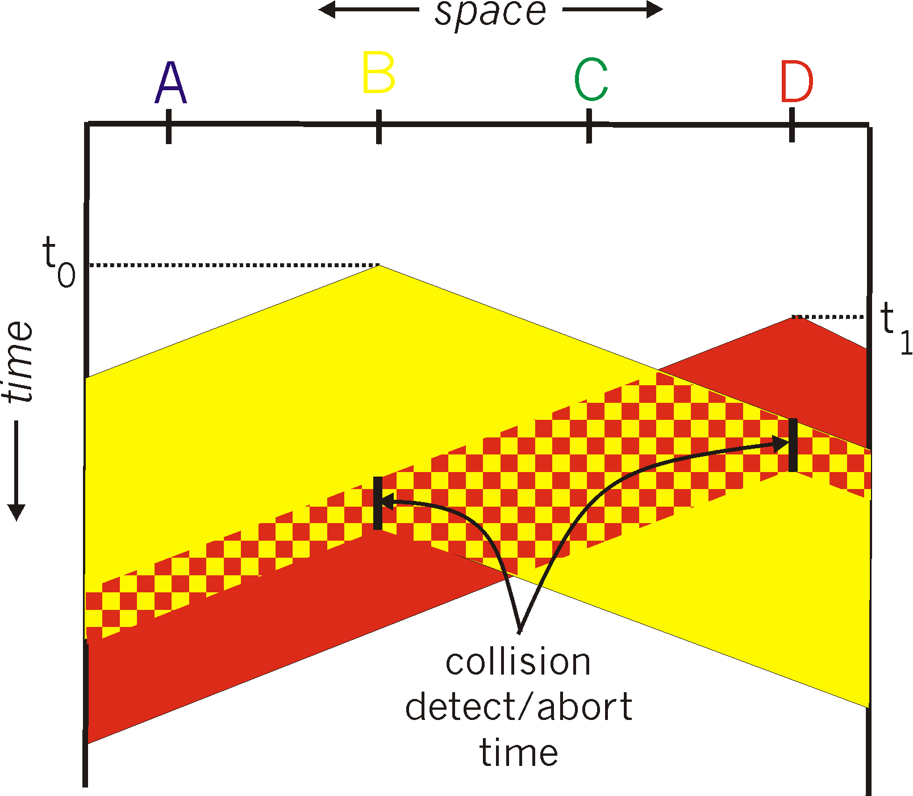
Minimum Packet Size
What if two people sent really small packets
  How do you find collision?

Slide 13

Ethernet Frame Structure
Sending adapter encapsulates IP datagram (or other network layer protocol packet) in Ethernet frame

Slide 14
Ethernet Frame Structure (cont.)
Addresses: 6 bytes
  Each adapter is given a globally unique address at manufacturing time
    Address space is allocated to manufacturers
      24 bits identify manufacturer
      E.g., 0:0:15:* → 3com adapter
    Frame is received by all adapters on a LAN and dropped if address does not match
  Special addresses
    Broadcast – FF:FF:FF:FF:FF:FF is “everybody”
    Range of addresses allocated to multicast
      Adapter maintains list of multicast groups node is interested in

Slide 15
Summary
CSMA/CD → carrier sense multiple access with collision detection
  Why do we need exponential backoff?
  Why does collision happen?
  Why do we need a minimum packet size?
    How does this scale with speed?
Ethernet
  What is the purpose of different header fields?
  What do Ethernet addresses look like?
What are some alternatives to Ethernet design?

Slide 16
Today's Lecture
Network Interface
Link Layer
Addressing/IP
Routing
TCP

Slide 17
Routing Techniques Comparison
Source Routing
Global Addresses
Virtual Circuits
Header Size
Worst
OK – Large address
Best
Router Table Size
None
Number of hosts (prefixes)
Number of circuits
Forward Overhead
Best
Prefix matching
(Worst)
Pretty Good
Setup Overhead
None
None
Connection Setup
Error Recovery
Tell all hosts
Tell all routers
Tell all routers and Tear down circuit and re-route

Slide 18
IP Addresses
Fixed length: 32 bits
Initial classful structure (1981) (not relevant now!!!)
Total IP address size: 4 billion
  Class A: 128 networks, 16M hosts
  Class B: 16K networks, 64K hosts
  Class C: 2M networks, 256 hosts
High Order Bits
0
10
110
Format
7 bits of net, 24 bits of host
14 bits of net, 16 bits of host
21 bits of net, 8 bits of host
Class
A
B
C

Slide 19
Subnet Addressing
RFC917 (1984)
Class A & B networks too big
  Very few LANs have close to 64K hosts
  For electrical/LAN limitations, performance or administrative reasons
Need simple way to get multiple “networks”
  Use bridging, multiple IP networks or split up single network address ranges (subnet)
CMU case study in RFC
  Chose not to adopt – concern that it would not be widely supported ☺

Slide 20
Classless Inter-Domain Routing
(CIDR) – RFC1338
Allows arbitrary split between network & host part of address
  Do not use classes to determine network ID
  Use common part of address as network number
  E.g., addresses 192.4.16 - 192.4.31 have the first 20 bits in common. Thus, we use these 20 bits as the network number → 192.4.16/20
Enables more efficient usage of address space (and router tables) → How?
  Use single entry for range in forwarding tables
  Combined forwarding entries when possible

Slide 21
IP Addresses: How to Get One?
Network (network portion):
Get allocated portion of ISP’s address space:
ISP's block 11001000 00010111 00010000 00000000 200.23.16.0/20
Organization 0 11001000 00010111 00010000 00000000 200.23.16.0/23
Organization 1 11001000 00010111 00010010 00000000 200.23.18.0/23
Organization 2 11001000 00010111 00010100 00000000 200.23.20.0/23
... ….. …. ….
Organization 7 11001000 00010111 00011110 00000000 200.23.30.0/23

Slide 22
IP Addresses: How to Get One?
How does an ISP get block of addresses?
  From Regional Internet Registries (RIRs)
    ARIN (North America, Southern Africa), APNIC (Asia-Pacific), RIPE (Europe, Northern Africa), LACNIC (South America)
How about a single host?
  Hard-coded by system admin in a file
  DHCP: Dynamic Host Configuration Protocol: dynamically get address: “plug-and-play”
    Host broadcasts “DHCP discover” msg
    DHCP server responds with “DHCP offer” msg
    Host requests IP address: “DHCP request” msg
    DHCP server sends address: “DHCP ack” msg
Notes:
IANA (Internet Assigned Numbers Authority) really has control over addresses and allocates them to the RIRs
Currently, ICANN (Internet Corporation for Assigned Names and Numbers) has contract to run IANA

Slide 23
Important Concepts
Base-level protocol (IP) provides minimal service level
  Allows highly decentralized implementation
  Each step involves determining next hop
  Most of the work at the endpoints
ICMP provides low-level error reporting
IP forwarding → global addressing, alternatives, lookup tables
IP addressing → hierarchical, CIDR
IP service → best effort, simplicity of routers
IP packets → header fields, fragmentation, ICMP

Slide 24
Today's Lecture
Network Interface
Link Layer
Addressing/IP
Routing
TCP

Slide 25
Distance-Vector Method
Initial Table for A
Dest | Cost | Next Hop
A | 0 | A
B | 4 | B
C | ∞ | –
D | ∞ | –
E | 2 | E
F | 6 | F
E
C
3
1
F
1
2
6
1
3
D
A
4
B
Idea
  At any time, have cost/next hop of best known path to destination
  Use cost ∞ when no path known
Initially
  Only have entries for directly connected nodes

Slide 26
Distance-Vector Update
z
d(z,y)
c(x,z)
y
x
d(x,y)
Update(x,y,z)
  d ← c(x,z) + d(z,y) # Cost of path from x to y with first hop z
  if d < d(x,y)
    # Found better path
    return d,z # Updated cost / next hop
  else
    return d(x,y), nexthop(x,y) # Existing cost / next hop

Slide 27
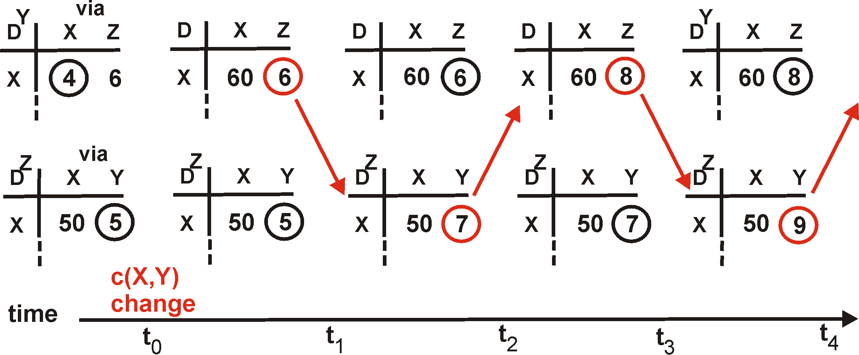
Distance Vector: Link Cost Changes
Link cost changes:
Good news travels fast
Bad news travels slow - “count to infinity” problem!
60
Y
4
1
X
Z
50
algorithm
continues
on!

Slide 28
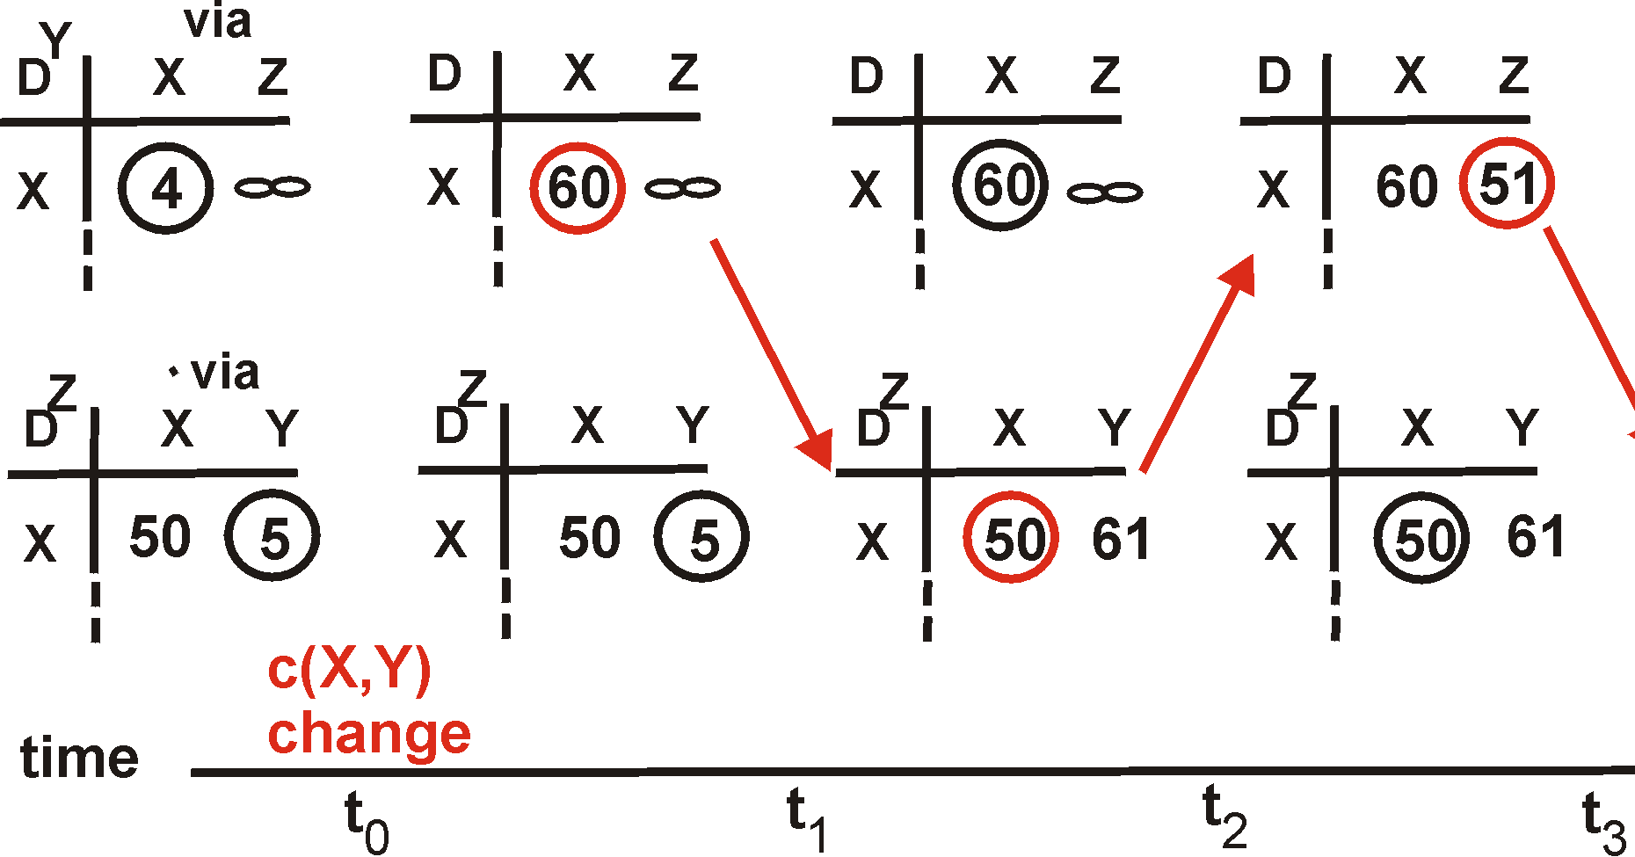
Distance Vector: Split Horizon
If Z routes through Y to get to X :
Z does not advertise its route to X back to Y
60
Y
4
1
X
Z
50
algorithm
terminates
?
?
?

Slide 29
Link State Protocol Concept
Every node gets complete copy of graph
  Every node “floods” network with data about its outgoing links
Every node computes routes to every other node
  Using single-source, shortest-path algorithm
Process performed whenever needed
  When connections die / reappear

Slide 30
Sending Link States by Flooding
X Wants to Send Information
  Sends on all outgoing links
When Node Y Receives Information from Z
  Send on all links other than Z
X
A
X
A
C
B
D
C
B
D
(a)
(b)
X
A
X
A
C
B
D
C
B
D
(c)
(d)

Slide 31
Comparison of LS and DV Algorithms
Message complexity
LS: with n nodes, E links, O(nE) messages
DV: exchange between neighbors only O(E)
Speed of Convergence
LS: Complex computation
  But…can forward before computation
  may have oscillations
DV: convergence time varies
  may be routing loops
  count-to-infinity problem
  (faster with triggered updates)
Space requirements:
  LS maintains entire topology
  DV maintains only neighbor state

Slide 32
Comparison of LS and DV Algorithms
Robustness: what happens if router malfunctions?
LS:
  node can advertise incorrect link cost
  each node computes only its own table
DV:
  DV node can advertise incorrect path cost
  each node’s table used by others
    errors propagate thru network
Other tradeoffs
  Making LSP flood reliable

Slide 33
Today's Lecture
Network Interface
Link Layer
Addressing/IP
Routing
TCP
  Connection establishment, flow control, reliability, congestion control

Slide 34
Establishing Connection:
Three-Way handshake
Each side notifies other of starting sequence number it will use for sending
  Why not simply chose 0?
    Must avoid overlap with earlier incarnation
    Security issues
Each side acknowledges other’s sequence number
  SYN-ACK: Acknowledge sequence number + 1
Can combine second SYN with first ACK
SYN: SeqC
ACK: SeqC+1
SYN: SeqS
ACK: SeqS+1
Client
Server

Slide 35
Tearing Down Connection
Either side can initiate tear down
  Send FIN signal
  “I’m not going to send any more data”
Other side can continue sending data
  Half open connection
  Must continue to acknowledge
Acknowledging FIN
  Acknowledge last sequence number + 1
A
B
FIN, SeqA
ACK, SeqA+1
Data
ACK
FIN, SeqB
ACK, SeqB+1

Slide 36
Sender/Receiver State
Sender
Receiver
Max ACK received
Next seqnum
Next expected
Max acceptable
…
…
…
…
Sender window
Receiver window
Sent & Acked
Sent Not Acked
Received & Acked
Acceptable Packet
OK to Send
Not Usable
Not Usable

Slide 37
Window Flow Control: Send Side
Packet Sent
Packet Received
Source Port
Dest. Port
Source Port
Dest. Port
Sequence Number
Sequence Number
Acknowledgment
Acknowledgment
HL/Flags
Window
HL/Flags
Window
D. Checksum
Urgent Pointer
D. Checksum
Urgent Pointer
Options…
Options...
App write
acknowledged
sent
to be sent
outside window

Slide 38
Fast Retransmit
X
Retransmission
Sequence No
Duplicate Acks
Packets
Acks
Time

Slide 39
TCP (Reno variant)
X
X
X
Now what? - timeout
X
Sequence No
Packets
Acks
Time

Slide 40
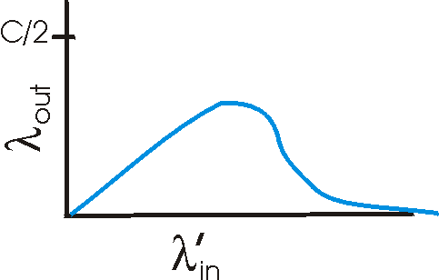
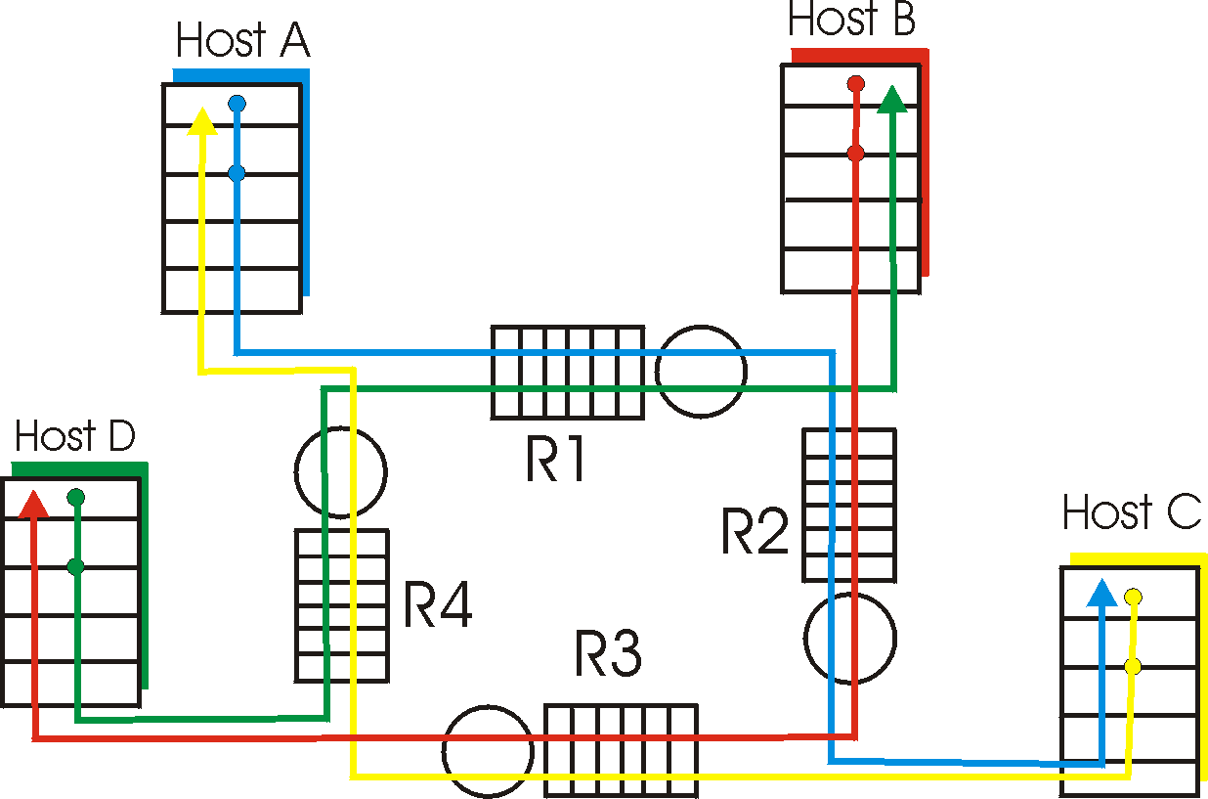
Causes & Costs of Congestion
When packet dropped, any “upstream transmission capacity used for that packet was wasted!

Slide 41
TCP Congestion Control
Changes to TCP motivated by ARPANET congestion collapse
Basic principles
  AIMD
  Packet conservation
  Reaching steady state quickly
  ACK clocking

Slide 42
TCP Saw Tooth Behavior
Congestion
Window
Timeouts
may still
occur
Slowstart
to pace
packets
Time
Initial
Slowstart
Fast
Retransmit
and Recovery

Slide 43
Important Lessons
TCP state diagram → setup/teardown
  Making sure both sides end up in same state
TCP timeout calculation → how is RTT estimated
  Good example of adapting to network performance
Modern TCP loss recovery
  Why are timeouts bad?
  How to avoid them? → e.g. fast retransmit
  Making the common case work well

Slide 44
Important Lessons
Sliding window flow control
  Addresses buffering issues and keeps link utilized
  Need to ensure that distributed resources that are known about aren’t overloaded
Why is congestion control needed?
  Need to share some resources without knowing their current state
How to evaluate congestion control algorithms?
  Why is AIMD the right choice for congestion control?
    Results in stable and fair behavior

Slide 45
Next Lecture
Android APIs (Dongsu)
Reading
  Project 1 handout

