Slide 1
15-446 Distributed Systems
Spring 2009
L-1 Introduction

Slide 2
Today's Lecture
Administrivia
Example topics

Slide 3
Instructors
Instructor
  Srini Seshan
  srini@cmu.edu, Wean Hall 8113
  Office hours: Thursday 1-2pm
Teaching assistant
  Dongsu Han
  dongsuh@cs.cmu.edu, Wean 8218
  Office hours: Mon 1:30-2:30

Slide 4
Course Goals
Become familiar with the principles and practice of distributed systems
  algorithms, APIs, ...
Learn how to write distributed applications that use the network
  How does a distributed file system work?
Mobile/Ubiquitous computing focus
  Projects and programming done using Android platform

Slide 5
Android
Dramatically updated class focus
  Distributed systems + mobile/ubiquitous
New projects
  Project 1
    Part A → discovery protocol for mobile phones
    Part B → distributed file updates with eventual consistency
  Project 2
    Self-defined
    3-person groups
    We’ll provide some ideas, but you can make up your own

Slide 6
Course Format
~30 lectures
  Cover the “principles and practice”
  Complete readings before lecture
4 paper/lab homework assignments
  Loosely tied to lecture materials
  Teach networking concepts/tools
2.5 programming projects
  How to use and build networks / networked applications
  Application-layer programming
  Larger, open-ended projects. Start early!
Midterm and final
  Covers each of the above 3 parts of class

Slide 7
Lecture Schedule
Syllabus online
Lectures Tue/Thu 10:30-11:50
Recitations Wed 3:30-4:20
  Used for:
    Project/programming related lectures
    Exam reviews
    Makeup lectures
  Not taught every week – keep an eye on syllabus

Slide 8
Reading
Recommended textbooks
  Distributed Systems: Concepts and Design, 4rd ed by Coulouris, G, Dollimore, J., and Kindberg, T., Addison-Wesley, 2006. ISBN: 0321263545
  Distributed Systems: Principles and Paradigms, 2nd ed by Tanenbaum, A. and van Steen, M., Prentice Hall, 2007. ISBN: 0132392275
  Either is fine, will post readings on Web page for both
    Both will be placed on reserve in library
Paper readings
  Classic academic papers on different topics

Slide 9
Sounds Great!
How Do I Get In?
Currently 17 people are enrolled, and 13 people are on the waiting list.
  Limited to about 20 ☹
  If you do not plan to take the course, please drop it ASAP so somebody else can take your place!
Preference will not be based on online waitlist order
  We give preference to students attending class.
    Sign in sheet
  Preference given to undergraduates

Slide 10
Administrative Stuff
Watch the course web page
  http://www.cs.cmu.edu/~srini/15-446/S09/
  Handouts, readings, ..
Read bboards
  cyrus.academic.cs.15-441.announce for official announcements
  cyrus.academic.cs.15-441 for questions/answers
Course secretary
  Barbara Grandillo, Wean Hall 8018

Slide 11
Grading
Roughly equal weight in projects and testing
  20% for Project I
  20% for Project II
  15% for Midterm exam
  25% for Final exam
  20% for Homework
You MUST demonstrate competence in both projects and tests to pass the course
  Fail either and you fail the class!

Slide 12
Policy on Collaboration
Working together is important
  Discuss course material in general terms
  Work together on program debugging, ..
Final submission must be your own work
  Homeworks, midterm, final
Project 1
  Done independently
Project 2
  Teams of three
  Collaboration, group project skills
  All students should understand the entire project

Slide 13
Late Work and Regrading
Late work will receive a 15% penalty/day
  No assignment can be more than 2 days late
  Only exception is documented illness and family emergencies
Requests for regrading must be submitted in writing to course secretary within 2 weeks.
  Regrading will be done by original grader
No assignments with a “short fuse”
  Homeworks: ~1-2 weeks
  Projects: ~5 weeks
  Start on time!
  Every year some students discover that a 5 week project cannot be completed in a week

Slide 14
Today's Lecture
Administrivia
Examples topics

Slide 15
Topics
Traditional
Networking
Naming
Time synchronization
Replication/Consistency
Security
Transactions
Distributed file systems
Group communication
Cluster computing
Ubicomp
Wireless networks
Localization
P2P
Sensor networks
Adaptive applications
Social networks
P2P applications
Android APIs

Slide 16
Definition of a Distributed System
A distributed system is:
A collection of independent computers that appears to its users as a single coherent system
"A distributed system is one in which the failure of a computer you didn't even know existed can render your own computer unusable." – Leslie Lamport

Slide 17
Figure 1.1
A typical portion of the Internet
intranet
%
ISP
%
%
%
backbone
satellite link
desktop computer:
server:
network link:

Slide 18
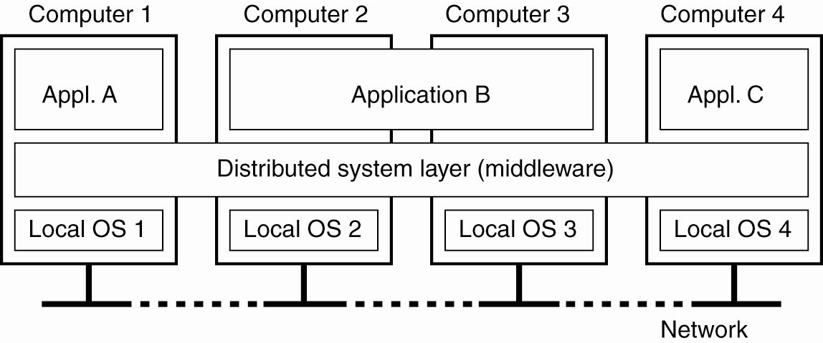
Middleware
The middleware layer extends over multiple machines, and offers each application the same interface.

Slide 19
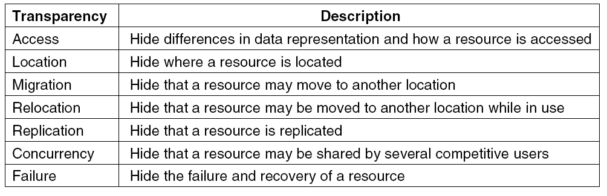
Transparency in a Distributed System

Slide 20
Pitfalls when Developing
Distributed Systems
False assumptions made by first time developer:
The network is reliable.
The network is secure.
The network is homogeneous.
The topology does not change.
Latency is zero.
Bandwidth is infinite.
Transport cost is zero.
There is one administrator.

Slide 21
Scalability Problems
Characteristics of decentralized algorithms:
No machine has complete information about the system state.
Machines make decisions based only on local information.
Failure of one machine does not ruin the algorithm.
There is no implicit assumption that a global clock exists.

Slide 22
Reasons for Replication
Data are replicated to increase the reliability of a system.
Replication for performance
  Scaling in numbers
  Scaling in geographical area
Caveat
  Gain in performance
  Cost of increased bandwidth for maintaining replication

Slide 23
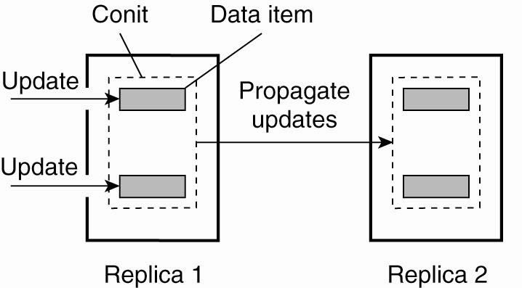
Continuous Consistency

Slide 24
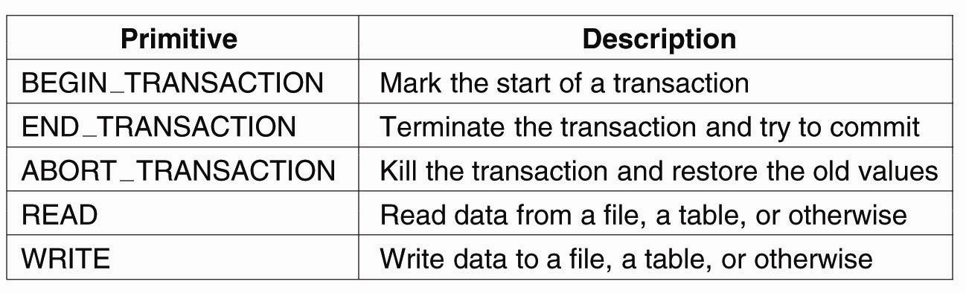
Transaction Processing Systems

Slide 25
Transaction Processing Systems
ACID properties of transactions:
Atomic: To the outside world, the transaction happens indivisibly.
Consistent: The transaction does not violate system invariants.
Isolated: Concurrent transactions do not interfere with each other.
Durable: Once a transaction commits, the changes are permanent.

Slide 26
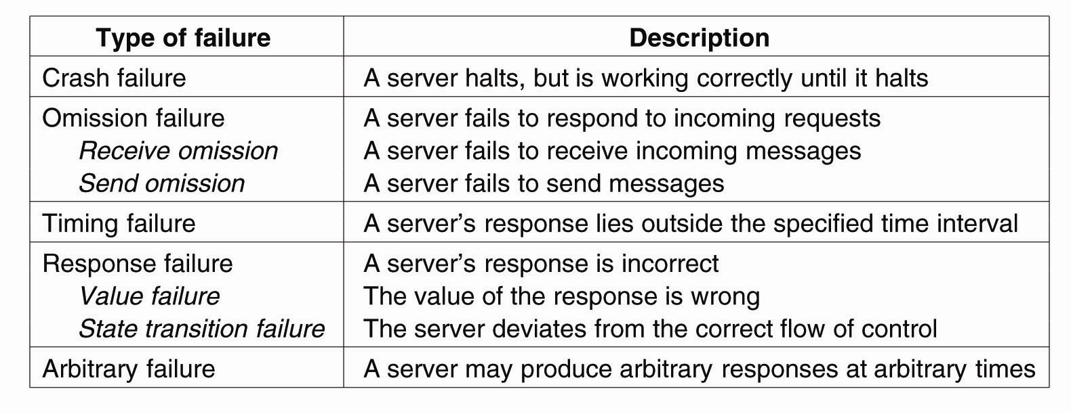
Failure Models

Slide 27
Next Lecture
Networking intro
Read “End-to-End Arguments” paper

