Slide 1
Distributed Replication
Lecture 11, Oct 6th 2016

Slide 2
How’d we get here?
Failures & single systems; fault tolerance techniques added redundancy (ECC memory, RAID, etc.)
Conceptually, ECC & RAID both put a “master” in front of the redundancy to mask it from clients -- ECC handled by memory controller, RAID looks like a very reliable hard drive behind a (special) controller

Slide 3
Simpler examples...
Replicated web sites
e.g., Yahoo! or Amazon:
  DNS-based load balancing (DNS returns multiple IP addresses for each name)
  Hardware load balancers put multiple machines behind each IP address

Slide 4
Read-only content
Easy to replicate - just make multiple copies of it.
  Performance boost: Get to use multiple servers to handle the load;
  Perf boost 2: Locality. We’ll see this later when we discuss CDNs, can often direct client to a replica near it
  Availability boost: Can fail-over (done at both DNS level -- slower, because clients cache DNS answers -- and at front-end hardware level)

Slide 5
But for read-write data...
Must implement write replication, typically with some degree of consistency

Slide 6

Sequential Consistency (1)
Behavior of two processes operating on the same data item. The horizontal axis is time.
P1: Writes “W” value a to variable “x”
P2: Reads `NIL’ from “x” first and then `a’
Notes:
Pg/282/Tanenbaum
Idea is that P1 writes to variable X, updating it to Value a. That update is propagated to all other local copies.
At some point P2 reads x, gets a value Nil (since it was unitalized) and then subsequently gets a value of “a” for variable x.

Slide 7
Sequential Consistency (2)
A data store is sequentially consistent when:
The result of any execution is the same as if the (read and write) operations by all processes on the data store …
  Were executed in some sequential order and …
  the operations of each individual process appear …
    in this sequence
    in the order specified by its program.

Slide 8
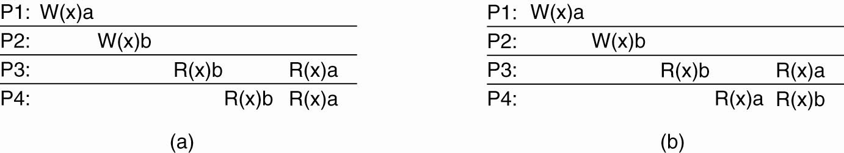
Sequential Consistency (3)
(a) A sequentially consistent data store.
(b) A data store that is not sequentially consistent.
Notes:
(a) Is sequentiually consistent since even though P3 and P4 first read the value of ‘x’ as a and then b, both of them have the same view.
(b) Is not sequentially consistent since at the end, P3 and P4 will have different values of x ( a or b) at the end.

Slide 9
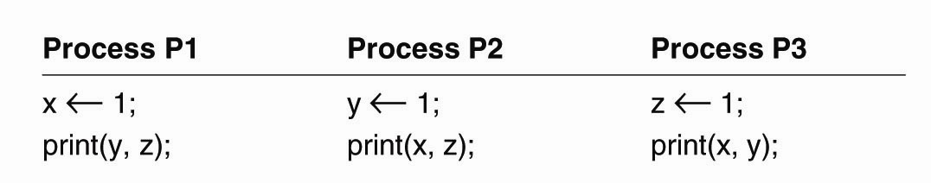
Sequential Consistency (4)
Figure 7-6. Three concurrently-executing processes.
Notes:
How are there 720 orderings? 6 statements, so 6! = 720.
However many of them are not valid since you cannot have the print (y,z) before x <-1 for P1, etc.

Slide 10
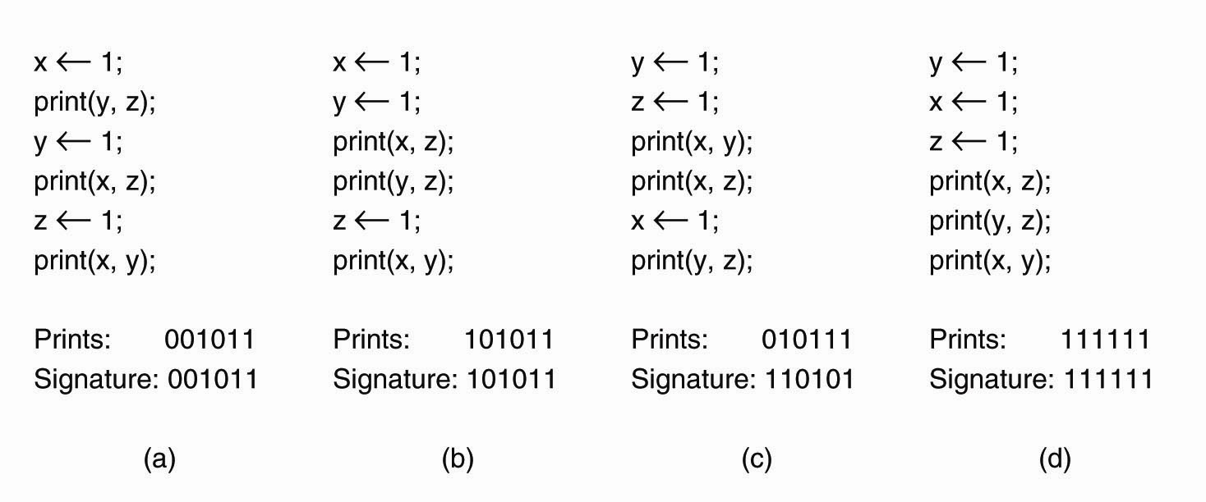
Sequential Consistency (5)
Figure 7-7. Four valid execution sequences for the processes of Fig. 7-6. The vertical axis is time.
Overall, there are 90 (out of 720) valid statement orderings that are allowed under sequental consistency
Notes:
How are there 720 orderings? 6 statements, so 6! = 720.
However many of them are not valid since you cannot have the print (y,z) before x <-1 for P1, etc.
Prints: shows the actual output of the 2 bit strings for each of the print(-, -) statements, so 2 bits for each P1,P2,P3 = 6 bits in total.
Signature: Shows the values of the prints if P1 (y,z), P2(x,z), P3 (x,y) were printed in that fixed order.

Slide 11
Causal Consistency (1)
For a data store to be considered causally consistent, it is necessary that the store obeys the following condition:
Writes that are potentially causally related …
  must be seen by all processes
  in the same order.
Concurrent writes …
  may be seen in a different order
  on different machines.
Notes:
What are causally related here?
Process P1 writes a data item x. Then P2 reads that data item x, and writes y. In this example P1 and P2 are potentially causually related since y may depend on x.
Alternatively, if P1 and P2 are writing two different data items that are simultaneous and not related to each other then they are considered concurrent.

Slide 12
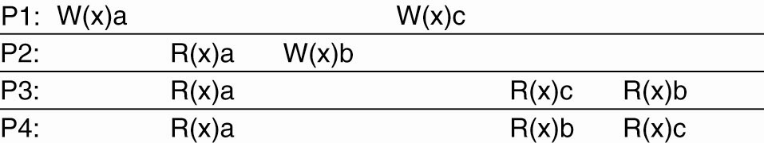
Causal Consistency (2)
Figure 7-8. This sequence is allowed with a causally-consistent store, but not with a sequentially consistent store.
Notes:
Note: P1: W(x)c and P2: W(x)b are concurrent so its not important that all processes see them in the same order
However Wx(a) and R(x) a and then W(x)b are potentially causally related so they must be in order.

Slide 13
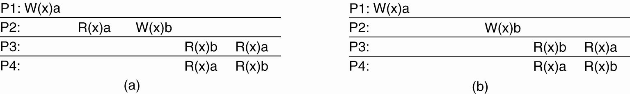
Causal Consistency (3)
Figure 7-9. (a) A violation of a causally-consistent store.
Notes:
P2 W(x) b may be causally realted to the W (x) a -- for example it may be the result of value read in P2: R (x) a and hence the two writes are causally related.
If so, then P3 and P4 must see them in the same order and the currnet output is incorrect and violates causally consistent ordering.

Slide 14
Causal Consistency (4)
Figure 7-9. (b) A correct sequence of events in a causally-consistent store.
Notes:
In this figure, P1: W (x)a is concurrent with P2: W(x) b and hence they are not causally related, and hence P3 and P4 could see them in diffferent order -- so OK.

Slide 15
Important ?: What is the consistency model?
Just like in filesystems, want to look at the consistency model you supply
Real Life example: Google mail.
  Sending mail is replicated to ~2 physically separated datacenters (users hate it when they think they sent mail and it got lost); mail will pause while doing this replication.
    Q: How long would this take with 2-phase commit? in the wide area?
  Marking mail read is only replicated in the background - you can mark it read, the replication can fail, and you’ll have no clue (re-reading a read email once in a while is no big deal)
Weaker consistency is cheaper if you can get away with it.
Notes:
Recap 2-PC
Messages in first phase
A: Coordinator sends “CanCommit?” to participants
B: Participants respond: “VoteCommit” or “VoteAbort”
Messages in the second phase
A: if any participant “VoteAbort” transaction aborts. Co-ordinator sends “DoAbort” to everyone => release locks
Else, send “DoCommit” to everyone => complete transaction

Slide 16
Replicate: State versus Operations
Possibilities for what is to be propagated:
Propagate only a notification of an update.
- Sort of an “invalidation” protocol
Transfer data from one copy to another.
- Read-to-Write ratio high, can propagate logs (save bandwidth)
Propagate the update operation to other copies
- Don’t transfer data modifications, only operations – “Active replication”
Notes:
Invalidation part just tells the replicas that their copy of the data is invalid and maybe even which part is invalid.
Key thing is no more than an invalidation message is sent.
Advantage: Low network bandwith
Transfer copy from one to the other:
read-to-write ratio high, transfer data to replica. Can also
Propagate update operations -= assumes that each repliaca has a process capable of actively keeping its data in sync by update operations

Slide 17
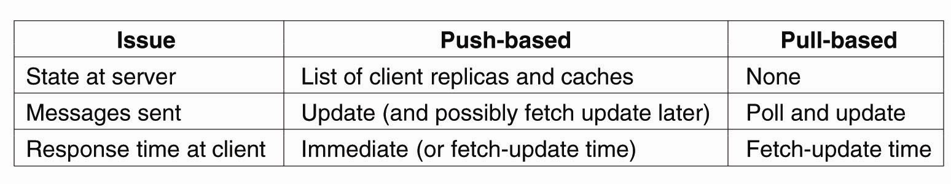
When to Replicate: Pull versus Push Protocols
Comparison between push- and pull-based protocols in the case of multiple-client, single-server systems.
- Pull Based: Replicas/Clients poll for updates (caches)
- Push Based: Server pushes updates (stateful)

Slide 18
Failure model
We’ll assume for today that failures and disconnections are relatively rare events - they may happen pretty often, but, say, any server is up more than 90% of the time.
We looked at “disconnected operation” models. For example, the CMU CODA system, that allowed AFS filesystem clients to work “offline” and then reconnect later.

Slide 19
Tools we’ll assume
Group membership manager
  Allow replica nodes to join/leave
Failure detector
  e.g., process-pair monitoring, etc.

Slide 20
Goal
Provide a service
Survive the failure of up to f replicas
Provide identical service to a non-replicated version (except more reliable, and perhaps different performance)

Slide 21
We’ll cover today...
Primary-backup
  Operations handled by primary, it streams copies to backup(s)
  Replicas are “passive”, i.e. follow the primary
  Good: Simple protocol. Bad: Clients must participate in recovery.
Quorum consensus
  Designed to have fast response time even under failures
  Replicas are “active” - participate in protocol; there is no master, per se.
  Good: Clients don’t even see the failures. Bad: More complex.

Slide 22
Primary-Backup
Clients talk to a primary
The primary handles requests, atomically and idempotently, just like your lock server would
Executes them
Sends the request to the backups
Backups reply, “OK”
ACKs to the client

Slide 23
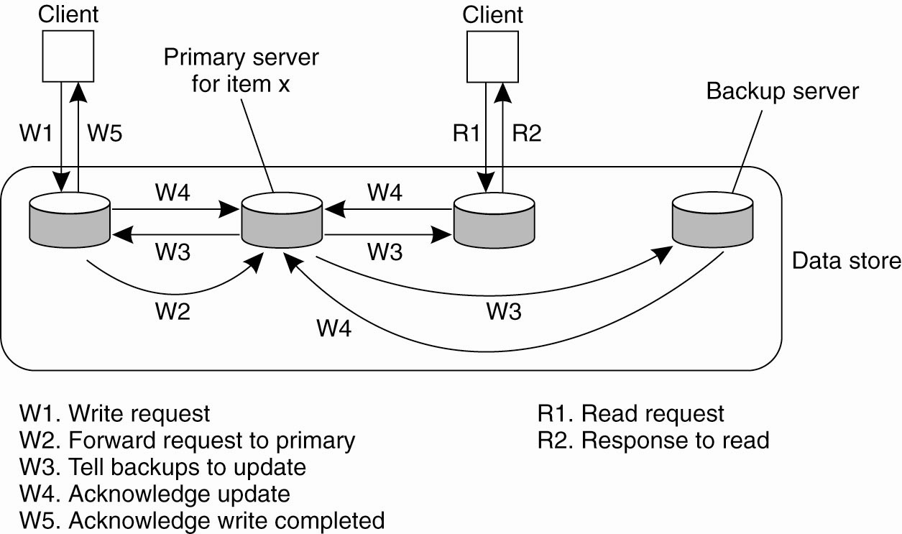
Remote-Write PB Protocol
Updates are blocking, although non-blocking possible
Notes:
The simplest form of primary backup protocol that supports replication is where all the writes go to a single server (fixed) and the read operations can be carried out locally.
Due to blocking operation, processes will see the effects of the most recent write.
Non blocking means that the Primary issues an ACK after it receives and commits a local copy of item “x” and then tells the backups/replica to update it. This comes at the cost of fault tolerance.

Slide 24
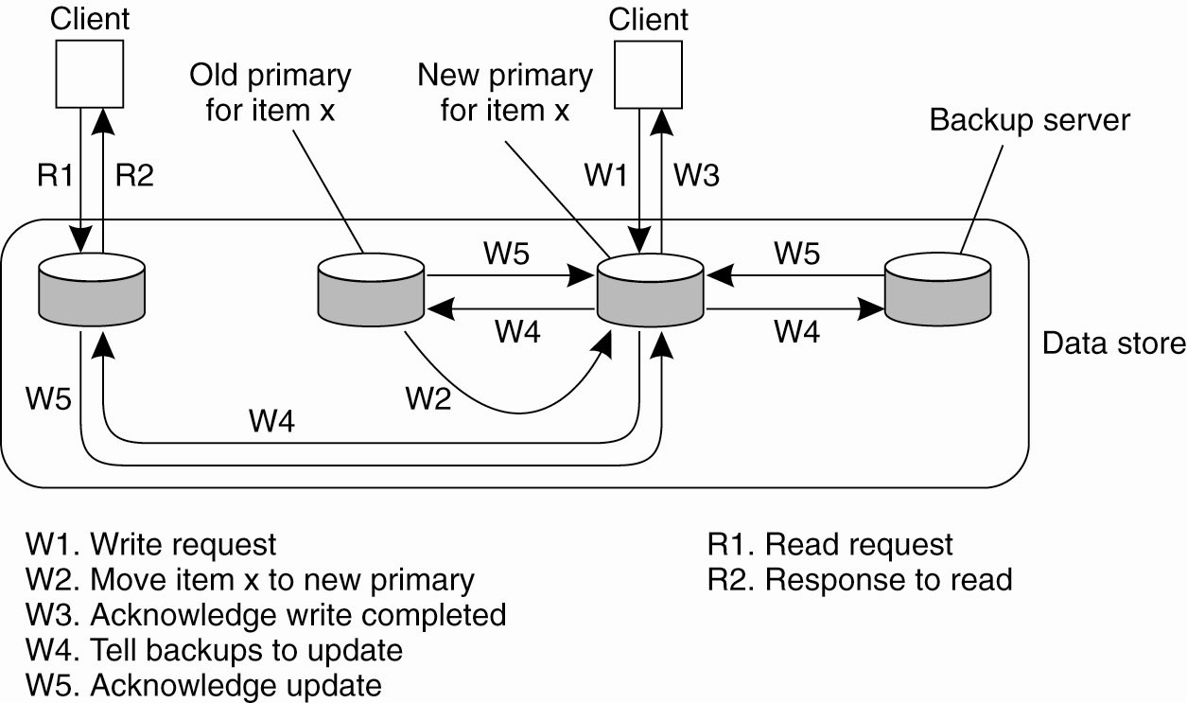
Local-Write P-B Protocol
Primary migrates to the process wanting to process update
For performance, use non-blocking op.
What does this scheme remind you of?
Notes:
Variant of PB, where the primary migrates copy of a particular item migrates to the process that wants to perform update.
Advatage: multiple successive write opeations can be peformed locally on the replicas, while reading processes can access their local copy.
Note, for the actual performance advantage, you must apply non-blocking protocol.
This is a useful scheme for Mobile computers. Before disconnecting, a mobile client can become the primary server for the files it wants to update. All update operations (in disconnected mode) are done locally and then propagated from the primary to the backups to bring things into a consistent state again. (somewhat like CODA?)

Slide 25
Primary-Backup
Note: If you don’t care about strong consistency (e.g., the “mail read” flag), you can reply to client before reaching agreement with backups (sometimes called “asynchronous replication”).
This looks cool. What’s the problem?
  What do we do if a replica has failed?
  We wait... how long? Until it’s marked dead.
  Primary-backup has a strong dependency on the failure detector
This is OK for some services, not OK for others
Advantage: With N servers, can tolerate loss of N-1 copies

Slide 26
Implementing P-B
Remember logging? :-)
Common technique for replication in databases and filesystem-like things: Stream the log to the backup. They don’t have to actually apply the changes before replying, just make the log durable.
You have to replay the log before you can be online again, but it’s pretty cheap.

Slide 27
p-b: Did it happen?
Client
Primary
Backup
Commit!
Log
Commit!
OK!
OK!
Log
OK!
Failure here:
Commit logged only at primary
Primary dies? Client must re-send to backup

Slide 28
p-b: Happened twice
Client
Primary
Backup
Commit!
Commit!
Log
OK!
Log
OK!
Failure here:
Commit logged at backup
Primary dies? Client must check with backup
(Seems like at-most-once / at-least-once... :)

Slide 29
Problems with p-b
Not a great solution if you want very tight response time even when something has failed: Must wait for failure detector
For that, quorum based schemes are used
As name implies, different result:
To handle f failures, must have 2f + 1 replicas (so that a majority is still alive)
Also, for replicated-write => write to all replica’s not just one.
Notes:
Major difference, you want replicated Write protocols so that you can write to multiple replicas instead of just one.

Slide 30
Paxos [Lamport]
quorum consensus usually boils down to the Paxos algorithm.
Very useful functionality in big systems/clusters.
Some notes in advance:
  Paxos is painful to get right, particularly the corner cases. Start from a good implementation if you can. See Yahoo’s “Zookeeper” as a starting point.
  There are lots of optimizations to make the common / no or few failures cases go faster; if you find yourself implementing, research these.
  Paxos is expensive, as we’ll see. Usually, used for critical, smaller bits of data and to coordinate cheaper replication techniques such as primary-backup for big bulk data.

Slide 31
Paxos: fault tolerant consensus
Paxos lets all nodes agree on the same value despite node failures, network failures and delays
Some good use Cases:
e.g. Nodes agree that X is the primary
e.g. Nodes agree that W should be the most recent operation executed

Slide 32
Paxos requirement
Correctness (safety):
  All nodes agree on the same value
  The agreed value X has been proposed by some node
Fault-tolerance:
  If less than N/2 nodes fail, the rest should reach agreement eventually w.h.p
  Liveness is not guaranteed
Termination (not guaranteed)
Notes:
PAXOS sacrifices liveness in favor of correctness

Slide 33
Fischer-Lynch-Paterson [FLP’85] impossibility result
It is impossible for a set of processors in an asynchronous system to agree on a binary value, even if only a single processor is subject to an unannounced failure.
Synchrony --> bounded amount of time node can take to process and respond to a request
Asynchrony --> timeout is not perfect
Notes:
Fail-stop vs Fail-recover faults. Synchronous systems vs asynchronous systems.
Additional Reading: http://the-paper-trail.org/blog/consensus-protocols-paxos/

Slide 34
Paxos: general approach
Elect a replica to be the Leader
Leader proposes a value and solicits acceptance from others
If a majority ACK, the leader then broadcasts a commit message.
This process may be repeated many times, as we’ll see.
Paxos slides adapted from Jinyang Li, NYU; some terminology from “Paxos Made Live” (Google)
Notes:
Each node in PAXOS runs as a proposer, acceptor and learner
Notes from: http://the-paper-trail.org/blog/consensus-protocols-paxos/
Precise Protocol
Informally, here are the steps that each principal in the protocol must execute.
PROPOSERS (Or LEADER in our terminology):
1. Submit a proposal numbered to a majority of acceptors. Wait for a majority of acceptors to reply.
2. If the majority reply ‘agree’, they will also send back the value of any proposals they have already accepted. Pick one of these values, and send a ‘commit’ message with the proposal number and the value. If no values have already been accepted, use your own. If instead a majority reply ‘reject’, or fail to reply, abandon the proposal and start again.
3. If a majority reply to your commit request with an ‘accepted’ message, consider the protocol terminated. Otherwise, abandon the proposal and start again.
ACCEPTORS:
1. Once a proposal is received, compare its number to the highest numbered proposal you have already agreed to. If the new proposal is higher, reply ‘agree’ with the value of any proposals you have already accepted. If it is lower, reply ‘reject’, along with the sequence number of the highest proposal.
2. When a ‘commit’ message is received, accept it if a) the value is the same as any previously accepted proposal and b) its sequence number is the highest proposal number you have agreed to. Otherwise, reject it.

Slide 35
Why is agreement hard?
What if >1 nodes think they’re leaders simultaneously?
What if there is a network partition?
What if a leader crashes in the middle of solicitation?
What if a leader crashes after deciding but before broadcasting commit?
What if the new leader proposes different values than already committed value?

Slide 36
Basic two-phase
Coordinator tells replicas: “Value V”
Replicas ACK
Coordinator broadcasts “Commit!”
This isn’t enough
  What if there’s more than 1 coordinator at the same time? (let’s solve this first)
  What if some of the nodes or the coordinator fails during the communication?

Slide 37
Paxos setup
Each node runs as a proposer, acceptor and learner
Proposer (leader) proposes a value and solicit acceptance from acceptors
Leader announces the chosen value to learners

Slide 38
Combined leader election and two-phase
Prepare(N) -- dude, I’m the master
if N >= nH, Promise(N) –
ok, you’re the boss. (I haven’t seen anyone with a higher N)
if majority promised: Accept(V, N) -- please agree on the value V
if N >= nH, ACK(V, N) -- Ok!
if majority ACK: Commit(V)
Notes:
hN = highest proposal number N that this node (Acceptor) has seen.
Promise N means that I promise that I will not accept any value with a value lower than N.

Slide 39
Multiple coordinators
The value N is basically a lamport clock.
Nodes that want to be the leader generate an N higher than any they’ve seen before
If you get NACK’d on the propose, back off for a while - someone else is trying to be leader
Have to check N at later steps, too, e.g.:
L1: N = 5 --> propose --> promise
L2: N = 6 --> propose --> promise
L1: N = 5 --> accept(V1, ...)
Replicas: NACK! Someone beat you to it.
L2: N = 6 --> accept(V2, ...)
Replicas: Ok!
Notes:
Coordinators are essentially Leaders in Paxos

Slide 40
But...
What happens if there’s a failure? Let’s say the coordinator crashes before sending the commit message
Or only one or two of the replicas received it
Notes:
Question?

Slide 41
Paxos solution
Proposals are ordered by proposal #
Each acceptor may accept multiple proposals
  If a proposal with value `v' is chosen, all higher proposals must have value `v'

Slide 42
Paxos operation: node state
Each node maintains:
  na, va: highest proposal # and its corresponding accepted value
  nh: highest proposal # seen
  myn: my proposal # in current Paxos

Slide 43
Paxos operation: 3-phase protocol
Phase 1 (Prepare)
  A node decides to be leader (and propose)
  Leader chooses myn > nh
  Leader sends <prepare, myn> to all nodes
  Upon receiving <prepare, n>
    If n < nh
    reply <prepare-reject>
    Else
    nh = n
    reply <prepare-ok, na,va>
See the
relation to
lamport
clocks?
This node will not accept
any proposal lower than n

Slide 44
Paxos operation
Phase 2 (Accept):
  If leader gets prepare-ok from a majority
    V = non-empty value corresponding to the highest na received
    If V= null, then leader can pick any V
    Send <accept, myn, V> to all nodes
  If leader fails to get majority prepare-ok
    Delay and restart Paxos
  Upon receiving <accept, n, V>
    If n < nh
    reply with <accept-reject>
    else
    na = n; va = V; nh = n
    reply with <accept-ok>
Notes:
Why pick any V?

Slide 45
Paxos operation
Phase 3 (Commit)
  If leader gets accept-ok from a majority
    Send <commit, va> to all nodes
  If leader fails to get accept-ok from a majority
    Delay and restart Paxos

Slide 46
Paxos operation: an example
nh=N0:0
na = va = null
nh=N1:0
na = va = null
nh=N2:0
na = va = null
Prepare,N1:1
Prepare,N1:1
nh= N1:1
na = null
va = null
nh: N1:1
na = null
va = null
ok, na= va=null
ok, na =va=nulll
Accept,N1:1,val1
Accept,N1:1,val1
nh=N1:1
na = N1:1
va = val1
nh=N1:1
na = N1:1
va = val1
ok
ok
Decide,val1
Decide,val1
N0
N1
N2
Notes:
Further *recommended* Reading on PAXOS: http://the-paper-trail.org/blog/consensus-protocols-paxos/

Slide 47
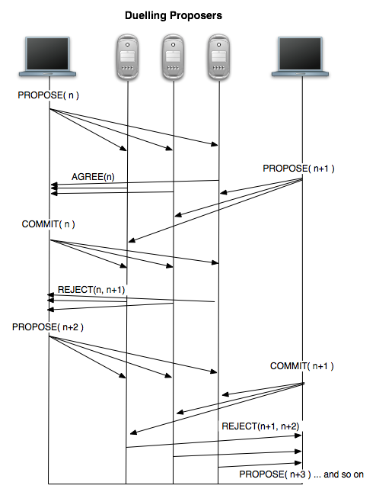
Paxos : dueling proposers
Duelling proposers (leader)
  Violates Liveness
  Likelihood that proposers
  observe each other and let
  one go first.
  Or have a leader election
Source: http://the-paper-trail.org/blog/consensus-protocols-paxos/
Notes:
Further *recommended* Reading on PAXOS: http://the-paper-trail.org/blog/consensus-protocols-paxos/

Slide 48
Paxos properties
When is the value V chosen?
  When leader receives a majority prepare-ok and proposes V
  When a majority nodes accept V
  When the leader receives a majority accept-ok for value V

Slide 49
Paxos is widespread!
Industry and academia
  Google: Chubby (distributed lock service)
  Yahoo: Zookeeper (distributed lock service)
  MSR: Frangipani (distributed lock service)
  OpenSource implementations
    Libpaxos (paxos based atomic broadcast)
    Zookeeper is open source, integrated w/Hadoop
Paxos slides adapted from Jinyang Li, NYU;

Slide 50
Paxos History
It took 25 years to come up with safe protocol
– 2PC appeared in 1979 (Gray)
– In 1981, a basic, unsafe 3PC was proposed (Stonebraker)
– In 1998, the safe, mostly live Paxos appeared (Lamport), 2001 ”Paxos made simple”.
– In ~2007 RAFT appears

Slide 51
Understanding Paxos
(for you to think about)
What if more than one leader is active?
Suppose two leaders use different proposal number, N0:10, N1:11
Can both leaders see a majority of prepare-ok?

Slide 52
Understanding Paxos
(for you to think about)
What if leader fails while sending accept?
What if a node fails after receiving accept?
  If it doesn’t restart …
  If it reboots …
What if a node fails after sending prepare-ok?
  If it reboots …

Slide 53
Replication Wrap-Up
Primary/Backup quite common, works well, introduces some time lag to recovery when you switch over to a backup. Doesn’t handle as large a set of failures. f+1 nodes can handle f failures.
Paxos is a general, quorum-based mechanism that can handle lots of failures, still respond quickly. 2f+1 nodes.
Notes:
Understand this.

Slide 54
Beyond PAXOS
Many follow ups and variants
RAFT consensus algorithm
  https://raft.github.io/
  Great visualization of how it work
    http://thesecretlivesofdata.com/raft/

