Slide 1
15-440 Distributed Systems
Fall 2015
L-25 Security II

Slide 2
Logistics
Please sign up for slots for P3 presentation
  TAs have shared sign up sheet, 10min slots
  Demo App, details will be given by the TAs
Thursday 12/9 – Review lecture
  Focus on topics on 2nd half of the class
  Similar to the mid-term review. What that helpful?
Final in class – DH2315
  Date: 12/15 (Tuesday), Time: 8:30am
Please fill out course evaluations (FCE)
  Helps us improve the course, we appreciate feedback

Slide 3
Logistics II
Green Computing Class (Spring 2016)
  Tuesday/Thursday 10:30 – 11:50am
  08-540: Undergrad and MS version
    Paper readings, Final report OR project (reduced scope)
  08-840: PhD or MS version
    More paper readings, more significant project
  Example Projects included (individual or groups of 2)
    Project: Occupancy based control of systems
    Project: App for finding “energy bugs” on Android
    Project: “Effectiveness of energy feedback”
    Report: “Privacy in Smart Building
    Project: “GreenScreen: Smartphone sensor caching”
    Report: Perceptions of Energy Savings in the Home”
  Based on student FCE reports: 4-8 hours/week
  Talk to me after class in case of more questions
http://www.synergylabs.org/yuvraj/courses/08-840/

Slide 4
Today's Lecture
Effective secure channels
Access control
Privacy and Tor

Slide 5
The Great Divide
Asymmetric Crypto:
(Public key)
Example: RSA
Symmetric Crypto: (Private key)
Example: AES
Requires a pre-shared secret between communicating parties?
Yes
No
Overall speed of cryptographic operations
Fast
Slow
Notes:
The three attributes of a secure communication we mentioned can be achieved using two different “types”, or “families” of cryptography. Each family has within it many different algorithms, with slightly different properties.
Symmetric and Asymmetric cryptography differ in the assumptions they make about the “secrets”, or “keys” that two participants use to enable secure communication. Symmetric key crypto assumes that the parties have used some mechanism to set-up a “shared secret” between the two parties that can be used to secure further communication. Public key crypto, as we will see, does not make this assumption, yet can still provide strong security properties. However, the mechanism to do this uses complex math, and as a result, the time to perform asymmetric crypto operations is significantly longer than their symmetric counter-parts.

Slide 6
One last “little detail”…
How do I get these keys in the first place??
Remember:
Symmetric key primitives assumed Alice and Bob had already shared a key.
Asymmetric key primitives assumed Alice knew Bob’s public key.
This may work with friends, but when was the last time you saw Amazon.com walking down the street?

Slide 7
Symmetric Key Distribution
How does Andrew do this?
Andrew Uses Kerberos, which relies on a Key Distribution Center (KDC) to establish shared symmetric keys.

Slide 8



Key Distribution Center (KDC)
Alice, Bob need shared symmetric key.
KDC: server shares different secret key with each registered user (many users)
Alice, Bob know own symmetric keys, K_{A-KDC} K_{B-KDC} , for communicating with KDC.
KDC
K_{A-KDC}
K_{P-KDC}
K_{X-KDC}
K_{P-KDC}
K_{B-KDC}
K_{Y-KDC}
K_{Z-KDC}
K_{A-KDC}
K_{B-KDC}

Slide 9
Key Distribution Center (KDC)
Q: How does KDC allow Bob, Alice to determine shared symmetric secret key to communicate with each other?
KDC generates R1
K_{A-KDC}(A,B)
Alice
knows R1
K_{A-KDC}(R1, K_{B-KDC}(A,R1) )
Bob knows to use R1 to communicate with Alice
K_{B-KDC}(A,R1)
Alice and Bob communicate: using R1 as
session key for shared symmetric encryption
Notes:
Downside:
KDC must always be online to communicate securely
KDC can give our session keys away (escrow)

Slide 10
How Useful is a KDC?
Must always be online to support secure communication
KDC can expose our session keys to others!
Centralized trust and point of failure.
In practice, the KDC model is mostly used within single organizations (e.g. Kerberos) but not more widely.

Slide 11
The Dreaded PKI
Definition:
Public Key Infrastructure (PKI)
A system in which “roots of trust” authoritatively bind public keys to real-world identities
A significant stumbling block in deploying many “next generation” secure Internet protocol or applications.
Notes:
PKI’s are notoriously complex

Slide 12
Certification Authorities
Certification authority (CA): binds public key to particular entity, E.
An entity E registers its public key with CA.
  E provides “proof of identity” to CA.
  CA creates certificate binding E to its public key.
  Certificate contains E’s public key AND the CA’s signature of E’s public key.
Bob’s
public
key
CA generates
S = Sign(K_{B})
K_{B}
K_{B}
CA
private
key
certificate = Bob’s public key and signature by CA
Bob’s
identifying information
K⁻¹ _{CA}
Notes:
Note: CA’s do NOT generate keys. They simply are handed a public key along with proof of identify, and generate a signature which can accompany the key when it is given to a user that must validate that they key is in fact Bob’s public key.

Slide 13
Certification Authorities
When Alice wants Bob’s public key:
  Gets Bob’s certificate (Bob or elsewhere).
  Use CA’s public key to verify the signature within Bob’s certificate, then accepts public key
K_{B}
Verify(S, K_{B})
If signature is valid, use K_{B}
CA
public
key
K_{CA}

Slide 14
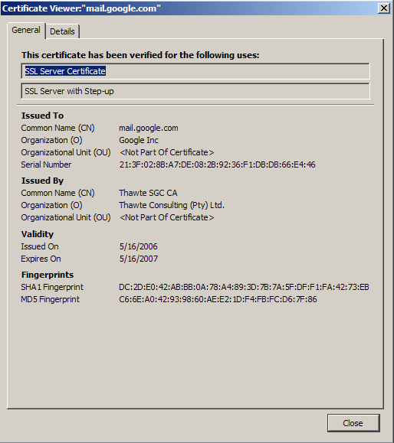
Certificate Contents
info algorithm and key value itself (not shown)
Cert owner
Cert issuer
Valid dates
Fingerprint of signature
Notes:
Wait… didn’t we just say that we needed to have the key’s from the CA’s? What does our browser use?

Slide 15
Transport Layer Security (TLS) aka Secure Socket Layer (SSL)
Used for protocols like HTTPS
Special TLS socket layer between application and TCP (small changes to application).
Handles confidentiality, integrity, and authentication.
Uses “hybrid” cryptography.
Notes:
Originally created by a little known and now largely defunct net start-up called “netscape” in the mid-90’s

Slide 16
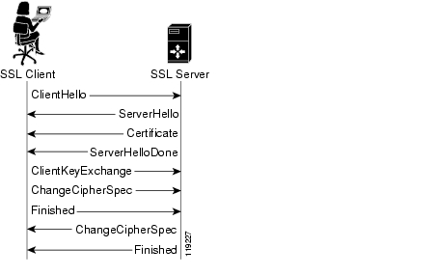
Setup Channel with TLS “Handshake”
Handshake Steps:
Clients and servers negotiate exact cryptographic protocols
Client’s validate public key certificate with CA public key.
Client encrypt secret random value with servers key, and send it as a challenge.
Server decrypts, proving it has the corresponding private key.
This value is used to derive symmetric session keys for encryption & MACs.

Slide 17
How TLS Handles Data
1) Data arrives as a stream from the application via the TLS Socket
2) The data is segmented by TLS into chunks
3) A session key is used to encrypt and MAC each chunk to form a TLS “record”, which includes a short header and data that is encrypted, as well as a MAC.
4) Records form a byte stream that is fed to a TCP socket for transmission.

Slide 18
Analysis
Public key lets us take the trusted third party offline:
  If it’s down, we can still talk!
  But we trade-off ability for fast revocation
    If server’s key is compromised, we can’t revoke it immediately...
    Usual trick:
      Certificate expires in, e.g., a year.
      Have an on-line revocation authority that distributes a revocation list. Kinda clunky but mostly works, iff revocation is rare. Clients fetch list periodically.
Better scaling: CA must only sign once... no matter how many connections the server handles.
If CA is compromised, attacker can trick clients into thinking they’re the real server.

Slide 19
Important Lessons
Symmetric (pre-shared key, fast) and asymmetric (key pairs, slow) primitives provide:
    Confidentiality
    Integrity
    Authentication
“Hybrid Encryption” leverages strengths of both.
Great complexity exists in securely acquiring keys.
Crypto is hard to get right, so use tools from others, don’t design your own (e.g. TLS).

Slide 20
Forward secrecy
In KDC design, if key K_{server-KDC} is compromised a year later,
  from the traffic log, attacker can extract session key (encrypted with auth server keys).
  attacker can decode all traffic retroactively.
In SSL, if CA key is compromised a year later,
  Only new traffic can be compromised. Cool…
But in SSL, if server’s key is compromised...
  Old logged traffic can still be compromised...

Slide 21
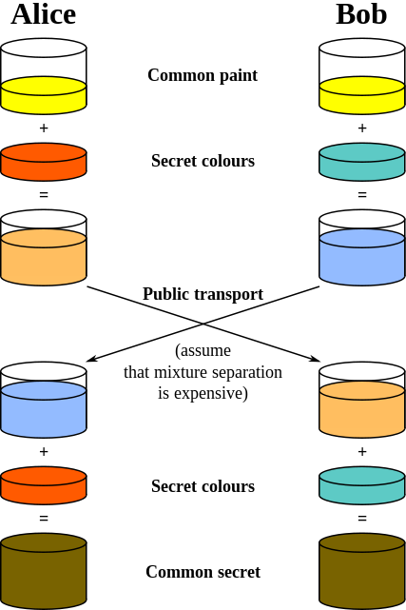
Diffie-Hellman Key Exchange
Different model of the world: How to generate keys between two people, securely, no trusted party, even if someone is listening in.
Illustrative Example
image from wikipedia
https://en.wikipedia.org/wiki/Diffie%E2%80%93Hellman_key_exchange

Slide 22
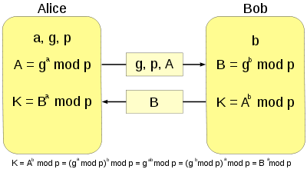
Diffie-Hellman Key Exchange
Different model of the world: How to generate keys between two people, securely, no trusted party, even if someone is listening in.
This is cool. But: Vulnerable to man-in-the-middle attack. Attacker pair-wise negotiates keys with each of A and B and decrypts traffic in the middle. No authentication...
image from wikipedia
Notes:
a,b are very large numbers and p is a very large prime number (600 digits!).

Slide 23
Authentication?
But we already have protocols that give us authentication!
  They just happen to be vulnerable to disclosure if long-lasting keys are compromised later...
Hybrid solution:
  Use diffie-hellman key exchange with the protocols we’ve discussed so far.
  Auth protocols prevent M-it-M attack if keys aren’t yet compromised.
  D-H means that an attacker can’t recover the real session key from a traffic log, even if they can decrypt that log.
  Client and server discard the D-H parameters and session key after use, so can’t be recovered later.
This is called “perfect forward secrecy”. Nice property.

Slide 24
One more note…
public key infrastructures (PKI)s are great, but have some challenges…
  Yesterday, we discussed how your browser trusts many, many different CAs.
  If any one of those is compromised, an attacker can convince your browser to trust their key for a website... like your bank.
  Often require payment, etc.
Alternative: the “ssh” model, which we call “trust on first use” (TOFU). Sometimes called “prayer.”

Slide 25
Today's Lecture
Effective secure channels
Access control
Privacy and Tor

Slide 26
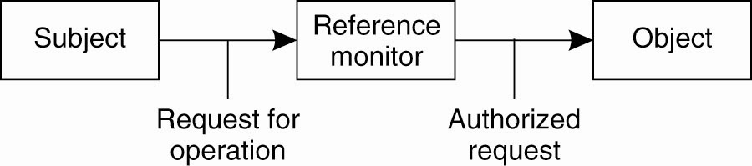
Access Control
Once secure communication between a client and server has been established, we now have to worry about access control – when the client issues a request, how do we know that the client has authorization?

Slide 27
The Access Control Matrix (ACM)
A model of protection systems
Describes who (subject) can do what (rights) to what/whom (object/subject)
Example
  An instructor can assign and grade homework and exams
  A TA can grade homework
  A Student can evaluate the instructor and TA
27
Notes:
homework exam instructor TA students
Instructor {assign,grade} {assign,grade}
TA {grade}
Students {evaluate} {evaluate}

Slide 28
An Access Control Matrix
Allowed Operations (Rights): r,x,w
 | File1 | File2 | File3
Ann | rx | r | rwx
Bob | rwx | r | --
Charlie | rx | rw | w

Slide 29
ACMs and ACLs; Capabilities
Real systems have to be fast and not use excessive space

Slide 30
What’s Wrong with an ACM?
If we have 1k ‘users’ and 100k ‘files’ and a user should only read/write his or her own files
  The ACM will have 100k columns and 1k rows
  Most of the 100M elements are either empty or identical
Good for theoretical study but bad for implementation
  Remove the empty elements?
30

Slide 31
Two ways to cut a table (ACM)
Order by columns (ACL) or rows (Capability Lists)?
 | File1 | File2 | File3
Ann | rx | r | rwx
Bob | rwx | r | --
Charlie | rx | rw | w
ACLs
Capability

Slide 32
Access Control Lists
An ACL stores (non-empty elements of) each column with its object
Columns of access control matrix
ACLs:
file1: { (Andy, rx) (Betty, rwx) (Charlie, rx) }
file2: { (Andy, r) (Betty, r) (Charlie, rw) }
file3: { (Andy, rw) (Charlie, w) }
 | File1 | File2 | File3
Andy | rx | r | rwx
Betty | rwx | r | --
Charlie | rx | rw | w
32

Slide 33
Capability Lists
Rows of access control matrix
C-Lists:
  Andy: { (file1, rx) (file2, r) (file3, rw) }
  Betty: { (file1, rwx) (file2, r) }
  Charlie: { (file1, rx) (file2, rw) (file3, w) }
 | File1 | File2 | File3
Andy | rx | r | rwx
Betty | rwx | r | --
Charlie | rx | rw | w
33

Slide 34
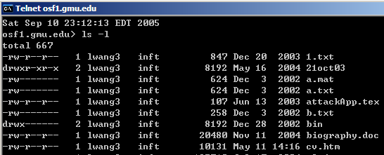
ACL:Default Permission and Abbreviation
Example: UNIX ➔
  Three classes of users: owner, group, all others
34

Slide 35
Capability
Like a bus ticket
  Mere possession indicates rights that subject has over object
  Object identified by capability (as part of the token)
    Name may be a reference, location, or something else
  The key challenge is to prevent process/user from altering capabilities
    Otherwise a subject can augment its capabilities at will
Cryptography
  Associate with each capability a cryptographic checksum enciphered using a key known to OS
  When process presents capability, OS validates checksum
35

Slide 36
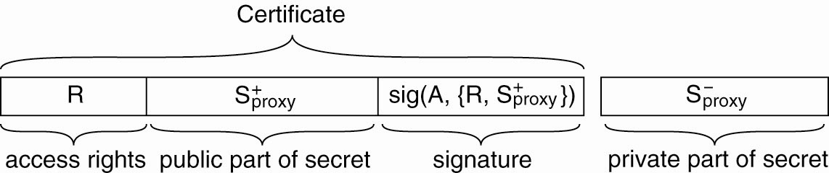
Delegation (1)
The general structure of a proxy as used for delegation.

Slide 37
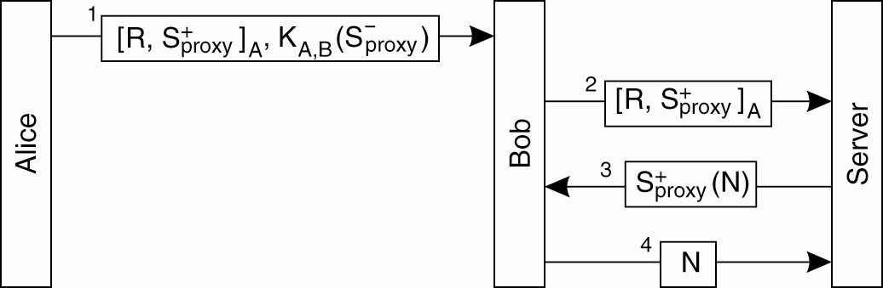
Delegation (2)
Using a proxy to delegate and prove ownership of access rights.

Slide 38
ACLs vs. Capabilities
They are equivalent:
  Given a subject, what objects can it access, and how?
  Given an object, what subjects can access it, and how?
  ACLs answer second easily; C-Lists, answer the first easily.
The second question in the past was most used; thus ACL-based systems are more common
But today some operations need to answer the first question

Slide 39
Today's Lecture
Effective secure channels
Access control
Privacy and Tor

Slide 40
Randomized Routing
Hide message source by routing it randomly
  Popular technique: Crowds, Freenet, Onion routing
Routers don’t know for sure if the apparent source of a message is the true sender or another router

Slide 41
Onion Routing
R
R
R₄
R
R₃
R
R₁
R
R₂
Alice
R
Bob
Sender chooses a random sequence of routers
  Some routers are honest, some controlled by attacker
  Sender controls the length of the path

Slide 42
Route Establishment
R₂
R₄
Alice
R₃
Bob
R₁
{M}_{pk(B)}
{B,k₄}_{pk(R4)},{ }_{k4}
{R₄,k₃}_{pk(R3)},{ }_{k3}
{R₃,k₂}_{pk(R2)},{ }_{k2}
{R₂,k₁}_{pk(R1)},{ }_{k1}
Routing info for each link encrypted with router’s public key
Each router learns only the identity of the next router

Slide 43
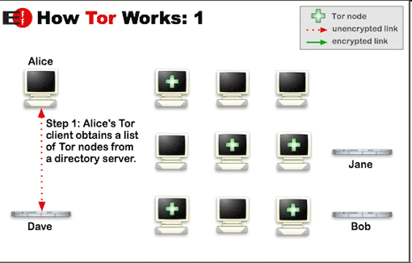
How does Tor work?

Slide 44
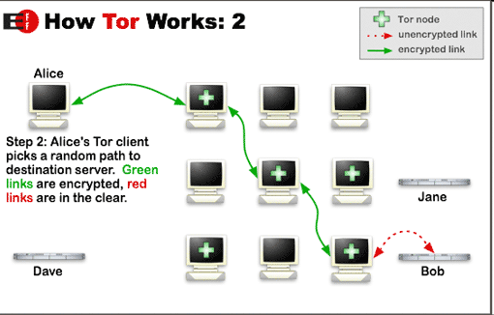
How does Tor work?

Slide 45
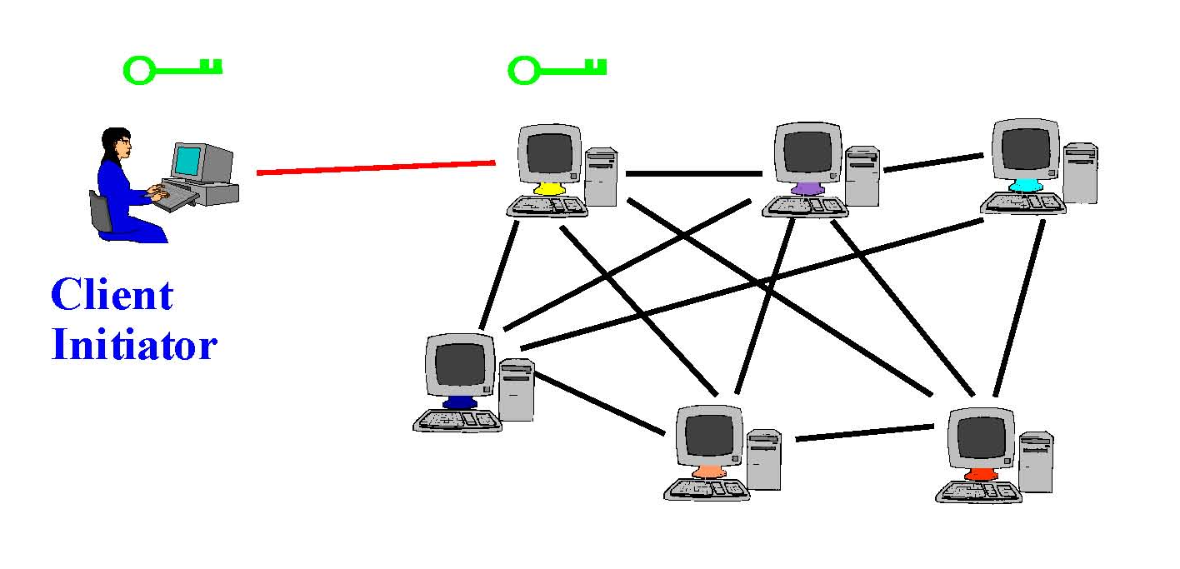
Tor Circuit Setup (1)
Client proxy establish a symmetric session key and circuit with Onion Router #1

Slide 46
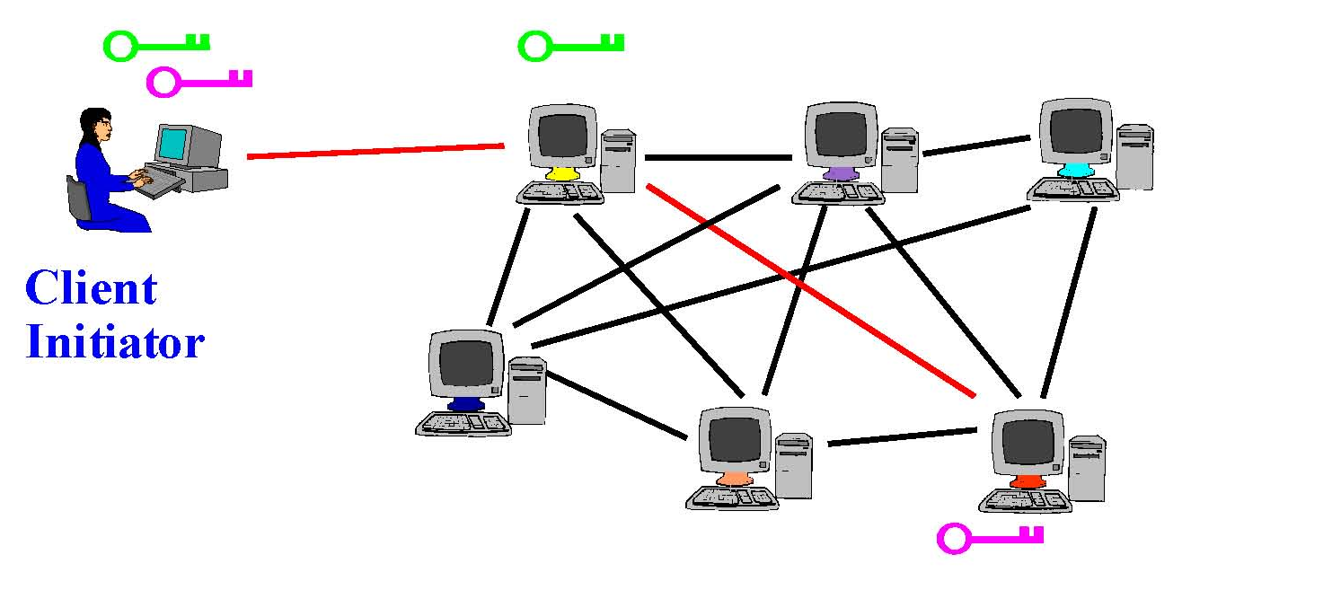
Tor Circuit Setup (2)
Client proxy extends the circuit by establishing a symmetric session key with Onion Router #2
  Tunnel through Onion Router #1

Slide 47

Tor Circuit Setup (3)
Client proxy extends the circuit by establishing a symmetric session key with Onion Router #3
  Tunnel through Onion Routers #1 and #2

Slide 48
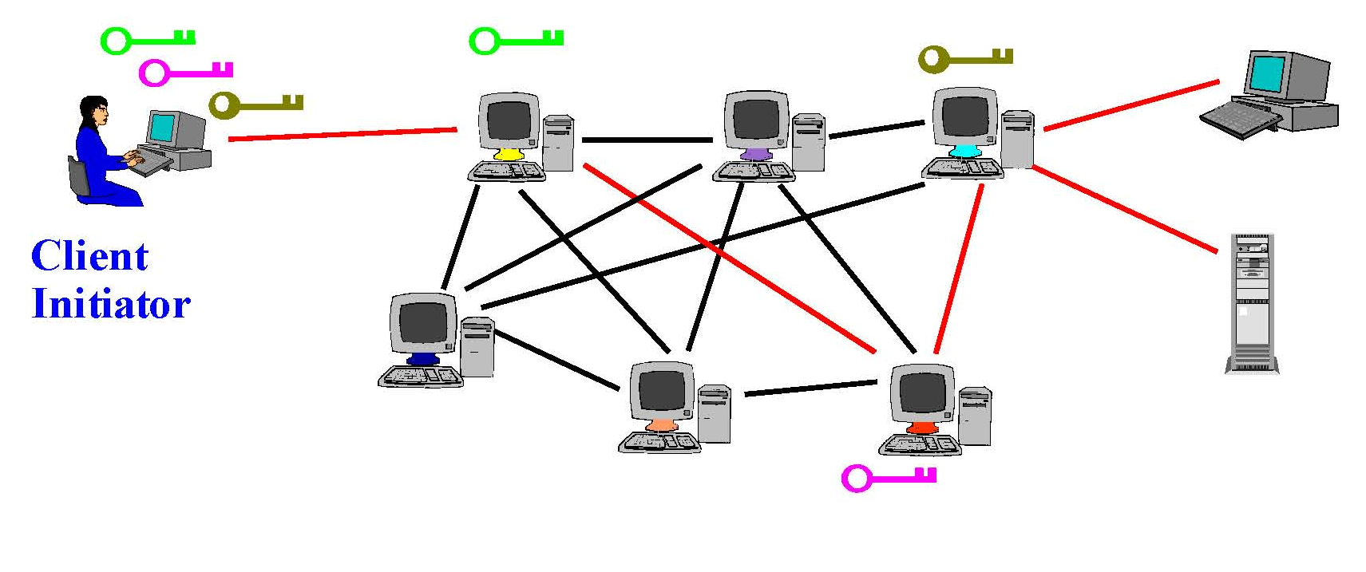
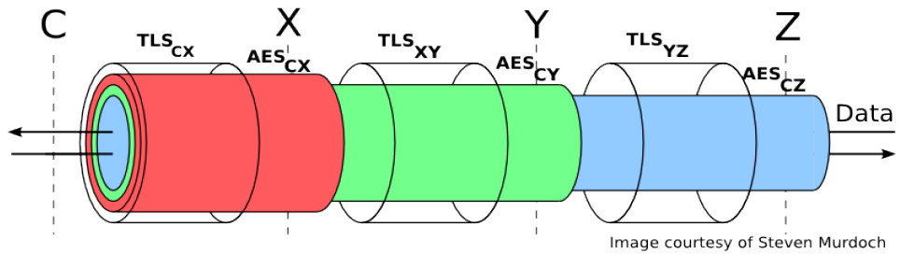
Using a Tor Circuit
Client applications connect and communicate over the established Tor circuit

Slide 49
Location Hidden Servers
Goal: deploy a server on the Internet that anyone can connect to without knowing where it is or who runs it
Accessible from anywhere
Resistant to censorship
Can survive full-blown DoS attack
Resistant to physical attack
  Can’t find the physical server!

Slide 50
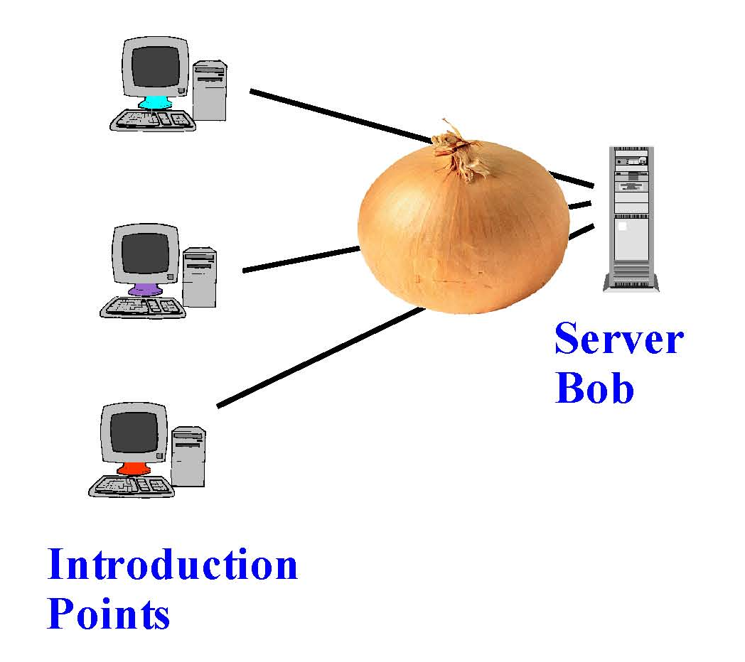
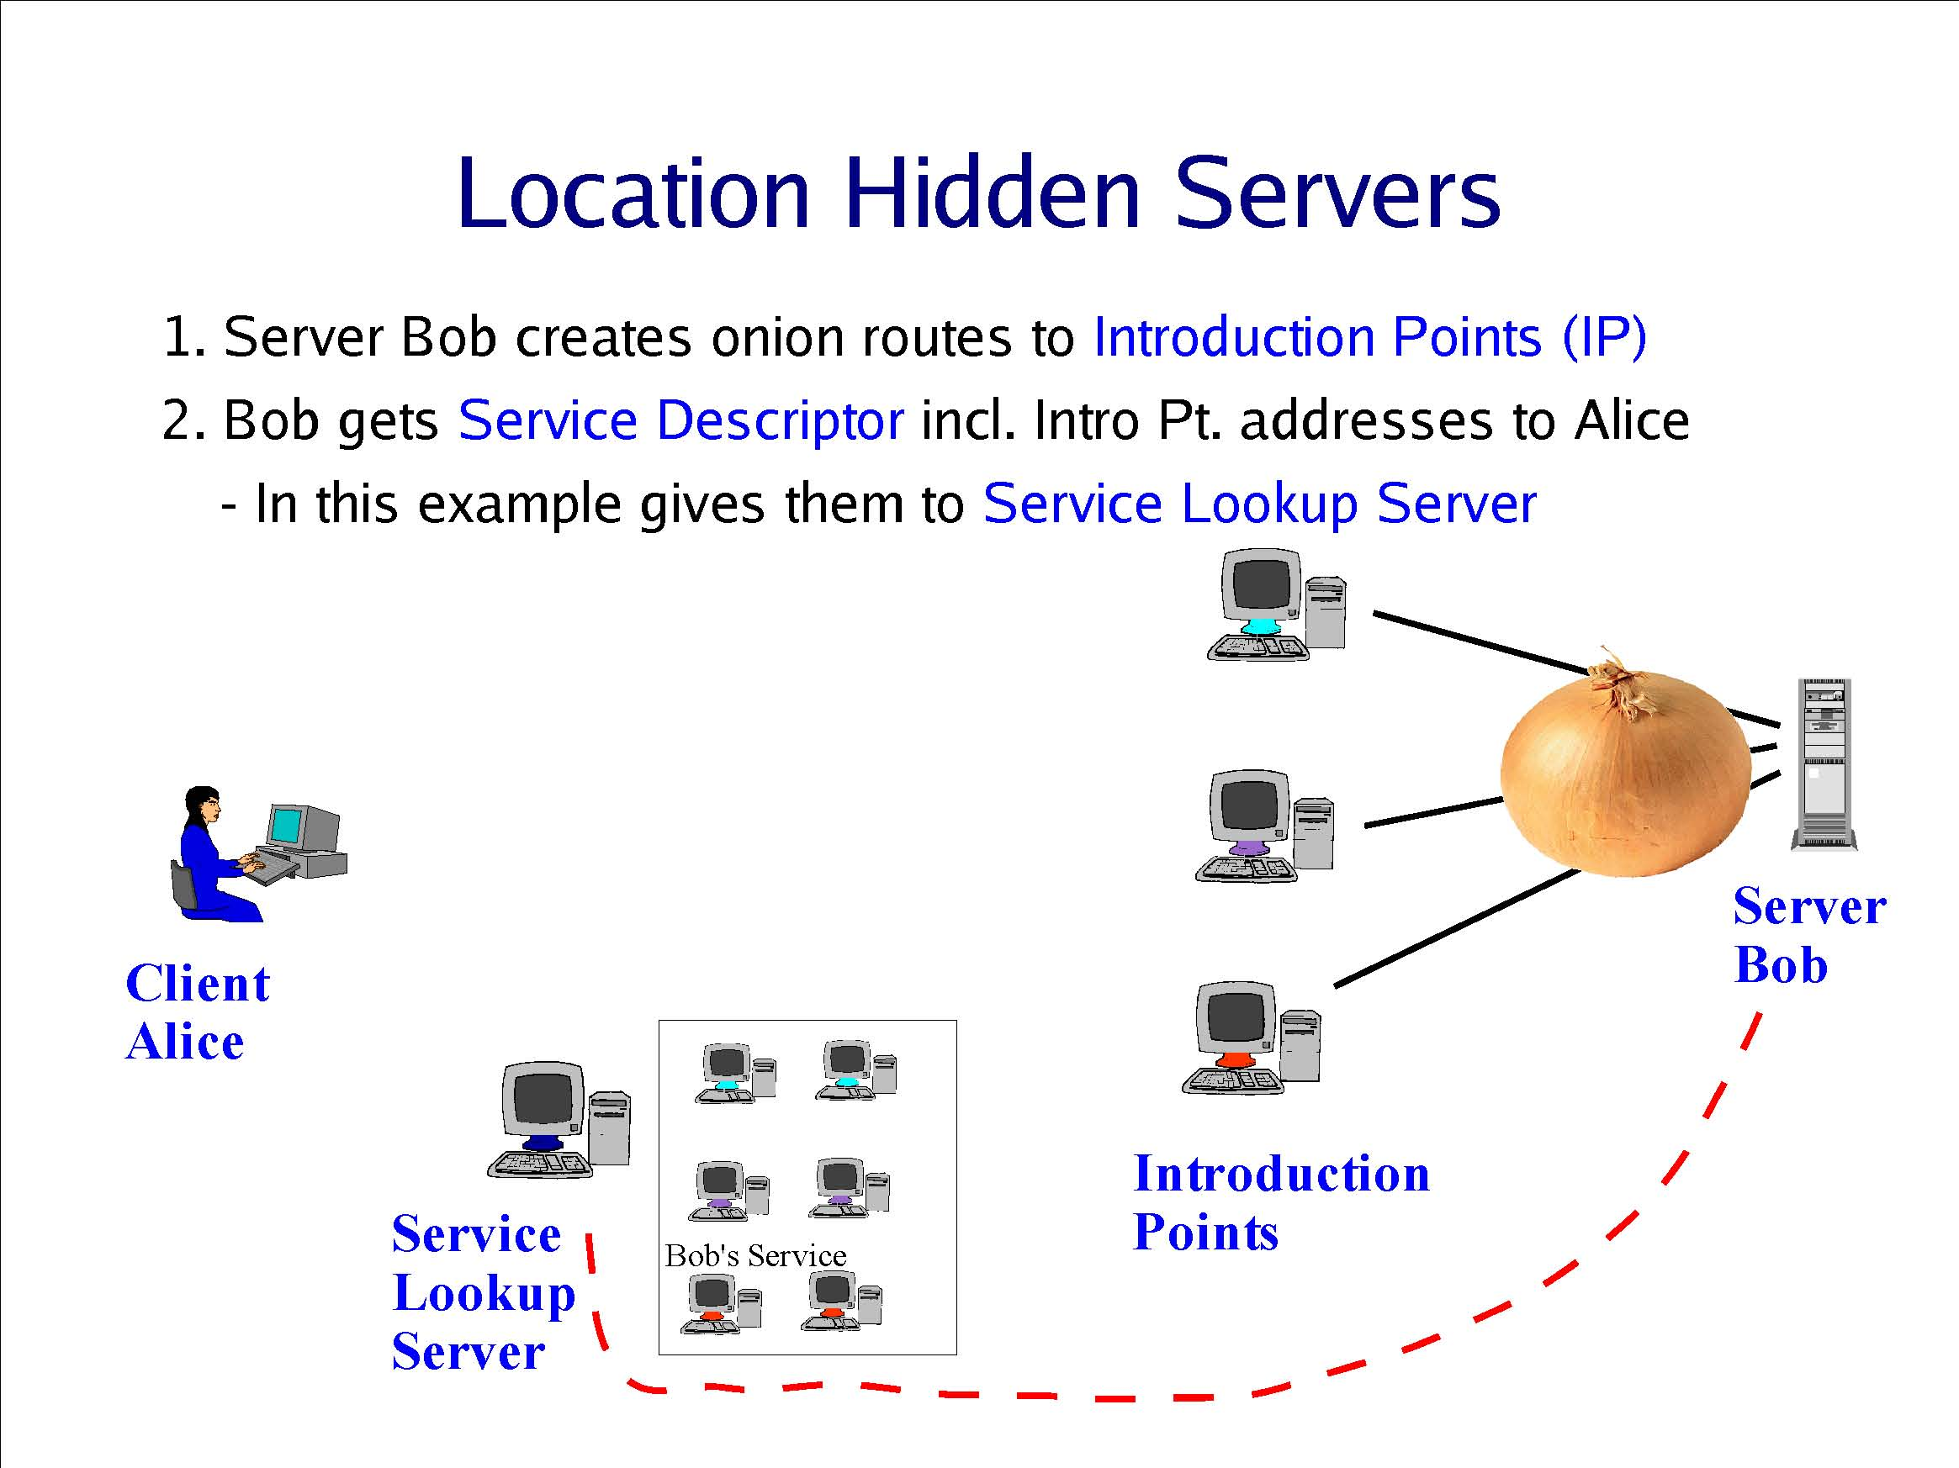
Creating a Location Hidden Server
Server creates onion routes
to “introduction points”
Client obtains service
descriptor and intro point
address from directory
Server gives intro points’
descriptors and addresses
to service lookup directory

Slide 51
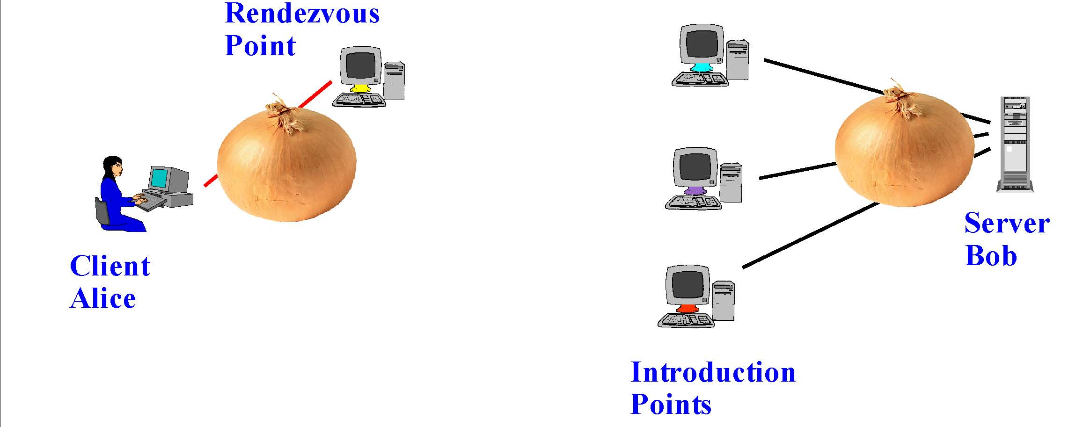
Using a Location Hidden Server
Client creates onion route
to a “rendezvous point”
Rendezvous point
mates the circuits
from client & server
If server chooses to talk to client,
connect to rendezvous point
Client sends address of the
rendezvous point and any
authorization, if needed, to
server through intro point

Slide 52
Tor
Second-generation onion routing network
  http://tor.eff.org
  Developed by Roger Dingledine, Nick Mathewson and Paul Syverson
  Specifically designed for low-latency anonymous Internet communications
Running since October 2003
100s nodes on four continents, thousands of users
“Easy-to-use” client proxy
  Freely available, can use it for anonymous browsing

Slide 53
Key Bits: Today's Lecture
Effective secure channels
  Key Distribution Centers and Certificate Authorities
  Diffie-Hellman for key establishment in the “open”
Access control
  Way to store what “subjects” can do to “objects”
  Access Control Matrix: ACLs and Capability lists
Privacy and Tor
  Used for anonymity on the internet (Onion Routes)
  Uses ideas from encryption, networking, P2P

Slide 54
ACL Abbreviations
Augment abbreviated lists with ACLs
  Intent is to shorten ACL without losing the granularity
Example ➔ IBM AIX
  ACL overrides base permission
  Denial takes precedence
54

Slide 55
Permissions in IBM AIX
attributes:
base (traditional UNIX) permissions
owner(bishop): rw-
group(sys): r--
others: ---
extended permissions enabled
permit -w- u:heidi, g=sys [Add]
permit rw- u:matt
deny -w- u:holly, g=faculty [Remove right]
55

Slide 56

Capabilities and Attribute Certificates (1)
Owner capability in Amoeba.

Slide 57
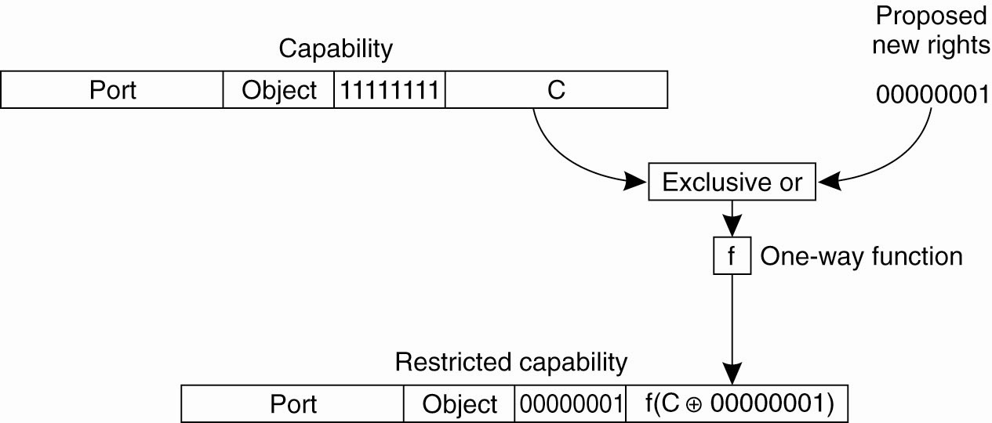
Capabilities and Attribute Certificates (2)
Generation of a restricted capability
from an owner capability.

