Slide 1
15-440 Distributed Systems
Lecture 19 – BigTable, Spanner, Hashing

Slide 2
Overview
BigTable
Spanner
Hashing Tricks

Slide 3
BigTable
Distributed storage system for managing structured data.
Designed to scale to a very large size
  Petabytes of data across thousands of servers
Used for many Google projects
  Web indexing, Personalized Search, Google Earth, Google Analytics, Google Finance, …
Flexible, high-performance solution for all of Google’s products

Slide 4
Motivation
Lots of (semi-)structured data at Google
  URLs:
    Contents, crawl metadata, links, anchors, pagerank, …
  Per-user data:
    User preference settings, recent queries/search results, …
  Geographic locations:
    Physical entities (shops, restaurants, etc.), roads, satellite image data, user annotations, …
Scale is large
  Billions of URLs, many versions/page (~20K/version)
  Hundreds of millions of users, thousands or q/sec
  100TB+ of satellite image data

Slide 5
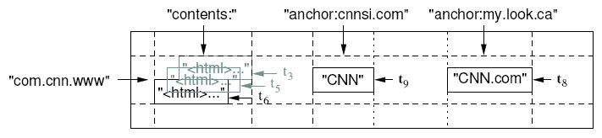
Basic Data Model
A BigTable is a sparse, distributed persistent multi-dimensional sorted map
(row, column, timestamp)→ cell contents
Good match for most Google applications

Slide 6
WebTable Example
Want to keep copy of a large collection of web pages and related information
Use URLs as row keys
Various aspects of web page as column names
Store contents of web pages in the contents: column under the timestamps when they were fetched.
Anchors: is a set of links that point to the page

Slide 7
Rows
Name is an arbitrary string
  Access to data in a row is atomic
  Row creation is implicit upon storing data
Rows ordered lexicographically
  Rows close together lexicographically usually on one or a small number of machines

Slide 8
Rows (cont.)
Reads of short row ranges are efficient and typically require communication with a small number of machines.
Can exploit this property by selecting row keys so they get good locality for data access.
Example:
  math.gatech.edu, math.uga.edu, phys.gatech.edu, phys.uga.edu
  VS
  edu.gatech.math, edu.gatech.phys, edu.uga.math, edu.uga.phys

Slide 9
Columns
Columns have two-level name structure:
    family:optional_qualifier
Column family
  Unit of access control
  Has associated type information
Qualifier gives unbounded columns
  Additional levels of indexing, if desired

Slide 10
Timestamps
Used to store different versions of data in a cell
  New writes default to current time, but timestamps for writes can also be set explicitly by clients
Lookup options:
  “Return most recent K values”
  “Return all values in timestamp range (or all values)”
Column families can be marked w/ attributes:
  “Only retain most recent K values in a cell”
  “Keep values until they are older than K seconds”

Slide 11
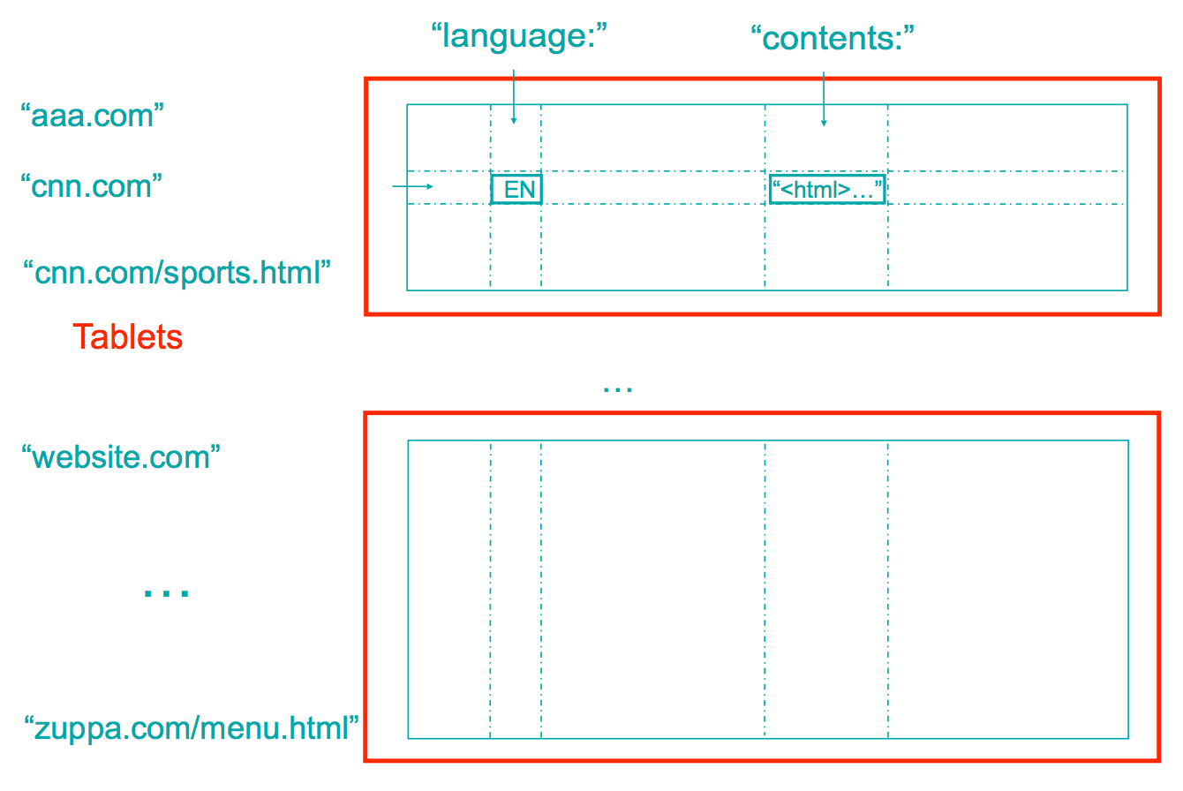
Tablets & Splitting

Slide 12
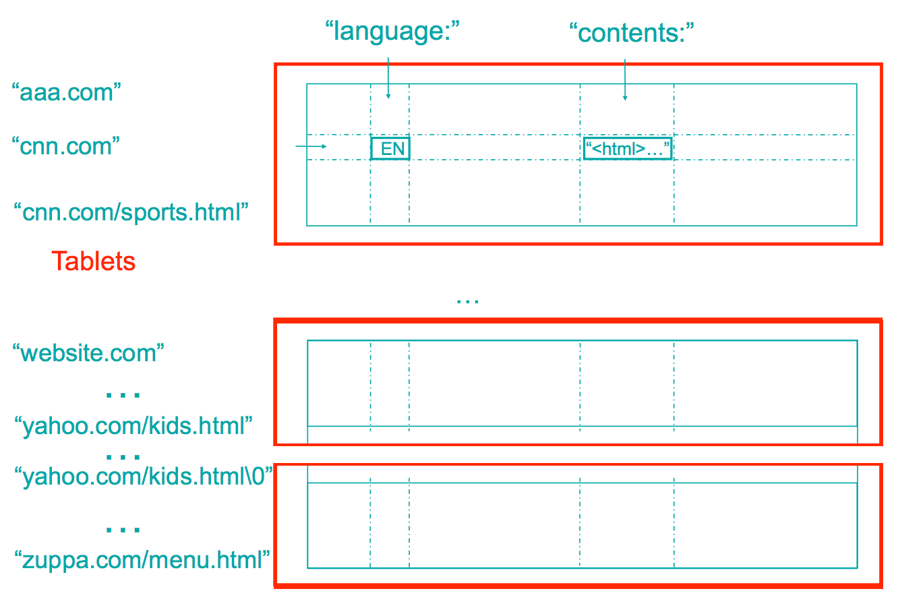
Tablets & Splitting

Slide 13
Servers
Tablet servers manage tablets, multiple tablets per server. Each tablet is 100-200 MB
  Each tablet lives at only one server
  Tablet server splits tablets that get too big
Master responsible for load balancing and fault tolerance

Slide 14
Tablet
Contains some range of rows of the table
Built out of multiple SSTables
Tablet
Start:aardvark
End:apple
64K block
64K block
64K block
SSTable
64K block
64K block
64K block
SSTable
Index
Index

Slide 15
Tablets
Large tables broken into tablets at row boundaries
  Tablet holds contiguous range of rows
    Clients can often choose row keys to achieve locality
  Aim for ~100MB to 200MB of data per tablet
Serving machine responsible for ~100 tablets
  Fast recovery:
    100 machines each pick up 1 tablet for failed machine
  Fine-grained load balancing:
    Migrate tablets away from overloaded machine
    Master makes load-balancing decisions

Slide 16
SSTable
Immutable, sorted file of key-value pairs
Chunks of data plus an index
  Index is of block ranges, not values
64K block
64K block
64K block
SSTable
Index

Slide 17
Table
Multiple tablets make up the table
SSTables can be shared
Tablets do not overlap, SSTables can overlap
Tablet
Tablet
aardvark
apple
apple_two_E
boat
SSTable
SSTable
SSTable
SSTable

Slide 18
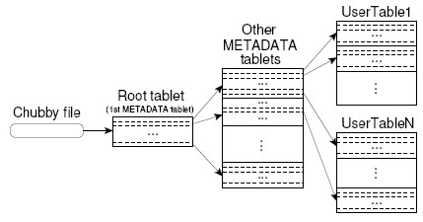
Tablet Location
Since tablets move around from server to server, given a row, how do clients find the right machine?
  Need to find tablet whose row range covers the target row

Slide 19
Chubby
{lock/file/name} service
Coarse-grained locks, can store small amount of data in a lock
5 replicas, need a majority vote to be active
Uses Paxos

Slide 20
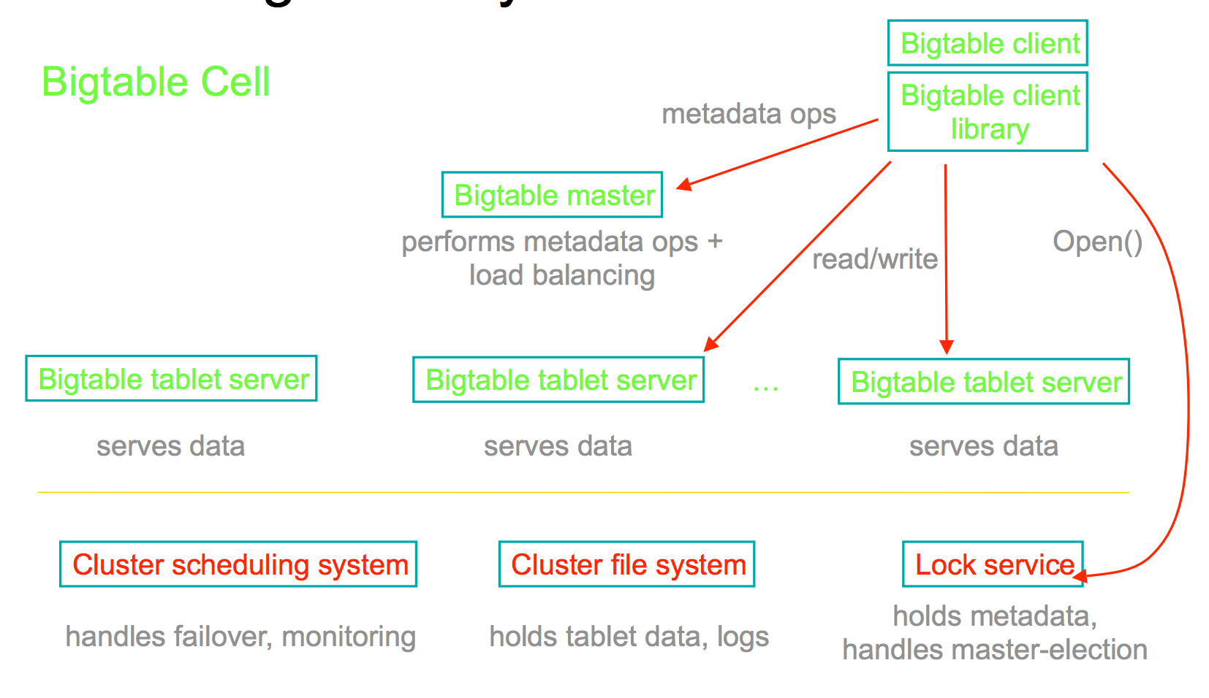
Putting it all together…

Slide 21
Editing a table
Mutations are logged, then applied to an in-memory memtable
  May contain “deletion” entries to handle updates
  Group commit on log: collect multiple updates before log flush
Tablet
Memtable
Insert
Insert
Memory
apple_two_E
boat
Delete
tablet log
Insert
Delete
SSTable
SSTable
GFS
Insert

Slide 22
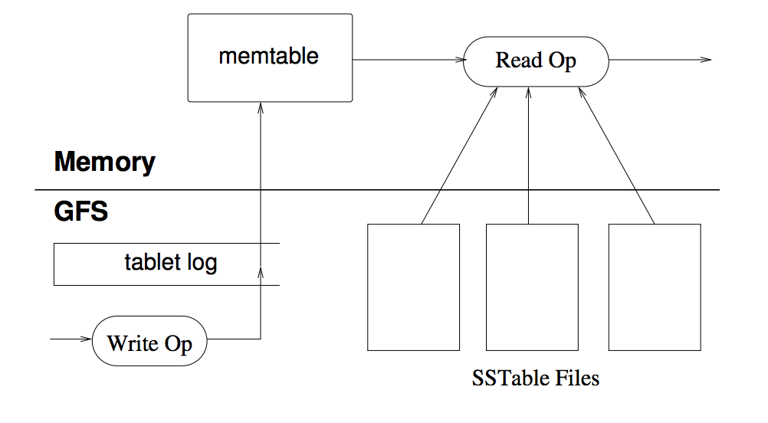
Reading from a table

Slide 23
Compactions
Minor compaction – convert the memtable into an SSTable
  Reduce memory usage
  Reduce log traffic on restart
Merging compaction
  Reduce number of SSTables
  Good place to apply policy “keep only N versions”
Major compaction
  Merging compaction that results in only one SSTable
  No deletion records, only live data

Slide 24
Overview
BigTable
Spanner
Hashing Tricks

Slide 25
What is Spanner?
Distributed multiversion database
  General-purpose transactions (ACID)
  SQL query language
  Schematized tables
  Semi-relational data model
Running in production
    Storage for Google’s ad data
    Replaced a sharded MySQL database

Slide 26
Example: Social Network
Sao Paulo
Santiago
Buenos Aires
x1000
San Francisco
Seattle
Arizona
Brazil
User posts
Friend lists
User posts
Friend lists
User posts
Friend lists
User posts
Friend lists
User posts
Friend lists
x1000
US
London
Paris
Berlin
Madrid
Lisbon
Moscow
Berlin
Krakow
x1000
x1000
Russia
Spain

Slide 27
Read Transactions
Generate a page of friends’ recent posts
  Consistent view of friend list and their posts
Why consistency matters
Remove untrustworthy person X as friend
Post P: “My government is repressive…”

Slide 28
Single Machine
Block writes
Generate my page
Friend1 post
User posts
Friend lists
User posts
Friend lists
Friend2 post
…
Friend999 post
Friend1000 post

Slide 29
Multiple Machines
Block writes
User posts
Friend lists
User posts
Friend lists
Friend1 post
Friend2 post
…
Generate my page
User posts
Friend lists
Friend999 post
User posts
Friend lists
Friend1000 post

Slide 30
Multiple Datacenters
User posts
Friend lists
Friend1 post
x1000
US
User posts
Friend lists
Friend2 post
x1000
Spain
…
Generate my page
User posts
Friend lists
Friend999 post
x1000
Brazil
User posts
Friend lists
Friend1000 post
x1000
Russia

Slide 31
Version Management
Transactions that write use strict 2PL
  Each transaction T is assigned a timestamp s
  Data written by T is timestamped with s
Time
<8
8
15
My friends
[X]
[]
My posts
[P]
X’s friends
[me]
[]

Slide 32
Synchronizing Snapshots
Global wall-clock time
==
External Consistency:
Commit order respects global wall-time order
==
Timestamp order respects global wall-time order
given
timestamp order == commit order

Slide 33
Timestamps, Global Clock
Strict two-phase locking for write transactions
Assign timestamp while locks are held
Acquired locks
Release locks
T
Pick s = now()

Slide 34
TrueTime
“Global wall-clock time” with bounded uncertainty
TT.now()
time
earliest
latest
2*ε

Slide 35
Timestamps and TrueTime
Acquired locks
Release locks
T
Pick s = TT.now().latest
s
Wait until TT.now().earliest > s
Commit wait
average ε
average ε

Slide 36
Summary
GFS/HDFS
  Data-center customized API, optimizations
  Append focused DFS
  Separate control (filesystem) and data (chunks)
  Replication and locality
  Rough consistency → apps handle rest
BigTable
  Built on top of GFS, Chubby, etc.
  Similar master/storage split
  Use memory + log for speed
  Motivated range of work into non-SQL databases
Spanner
  Globally distributed, and synchronously-replicated database
  Uses time sync and some slowdown to get consistency

Slide 37
Overview
BigTable
Spanner
Hashing Tricks

Slide 38
Hashing
Two uses of hashing that are becoming wildly popular in distributed systems:
Content-based naming
Consistent Hashing of various forms

Slide 39
Example systems that use them
BitTorrent & many other modern p2p systems use content-based naming
Content distribution networks such as Akamai use consistent hashing to place content on servers
Amazon, Linkedin, etc., all have built very large-scale key-value storage systems (databases--) using consistent hashing

Slide 40
Dividing items onto storage servers
Option 1: Static partition (items a-c go there, d-f go there, ...)
  If you used the server name, what if “cowpatties.com” had 1000000 pages, but “zebras.com” had only 10? → Load imbalance
  Could fill up the bins as they arrive → Requires tracking the location of every object at the front-end.

Slide 41
Hashing 1
Let nodes be numbered 1..m
Client uses a good hash function to map a URL to 1..m
Say hash (url) = x, so, client fetches content from node x
No duplication – not being fault tolerant.
Any other problems?
  What happens if a node goes down?
  What happens if a node comes back up?
  What if different nodes have different views?

Slide 42
Option 2: Conventional Hashing
bucket = hash(item) % num_buckets
Sweet! Now the server we use is a deterministic function of the item, e.g., sha1(URL) → 160 bit ID % 20 → a server ID
But what happens if we want to add or remove a server?

Slide 43
Option 2: Conventional Hashing
Let 90 documents, node 1..9, node 10 which was dead is alive again
% of documents in the wrong node?
  10, 19-20, 28-30, 37-40, 46-50, 55-60, 64-70, 73-80, 82-90
  Disruption coefficient = ½ ☹

Slide 44
Consistent Hash
“view” = subset of all hash buckets that are visible
Desired features
  Balanced – in any one view, load is equal across buckets
  Smoothness – little impact on hash bucket contents when buckets are added/removed
  Spread – small set of hash buckets that may hold an object regardless of views
  Load – across all views # of objects assigned to hash bucket is small

Slide 45
Consistent Hash – Example
Construction
  Assign each of C hash buckets to random points on mod 2^{n} circle, where, hash key size = n.
  Map object to random position on circle
  Hash of object = closest clockwise bucket
0
14
Bucket
12
4
8
Smoothness → addition of bucket does not cause much movement between existing buckets
Spread & Load → small set of buckets that lie near object
Balance → no bucket is responsible for large number of objects

Slide 46
Hashing 2: For naming
Many file systems split files into blocks and store each block on a disk.
Several levels of naming:
  Pathname to list of blocks
  Block #s are addresses where you can find the data stored therein. (But in practice, they’re logical block #s – the disk can change the location at which it stores a particular block... so they’re actually more like names and need a lookup to location :)

Slide 47
A problem to solve...
Imagine you’re creating a backup server
It stores the full data for 1000 CMU users’ laptops
Each user has a 100GB disk.
That’s 100TB and lots of $$$
How can we reduce the storage requirements?

Slide 48
“Deduplication”
A common goal in big archival storage systems. Those 1000 users probably have a lot of data in common -- the OS, copies of binaries, maybe even the same music or movies
How can we detect those duplicates and coalesce them?
One way: Content-based naming, also called content-addressable foo (storage, memory, networks, etc.)
A fancy name for...

Slide 49
Name items by their hash
Imagine that your filesystem had a layer of indirection:
  pathname → hash(data)
  hash(data) → list of blocks
For example:
  /src/foo.c -> 0xfff32f2fa11d00f0
  0xfff32f2fa11d00f0 -> [5623, 5624, 5625, 8993]
If there were two identical copies of foo.c on disk ... We’d only have to store it once!
  Name of second copy can be different

Slide 50
A second example
Several p2p systems operate something like:
Search for “national anthem”, find a particular file name (starspangled.mp3).
Identify the files by the hash of their content (0x2fab4f001...)
Request to download a file whose hash matches the one you want
Advantage? You can verify what you got, even if you got it from an untrusted source (like some dude on a p2p network)

Slide 51
P2P-enabled Applications:
Self-Certifying Names
Name = Hash(pubkey, salt)
Value = <pubkey, salt, data, signature>
  can verify name related to pubkey and pubkey signed data
Can receive data from caches, peers or other 3rd parties without worry

Slide 52
Hash functions
Given a universe of possible objects U,
map N objects from U to an M-bit hash.
Typically, |U| >>> 2^{M}.
  This means that there can be collisions: Multiple objects map to the same M-bit representation.
Likelihood of collision depends on hash function, M, and N.
  Birthday paradox → roughly 50% collision with 2^{M/2} objects for a well designed hash function

Slide 53
Desirable Properties
Compression: Maps a variable-length input to a fixed-length output
Ease of computation: A relative metric...
Pre-image resistance: For all outputs, computationally infeasible to find input that produces output.
2nd pre-image resistance: For all inputs, computationally infeasible to find second input that produces same output as a given input.
collision resistance: For all outputs, computationally infeasible to find two inputs that produce the same output.

Slide 54

Similar Files: Rabin Fingerprinting
Hash 1
Hash 2
File Data
Rabin Fingerprints
4
7
8
2
8
Natural Boundary
Natural Boundary
Given Value - 8

Slide 55
Longevity
“Computationally infeasible” means different things in 1970 and 2012.
  Moore’s law
  Some day, maybe, perhaps, sorta, kinda: Quantum computing.
Hash functions are not an exact science yet.
  They get broken by advances in crypto.

Slide 56

Real hash functions
Name | Introduced | Weakened | Broken | Lifetime | Replacement
MD4 | 1990 | 1991 | 1995 | 1-5y | MD5
MD5 | 1992 | 1994 | 2004 | 8-10y | SHA-1
MD2 | 1992 | 1995 | abandoned | 3y | SHA-1
RIPEMD | 1992 | 1997 | 2004 | 5-12y | RIPEMD-160
HAVAL-128 | 1992 | - | 2004 | 12y | SHA-1
SHA-0 | 1993 | 1998 | 2004 | 5-11y | SHA-1
SHA-1 | 1995 | 2004 | not quite yet | 9+ | SHA-2 & 3
SHA-2 (256, 384, 512) | 2001 | still good
SHA-3 | 2012 | brand new

Slide 57
Using them
How long does the hash need to have the desired properties (preimage resistance, etc)?
  rsync: For the duration of the sync;
  dedup: Until a (probably major) software update;
  store-by-hash: Until you replace the storage system
What is the adversarial model?
  Protecting against bit flips vs. an adversary who can try 1B hashes/second?

Slide 58
Final pointer
Hashing forms the basis for MACs - message authentication codes
  Basically, a hash function with a secret key.
  H(key, data) - can only create or verify the hash given the key.
  Very, very useful building block

Slide 59
Summary
Hashes used for:
  Splitting up work/storage in a distributed fashion
  Naming objects with self-certifying properties
Key applications
  Key-value storage
  P2P content lookup
  Deduplication
  MAC

Slide 60
Detail - “virtual” nodes
The way we outlined it results in moderate load imbalance between buckets (remember balls and bins analysis of hashing?)
To reduce imbalance, systems often represent each physical node as k different buckets, sometimes called “virtual nodes” (but really, it’s just multiple buckets).
log n buckets gets you a very pleasing load balance - O(#items/n) with high probability, if #items large and uniformly distributed

Slide 61
Use of consistent hashing
Consistent hashing was first widely used by Akamai CDN
Also used in systems like Chord DHT
  Provided key-value storage, designed to scale to millions or billions of nodes
  Had a p2p lookup algorithm, completely decentralized, etc. Fun to read about; very influential, but not widely used outside of p2p systems.
In practice, many more systems use consistent hashing where the people doing the lookups know the list of all storage nodes (tens to tens of thousands; not too bad) and directly determine who to contact

Slide 62
How Akamai Works
Clients fetch html document from primary server
  E.g. fetch index.html from cnn.com
URLs for replicated content are replaced in html
  E.g. <img src=“http://cnn.com/af/x.gif”> replaced with <img src=“http://a73.g.akamaitech.net/7/23/cnn.com/af/x.gif”>
Client is forced to resolve aXYZ.g.akamaitech.net hostname

Slide 63
Self-certifying Names
Use a name that helps validate the data associated with the name
  Seems like a circular argument but…
  Traditional name → Declaration of Independence
  Self-certifying name →
  SHA1(Declaration of Independence contents)
    SHA1 → cryptographic hash

Slide 64
Self-Certifying Names
Can also create names using public key crypto
  Name = Hash(pubkey, salt)
  Value = <pubkey, salt, data, signature>
  Can verify name related to pubkey and pubkey signed data
Benefits
  Can verify contents after receiving file
  Can fetch file from untrustworthy sources
Weaknesses
  No longer human readible

Slide 65
Overview
BigTable
Spanner
Naming Overview
Hashing Tricks

Slide 66
Names
Names are associated with objects
  Enables passing of references to objects
  Indirection
  Deferring decision on meaning/binding
Examples
  Registers → R5
  Memory → 0xdeadbeef
  Host names → srini.com
  User names → sseshan
  Email → srini@cmu.edu
  File name → /usr/srini/foo.txt
  URLs → http://www.srini.com/index.html

Slide 67
Naming Model
3 key elements
Name space
  Alphabet of symbols + syntax that specify names
Name-mapping
  Associates each name to some value in…
Universe of values
  Typically an object or another name from original name space (or another name space)
Name-to-value mapping is called a “binding” i.e. name is bound to value

Slide 68
Names
Uniqueness
  One-to-one mapping
  One-to-many or many-to-one (name-to-value) mappings
  Context sensitive resolution
Stable binding
  Names that are never reused
  Values that can only have one name
  E.g. using MD5 of file contents, bank account numbers
Reverse lookup support

Slide 69
Name Mapping
Names are mapped to values within some context
  E.g., different lookup tables for names in different settings
Two sources for context
  Resolver can supply default context
  Name can specify an explicit context to use → qualified name
    “cd /users/srini/440/midterm” vs
    “cd 440/midterm”

Slide 70
Context
Common problem → what context to use for names without context
Consider email from CMU
  To: srini, yuvraj@gmail.com
  What happens when yuvraj replies to all?
    What context will he email srini
  Solutions:
    Sendmail converts all address to qualified names
      Not in body of message
    Provide context information in email header
      E.g. like base element in HTML

Slide 71
Name Lookup Styles
Table lookup
  Simple, table per context
Recursive
  Names consist of context + name
  E.g. path + filename, hostname + domain name
  Context name must also be resolved
    Need special context such as “root” built into resolver
Multiple lookup
  Try multiple contexts to resolve name → search paths

Slide 72
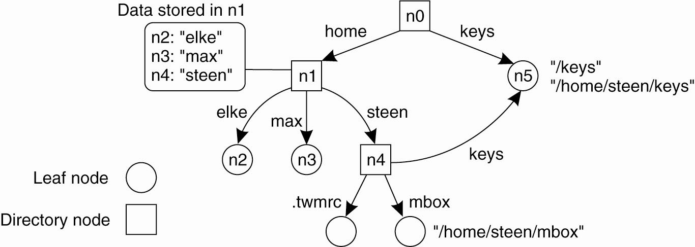
Recursive Name Spaces
A general naming graph with a single root node.

Slide 73
Name Discovery
Well-known name
  www.google.com, port 80…
Broadcast
  Advertise name → e.g. 802.11 Beacons
Query
  Use google
Broadcast query
  802.11 probes
Use another naming system
  DNS returns IP addresses
Introductions
  Web page hyperlinks
Physical rendezvous
  Exchange info in the real world

