Slide 1
MapReduce Programming
15-440 / 15-640
Lecture 17, Oct 29th 2015
Topics
  Large-scale computing
    Traditional high-performance computing (HPC)
    Cluster computing
  MapReduce
    Definition
    Examples
  Implementation
  Alternatives to MapReduce
  Properties

Slide 2
Typical HPC Machine
Compute Nodes
  High end processor(s)
  Lots of RAM
Network
  Specialized
  Very high performance
Storage Server
  RAID-based disk array
Compute Nodes
CPU
CPU
CPU
• • •
Mem
Mem
Mem
Network
Storage Server
• • •

Slide 3
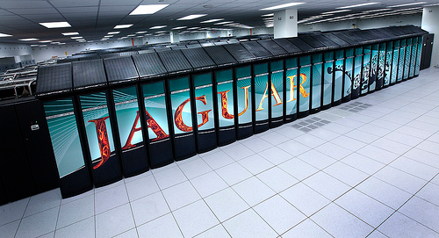
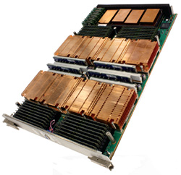
HPC Machine Example
Jaguar Supercomputer
  3rd fastest in world
Compute Nodes
  18,688 nodes in largest partition
  2X 2.6Ghz 6-core AMD Opteron
  16GB memory
  Total: 2.3 petaflop / 300 TB memory
Network
  3D torus
    Each node connected to 6 neighbors via 6.0 GB/s links
Storage Server
  10PB RAID-based disk array

Slide 4
HPC Programming Model
Application
Programs
Software
Packages
Machine-Dependent
Programming Model
Hardware
  Programs described at very low level
    Specify detailed control of processing & communications
  Rely on small number of software packages
    Written by specialists
    Limits classes of problems & solution methods

Slide 5
Bulk Synchronous Programming
Solving Problem Over Grid
  E.g., finite-element computation
Partition into Regions
  p regions for p processors
Map Region per Processor
  Local computation sequential
  Periodically communicate boundary values with neighbors

Slide 6
Typical HPC Operation
Characteristics
  Long-lived processes
  Make use of spatial locality
  Hold all program data in memory (no disk access)
  High bandwidth communication
Strengths
  High utilization of resources
  Effective for many scientific applications
Weaknesses
  Requires careful tuning of application to resources
  Intolerant of any variability
Message Passing
P₁
P₂
P₃
P₄
P₅

Slide 7
HPC Fault Tolerance
P₁
P₂
P₃
P₄
P₅
Checkpoint
Checkpoint
  Periodically store state of all processes
  Significant I/O traffic
Restore
  When failure occurs
  Reset state to that of last checkpoint
  All intervening computation wasted
Performance Scaling
  Very sensitive to number of failing components
Wasted
Computation
Restore
Checkpoint

Slide 8
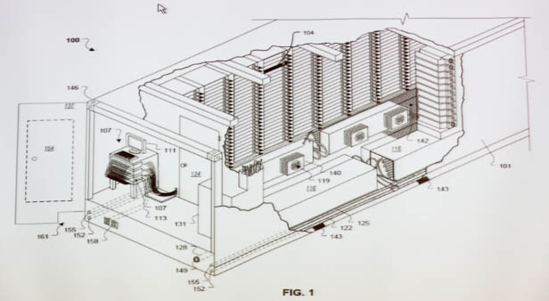
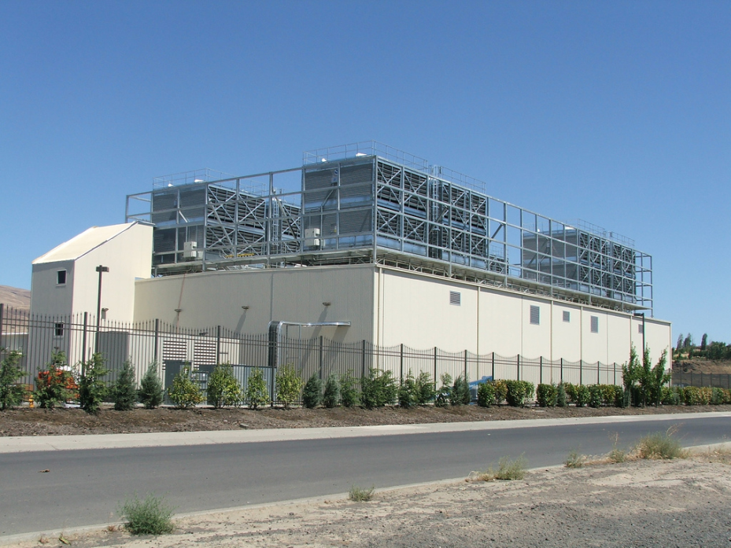
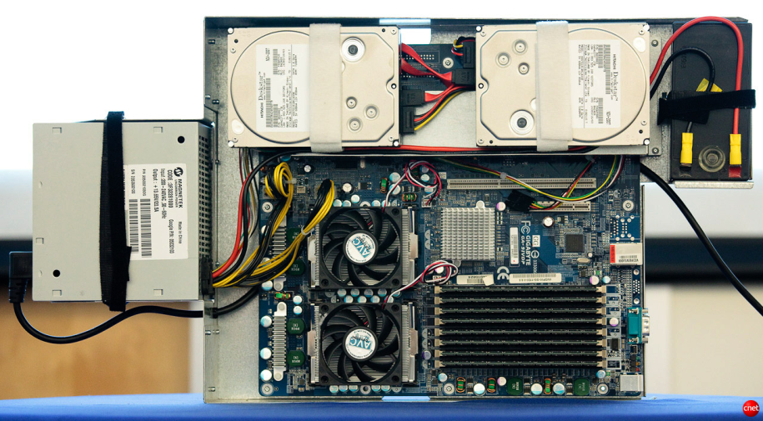
Google Data Centers
Dalles, Oregon
  Hydroelectric power @ 2¢ / KW Hr
  50 Megawatts
    Enough to power 60,000 homes
  Engineered for maximum modularity & power efficiency
  Container: 1160 servers, 250KW
  Server: 2 disks, 2 processors
Notes:
One of the biggest users of cluster computing is Google. They have set up dozens of data centers around the world, containing more computer power than just about anyone else.
Here’s a picture of their data center in Dalles, Oregon. It cost them $600M and requires around 50 megawatts of power. (For reference, that much power would supply the residential electricity needs of 6,000 households in the U.S.). They located the data center near the Columbia River to take advantage of low-cost electricity.
Imagine what our intelligence sources could do if they had facilities on this scale to store and process satellite imagery, voice signals, and feeds from media outlets.

Slide 9
Typical Cluster Machine
Compute + Storage Nodes
  Medium-performance processors
  Modest memory
  1-2 disks
Network
  Conventional Ethernet switches
    10 Gb/s within rack
    100 Gb/s across racks
Compute + Storage Nodes
CPU
CPU
CPU
• • •
Mem
Mem
Mem
Network

Slide 10
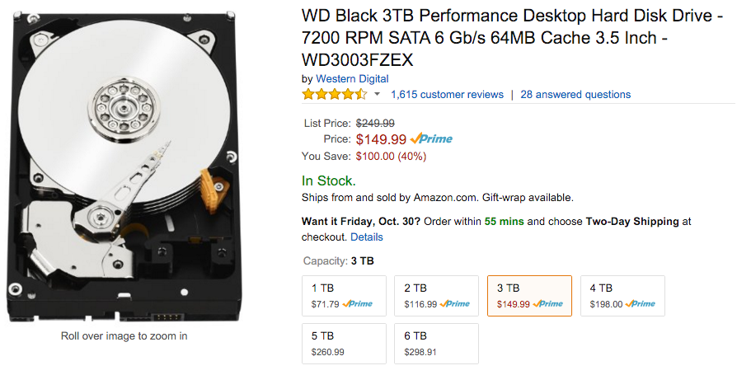
Machines with Disks
Lots of storage for cheap
  3 TB @ $150
    (5¢ / GB)
  Compare 2007:
    0.75 TB @ $266
    35¢ / GB
Drawbacks
  Long and highly variable delays
  Not very reliable
Not included in HPC Nodes

Slide 11



Oceans of Data, Skinny Pipes
1 Terabyte
  Easy to store
  Hard to move
Disks | MB / s | Time
Seagate Barracuda | 115 | 2.3 hours
Seagate Cheetah | 125 | 2.2 hours
Networks | MB / s | Time
Home Internet | < 0.625 | > 18.5 days
Gigabit Ethernet | < 125 | > 2.2 hours
PSC Teragrid Connection | < 3,750 | > 4.4 minutes
Notes:
Even if you assume the 50Mbps Verizon speeds now, you are looking at 1.85 days to transfer the data.

Slide 12
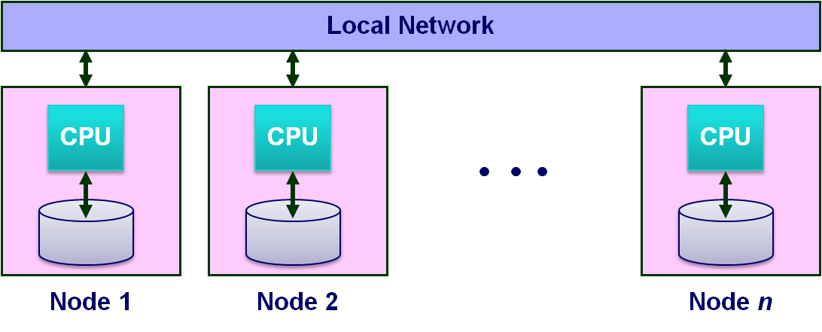
Data-Intensive System Challenge
For Computation That Accesses 1 TB in 5 minutes
  Data distributed over 100+ disks
    Assuming uniform data partitioning
  Compute using 100+ processors
  Connected by gigabit Ethernet (or equivalent)
System Requirements
  Lots of disks
  Lots of processors
  Located in close proximity
    Within reach of fast, local-area network

Slide 13
Ideal Cluster Programming Model
Application
Programs
Machine-Independent
Programming Model
Runtime
System
Hardware
  Application programs written in terms of high-level operations on data
  Runtime system controls scheduling, load balancing, …

Slide 14
Map/Reduce Programming Model
k₁
k₁
k_{r}
• • •
Reduce
Key-Value
Pairs
M
M
M
• • •
M
Map
x₁
x₂
x₃
x_{n}
  Map computation across many objects
    E.g., 10¹⁰ Internet web pages
  Aggregate results in many different ways
  System deals with issues of resource allocation & reliability
Dean & Ghemawat: “MapReduce: Simplified Data Processing on Large Clusters”, OSDI 2004

Slide 15

MapReduce Example
Come,
Dick
Come and see.
Come, come.
Come and see.
Come and see Spot.
  Create an word index of set of documents

Slide 16
MapReduce Example
1
3
6
3
1
dick
∑
and
∑
come
∑
see
∑
spot
∑
Sum
⟨see, 1⟩
⟨dick, 1⟩
⟨come, 1⟩
Word-Count
Pairs
⟨come, 1⟩
⟨come, 1⟩
⟨spot, 1⟩
⟨and, 1⟩
⟨see, 1⟩
⟨come, 1⟩
⟨come, 2⟩
⟨and, 1⟩
⟨and, 1⟩
M
M
M
M
M
Extract
Come,
Dick
Come and see.
Come, come.
Come and see.
Come and see Spot.
  Map: generate ⟨word, count⟩ pairs for all words in document
  Reduce: sum word counts across documents

Slide 17

Hadoop Project
File system with files distributed across nodes
  Store multiple (typically 3 copies of each file)
    If one node fails, data still available
  Logically, any node has access to any file
    May need to fetch across network (ideally, leverage locality for perf.)
Map / Reduce programming environment
  Software manages execution of tasks on nodes
Local Network
CPU
CPU
CPU
• • •
Node 1
Node 2
Node n

Slide 18
Hadoop MapReduce API
Requirements
  Programmer must supply Mapper & Reducer classes
Mapper
  Steps through file one line at a time
  Code generates sequence of <key, value> pairs
    Call output.collect(key, value)
  Default types for keys & values are strings
    Lots of low-level machinery to convert to & from other data types
    But can use anything “writable”
Reducer
  Given key + iterator that generates sequence of values
  Generate one or more <key, value> pairs
    Call output.collect(key, value)

Slide 19
Hadoop Word Count Mapper
public class WordCountMapper extends MapReduceBase
implements Mapper {
private final static Text word = new Text();
private final static IntWritable count = new IntWritable(1);
public void map(WritableComparable key, Writable values,
OutputCollector output, Reporter reporter)
throws IOException {
/* Get line from file */
String line = values.toString();
/* Split into tokens */
StringTokenizer itr = new StringTokenizer(line.toLowerCase(),
" \t.!?:()[],'&-;|0123456789");
while(itr.hasMoreTokens()) {
word.set(itr.nextToken());
/* Emit <token,1> as key + value
output.collect(word, count);
}
}
}

Slide 20
Hadoop Word Count Reducer
public class WordCountReducer extends MapReduceBase
implements Reducer {
public void reduce(WritableComparable key, Iterator values,
OutputCollector output, Reporter reporter)
throws IOException {
int cnt = 0;
while(values.hasNext()) {
IntWritable ival = (IntWritable) values.next();
cnt += ival.get();
}
output.collect(key, new IntWritable(cnt));
}
}

Slide 21
Cluster Scalability Advantages
  Distributed system design principles lead to scalable design
  Dynamically scheduled tasks with state held in replicated files
Provisioning Advantages
  Can use consumer-grade components
    maximizes cost-peformance
  Can have heterogenous nodes
    More efficient technology refresh
Operational Advantages
  Minimal staffing
  No downtime

Slide 22
Example: Sparse Matrices with Map/Reduce
A
B
C
10
20
-1
-10
-80
30
40
X
-2
-3
=
-60
-250
50
60
70
-4
-170
-460
  Task: Compute product C = A·B
  Assume most matrix entries are 0
Motivation
  Core problem in scientific computing
  Challenging for parallel execution
  Demonstrate expressiveness of Map/Reduce

Slide 23
Computing Sparse Matrix Product
A
B
1
10
1
1
-1
1
10
20
A
-1
B
1
20
3
2
-2
1
30
40
A
-2
-3
B
2
30
2
2
-3
2
50
60
70
A
-4
B
2
40
3
3
-4
2
A
B
3
50
1
A
3
60
2
A
3
70
3
A
  Represent matrix as list of nonzero entries
    ⟨row, col, value, matrixID⟩
  Strategy
    Phase 1: Compute all products a_{i,k} · b_{k,j}
    Phase 2: Sum products for each entry i,j
    Each phase involves a Map/Reduce

Slide 24
Phase 1 Map of Matrix Multiply
1
10
1
Key = 1
A
10
1
20
3
1
A
1
A
1
-1
1
30
50
B
2
2
3
A
1
A
2
40
3
Key = col
A
Key = 2
3
50
1
2
30
2
2
-2
1
A
A
B
3
60
2
60
2
-3
2
A
3
A
2
B
3
70
3
A
1
-1
1
Key = 3
B
1
20
3
2
-2
1
A
Key = row
B
40
3
-4
2
2
-3
2
2
A
3
B
B
3
-4
2
3
70
3
B
A
  Group values a_{i,k} and b_{k,j} according to key k

Slide 25
Phase 1 “Reduce” of Matrix Multiply
Key = 1
1
-10
1
1
10
1
C
A
X
1
-1
1
-50
B
3
A
1
3
50
1
A
2
-60
1
Key = 2
C
2
30
2
2
-2
1
2
-90
2
A
X
B
C
60
2
-3
2
3
-120
1
3
A
2
B
C
3
-180
2
C
Key = 3
20
1
-80
2
1
A
3
C
-4
2
-160
2
2
40
3
X
3
B
2
C
A
-280
3
C
2
3
70
3
A
  Generate all products a_{i,k} · b_{k,j}

Slide 26
Phase 2 Map of Matrix Multiply
-10
Key = 1,1
1
1
1
-10
1
C
C
3
-50
1
-80
Key = 1,2
A
1
C
2
-60
Key = 2,1
2
1
2
-60
1
C
C
2
-90
2
Key = row,col
Key = 2,2
C
2
-90
2
-120
C
3
C
1
2
-160
2
-180
C
3
C
2
Key = 3,1
3
-120
1
-80
C
1
C
2
3
-50
1
A
2
-160
2
C
Key = 3,2
3
-280
2
3
-280
2
C
C
-180
3
C
2
  Group products a_{i,k} · b_{k,j} with matching values of i and j

Slide 27
Phase 2 Reduce of Matrix Multiply
Key = 1,1
1
-10
1
1
-10
1
C
C
-80
-80
Key = 1,2
1
C
2
1
C
2
Key = 2,1
2
-60
1
2
-60
1
C
C
C
Key = 2,2
-10
-80
2
-90
2
-250
C
2
C
2
-160
-60
-250
2
C
2
-170
-460
Key = 3,1
3
-120
1
3
-170
1
C
C
3
-50
1
A
Key = 3,2
3
-280
2
-460
C
3
C
2
3
-180
2
C
  Sum products to get final entries

Slide 28
Matrix Multiply Phase 1 Mapper
public class P1Mapper extends MapReduceBase implements Mapper {
public void map(WritableComparable key, Writable values,
OutputCollector output, Reporter reporter) throws IOException {
try {
GraphEdge e = new GraphEdge(values.toString());
IntWritable k;
if (e.tag.equals("A"))
k = new IntWritable(e.toNode);
else
k = new IntWritable(e.fromNode);
output.collect(k, new Text(e.toString()));
} catch (BadGraphException e) {}
}
}

Slide 29
Matrix Multiply Phase 1 Reducer
public class P1Reducer extends MapReduceBase implements Reducer {
public void reduce(WritableComparable key, Iterator values,
OutputCollector output, Reporter reporter)
throws IOException
{
Text outv = new Text(""); // Don't really need output values
/* First split edges into A and B categories */
LinkedList<GraphEdge> alist = new LinkedList<GraphEdge>();
LinkedList<GraphEdge> blist = new LinkedList<GraphEdge>();
while(values.hasNext()) {
try {
GraphEdge e =
new GraphEdge(values.next().toString());
if (e.tag.equals("A")) {
alist.add(e);
} else {
blist.add(e);
}
} catch (BadGraphException e) {}
}
// Continued

Slide 30
MM Phase 1 Reducer (cont.)
// Continuation
Iterator<GraphEdge> aset = alist.iterator();
// For each incoming edge
while(aset.hasNext()) {
GraphEdge aedge = aset.next();
// For each outgoing edge
Iterator<GraphEdge> bset = blist.iterator();
while (bset.hasNext()) {
GraphEdge bedge = bset.next();
GraphEdge newe = aedge.contractProd(bedge);
// Null would indicate invalid contraction
if (newe != null) {
Text outk = new Text(newe.toString());
output.collect(outk, outv);
}
}
}
}
}

Slide 31
Matrix Multiply Phase 2 Mapper
public class P2Mapper extends MapReduceBase implements Mapper {
public void map(WritableComparable key, Writable values,
OutputCollector output, Reporter reporter)
throws IOException {
String es = values.toString();
try {
GraphEdge e = new GraphEdge(es);
// Key based on head & tail nodes
String ks = e.fromNode + " " + e.toNode;
output.collect(new Text(ks), new Text(e.toString()));
} catch (BadGraphException e) {}
}
}

Slide 32
Matrix Multiply Phase 2 Reducer
public class P2Reducer extends MapReduceBase implements Reducer {
public void reduce(WritableComparable key, Iterator values,
OutputCollector output, Reporter reporter)
throws IOException
{
GraphEdge efinal = null;
while (efinal == null && values.hasNext()) {
try {
efinal = new GraphEdge(values.next().toString());
} catch (BadGraphException e) {}
}
if (efinal != null) {
while(values.hasNext()) {
try {
GraphEdge eother =
new GraphEdge(values.next().toString());
efinal.weight += eother.weight;
} catch (BadGraphException e) {}
}
if (efinal.weight != 0)
output.collect(new Text(efinal.toString()),
new Text(""));
}
}
}

Slide 33
Lessons from Sparse Matrix Example
Associative Matching is Powerful Communication Primitive
  Intermediate step in Map/Reduce
Similar Strategy Applies to Other Problems
  Shortest path in graph
  Database join
Many Performance Considerations
  Kiefer, Volk, Lehner, TU Dresden
  Should do systematic comparison to other sparse matrix implementations

Slide 34
MapReduce Implementation
Built on Top of Parallel File System
  Google: GFS, Hadoop: HDFS
  Provides global naming
  Reliability via replication (typically 3 copies)
Breaks work into tasks
  Master schedules tasks on workers dynamically
  Typically #tasks >> #processors
Net Effect
  Input: Set of files in reliable file system
  Output: Set of files in reliable file system
Notes:
Notes: Reliability? Just repeat “backup” computations when the primary ones are done ➔ also deals with stragglers (i.e. parts of a map/reduce operation that may take much more time than the other computations).

Slide 35
MapReduce Execution
R Output Files
Reducer
Reducer
Reducer
• • •
R Reducers
Shuffle
Task Manager
Mapper
Mapper
Mapper
• • •
M Mappers
Input Files (Partitioned into Blocks)
Notes:
Task Manager == one “primary” node in the MapReduce paper. Only one needed really, since if that crashes the system is meant to just choose another primary node (of course this primary node can checkpoint etc for failure recovery).
From the paper: In MapReduce the file chunks/blocks are usually 16MB to 64MB

Slide 36

Mapping
h
K
Hash Function h
  Maps each key K to integer i such that 0 ≤ i < R
Mapper Operation
  Reads input file blocks
  Generates pairs ⟨K, V⟩
  Writes to local file h(K)
Local
Files

Slide 37
Mapping
  Dynamically map input file blocks onto mappers
  Each generates key/value pairs from its blocks
  Each writes R files on local file system
R local files
per mapper
•••
•••
•••
Mapper
Mapper
Mapper
• • •
M Mappers
Task Manager
Input Files (Partitioned into Blocks)

Slide 38
Shuffling
Each Reducer:
  Handles 1/R of the possible key values
  Fetches its file from each of M mappers
  Sorts all of its entries to group values by keys
Reducer
Reducer
Reducer
• • •
R Reducers
M X R
local files
•••
•••
•••

Slide 39
Reducing
Each Reducer:
  Executes reducer function for each key
  Writes output values to parallel file system
R Output Files
Reducer
Reducer
Reducer
• • •
R Reducers

Slide 40
MapReduce Effect
R Output Files
MapReduce
Input Files (Partitioned into Blocks)
MapReduce Step
  Reads set of files from file system
  Generates new set of files
Can iterate to do more complex processing

Slide 41
Map/Reduce Operation
Characteristics
  Computation broken into many, short-lived tasks
    Mapping, reducing
  Use disk storage to hold intermediate results
Strengths
  Great flexibility in placement, scheduling, and load balancing
  Can access large data sets
Weaknesses
  Higher overhead
  Lower raw performance
Map/Reduce
Map
Reduce
Map
Reduce
Map
Reduce
Map
Reduce

Slide 42
Example Parameters
Sort Benchmark
  10¹⁰ 100-byte records
  Partition into M = 15,000 64MB pieces
    Key = value
    Partition according to most significant bytes
  Sort locally with R = 4,000 reducers
Machine
  1800 2Ghz Xeons
  Each with 2 160GB IDE disks
  Gigabit ethernet
  891 seconds total

Slide 43
Interesting Features
Fault Tolerance
  Assume reliable file system
  Detect failed worker
    Heartbeat mechanism
  Reschedule failed task
Stragglers
  Tasks that take long time to execute
  Might be bug, flaky hardware, or poor partitioning
  When done with most tasks, reschedule any remaining executing tasks
    Keep track of redundant executions
    Significantly reduces overall run time

Slide 44
Map/Reduce Fault Tolerance
Data Integrity
  Store multiple copies of each file
  Including intermediate results of each Map / Reduce
    Continuous checkpointing
Recovering from Failure
  Simply recompute lost result
    Localized effect
  Dynamic scheduler keeps all processors busy
Map/Reduce
Map
Reduce
Map
Reduce
Map
Reduce
Map
Reduce

Slide 45
Exploring Parallel Computation Models
Map/Reduce
MPI
SETI@home
Threads
PRAM
Low Communication
Coarse-Grained
High Communication
Fine-Grained
Map/Reduce Provides Coarse-Grained Parallelism
  Computation done by independent processes
  File-based communication
Observations
  Relatively “natural” programming model
  Research issue to explore full potential and limits

Slide 46
Beyond Map/Reduce
Typical Map/Reduce Applications
  Sequence of steps, each requiring map & reduce
  Series of data transformations
  Iterating until reach convergence
Strengths of Map/Reduce
  User writes simple functions, system manages complexities of mapping, synchronization, fault tolerance
  Very general
  Good for large-scale data analysis
Limitations
  No locality of data or activity
  Each map/reduce step must complete before next begins

Slide 47
Generalizing Map/Reduce
  Microsoft Dryad Project
Computational Model
  Acyclic graph of operators
    But expressed as textual program
  Each takes collection of objects and produces objects
    Purely functional model
Implementation Concepts
  Objects stored in files or memory
  Any object may be lost; any operator may fail
  Replicate & recompute for fault tolerance
  Dynamic scheduling
    # Operators >> # Processors
Op_{k}
Op_{k}
Op_{k}
• • •
Op_{k}
• • •
Op₂
Op₂
Op₂
• • •
Op₂
Op₁
Op₁
Op₁
• • •
Op₁
x₁
x₂
x₃
x_{n}

Slide 48
CMU GraphLab
  Carlos Guestrin, et al.
  Graph algorithms used in machine learning
View Computation as Localized Updates on Graph
  New value depends on own value + those of neighbors
  Update repeatedly until converge

Slide 49







Machine Learning Example
PageRank Computation
  Larry Page & Sergey Brinn, 1998
Rank “Importance” of Web Pages
1.20
0.79
1.51
0.42
1.16
0.78
1.14

Slide 50
PageRank Computation
Initially
  Assign weight 1.0 to each page
Iteratively
  Select arbitrary node and update its value
Convergence
  Results unique, regardless of selection ordering
R₂
R₃
R₁
R₅
R₁ ← 0.1 + 0.9 * (½ R₂ + ¼ R₃ + ⅓ R₅)

Slide 51
PageRank with Map/Reduce
R₁ ← 0.1 + 0.9 * (½ R₂ + ¼ R₃ + ⅓ R₅)
Each Iteration: Update all nodes
  Map: Generate values to pass along each edge
    Key value 1: (1, ½ R₂) (1, ¼ R₃) (1, ⅓ R₅)
    Similar for all other keys
  Reduce: Combine edge values to get new rank
    R₁ ← 0.1 + 0.9 * (½ R₂ + ¼ R₃ + ⅓ R₅)
    Similar for all other nodes
Performance
  Very slow!
  Altavista Webgraph 2002
    1.4B vertices, 6.7B edges
Hadoop
800 cores
9000s

Slide 52
PageRank with GraphLab
Operation
  Graph partitioned across multiple processors
    Each doing updates to its portion of graph
    Exploits locality
    Greater asynchrony
    Only iterate over portions of graph where values are changing
Performance
  Altavista Webgraph 2002
    1.4B vertices, 6.7B edges
Hadoop
800 cores
9000s
Prototype GraphLab2
512 cores
431s

Slide 53
Conclusions
Distributed Systems Concepts Lead to Scalable Machines
  Loosely coupled execution model
  Lowers cost of procurement & operation
Map/Reduce Gaining Widespread Use
  Hadoop makes it widely available
  Great for some applications, good enough for many others
Lots of Work to be Done
  Richer set of programming models and implementations
  Expanding range of applicability
    Problems that are data and compute intensive
    The future of supercomputing?

Slide 54
SP2016: Green Computing 08-540/840
I will teach a class called “Green Computing” in SP’15
- Energy Efficient Computing topics
- Multiple domains: Mobile, Embedded, Servers, …
- Using Computing/IT for sustainability
- Smart Buildings, Energy, Water, ....
- Seminal research papers + latest advances studied
- Paper reading/review, Presentations, Hands on Project
- In case you are interested, come talk to me
- Class URL from SP2015: http://www.synergylabs.org/yuvraj/courses/08-840/

