Slide 1
15-440 Distributed Systems
Lecture 10 – Mutual Exclusion

Slide 2
Today's Lecture
NTP correction
Totally ordered multicast
Centralized Mutual Exclusion
Distributed Mutual Exclusion

Slide 3
NTP Protocol
All modes use UDP
Each message bears timestamps of recent events:
  Local times of Send and Receive of previous message
  Local times of Send of current message
Recipient notes the time of receipt T₃ (we have T₀, T₁, T₂, T₃)
Server
T₁
T₂
Time
m
m'
Time
Client
T₀
T₃
Notes:
Local times of Send and Receive of previous message
Local times of Send of current message
Recipient notes the time of receipt ( we have T_{i-3}, T_{i-2}, T_{i-1}, T_{i})
In symmetric mode there can be a non-negligible delay between messages

Slide 4
Accuracy of NTP
Timestamps
  t₀ is the client's timestamp of the request packet transmission,
  t₁ is the server's timestamp of the request packet reception,
  t₂ is the server's timestamp of the response packet transmission and
  t₃ is the client's timestamp of the response packet reception.
RTT = wait_time_client – server_proc_time
= (t₃-t₀) – (t₂-t₁)
Offset = ((t₁-t₀) + (t₃-t₂))/2
= ((offset + delay) + (offset – delay))/2
NTP servers filter pairs <rtt_{i}, offset_{i}>, estimating reliability from variation, allowing them to select peers
Accuracy of 10s of millisecs over Internet paths (1 on LANs)

Slide 5
Accuracy of NTP
Timestamps
  t₀ is the client's timestamp of the request packet transmission,
  t₁ is the server's timestamp of the request packet reception,
  t₂ is the server's timestamp of the response packet transmission and
  t₃ is the client's timestamp of the response packet reception.
RTT = wait_time_client – server_proc_time
= (t₃-t₀) – (t₂-t₁)
Offset = ((t₁-t₀) + (t₂-t₃))/2
= ((offset + delay) + (offset – delay))/2
NTP servers filter pairs <rtt_{i}, offset_{i}>, estimating reliability from variation, allowing them to select peers
Accuracy of 10s of millisecs over Internet paths (1 on LANs)

Slide 6
Today's Lecture
NTP correction
Totally ordered multicast
Centralized Mutual Exclusion
Distributed Mutual Exclusion

Slide 7
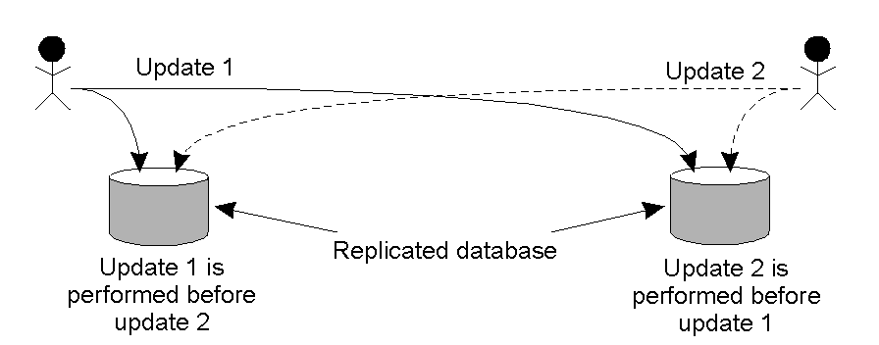
Example: Totally-Ordered Multicasting
(+$100)
(+1%)
(San Francisco)
(New York)
San Fran customer adds $100, NY bank adds 1% interest
  San Fran will have $1,111 and NY will have $1,110
Updating a replicated database and leaving it in an inconsistent state.
Can use Lamport’s to totally order

Slide 8
Totally-Ordered Multicast
A multicast operation by which all messages are delivered in the same order to each receiver.
Lamport Details:
  Each message is timestamped with the current logical time of its sender.
  Multicast messages are also sent back to the sender.
  Assume all messages sent by one sender are received in the order they were sent and that no messages are lost.

Slide 9
Totally-Ordered Multicast
Lamport Details (cont):
  Receiving process puts a message into a local queue ordered according to timestamp.
  The receiver multicasts an ACK to all other processes.
  Only deliver message when it is *both* at the head of queue and ack’ed by all participants
Why does this work?
  Key point from Lamport: the timestamp of the received message is lower than the timestamp of the ACK.
  All processes will eventually have the same copy of the local queue → consistent global ordering.

Slide 10
Today's Lecture
NTP correction
Totally ordered multicast
Centralized Mutual Exclusion
Distributed Mutual Exclusion

Slide 11
Mutual Exclusion
while true:
Perform local operations Acquire(lock)
Execute critical section Release(lock)
Must ensure that only one instance of code is in critical section
Whereas multithreaded systems can use shared memory, we assume that processes can only coordinate message passing.

Slide 12
Requirements
Correctness/Safety: At most one process holds the lock/enter C.S. at a time
Fairness: Any process that makes a request must be granted lock
  Implies that system must be deadlock-free
  Assumes that no process will hold onto a lock indefinitely
  Eventual fairness: Waiting process will not be excluded forever
  Bounded fairness: Waiting process will get lock within some bounded number of cycles (typically n)

Slide 13
Other Requirements
Low message overhead
No bottlenecks
Tolerate out-of-order messages
Allow processes to join protocol or to drop out
Tolerate failed processes
Tolerate dropped messages
Today, will focus on 1-3
  Total number of processes is fixed at n
  No process fails or misbehaves
  Communication never fails, but messages may be delivered out of order.

Slide 14
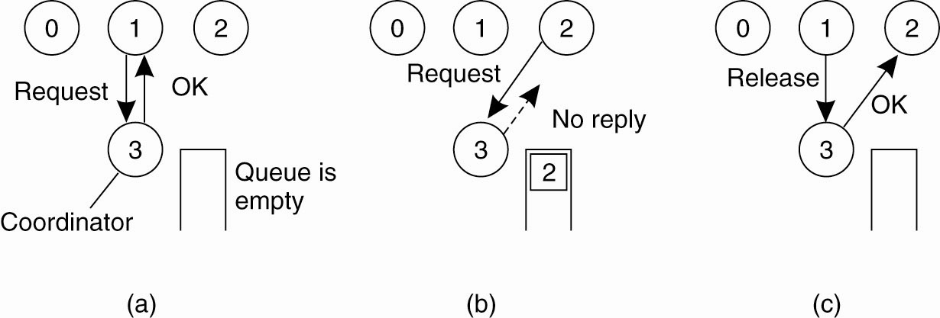
Mutual Exclusion
A Centralized Algorithm (1)
@ Server:
while true:
m = Receive()
If m == (Request, i): If Available():
Send (Grant) to i
@ Client → Acquire:
  Send (Request, i) to coordinator
  Wait for reply

Slide 15
Mutual Exclusion
A Centralized Algorithm (2)
@ Server:
while true:
m = Receive()
If m == (Request, i): If Available():
Send (Grant) to I
else:
Add i to Q

Slide 16
Mutual Exclusion
A Centralized Algorithm (3)
@ Server:
while true:
m = Receive()
If m == (Request, i):
If Available():
Send (Grant) to I
else:
Add i to Q
If m == (Release)&&!empty(Q):
Remove ID j from Q
Send (Grant) to j
@ Client → Release:
  Send (Release) to coordinator

Slide 17
Mutual Exclusion
A Centralized Algorithm (4)
Correctness:
  Clearly safe
  Fairness depends on queuing policy.
    E.g., if always gave priority to lowest process ID, then processes 1 & 2 lock out 3
Performance
  "cycle" is a complete round of the protocol with one process i entering its critical section and then exiting.
  3 messages per cycle (1 request, 1 grant, 1 release)
  Lock server creates bottleneck
Issues
  What happens when coordinator crashes?
  What happens when it reboots?

Slide 18
Today's Lecture
NTP correction
Totally ordered multicast
Centralized Mutual Exclusion
Distributed Mutual Exclusion

Slide 19
Distributed Algorithm Strawman
Assume that there are n coordinators
  Access requires a majority vote from m > n/2 coordinators.
  A coordinator always responds immediately to a request with GRANT or DENY
Node failures are still a problem
Large numbers of nodes requesting access can affect availability

Slide 20
A Distributed Algorithm 2
(Lamport Mutual Exclusion)
Every process maintains a queue of pending requests for entering critical section in order. The queues are ordered by virtual time stamps derived from Lamport timestamps
  For any events e, e' such that e --> e' (causality ordering), T(e) < T(e')
  For any distinct events e, e', T(e) != T(e')
When node i wants to enter C.S., it sends time-stamped request to all other nodes (including itself)
  Wait for replies from all other nodes.
  If own request is at the head of its queue and all replies have been received, enter C.S.
  Upon exiting C.S., remove its request from the queue and send a release message to every process.

Slide 21
A Distributed Algorithm 2
Other nodes:
  After receiving a request, enter the request in its own request queue (ordered by time stamps) and reply with a time stamp.
    This reply is unicast unlike the Lamport totally order multicast example. Why?
      Only the requester needs to know the message is ready to commit.
      Release messages are broadcast to let others to move on
  After receiving release message, remove the corresponding request from its own request queue.
  If own request is at the head of its queue and all replies have been received, enter C.S.

Slide 22
A Distributed Algorithm 2
Correctness
  When process x generates request with time stamp Tx, and it has received replies from all y in Nx, then its Q contains all requests with time stamps <= Tx.
Performance
  Process i sends n-1 request messages
  Process i receives n-1 reply messages
  Process i sends n-1 release messages.
Issues
  What if node fails?
  Performance compared to centralized
  What about message reordering?

Slide 23
A Distributed Algorithm 3
(Ricart & Agrawala)
Also relies on Lamport totally ordered clocks.
When node i wants to enter C.S., it sends time-stamped request to all other nodes. These other nodes reply (eventually). When i receives n-1 replies, then can enter C.S.
Trick: Node j having earlier request doesn't reply to i until after it has completed its C.S.

Slide 24
A Distributed Algorithm
Three different cases:
If the receiver is not accessing the resource and does not want to access it, it sends back an OK message to the sender.
If the receiver already has access to the resource, it simply does not reply. Instead, it queues the request.
If the receiver wants to access the resource as well but has not yet done so, it compares the timestamp of the incoming message with the one contained in the message that it has sent everyone. The lowest one wins.

Slide 25
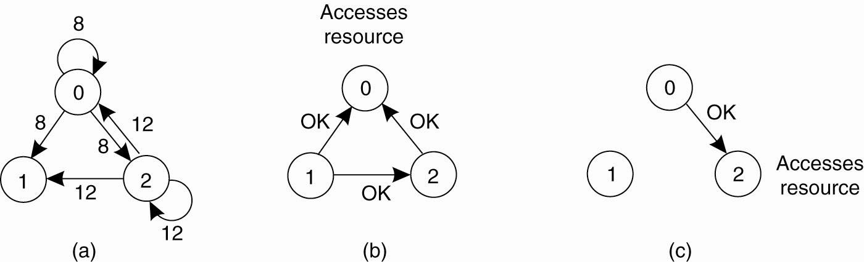
A Distributed Algorithm
Two processes (0 and 2) want to access a
shared resource at the same moment.

Slide 26
A Distributed Algorithm
Process 0 has the lowest timestamp, so it wins.

Slide 27
A Distributed Algorithm (4)
When process 0 is done, it sends an OK also, so 2 can now go ahead.

Slide 28
Correctness
Look at nodes A & B. Suppose both are allowed to be in their critical sections at same time.
  A must have sent message (Request, A, Ta) & gotten reply (Reply, A).
  B must have sent message (Request, B, Tb) & gotten reply (Reply, B).
Case 1: One received request before other sent request.
  E.g., B received (Request, A, Ta) before sending (Request, B, Tb). Then would have Ta < Tb. A would not have replied until after leaving its C.S.
Case 2: Both sent requests before receiving others request.
  But still, Ta & Tb must be ordered. Suppose Ta < Tb. Then A would not sent reply to B until after leaving its C.S.

Slide 29
Deadlock Free
Cannot have cycle where each node waiting for some other
Consider two-node case: Nodes A & B are causing each other to deadlock.
  This would result if A deferred reply to B & B deferred reply to A, but this would require both Ta < Tb & Tb < Ta.
For general case, would have set of nodes A, B, C, ..., Z, such that A is holding deferred reply to B, B to C, ... Y to Z, and Z to A.This would require Ta < Tb < ... < Tz < Ta, which is not possible.

Slide 30
Starvation Free
If node makes request, it will be granted eventually
Claim: If node A makes a request with time stamp Ta, then eventually, all nodes will have their local clocks > Ta.
Justification: From the request onward, every message A sends will have time stamp > Ta.
  All nodes will update their local clocks upon receiving those messages.
  So, eventually, A's request will have a lower time stamp than anyother node's request, and it will be granted.

Slide 31
Performance
Each cycle involves 2(n-1) messages
  n-1 requests by I
  n-1 replies to I
Issues
  What if node fails?
  Performance compared to centralized

Slide 32
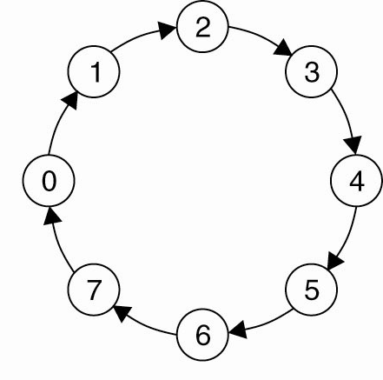
A Token Ring Algorithm
Organize the processes involved into a logical ring
One token at any time → passed from node to node along ring

Slide 33
A Token Ring Algorithm
Correctness:
  Clearly safe: Only one process can hold token
Fairness:
  Will pass around ring at most once before getting access.
Performance:
  Each cycle requires between 1 - ∞ messages
  Latency of protocol between 0 & n-1
Issues
  Lost token

Slide 34
Summary
Lamport algorithm demonstrates how distributed processes can maintain consistent replicas of a data structure (the priority queue).
Ricart & Agrawala's algorithms demonstrate utility of logical clocks.
Centralized & ring based algorithms much lower message counts
None of these algorithms can tolerate failed processes or dropped messages.

Slide 35
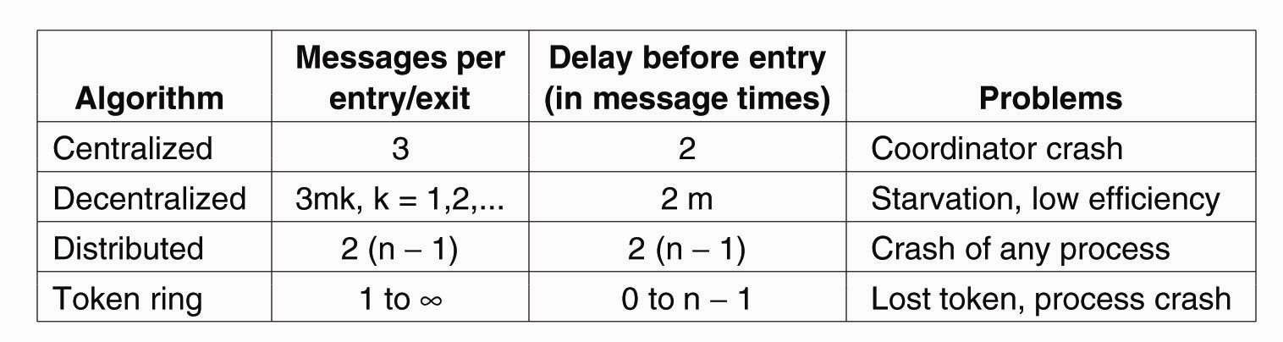
A Comparison of the Four Algorithms

Slide 36
Ricart & Agrawala Example
Processes 1, 2, 3. Create totally ordered clocks by having process ID compute timestamp of form T(e) = 10*L(e), where L(e) is a regular Lamport clock.
Initial timestamps → P1: 421, P2: 112, P3: 143
Action types:
  R m: Receive message m
  B m: Broadcast message m to all other processes
  S m to j: Send message m to process j

Slide 37
Timeline
Process | T1 | T2 | T3 | Action
3 |  |  | 153 | B (Request, 3, 153)
2 |  | 162 |  | R (Request, 3, 153)
1 | 431 |  |  | R (Request, 3, 153)
1 | 441 |  |  | S (Reply, 1) to 3
2 |  | 172 |  | S (Reply, 2) to 3
3 |  |  | 453 | R (Reply, 1)
3 |  |  | 463 | R (Reply, 2)
3 |  |  | 473 | Enter critical section
1 | 451 |  |  | B (Request, 1, 451)
2 |  | 182 |  | B (Request, 2, 182)
3 |  |  | 483 | R (Request, 1, 451)
3 |  |  | 493 | R (Request, 2, 182)
1 | 461 |  |  | R (Request, 2, 182)
2 |  | 462 |  | R (Request, 1, 451) # 2 has D = {1}
1 | 471 |  |  | S (Reply, 1) to 2 # 2 has higher priority
2 |  | 482 |  | R (Reply, 1)
3 |  |  | 503 | S (Reply, 3) to 1 # Release lock
3 |  |  | 513 | S (Reply, 3) to 2
1 | 511 |  |  | R (Reply, 3) # 1 has R = {2}
2 |  | 522 |  | R (Reply, 3) # 2 has R = {}
2 |  | 532 |  | Enter critical section
2 |  | 542 |  | S (Reply, 2) to 1 # Release lock
1 | 551 |  |  | R (Reply, 2) # 1 has R = {}
1 | 561 |  |  | Enter critical section

Slide 38
Overall Flow in Example
P1 and P2 compete for lock after it is released by P3.
P1's request has timestamp 451, while P2's request has timestamp 182.
P2 defers reply to P1, but P1 replies to P2 immediately.
This allows P2 to proceed ahead of P1.

