Slide 1



Improving Collaboration Efficiency in Fork-based Development
Shurui Zhou
Advisor: Christian Kästner

Slide 2







History of Forks
A need of a community that was not fulfilled by the original project.

Slide 3



Forking is a Weighty Decision
“Some open-source forks have made life difficult for developers. ... that will force developers to pick sides.” -Lauren Orsini

Slide 4

Community Fragmentation
Incompatible
A strong norm against forking [Yoo 2016]

Slide 5





GitHub is Encouraging Forking
Distributed Version Control + Social Coding

Slide 6


Fork-based Development
#Forks | #GitHub Projects
>50 | 114,120
>500 | 9164
>1,000 | 2236
>5,000 | 198
>10,000 | 72
>100,000 | 2
[GHTorrent 2019-06]

Slide 7


Hard Fork
(Social) Fork
Notes:
5‘

Slide 8
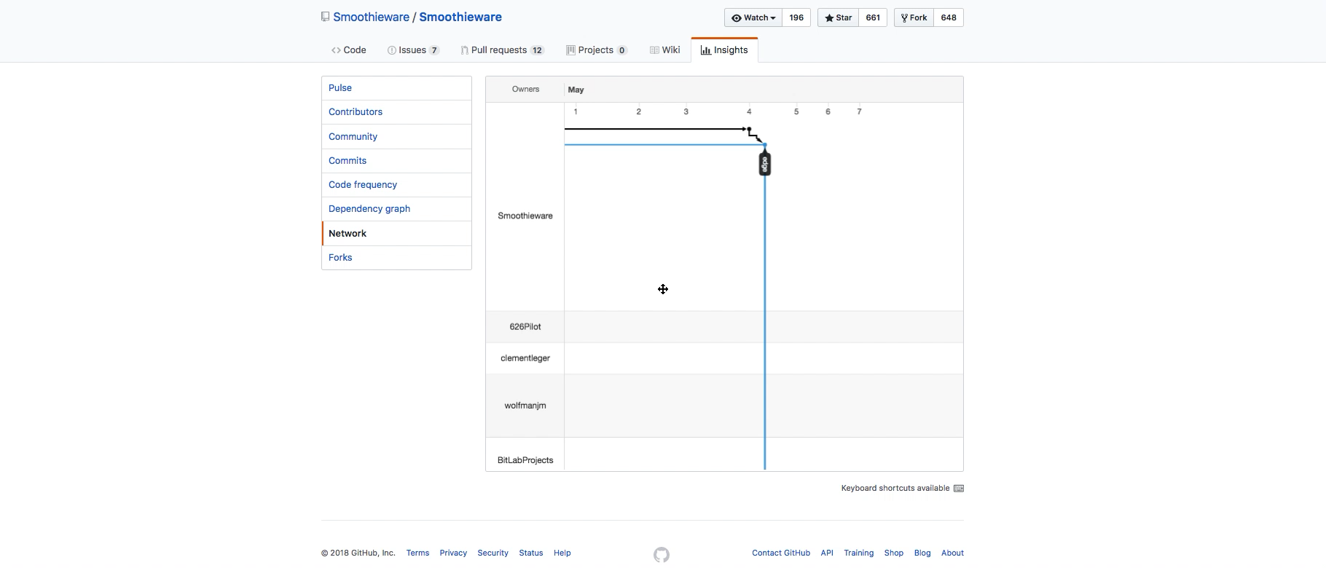

Network View

Slide 9
Problems Inefficiency
Lost Contribution
Lack of an overview
Redundant Development
Fragmented Community

Slide 10
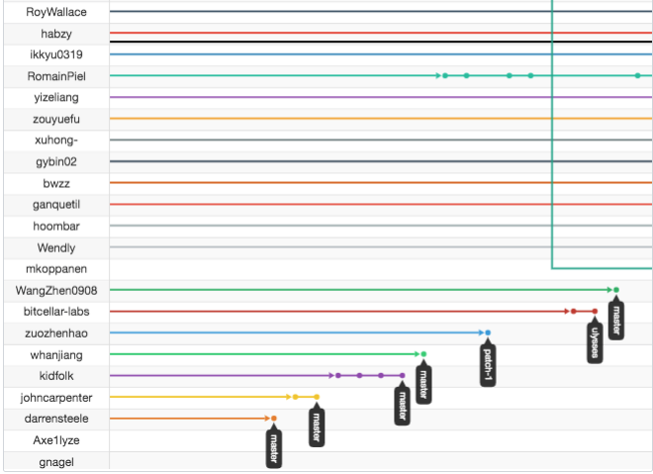
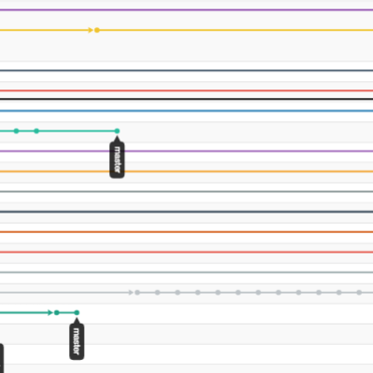
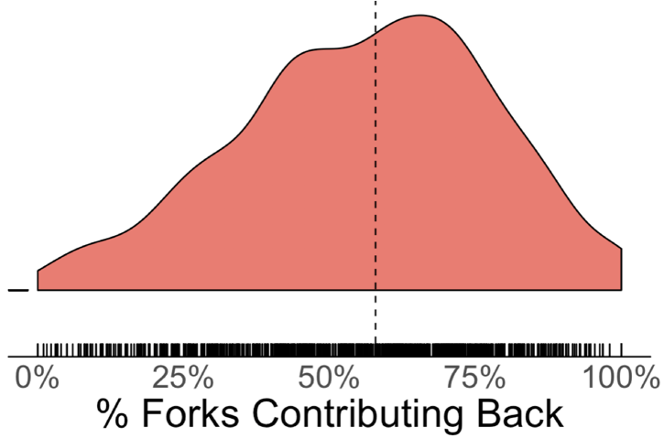
Lost Contribution
Only 14% of all forks of nine popular JavaScript projects on GitHub contained changes that were integrated back [Fung et al. 2012]
more efficient

Slide 11
Problems Inefficiency
Lost Contribution
Lack of an overview
Redundant Development
Fragmented Community

Slide 12

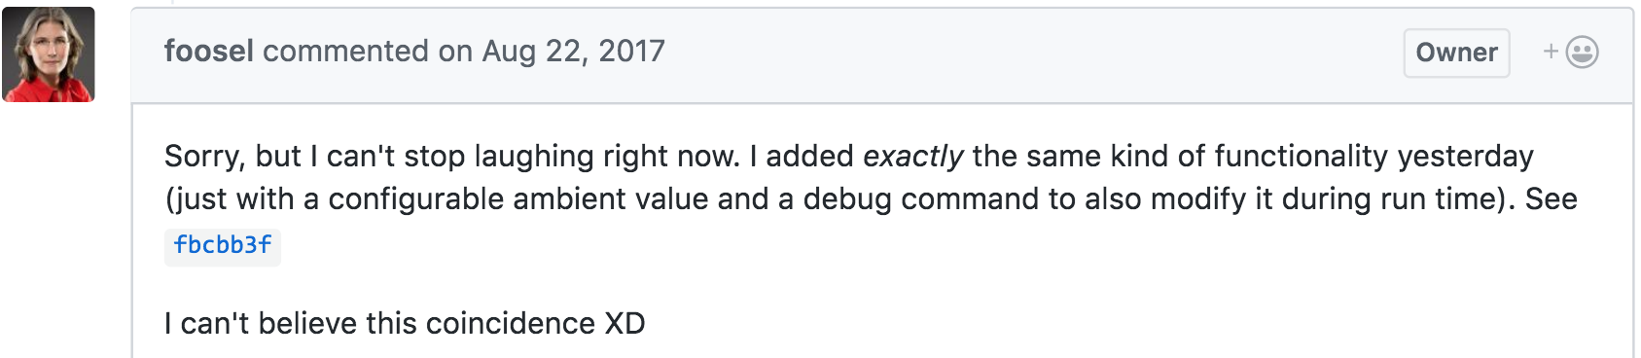

Redundant Development

Slide 13
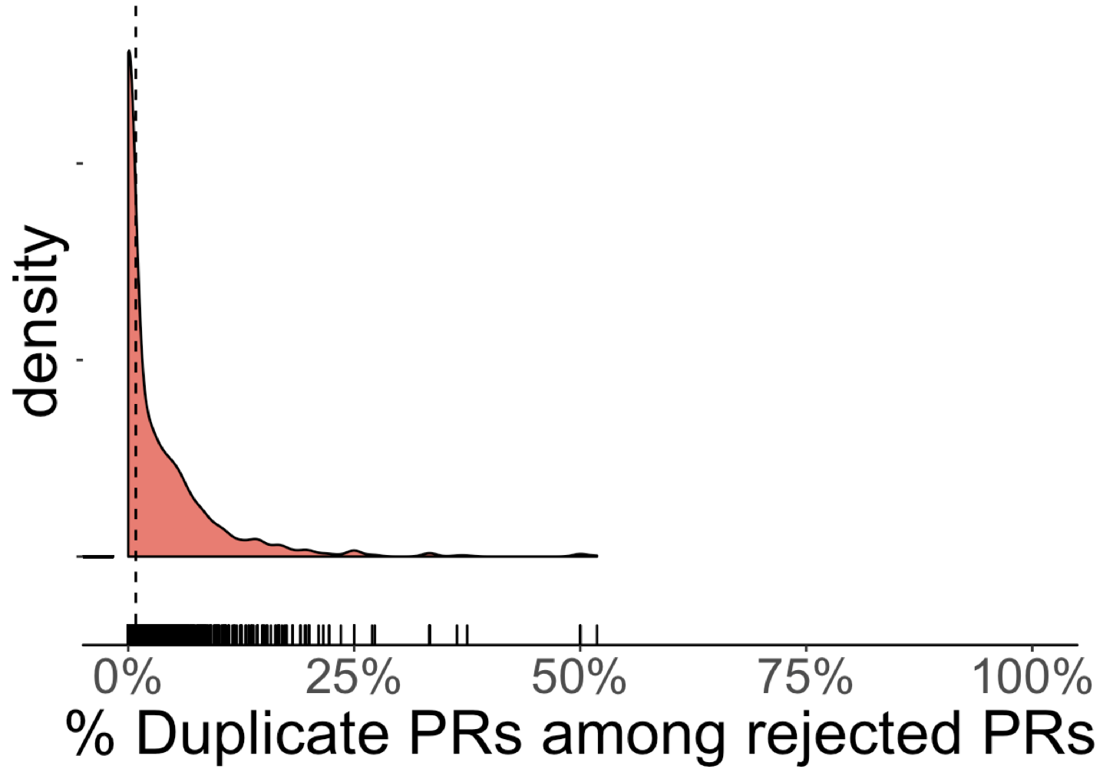
Redundant Development
23% un-merged PRs were rejected due to redundant dev. [Gousios et al. ICSE'14]
Cost of Reviewing [Li et al. MSR'18]
De-motivate developers [Steinmacher et al. ICSE'18]

Slide 14
Problems Inefficiency
Lost Contribution
Lack of an overview
Redundant Development
Fragmented Community

Slide 15

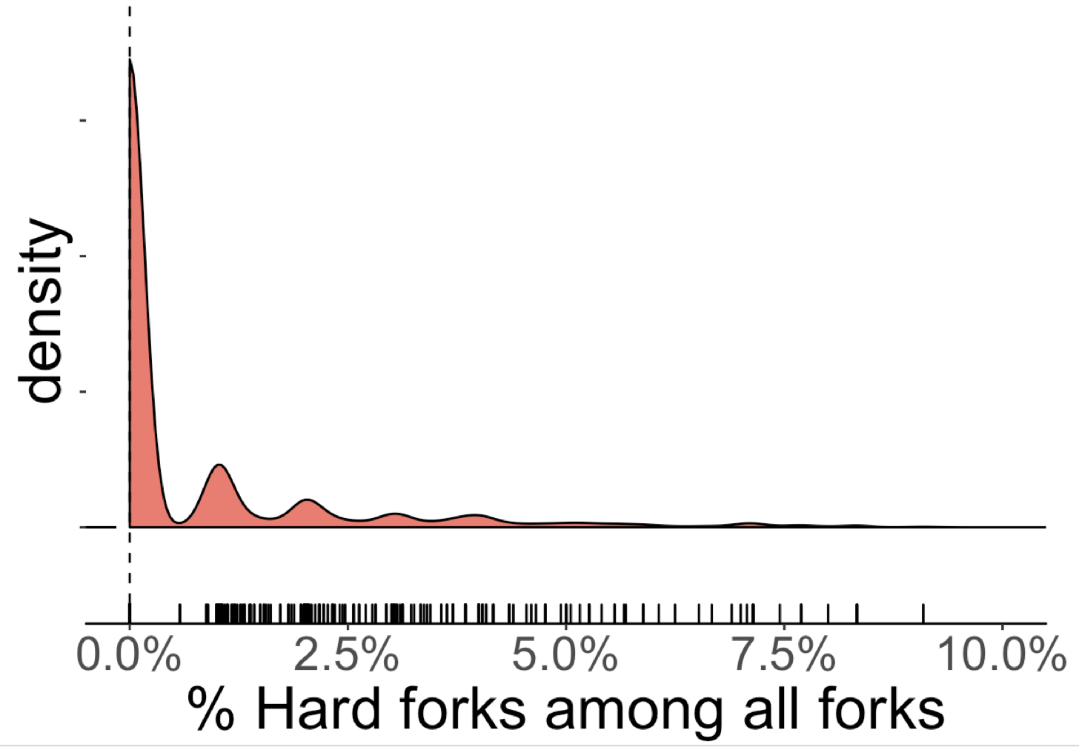

Communities Fragmentation (Hard Fork)

Slide 16
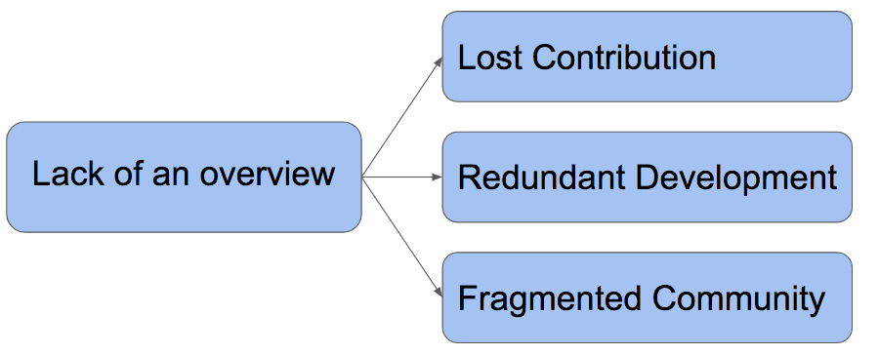
Problems Inefficiency

Slide 17
Designing Measures for Inefficiencies

Slide 18
Problems
Solutions
Quantifying Inefficiencies

Slide 19
Projects are Different

Slide 20
Problems
Solutions
Quantifying Inefficiencies
Identifying Interventions
from Best Practices

Slide 21

Lack of Awareness

Slide 22
Problems
Solutions
Quantifying Inefficiencies
Identifying Interventions
from Best Practices
Improving
Awareness

Slide 23
Problems
Solutions
Empirical Study
Identifying Natural Interventions from Best Practices
Lost Contribution
Redundant
Development
Awareness Tools
INFOX:
Identifying Features from Forks
Fragmented
Community
Identifying Redundant Development in Fork-based Development
Quantifying Inefficiencies

Slide 24
Identifying Natural Interventions from Best Practices [FSE '19]
Joint work with Bogdan Vasilescu and Christian Kästner

Slide 25
RQ: What characteristics and practices of a project associate with efficient forking practices?

Slide 26
Research Method
Interviewing Stakeholders
Deriving Hypotheses
Literature Search
Sampling
Quant.
Test Hypotheses
Inefficiencies
Practices
Context Factors
Modeling

Slide 27





Coordination Mechanism Affects Forking Practices
VS
- Project proposal
- Resolve issues on
the issue tracker
- Open for any contribution

Slide 28
Coordination Mechanism Affects Forking Practices
Centralization makes it easier to coordinate the divisions’ product types but more difficult to take advantage of the divisions’ private information. [Brandts et al. 2018]

Slide 29
Deriving Hypotheses
Centralized mgmt ➔ Larger portion of contributing forks
(7 more in the paper)

Slide 30
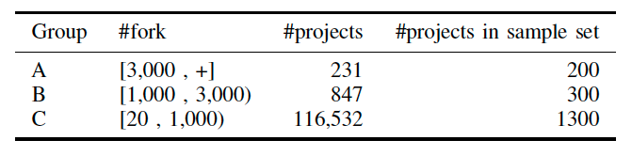
Test Hypotheses
Sampling
Quantifying
Inefficiencies
Practices
Context Factors
Modeling

Slide 31
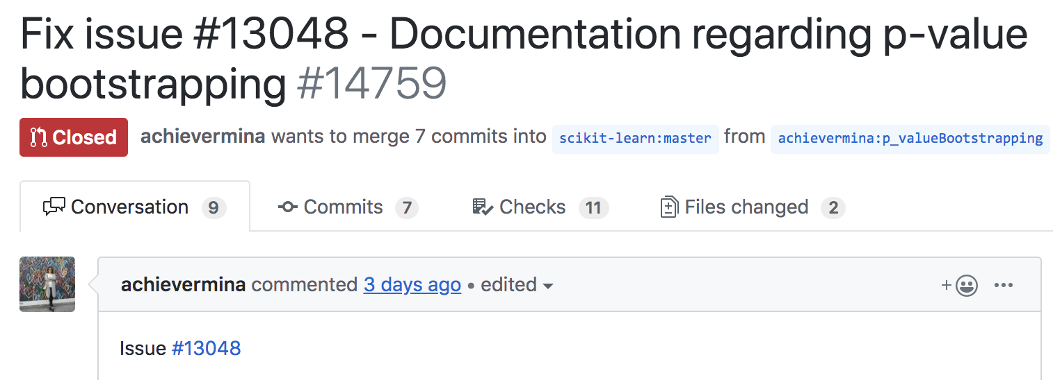
Operationalization - Centralized Management
Number of PRs referring to an Existing Issue
Measure:
All the PRs
Notes:
+formula

Slide 32
Centralized Mgmt → More Contributing Forks (R² = 17%)
Ratio contributing forks
Plus controls for:
NumForks
Size
ProjectAge
+
+
Modularity
Centralized Mgmt
(1% of deviance explained)
(18% of deviance explained)

Slide 33
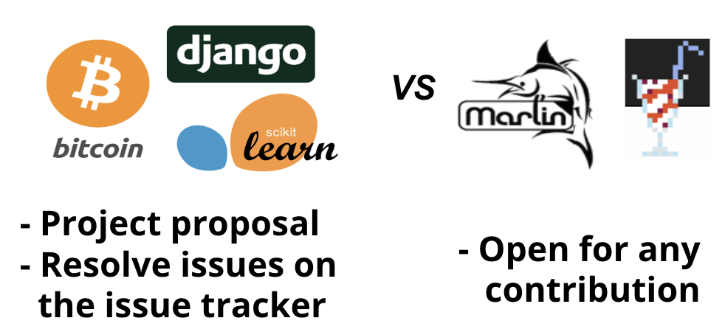
Evidence-based Intervention
For practitioners:
Coordinating planned changes through an issue tracker
Trade-offs?

Slide 34
Trade-off: Centralized Mgmt
Community Fragmentation
-
+
Plus controls for:
NumFork
Size
Centralized Mgmt
(12% of variance explained)
PR Merge Ratio
(35% of variance explained)

Slide 35
RQ: What characteristics and practices of a project associate with efficient forking practices?
- Coordination
- Modularity

Slide 36
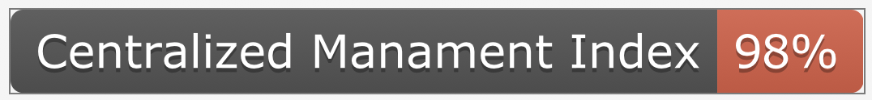

Opportunities to Design Further Interventions
Tooling to navigate and understand changes in forks
Making practices transparent
Cost of community fragmentation
Notes:
+ badge shields.io

Slide 37
Problems
Solutions
Empirical Study
Identifying Natural Interventions from Best Practices
Lost Contribution
Redundant
Development
Awareness Tools
INFOX:
Identifying Features from Forks
Fragmented
Community
Identifying Redundant Development in Fork-based Development
Quantifying Inefficiencies

Slide 38
Problems
Solutions
Empirical Study
Identifying Natural Interventions from Best Practices
Lost Contribution
Redundant
Development
Awareness Tools
INFOX:
Identifying Features from Forks
Fragmented
Community
Identifying Redundant Development in Fork-based Development
Quantifying Inefficiencies

Slide 39

INFOX:
Identifying Features in Forks [ICSE’18]
Joint work with Ştefan Stănciulescu, Olaf Leßenich
Yingfei Xiong, Andrzej Wąsowski,Christian Kästner

Slide 40
Goal: a Better Overview of Forks
Which are the active forks?
What kind of code changes have been made in forks?
What features were implemented in forks?
Notes:
solution,

Slide 41
INFOX
Summarizing forks that has un-merged commits
Mapping between feature to code changes

Slide 42
INFOX
Dependency graph for code changes
(static analysis)
Clustering features
(community detection)
Labeling features
(NLP)
42

Slide 43
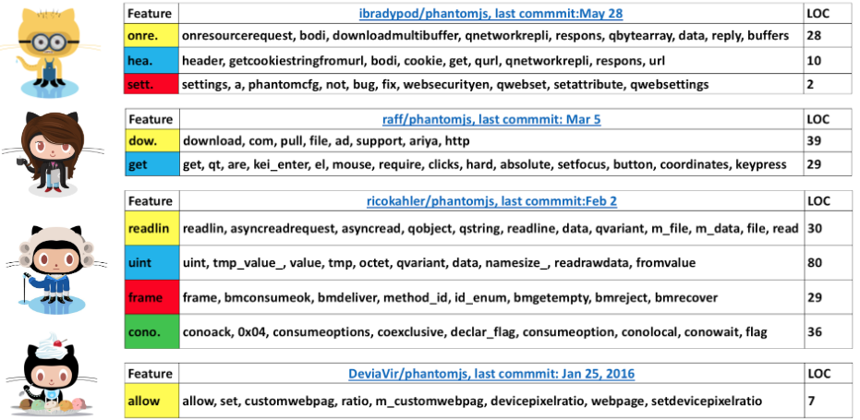
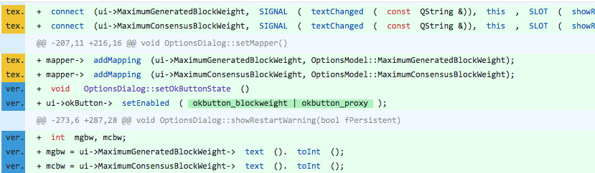
INFOX
Feature | Navigation | Keyword List | LOC
Sig. |  | Signature, isSigned, ... | 23
Enc. |  | Encryption, Decryption, isEncrpyed, Decrypt, ... | 100
Prev.
Next
Prev.
Next
Sig.
Sig.
Sig.
Sig.
Enc
Enc
Enc
Enc
Enc

Slide 44
INFOX - Evaluation
Effectiveness
Usefulness
Quantitative Study
Human-subject Study

Slide 45
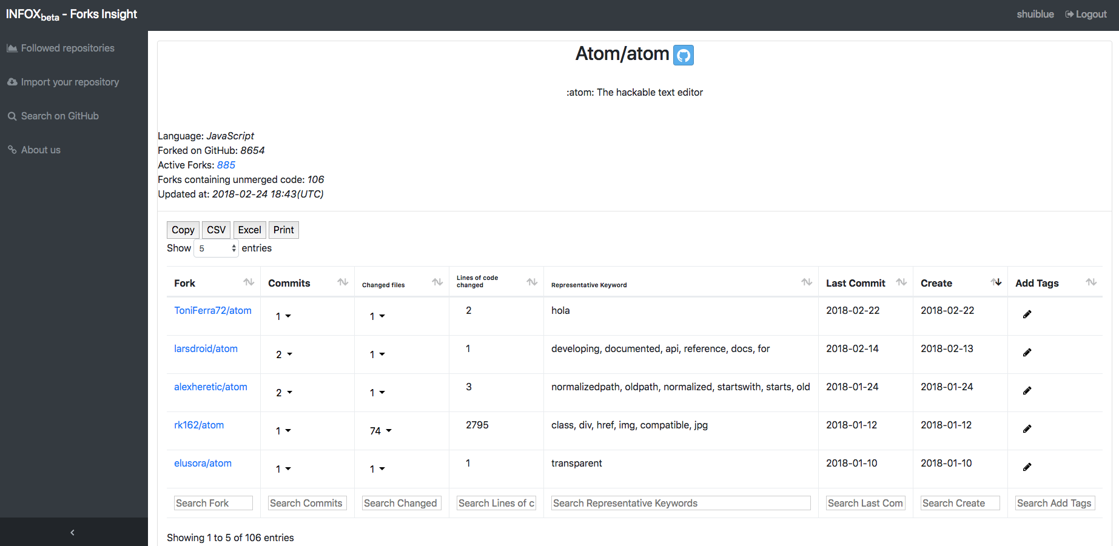
forks-insight.com

Slide 46
Problems
Solutions
Empirical Study
Identifying Natural Interventions from Best Practices
Lost Contribution
Redundant
Development
Awareness Tools
INFOX:
Identifying Features from Forks
Fragmented
Community
Identifying Redundant Development in Fork-based Development
Quantifying Inefficiencies

Slide 47
Identifying Redundancies in Fork-based Development [SANER’19]
Joint work with Luyao Ren, Andrzej Wąsowski, Christian Kästner

Slide 48
Research Method
Manually analyze duplicate PRs
Developing clues as indicators
Operationalization
ML predicting redundancies

Slide 49
Evaluation - effectiveness
RQ1: How accurate is our approach to help maintainers identify redundant contributions?
RQ2: How much effort could our approach save for developers in terms of commits?

Slide 50
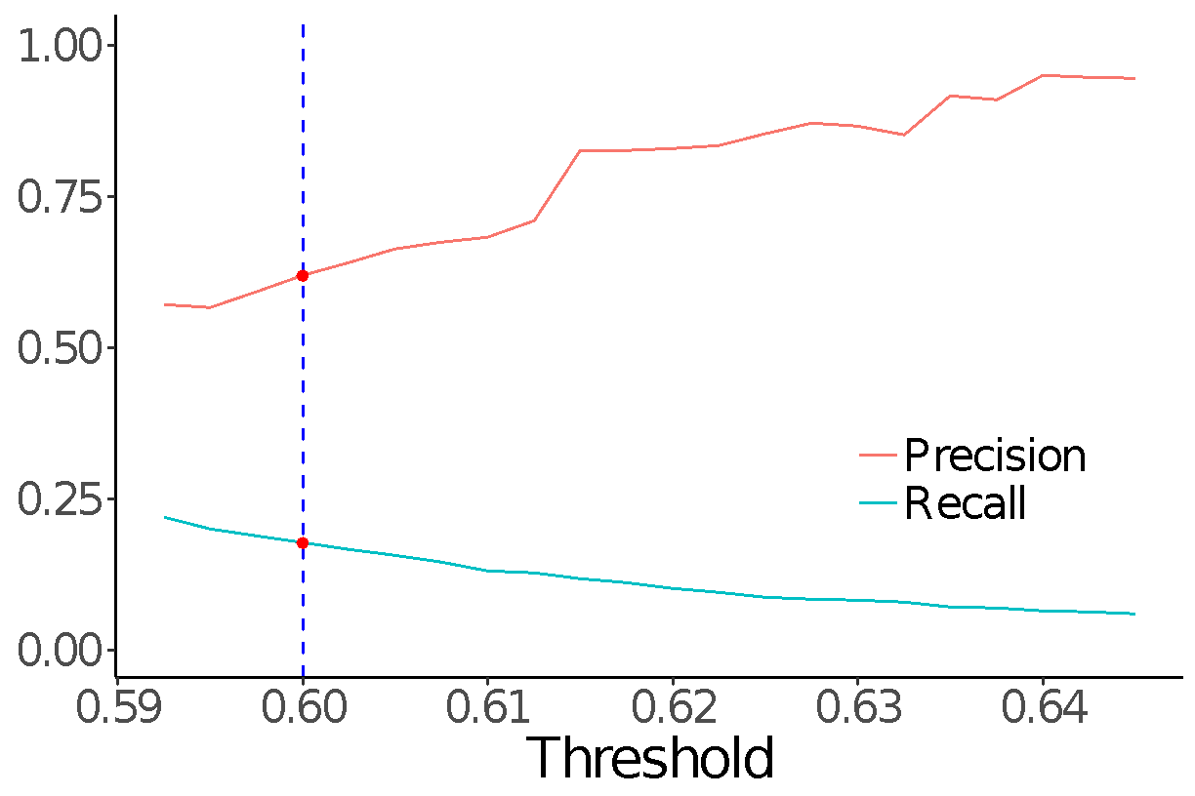
RQ1: helping maintainers to find duplicate PRs
Randomly sample 400
PRs from each project
Precision 57%-83%
Recall 10%-25%

Slide 51
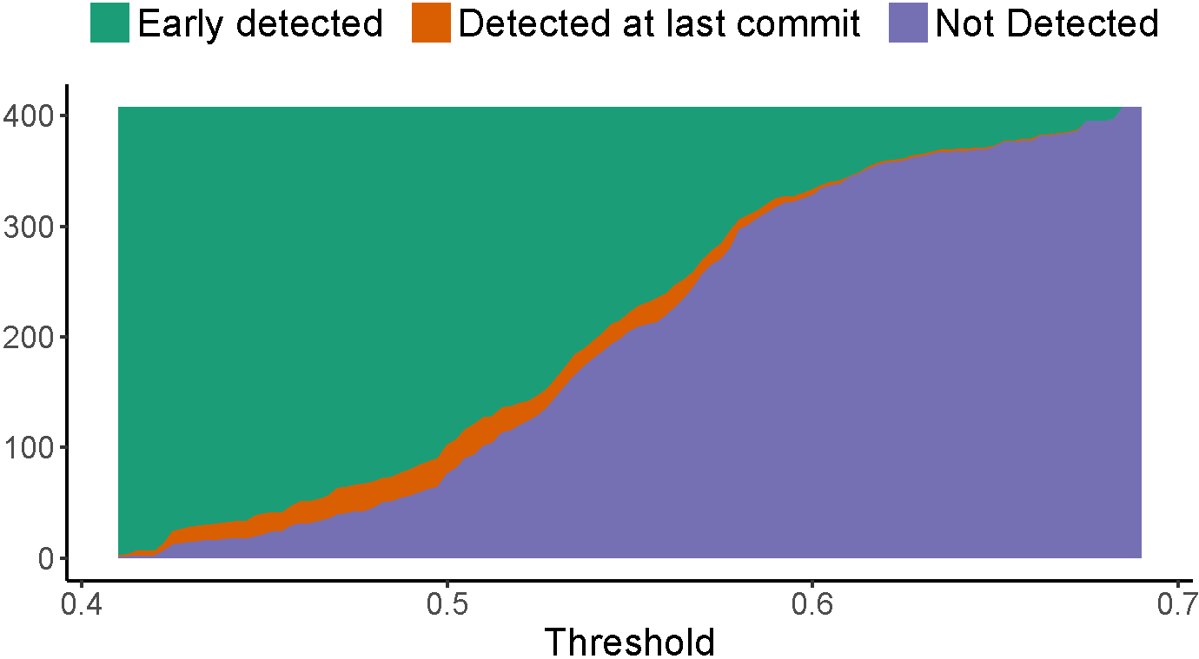
RQ2: helping developers to find duplicate changes early
Recall 46% - 71%
0.07–0.5% false positive rate
Save 1.9 - 3.0 commits per PR

Slide 52
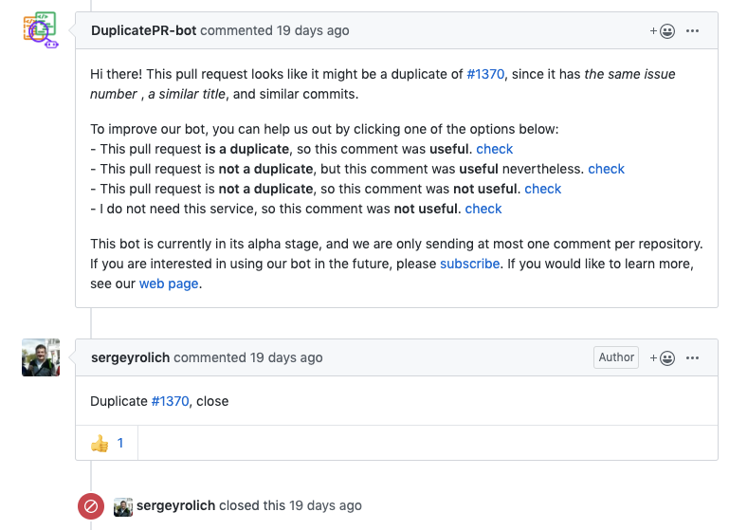
Planned Work - Evaluating Usefulness

Slide 53
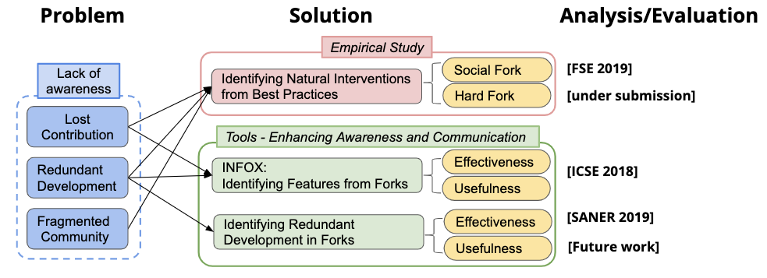
Improving Collaboration Efficiency in Fork-based Development
Shurui Zhou

