Slide 1
MIXER
Mixed-Initiative Data Retrieval and Integration by Example
Steve Gardiner, Anthony Tomasic, John Zimmerman, Rafae Aziz, and Kathryn Rivard

Slide 2
Meet Sally the Admin
Sally is an admin
Tasked with listing all collaborations between a department and some other research lab
Good news: the data is available from DBLP / ACM Digital Library
Bad news: retrieving the data is difficult (or impossible)
So Sally has to copy-and-paste information manually MANY times

Slide 3
Sally’s Repetitive Task
Go to DBLP / ACM Digital Library
Search for the department
Click on the first paper by a prof from the dept
Examine coauthors and their affiliations; if appropriate, copy the info into a local spreadsheet
Click on the second paper
…
…
…
Proudly present the local document
Notes:
How to put more accent on the pain?

Slide 4
Administrative office workers spend a LOT of time doing a LOT of these tasks
And the tasks are painful
Tedious
Error-prone
and the data is immediately stale

Slide 5
There’s a better way: automate it
There's got to be a better way!
Rote repetition is what computers are good at ...
Why not let a program do the heavy lifting?

Slide 6
Programming by Demonstration
Imagine you were training a person to perform the task
You would (probably)
show how to complete the first task
maybe review the second one
... and walk away
Mixer brings this interaction model to web integration tasks in a way that nonprogrammers can use

Slide 7
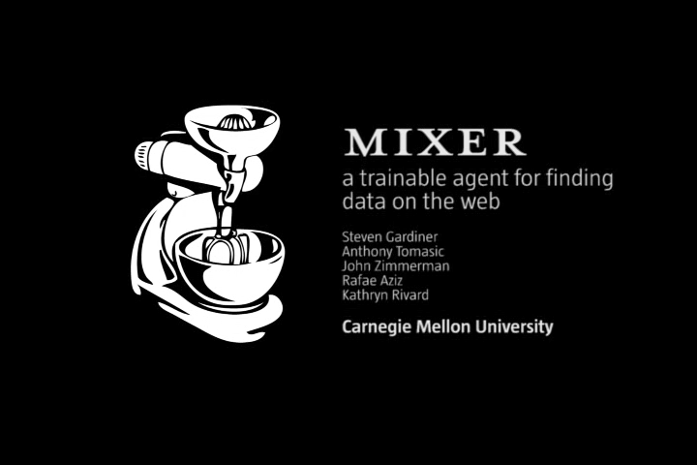
MIXER
Notes:
Demo (approx 2 minutes)

Slide 8
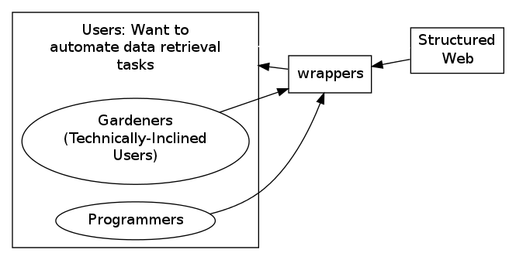
Vision: The MIXER Ecosystem
Notes:
Users consume wrappers, gardeners and programmers contribute wrappers

Slide 9
Why not just write a program?
Most users are not programmers
Nonprogrammers do not want to program
It is not their job! (Rode)
They do not want to deal with code (python, greasemonkey, etc), but also
they do not want to deal with programming constructs
But they can and do use spreadsheets!
Notes:
For some of you, this may have been your first question …

Slide 10
Experimental Setup
Recruited 12 university administrators
None reported "programming experience" -- so these were nonprogrammers!
We gave them 4 experimental tasks

Slide 11
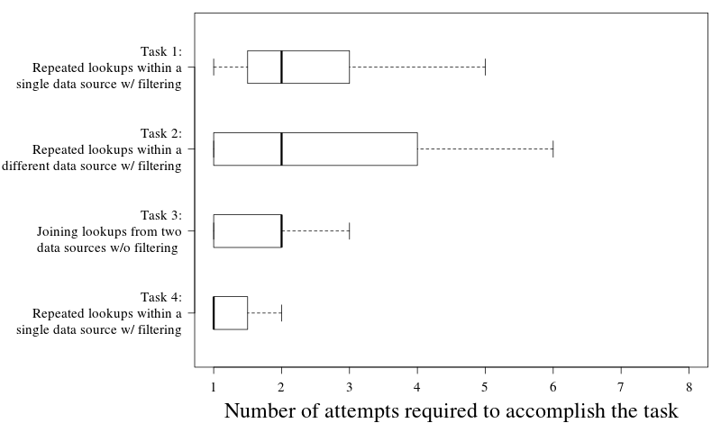
Results: Users learned to use MIXER effectively to accomplish their tasks

Slide 12
Findings: Nonprogrammers can accomplish their tasks with MIXER
Mixer does not feel like programming
and it succeeded
and people liked it
maybe causal, maybe not (future work?)
Mixer just enforces arbitrary constraints (e.g. copy-paste instead of typing) but users can figure it out

Slide 13
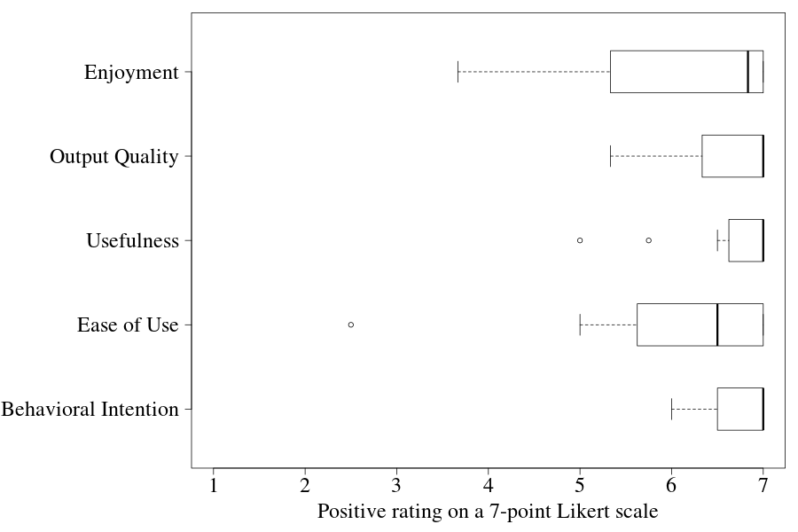
Results: Users subjectively rated MIXER highly
Cite TAM3 paper

Slide 14
Findings: Users conceive of the target table rather than the sources
Mixer does not differentiate between extracting data from a single site, and bridging multiple sites
And users did not seem to draw a distinction either

Slide 15
Findings: Users appreciate guidance in constructing the target table
An earlier version of MIXER (CHI 2010 WOZ) allowed users to select any text on the page for inclusion in the target table
Users constructed tables which did not have a clear interpretation for MIXER
Now MIXER guides the user to create the table that MIXER knows how to complete

Slide 16
Challenges for adoption of PBD systems
Users can use MIXER
Many PBD systems have been developed, but few adopted
We argue that MIXER’s incorporation of Mixed Initiative concepts increases adoptability

Slide 17
Future Work: Crowd-sourcing wrapper construction

Slide 18
Conclusion: Nonprogrammers can conceive and execute data gathering tasks with a desktop tool
Thanks!
This work is supported by grant number H133E080019 from the United States Department of Education through the National Institute on Disability and Rehabilitation Research

Slide 19
Mixed Initiative
A central issue is communicating knowledge and needs between the user and the agent
Gulf of execution
Gulf of evaluation
John ZIMMERMAN
MIXER: Mixed-Initiative Data Retrieval and Integration by Example

Slide 20
Design
Interaction begins in a normal browser session (just like web browsing)
User simply navigates to first page and activates Mixer
Mixer responds
displays "workspace"
highlighting the information it knows about ("wraps") in the page
John ZIMMERMAN
MIXER: Mixed-Initiative Data Retrieval and Integration by Example
Notes:
does this section overlap too much with the demo video?

Slide 21
Design
The spreadsheet-like workspace is the principal shared communication medium between the human and the agent
this shows the info the agent has accumulated so far
also the info the agent has not retrieved but intends to ("+++")
also graphically depicts the relationships between the pieces of info in a nested table representation
John ZIMMERMAN
MIXER: Mixed-Initiative Data Retrieval and Integration by Example
Notes:
does this section overlap too much with the demo video?
distinguish single workspace nested relation from constructing independent relations and then (in a separate mode) specifying their join?
on the one hand, this is an improvement of mixer over vegemite; on the other hand, someone who does not know vegemite or other tools might not care

Slide 22
Design
When the user is satisfied with the table so far, simply presses "Fill Table"
Mixer responds by replaying all browser steps taken in constructing the example
Finally, the user can export the table they've constructed collaboratively with Mixer into a spreadsheet program
John ZIMMERMAN
MIXER: Mixed-Initiative Data Retrieval and Integration by Example
Notes:
does this section overlap too much with the demo video?
mention that replaying is slow, but could be faster with server-side execution?

Slide 23
Barriers to programming
Why not just write a program?
most people are not programmers (obviously)
Why not just hire a programmer?
Unless you've got a ton of tasks, or are really important, programmers are way too busy to look at each task you do
Crossing institutional boundaries makes it unclear which programmer is responsible
Why not just demand an API from the websites you're integrating?
What's an API? (you're a nonprogrammer, remember?)
John ZIMMERMAN
MIXER: Mixed-Initiative Data Retrieval and Integration by Example

Slide 24
What we know: Spreadsheets
Spreadsheets are widely used by everyday users to represent and manipulate data
John ZIMMERMAN
MIXER: Mixed-Initiative Data Retrieval and Integration by Example
Notes:
Nardi?

