Slide 1
Mechanism design via extensive-form games
Brian Zhang

Slide 2
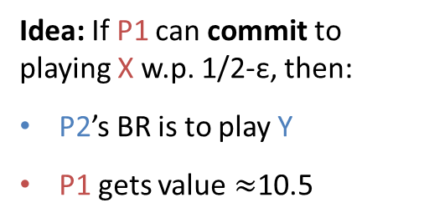
Problem 1: Stackelberg equilibria in normal-form games
Follower
 | X | Y
X | 1, 1 | 11, 0
Y | 0, 0 | 10, 1
Leader
unique Nash
Idea: If P1 can commit to playing X w.p. 1/2-ε, then:
P2’s BR is to play Y
P1 gets value $≈$10.5

Slide 3
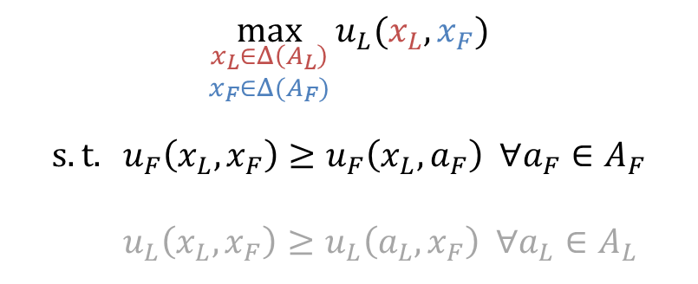
Problem 1: Stackelberg equilibria in normal-form games
We’ll ignore tiebreaking.
Equivalently:
P1 issues a recommendation (here Y) to P2
P2 must satisfy an obedience constraint
Also equivalently: Optimal equilibrium for P1, ignoring P1’s incentive constraint
Follower
 | X | Y
X | 1, 1 | 11, 0
Y | 0, 0 | 10, 1
Leader
$$\max_{\begin{aligned}x_{L}∈Δ\left(A_{L}\right) \\ x_{F}∈Δ(A_{F})\end{aligned}}{u_{L}(x_{L}, x_{F})}$$
$$s.t. u_{F}\left(x_{L}, x_{F}\right)≥u_{F}\left(x_{L}, a_{F}\right) ∀a_{F}∈A_{F}$$
$$u_{L}\left(x_{L},x_{F}\right)≥u_{L}\left(a_{L}, x_{F}\right) ∀a_{L}∈A_{L}$$
Idea: If P1 can commit to playing X w.p. 1/2, then:
P2’s BR is to play Y
P1 gets value 10.5
(with this constraint, it would be optimal Nash eq.)

Slide 4
Problem 1: Stackelberg equilibria in normal-form games
Follower
 | X | Y
X | 1, 1 | 11, 0
Y | 0, 0 | 10, 1
play X
rec X
play Y
rec X
play X
rec Y
play Y
rec Y
Leader
1
1
11
0
0
0
10
1
1
1
11
0
0
0
10
1
Stackelberg equilibrium = strategy for leader
s.t. holding leader’s strategy fixed,
direct strategy is a best response for follower

Slide 5
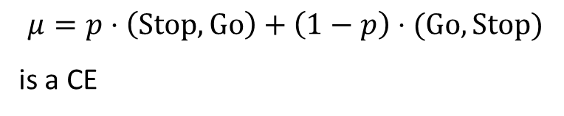
Problem 2: Optimal correlated equilibria (for normal-form games)
Chicken
 | Stop | Go
Stop | 0, 0 0 | 0, 1 p
Go | 1, 0 1-p | -5, -5 0
$$μ=p⋅\left(Stop, Go\right)+\left(1−p\right)⋅(Go, Stop)$$
is a CE
Player strategies are direct: incentivized to follow recommendations

Slide 6
Problem 2: Optimal correlated equilibria (for normal-form games)
Chicken
Correlated equilibrium = strategy for the mediator
s.t. holding mediator’s strategy fixed,
direct profile is Nash equilibrium for other players
 | Stop | Go
Stop | 0, 0 0 | 0, 1 p
Go | 1, 0 1-p | -5, -5 0
S,S S,G G,S G,G
p
1-p
R
R
R
R
S G
S G
S G
S G
C
C
C
C
C
C
C
C
S G
S G
S G
S G
S G
S G
S G
S G
0
0
0
1
1
0
-5
-5
0
0
0
1
1
0
-5
-5
0
0
0
1
1
0
-5
-5
0
0
0
1
1
0
-5
-5

Slide 7
Problem 3: Mechanism design
How to maximize (expected) revenue?
$6k
Buyer 1
I don't know how much buyers value car
Auctioneer
I could ask them directly, but:
what if they lie?
is that best?
$4k
Buyer 2
Notes:
Mechanism design: what's the best way to elicit information?
EXAMPLE: Auction

Slide 8

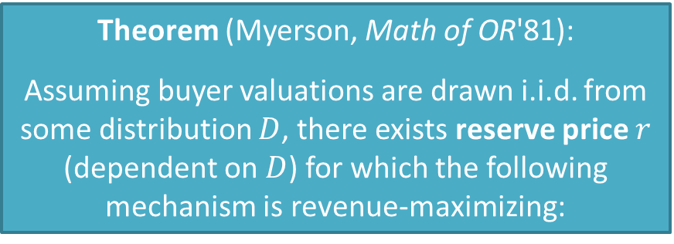
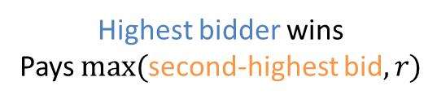
Problem 3: Mechanism design
Theorem (Myerson, Math of OR'81):
Assuming buyer valuations are drawn i.i.d. from some distribution $D$, there exists reserve price $r$ (dependent on $D$) for which the following mechanism is revenue-maximizing:
Buyer 1
Auctioneer
What are your valuations ("bids")?
$6k
$4k
$6k > $r$?
Yes
No
Highest bidder wins
Pays $max⁡($second-highest bid$,r)$
Nobody wins
Buyer 2
This mechanism is “direct”: buyers bidding true values is Nash eqm
Notes:
Interesting: sometimes you must not sell the item to maximize revenue

Slide 9



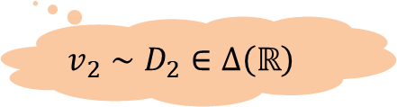
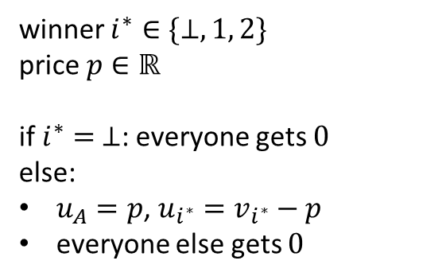

Problem 3: Mechanism design
Buyer 1
$$v_{1}∼D_{1}∈Δ\left(ℝ\right)$$
Auctioneer
$$v_{1}^{′}∈ℝ$$
Buyer 2
$$v_{2}^{′}∈ℝ$$
$$v_{2}∼D_{2}∈Δ\left(ℝ\right)$$
winner $i^{∗}∈\{⊥, 1, 2\}$
price $p∈ℝ$
if $i^{∗}= ⊥$: everyone gets $0$
else:
$u_{A}=p$, $u_{i^{∗}}=v_{i^{∗}}−p$
everyone else gets $0$
Direct strategy of buyer $i$: report $v_{i}^{′}=v_{i}$
Optimal mechanism = strategy for the auctioneer
s.t. holding auctioneer’s strategy fixed,
direct profile is Nash equilibrium for other players

Slide 10
Problem 4: Information design
a.k.a. (Bayesian) persuasion
("Mechanism design, but backwards")
Kamenica & Gentzkow (American Econometric Review'11)
p = 1/3
Value to buyer = $6k
p = 2/3
Value to buyer = $4k
A car is on sale for $5,000…
…but only the seller knows the car's true quality
As before: The seller can commit, and send messages
Buy
Pass
Buy
Pass
u(Seller) = $5k
u(Buyer) = $1k
u(Seller) = $0
u(Buyer) = $0
u(Seller) = $5k
u(Buyer) = -$1k
u(Seller) = $0
u(Buyer) = $0
Notes:
Information design: "What's the best way to give information?"

Slide 11
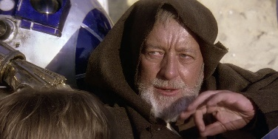
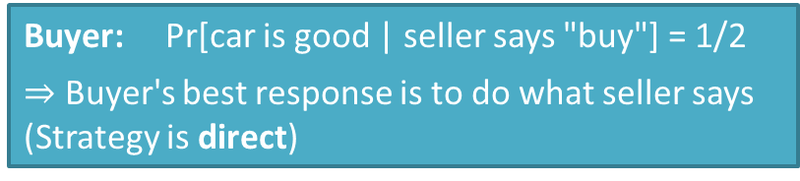
Problem 4: Information design
a.k.a. (Bayesian) persuasion
("Mechanism design, but backwards")
Kamenica & Gentzkow (American Econometric Review'11)
p = 1/3
Value to buyer = $6k
p = 2/3
Value to buyer = $4k
A car is on sale for $5,000…
…but only the seller knows the car's true quality
As before: The seller can commit, and send messages
B P B P
1/2
1/2
B P B P B P B P
You should buy the car
5k
1k
0
0
5k
-1k
0
0
5k
1k
0
0
5k
-1k
0
0
I should buy the car
Buyer: Pr[car is good | seller says "buy"] = 1/2
$⇒$ Buyer's best response is to do what seller says (Strategy is direct)
Even though the car is good only 1/3 of the time, the seller sells the car 2/3 of the time!
Notes:
Information design: "What's the best way to give information?"

Slide 12
Problem 4: Information design
a.k.a. (Bayesian) persuasion
("Mechanism design, but backwards")
Kamenica & Gentzkow (American Econometric Review'11)
p = 1/3
Value to buyer = $6k
p = 2/3
Value to buyer = $4k
A car is on sale for $5,000…
…but only the seller knows the car's true quality
As before: The seller can commit, and send messages
B P B P
1/2
1/2
B P B P B P B P
You should buy the car
5k
1k
0
0
5k
-1k
0
0
5k
1k
0
0
5k
-1k
0
0
I should buy the car
Optimal solution = strategy for the seller
s.t. holding seller’s strategy fixed,
direct strategy is best response for the buyer
Notes:
Information design: "What's the best way to give information?"

Slide 13
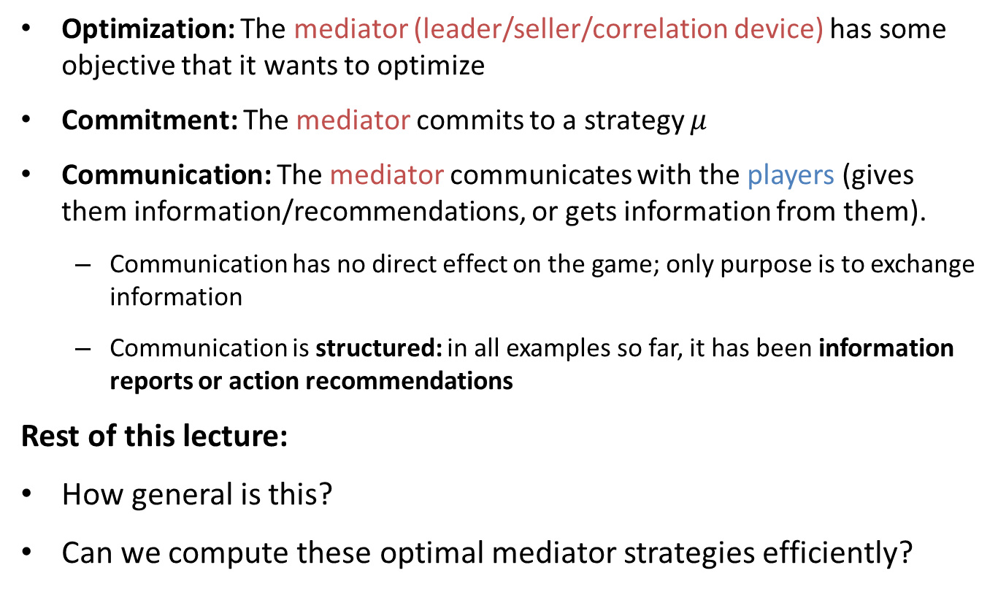
What’s common to all these problems?
Optimization: The mediator (leader/seller/correlation device) has some objective that it wants to optimize
Commitment: The mediator commits to a strategy $μ$
Communication: The mediator communicates with the players (gives them information/recommendations, or gets information from them).
  Communication has no direct effect on the game; only purpose is to exchange information
  Communication is structured: in all examples so far, it has been information reports or action recommendations
Rest of this lecture:
How general is this?
Can we compute these optimal mediator strategies efficiently?

Slide 14
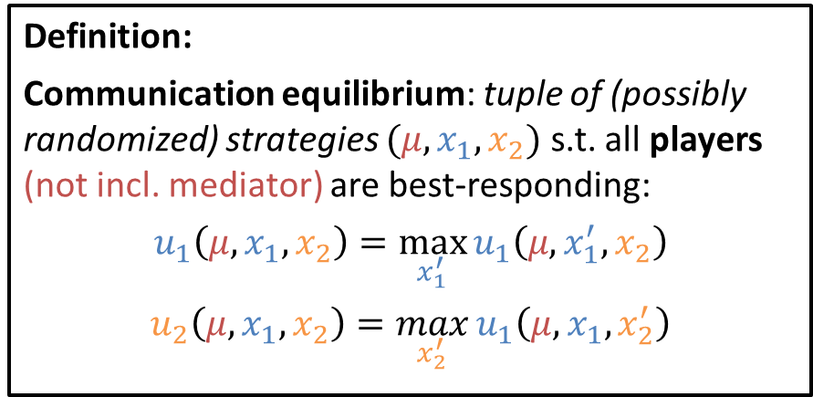
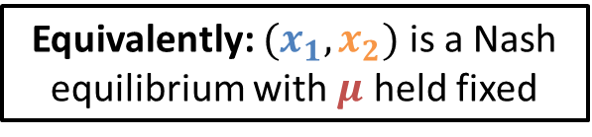
Extensive-Form Games and Communication Equilibria
Definition:
Communication equilibrium: tuple of (possibly randomized) strategies $(μ,x_{1},x_{2})$ s.t. all players (not incl. mediator) are best-responding:
$$u_{1}\left(μ,x_{1},x_{2}\right)=\max_{x_{1}^{′}}{u_{1}\left(μ,x_{1}^{′},x_{2}\right)}$$
$$u_{2}\left(μ,x_{1},x_{2}\right)=\max_{x_{2}^{′}}{u_{1}\left(μ,x_{1},x_{2}^{′}\right)}$$
u_{M} = 5
u₁ = 0
u₂ = -1
Communication is implicit. At every timestep in the game…
Equivalently: $(x_{1},x_{2})$ is a Nash equilibrium with $μ$ held fixed
Players
Mediator
Notes:
In an arbitrary extensive-form game…

Slide 15
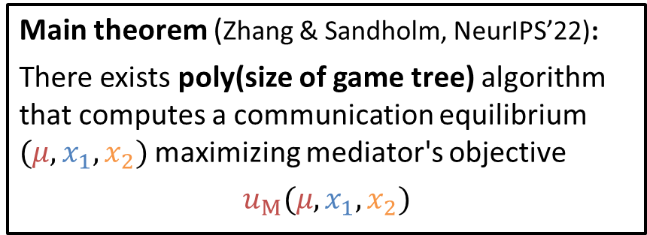
Extensive-Form Games and Communication Equilibria
Definition:
Communication equilibrium: tuple of (possibly randomized) strategies $(μ,x_{1},x_{2})$ s.t. all players (not incl. mediator) are best-responding:
$$u_{1}\left(μ,x_{1},x_{2}\right)=\max_{x_{1}^{′}}{u_{1}\left(μ,x_{1}^{′},x_{2}\right)}$$
$$u_{2}\left(μ,x_{1},x_{2}\right)=\max_{x_{2}^{′}}{u_{1}\left(μ,x_{1},x_{2}^{′}\right)}$$
u_{M} = 5
u₁ = 0
u₂ = -1
Communication is implicit. At every timestep in the game…
Main theorem (Zhang & Sandholm, NeurIPS’22):
There exists poly(size of game tree) algorithm that computes a communication equilibrium $(μ,x_{1},x_{2})$ maximizing mediator's objective
$$u_{M}(μ,x_{1},x_{2})$$
Players
Mediator
Notes:
Now let's talk about the general problem:
has "mechanism design-like aspects" and "information design-like aspects"
Here, I state it for two players, but it obviously generalizes to more than two
In particular, Nashes are comm eqs

Slide 16
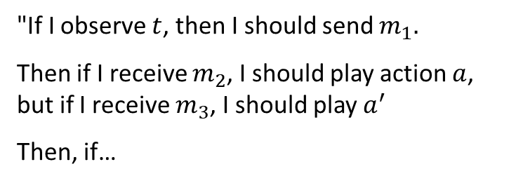
Extensive-Form Games and Communication Equilibria
Definition:
Communication equilibrium: tuple of (possibly randomized) strategies $(μ,x_{1},x_{2})$ s.t. all players (not incl. mediator) are best-responding:
$$u_{1}\left(μ,x_{1},x_{2}\right)=\max_{x_{1}^{′}}{u_{1}\left(μ,x_{1}^{′},x_{2}\right)}$$
$$u_{2}\left(μ,x_{1},x_{2}\right)=\max_{x_{2}^{′}}{u_{1}\left(μ,x_{1},x_{2}^{′}\right)}$$
u_{M} = 5
u₁ = 0
u₂ = -1
Communication is implicit. At every timestep in the game…
What are strategies?
"If I observe $t$, then I should send $m_{1}.$
Then if I receive $m_{2}$, I should play action $a$, but if I receive $m_{3}$, I should play $a^{′}$
Then, if…
Players
Mediator
Problem: Message space is infinite

Slide 17
Proof in Three Steps
Step 1: Reduce game from infinite to finite.
  ("Revelation principle" introduces structure to the messages)
Step 2: Reduce game from finite to polynomial.
  (Using more "without loss of generality" reductions)
Step 3: Solve game.
  (LP duality)
Notes:
Say in words: I use RP in a more simple way here; this is more general as I show in the full paper

Slide 18
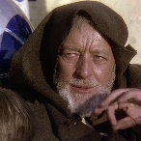
Step 1: Revelation Principle
Theorem (Revelation Principle, informal)
(Forges, Econometrica'85, generalized in our full paper)
For every comm eqm, exists equivalent direct comm eqm. "Direct" means both:
Players' messages to mediator are reports of private information. In equilibrium, players always send their true private information
Mediator's messages to players are action recommendations. In equilibrium, players play actions that they are recommended
Mechanism Design
= $6k
My bid is $6k
Information Design
You should buy the car
I should buy the car
Notes:
This form of the revelation principle was first introduced by (Forges 1985), but
this form is interesting enough for this talk
full paper contains more powerful, new RP
"WLOG" means without changing comm eq solution
make sure note that main result is not new

Slide 19
Step 1: Revelation Principle
Original equilibrium (indirect)
Direct equilibrium
Deviation against direct eqm
Deviation against original eqm
Notes:
Say in words: this is proof by contradiction

Slide 20




Step 1: Revelation Principle
1. The players' messages to the mediator are reports of private information. In equilibrium, players always send their true private information.
Original equilibrium (indirect)
Direct equilibrium
= $6k
= $6k
I bid $6k
Mediator
Mediator
I bid $f($$6k$)$
You would have bid $f$($6k$)$. I'll pretend that you did
= $6k
= $6k
Mediator
I bid $f($$4k$)$
Mediator
I bid $4k
I'll pretend you bid $f($$4k$)$
Notes:
This is the first part

Slide 21


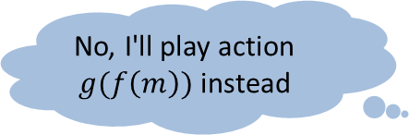



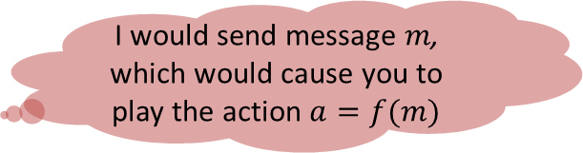

Step 1: Revelation Principle
2. The mediator's messages to the players are action recommendations. In equilibrium, players play the actions that they are recommended.
Original equilibrium (indirect)
Direct equilibrium
Mediator
Mediator
I would send message $m$, which would cause you to play the action $a=f(m)$
$$m$$
I'll play action $a=f(m)$
You should play action $a$
Okay!
Mediator
Mediator
You should play action $a$
$$m$$
No, I'll play action $g(f\left(m\right))$ instead
No, I'll play action $g(a)$ instead

Slide 22
Proof in Three Steps
Step 1: Reduce game from infinite to finite.
  ("Revelation principle" introduces structure to the messages)
Step 2: Reduce game from finite to polynomial.
  (Using more "without loss of generality" reductions)
Step 3: Solve game.
  (LP duality)
✓
Notes:
From here the rest of the proof is new to our paper

Slide 23




























Step 2: Communication Game
Revelation principle
L
R
Player
sends info
L
R
R
L
R
L
Mediator recommends
action
$$ℓ$$
$$r$$
$$ℓ$$
$$r$$
$$ℓ$$
$$r$$
$$ℓ$$
$$r$$
$$ℓ$$
$$r$$
$$ℓ$$
$$r$$
Player
plays action
$$ℓ$$
$$r$$
$$ℓ$$
$$r$$
$$r$$
$$ℓ$$
$$r$$
$$r$$
$$ℓ$$
$$r$$
$$r$$
$$ℓ$$
$$r$$
$$ℓ$$
$$ℓ$$
$$ℓ$$
"Communication game"
Notes:
Mediator doesn't know player's true private info (L/R), only reported type
I'm introducing this game here: explicit communication now!

Slide 24
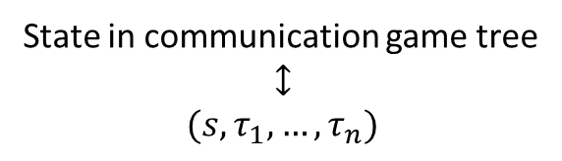
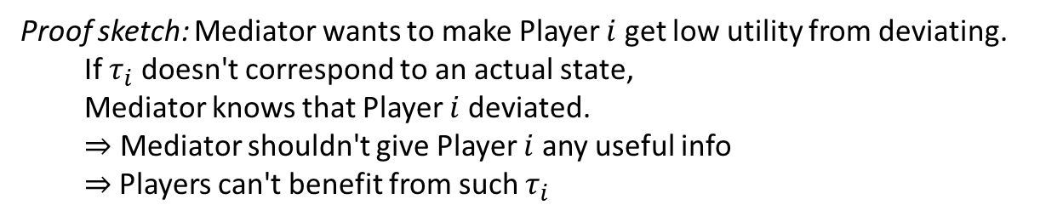
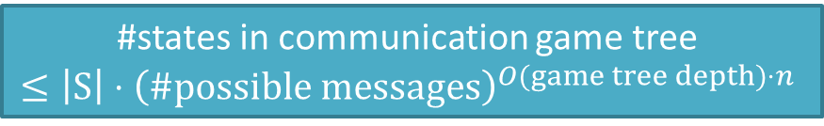
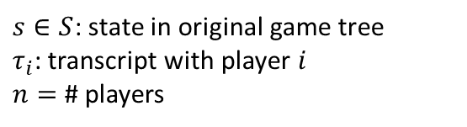
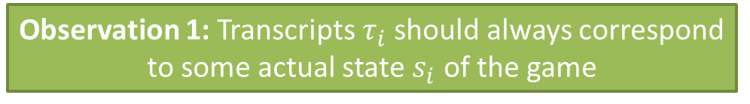
Step 2: Communication Game
L
R
State in communication game tree
$$↕$$
$$(s, τ_{1},…,τ_{n})$$
L
R
L
R
$$ℓ$$
$s∈S$: state in original game tree
$τ_{i}$: transcript with player $i$
$n=$ # players
$$r$$
$$ℓ$$
$$r$$
$$ℓ$$
$$r$$
$$ℓ$$
$$r$$
$$ℓ$$
$$r$$
$$ℓ$$
$$r$$
$$r$$
$$ℓ$$
$$r$$
$$r$$
$$ℓ$$
$$r$$
$$r$$
$$ℓ$$
$$r$$
$$ℓ$$
$$ℓ$$
$$ℓ$$
#states in communication game tree
$≤\left|S\right|⋅{\left(\#possible messages\right)}^{O(game tree depth)⋅n}$
The communication game is finite! ☺
…but it is still exponentially big ☹
Observation 1: Transcripts $τ_{i}$ should always correspond to some actual state $s_{i}$ of the game
Proof sketch: Mediator wants to make Player $i$ get low utility from deviating.
  If $τ_{i}$ doesn't correspond to an actual state,
  Mediator knows that Player $i$ deviated.
  $⇒$ Mediator shouldn't give Player $i$ any useful info
  $⇒$Players can't benefit from such $τ_{i}$
Notes:
Transcript = message history between mediator and player I
Fewer states than possible transcripts

Slide 25
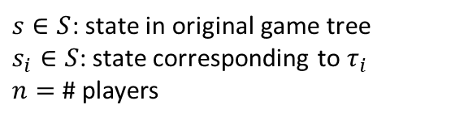
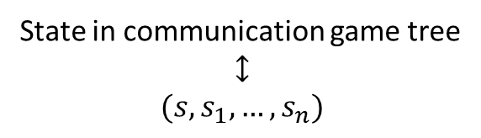
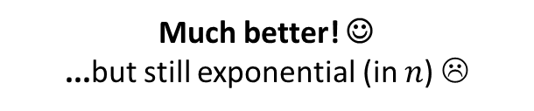
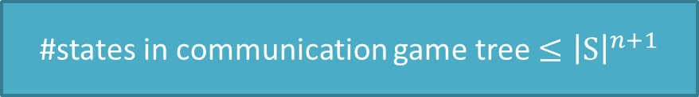
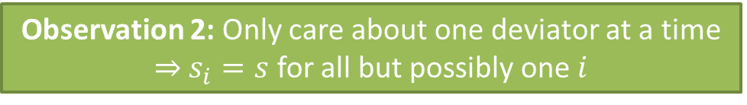
Step 2: Communication Game
L
R
State in communication game tree
$$↕$$
$$(s, s_{1},…,s_{n})$$
L
R
L
R
$$ℓ$$
$s∈S$: state in original game tree
$s_{i}∈S$: state corresponding to $τ_{i}$
$n=$ # players
$$r$$
$$ℓ$$
$$r$$
$$ℓ$$
$$r$$
$$ℓ$$
$$r$$
$$ℓ$$
$$r$$
$$ℓ$$
$$r$$
$$r$$
$$ℓ$$
$$r$$
$$r$$
$$ℓ$$
$$r$$
$$r$$
$$ℓ$$
$$r$$
$$ℓ$$
$$ℓ$$
$$ℓ$$
#states in communication game tree
$≤\left|S\right|⋅{\left(\#possible messages\right)}^{O(game tree depth)⋅n}$
The communication game is finite! ☺
…but it is still exponentially big ☹
#states in communication game tree $≤{\left|S\right|}^{n+1}$
Much better! ☺
...but still exponential (in $n$) ☹
Observation 1: Transcripts $τ_{i}$ should always correspond to some actual state $s_{i}$ of the game
Observation 2: Only care about one deviator at a time $⇒$ $s_{i}=s$ for all but possibly one $i$

Slide 26
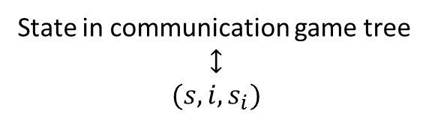
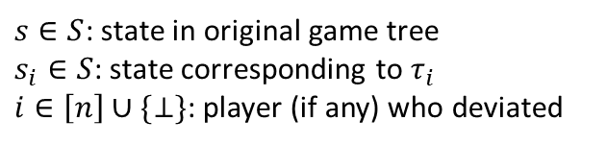

Step 2: Communication Game
L
R
State in communication game tree
$$↕$$
$$(s,i, s_{i})$$
L
R
L
R
$$ℓ$$
$s∈S$: state in original game tree
$s_{i}∈S$: state corresponding to $τ_{i}$
$i∈\left[n\right]∪\{⊥\}$: player (if any) who deviated
$$r$$
$$ℓ$$
$$r$$
$$ℓ$$
$$r$$
$$ℓ$$
$$r$$
$$ℓ$$
$$r$$
$$ℓ$$
$$r$$
$$r$$
$$ℓ$$
$$r$$
$$r$$
$$ℓ$$
$$r$$
$$r$$
$$ℓ$$
$$r$$
$$ℓ$$
$$ℓ$$
$$ℓ$$
#states in communication game tree $≤{\left|S\right|}^{n+1}$
Yes!
$$n⋅{\left|S\right|}^{2}$$
Much better! ☺
...but still exponential (in $n$) ☹
Observation 2: Only care about one deviator at a time $⇒$ $s_{i}=s$ for all but possibly one $i$

Slide 27
Proof in Three Steps
Step 1: Reduce game from infinite to finite.
  ("Revelation principle" introduces structure to the messages)
Step 2: Reduce game from finite to polynomial.
  (Using more "without loss of generality" reductions)
Step 3: Solve game.
  (LP duality)
✓
✓
Notes:
Say in words: I use RP in a more simple way here; this is more general as I show in the full paper

Slide 28
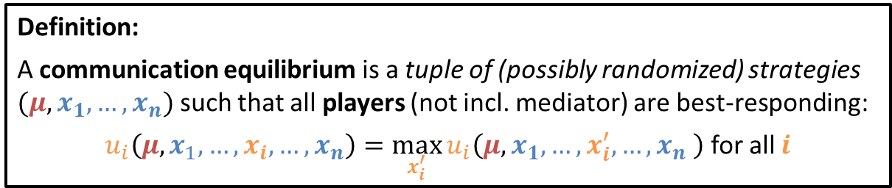
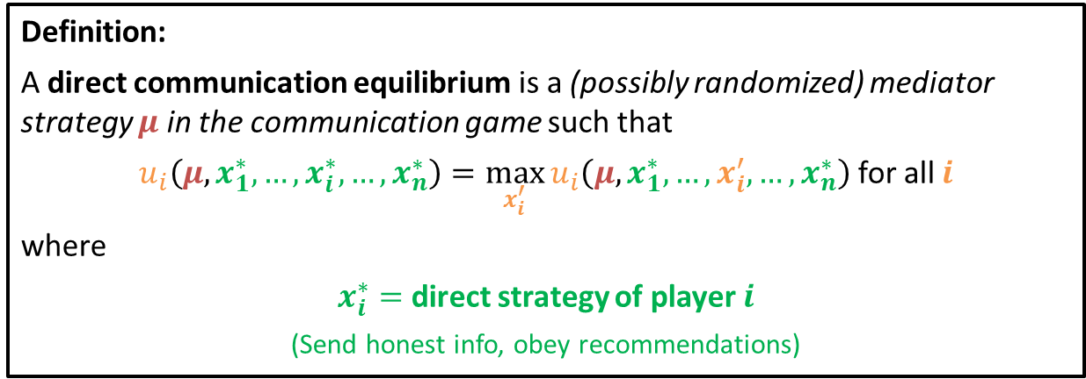
Step 3: Solving the Game
Definition:
A communication equilibrium is a tuple of (possibly randomized) strategies $(μ,x_{1},…, x_{n})$ such that all players (not incl. mediator) are best-responding:
$u_{i}\left(μ,x_{1},…,x_{i},…,x_{n}\right)=\max_{x_{i}^{′}}{u_{i}\left(μ,x_{1}, …,x_{i}^{′},…,x_{n} \right)}$ for all $i$
Steps 1 & 2
Definition:
A direct communication equilibrium is a (possibly randomized) mediator strategy $μ$ in the communication game such that
$u_{i}\left(μ,x_{1}^{∗},…,x_{i}^{∗},…,x_{n}^{∗}\right)=\max_{x_{i}^{′}}{u_{i}\left(μ,x_{1}^{∗},…,x_{i}^{′},…,x_{n}^{∗}\right)}$ for all $i$
where
$x_{i}^{∗}=$ direct strategy of player $i$
(Send honest info, obey recommendations)

Slide 29
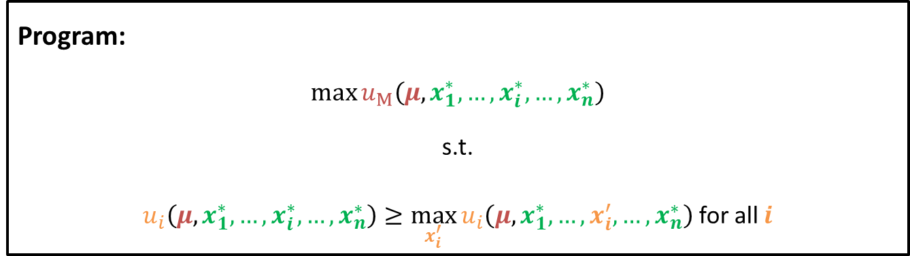


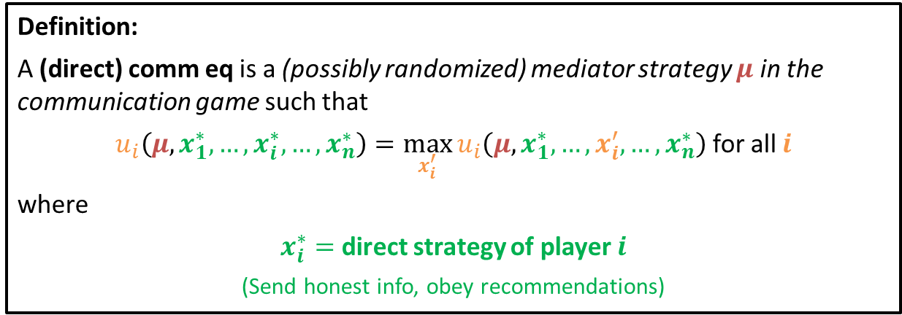

Step 3: Solving the Game
Program:
$$\max{u_{M}\left(μ,x_{1}^{∗},…,x_{i}^{∗},…,x_{n}^{∗}\right)}$$
s.t.
$u_{i}\left(μ,x_{1}^{∗},…,x_{i}^{∗},…,x_{n}^{∗}\right)≥\max_{x_{i}^{′}}{u_{i}\left(μ,x_{1}^{∗},…,x_{i}^{′},…,x_{n}^{∗}\right)}$ for all $i$
linear in $μ$
linear in $μ$
constants
bilinear in $μ$,$x_{i}^{′}$
Definition:
A (direct) comm eq is a (possibly randomized) mediator strategy $μ$ in the communication game such that
$u_{i}\left(μ,x_{1}^{∗},…,x_{i}^{∗},…,x_{n}^{∗}\right)=\max_{x_{i}^{′}}{u_{i}\left(μ,x_{1}^{∗},…,x_{i}^{′},…,x_{n}^{∗}\right)}$ for all $i$
where
$x_{i}^{∗}=$ direct strategy of player $i$
(Send honest info, obey recommendations)
Notes:
Voice over: make this a convex program -> duality -> LP!

Slide 30



Step 3: Solving the Game
Program:
$$\max{u_{M}\left(μ,x_{1}^{∗},…,x_{i}^{∗},…,x_{n}^{∗}\right)}$$
s.t.
$u_{i}\left(μ,x_{1}^{∗},…,x_{i}^{∗},…,x_{n}^{∗}\right)≥\max_{x_{i}^{′}}{u_{i}\left(μ,x_{1}^{∗},…,x_{i}^{′},…,x_{n}^{∗}\right)}$ for all $i$
linear in $μ$
$$c^{⊤}μ$$
linear in $μ$
bilinear in $μ$,$x_{i}^{′}$
$$b_{i}^{⊤}μ$$
$$\max_{x_{i}^{′}}{ μ^{⊤}A_{i}x_{i}^{′}}$$
Definition:
A (direct) comm eq is a (possibly randomized) mediator strategy $μ$ in the communication game such that
$u_{i}\left(μ,x_{1}^{∗},…,x_{i}^{∗},…,x_{n}^{∗}\right)=\max_{x_{i}^{′}}{u_{i}\left(μ,x_{1}^{∗},…,x_{i}^{′},…,x_{n}^{∗}\right)}$ for all $i$
where
$x_{i}^{∗}=$ direct strategy of player $i$
(Send honest info, obey recommendations)
Notes:
Voice over: make this a convex program -> duality -> LP!

Slide 31
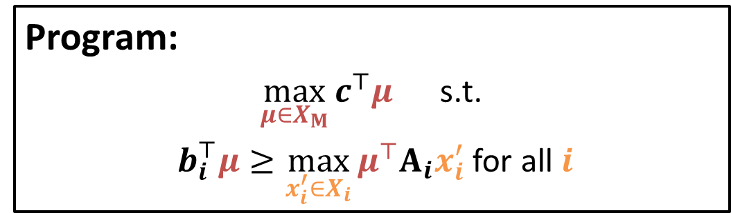
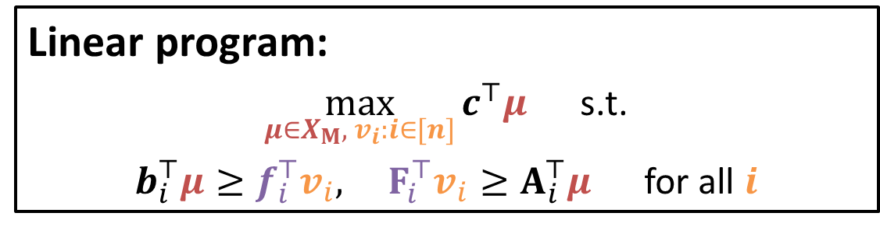
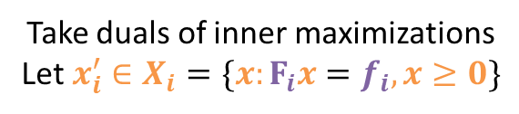
Step 3: Solving the Game
Program:
$\max_{μ∈X_{M}}{c^{⊤}μ }$ s.t.
$b_{i}^{⊤}μ≥\max_{x_{i}^{′}∈X_{i}}{μ^{⊤}A_{i}x_{i}^{′}}$ for all $i$
Take duals of inner maximizations
Let ${x_{i}^{′}∈X}_{i}=\{x:F_{i}x=f_{i},x≥0\}$
Linear program:
$\max_{μ∈X_{M}, v_{i}:i∈[n]}{c^{⊤}μ }$ s.t.
$b_{i}^{⊤}μ≥f_{i}^{⊤}v_{i},$ $F_{i}^{⊤}v_{i}≥A_{i}^{⊤}μ$ for all $i$

Slide 32
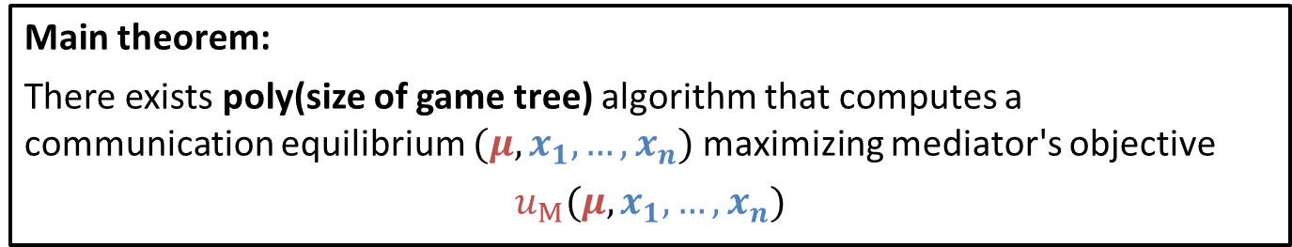
Recap
Main theorem:
There exists poly(size of game tree) algorithm that computes a communication equilibrium $(μ,x_{1},…,x_{n})$ maximizing mediator's objective
$$u_{M}(μ,x_{1},…,x_{n})$$
Polytime algorithms for:
Optimal sequential mechanism design
Optimal sequential information design
…and more!
Optimal "certification equilibria" [Forges & Koessler, J Math Econ'05]
Optimal "mediated equilibria" [Monderer & Tennenholtz, AI'09]
Notes:
Say in words: I use RP in a more simple way here; this is more general as I show in the full paper
add more notions?

Slide 33
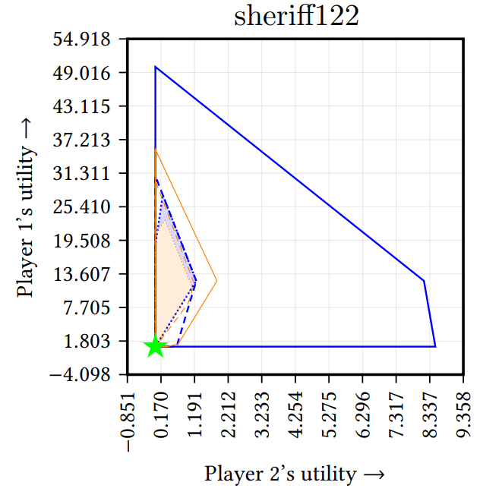
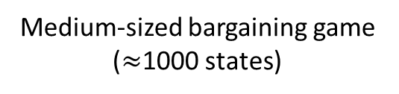
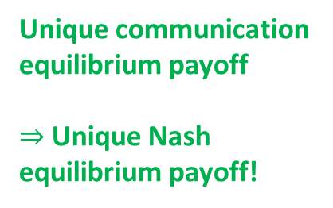
Experiments: Payoff Space Plots
Medium-sized bargaining game ($≈$1000 states)
Unique communication equilibrium payoff
$⇒$Unique Nash equilibrium payoff!
Other notions of equilibrium
★ Communication equilibrium
Notes:
explain axes,
say that the area (not the boundary) shows the various concepts
remark that Nash computation is hard (some of these other notions were explicitly motivated by hardness of Nash computation); I didn't actually know the unique Nash before running alg

Slide 34
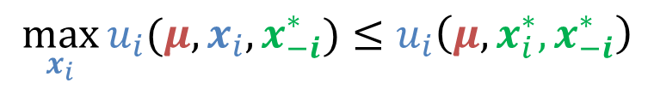
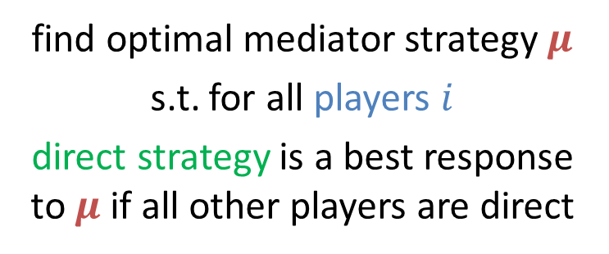
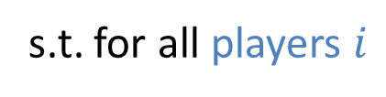
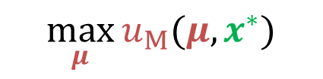
A Lagrangian-Based Method
find optimal mediator strategy $μ$
s.t. for all players $i$
direct strategy is a best response to $μ$ if all other players are direct
$$\max_{μ}{u_{M}(μ,x^{∗})}$$
s.t. for all players $i$
$$\max_{x_{i}}{u_{i}(μ,x_{i},x_{−i}^{∗})}≤u_{i}\left(μ,x_{i}^{∗},x_{−i}^{∗}\right)$$

Slide 35


A Lagrangian-Based Method
find optimal mediator strategy $μ$
s.t. for all players $i$
direct strategy is a best response to $μ$ if all other players are direct
$$\max_{μ}{u_{M}(μ,x^{∗})}$$
s.t. for all players $i$
$$\max_{x_{i}}{u_{i}(μ,x_{i},x_{−i}^{∗})}≤u_{i}\left(μ,x_{i}^{∗},x_{−i}^{∗}\right)$$
$$\max_{μ}{\min_{i, x_{i}}{u_{M}\left(μ,x^{∗}\right)−λ⋅\left[u_{i}\left(μ,x_{i},x_{−i}^{∗}\right)−u_{i}\left(μ,x_{i}^{∗},x_{−i}^{∗}\right)\right]}}$$
This is a zero-sum game!
Proposition: There exists $λ^{∗}>0$ s.t. for all $λ>λ^{∗}$:
Equilibrium strategy for max-player of this zero-sum game | $$≡$$ | Optimal correlated equilibrium of original game

Slide 36
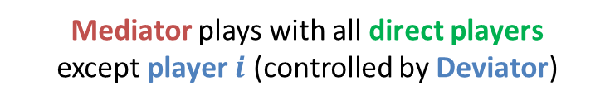

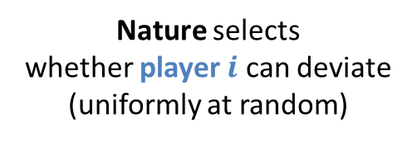





The Lagrangian as an Extensive-Form Game
mediator (Max)
Deviator selects
a player to represent
P1
P2
deviator (Min)
Nature selects
whether player $i$ can deviate
(uniformly at random)
$$z$$
$$z$$
$$z$$
$$z$$
zero-sum game
utility function:
$$2u_{M}\left(z\right)+2λu_{i}\left(z\right)$$
$$−2λu_{i}\left(z\right)$$
Mediator plays with
all direct players
Mediator plays with all direct players
except player $i$ (controlled by Deviator)
$$\max_{μ}{\min_{i, x_{i}}{u_{M}\left(μ,x^{∗}\right)−λ⋅\left[u_{i}\left(μ,x_{i},x_{−i}^{∗}\right)−u_{i}\left(μ,x_{i}^{∗},x_{−i}^{∗}\right)\right]}}$$

Slide 37
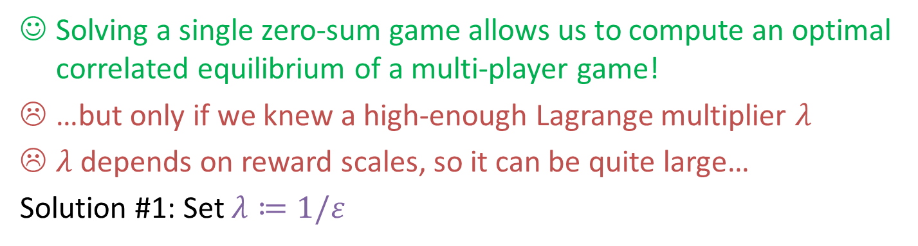
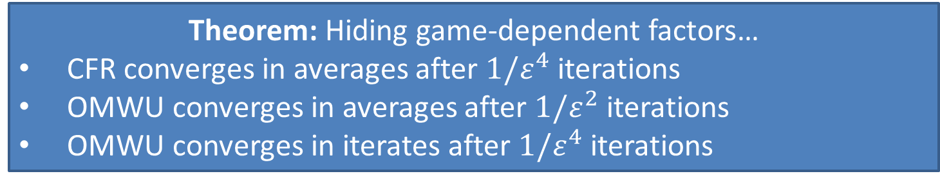
The Lagrangian as an Extensive-Form Game
Solving a single zero-sum game allows us to compute an optimal correlated equilibrium of a multi-player game!
…but only if we knew a high-enough Lagrange multiplier $λ$
$λ$ depends on reward scales, so it can be quite large…
Solution #1: Set $λ≔1/ε$
Theorem: Hiding game-dependent factors…
CFR converges in averages after $1/ε^{4}$ iterations
OMWU converges in averages after $1/ε^{2}$ iterations
OMWU converges in iterates after $1/ε^{4}$ iterations
$$\max_{μ}{\min_{i, x_{i}}{u_{M}\left(μ,x^{∗}\right)−λ⋅\left[u_{i}\left(μ,x_{i},x_{−i}^{∗}\right)−u_{i}\left(μ,x_{i}^{∗},x_{−i}^{∗}\right)\right]}}$$

Slide 38
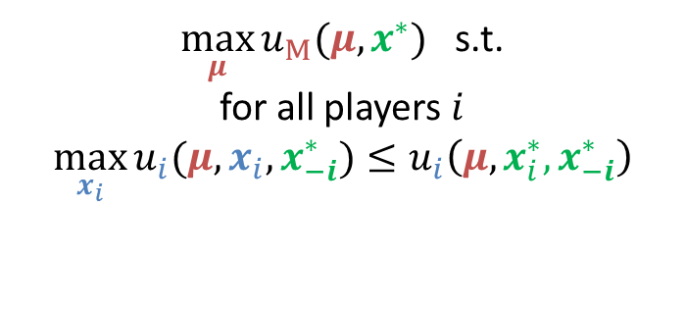
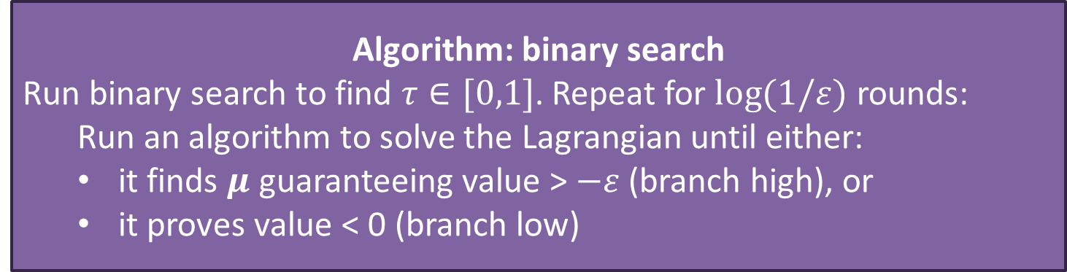

Solution #2: An Alternative Lagrangian
$\max_{μ}{u_{M}(μ,x^{∗})}$ s.t.
for all players $i$
$$\max_{x_{i}}{u_{i}(μ,x_{i},x_{−i}^{∗})}≤u_{i}\left(μ,x_{i}^{∗},x_{−i}^{∗}\right)$$
find $μ$ s.t.
$$u_{M}\left(μ,x^{∗}\right)≥τ$$
and for all players $i$
$\max_{x_{i}}{u_{i}(μ,x_{i},x_{−i}^{∗})}≤u_{i}\left(μ,x_{i}^{∗},x_{−i}^{∗}\right)$
Algorithm: binary search
Run binary search to find $τ∈[0,1]$. Repeat for $log(1/ε)$ rounds:
  Run an algorithm to solve the Lagrangian until either:
  it finds $μ$ guaranteeing value > $−ε$ (branch high), or
  it proves value < 0 (branch low)
Lagrangian value 0 iff exists equilibrium $μ$ of value $≥τ$
$$\max_{μ}{\min_{i, x_{i}}{u_{M}\left(μ,x^{∗}\right)−λ⋅\left[u_{i}\left(μ,x_{i},x_{−i}^{∗}\right)−u_{i}\left(μ,x_{i}^{∗},x_{−i}^{∗}\right)\right]}}$$

Slide 39

Solution #2: An Alternative Lagrangian
Theorem:
The last $μ$ found by the binary search algorithm is an $ε$-equilibrium
whose mediator objective is at least $v^{∗}−O\left(ε\right)$
(where $v^{∗}$ = optimal equilibrium mediator objective)
Algorithm: binary search
Run binary search to find $τ∈[0,1]$. Repeat for $log(1/ε)$ rounds:
  Run an algorithm to solve the Lagrangian until either:
  it finds $μ$ guaranteeing value > $−ε$ (branch high), or
  it proves value < 0 (branch low)
Lagrangian value 0 iff exists equilibrium $μ$ of value $≥τ$
$$\max_{μ}{\min\left\{u_{M}\left(μ,x^{∗}\right)−τ,\underset{i,x_{i}}{\overset{}{−max}}\left[u_{i}\left(μ,x_{i},x_{−i}^{∗}\right)−u_{i}\left(μ,x_{i}^{∗},x_{−i}^{∗}\right)\right]\right\}}$$

Slide 40










The Alternative Lagrangian as an Extensive-Form Game
Deviator selects
a player to represent (or none)
P1
P2
none
Deviator's mixed strategy probability for this edge is ~1/$λ$
Nature selects
whether player $i$ can deviate
(uniformly at random)
$$z$$
$$z$$
$$z$$
$$z$$
$$z$$
zero-sum game
utility function:
$$u_{M}\left(z\right)−τ$$
$$2u_{i}\left(z\right)$$
$$−2u_{i}\left(z\right)$$
Mediator plays with
all direct players
Mediator plays with all direct players
except player $i$ (controlled by Deviator)
$$\max_{μ}{\min\left\{u_{M}\left(μ,x^{∗}\right)−τ,\underset{i,x_{i}}{\overset{}{−max}}\left[u_{i}\left(μ,x_{i},x_{−i}^{∗}\right)−u_{i}\left(μ,x_{i}^{∗},x_{−i}^{∗}\right)\right]\right\}}$$

Slide 41


Which is Better?
41
"Direct" Lagrangian
"Binary Search" Lagrangian
Can be formulated as an extensive-form zero-sum game
Need to solve one game
Last-iterate convergence is possible
$O(1/ε^{2})$ convergence rate (with OMWU)
Extensive-form Lagrangian game has utilities whose scale depends on $λ$
Can be formulated as an extensive-form zero-sum game
Need to solve $log⁡(1/ε)$ games
Unclear what last-iterate convergence even means
$\tilde{O}(1/ε)$ convergence rate (with OMWU)
Extensive-form Lagrangian game has utilities bounded by absolute constant
If you can solve zero-sum games, you can compute optimal equilibria in various notions, optimal mechanisms, etc!
Amenable to deep RL!
This really matters in practice:
deep learning solvers aren't really good at high precision!

Slide 42

Experiments in the Tabular Setting (not deep RL):
Learning scales better than LP!
Here, we used our “direct Lagrangian” algorithm.

Slide 43


Experiments on back-to-back auctions among budget-constrained bidders
2 items. Valuations of 2nd item drawn after 1st auction.
Used tabular CFR+ to solve
4 items. Valuations drawn after previous auction.
Used deep learning to solve
binary search Lagrangians!
$FP$ = first price (highly exploitable, as expected, but revenue-maximizing if bidders are truthful)
$SP$ = second price with no reserve
$R_{p}$ = second price with reserve price $p$

Slide 44
Bibliographic Notes
Many special cases independently analyzed as separate problems.
This talk can be viewed as a unifying framework for these results & more!
LP-based algorithms for finding optimal equilibria:
Mechanism design
  Single-shot [Conitzer & Sandholm UAI 2002; Sandholm CP 2003]
  One player [Zhang & Conitzer NeurIPS 2021]
  Auctions [Papadimitriou, Pierrakos, Psomas, Rubinstein GEB 2014]
Sequential information design
  One player [Gan, Majumdar, Radanovic, Singla AAAI 2022]
  Multiple myopic players [Wu, Zhang, Feng, Wang, Yang, Jordan EC 2022]
Optimal correlated equilibria [Zhang, Farina, Celli, Sandholm EC 2022]
Lagrangians:
"Direct" Lagrangian in the single-step mechanism design case
    [Dütting, Feng, Narasimhan, Parkes, Ravindranath JACM 2023]
"Binary search" Lagrangian stated (but not analyzed) for EFCE and NFCCE
    [Farina, Ling, Fang, Sandholm NeurIPS 2019]

Slide 45

Bibliographic Notes
No-regret learning algorithms for computing one equilibrium
  Extensive-form correlated equilibrium
    [Farina, Celli, Marchesi, Gatti JACM 2022]
  Communication equilibrium
    [Fujii arXiv 2023]
  Linear correlated equilibrium
    [Farina & Pipis NeurIPS 2023; Zhang, Farina, Sandholm ICLR 2024]
  Normal-form correlated equilibrium
    $n^{\tilde{O}(1/ε)}$ convergence rate, where n is the number of nodes
    [Peng & Rubinstein arXiv 2023; Dagan, Daskalakis, Fishelson & Golowich arXiv 2023]
    Open: can $poly(n,1/ε)$ rate be achieved as in the other equilibrium concepts above?
Other applications of mediators:
  Team-correlated equilibria in adversarial team games
    [Carminati, Cacciamani, Ciccone, Gatti ICML 2022]
    [Zhang, Farina, Sandholm ICML 2023]
    [Zhang & Sandholm AAAI 2022]
  Hidden-role games, such as Avalon
    [Carminati, Zhang, Farina, Gatti, Sandholm arXiv 2023]
Future research: Large-scale experiments (e.g., in sequential auctions) with deep RL?

Slide 46
Bonus:
Extensive-Form Correlated Equilibria
"Signalling game": P1 knows some information and can choose whether or not to send it to P2
Information design: Mediator knows P1's private info; can leak it to P2 even against P1's will
Extensive-form correlated equilibria: Mediator prohibited from leaking information
Equivalently (by revelation principle): Mediator's strategy must be a distribution over player strategy profiles
"The only thing the mediator can do is generate and share randomness with which players can correlate"
Problem: Mediator has "imperfect recall"

