Slide 1
Team games
Brian Hu Zhang

Slide 2





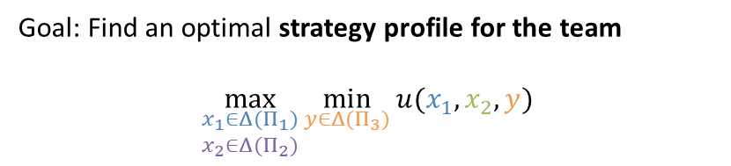




What are team games?
P1 and P2 are teammates (same utility function)
$$\max_{\begin{aligned}x_{1}∈Δ(Π_{1}) \\ x_{2}∈Δ(Π_{2})\end{aligned}}{\min_{x_{3}∈Δ(Π_{3})}{u(x_{1},x_{2},y)}}$$
1
1
$$\overline{x} ≔1−x$$
$a$ $b$
$$=\max_{a,b,c,d∈[0,1]}{\min_{e,f∈[0,1]}{\frac{1}{2}\left(ac\overline{e}+\overline{a}d\overline{f}+b\overline{c}e+\overline{b}\overline{d}f\right)}}$$
2
2
2
2
$$≤\max_{a,b,c,d}{\frac{1}{2}\left(ac\overline{c}+\overline{a}d\overline{d}+b\overline{c}c+\overline{b}\overline{d}d\right)}$$
$$e←c, \\ f←d$$
$c$ $c$ $d$ $d$
0
0
0
0
$$≤\frac{1}{2}⋅\frac{1}{4}⋅\left(a+\overline{a}+b+\overline{b}\right)=\frac{1}{4}$$
$$x\overline{x}=x\left(1−x\right)≤\frac{1}{4}$$
3
3
3
3
$e$ $e$ $f$ $f$
(in fact, $=1/4$ by setting $a=b=c=d=1/2$)
0
1
1
0
0
1
1
0
“Communication game”: P1 must send one bit of information to P2 without P3 knowing
Goal: Find an optimal strategy profile for the team
$$\max_{\begin{aligned}x_{1}∈Δ(Π_{1}) \\ x_{2}∈Δ(Π_{2})\end{aligned}}{\min_{y∈Δ(Π_{3})}{u(x_{1},x_{2},y)}}$$

Slide 3




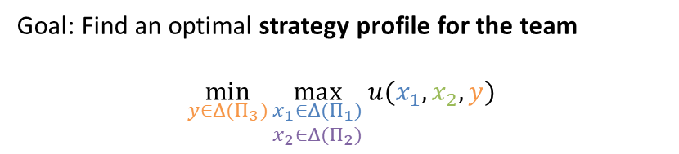



What are team games?
P1 and P2 are teammates (same utility function)
$$\min_{y∈Δ(Π_{3})} \max_{\begin{aligned}x_{1}∈Δ(Π_{1}) \\ x_{2}∈Δ(Π_{2})\end{aligned}}{u(x_{1},x_{2},y)}$$
1
1
$a$ $b$
$$=\min_{e,f}\max_{a,b,c,d}{\frac{1}{2}\left(ac\overline{e}+\overline{a}d\overline{f}+b\overline{c}e+\overline{b}\overline{d}f\right)}$$
2
2
2
2
either $a=c=0, b=d=1$
or $a=c=1, b=d=0$
$$≥\frac{1}{2}\min_{e,f}\max\left\{\overline{f}+e,\overline{e}+f\right\}$$
$c$ $c$ $d$ $d$
0
0
0
0
$$=\frac{1}{2}$$
set $e=f$ so that $\overline{f}+e=\overline{e}+f=1$
3
3
3
3
$e$ $e$ $f$ $f$
$$>\frac{1}{4}$$
Why?
0
1
1
0
0
1
1
0
“Communication game”: P1 must send one bit of information to P2 without P3 knowing
Goal: Find an optimal strategy profile for the team
$$\min_{y∈Δ(Π_{3})}\max_{\begin{aligned}x_{1}∈Δ(Π_{1}) \\ x_{2}∈Δ(Π_{2})\end{aligned}}{u(x_{1},x_{2},y)}$$
?

Slide 4
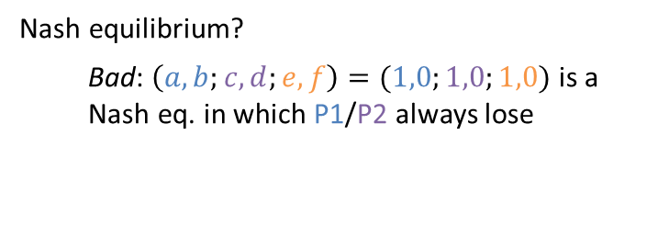
Solution concepts for team games
P1 and P2 are teammates (same utility function)
Nash equilibrium?
  Bad: $\left(a,b;c,d;e,f\right)=(1,0;1,0;1,0)$ is a Nash eq. in which P1/P2 always lose
1
1
$a$ $b$
2
2
2
2
$c$ $c$ $d$ $d$
0
0
0
0
3
3
3
3
$e$ $e$ $f$ $f$
0
1
1
0
0
1
1
0
“Communication game”: P1 must send one bit of information to P2 without P3 knowing

Slide 5
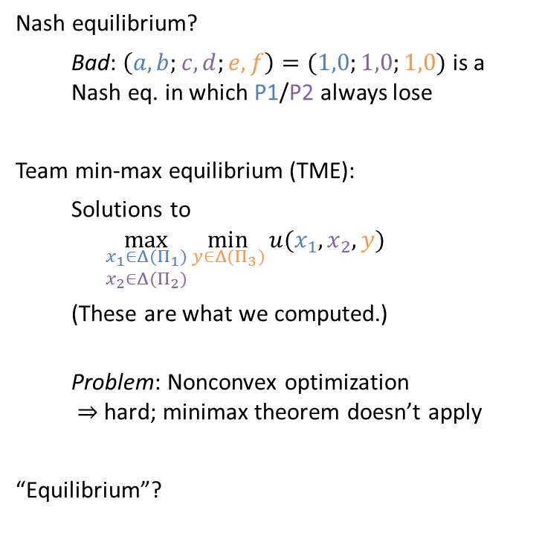
Solution concepts for team games
P1 and P2 are teammates (same utility function)
Nash equilibrium?
  Bad: $\left(a,b;c,d;e,f\right)=(1,0;1,0;1,0)$ is a Nash eq. in which P1/P2 always lose
Team min-max equilibrium (TME):
  Solutions to
  $$\max_{\begin{aligned}x_{1}∈Δ(Π_{1}) \\ x_{2}∈Δ(Π_{2})\end{aligned}}{\min_{y∈Δ(Π_{3})}{u(x_{1},x_{2},y)}}$$
  (These are what we computed.)
  Problem: Nonconvex optimization
  $⇒$ hard; minimax theorem doesn’t apply
“Equilibrium”?
1
1
$a$ $b$
2
2
2
2
$c$ $c$ $d$ $d$
0
0
0
0
3
3
3
3
$e$ $e$ $f$ $f$
0
1
1
0
0
1
1
0
“Communication game”: P1 must send one bit of information to P2 without P3 knowing

Slide 6
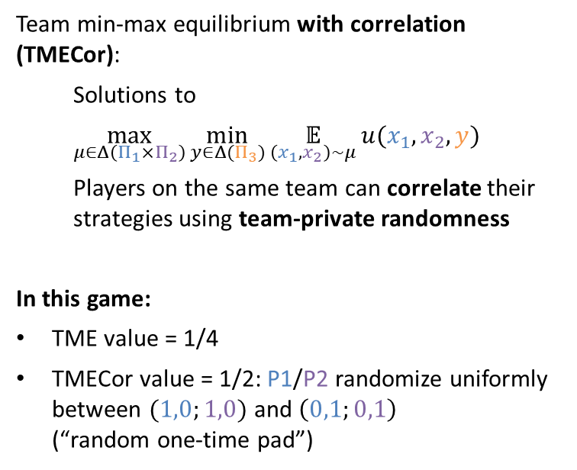
Solution concepts for team games
P1 and P2 are teammates (same utility function)
Team min-max equilibrium with correlation (TMECor):
  Solutions to
  $$\max_{μ∈Δ\left(Π_{1}×Π_{2}\right)}{\min_{y∈Δ(Π_{3})}{\underset{\left(x_{1},x_{2}\right)∼μ}{𝔼}{u(x_{1},x_{2},y)}}}$$
  Players on the same team can correlate their strategies using team-private randomness
In this game:
TME value = 1/4
TMECor value = 1/2: P1/P2 randomize uniformly between $(1,0;1,0)$ and $\left(0,1;0,1\right)$
(“random one-time pad”)
1
1
$a$ $b$
2
2
2
2
$c$ $c$ $d$ $d$
0
0
0
0
3
3
3
3
$e$ $e$ $f$ $f$
0
1
1
0
0
1
1
0
“Communication game”: P1 must send one bit of information to P2 without P3 knowing
TME | TMECor
nonconvex optimization problem | convex optimization problem (bilinear saddle point)
minimax theorem fails | minimax theorem holds

Slide 7
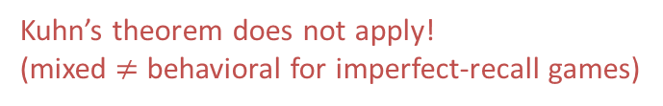
Equivalently: (Timeable) two-player zero-sum games of imperfect recall
Team games | Imperfect-recall games
team | player
strategy profile for team | strategy for player
uncorrelated strategy profile | behavioral strategy
correlated strategy profile | mixed strategy
TME | optimal behavioral strategy
TMECor | mixed Nash equilibrium
1
1
1
1
1
1
0
0
0
0
2
2
2
2
Kuhn’s theorem does not apply!
(mixed $≠$ behavioral for imperfect-recall games)
0
1
1
0
0
1
1
0
Question for remainder of class: When can we compute TMECor efficiently?

Slide 8
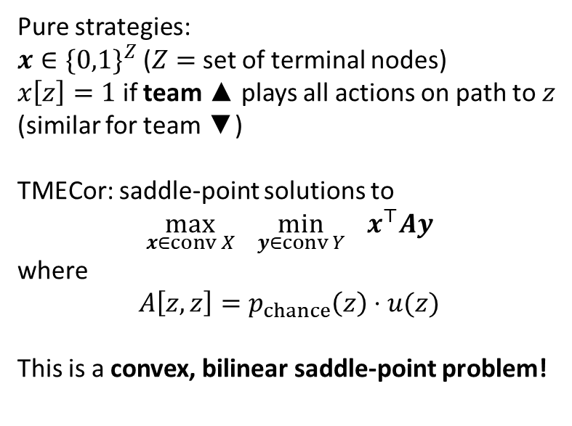

Representing strategy profiles of a team: Realization form
Pure strategies:
$x∈{\{0,1\}}^{Z}$ ($Z=$ set of terminal nodes)
$x\left[z\right]=1$ if team ▲ plays all actions on path to $z$
(similar for team ▼)
TMECor: saddle-point solutions to
$$\max_{x∈conv X}{ \min_{y∈conv Y}{ x^{⊤}Ay}}$$
where
$$A\left[z,z\right]=p_{chance}\left(z\right)⋅u(z)$$
This is a convex, bilinear saddle-point problem!
1
1
$a$ $b$
2
2
2
2
$c$ $c$ $d$ $d$
$$a\overline{c} bc \overline{a}\overline{d} \overline{b}d$$
$$ac ac b\overline{c} b\overline{c} \overline{a}d \overline{a}d \overline{b}\overline{d} \overline{b}\overline{d}$$
Intuition: if both teams have one player, this is the same as the sequence-form max-min problem
(modulo a linear transformation)

Slide 9

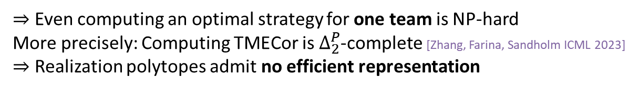
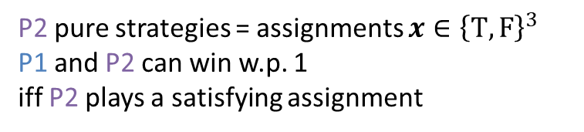

Computing TMECor is hard
$$φ\left(x_{1},x_{2},x_{3}\right)=\left(x_{1}∨x_{2}\right)∧(¬x_{1}∨x_{3})$$
chance picks the clause
P1 picks a variable in that clause
P2 learns the variable (but not the clause) and assigns T or F
1
1
$x_{1}$ $x_{2}$ $x_{1}$ $x_{3}$
2
2
2
2
T F T F T F T F
1
0
0
1
1
0
1
0
P2 pure strategies = assignments $x∈{\left\{T,F\right\}}^{3}$
P1 and P2 can win w.p. 1
iff P2 plays a satisfying assignment
$⇒$ Even computing an optimal strategy for one team is NP-hard
More precisely: Computing TMECor is $Δ_{2}^{P}$-complete [Zhang, Farina, Sandholm ICML 2023]
$⇒$ Realization polytopes admit no efficient representation

Slide 10
Can we do anything?
Idea #1: Run PSRO.
Problem: Team best responses are hard…
But maybe for sufficiently large games, this is the only possible thing
McAleer, Farina, Zhou, Wang, Yang, Sandholm (NeurIPS 2023)

Slide 11
Can we do anything?
[Zhang, Farina, Sandholm ICML 2023]
Idea: Construct single-player decision problem (like sequence form) by representing what is common knowledge for the team
AB
A
B
CD
CF
DE
EF
C
D
E
F
C
CD
D
E
F
G
H
I
J
K
L
M
N
G
H
GI
HJ
I
J
K
L
M
N
G
H
I
J

Slide 12
Can we do anything?
[Zhang, Farina, Sandholm ICML 2023]
Idea: Construct single-player decision problem (like sequence form) by representing what is common knowledge for the team
Decision point (“belief”): identified by a set of nodes (for perfect recall: an infoset)
AB
A
B
CD
CF
DE
EF
C
D
E
F
C
CD
D
E
F
G
H
I
J
K
L
M
N
G
H
GI
HJ
I
J
K
L
M
N
G
H
I
J

Slide 13
Can we do anything?
[Zhang, Farina, Sandholm ICML 2023]
Idea: Construct single-player decision problem (like sequence form) by representing what is common knowledge for the team
Prescription: selection of one action per infoset intersecting the decision point
AB
A
B
CD
CF
DE
EF
C
D
E
F
C
CD
D
E
F
G
H
I
J
K
L
M
N
G
H
GI
HJ
I
J
K
L
M
N
G
H
I
J

Slide 14
Can we do anything?
[Zhang, Farina, Sandholm ICML 2023]
Idea: Construct single-player decision problem (like sequence form) by representing what is common knowledge for the team
Observation point: also identified with set of nodes
AB
A
B
CD
CF
DE
EF
C
D
E
F
C
CD
D
E
F
G
H
I
J
K
L
M
N
G
H
GI
HJ
I
J
K
L
M
N
G
H
I
J

Slide 15
Can we do anything?
[Zhang, Farina, Sandholm ICML 2023]
Idea: Construct single-player decision problem (like sequence form) by representing what is common knowledge for the team
Observation point: also identified with set of nodes
AB
A
B
CD
CF
DE
EF
C
D
E
F
C
CD
D
E
F
G
H
I
J
K
L
M
N
G
H
GI
HJ
I
J
K
L
M
N
G
H
I
J

Slide 16
Can we do anything?
[Zhang, Farina, Sandholm ICML 2023]
Idea: Construct single-player decision problem (like sequence form) by representing what is common knowledge for the team
Public observation: Team observes information that is common knowledge to all team members
AB
A
B
CD
CF
DE
EF
C
D
E
F
C
CD
D
E
F
G
H
I
J
K
L
M
N
G
H
GI
HJ
I
J
K
L
M
N
G
H
I
J

Slide 17
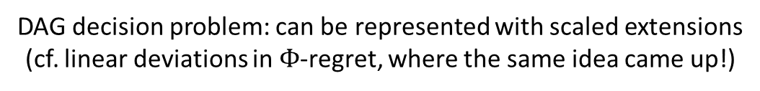
Can we do anything?
[Zhang, Farina, Sandholm ICML 2023]
Idea: Construct single-player decision problem (like sequence form) by representing what is common knowledge for the team
AB
A
B
CD
CF
DE
EF
C
D
E
F
C
CD
D
E
F
G
H
I
J
K
L
M
N
G
H
GI
HJ
I
J
K
L
M
N
G
H
I
J
DAG decision problem: can be represented with scaled extensions
(cf. linear deviations in $Φ$-regret, where the same idea came up!)
“Team belief DAG” (TB-DAG)

Slide 18
How big is the TB-DAG?
[Zhang, Farina, Sandholm ICML 2023]
Size is dominated by observation points.
How many observation points (i.e., (decision point, prescription) pairs) are there?
AB
A
B
CD
CF
DE
EF
C
D
E
F
C
CD
D
E
F
G
H
I
J
K
L
M
N
G
H
GI
HJ
I
J
K
L
M
N
Public states (common-knowledge sets)
G
H
I
J

Slide 19
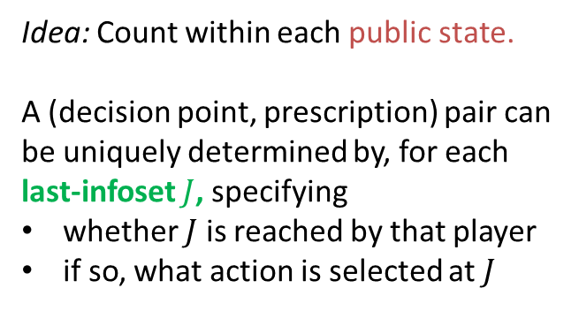
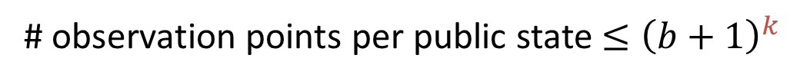

How big is the TB-DAG?
[Zhang, Farina, Sandholm ICML 2023]
Size is dominated by observation points.
How many observation points (i.e., (decision point, prescription) pairs) are there?
Idea: Count within each public state.
A (decision point, prescription) pair can be uniquely determined by, for each last-infoset $J$, specifying
whether $J$ is reached by that player
if so, what action is selected at $J$
1
unreached by P1
1
2
2
reached, P2 plays L
3
3
3
3
reached, P3 plays R
reached, P3 plays L
number of last-infosets
1
1
observation point contains only this node
branching factor
# observation points per public state $≤{\left(b+1\right)}^{k}$

Slide 20
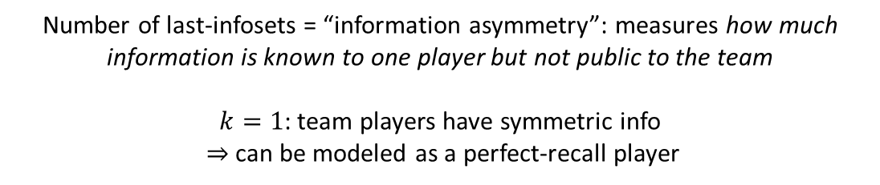
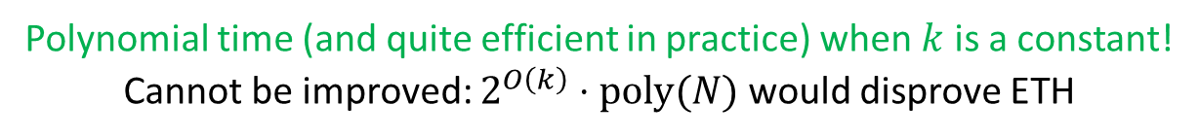

How big is the TB-DAG?
[Zhang, Farina, Sandholm ICML 2023]
Size is dominated by observation points.
How many observation points (i.e., (decision point, prescription) pairs) are there?
number of last-infosets
branching factor
# observation points per public state $≤{\left(b+1\right)}^{k}$
Number of last-infosets = “information asymmetry”: measures how much information is known to one player but not public to the team
$k=1$: team players have symmetric info
$⇒$ can be modeled as a perfect-recall player
tree size
CFR per-iteration runtime $∝$ size of TB-DAG $≤{\left(b+1\right)}^{k}⋅poly(N)$
Polynomial time (and quite efficient in practice) when $k$ is a constant!
Cannot be improved: $2^{O\left(k\right)}⋅poly(N)$ would disprove ETH

Slide 21
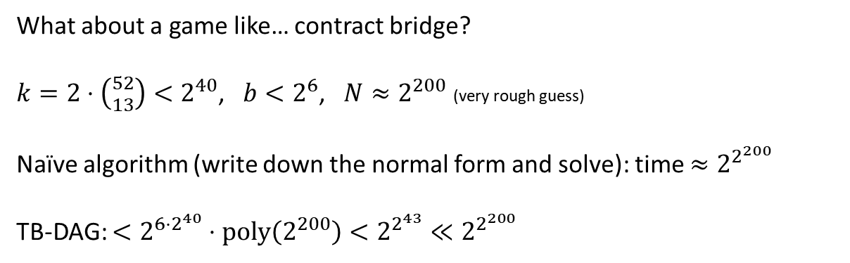
How big is the TB-DAG?
[Zhang, Farina, Sandholm ICML 2023]
CFR per-iteration runtime $∝$ size of TB-DAG $≤{\left(b+1\right)}^{k}⋅poly(N)$
What about a game like… contract bridge?
$k=2⋅\left({52 \atop 13}\right)<2^{40}$, $b<2^{6}$, $N≈2^{200}$ (very rough guess)
Naïve algorithm (write down the normal form and solve): time $≈2^{2^{200}}$
TB-DAG: $<2^{6⋅2^{40}}⋅poly\left(2^{200}\right)<2^{2^{43}}≪2^{2^{200}}$

Slide 22
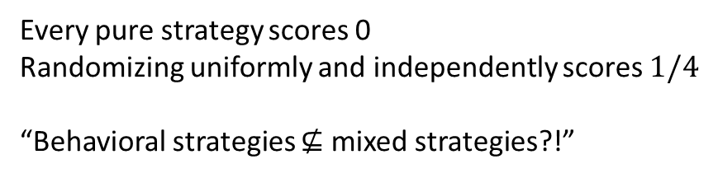
Why timeability?
Partial answer:
Untimeable games of imperfect recall are weird…
1
Every pure strategy scores 0
Randomizing uniformly and independently scores $1/4$
“Behavioral strategies $⊈$ mixed strategies?!”
1
0
0
1

Slide 23
Hidden-role games
Luca Carminati*, Brian Hu Zhang*, Gabriele Farina, Nicola Gatti, Tuomas Sandholm (EC 2024) “Hidden-Role Games: Equilibrium Concepts and Computation”

Slide 24



What Are Hidden-Role Games?
a.k.a. social deduction games
Adversarial team games in which one team ("Good") does not know who its teammates are.
Emphasis on communication: Players are free to talk to each other (e.g., to establish trust and coordinate actions), but Good players don't know whether they are talking to a Bad player!
+ more applications: distributed systems, network security, federated learning, …

Slide 25
Solution Concepts for
Hidden-Role Games
Can we just use…
Nash equilibrium?
  Most basic notion of equilibrium
  Problem: Nash doesn't capture team coordination.
  (If there is only one team (Good or Bad), we want to capture the jointly-optimal strategy of the team, not simply a Nash equilibrium)
Team-correlated equilibrium?
  Most natural concept when teams are common knowledge.
  Teammates can discuss strategy (incl. flipping random coins, i.e., correlating) before the game begins
  Problem: in hidden-role games, before the game begins, you don't even know your teammates!
We need a new solution concept!

Slide 26
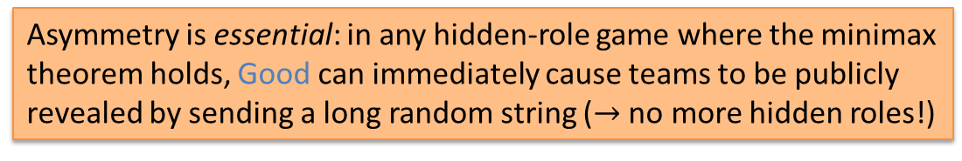
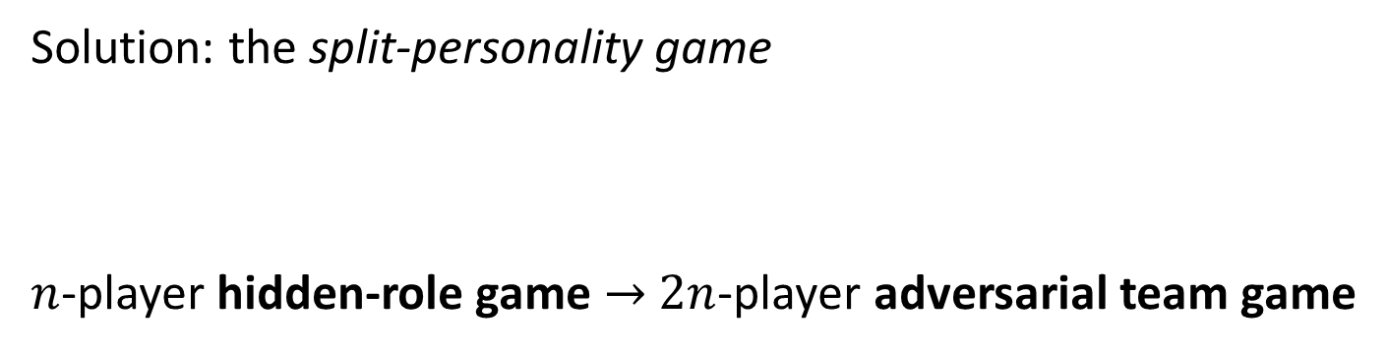
Solution Concepts for
Hidden-Role Games
Bad-P1
Solution: the split-personality game
$n$-player hidden-role game $→$ $2n$-player adversarial team game
P1
Good-P1
Definition: Hidden-role equilibrium
= Team (uncorrelated) equilibrium of the split-personality game
= Optimal team strategy for the good team to commit to
Inherently asymmetric (no duality/minimax theorem)!
Asymmetry is essential: in any hidden-role game where the minimax theorem holds, Good can immediately cause teams to be publicly revealed by sending a long random string ($→$ no more hidden roles!)

Slide 27
Example
Good
Good
Bad
P1
P3
P2

Slide 28
Example
I'm bad
P1
…
…
…
I'm good
I'm good
P3
P2

Slide 29
Example
I'm bad
P1
I vote for myself!
I vote for myself!
I vote for P2!
I'm good
I'm good
P3
P2

Slide 30
Example
I'm bad
P1
I vote for myself!
Good player elected (Good players win)
I vote for myself!
I vote for P2!
I'm good
Good
I'm good
P3
P2

Slide 31
Example
I'm bad
Bad
P1
I vote for myself!
Bad player elected
(Bad player wins)
I vote for P1!
I vote for P2!
I'm good
I'm good
P3
P2

Slide 32
Example
I'm bad
P1
I vote for myself!
No consensus
(Bad player wins by default)
I vote for myself!
I vote for myself!
I'm good
I'm good
P3
P2

Slide 33
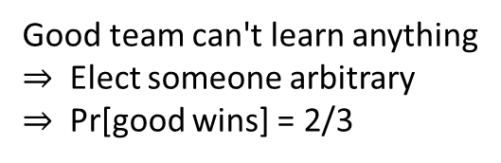
Example
I'm bad
I should pretend to be good
P1
Good team can't learn anything
$⇒$ Elect someone arbitrary
$⇒$ Pr[good wins] = 2/3
I'm good
I'm good
P3
P2

Slide 34
Example
Good
Good'
Bad
P1
One small change…
P3
P2

Slide 35
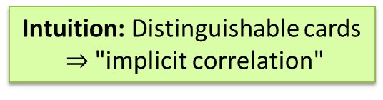
Example
I'm bad
P1
Uh oh…
If I claim to be good, they will elect good'
If I claim to be good', they will elect good
If I claim neither, they know I'm bad
I'm doomed!
Claim: Good team can win deterministically
Intuition: Distinguishable cards
$⇒$ "implicit correlation"
I'm good
I'm good'
I'm good
I'm good'
P3
P2

Slide 36
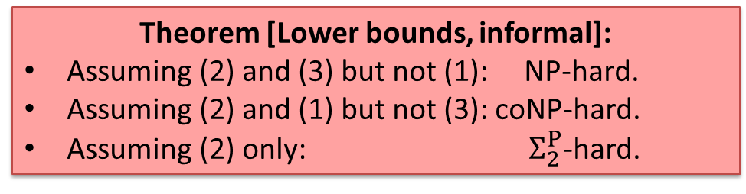
Computing Hidden-Role Equilibria
Team Bad is a minority if it has fewer players than Good
Team Bad is coordinated if (informally) the team "acts like it is being controlled by a single adversary controller"
Theorem [Main algorithmic result]:
There exists an efficient algorithm for computing hidden-role equilibria, assuming:
private communication is allowed,
Team Bad is a minority, and
Team Bad is coordinated,
Reasonable assumption: can be implemented with public communication + public-key crypto, assuming Bad is computationally bounded
Theorem [Lower bounds, informal]:
Assuming (2) and (3) but not (1): NP-hard.
Assuming (2) and (1) but not (3): coNP-hard.
Assuming (2) only: $Σ_{2}^{P}$-hard.
Open problem: What about assuming (1) and (3)?

Slide 37
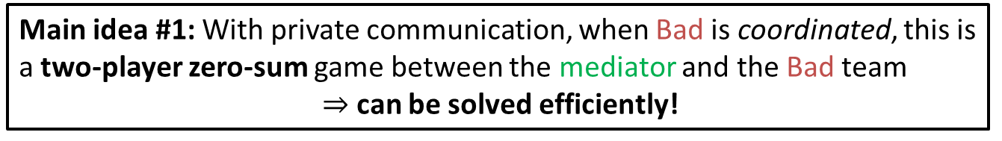
Proof Ideas for Main Theorem
Suppose that there is a player, who we call the mediator, who is always on the Good team.
Revelation principle:
True information
Action recommendations
Obey
recommendations
Mediator
(always good)
Possibly false information
Action recommendations
Possibly disobey
recommendations
Main idea #1: With private communication, when Bad is coordinated, this is a two-player zero-sum game between the mediator and the Bad team
$⇒$ can be solved efficiently!
Implies that game values of hidden-role games are rational under these assumptions!
Main idea #2: If there is no mediator, simulate one using multi-party computation! (requires minority Bad team + private communication)

Slide 38
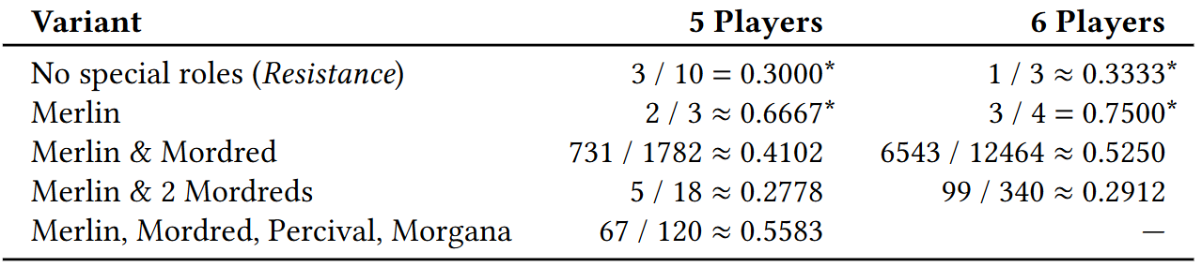
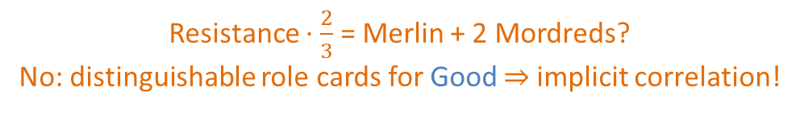
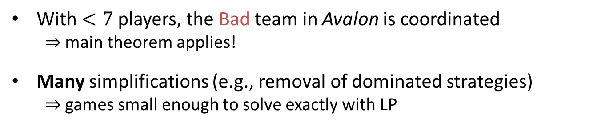
Application: Exact solving of Avalon
With $<7$ players, the Bad team in Avalon is coordinated
  $⇒$ main theorem applies!
Many simplifications (e.g., removal of dominated strategies)
  $⇒$ games small enough to solve exactly with LP
*: Known to Christiano [2018]
Resistance $⋅\frac{2}{3}$ = Merlin + 2 Mordreds?
No: distinguishable role cards for Good $⇒$implicit correlation!

Slide 39
Future Research
This is a new class of games for which we can reasonably define what it means to "solve" a game! Still many open questions & possible future directions:
(From earlier slide) Efficient algorithm or hardness result for the case of coordinated, non-minority Bad team and private communication?
Not even clear whether a finite-time alg exists if only public communication is allowed (how to bound the length of communication?)
  Especially important for practical interpretations, since humans playing these games often restrict ourselves to public communication + no crypto
Other messaging structures? (e.g., anonymous messages)?
What happens when both teams are hidden?
  Is there even a way to define hidden-role equilibria so that it does not depend on the seemingly-arbitrary choice of which team picks its strategy first?
Thank you!

Slide 40
References
Brian Hu Zhang, Gabriele Farina, Tuomas Sandholm (arXiv 2022; ICML 2023) “Team Belief DAG: Generalizing the Sequence Form to Team Games for Fast Computation of Correlated Team Max-Min Equilibria via Regret Minimization”
Stephen McAleer, Gabriele Farina, Gaoyue Zhou, Mingzhi Wang, Yaodong Yang, Tuomas Sandholm (NeurIPS 2023) “Team-PSRO for learning approximate TMECor in large team games via cooperative reinforcement learning”
Luca Carminati*, Brian Hu Zhang*, Gabriele Farina, Nicola Gatti, Tuomas Sandholm (EC 2024) “Hidden-Role Games: Equilibrium Concepts and Computation”

