Slide 1
Words
What constitutes a word? Does it matter?
Word tokens vs. word types; type-token curves
Zipf’s law, Mandlebrot’s law; explanation
Heterogeneity of language:
written vs. spoken
period, genre, register, domain
topic (hierarchy), speaker, audience
“uncertainty principle of language modeling”

Slide 2
Sub-language Example 1
“Wall Street Journal” Corpus (WSJ):
Newspaper articles, 1988-1992
Written English, rich vocabulary (leaning towards finance)
“Switchboard” Corpus (SWB):
Transcribed spoken conversations
over the telephone
Proscribed topic (one of 70)
1990’s
“Broadcast News” Corpus (BN):
Transcribed TV/Radio News programs
Spoken, but somewhat scripted

Slide 3
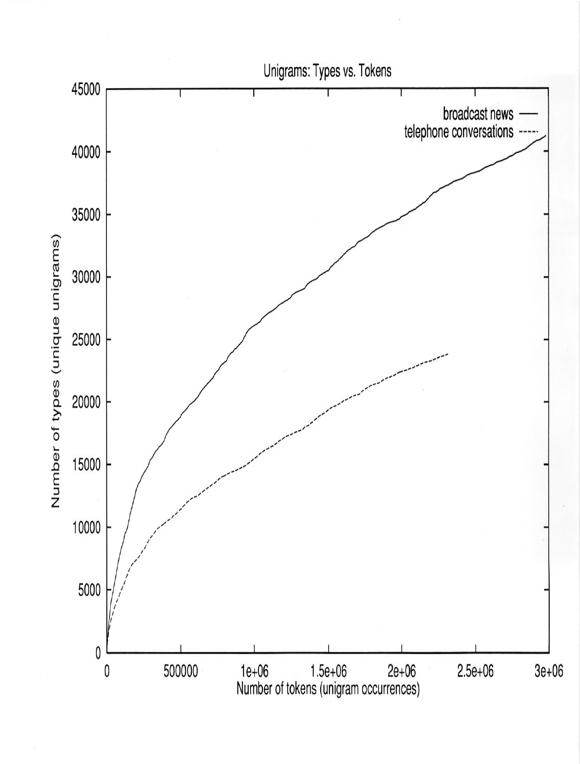
Unigram Type-Token Curve – BN vs. SWB

Slide 4
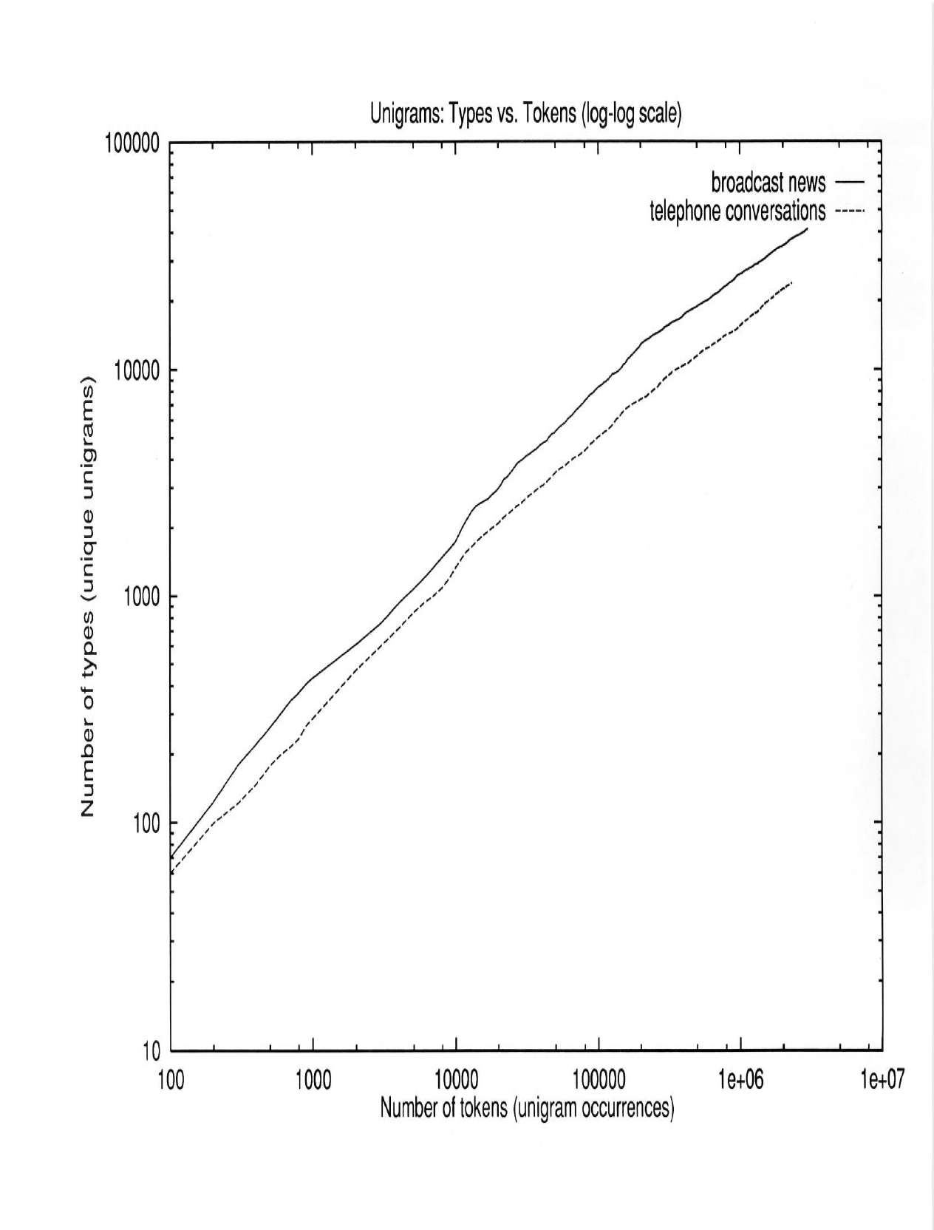
Unigram Type-Token Curve – BN vs. SWB (log scale)

Slide 5
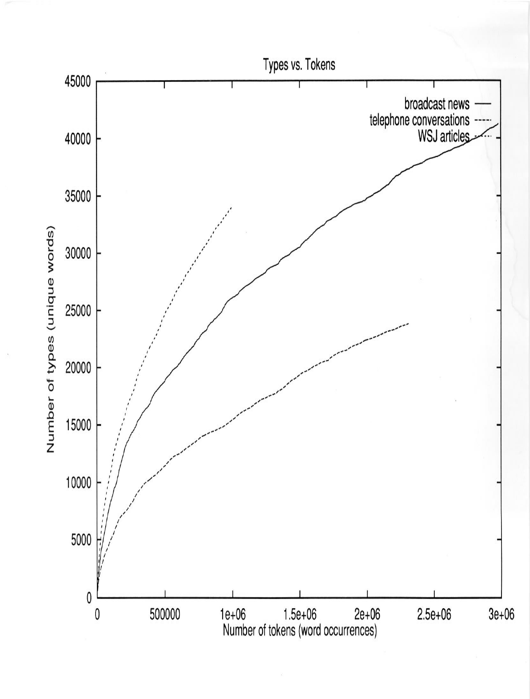
Unigram Type-Token Curve – BN vs. SWB vs. WSJ

Slide 6
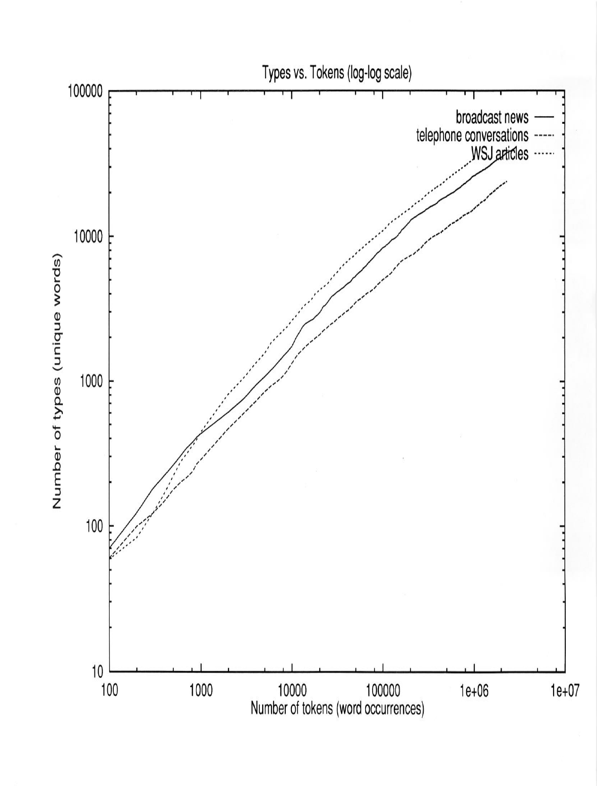
Unigram Type-Token Curve – BN vs. SWB vs. WSJ (log scale)

Slide 7
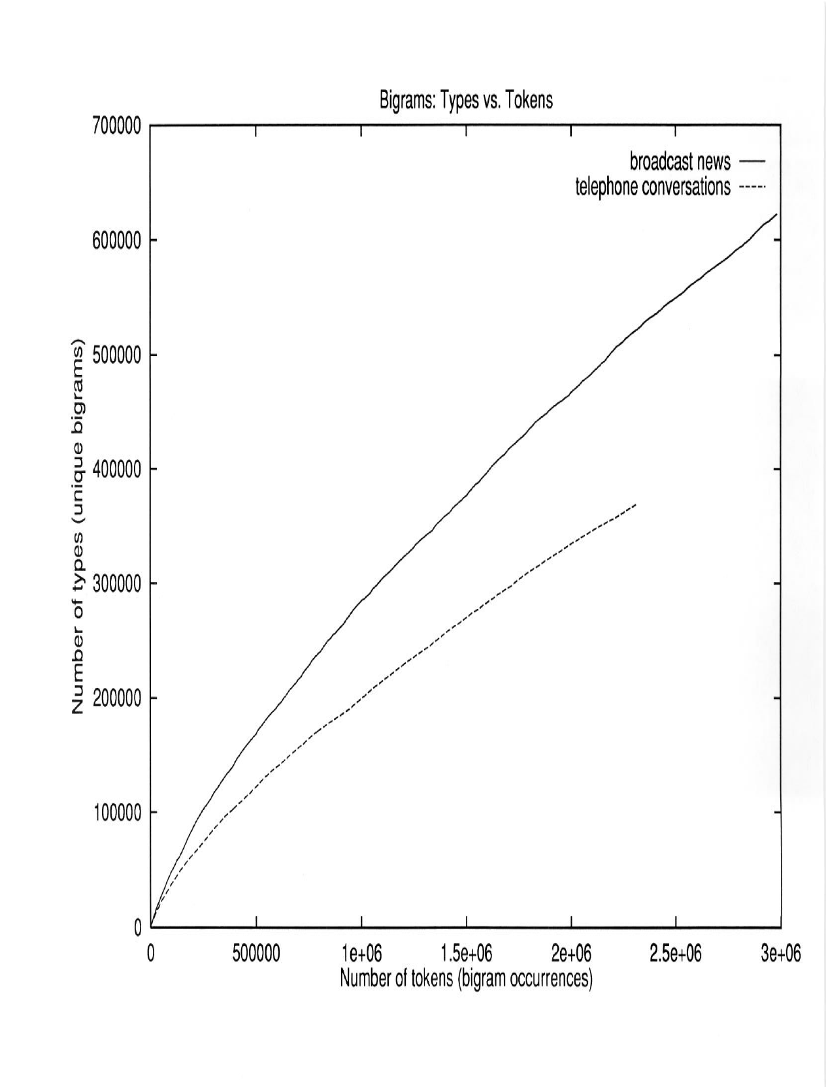
Bigram Token-Type Curve – BN vs. SWB

Slide 8
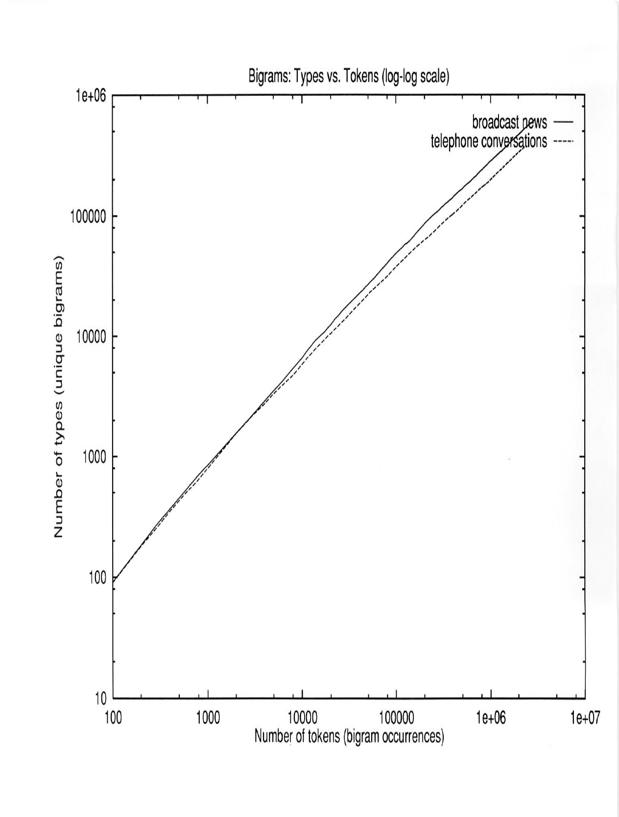
Bigram Token Type Curve – BN vs. SWB (log scale)

Slide 9
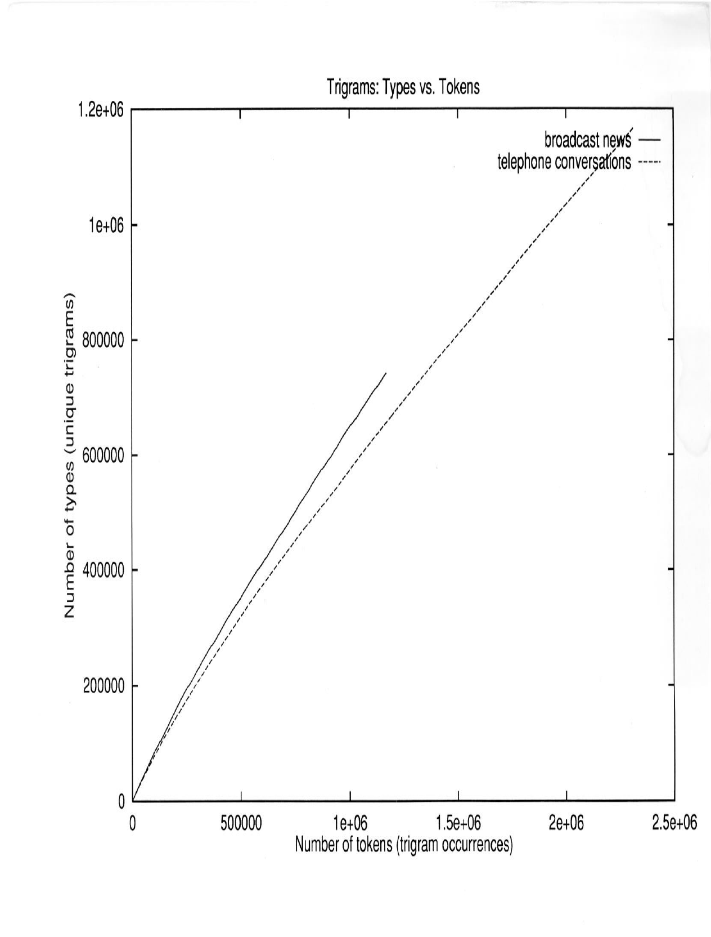
Trigram Token-Type Curve – BN vs. SWB

Slide 10
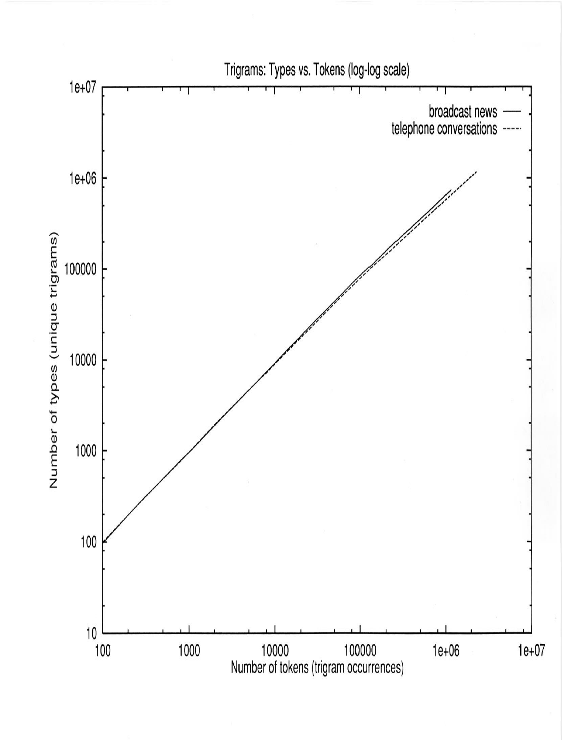
Trigram Token-Type Curve – BN vs. SWB (log scale)

Slide 11
Head of Word Frequency List (counts per 1,000 tokens)
WSJ |  | BN |  | SWB
THE | 49 | </S> | 62 | I | 38
</S> | 42 | THE | 49 | AND | 34
TO | 24 | TO | 27 | <SIL> | 31
OF | 24 | AND | 25 | THE | 28
A | 22 | A | 22 | YOU | 26
AND | 19 | OF | 21 | UH | 26
IN | 19 | IN | 17 | A | 24
THAT | 9 | THAT | 16 | TO | 23
FOR | 9 | IS | 13 | THAT | 20
IS | 8 | YOU | 12 | IT | 17
ONE | 7 | I | 12 | OF | 17
ON | 6 | IT | 10 | KNOW | 16
POINT | 5 | FOR | 8 | YEAH | 14
AS | 5 | THIS | 8 | IN | 12
SAID | 5 | ON | 7 | +NOISE+ | 12
WITH | 5 | HAVE | 6 | THEY | 10
IT | 5 | ARE | 6 | UH-HUH | 10
FIVE | 5 | WE | 6 | HAVE | 10
TWO | 5 | THEY | 6 | BUT | 9
DOLLARS | 5 | BE | 6 | SO | 8
AT | 5 | WITH | 6 | IT’S | 8
MR. | 5 | BUT | 5 | IS | 8
BY | 5 | WAS | 5 | WE | 8

Slide 12
Tail of Word Frequency List: Count=1 (“Singletons”)
WSJ | BN | SWB
ZEN | ZEROS | YEARBOOK
ZENKER | ZHA | YEARS”
ZEOLITE | ZHIVAGOS | YELLER
ZEROS’ | ZIANGSHING | YELLOWISH
ZEROED | ZILLIONS | YELLS
ZEROS | ZIMBABBWE’S | YIELD
ZESTY | ZINGA | YIP
ZEUS’S | ZION | YOGURT
ZHI | ZIONLIST | YORKER
ZHONGTIAN | ZOG | YOUNT
ZIGZAG | ZOIST | YOURSELFER
ZIGZAGGING | ZOO’S | YUPPISH
ZILLION | ZOOMED | ZACK
ZIONIST | ZUCKERMAN | ZAK’S
ZIP | ZULU | ZALES
ZIPPER | ZUICH | ZANTH
ZIPPY | ZWEIMAR | ZEALAND
ZOO | ZWICK’S | ZEROED
ZOOKEEPER | ZWINKELS | ZIRCONIUHS

Slide 13
Sub-language Example 2
The Diabetes set includes 9 Diabetes-related journals and a total of 4.5M tokens and 95K types.
The Veterinary science set includes 11 journals and 3.2M tokens and 87K types.
All Journals were extracted from PubMed in Oct 2010 and they include everything that was available by those journals up until then.
This example is provided by Dana Movshovitz-Attias.

Slide 14
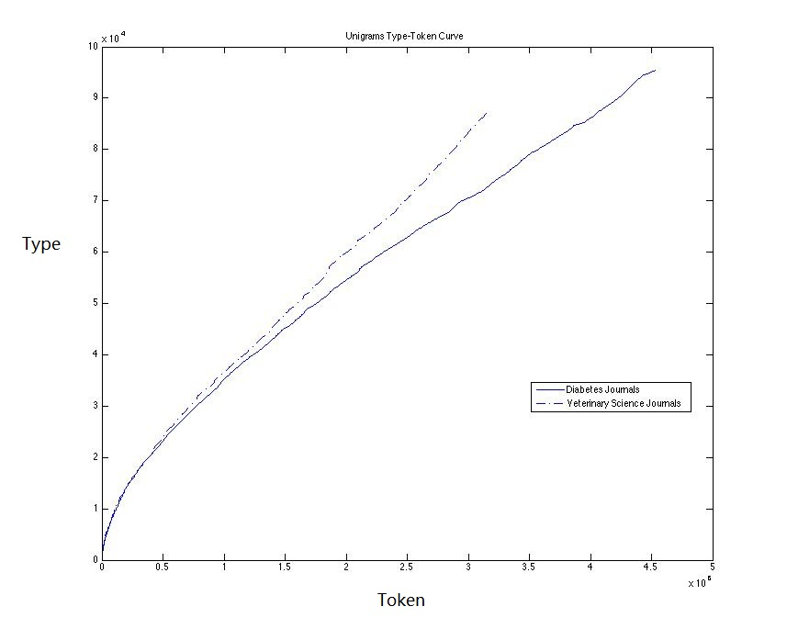
Diabetes vs. Veterinary: Type-Token Curve

Slide 15
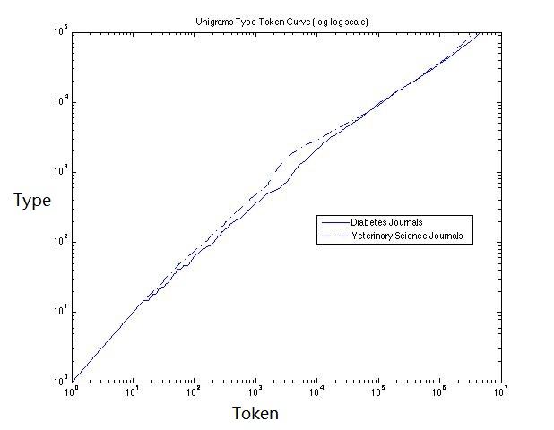
Diabetes vs. Veterinary: Type-Token Curve (log scale)

Slide 16
Head of Word Frequency List (counts per 1,000 tokens)
diabetes | count | veterinary | count
THE | 42 | THE | 57
OF | 35 | OF | 39
AND | 31 | AND | 30
IN | 29 | IN | 29
TO | 16 | TO | 17
WITH | 13 | A | 14
A | 13 | WERE | 11
FOR | 10 | WAS | 10
WAS | 10 | FOR | 10
WERE | 9 | WITH | 9
DIABETES | 7 | FROM | 7
THAT | 7 | THAT | 6
BY | 6 | IS | 6
IS | 6 | AS | 6
2 | 6 | BY | 6
AS | 5 | ON | 5
INSULIN | 5 | AT | 5
OR | 5 | 1 | 4
GLUCOSE | 5 | BE | 4
1 | 5 | THIS | 4
Notes:
Diabetes: 1 2 occur a lot due to “type 1 diabetes” or “type 2 diabetes”
Content words start to show up relatively late: 33rd: animal; 58th: infection; 62nd: disease.

Slide 17
Tail of Word Frequency List: Count=1 (“Singletons”)
Diabetes | Veterinary
QUESTIONNAIRE-BASED | MOLARITIES
CAPACITY-CONSTRAINED | LIDOCAIN
DND | MULTIORGAN
1003500 | MICROGLIA-MEDIATED
ENZYME-INHIBITOR | NALYSIS
ALVEOLUS-CAPILLARY | 10702
KUZUYA | BLUE-DNA
$6054 | HAIR-LOSS
SENTENCING | POPULATION-DYNAMICAL
PAPER-AND-PENCIL | STATE-TRANSITION
Notes:
Lidocain is a typo of “Lidocaine”, which is used topically to relieve itching, burning and pain from skin inflammations, injected as a dental anesthetic or as a local anesthetic for minor surgery.
Nosema ceranae is a microsporidian, a small, unicellular parasite that mainly affects Apis cerana, the Asiatic honey bee

Slide 18
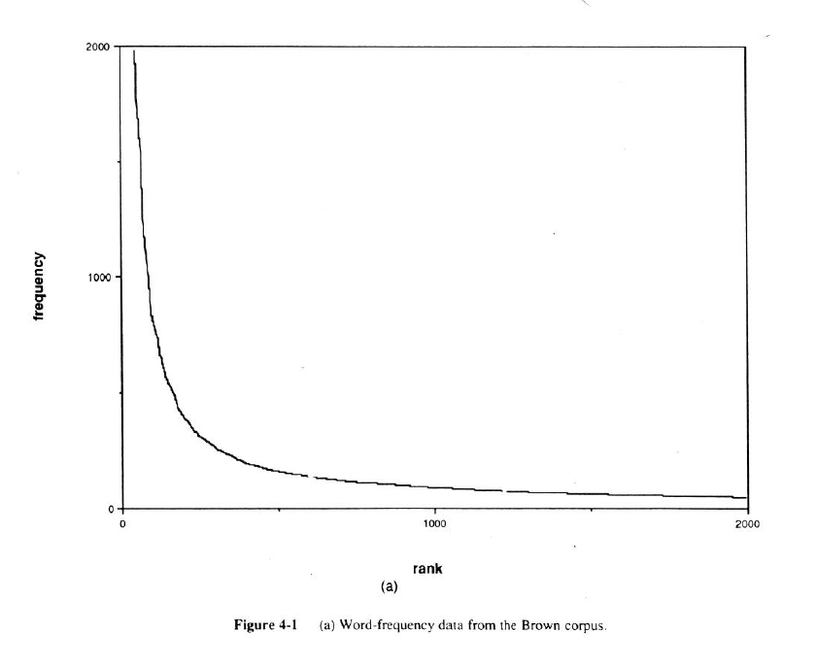
Zipf’s Law – Frequency vs. Rank (Brown Corpus)

Slide 19
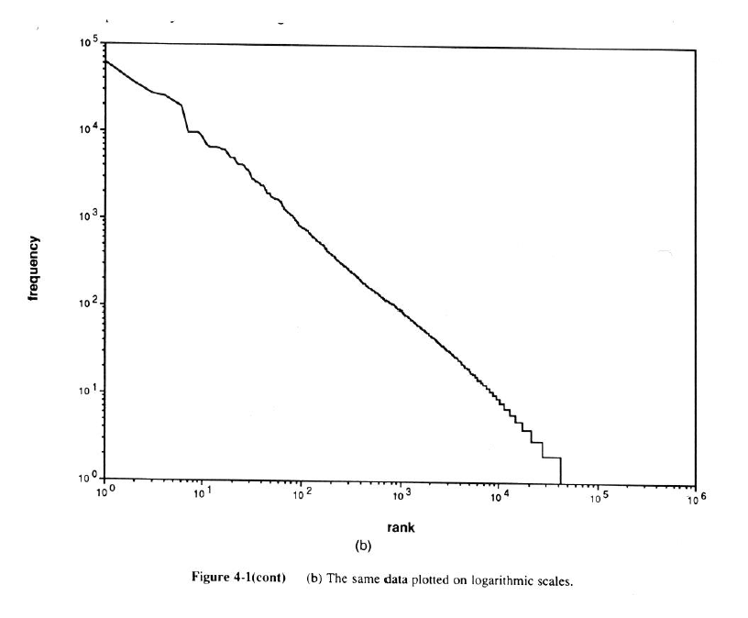
Zipf’s Law – Frequency vs. Rank (Brown Corpus) (log scale)

Slide 20
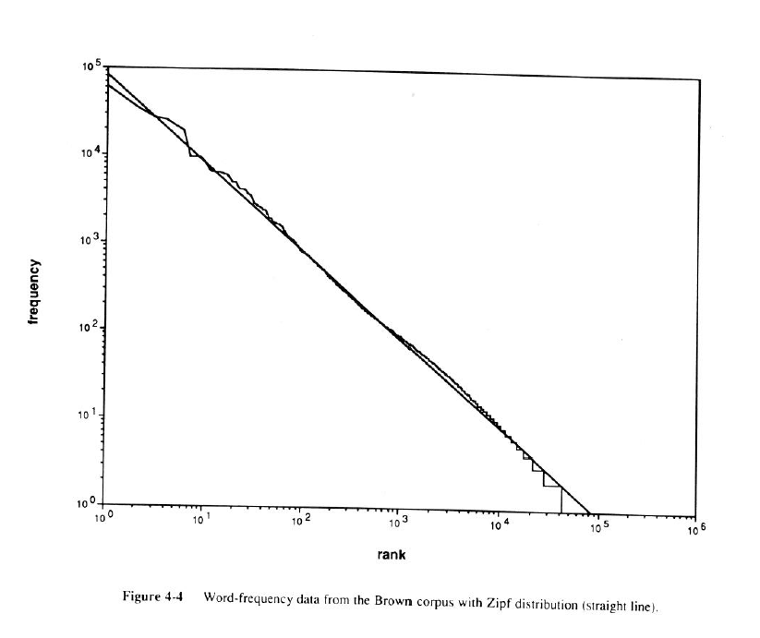
Zipf’s Law – Frequency vs. Rank (Brown Corpus) (log scale) + theoretical Zipf distribution

