Slide 1
15-441 Computer Networking
15-441
15-641
Lecture 25??: Cellular Eric Anderson
Fall 2013
www.cs.cmu.edu/~prs/15-441-F13

Slide 2
Outline
Principles of Cellular Service
Cellular at Layer 1 and Layer 2
From http://ourvaluedcustomers.blogspot.com/2013/10/while-discusing-movies-and-future.html , by Tim Chamberlain

Slide 3
Cellular versus WiFi
Cellular
Licensed
Provisioned
“for pay”
Fixed bandwidth
SLAs
WiFi
Unlicensed
Unprovisioned
“free” – no SLA
Best effort
no SLAs
Spectrum
Service model
MAC services

Slide 4
Implications WiFi
WiFi
Unlicensed
Unprovisioned
“free”
Best effort
no SLAs
Implication
No control –
open, diverse access
No guarantees
maximize throughput,
fairness
???
Spectrum
Service model
MAC services

Slide 5
Implications Cellular
Cellular
Licensed
Provisioned
“for pay”
Fixed bandwidth
SLAs
Implication
Provider has control
over interference
Can and must charge
+ make commitments
TDMA, FDMA,
CDMA; access control
Spectrum
Service model
MAC services

Slide 6
Overview
Cellular design
Frequency Reuse
Capacity and Interference
Elements of a cellular network
How does a mobile phone take place?
Paging
Handoff
Frequency Allocation
Traffic Engineering

Slide 7
The Advent of Cellular Networks
Mobile radio telephone system was based on:
High power transmitter/receivers
Could support about 25 channels
in a radius of 80 Km
To increase network capacity:
Multiple low-power transmitters (100W or less)
Small transmission radius -> area split in cells
Each cell with its own frequencies and base station
Adjacent cells use different frequencies
The same frequency can be reused at sufficient distance

Slide 8
Cellular Network Design Options
Simplest layout
Adjacent antennas not equidistant – how do you handle users at the edge of the cell?
Ideal layout
But we know signals travel whatever way they fell like
d
d
√2d
d
d

Slide 9
The Hexagonal Pattern
A hexagon pattern can provide equidistant access to neighboring cell towers
d = √3R
In practice, variations from ideal due to topological reasons
Signal propagation
Tower placement
d
R

Slide 10
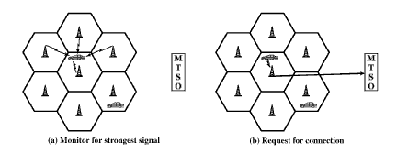
Call progression
(a) Monitor for strongest signal
(b) Request for connection

Slide 11
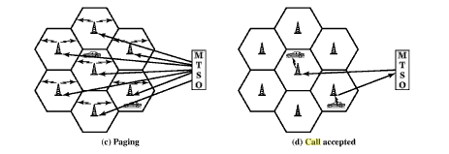
Call progression
(c) Paging
(d) Call accepted
Notes:
Each mobile monitors their setup channels for incoming calls and responds using the uplink channel
The MTSO sets up a circuit between the calling and called BSs. At the same time
The MTSO selects an available traffic channel with each BS’s cell and notifies each BS,
Which in turn notifies its mobile unit. The mobile units tune to their assigned channels

Slide 12
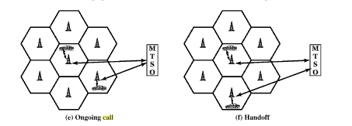
Call progression
(e) Ongoing call
(f) Handoff

Slide 13

Handoff between 2 cells
Base station A
Base station B
Notes:
Prediction could also be used
Dwell time The time over which a call may be maintained within a cell, without handoff, depending on propagation, interference, distance between the MS and BS, and other time varying effects

Slide 14
Handoff Options
Switch when a different cell is better … or the current one is too bad.
Defined how? Who measures? How often?
What thresholds?
Set up new connection before tearing down the old one?
What kind of resources are involved?
How do you deliver data while >1 connections open?

Slide 15
Handoff
Could be network or client initiated
Target performance metrics:
Cell blocking probability
Call dropping probability
Call completion probability
Probability of unsuccessful handoff
Handoff blocking probability
Handoff probability
Rate of handoff
Interruption duration
Handoff delay

Slide 16
Frequency reuse
Each cell features one base transceiver
Through power control cover the cell area while limiting the power leaking to other co-frequency cells
Frequency reuse not possible for adjacent towers!
The number of frequency bands assigned to a cell dependent on its traffic

Slide 17
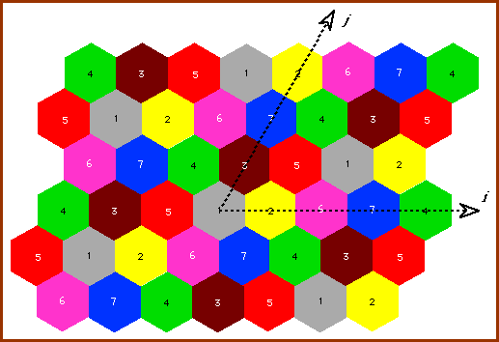
Minimum separation?

Slide 18
How to Increase Capacity?
Adding new channels
Frequency borrowing
Sectoring antennas
Microcells
Antennas on top of buildings, even lamp posts
Form micro cells with reduced power
Good for city streets, roads and inside buildings

Slide 19
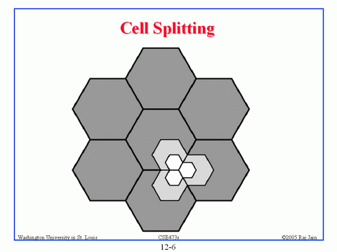
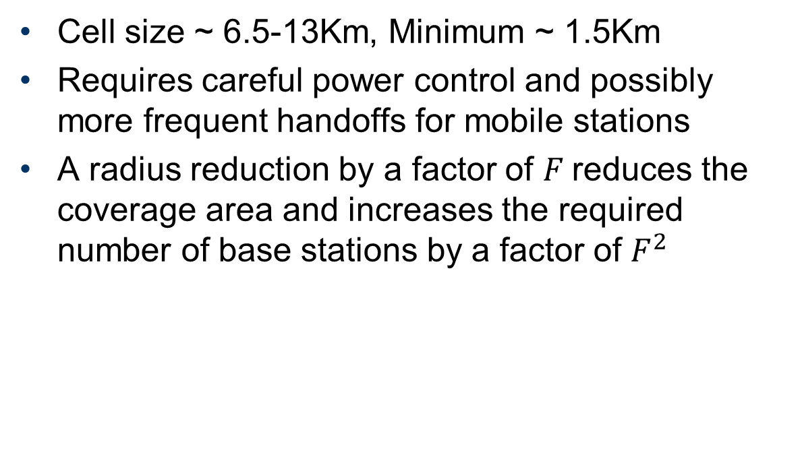
Cell splitting
Cell size ~ 6.5-13Km, Minimum ~ 1.5Km
Requires careful power control and possibly more frequent handoffs for mobile stations
A radius reduction by a factor of $F$reduces the coverage area and increases the required number of base stations by a factor of $F^{2}$

Slide 20
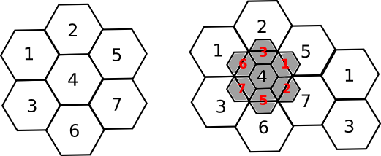
Cell splitting
Radius of small cell half that of the original

Slide 21
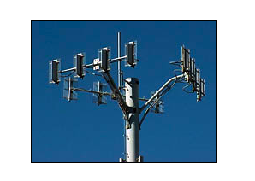
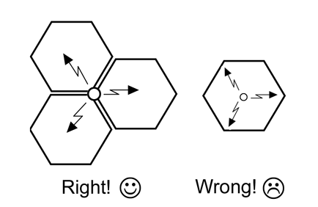
Cell sectoring
Cell divided into wedge shaped sectors
3-6 sectors per cell, each with own channel set
Subset of cell’s channel, use of directional antennas

Slide 22
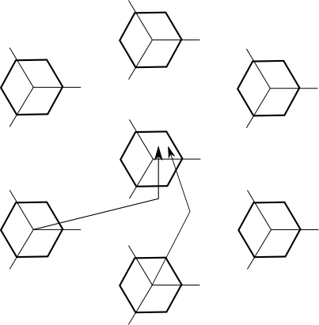
Cell Sectoring - Interference
1/3

Slide 23
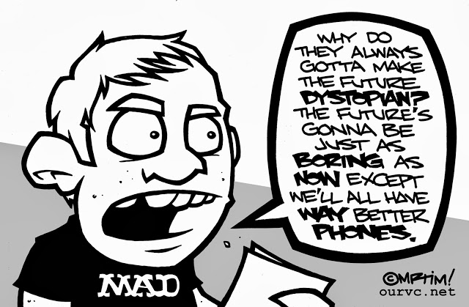
Outline
Principles of Cellular Service
Cellular at Layer 1 and Layer 2
From http://ourvaluedcustomers.blogspot.com/2013/10/while-discusing-movies-and-future.html , by Tim Chamberlain

Slide 24
GSM Multiple Access
Combination of FDD, FDMA and TDMA
890-915 MHz for uplink
935-960 MHz for downlink
Each of those 25 MHz bands is sub divided into 124 single carrier channel of 200 KHz
In each uplink/downlink band there is a 200 KHz guard band
Each 200 KHz channel carries 8 TDMA channels
Notes:
Not all countries use the same frequency bands due to military or previous analog systems

Slide 25
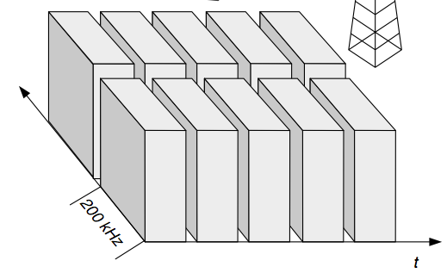
FDMA/TDMA
Notes:
http://www.comlab.hut.fi/opetus/238/lecture4_Intro_to_WCDMA.pdf

Slide 26
LTE
Some slides from
Tsung-Yin Lee
Roger Piqueras Jover

Slide 27
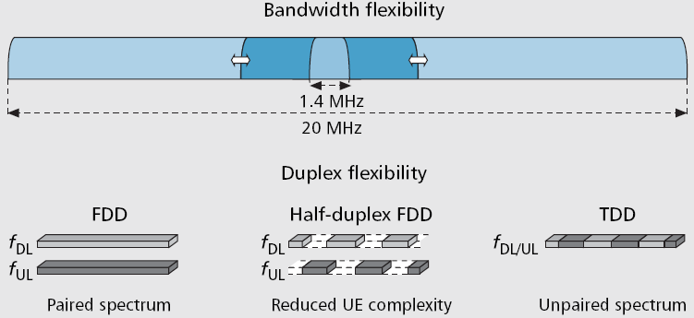
LTE spectrum (bandwidth and duplex) flexibility

Slide 28
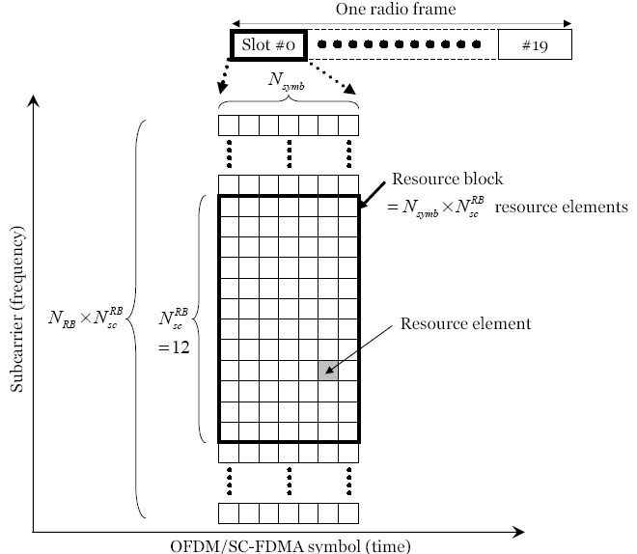
Resource Grid
One frame is 10ms → 10 subframes
One subframe is 1ms → 2 slots
One slot is 0.5ms → N resource blocks [ 6 < N < 110]
One resource block is 0.5ms and contains 12 subcarriers from each OFDM symbol

Slide 29
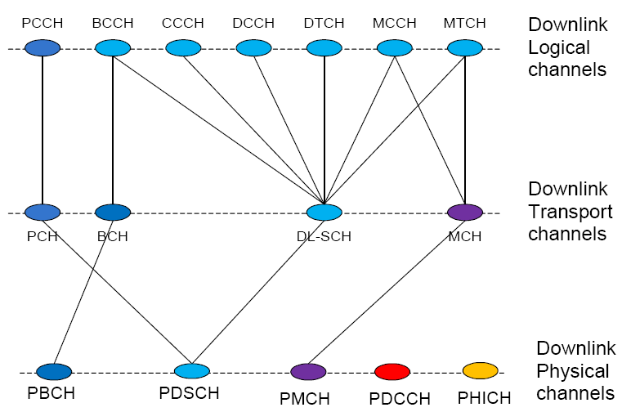
LTE Downlink Channels
Paging Control Channel
Paging Channel
Physical Downlink Shared Channel

Slide 30
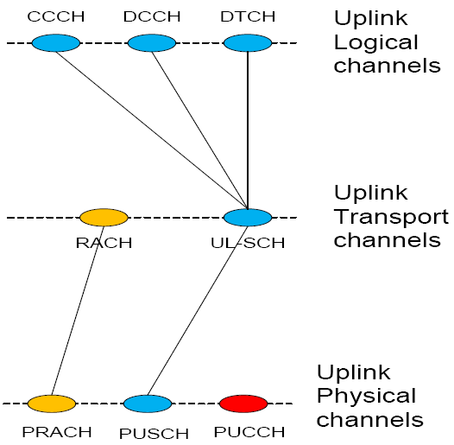
LTE Uplink Channels
Random Access Channel
CQI report
Physical Uplink Shared Channel
Physical Radio Access Channel

Slide 31
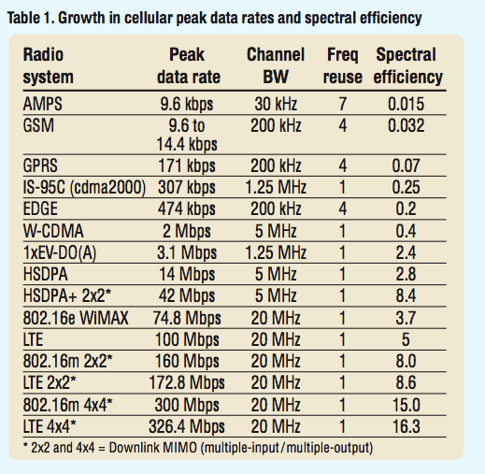
Rates and spectral efficiency

Slide 32
Growth Explanation
No impact on spectral efficiency or network capacity
Allocating more time (TDMA duty cycle)
Allocating more bandwidth
Improving frequency reuse
Reducing channel coding protection
Using higher order modulation
Taking advantage of spatial diversity (MIMO)
Increase peak data rates
Increase spectral efficiency and can increase network capacity
Notes:
Older systems such as GSM were designed to work to full speciﬁ cation at the cell edge and the better radio conditions further into the cell were used to reduce uplink and downlink transmission power rather than deliver higher- rate services. Newer systems take advantage of the variation in radio conditions across the cell to opportunistically deliver higher rate services. For example, GSM requires 9 dB SNR at the cell boundary but full-rate EDGE requires 24 dB SNR and so only performs at its peak rate towards the middle of a cell dimen- sioned for basic GSM.

Slide 33
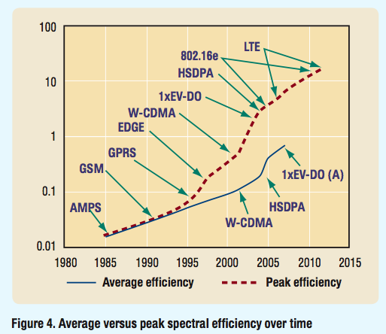
Average vs. peak rate
AMPS, GSM designed to operate at their maximum rate at the edge of the cell

