Slide 1
15-441 Computer Networking
Lecture 17 – TCP Performance & Future
Eric Anderson
Fall 2013
www.cs.cmu.edu/~prs/15-441-F13

Slide 2
Outline
TCP modeling
TCP details

Slide 3
TCP Performance
Can TCP saturate a link?
Congestion control
  Increase utilization until… link becomes congested
  React by decreasing window by 50%
  Window is proportional to rate * RTT
Doesn’t this mean that the network oscillates between 50 and 100% utilization?
  Average utilization = 75%??
  No…this is *not* right!

Slide 4
TCP Congestion Control
Rule for adjusting W
  If an ACK is received: W ← W+1/W
  If a packet is lost: W ← W/2
Only W packets
may be outstanding
Source
Dest
Window size
t

Slide 5
Single TCP Flow
Router without buffers
Source
Dest
Window size
RTT × BW
???
t
Intuition: think in discrete time slots = RTT
The router can’t fully utilize the link
  If the window is too small, link is not full
  If the link is full, next window increase causes drop
  With no buffer it still achieves 75% utilization

Slide 6
Single TCP Flow
Router with large enough buffers for full link utilization
Source
Dest
Window size
???
RTT × BW
t
What is the minimum queue size for full utilization?
  Must make sure that link is always full
    W/2 > RTT * BW - also W = RTT * BW + Qsize
    Therefore, Qsize > RTT * BW
  Delay? Varies between RTT and 2 * RTT

Slide 7
Summary Buffered Link
W
Buffer
Minimum window for full utilization
t
With sufficient buffering we achieve full link utilization
  The window is always above the critical threshold
  Buffer absorbs changes in window size
    I.e. when window is larger, buffering increases RTT
    Buffer Size = Height of TCP Sawtooth
  This is the origin of the rule-of-thumb
Routers queues play critical role, not just to deal with burstiness of traffic, but also to allow TCP to fully utilize bottleneck links
But, at what cost!?

Slide 8
TCP Modeling
Given the congestion behavior of TCP can we predict what type of performance we should get?
What are the important factors
  Loss rate: Affects how often window is reduced
  RTT: Affects increase rate and relates BW to window
  RTO: Affects performance during loss recovery
  MSS: Affects increase rate

Slide 9
Overall TCP Behavior
Let’s concentrate on steady state behavior with no timeouts and perfect loss recovery
Packets transferred = area under curve
Window
Time

Slide 10
Transmission Rate
What is area under curve?
  W = pkts/RTT, T = RTTs
  A = avg window * time = ¾ W * T
What was bandwidth?
  BW = A / T = ¾ W
    In packets per RTT
  Need to convert to bytes per second
  BW = ¾ W * MSS / RTT
What is W?
  Depends on loss rate
W
W/2
Time

Slide 11
Simple TCP Model
Some additional assumptions
  Fixed RTT
  No delayed ACKs
In steady state, TCP losses packet each time window reaches W packets
  Window drops to W/2 packets
  Each RTT window increases by 1 packet→W/2 * RTT before next loss

Slide 12
Simple Loss Model
What was the loss rate?
  Packets transferred = (¾ W/RTT) * (W/2 * RTT) = 3W²/8
  1 packet lost → loss rate = p = 8/3W²
BW = ¾ * W * MSS / RTT

Slide 13

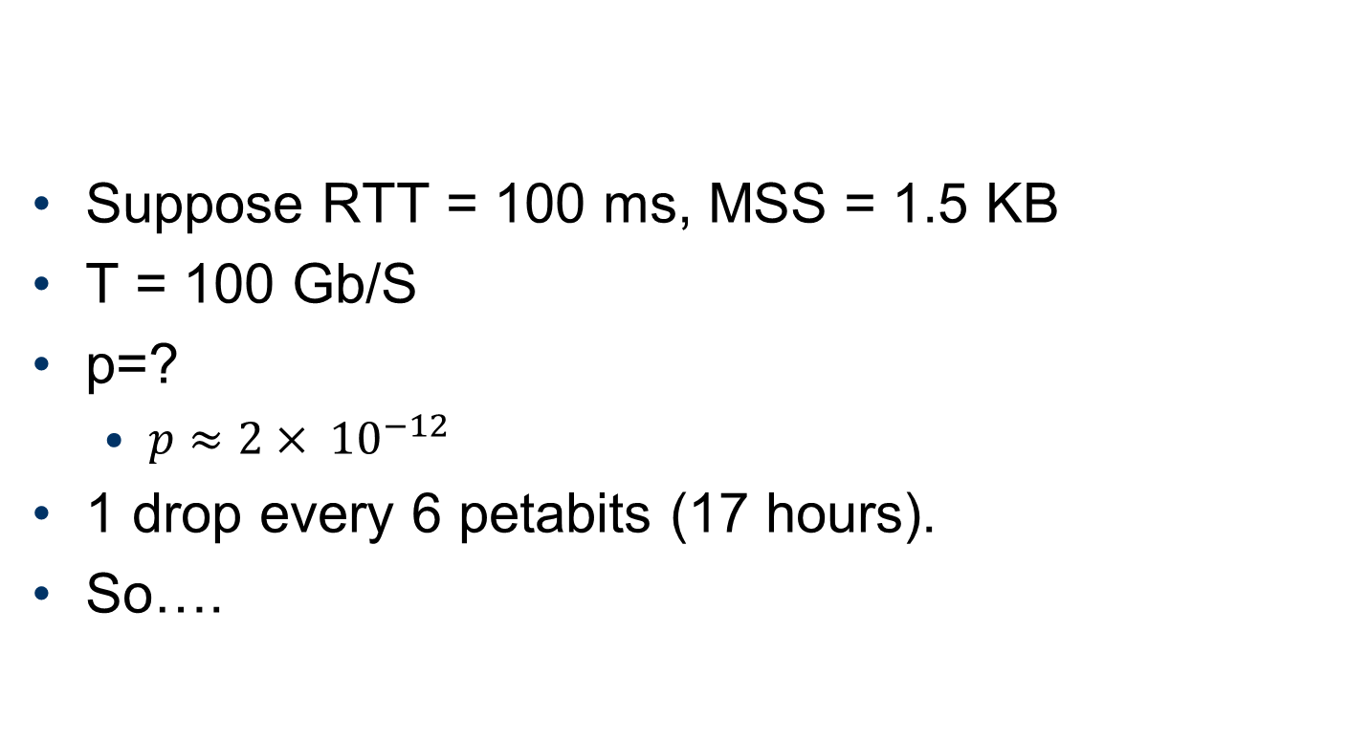
Throughput Equation Implications 1
Suppose RTT = 100 ms, MSS = 1.5 KB
T = 100 Gb/S
p=?
  $p≈2{× 10}^{−12}$
1 drop every 6 petabits (17 hours).
So….
$$T≈\frac{\sqrt{1.5} MSS }{RTT \sqrt{p}}$$

Slide 14
TCP over High-Speed Networks
A TCP connection with 1250-Byte packet size and 100ms RTT is running over a 10Gbps link (assuming no other connections, and no buffers at routers)
1.4 hours
1.4 hours
1.4 hours
Packet loss
Packet loss
Packet loss
Packet loss
TCP
cwnd
100,000
10Gbps
50,000
5Gbps
Slow start
Congestion avoidance
Time (RTT)
Source: Rhee, Xu. “Congestion Control on High-Speed Networks”
Notes:
Now let’s look at an example of TCP over a high-speed network. We have the same parameters as the previous one, except that the link capacity is 10Gbps.
This time, TCP has packet losses at 10Gbps, which corresponds to a cwnd of 125000. After a packet loss, TCP decreases its transmission rate to 5Gbps, which corresponds to a cwnd of 62500. Since RTT is 100ms, it takes about 1.7hours for TCP to increase its transmission rate from 5Gbps to 10Gbps.
We can see that, if a TCP connection is a short connection with a short duration, then TCP may finish the transmission, even before it reaches to 10Gbps. In that case, we will have a low link utilization.

Slide 15
Throughput Equation Implications 2
What if we just do this?
$$T≈\frac{\sqrt{1.5} MSS }{RTT \sqrt{p}}$$

Slide 16
Throughput Equation Implications 3
BW proportional to 1/RTT?
Do flows sharing a bottleneck get the same bandwidth?
  NO!
TCP is RTT fair
  If flows share a bottleneck and have the same RTTs then they get same bandwidth
  Otherwise, in inverse proportion to the RTT

Slide 17
TCP Friendliness
What does it mean to be TCP friendly?
  TCP is not going away
  Any new congestion control must compete with TCP flows
    Should not clobber TCP flows and grab bulk of link
    Should also be able to hold its own, i.e. grab its fair share, or it will never become popular
How is this quantified/shown?
  Has evolved into evaluating loss/throughput behavior
  If it shows 1/sqrt(p) behavior it is ok
  But is this really true?

Slide 18
Other Transport Protocols
Request-response: overhead too high
  Use RPC: response is ACK for request
  What about congestion control?
Multi-media streaming: timeouts add excessive delays, reducing “Quality of Experience”
  Typically implement custom transport in the application
  Can either tolerate some losses, use FEC, or use TCP, but avoid negative impact of timeouts
  Real-time Transport Protocol can help
    Limited scope: packet format, control information
  What about congestion control?

Slide 19
Outline
TCP modeling
Congestion control variants
TCP details

Slide 20
Let’s stop for a moment
What can the network (really) do?
  Enforce
    Maximum aggregate rate & buffer (has to)
    Isolation?
    Fair sharing?
  Inform
    Aggregate limits exceeded (by packet drop)
    Queue lengths (by delay) (or explicitly)
    Degree of congestion?
    Allowed rate?
What are the end hosts’ options?

Slide 21
Equation-Based Rate Control 1
TCP-Friendly Rate Control (TFRC)
  Goal: “like TCP, but smoother”
  Compute allowed BW T using TCP equation
    Average time between loss events
  Maintain smoothed estimate of loss rate, RTT
  Implement rate control through inter-packet time t

Slide 22
Equation-Based Rate Control 2
Delay-based rate control (TCP Vegas)
  Goal: Respond to congestion before buffers are full
  Drop/no-drop is a binary signal,
  Delay is a continuous signal
  Measure RTT
    Estimate minimum (no-queuing) RTT
    Estimate expected throughput
  When actual throughput < expected, reduce rate

Slide 23
Data Center TCP (DCTCP)
High throughput
Full buffers*
Large buffers
Low latency
Empty buffers
Solutions:
Explicit congestion notification** (before buffers are full)
Estimate degree of congestion
  (Fraction of marked packets)
Proportional response

Slide 24
TCP (CU)BIC
Adaptive additive increase
  Fast recovery toward wmax
  Slow change around (expected) wmax
  Fast search for (higher) wmax

Slide 25
Binary Search with Smax and Smin
Available Bandwidth
Wmax
Smin
Smax
Wmin

Slide 26
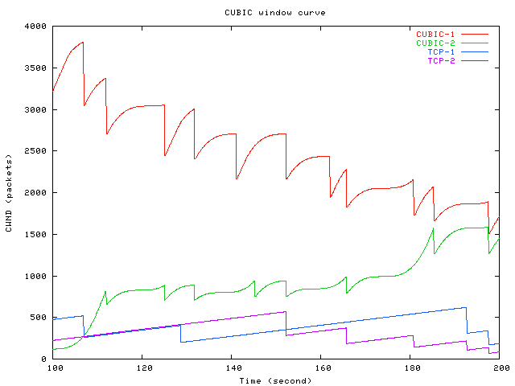
TCP CUBIC in one slide

Slide 27
Outline
TCP modeling
Congestion control variants
TCP details

Slide 28
Delayed ACKS
Problem:
  In request/response programs, you send separate ACK and Data packets for each transaction
Solution:
  Don’t ACK data immediately
  Wait 200ms (must be less than 500ms – why?)
  Must ACK every other packet
  Must not delay duplicate ACKs

Slide 29
Delayed ACKS
Problem:
  In request/response programs, you send separate ACK and Data packets for each transaction
Solution:
  Don’t ACK data immediately
  Wait 200ms (must be less than 500ms – why?)
  Must ACK every other packet
  Must not delay duplicate ACKs

Slide 30
TCP ACK Generation [RFC 1122, RFC 2581]
Event
In-order segment arrival,
No gaps,
Everything else already ACKed
In-order segment arrival,
No gaps,
One delayed ACK pending
Out-of-order segment arrival
Higher-than-expect seq. #
Gap detected
Arrival of segment that
partially or completely fills gap
TCP Receiver action
Delayed ACK. Wait up to 500ms
for next segment. If no next segment,
send ACK
Immediately send single
cumulative ACK
Send duplicate ACK, indicating seq. #
of next expected byte
Immediate ACK

Slide 31
Delayed Ack Impact
TCP congestion control triggered by acks
  If receive half as many acks → window grows half as fast
Slow start with window = 1
  Will trigger delayed ack timer
  First exchange will take at least 200ms
  Start with > 1 initial window
    Bug in BSD, now a “feature”/standard

Slide 32
Nagel’s Algorithm
Small packet problem:
  Don’t want to send a 41 byte packet for each keystroke
  How long to wait for more data?
Solution:
  Allow only one outstanding small (not full sized) segment that has not yet been acknowledged
  Can be disabled for interactive applications

Slide 33
Large Windows
Delay-bandwidth product for 100ms delay
  1.5Mbps: 18KB
  10Mbps: 122KB
  45Mbps: 549KB
  100Mbps: 1.2MB
  622Mbps: 7.4MB
  1.2Gbps: 14.8MB
Why is this a problem?
  10Mbps > max 16bit window
Scaling factor on advertised window
  Specifies how many bits window must be shifted to the left
  Scaling factor exchanged during connection setup

Slide 34
Window Scaling:
Example Use of Options
“Large window” option (RFC 1323)
  Negotiated by the hosts during connection establishment
  Option 3 specifies the number of bits by which to shift the value in the 16 bit window field
  Independently set for the two transmit directions
The scaling factor specifies bit shift of the window field in the TCP header
  Scaling value of 2 translates into a factor of 4
Old TCP implementations will simply ignore the option
  Definition of an option
TCP syn
SW?
3
TCP syn,ack
SW yes
3
SW?
2
TCP ack
SW yes
2

Slide 35
Maximum Segment Size (MSS)
Problem: what packet size should a connection use?
Exchanged at connection setup
  Uses a TCP option
  Typically pick MTU of local link
What all does this effect?
  Efficiency
  Congestion control
  Retransmission
Path MTU discovery
  Why should MTU match MSS?

Slide 36
Silly Window Syndrome
Problem: (Clark, 1982)
  If receiver advertises small increases in the receive window then the sender may waste time sending lots of small packets
Solution
  Receiver must not advertise small window increases
  Increase window by min(MSS,RecvBuffer/2)

Slide 37
Protection From Wraparound
Wraparound time vs. Link speed
    1.5Mbps: 6.4 hours
    10Mbps: 57 minutes
    45Mbps: 13 minutes
    100Mbps: 6 minutes
    622Mbps: 55 seconds
    1.2Gbps: 28 seconds
Why is this a problem?
  55seconds < MSL!
Use timestamp to distinguish sequence number wraparound

Slide 38
TCP Summary
General loss recovery
  Stop and wait
  Selective repeat
TCP sliding window flow control
TCP state machine
TCP loss recovery
  Timeout-based
    RTT estimation
  Fast retransmit
  Selective acknowledgements

Slide 39
TCP Summary
Congestion collapse
  Definition & causes
Congestion control
  Why AIMD?
  Slow start & congestion avoidance modes
  ACK clocking
  Packet conservation
TCP performance modeling
  How does TCP fully utilize a link?
    Role of router buffers
  How does TCP throughput depends on RTT, loss, ..

Slide 40
Outline
TCP modeling
TCP details

Slide 41
EXTRA SLIDES
The rest of the slides are FYI

Slide 42
TCP Variations
Tahoe, Reno, NewReno, Vegas
TCP Tahoe (distributed with 4.3BSD Unix)
  Original implementation of Van Jacobson’s mechanisms (VJ paper)
  Includes:
    Slow start
    Congestion avoidance
    Fast retransmit

Slide 43
Multiple Losses
X
X
X
Now what?
Retransmission
X
Duplicate Acks
Sequence No
Packets
Acks
Time

Slide 44
Tahoe
X
X
X
X
Sequence No
Packets
Acks
Time

Slide 45
TCP Reno (1990)
All mechanisms in Tahoe
Addition of fast-recovery
  Opening up congestion window after fast retransmit
Delayed acks
Header prediction
  Implementation designed to improve performance
  Has common case code inlined
With multiple losses, Reno typically timeouts because it does not see duplicate acknowledgements

Slide 46
Reno
X
X
X
Now what? - timeout
X
Sequence No
Packets
Acks
Time

Slide 47
NewReno
The ack that arrives after retransmission (partial ack) could indicate that a second loss occurred
When does NewReno timeout?
  When there are fewer than three dupacks for first loss
  When partial ack is lost
How fast does it recover losses?
  One per RTT

Slide 48
NewReno
X
X
X
Now what? – partial ack
recovery
X
Sequence No
Packets
Acks
Time

Slide 49
Changing Workloads
New applications are changing the way TCP is used
1980’s Internet
  Telnet & FTP → long lived flows
  Well behaved end hosts
  Homogenous end host capabilities
  Simple symmetric routing
2000’s Internet
  Web & more Web → large number of short xfers
  Wild west – everyone is playing games to get bandwidth
  Cell phones and toasters on the Internet
  Policy routing

Slide 50
Short Transfers
Fast retransmission needs at least a window of 4 packets
  To detect reordering
Short transfer performance is limited by slow start → RTT

Slide 51
Short Transfers
Start with a larger initial window
What is a safe value?
  TCP already burst 3 packets into network during slow start
  Large initial window = min (4*MSS, max (2*MSS, 4380 bytes)) [rfc2414]
    Not a standard yet
  Enables fast retransmission
  Only used in initial slow start not in any subsequent slow start

Slide 52
Well Behaved vs. Wild West
How to ensure hosts/applications do proper congestion control?
Who can we trust?
  Only routers that we control
  Can we ask routers to keep track of each flow
    Per flow information at routers tends to be expensive
    Fair-queuing later in the semester

Slide 53
TCP Fairness Issues
Multiple TCP flows sharing the same bottleneck link do not necessarily get the same bandwidth.
  Factors such as roundtrip time, small differences in timeouts, and start time, … affect how bandwidth is shared
  The bandwidth ratio typically does stabilize
Users can grab more bandwidth by using parallel flows.
  Each flow gets a share of the bandwidth to the user gets more bandwidth than users who use only a single flow

