Slide 1


Multisource transfer learning for protein interaction prediction
Meghana Kshirsagar¹
Jaime Carbonell¹ Judith Klein-Seetharaman^{1,2}
¹Language Technologies Institute
School of Computer Science
Carnegie Mellon University, USA
²Systems Biology Centre
University of Warwick, Coventry, UK

Slide 2

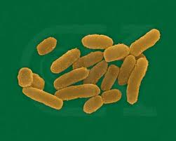
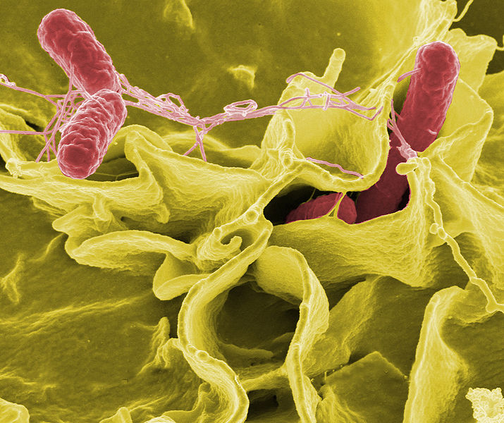
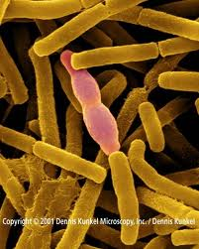
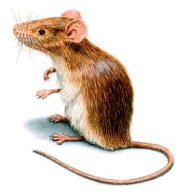
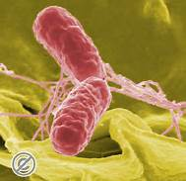
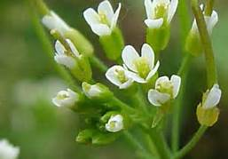
Infectious diseases:
Host pathogen interactions
Y. pestis
B. anthracis
S. typhi
Electron micrograph showing
Salmonella typhimurium invading human cells (source: NIH)
Protein protein interactions between host and pathogen are
important to understand diseases!
Notes:
The image here shows Salm….
One of the key mechanisms underlying infectious diseases is the molecular interaction between the causative agent, such as a bacterium or virus and the host, such as †he human body or a mouse. In particular we’re interested in PPIs as these form the majority of the molecular interactions. The graph on the right depicts multiple such host-pathogen interactions. There are multiple host organisms – human mouse plant and multiple pathogen organisms as well. Despite the diversity of these organisms, there are still similarities in how the pathogens exploit the hosts and how the hosts defend themselves. This notion leads us to develop methods that can work well by combining knowledge across these organisms. Basically using better studied diseases to understand the lesser studied ones.

Slide 3
Outline
Introduction to protein interaction prediction
Multi-source learning using a Kernel-mean matching based approach
Results
Notes:
This is the outline of my talk today.

Slide 4
1. Protein-interaction prediction: Background

Slide 5
Discovery of host-pathogen protein interactions : Challenges
Bio-chemical methods (co-IP, NMR, Y2H assay)
  Cross-species interaction studies are hard
  Expensive and time-consuming
  Prohibitively large set of possible interactions
    Example: human-B. anthracis protein pairs
      2321 proteins in B. anthracis, ≈25000 human proteins
      2321 x 25000 ≈ 60 x 10⁶ protein pairs to test!
Computational methods (statistical, algorithmic)
  Rely on availability of known, high-confidence interactions
    Often, very few or no interactions may exist for the organism of interest
Notes:
Bio-chemical methods like co-immunoprecipitation, yeast2h assays are used to determine whether 2 given protein molecules will bind to each other or not. The big challenge for these methods is – they’re often very expensive and time-consuming. More so because of the number of potential interactions that need to be tested. For example if you have a human host and B.anthracis as the pathogen, there are about 60 million pairs of proteins that could potentially interact.
Computational techniques can help reduce this search space, by predicting possible interactions. They use known interactions to build predictive models. The challenge here is – often there may not be enough interactions data available, and in some cases none at all.

Slide 6
Predicting host pathogen protein interactions
  Known interactions curated by several databases such as: PHI-BASE, PHISTO, HPIDB, VirusMint etc.
Predicting unknown interactions:
Use known interactions as training data for a classifier
Obtain features (using protein sequence, protein domains etc.)
Notes:
Interactions that have already been discovered are curated by various databases. To predict the unknown interactions, machine learning based approaches will use the known interactions as training data. For all training examples you obtain features for each pair of proteins and treat that as the instance X. The label is 0 or 1. Essentially this is a binary classification problem and people often use classifiers such as support vector machines, logistic regression etc.

Slide 7
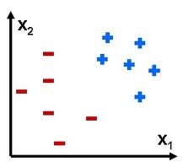
Machine Learning approaches
host
pathogen
Two classes (i.e label Y):
‘1’ - interacting
‘0’ - non-interacting
Known
interactions
(training data)
X
Feature Generation
Training
Build classifier model
Prediction
  For new protein pairs, generate features and apply model
[f₁, f₂ . . . . f_{N}]
f₂
f₂
Gene Ontology (GO)
Gene Expression (GEO)
Uniprot (sequence)
x
model
f₁
f₁
+ : interacting pairs
− : non-interacting pairs
We use random protein pairs
Notes:
The prediction task is posed as a classification problem where the two target classes are “interact” and “not interact”. The procedure consists of a pipeline which starts with feature generation, where for every protein pair, features are computed using biological attributes from databases like Gene Ontology, Protein family etc. The second step is Training where a model is built to separate the interactions from the non-interactions.
This is followed by the Prediction step where the model is used to classify a given protein pair indicated by “x” in this figure.
A thing to note is that : we don’t have any gold-standard non-interacting datasets. Various methods have been proposed in the literature to generate the negative class, i.e the non-interacting protein pairs. We use a simple method – where we sample random protein-pairs from the set of all possible protein pairs.
?? We chose this because the probability that this negative class data will have true positives is very low.

Slide 8
2. Learning from multiple tasks

Slide 9
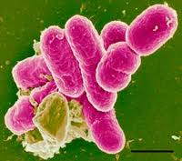
Transfer Learning setting
Source Tasks (S)
Target Task (T)
Task-1
Task-2
Task-3
(x₁ , y₁)
(x₂ , y₂)
…
(x_{n1,} y_{n1})
(x₁ , y₁)
(x₂ , y₂)
…
…
(x_{n2,} y_{n2})
(x₁ , ?)
(x₂ , ?)
…
…
(x_{n3} , ?)
If all tasks identical, P (S) = P (T)
Train on S, test on T
No labeled data
Notes:
Given: “source” tasks with labeled examples
Goal : predictions on target task
Different source examples have varying similarity to target examples
If the distributions are identical, then it is the conventional classification setting where you can use all source data for training and apply the built model on the target data. However, often this is not the case. For instance when each task’s data comes a different organism. If the features “x” were say, the protein sequence then this distribution would be different across organisms.

Slide 10
Reweighting the source
Source Tasks (S)
Target Task (T)
Task-1
Task-2
Task-3
(x₁ , y₁)
(x₂ , y₂)
…
(x_{n1,} y_{n1})
(x₁ , y₁)
(x₂ , y₂)
(x₃ , y₃)
…
(x_{n2,} y_{n2})
(x₁ , ?)
(x₂ , ?)
…
…
(x_{n3} , ?)
How to find the most relevant source examples?
Notes:
However, there might be some source examples that are similar to the target examples. How do we find these “best” source examples?
Several methods have been proposed to address this problem of selecting examples when there is a distribution shift in the data. We use popular method, called Kernel Mean Matching.

Slide 11
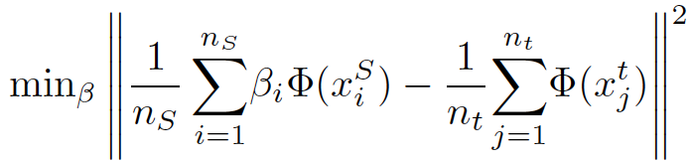
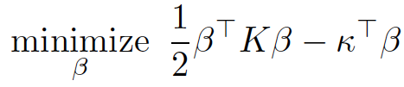
Kernel Mean Matching
Huang, Smola et al. NIPS 2007
KMM allows us to select examples
  “soft selection”
  using the features x_{i} from all tasks
Reweighs source examples to make them look similar to target examples
-- MMD
Notes:
Based on a feature map phi, KMM compares the mean of the reweighted source feature vectors with the mean of the target feature vectors. Clearly if the two distributions were identical, the means would be the same. For sufficiently rich phi such as gaussian kernels, matching the means is identical to matching the two distributions. Hence we can minimize the distance over all possible reweightings. This function is also called Maximum Mean Discrepancy (MMD).
Doing some simple algebra on this gives us this kernalized function.

Slide 12
Spectrum RBF kernel
Protein sequence based
RBF (Radial Basis Function) kernel over sequence features
Sequence features:
  incorporate physiochemical properties of amino acids
  compute k-mers for k=2, 3, 4, 5
  frequency of these k-mers

Slide 13


Step 1 : Instance reweighting
Source Tasks (S)
Task-1
Task-2
Source instances
with weight
(x₁ , y₁)
(x_{n1,} y_{n1})
(x₂ , y₂)
(x₃ , y₃)
β_{i}> 0
Train models
Θ₁ Θ₂ … Θ_{K}
number of
hyperparameters
Notes:
Minimize a reweighted loss function, for instance reweighted logistic loss or hinge loss.

Slide 14
Step 2 : Model selection
Θ₁ Θ₂ … Θ_{K}
Θ*
Two techniques:
Class-skew based selection
Reweighted cross-validation

Slide 15
3. Results

Slide 16

Models compared
Inductive Kernel-SVM
  assumes P(S) = P(T)
Transductive SVM
  treat target task as “test data”
KMM + Kernel-SVM
  with two model selection strategies:
    Class-skew based (skew)
    Reweighted cross-validation (rwcv)

Slide 17
Datasets
 | Human – F. tularensis | Human - E. coli | Human - Salmonella | Plant – Salmonella
No. of known interactions | 1380 | 32 | 62 | 0
Cannot evaluate on Plant – Salmonella
Use other tasks for quantitative evaluation

Slide 18
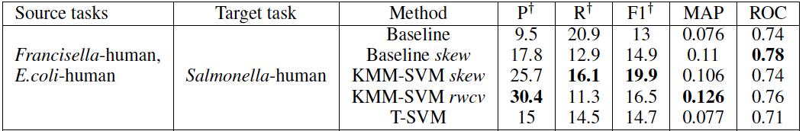
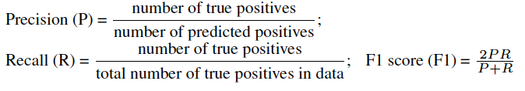
10-fold cross-validation: Average F1
Train Held-out Test
8 folds 1 fold 1 fold

Slide 19
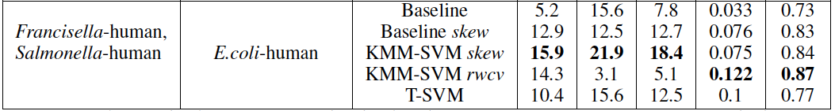
10-fold cross-validation: Average F1

Slide 20
Plant – Salmonella interactome
Preliminary analysis of predictions shows enrichment of interesting plant processes
Expanded model with additional tasks:
  A. thaliana – Agrobact. tumefaciens
  A. thaliana – E. coli
  A. thaliana - Pseudomonas syringae
  A. thaliana – Synechocystis
Predictions currently under validation

Slide 21
Conclusion
Presented a technique to predict PPI in tasks with no supervised data
Advantages:
  Simple and intuitive method
  Can use different feature spaces for each task
Disadvantages:
  Kernel-SVM model is slow
  Model selection is challenging

Slide 22
References
J. Huang, A. Smola, A. Gretton, K.M. Borgwardt, and B. Scholkopf. Correcting sample selection bias by unlabeled data. NIPS, 2007.
Schleker, S., Sun, J., Raghavan, B., et al. (2012). The current salmonella-host interactome. Proteomics Clin Appl.

Slide 23
Questions
?

Slide 24
PHISTO¹
Pathogens and their interactions data
10
100
1000
(logscale)
M. anthritidis
C. sordelli
C. difficile
C. botulinum
S. dysgalactiae
S. pyrogenes
L. monocytogenes
B. anthracis
S. aureus
C. trachomatis
N. meningitidis
Number of host-pathogen interactions in the database
V. cholerae
E. coli-O15
E. coli-K12
S. enterica
Y. pseudotubercu.
Phylogenetic tree of the pathogen species
Y. pestis
Y. enterocolitica
S. flexneri
L. pneumophila
M. catarrhalis
P. aeruginosa
F. tularensis
H. pylori-J9
C. jejuni
Notes:
PHISTO is one database for host-pathogen protein interactions.
This chart shows a subset of the host-pathogen interactions in this database. On the left is a phylogenetic tree that I constructed using all the pathogen species. On the right hand you can see a histogram that shows the number of interactions for each pathogen. The take-away message here is – host-pathogen data spans several organisms and collectively we have a large repository of interactions. Can we combine all these interactions to build better models? Our work tries to address this question.
And we use the multi-task learning paradigm from machine learning which focuses on jointly building models when there exist multiple similar problems. In our scenario, each host-pathogen interaction prediction is one task.
We use three of these datasets – most of the interactions in these 3 are from high throughput experiments. In addition we use a dataset from our collaborators which has Salmonella-human interactions. All of these 62 come from small-scale experiments. All four pathogens are bacterial species.

Slide 25
Infectious diseases : manifestation statistics
 | Illnesses | Hospitalization | Deaths
Bacterial | 5,204,934 | 45,826 | 1,468
Parasitic | 2,541,316 | 12,010 | 827
Viral | 30,833,391 | 123,341 | 433
Total | 38,629,641 | 181,177 | 2,718
Source: CDC (Center for Disease Control), US 2011
Notes:
To motivate this talk, I would like to present some statistics on infectious diseases. This table shows the number of infections, hospitalizations and deaths caused by a variety of pathogens in the US in 2011. The total number of infections were 38 million – the numbers are much higher in developing countries. Note that number of deaths caused by Bacterial infections were much higher despite a lower number of illnesses.

