Slide 1
Trade-offs in Explanatory
Model Learning
1
22nd of February 2012
DCAP Meeting
Madalina Fiterau

Slide 2
Outline
2
Motivation: need for interpretable models
Overview of data analysis tools
Model evaluation – accuracy vs complexity
Model evaluation – understandability
Example applications
Summary

Slide 3


Example Application:
Nuclear Threat Detection
Border control: vehicles are scanned
Human in the loop interpreting results
prediction
feedback
vehicle scan

Slide 4
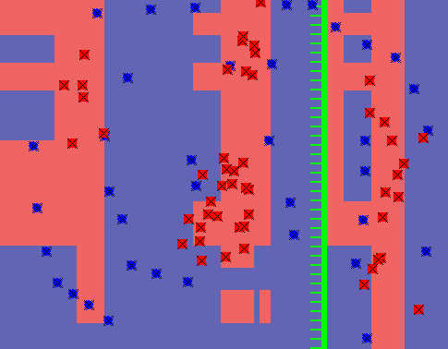

Boosted Decision Stumps
4
Accurate, but hard to interpret
How is the prediction derived from the input?

Slide 5
Decision Tree – More Interpretable
5
yes
Radiation > x%
no
no
Payload type = ceramics
yes
Consider balance of Th232, Ra226 and Co60
yes
Uranium level > max. admissible for ceramics
no
Threat
Clear

Slide 6
Motivation
6
Many users are willing to trade accuracy to
better understand the system-yielded results
Need: simple, interpretable model
Need: explanatory prediction process

Slide 7
Analysis Tools – Black-box
7
Random Forests
Boosting
Multi-boosting
Very accurate tree ensemble
L. Breiman,‘Random Forests’, 2001
Guarantee: decreases training error
R. Schapire, ‘The boosting approach to machine learning’
G. Webb, ‘MultiBoosting: A Technique for Combining Boosting and Weighted Bagging’
Bagged boosting

Slide 8
Analysis Tools – White-box
8
CART
Subspacing
EOP
Feating
Decision tree based on the Gini Impurity criterion
Dec. tree with leaf classifiers
K. Ting, G. Webb, ‘FaSS: Ensembles for Stable Learners’
Ensemble: each discriminator trained on a random subset of features
R. Bryll, ‘Attribute bagging ’
Builds a decision list that selects the classifier to deal with a query point

Slide 9
Explanation-Oriented Partitioning
9
2 Gaussians
Uniform cube
(X,Y) plot

Slide 10
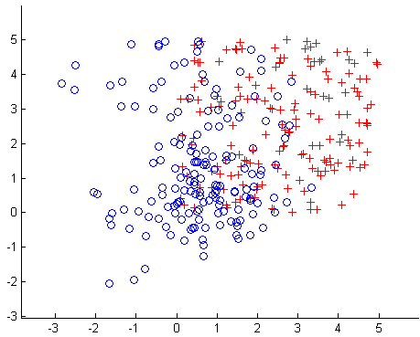

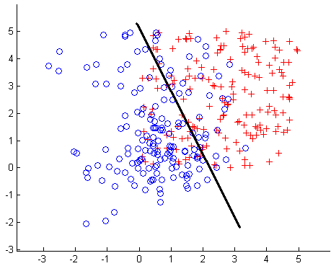
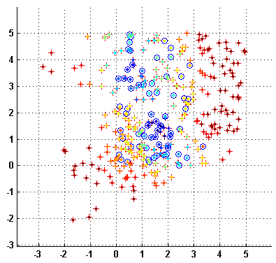
EOP Execution Example – 3D data
Step 1: Select a projection - (X₁,X₂)

Slide 11
EOP Execution Example – 3D data
Step 1: Select a projection - (X₁,X₂)

Slide 12
EOP Execution Example – 3D data
h₁
Step 2: Choose a good classifier - call it h₁

Slide 13
EOP Execution Example – 3D data
Step 2: Choose a good classifier - call it h₁

Slide 14
EOP Execution Example – 3D data
OK
NOT OK
Step 3: Estimate accuracy of h₁ at each point

Slide 15
EOP Execution Example – 3D data
Step 3: Estimate accuracy of h₁ for each point

Slide 16
EOP Execution Example – 3D data
Step 4: Identify high accuracy regions

Slide 17
EOP Execution Example – 3D data
Step 4: Identify high accuracy regions

Slide 18
EOP Execution Example – 3D data
Step 5:Training points - removed from consideration

Slide 19
EOP Execution Example – 3D data
Step 5:Training points - removed from consideration

Slide 20
EOP Execution Example – 3D data
Finished first iteration

Slide 21
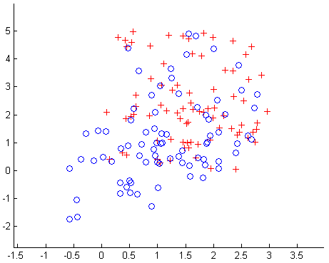
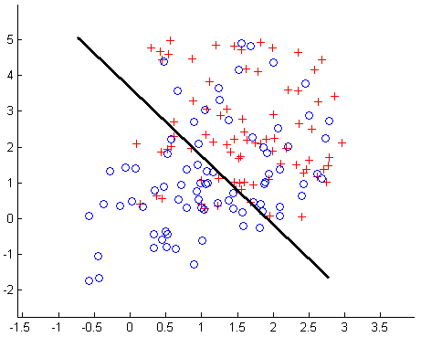
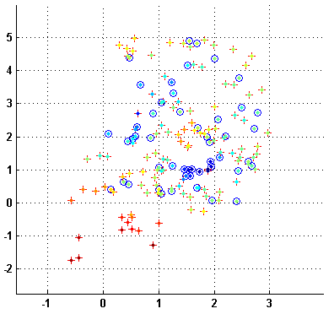
EOP Execution Example – 3D data
Finished second iteration

Slide 22
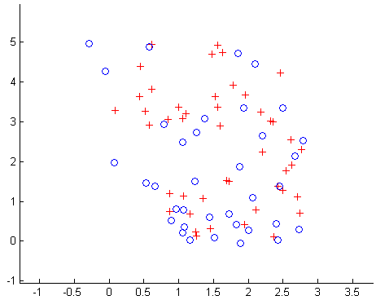
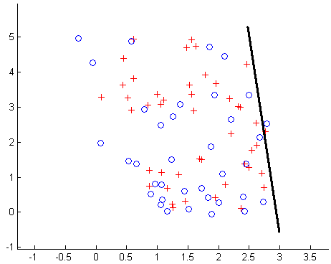
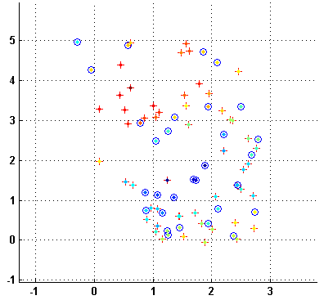
EOP Execution Example – 3D data
Iterate until all data is accounted for
or error cannot be decreased

Slide 23
Learned Model –
Processing query [x₁x₂x₃]
[x₁x₂] in R₁ ?
yes
h₁(x₁x₂)
no
[x₂x₃] in R₂ ?
yes
h₂(x₂x₃)
no
[x₁x₃] in R₃ ?
yes
h₃(x₁x₃)
no
Default Value

Slide 24

Parametric / Nonparametric Regions
Bounding Polyhedra |  | Nearest-neighbor Score
Enclose points in convex shapes (hyper-rectangles /spheres). |  | Consider the k-nearest neighbors Region: { X | Score(X) > t} t – learned threshold
 | Easy to test inclusion |  | Easy to test inclusion
 | Visually appealing |  | Can look insular
 | Inflexible |  | Deals with irregularities
decision
decision
n₃
p
n₂
n₅
n₁
n₄
Incorrectly classified
Correctly classified
Query point

Slide 25
EOP in context
25
Similarities
Differences
CART
Default classifiers in leafs
Decision structure
Feating
Models trained on all features
Local models
Subspacing
Low-d projection
Keeps all data points
Multiboosting
Ensemble learner
Committee decision
Gradually deals with difficult data
Boosting
Notes:
- Put boosting and CART on top of the table

Slide 26
Outline
26
Motivation: need for interpretable models
Overview of data analysis tools
Model evaluation – accuracy vs complexity
Model evaluation – understandability
Example applications
Summary

Slide 27
Overview of datasets
27
Real valued features, binary output
Artificial data – 10 features
  Low-d Gaussians/uniform cubes
UCI repository
Application-related datasets
Results by k-fold cross validation
  Accuracy
  Complexity = expected number of vector operations performed for a classification task
  Understandability = w.r.t. acknowledged metrics

Slide 28
EOP vs AdaBoost - SVM base classifiers
EOP is often less accurate, but not significantly
the reduction of complexity is statistically significant
Accuracy
Boosting
Complexity
EOP (nonparametric)
mean diff in accuracy: 0.5%
mean diff in complexity: 85
p-value of paired t-test: 0.832
p-value of paired t-test: 0.003

Slide 29
EOP (stumps as base classifiers) vs CART on data from the UCI repository
CART
EOP N.
EOP P.
Accuracy
Complexity
CART is the most accurate
Parametric EOP yields the simplest models
Dataset | # of Features | # of Points
Breast Tissue | 10 | 1006
Vowel | 9 | 990
MiniBOONE | 10 | 5000
Breast Cancer | 10 | 596

Slide 30
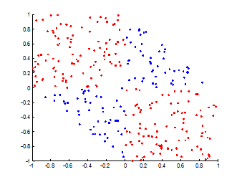
Why are EOP models less complex?
Typical XOR dataset

Slide 31
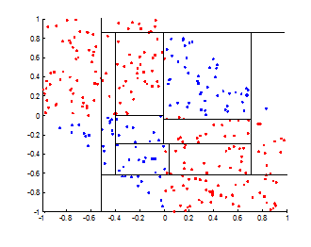
Why are EOP models less complex?
Typical XOR dataset
CART
is accurate
takes many iterations
does not uncover or leverage structure of data

Slide 32
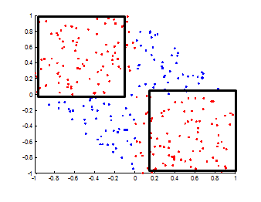
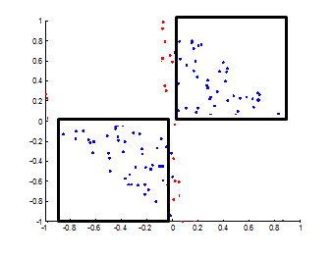
Why are EOP models less complex?
Typical XOR dataset
EOP
equally accurate
uncovers structure
CART
is accurate
takes many iterations
does not uncover or leverage structure of data
+
o
Iteration 1
o
+
Iteration 2

Slide 33
Error Variation With Model Complexity for EOP and CART
Error
Depth of decision tree/list
At low complexities, EOP is typically more accurate
Notes:
4. #33 recommend using "escalation" concept as a story behind it (more instances can be resolved by EOP at the first level of its hierarchy when compared to CART, etc), also showing only 4 lines to depict differences will make it more understandable

Slide 34
Error Variation With Model Complexity for EOP and CART
EOP_Error-CART_Error
Depth of decision tree/list
At low complexities, EOP is typically more accurate
Notes:
4. #33 recommend using "escalation" concept as a story behind it (more instances can be resolved by EOP at the first level of its hierarchy when compared to CART, etc), also showing only 4 lines to depict differences will make it more understandable

Slide 35
UCI data – Accuracy
35
White box models – including EOP – do not lose much

Slide 36
UCI data – Model complexity
36
White box models – especially EOP – are less complex
Complexity of Random Forests is huge
- thousands of nodes -

Slide 37
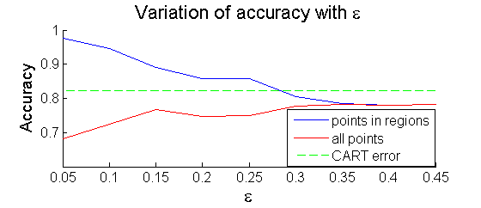
Robustness
Accuracy-targeting EOP
  Identifies which portions of the data can be confidently classified with a given rate.
  Allowed to set aside the noisy part of the data.
Accuracy of AT-EOP on 3D data
Accuracy
Max allowed expected error

Slide 38
Outline
38
Motivation: need for interpretable models
Overview of data analysis tools
Model evaluation – accuracy vs complexity
Model evaluation – understandability
Example applications
Summary

Slide 39




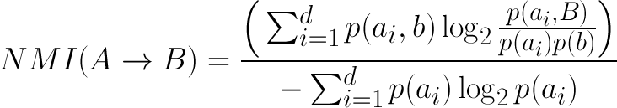
Metrics of Explainability*
Lift
Bayes Factor
J-Score
Normalized Mutual Information
* L.Geng and H. J. Hamilton - ‘Interestingness measures for data mining: A survey’

Slide 40
Evaluation with usefulness metrics
For 3 out of 4 metrics, EOP beats CART
 | CART |  |  |  | EOP
 | BF | L | J | NMI | BF | L | J | NMI
MB | 1.982 | 0.004 | 0.389 | 0.040 | 1.889 | 0.007 | 0.201 | 0.502
BCW | 1.057 | 0.007 | 0.004 | 0.011 | 2.204 | 0.069 | 0.150 | 0.635
BT | 0.000 | 0.009 | 0.210 | 0.000 | Inf | 0.021 | 0.088 | 0.643
V | Inf | 0.020 | 0.210 | 0.010 | 2.166 | 0.040 | 0.177 | 0.383
Mean | 1.520 | 0.010 | 0.203 | 0.015 | 2.047 | 0.034 | 0.154 | 0.541
BF =Bayes Factor. L = Lift. J = J-score. NMI = Normalized Mutual Info
Higher values are better

Slide 41
Outline
41
Motivation: need for interpretable models
Overview of data analysis tools
Model evaluation – accuracy vs complexity
Model evaluation – understandability
Example applications
Summary

Slide 42
Spam Detection (UCI ‘SPAMBASE’)
42
10 features: frequencies of misc. words in e-mails
Output: spam or not
Complexity

Slide 43
Spam Detection – Iteration 1
43
  classifier labels everything as spam
  high confidence regions do enclose mostly spam and:
    Incidence of the word ‘your’ is low
    Length of text in capital letters is high

Slide 44
Spam Detection – Iteration 2
44
  the required incidence of capitals is increased
  the square region on the left also encloses examples that will be marked as `not spam'

Slide 45
Spam Detection – Iteration 3
45
  Classifier marks everything as spam
  Frequency of ‘our’ and ‘hi’ determine the regions
word_frequency_hi

Slide 46




Example Applications
Stem Cells
ICU Medication
explain relationships between treatment
and cell evolution
identify combinations of drugs that correlate with readmissions
sparse features
class imbalance
Fuel Consumption
Nuclear Threats
identify causes of excess fuel consumption among driving behaviors
support interpretation of radioactivity detected in cargo containers
adapted regression problem
- high-d data
- train/test from different distributions
Notes:
!! For each, say what characteristics of the data make the problem special !!
Cell Data – explain relationships between treatment and cell evolution;
ICU Medication – identify combinations of drugs that correlate with readmissions
Fuel Consumption – identify causes of excess fuel consumption among driving behaviors
Nuclear Threats – support interpretation of radioactivity detected in cargo containers

Slide 47
Effects of Cell Treatment
47
Monitored population of cells
7 features: cycle time, area, perimeter ...
Task: determine which cells were treated
Complexity

Slide 48
48

Slide 49
Mimic Medication Data
49
Information about administered medication
Features: dosage for each drug
Task: predict patient return to ICU
Complexity

Slide 50
50

Slide 51
Predicting Fuel Consumption
51
10 features: vehicle and driving style characteristics
Output: fuel consumption level (high/low)
Complexity

Slide 52
52

Slide 53
Nuclear threat detection data
53
325 Features
Random Forests accuracy: 0.94
Rectangular EOP accuracy: 0.881
… but
Regions found in 1st iteration for Fold 0:
  incident.riidFeatures.SNR [2.90,9.2]
  Incident.riidFeatures.gammaDose [0,1.86]*10⁻⁸
Regions found in 1st iteration for Fold 1:
  incident.rpmFeatures.gamma.sigma [2.5, 17.381]
  incident.rpmFeatures.gammaStatistics.skewdose [1.31,…]
No match

Slide 54
Feating and EOP
54
Feating
EOP
Tiles in feature space
Decision Structures to pick right classification model
Flexible Regions
Models trained on all features
Models trained on subspaces
Decision Tree
Decision List

Slide 55
Summary
55
In most cases EOP:
  maintains accuracy
  reduces complexity
  identifies useful aspects of the data
EOP typically wins in terms of expressiveness
Open questions:
  What if no good low-dimensional projections exist?
  What to do with inconsistent models in folds of CV?
  What is the best metric of explainability?

