Slide 1


WRS: Waiting Room Sampling for Accurate Triangle Counting in Real Graph Streams
Kijung Shin

Slide 2



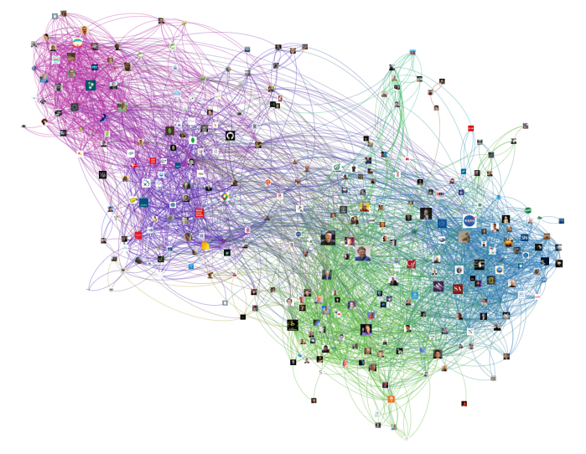



Triangles in a Graph
Introduction
Pattern
Algorithm
Experiments
Conclusion
Graphs are everywhere!
Social Network, Web, Emails, etc.
Triangles are a fundamental primitive
3 nodes connected to each other
Counting triangles has many applications
Community detection, Spam detection, Query optimization

Slide 3



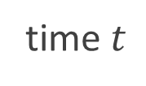
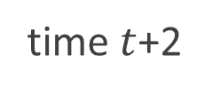
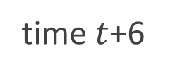
Challenges in Real Graphs
Introduction
Pattern
Algorithm
Experiments
Conclusion
Many algorithms for small and fixed graphs
However, real-world graphs are
Large: may not fit in main memory
Growing: new nodes and edges are added
Need to consider realistic settings
time $t$
time $t$+2
time $t$+6

Slide 4


Streaming Model
Introduction
Pattern
Algorithm
Experiments
Conclusion
Stream of edges
edges are streamed one by one from sources
Any or adversarial order
edges can be in any order in the stream
Limited memory
not every edge can be stored in memory
too strong
Source
Destination

Slide 5

Relaxed Streaming Model
Introduction
Pattern
Algorithm
Experiments
Conclusion
Stream of edges
edges are streamed one by one from sources
Chronological order
natural for dynamic graphs
edges are streamed when they are created
Limited memory
not every edge can be stored in memory
“What temporal patterns do exist?”
“How can we exploit them for accurate triangle counting?”

Slide 6


Roadmap
Introduction
Temporal Pattern <<
Proposed Algorithm
Experiments
Conclusion

Slide 7
Time Interval of a Triangle
Introduction
Pattern
Algorithm
Experiments
Conclusion
Time interval of a triangle:
arrival order
of its last edge
arrival order
of its first edge
–
Time interval
1 2 3 4 5 6 7 8
arrival order

Slide 8
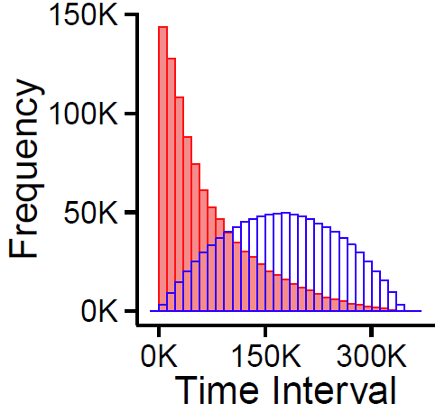

Time Interval Distribution
Temporal Locality:
average time interval is
2X shorter in the chronological order
than in a random order
chronological
order
chronological arrival order
random order
random arrival order

Slide 9
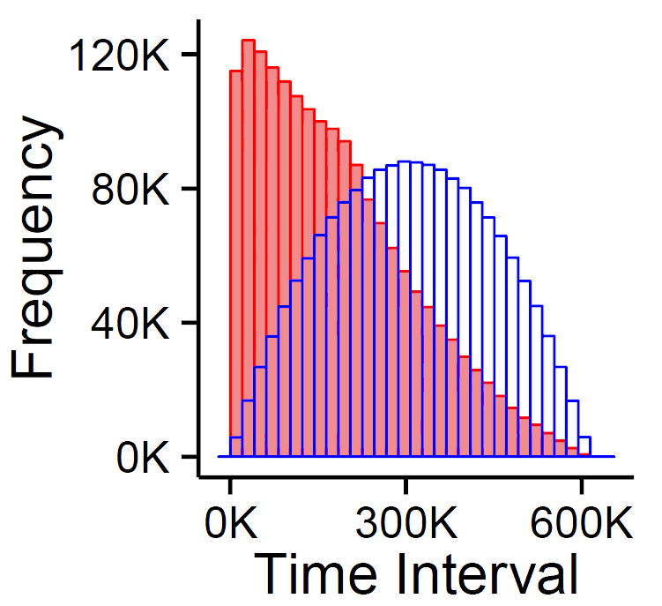

Temporal Locality (cont.)
Introduction
Pattern
Algorithm
Experiments
Conclusion
One interpretation:
edges are more likely to form
triangles with edges close in time
than with edges far in time
Another interpretation:
new edges are more likely to form
triangles with recent edges
than with old edges
chronological
order
random
order
“How can we exploit temporal locality
for accurate triangle counting?”

Slide 10
Roadmap
Introduction
Temporal Pattern
Proposed Algorithm <<
Experiments
Conclusion

Slide 11

Problem Definition
Introduction
Pattern
Algorithm
Experiments
Conclusion
Given:
a graph stream in the chronological order
memory budget:$k$ (i.e., up to $k$ edges can be stored)
Estimate: counts of global and local triangles
To Minimize: estimation error
3
2
Global triangles: all triangles in the graph
Local triangles: the triangles incident to each node
1
3
1
2
4
3
2
1

Slide 12

Algorithm Overview
Introduction
Pattern
Algorithm
Experiments
Conclusion
General approach used in [LK15] [DERU16]
∆: our estimate of global triangle counts
$p_{uvw}$: probability that triangle $(u,v,w)$ is discovered

Slide 13





Algorithm Overview
Introduction
Pattern
Algorithm
Experiments
Conclusion
General approach used in [LK15] [DERU16]
∆: our estimate of global triangle counts
$p_{uvw}$: probability that triangle $(u,v,w)$ is discovered
(1) Edge Arrival
new edge
$$u−v$$
$$u$$
$$|$$
$$x$$
$$u$$
$$|$$
$$y$$
$$v$$
$$|$$
$$x$$
$$v$$
$$|$$
$$v$$
memory

Slide 14












Algorithm Overview
Introduction
Pattern
Algorithm
Experiments
Conclusion
General approach used in [LK15] [DERU16]
∆: our estimate of global triangle counts
$p_{uvw}$: probability that triangle $(u,v,w)$ is discovered
(1) Edge Arrival
(2) Counting Step
discover!
new edge
$$u−v$$
$$u−v$$
$$u−v$$
$$x$$
$$u$$
$$|$$
$$x$$
$$u$$
$$|$$
$$y$$
$$v$$
$$|$$
$$x$$
$$v$$
$$|$$
$$v$$
$$u$$
$$|$$
$$x$$
$$u$$
$$|$$
$$y$$
$$v$$
$$|$$
$$x$$
$$v$$
$$|$$
$$v$$
memory
$$∆←∆+1/p_{uvx}$$

Slide 15





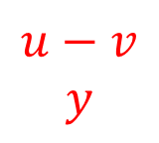

Algorithm Overview
Introduction
Pattern
Algorithm
Experiments
Conclusion
General approach used in [LK15] [DERU16]
∆: our estimate of global triangle counts
$p_{uvw}$: probability that triangle $(u,v,w)$ is discovered
(1) Edge Arrival
(2) Counting Step
discover!
new edge
$$u−v$$
$$u−v$$
$$u−v$$
$$y$$
$$u$$
$$|$$
$$x$$
$$u$$
$$|$$
$$y$$
$$v$$
$$|$$
$$x$$
$$v$$
$$|$$
$$v$$
$$u$$
$$|$$
$$x$$
$$u$$
$$|$$
$$y$$
$$v$$
$$|$$
$$x$$
$$v$$
$$|$$
$$v$$
memory
$$∆←∆+1/p_{uvy}$$

Slide 16
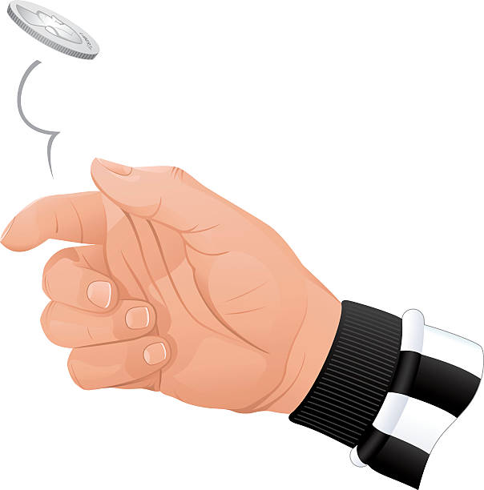
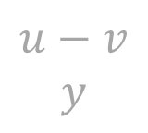










Algorithm Overview
Introduction
Pattern
Algorithm
Experiments
Conclusion
General approach used in [LK15] [DERU16]
∆: our estimate of global triangle counts
$p_{uvw}$: probability that triangle $(u,v,w)$ is discovered
(1) Edge Arrival
(2) Counting Step
(3) Sampling Step
(to be explained)
new edge
$$u−v$$
$$u−v$$
$$u−v$$
$$y$$
$$u$$
$$|$$
$$x$$
$$u$$
$$|$$
$$y$$
$$v$$
$$|$$
$$x$$
$$v$$
$$|$$
$$v$$
$$u$$
$$|$$
$$x$$
$$u$$
$$|$$
$$y$$
$$v$$
$$|$$
$$x$$
$$v$$
$$|$$
$$v$$
$$u$$
$$|$$
$$x$$
$$u$$
$$|$$
$$v$$
$$v$$
$$|$$
$$x$$
$$v$$
$$|$$
$$v$$
memory
$$∆←∆+1/p_{uvy}$$

Slide 17

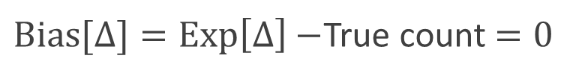
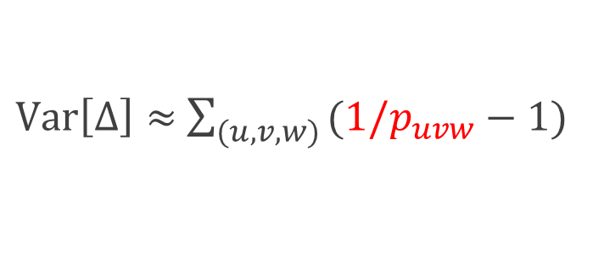
Bias and Variance Analyses
Introduction
Pattern
Algorithm
Experiments
Conclusion
Bias and variance analyses results
Theorem. Unbiasedness of our estimate:
Theorem. Variance of our estimate:
should increase discovering probability $p_{uvw}$
which depends on sampling algorithms
$Bias[∆]=Exp\left[∆\right]−$True count$=0$
$Var\left[∆\right]≈$ $\sum_{(u,v,w) }{(1/p_{uvw}−1)}$

Slide 18
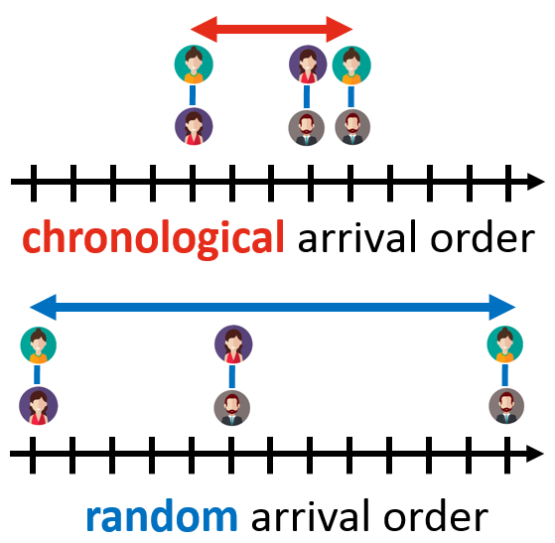
Increasing Discovering Prob.
Introduction
Pattern
Algorithm
Experiments
Conclusion
“How can we increase
discovering probabilities of triangles?”
Recall Temporal Locality:
new edges are more likely to form
triangles with recent edges
than with old edges
Waiting-Room Sampling (WRS)
exploits temporal locality
by treating recent edges better than old edges

Slide 19
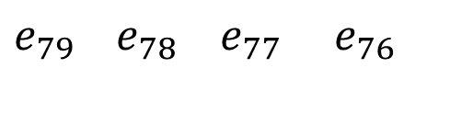
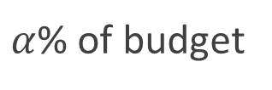
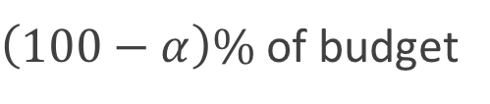

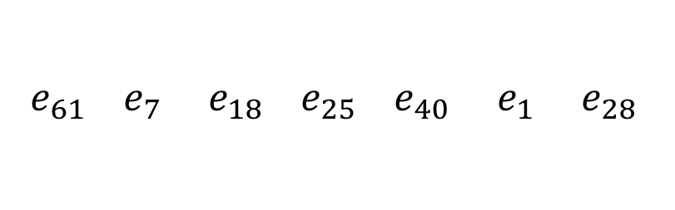
Waiting-Room Sampling (WRS)
Introduction
Pattern
Algorithm
Experiments
Conclusion
Divides memory space into two parts
Waiting Room: stores latest edges
Reservoir: store samples from the remaining edges
New edge
$$e_{80}$$
Waiting Room (FIFO)
Reservoir (Random Replace)
$e_{79}$ $e_{78}$ $e_{77}$ $e_{76}$
${ e}_{61}$ $e_{7}$ $e_{18}$ $e_{25}$ $e_{40}$ $e_{1}$ $e_{28}$
$α$% of budget
$\left(100−α\right)\%$ of budget

Slide 20

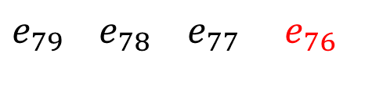

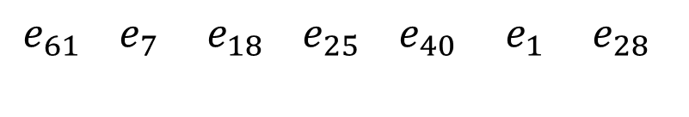
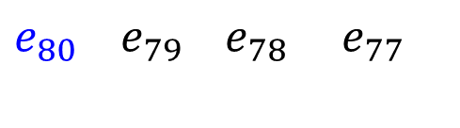
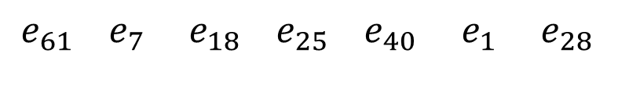
WRS: Sampling Steps (Step 1)
Introduction
Pattern
Algorithm
Experiments
Conclusion
New edge
$$e_{80}$$
Waiting Room (FIFO)
Reservoir (Random Replace)
$e_{79}$ $e_{78}$ $e_{77}$ $e_{76}$
${ e}_{61}$ $e_{7}$ $e_{18}$ $e_{25}$ $e_{40}$ $e_{1}$ $e_{28}$
Popped edge
$$e_{76}$$
Waiting Room (FIFO)
Reservoir (Random Replace)
$e_{80}$ $e_{79}$ $e_{78}$ $e_{77}$
${ e}_{61}$ $e_{7}$ $e_{18}$ $e_{25}$ $e_{40}$ $e_{1}$ $e_{28}$

Slide 21

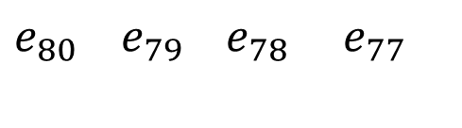
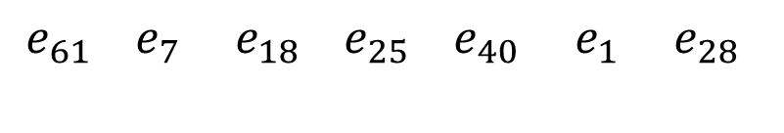
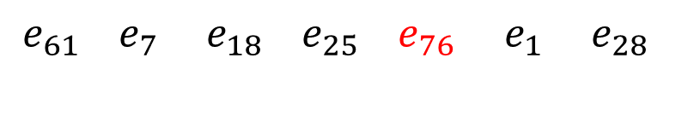
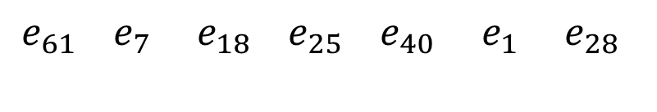
WRS: Sampling Steps (Step 2)
Introduction
Pattern
Algorithm
Experiments
Conclusion
Popped edge
$$e_{76}$$
Waiting Room (FIFO)
Reservoir (Random Replace)
$e_{80}$ $e_{79}$ $e_{78}$ $e_{77}$
${ e}_{61}$ $e_{7}$ $e_{18}$ $e_{25}$ $e_{40}$ $e_{1}$ $e_{28}$
replace!
store
${ e}_{61}$ $e_{7}$ $e_{18}$ $e_{25}$ $e_{76}$ $e_{1}$ $e_{28}$
or
or
discard
${ e}_{61}$ $e_{7}$ $e_{18}$ $e_{25}$ $e_{40}$ $e_{1}$ $e_{28}$

Slide 22


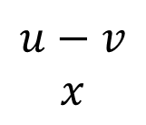













Summary of Algorithm
Introduction
Pattern
Algorithm
Experiments
Conclusion
(1) Arrival Step
(2) Discovery Step
(3) Sampling Step
discover!
new edge
$$u−v$$
$$u−v$$
$$u−v$$
$$x$$
$$u$$
$$|$$
$$x$$
$$u$$
$$|$$
$$y$$
$$v$$
$$|$$
$$x$$
$$v$$
$$|$$
$$v$$
$$u$$
$$|$$
$$x$$
$$u$$
$$|$$
$$y$$
$$v$$
$$|$$
$$x$$
$$v$$
$$|$$
$$v$$
$$u$$
$$|$$
$$x$$
$$u$$
$$|$$
$$v$$
$$v$$
$$|$$
$$x$$
$$v$$
$$|$$
$$v$$
memory
$$∆←∆+1/p_{uvx}$$
Waiting-Room
Sampling!

Slide 23
Roadmap
Introduction
Temporal Pattern
Proposed Algorithm
Experiments <<
Conclusion

Slide 24



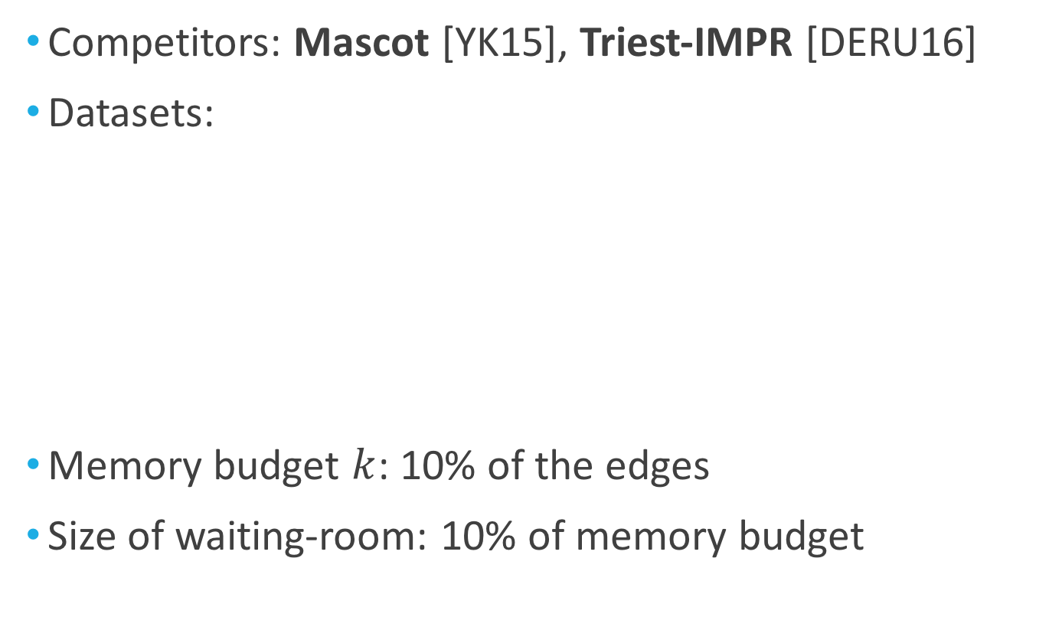
Experimental Settings
Introduction
Pattern
Algorithm
Experiments
Conclusion
Competitors: Mascot [YK15], Triest-IMPR [DERU16]
Datasets:
Memory budget $k$: 10% of the edges
Size of waiting-room: 10% of memory budget
citation
email
friendship

Slide 25
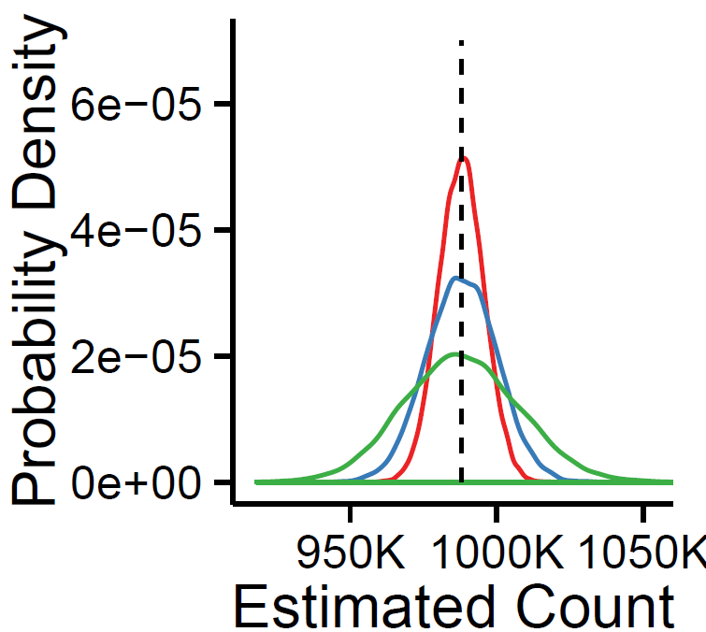
Distribution of Estimates
Introduction
Pattern
Algorithm
Experiments
Conclusion
Waiting Room Sampling (WRS) gives
unbiased estimates
with smallest variance
True Count
WRS
Triest-IMPR
MASCOT

Slide 26
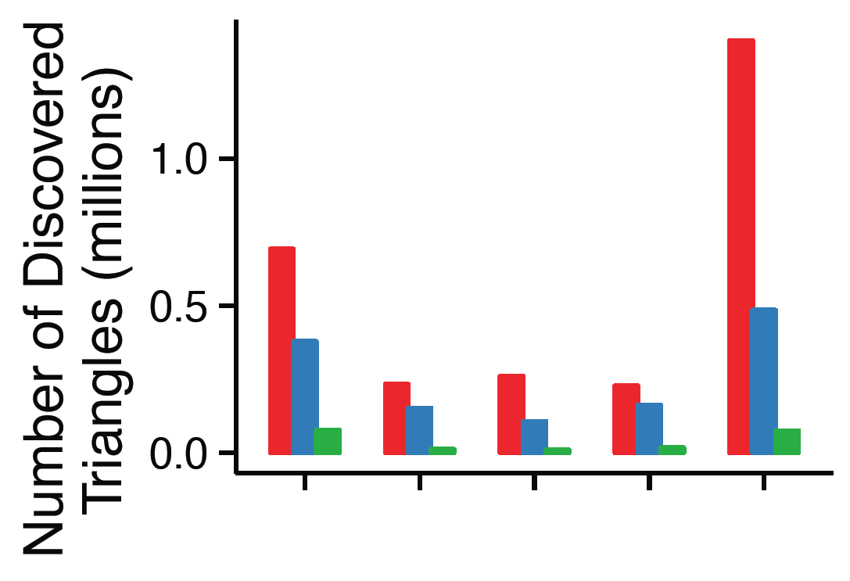

Discovering Probability
Introduction
Pattern
Algorithm
Experiments
Conclusion
WRS increases discovering probability $p_{uvw}$
WRS discovers up to $3×$more triangles
WRS
Triest-IMPR
MASCOT

Slide 27
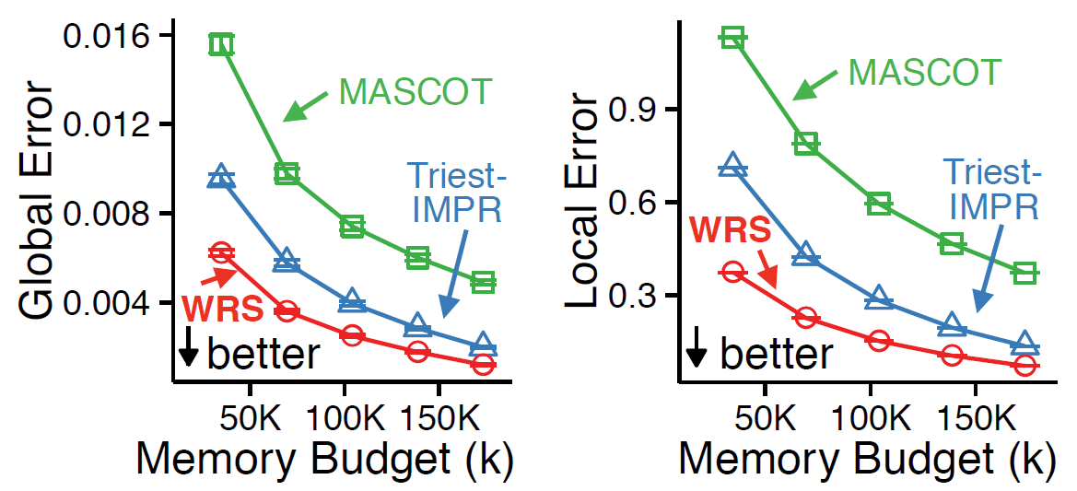
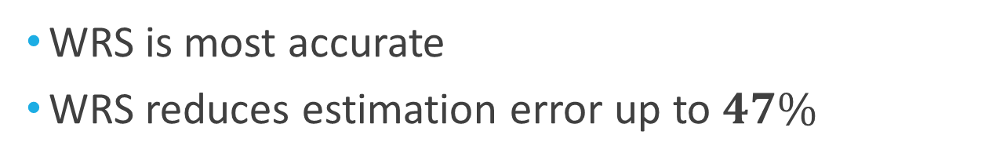
Estimation Errors
Introduction
Pattern
Algorithm
Experiments
Conclusion
WRS is most accurate
WRS reduces estimation error up to $47\%$

Slide 28
Roadmap
Introduction
Temporal Pattern
Proposed Algorithm
Experiments
Conclusion <<

Slide 29

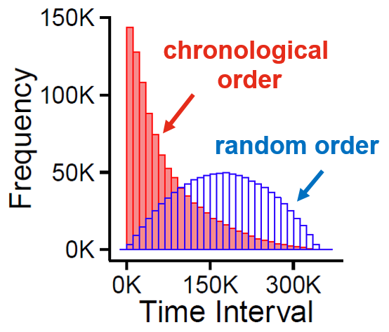
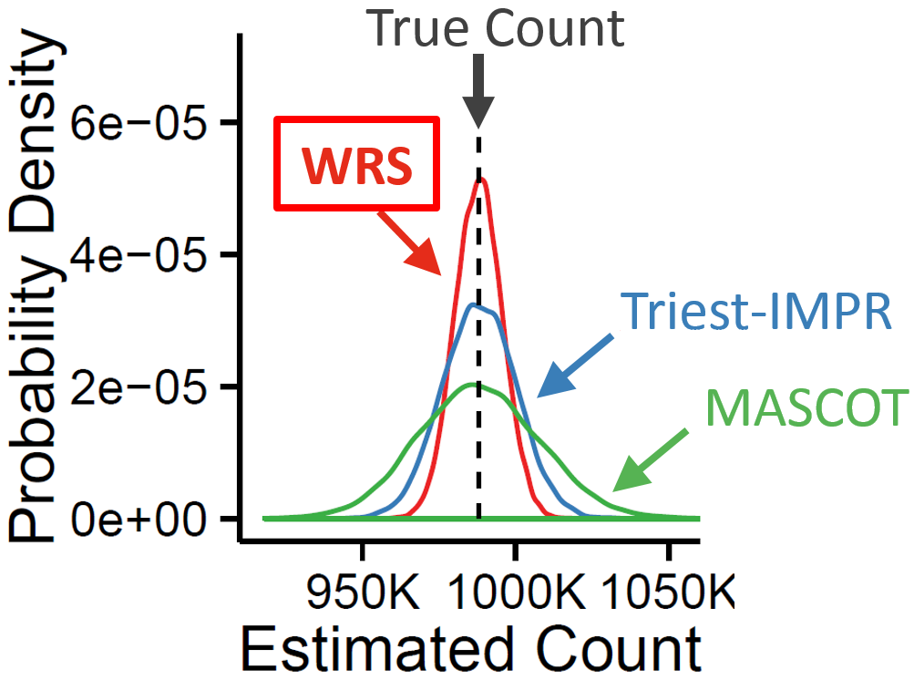
Contributions
Introduction
Pattern
Algorithm
Experiments
Conclusion
0.37
Pattern: Temporal Locality
short time interval of triangles in real graph streams
Algorithm: Waiting-Room Sampling (WRS)
exploits temporal locality for accurate triangle counting
Analyses: Bias and Variance Analyses
WRS gives unbiased estimates with small variances
0

Slide 30
Thank you!
Code and datasets:
https://github.com/kijungs/waiting_room
References:
[LK15] Yongsub Lim, and U Kang. "Mascot: Memory-efficient and accurate sampling for counting local triangles in graph streams.“ KDD 2015
[DERU16] Lorenzo De Stefani, Alessandro Epasto, Matteo Riondato and Eli Upfal. "TRIÈST: Counting Local and Global Triangles in Fully-Dynamic Streams with Fixed Memory Size." KDD 2016

