Slide 1

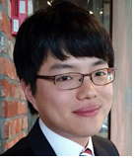


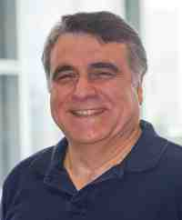
Think before You Discard:
Accurate Triangle Counting in Graph Streams with Deletions
Kijung Shin, Jisu Kim, Bryan Hooi, Christos Faloutsos

Slide 2



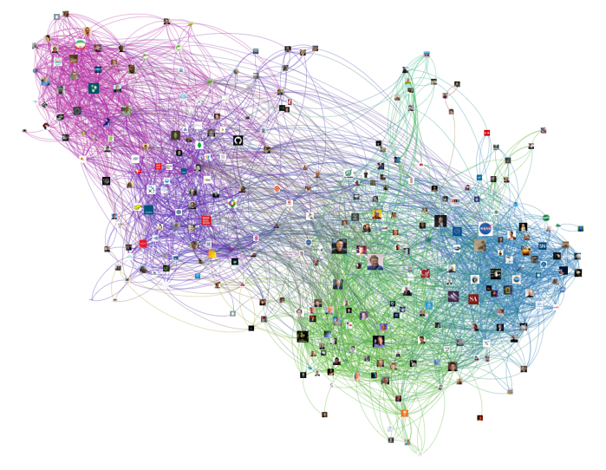



Triangles in a Graph
Introduction
Problem
Algorithm
Experiments
Conclusion
Graphs are everywhere!
  social networks, the web, citation networks
Triangles are a fundamental primitive
  3 nodes connected to each other
Counting triangles has many applications
  community detection, anomaly detection, query optimization

Slide 3


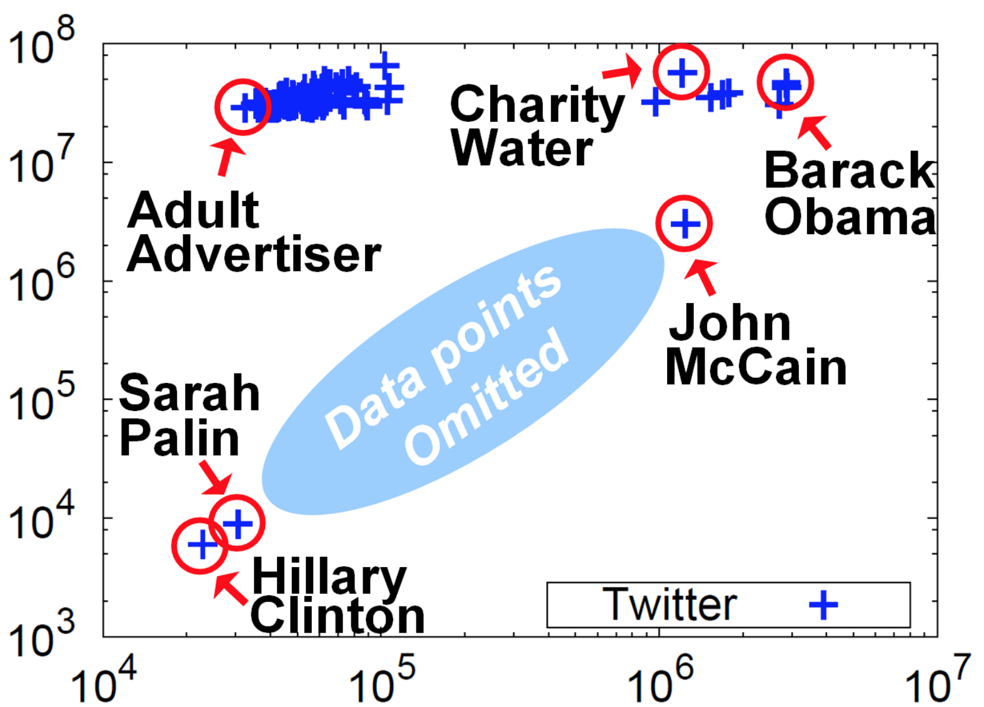
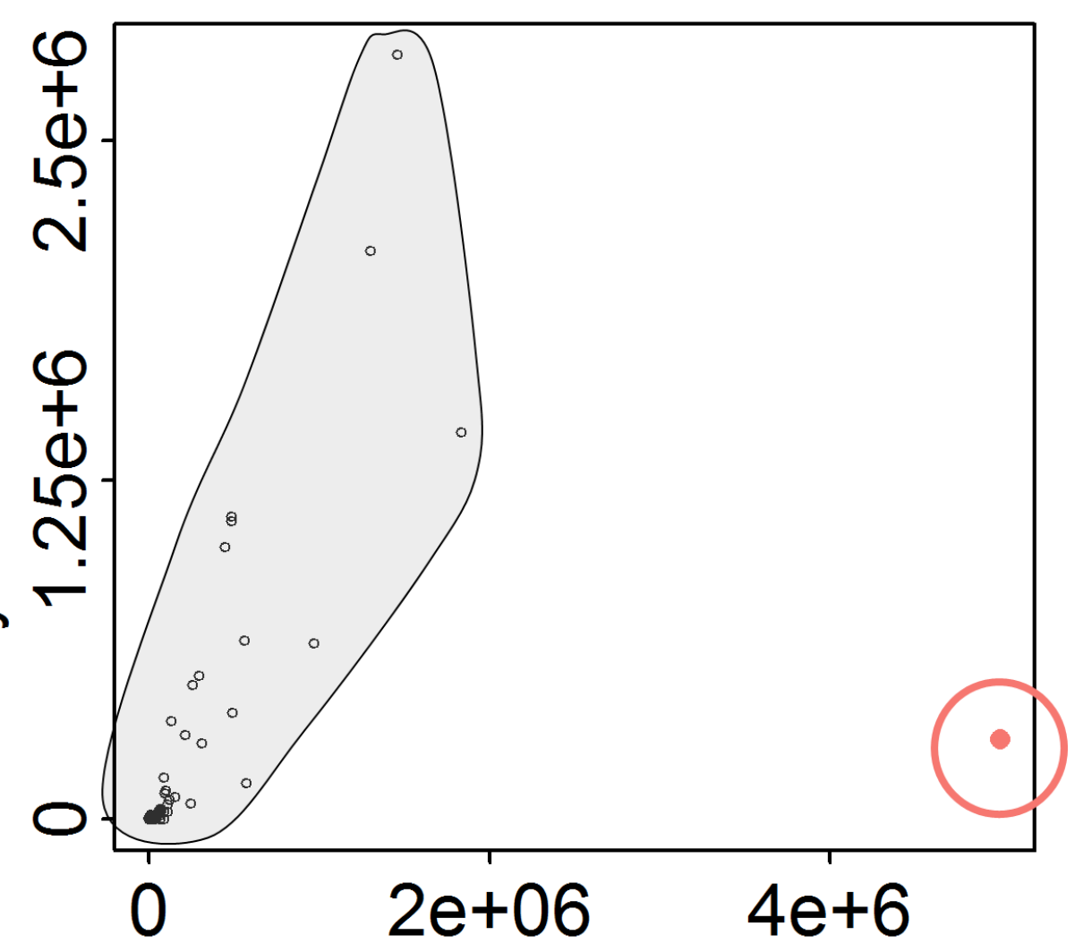
Application: Anomaly Detection
Introduction
Problem
Algorithm
Experiments
Conclusion
[KMF11]
[LJK18]
# Incident Triangles
# Incident Triangles
Telemarketer
Degree
Degree

Slide 4




Remaining Challenges
Introduction
Problem
Algorithm
Experiments
Conclusion
Counting triangles in real-world graphs
Real-world graphs are
  Large: not fitting in main memory
  Fully dynamic: both growing and shrinking
online social networks Web Citation networks Call networks

Slide 5




Previous Work
Introduction
Problem
Algorithm
Experiments
Conclusion
- Given: a large and fully-dynamic graph
- Goal: accurately estimate the count of triangles
 | Large Graph | Fully dynamic Graph |  | Accurate
 |  | Insertion | Deletion
MASCOT [LJK18]
Triest-IMPR [DERU17]
WRS [Shi17]
ESD [HS17]
Triest-FD [DERU17]
$$\sim 4×$$
$$\sim 4×$$
ThinkD (Proposed)

Slide 6
Our Contributions
Introduction
Problem
Algorithm
Experiments
Conclusion
We propose ThinkD (Think before You Discard)
Fast and Accurate: outperforming competitors
Scalable: linear data scalability
Theoretically Sound: unbiased estimates

Slide 7


Road Map
Problem Definition
Proposed Method: ThinkD
Experiments
Conclusions

Slide 8
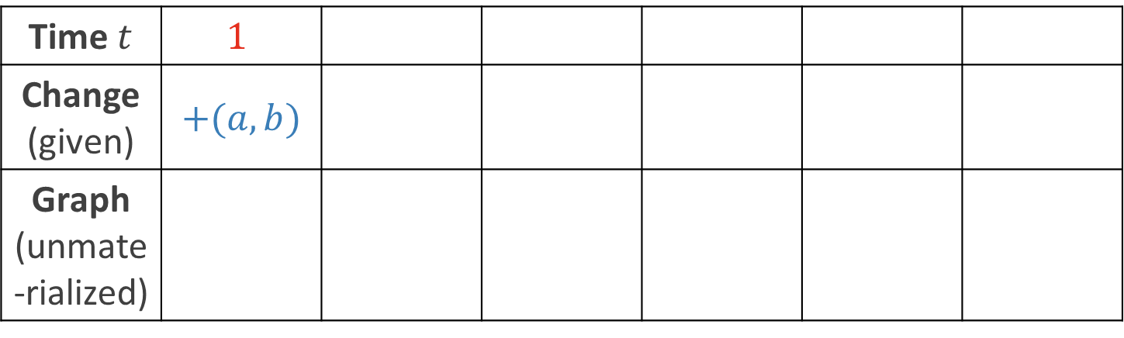



Fully Dynamic Graph Stream
Introduction
Problem
Algorithm
Experiments
Conclusion
Model for a large and fully-dynamic graph
Discrete time $t$, starting from 1 and ever increasing
At each time $t$, a change in the input graph arrives
  change: either an insertion or deletion of an edge
Time $t$ | $$1$$
Change (given) | $$+(a,b)$$
Graph (unmate-rialized)
$$a$$
$$b$$

Slide 9


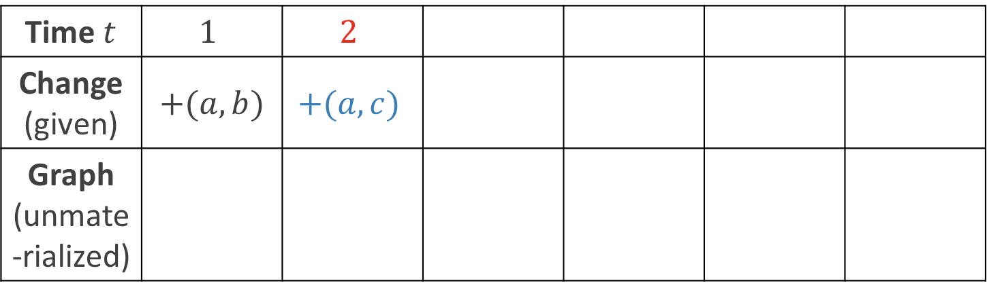
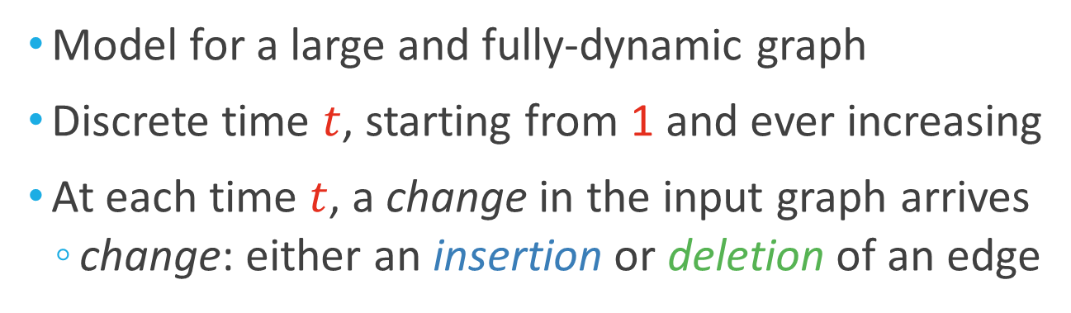

Fully Dynamic Graph Stream
Introduction
Problem
Algorithm
Experiments
Conclusion
Model for a large and fully-dynamic graph
Discrete time $t$, starting from 1 and ever increasing
At each time $t$, a change in the input graph arrives
  change: either an insertion or deletion of an edge
Time $t$ | $$1$$ | $$2$$
Change (given) | $$+(a,b)$$ | $$+(a,c)$$
Graph (unmate-rialized)
$$c$$
$$a$$
$$b$$
$$a$$
$$b$$

Slide 10

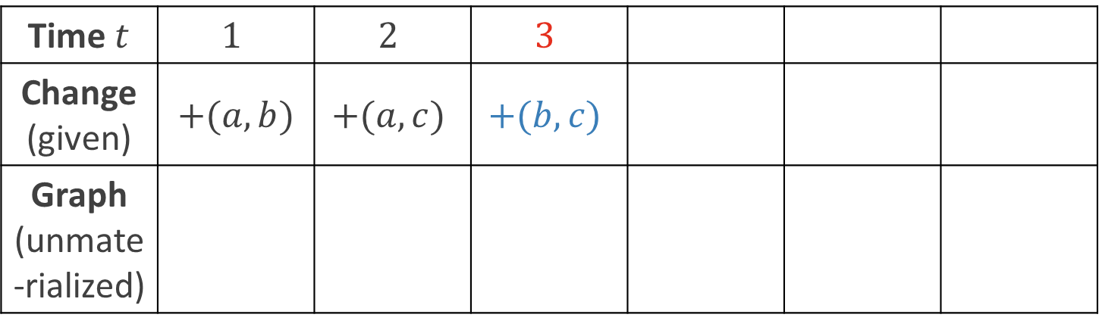







Fully Dynamic Graph Stream
Introduction
Problem
Algorithm
Experiments
Conclusion
Model for a large and fully-dynamic graph
Discrete time $t$, starting from 1 and ever increasing
At each time $t$, a change in the input graph arrives
  change: either an insertion or deletion of an edge
Time $t$ | $$1$$ | $$2$$ | $$3$$
Change (given) | $$+(a,b)$$ | $$+(a,c)$$ | $$+(b,c)$$
Graph (unmate-rialized)
$$c$$
$$c$$
$$a$$
$$b$$
$$a$$
$$b$$
$$a$$
$$b$$

Slide 11

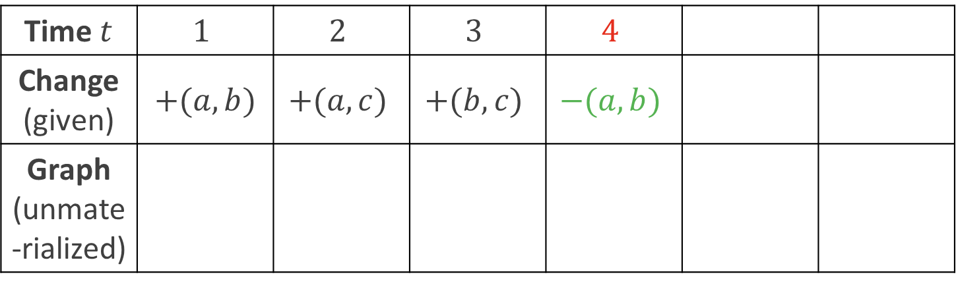


Fully Dynamic Graph Stream
Introduction
Problem
Algorithm
Experiments
Conclusion
Model for a large and fully-dynamic graph
Discrete time $t$, starting from 1 and ever increasing
At each time $t$, a change in the input graph arrives
  change: either an insertion or deletion of an edge
Time $t$ | $$1$$ | $$2$$ | $$3$$ | $$4$$
Change (given) | $$+(a,b)$$ | $$+(a,c)$$ | $$+(b,c)$$ | $$−(a,b)$$
Graph (unmate-rialized)
$$c$$
$$c$$
$$c$$
$$a$$
$$b$$
$$a$$
$$b$$
$$a$$
$$b$$
$$a$$
$$b$$

Slide 12



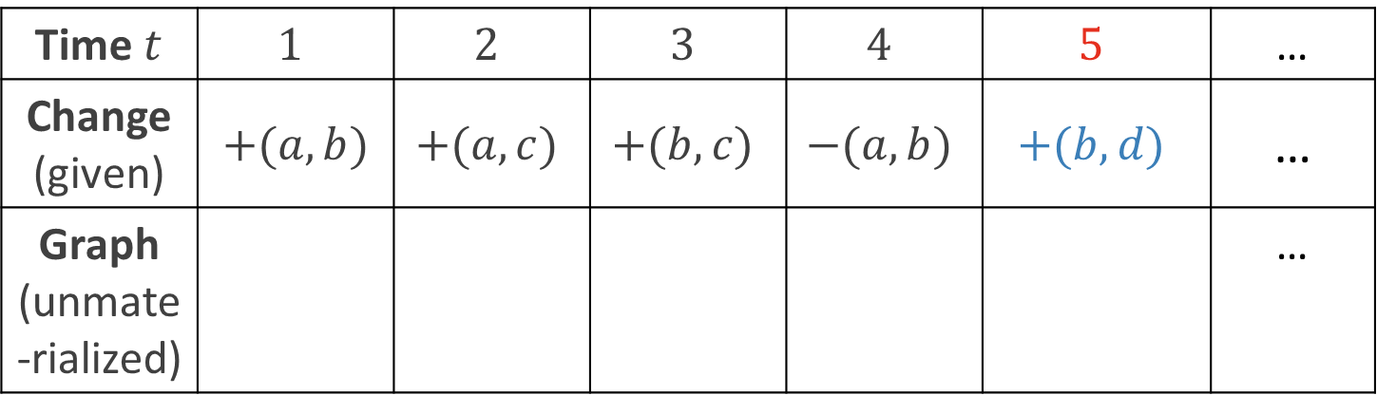

Fully Dynamic Graph Stream
Introduction
Problem
Algorithm
Experiments
Conclusion
Model for a large and fully-dynamic graph
Discrete time $t$, starting from 1 and ever increasing
At each time $t$, a change in the input graph arrives
  change: either an insertion or deletion of an edge
Time $t$ | $$1$$ | $$2$$ | $$3$$ | $$4$$ | $$5$$ | …
Change (given) | $$+(a,b)$$ | $$+(a,c)$$ | $$+(b,c)$$ | $$−(a,b)$$ | $$+(b,d)$$ | …
Graph (unmate-rialized) |  |  |  |  |  | …
$$c$$
$$c$$
$$c$$
$$c$$
$$d$$
$$a$$
$$b$$
$$a$$
$$b$$
$$a$$
$$b$$
$$a$$
$$b$$
$$a$$
$$b$$

Slide 13
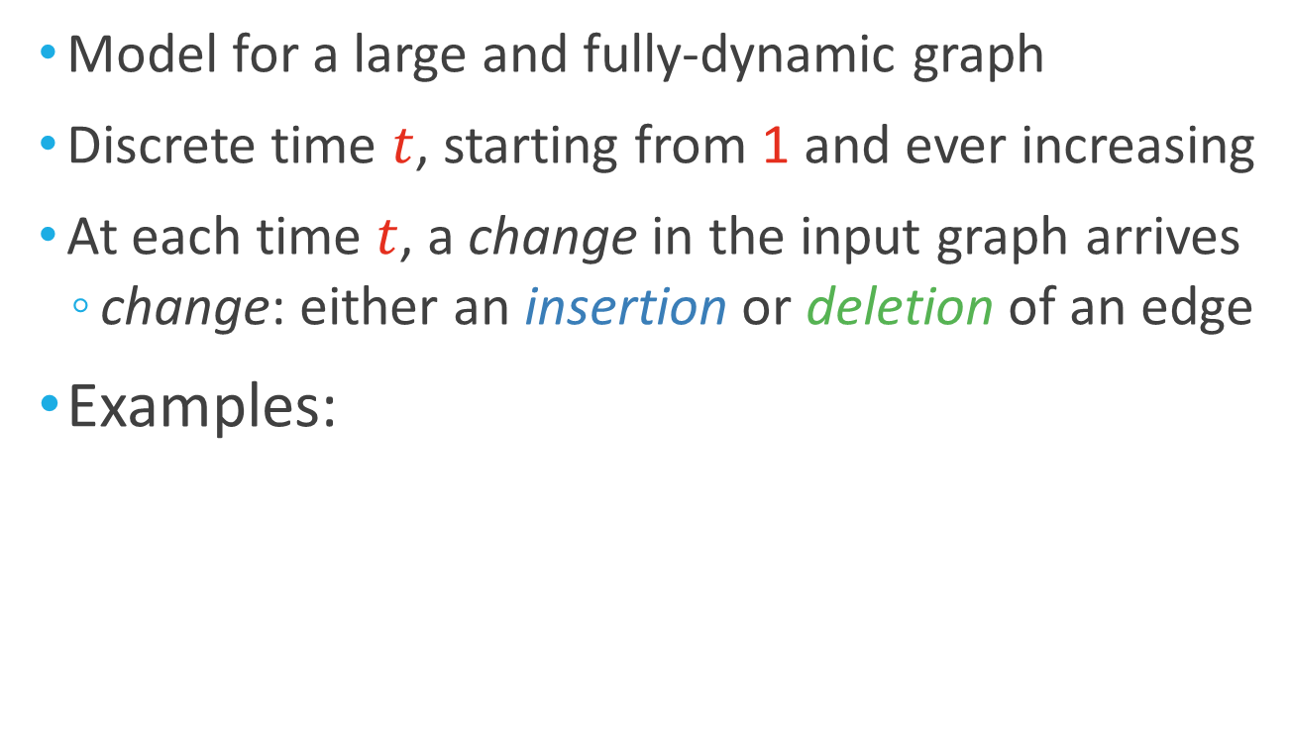
Fully Dynamic Graph Stream
Introduction
Problem
Algorithm
Experiments
Conclusion
Model for a large and fully-dynamic graph
Discrete time $t$, starting from 1 and ever increasing
At each time $t$, a change in the input graph arrives
  change: either an insertion or deletion of an edge
Examples:
…

Slide 14
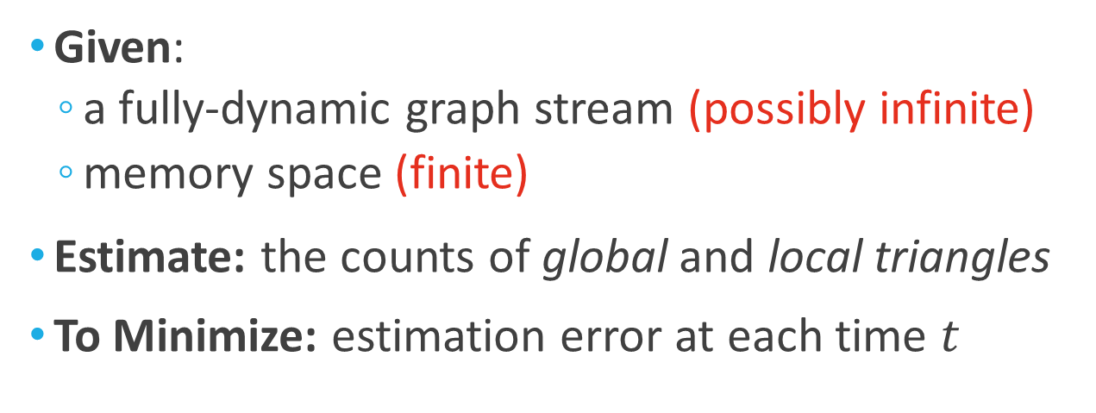
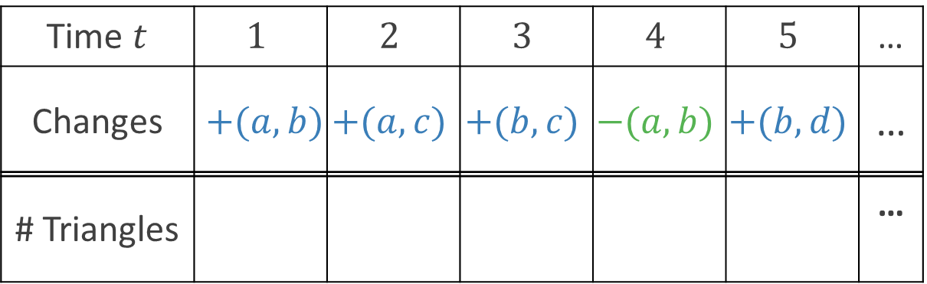
Problem Definition
Introduction
Problem
Algorithm
Experiments
Conclusion
Given:
  a fully-dynamic graph stream (possibly infinite)
  memory space (finite)
Estimate: the counts of global and local triangles
To Minimize: estimation error at each time $t$
Time $t$ | $$1$$ | $$2$$ | $$3$$ | $$4$$ | $$5$$ | …
Changes | $$+(a,b)$$ | $$+(a,c)$$ | $$+(b,c)$$ | $$−(a,b)$$ | $$+(b,d)$$ | …
# Triangles |  |  |  |  |  | …
Given
Estimate

Slide 15



Problem Definition (cont.)
Introduction
Problem
Algorithm
Experiments
Conclusion
Global Triangles: all triangles in the graph
Local triangles: the triangles incident to each node
3
2
1
3
1
2
4
3
2
1

Slide 16
Road Map
Problem Definition
Proposed Method: ThinkD <<
Experiments
Conclusions

Slide 17
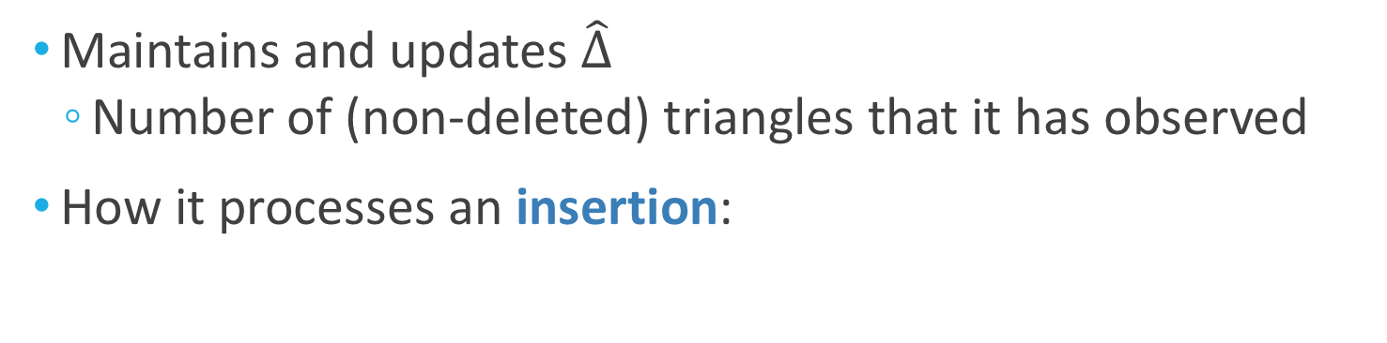
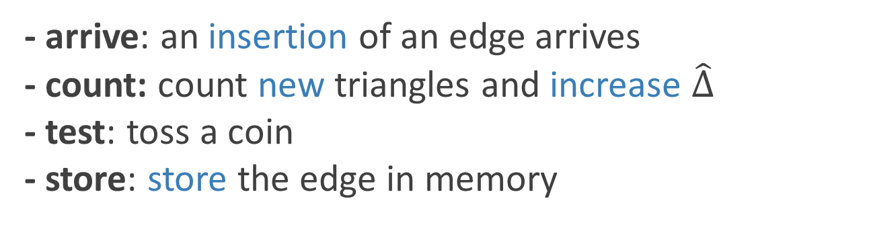
Overview of ThinkD
Introduction
Problem
Algorithm
Experiments
Conclusion
Maintains and updates $\hat{∆}$
  Number of (non-deleted) triangles that it has observed
How it processes an insertion:
arrive
count
test
store
Yes
No
- arrive: an insertion of an edge arrives
- count: count new triangles and increase $\hat{∆}$
- test: toss a coin
- store: store the edge in memory

Slide 18
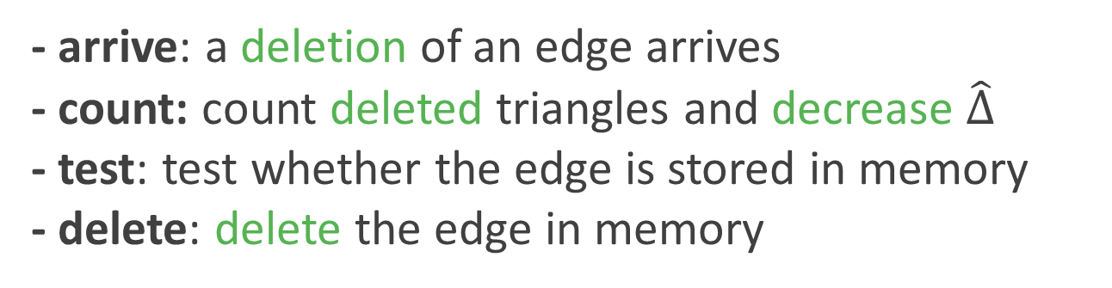
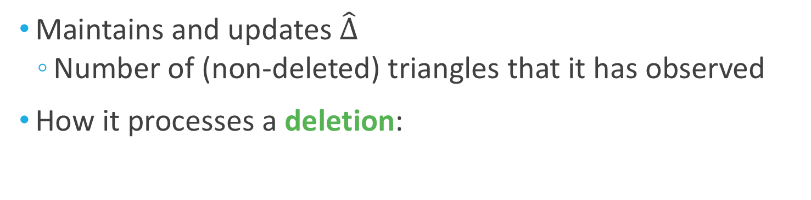
Overview of ThinkD (cont.)
Introduction
Problem
Algorithm
Experiments
Conclusion
Maintains and updates $\hat{∆}$
  Number of (non-deleted) triangles that it has observed
How it processes a deletion:
arrive
count
test
delete
Yes
No
- arrive: a deletion of an edge arrives
- count: count deleted triangles and decrease $\hat{∆}$
- test: test whether the edge is stored in memory
- delete: delete the edge in memory

Slide 19

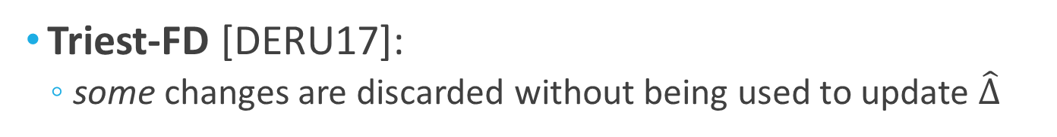
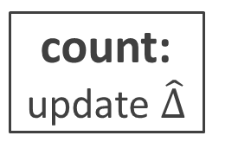


Comparison with Triest-FD
Introduction
Problem
Algorithm
Experiments
Conclusion
ThinkD (Think before You Discard):
  every arrived change is used to update $\hat{∆}$
arrive
count:
update $\hat{∆}$
test
store /
delete
Yes
No (discard)
Triest-FD [DERU17]:
  some changes are discarded without being used to update $\hat{∆}$
arrive
test
count:
update $\hat{∆}$
store /
delete
Yes
No (discard) $→$information loss!

Slide 20


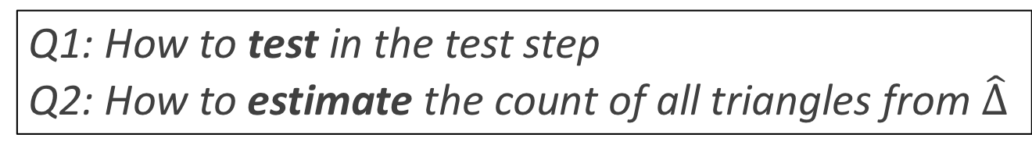
Two Versions of ThinkD
Introduction
Problem
Algorithm
Experiments
Conclusion
Q1: How to test in the test step
Q2: How to estimate the count of all triangles from $\hat{∆}$
ThinkD-FAST: simple and fast
  using independent Bernoulli trials
ThinkD-ACC: accurate and parameter-free
  using random pairing [GLH08]

Slide 21





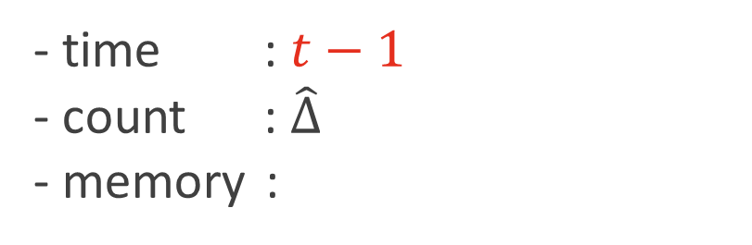
ThinkD-FAST: Details
Introduction
Problem
Algorithm
Experiments
Conclusion
Details
$\hat{∆}$: number of (non-deleted) triangles observed so far
Toy example:
- time : $t−1$
- count : $\hat{∆}$
- memory :
$$(u,x)$$
$$(v,x)$$
$$(u,y)$$
$$(v,y)$$

Slide 22
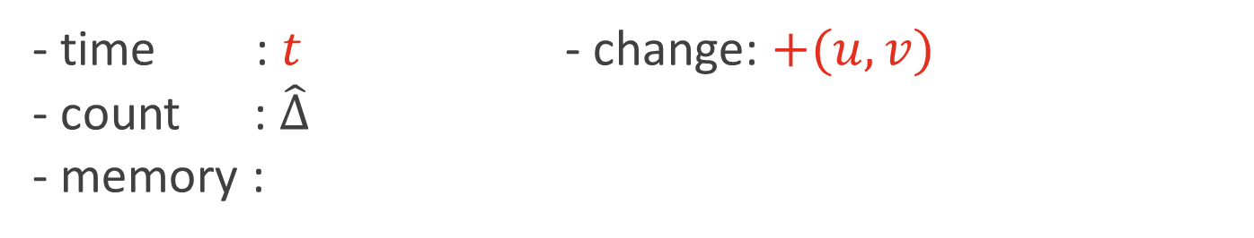




ThinkD-FAST: Arrive Step
Introduction
Problem
Algorithm
Experiments
Conclusion
Details
A new change in the input graph arrives
  change: either insertion or deletion of an edge
arrive
count
test
store /
delete
Yes
No
- time : $t$ - change: $+(u,v)$
- count : $\hat{∆}$
- memory :
$$(u,x)$$
$$(v,x)$$
$$(u,y)$$
$$(v,y)$$

Slide 23

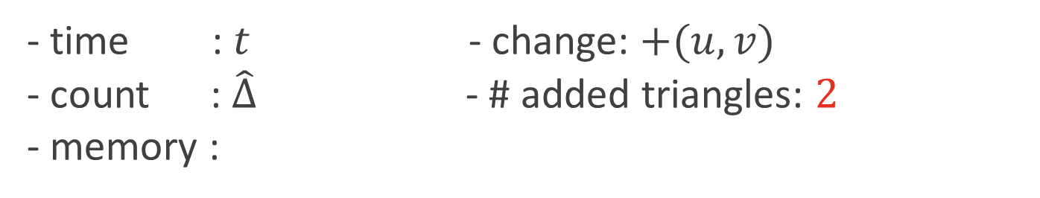







ThinkD-FAST: Count Step
Introduction
Problem
Algorithm
Experiments
Conclusion
Details
Count added or deleted triangles and update $\hat{∆}$
arrive
count
test
store /
delete
Yes
No
- time : $t$ - change: $+(u,v)$
- count : $\hat{∆}$ - # added triangles: $2$
- memory :
$$+=2$$
$$(u,x)$$
$$(v,x)$$
$$u$$
$$u$$
$$(u,y)$$
$$(v,y)$$
$$x$$
$$v$$
$$y$$
$$v$$

Slide 24

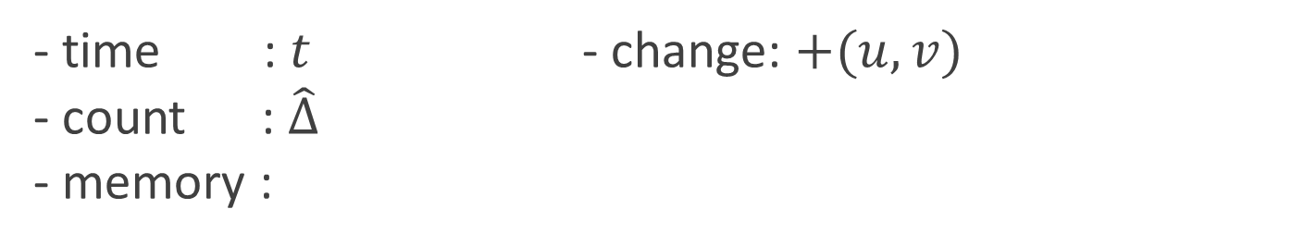
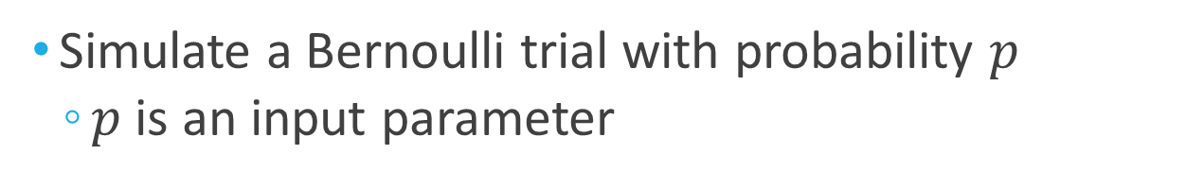
ThinkD-FAST: Test Step
Introduction
Problem
Algorithm
Experiments
Conclusion
Details
Simulate a Bernoulli trial with probability $p$
  $p$ is an input parameter
arrive
count
test
store /
delete
Yes
No
- time : $t$ - change: $+(u,v)$
- count : $\hat{∆}$
- memory :
$$(u,x)$$
$$(v,x)$$
$$(u,y)$$
$$(v,y)$$

Slide 25

ThinkD-FAST: Store Step
Introduction
Problem
Algorithm
Experiments
Conclusion
Details
Store the new edge in memory
arrive
count
test
store /
delete
Yes
No
- time : $t$ - change: $+(u,v)$
- count : $\hat{∆}$
- memory :
$$(u,x)$$
$$(v,x)$$
$$(u,y)$$
$$(v,y)$$
$$(u,v)$$

Slide 26

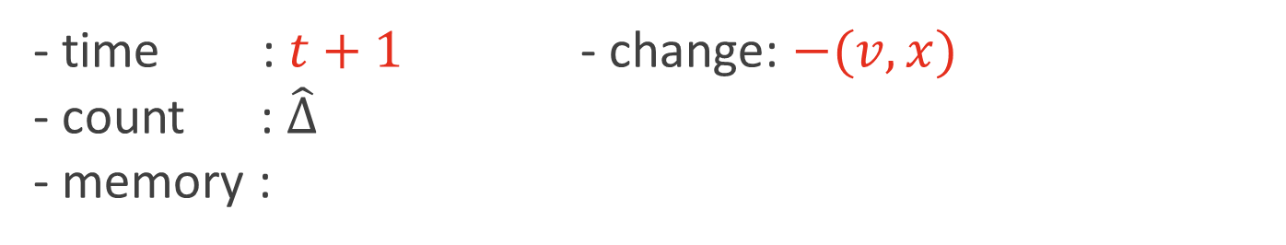
ThinkD-FAST: Arrive Step
Introduction
Problem
Algorithm
Experiments
Conclusion
Details
A new change in the input graph arrives
  change: either insertion or deletion of an edge
arrive
count
test
store /
delete
Yes
No
- time : $t+1$ - change: $−(v,x)$
- count : $\hat{∆}$
- memory :
$$(u,x)$$
$$(v,x)$$
$$(u,y)$$
$$(v,y)$$
$$(u,v)$$

Slide 27
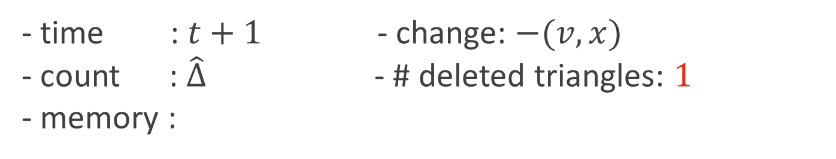



ThinkD-FAST: Count Step
Introduction
Problem
Algorithm
Experiments
Conclusion
Details
Count added or deleted triangles and update $\hat{∆}$
arrive
count
test
store /
delete
Yes
No
- time : $t+1$ - change: $−(v,x)$
- count : $\hat{∆}$ - # deleted triangles: $1$
- memory :
$$−=1$$
$$(u,x)$$
$$(v,x)$$
$$u$$
$$(u,y)$$
$$(v,y)$$
$$(u,v)$$
$$x$$
$$v$$

Slide 28
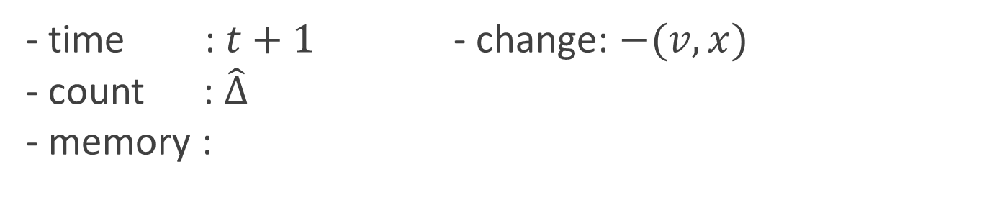

ThinkD-FAST: Test Step
Introduction
Problem
Algorithm
Analysis
Experiments
Conclusion
Details
Test if the arrived edge is in memory
arrive
count
test
store /
delete
Yes
No
- time : $t+1$ - change: $−(v,x)$
- count : $\hat{∆}$
- memory :
$$(u,x)$$
$$(v,x)$$
$$(u,y)$$
$$(v,y)$$
$$(u,v)$$

Slide 29

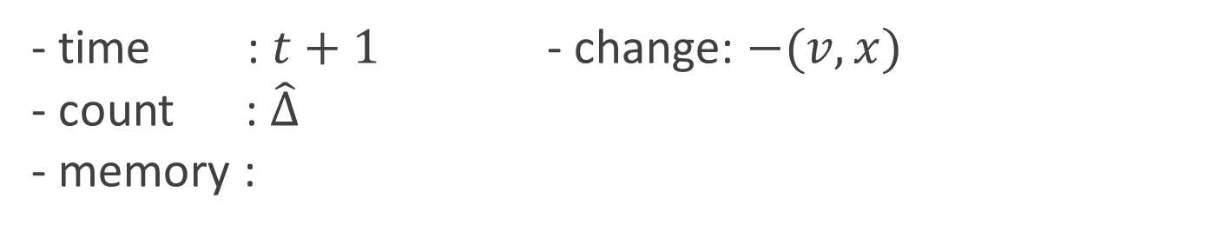

ThinkD-FAST: Store Step
Introduction
Problem
Algorithm
Analysis
Experiments
Conclusion
Details
Remove the arrived edge from memory
arrive
count
test
store /
delete
Yes
No
- time : $t+1$ - change: $−(v,x)$
- count : $\hat{∆}$
- memory :
$$(u,x)$$
$$(u,y)$$
$$(v,y)$$
$$(v,x)$$
$$(u,v)$$

Slide 30



Unbiased Estimation
Introduction
Problem
Algorithm
Experiments
Conclusion
$\hat{∆}$: count of observed triangles
$\frac{\hat{∆}}{p^{2}}$: estimated count of all triangles
$∆$: true count of all triangles
[ Theorem 1 ] At any time $t$,
Proof and a variance of $\hat{∆}/p^{2}$: see the paper
$𝔼$ $\left[\frac{\hat{∆}}{p^{2}}\right]=Δ$
Unbiased estimate of $Δ$

Slide 31


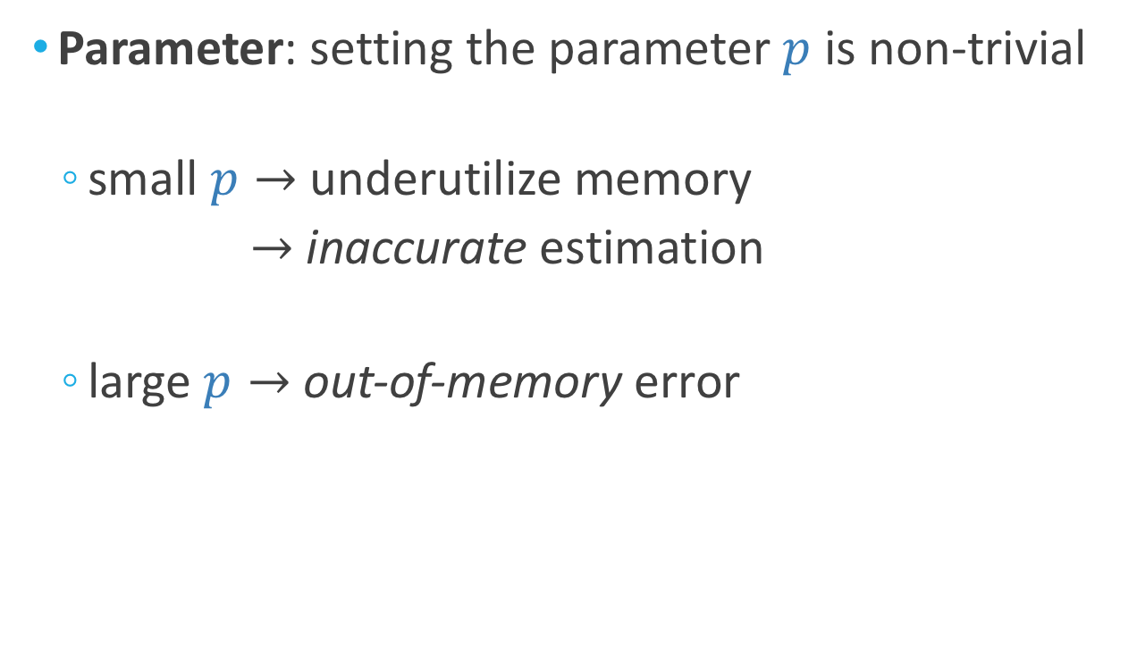
Disadvantages of ThinkD-FAST
Introduction
Problem
Algorithm
Experiments
Conclusion
Parameter: setting the parameter $p$ is non-trivial
  small $p→$ underutilize memory
  $→$ inaccurate estimation
  large $p→$ out-of-memory error

Slide 32
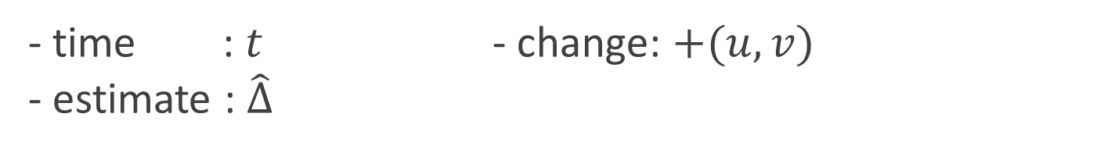
Disadvantages of ThinkD-FAST (cont.)
Introduction
Problem
Algorithm
Experiments
Conclusion
Information loss: it may discard inserted edges
even when memory is not full
arrive
count
test
store /
delete
Yes
No
- time : $t$ - change: $+(u,v)$
- estimate : $\hat{∆}$
$$(u,x)$$
$$(v,x)$$
$$(u,y)$$
$$(v,y)$$

Slide 33


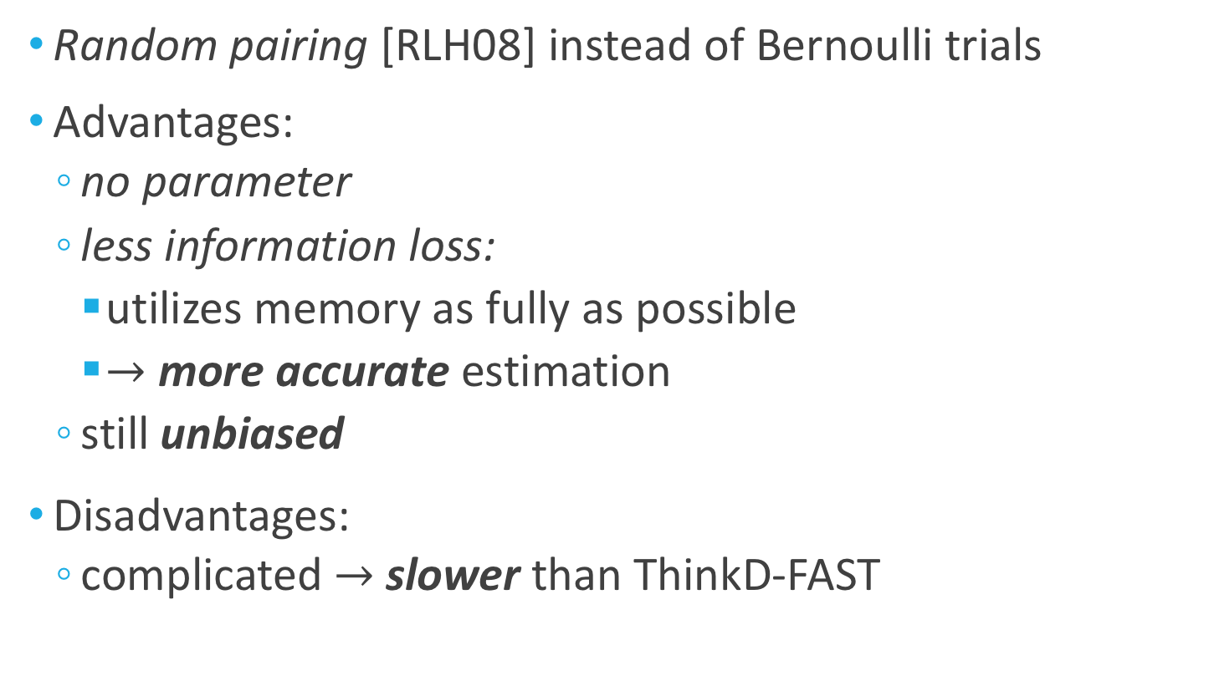
ThinkD-ACC: Even Better!
Introduction
Problem
Algorithm
Experiments
Conclusion
Random pairing [RLH08] instead of Bernoulli trials
Advantages:
  no parameter
  less information loss:
    utilizes memory as fully as possible
    $→$ more accurate estimation
  still unbiased
Disadvantages:
  complicated $→$ slower than ThinkD-FAST

Slide 34



Scalability of ThinkD
Introduction
Problem
Algorithm
Experiments
Conclusion
Let $k$ be the size of memory
For processing $t$ changes in the input stream,
[ Theorem 2 ] ThinkD-ACC takes
[ Theorem 3 ] ThinkD-FAST with $p=O\left(\frac{k}{t}\right)$ takes
$$O(k⋅t)$$
linear in data size
$$O(k⋅t)$$

Slide 35
Advantages of ThinkD
Introduction
Problem
Algorithm
Experiments
Conclusion
Fast and Accurate: outperforming competitors
Scalable: linear data scalability (Theorems 2 & 3)
Theoretically Sound: unbiased estimates (Theorem 1)

Slide 36
Road Map
Problem Definition
Proposed Method: ThinkD
Experiments <<
Conclusions

Slide 37







Experimental Settings
Introduction
Problem
Algorithm
Experiments
Conclusion
Competitors: Triest-FD [DERU17] & ESD [HS17]
  state-of-the-art algorithms for
  triangle counting in fully-dynamic graph streams
Implementations:
Datasets:
  insertions (edges in graphs) + deletions (random 20%)
ER
Synthetic
(100B edges)
Social Networks
(1.8B+ edges, …)
Citation
(16M+)
Web
(6M+)
Trust
(0.7M+)

Slide 38

EXP1. Bias Analysis [THM1]
Introduction
Problem
Algorithm
Experiments
Conclusion
“Does ThinkD give unbiased estimates?”
True Count
ThinkD-ACC
ThinkD-FAST
Triest-FD
- memory budget$:$ $5\%$of the edges
- dataset:
- #repeats: 10,000

Slide 39
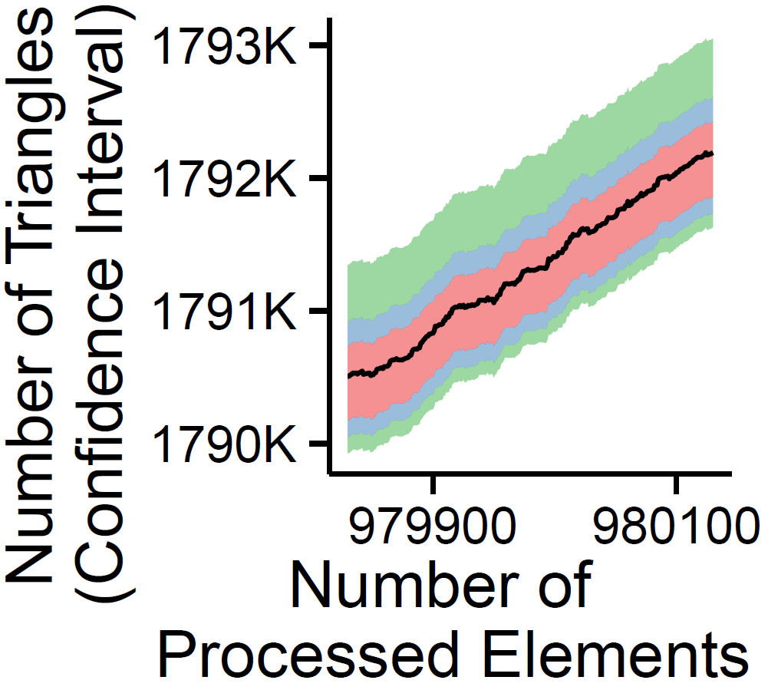
EXP2. Variance Analysis
Introduction
Problem
Algorithm
Experiments
Conclusion
“Does ThinkD maintain estimates with small variance?
Triest-FD
ThinkD-FAST
ThinkD-ACC
True Count
Number of Processed Changes
- memory budget$:$ $5\%$of the edges
- dataset:
- #repeats: 10,000

Slide 40
EXP3. Scalability [THM 2 & 3]
Introduction
Problem
Algorithm
Experiments
Conclusion
“Does ThinkD scale linearly with
the size of the input stream?” (THM 2 & 3)
ThinkD-ACC
ThinkD-FAST
Linear scalability
(slope=1)
Number of Changes
- dataset: ER
- memory budget$:$ fixed to ${10}^{7}$ (i.e., $p$ = size / ${10}^{7}$)

Slide 41
Advantages of ThinkD
Introduction
Problem
Algorithm
Experiments
Conclusion
Fast and Accurate: outperforming competitors
Scalable: linear data scalability (Theorems 2 & 3)
Theoretically Sound: unbiased estimates (Theorem 1)

Slide 42
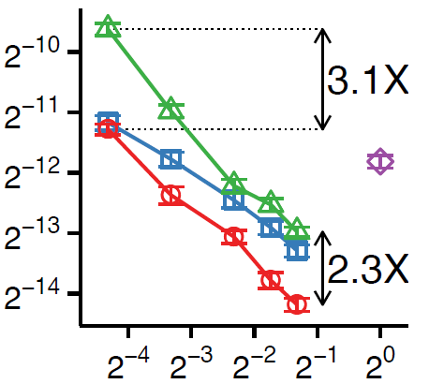
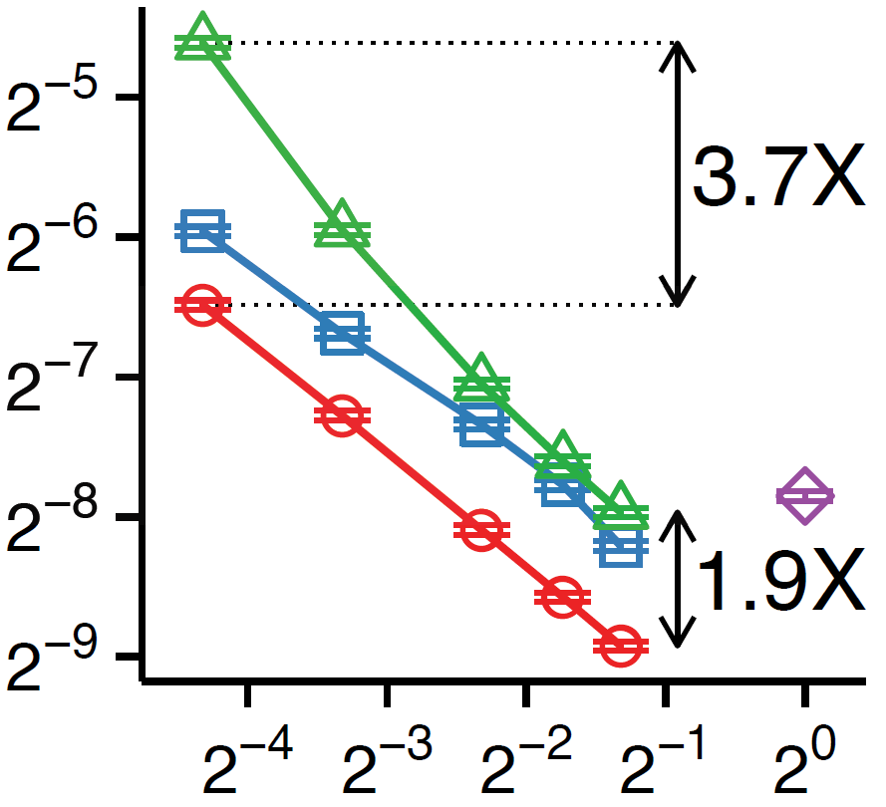
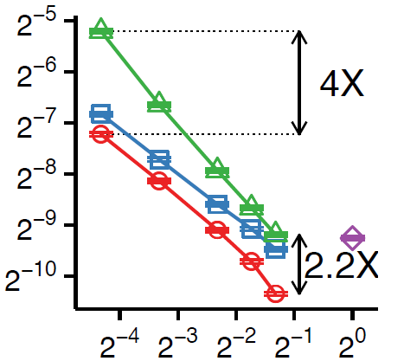
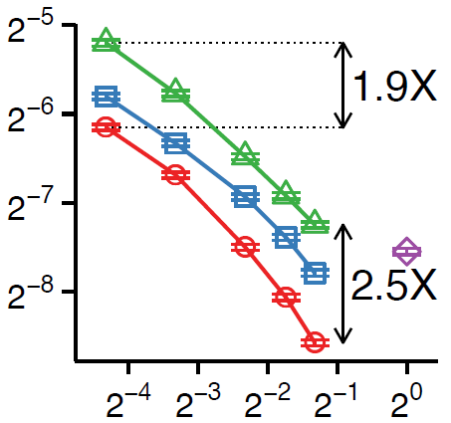
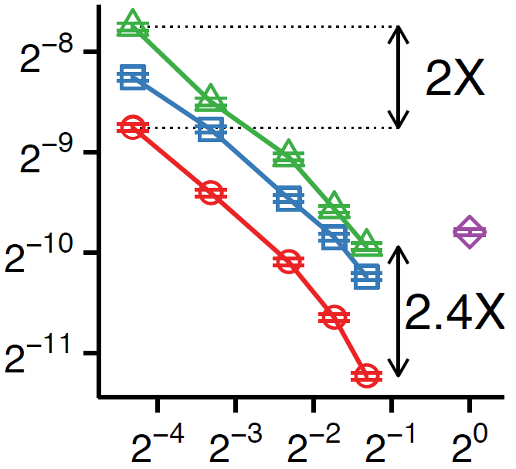
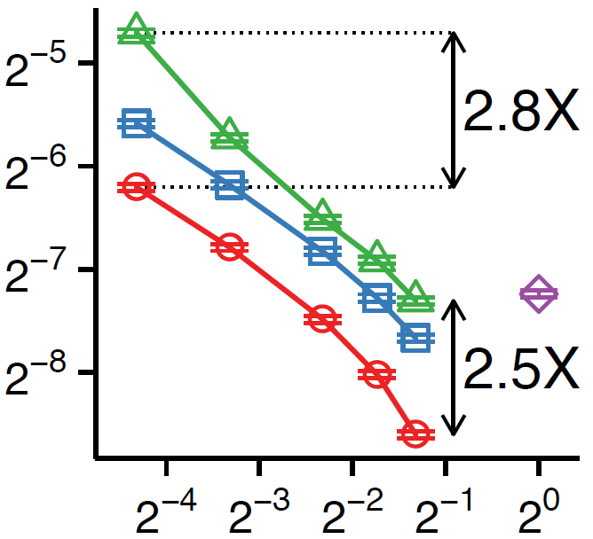
EXP4. Space & Accuracy
Introduction
Problem
Algorithm
Experiments
Conclusion
“Is ThinkD more accurate than its best competitors?”
Triest-FD
ThinkD-FAST
Estimation Error (ratio)
ESD
ThinkD
-ACC
Memory budget (ratio)
- dataset:
- # repeats: 1000

Slide 43
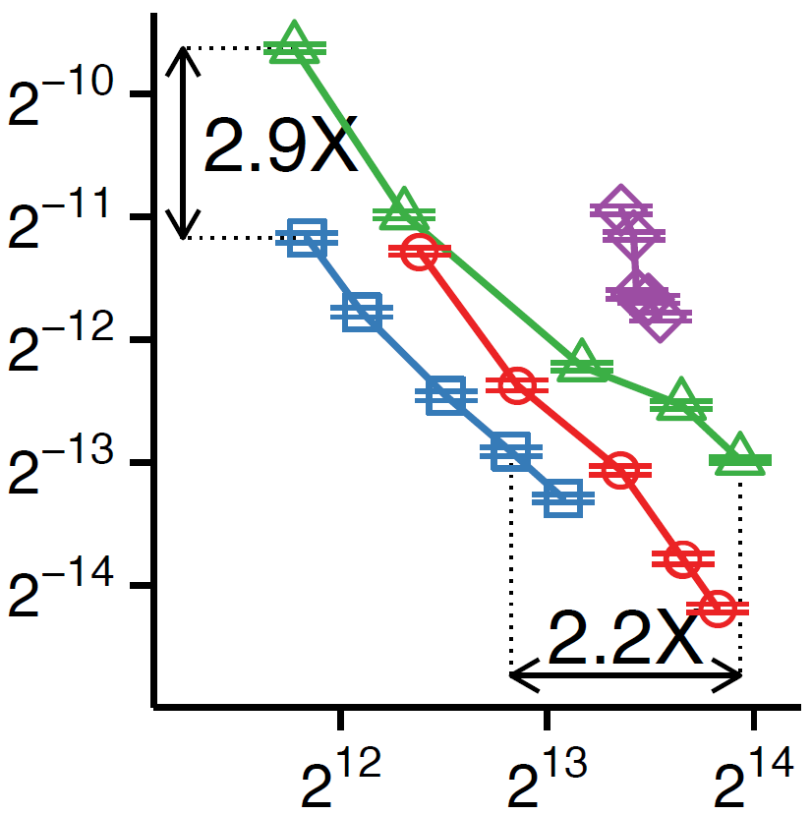
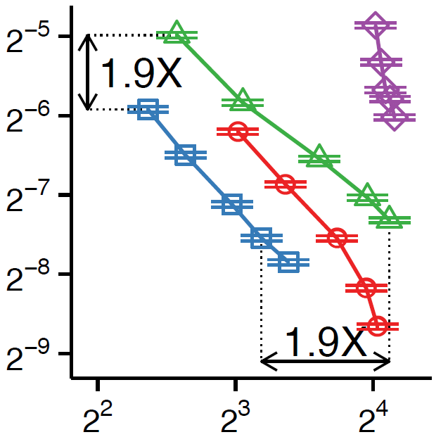
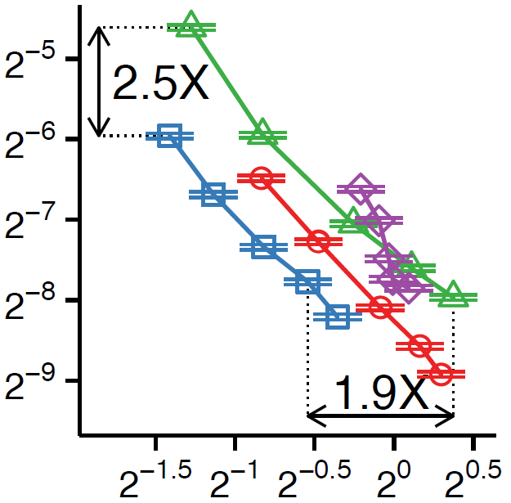
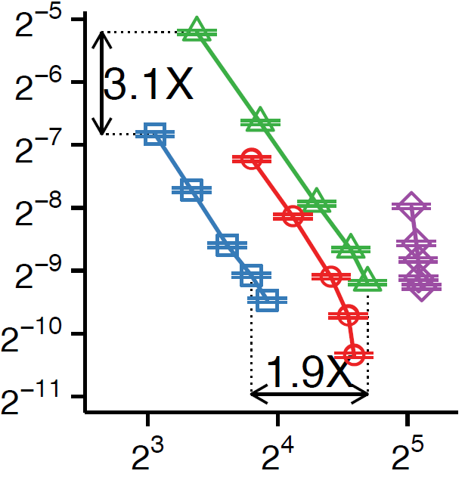
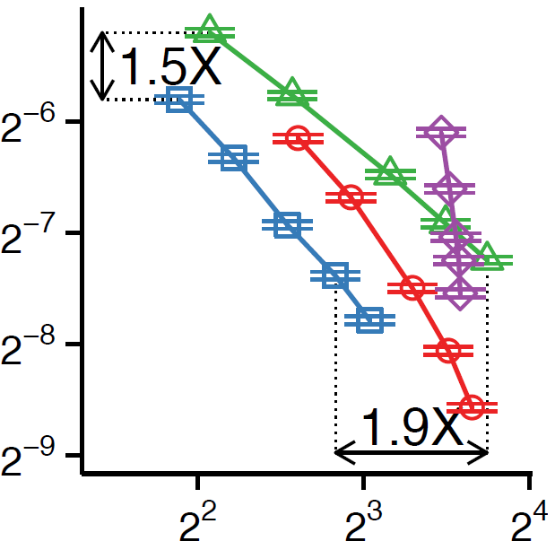


EXP5. Speed & Accuracy
Introduction
Problem
Algorithm
Experiments
Conclusion
“Is ThinkD faster than its best competitors?”
ThinkD-ACC
ESD
Triest-FD
Estimation Error (ratio)
ThinkD
-FAST
Running time (Sec)
- dataset:
- # repeats: 1000

Slide 44
Advantages of ThinkD
Introduction
Problem
Algorithm
Experiments
Conclusion
Fast and Accurate: outperforming competitors
Scalable: linear data scalability
Theoretically Sound: unbiased estimates

Slide 45
Road Map
Problem Definition
Proposed Method: ThinkD
Experiments
Conclusions <<

Slide 46

Conclusions
Introduction
Problem
Algorithm
Experiments
Conclusion
We propose ThinkD
  accurately estimates the count of triangles
  in large and fully-dynamic graphs
Fast and Accurate: outperforming competitors
Scalable: linear data scalability
Theoretically Sound: unbiased estimates
Download
ThinkD

Slide 47
References
Introduction
Problem
Algorithm
Experiments
Conclusion
[RLH08] Rainer Gemulla et al., “Maintaining bounded-size sample synopses of evolving datasets.” The VLDB Journal 2008
[KMF11] U Kang et al., “Spectral analysis for billion-scale graphs: Discoveries and implementation.” PAKDD 2011
[DERU17] Lorenzo De Stefani et al., “TRIÈST: Counting Local and Global Triangles in Fully-Dynamic Streams with Fixed Memory Size.” TKDD 2017
[Shi17] Kijung Shin, “WRS: Waiting Room Sampling for Accurate Triangle Counting in Real Graph Streams”, ICDM 2017
[HS17] Han, Guyue, and Harish Sethu, "Edge sample and discard: A new algorithm for counting triangles in large dynamic graphs." ASONAM 2017
[LJK18] Yongsub Lim et al., “Memory-efficient and Accurate Sampling for Counting Local Triangles in Graph Streams: From Simple to Multigraphs”, TKDD 2018

Slide 48
Backup Slides

Slide 49



Proof of Unbiasedness
Introduction
Problem
Algorithm
Experiments
Conclusion
Proof Sketch:
$∆ =\#\left(all added trianlges\right)$
$− \#(all removed triangles)$
$\hat{∆} =\#\left(observed added trianlges\right)$
$− \#(observed removed triangles)$
$p^{2} =$ Prob. that each added triangle is observed
$p^{2} =$ Prob. that each removed triangle is observed
Thus, $Exp\left[\hat{∆}\right]=∆⋅p^{2}$ $⇔ Exp\left[\hat{∆}/p^{2}\right]=Δ$

