Slide 1



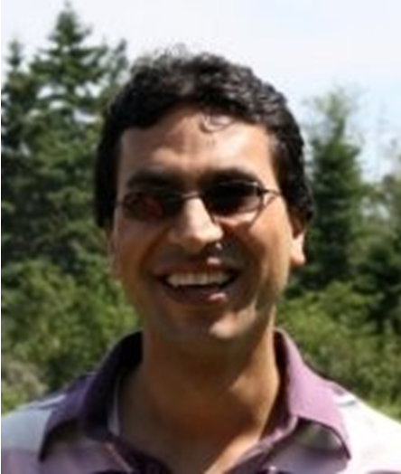
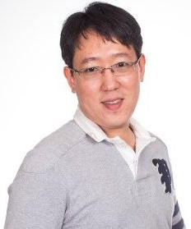


Discovering Progression Stages in Trillion-Scale Behavior Logs
Kijung Shin¹ Mahdi Shafiei² Myunghwan Kim²
Aastha Jain² Hema Raghavan²
¹Carnegie Mellon University, ²LinkedIn Corporation

Slide 2



Progression in Web Services
Introduction
Model
Algorithm
Experiments
Conclusion
Progression in Web Services
Wikipedia [West & Leskovec 2012]
RateBeer [McAuley & Leskovec 2013]
Textual Meme [Yang et al. 2014]
Application: Personalized service
what to show in newsfeeds
what to recommend
Application: Service diagnosis
which stages are important for user engagement

Slide 3


Example: Progression on LinkedIn
Introduction
Model
Algorithm
Experiments
Conclusion
“What aspects should we focus on
to understand progressions?”
Start
Goal
Welcome to
?
?
?
…

Slide 4
Example: Progression on LinkedIn
Introduction
Model
Algorithm
Experiments
Conclusion
A1. Types of actions or features
Start
Goal
Welcome to
?
?
?
connection
jobs
jobs
connection
jobs
connection
profile
profile
profile

Slide 5



Example: Progression on LinkedIn
Introduction
Model
Algorithm
Experiments
Conclusion
A1. Types of actions or features
A2. Frequencies of use
Start
Goal
Welcome to
?
?
?
…
connection
Monthly
jobs
Daily
Hourly
jobs
connection
jobs
connection
profile
profile
profile

Slide 6
Example: Progression on LinkedIn
Introduction
Model
Algorithm
Experiments
Conclusion
A1. Types of actions or features
A2. Frequencies of use
A3. Directions of progression
Start
Skip
Goal
Welcome to
?
?
?
…
Diverge
?

Slide 7

Research Questions
Introduction
Model
Algorithm
Experiments
Conclusion
 | [Tseng et al. 2008] | [McAuley & Leskovec 2013] | [Yang et al. 2014] | Proposed
A1. Action types
A2. Frequency of use
A3. Directions
Start & Goal Stages
“How can we discover and summarize
all three aspects of progressions
between given starting and goal stages?”

Slide 8


Road Map
Behavior Model
Optimization Algorithm
Experiments
Conclusion

Slide 9



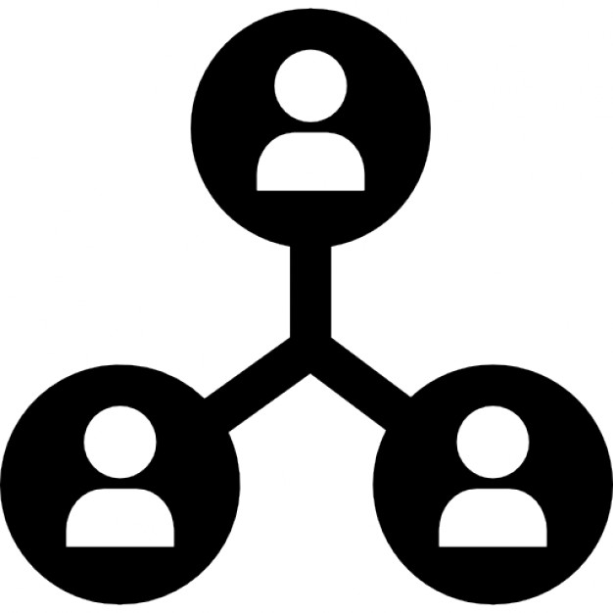



Problem Definition
Introduction
Model
Algorithm
Experiments
Conclusion
Given:
behavior logs
starting stage & goal stage
number of desired stages: $k$
Find: $k$ progression stages
types / frequencies of actions
transitions between stages
To best describe the given behavior logs
user | action | timestamp
… | … | …
“How do we define and describe stages?”

Slide 10




Stage Description: Action types
Introduction
Model
Algorithm
Experiments
Conclusion
Each stage $s∈\{1,2,…k\}$ has
$Θ_{s}$: action-type distribution in stage $s$
action types: profile connect view job post
follows a multinomial distribution (w/ Dirichlet prior)
$$Θ_{1}$$
$$Θ_{2}$$
$$Θ_{3}$$
Probability
Probability
Probability

Slide 11


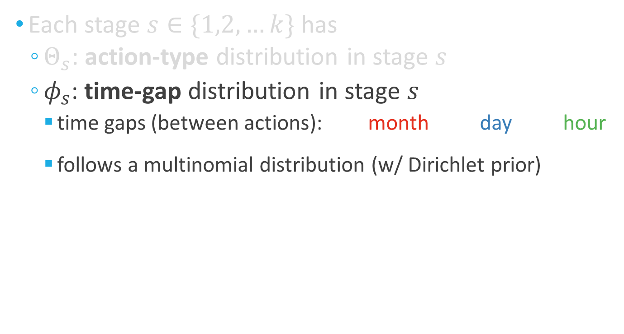

Stage Description: Time gaps
Introduction
Model
Algorithm
Experiments
Conclusion
Each stage $s∈\{1,2,…k\}$ has
$Θ_{s}$: action-type distribution in stage $s$
$φ_{s}$: time-gap distribution in stage $s$
time gaps (between actions): month day hour
follows a multinomial distribution (w/ Dirichlet prior)
$$φ_{1}$$
$$φ_{2}$$
$$φ_{3}$$
Probability
Probability
Probability

Slide 12
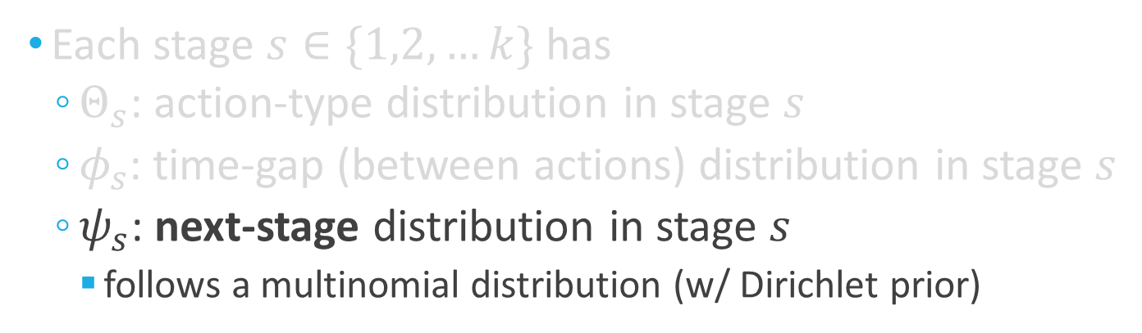



Stage Description: Transitions
Introduction
Model
Algorithm
Experiments
Conclusion
Each stage $s∈\{1,2,…k\}$ has
$Θ_{s}$: action-type distribution in stage $s$
$φ_{s}$: time-gap (between actions) distribution in stage $s$
$ψ_{s}$: next-stage distribution in stage $s$
follows a multinomial distribution (w/ Dirichlet prior)
$$ψ_{1}$$
$$ψ_{2}$$
$$ψ_{3}$$
Probability
Probability
Probability
1
2
3
1
2
3
1
2
3

Slide 13


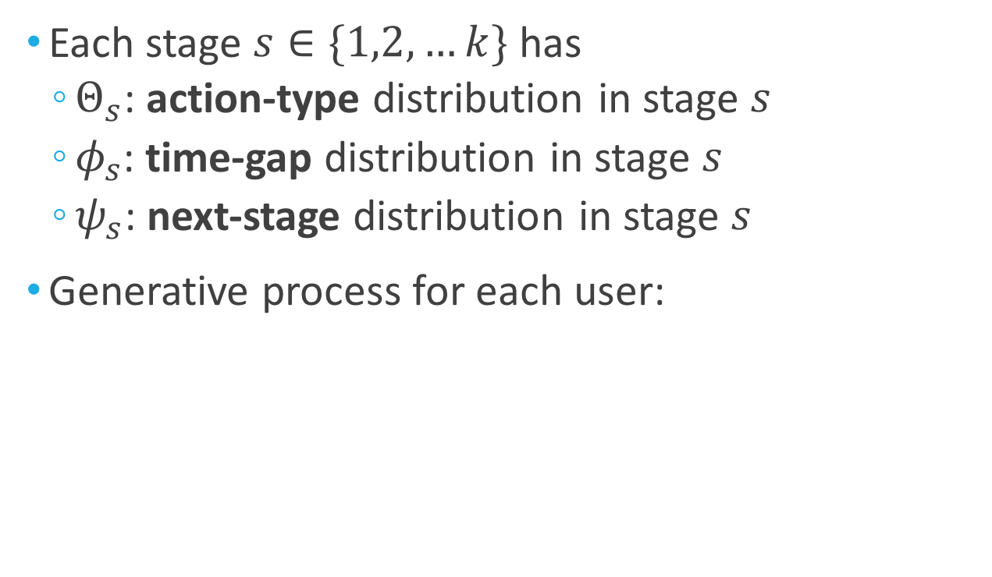









Generative Process
Introduction
Model
Algorithm
Experiments
Conclusion
Each stage $s∈\{1,2,…k\}$ has
$Θ_{s}$: action-type distribution in stage $s$
$φ_{s}$: time-gap distribution in stage $s$
$ψ_{s}$: next-stage distribution in stage $s$
Generative process for each user:
$$ψ_{0}$$
$$ψ_{1}$$
$$ψ_{2}$$
$$ψ_{2}$$
$$ψ_{3}$$
Welcome to
1
2
2
3
$$Θ_{1}$$
$$φ_{1}$$
$$Θ_{2}$$
$$φ_{2}$$
$$Θ_{2}$$
$$φ_{2}$$
$$Θ_{3}$$
$$φ_{3}$$

Slide 14
“No Decline” Constraint
Introduction
Model
Algorithm
Experiments
Conclusion
Users always either progress or stay
Stay: (allowed)
1
2
3
Skip
Progress:
(allowed)
1
2
3
Decline:
(not allowed)
1
2
3

Slide 15
Why “No Decline”?
Introduction
Model
Algorithm
Experiments
Conclusion
To obtain “progression” instead of cyclic patterns
Daily Pattern
Weekly Pattern
7am
Mon
9pm
Sat-Sun
9am
Tue
6pm
12pm
Fri
Wed
3pm
Thu

Slide 16
Road Map
Behavior Model
Optimization Algorithm <<
Experiments
Conclusion

Slide 17
Problem Definition
Introduction
Model
Algorithm
Experiments
Conclusion
Given:
behavior logs
starting stage & goal stage
number of desired stages: $k$
Find: $k$ progression stages
types / frequencies of actions
transitions between stages
To best describe the given behavior logs
user | action | timestamp
… | … | …
“How can we fit our model to the behavior logs?”

Slide 18
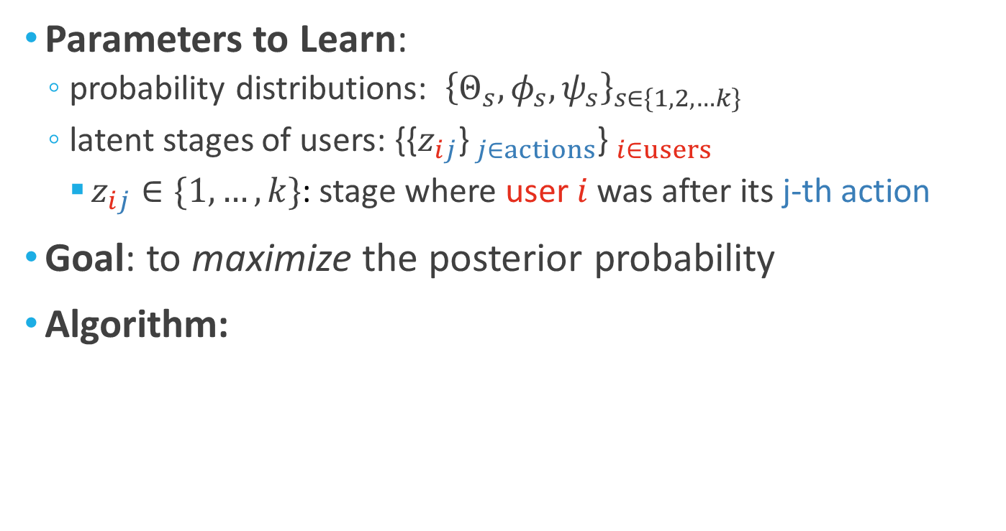
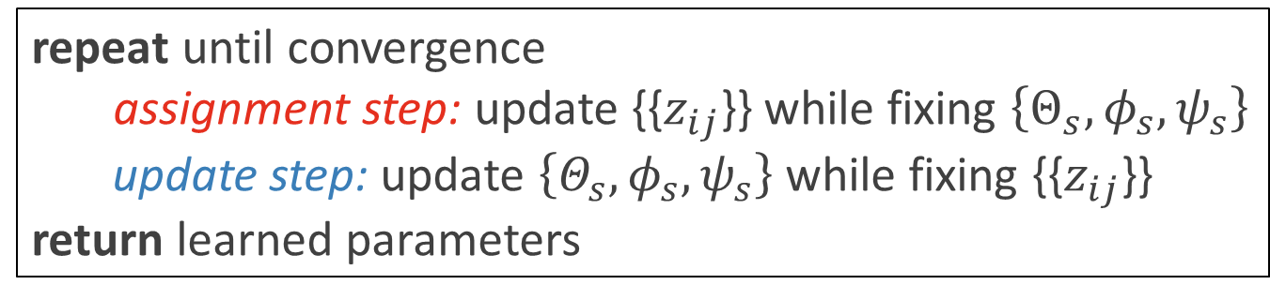
Algorithm: Overview
Introduction
Model
Algorithm
Experiments
Conclusion
Parameters to Learn:
probability distributions: ${\left\{Θ_{s},φ_{s},ψ_{s}\right\}}_{s∈\{1,2,…k\}}$
latent stages of users: {{$z_{ij}$}$_{j∈actions}$}$_{i∈users}$
$z_{ij}∈\{1,…,k\}$: stage where user $i$ was after its j-th action
Goal: to maximize the posterior probability
Algorithm:
repeat until convergence
assignment step: update {{$z_{ij}$}} while fixing $\left\{Θ_{s},φ_{s},ψ_{s}\right\}$
update step: update $\left\{Θ_{s},φ_{s},ψ_{s}\right\}$ while fixing {{$z_{ij}$}}
return learned parameters

Slide 19

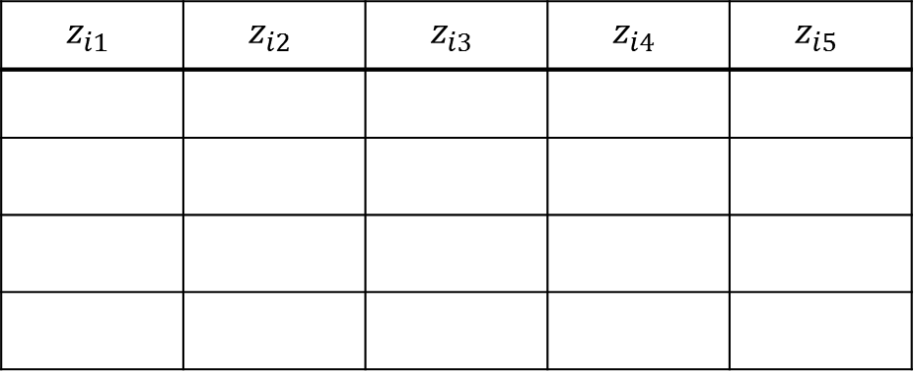
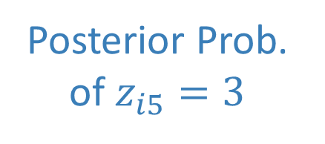
Algorithm: Assignment Step
Introduction
Model
Algorithm
Experiments
Conclusion
Details
Given (fixed): probability distributions $\left\{Θ_{s},φ_{s},ψ_{s}\right\}$
Assign: latent stages of users: {{$z_{ij}$}}
to Maximize: the posterior probability
Algorithm: “Viterbi” algorithm for each user
$$z_{i1}$$ | $$z_{i2}$$ | $$z_{i3}$$ | $$z_{i4}$$ | $$z_{i5}$$
3
2
Posterior Prob. of $z_{i5}=3$
1

Slide 20
Algorithm: Assignment Step
Introduction
Model
Algorithm
Experiments
Conclusion
Details
Given (fixed): probability distributions $\left\{Θ_{s},φ_{s},ψ_{s}\right\}$
Assign: latent stages of users: {{$z_{ij}$}}
to Maximize: the posterior probability
Algorithm: “Viterbi” algorithm for each user
$$z_{i1}$$ | $$z_{i2}$$ | $$z_{i3}$$ | $$z_{i4}$$ | $$z_{i5}$$
Assignments
maximizing
posterior probability
3
2
1

Slide 21

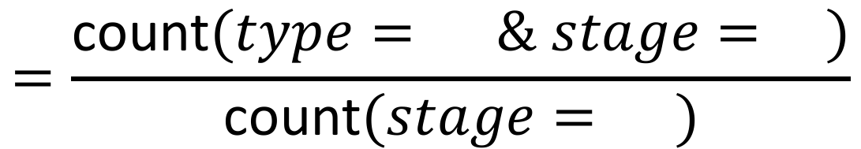
Algorithm: Update Step
Introduction
Model
Algorithm
Experiments
Conclusion
Details
Given (fixed): latent stages {{$z_{ij}$}}
Update: probability distributions $\left\{Θ_{s},φ_{s},ψ_{s}\right\}$
to Maximize: the posterior probability
Algorithm: simple counting for each parameter
$$Θ ( )=P\left(type= \right| stage= )$$
3
3
$$=\frac{\text{count}(type= \& stage= )}{\text{count}(stage= )}$$
3
3
+ smoothing terms (from prior distributions)

Slide 22



Extension of Algorithm
Introduction
Model
Algorithm
Experiments
Conclusion
“For scalability, how can we extend
our algorithm to different settings?”
External memory
(e.g., disk)
Multiprocessor
(or multi core)
Distributed
(e.g., MapReduce)
will focus on the assignment step

Slide 23

Out-of-core Processing
Introduction
Model
Algorithm
Experiments
Conclusion
Process disk-resident data too large to fit in memory
Input data:
process
user | action | timestamp
user | action | timestamp
load
sort
by
users
store
(latent stages)

Slide 24
Out-of-core Processing (cont.)
Introduction
Model
Algorithm
Experiments
Conclusion
Process disk-resident data too large to fit in memory
Input data:
process
user | action | timestamp
user | action | timestamp
load
sort
by
users
store
(latent stages)

Slide 25
Out-of-core Processing (cont.)
Introduction
Model
Algorithm
Experiments
Conclusion
Process disk-resident data too large to fit in memory
Input data:
process
user | action | timestamp
user | action | timestamp
sort
by
users
load
store
(latent stages)

Slide 26
Parallel Processing
Introduction
Model
Algorithm
Experiments
Conclusion
Speed up utilizing multiple processors
embarrassingly parallel
(sorted) input data:
user | action | timestamp
process
process
process

Slide 27

Distributed Processing (MapReduce)
Introduction
Model
Algorithm
Experiments
Conclusion
Speed up utilizing multiple machines
out-of-core processing
out-of-core processing
shuffle
by
users
out-of-core processing

Slide 28
Road Map
Behavior Model
Optimization Algorithm
Experiments <<
Conclusion

Slide 29
Q1. Case Study on LinkedIn
Introduction
Model
Algorithm
Experiments
Conclusion
Connected case:
starting stage: to join LinkedIn
goal stage: to have N connections
size: 500M+ actions (20+ types)
Engaged case:
starting stage: to have N connections
goal stage: to become an active user
size: 150M+ actions (20+ types)
How to set the number of stages?
“Elbow” method: adding a stage does not give much higher posterior probability

Slide 30
Case Study: Connected Case
Introduction
Model
Algorithm
Experiments
Conclusion
Representative behavior in each stage of the connected case
Build one’s
Profile
Onboarding Process
Join
Poke around the service
Make connections
Consume Newsfeeds
Have N
connections

Slide 31
Case Study: Stage Interpretation
Introduction
Model
Algorithm
Experiments
Conclusion
Action types and time gaps are useful for interpretation
Build one’s
Profile
Onboarding Process
Join
Many types of actions
In a short time
Frequent visit
Infrequent actions
Poke around the service
Make connections
Consume Newsfeeds
Have N
connections

Slide 32
Case Study: Service Diagnosis
Introduction
Model
Algorithm
Experiments
Conclusion
Transition probabilities are useful for service diagnosis
Build one’s
Profile
Onboarding Process
Join
Most important for goals
Skip
Poke around the service
Make connections
Consume Newsfeeds
Have N connections

Slide 33
Case Study: Engaged Case
Introduction
Model
Algorithm
Experiments
Conclusion
Representative behavior in each stage of the engaged case
Have 30 connections
Actively make connections
by search, import, etc.
Passively make connections by recommender system
Consume Newsfeeds
Become Active Users

Slide 34
Q2. Applications
Introduction
Model
Algorithm
Experiments
Conclusion
“Is latent stage information useful?”
Segmenting users by current stages improves prediction accuracy
 | Action Type | Time Interval | Goal Stage Reachability
No segmentation | 0.610 | 0.551 | 0.730
By K-means | 0.610 | 0.580 | 0.747
By current stage | 0.684 | 0.646 | 0.756
Method: logistic regression / Dataset: LinekdIn (connected)

Slide 35
Q3. Data Scalability
Introduction
Model
Algorithm
Experiments
Conclusion
“Does our algorithm scale linearly?”
“How large data can our algorithm process?”
In-memory
Out-of-core
Distributed
(slope=1)
one trillion actions
within 2 hours
(per iteration)

Slide 36
Q4. Machine Scalability
Introduction
Model
Algorithm
Experiments
Conclusion
“Does our algorithm scale out
with more machines (or more processors)?”
(slope=1)
(slope=1)
LinkedIn
(connected)
LinkedIn (engaged)
Synthetic dataset

Slide 37




Q5. Convergence
Introduction
Model
Algorithm
Experiments
Conclusion
“How rapidly does our algorithm converge?”
$$\#stages=20$$
$$\#stages=15$$
$$\#stages=10$$
20 iterations
$$\#stages=5$$
20 iterations
data: LinkedIn (engaged)
data: LinkedIn (connected)

Slide 38
Road Map
Behavior Model
Optimization Algorithm
Experiments
Conclusion <<

Slide 39










Conclusion
Introduction
Model
Algorithm
Experiments
Conclusion
Goal: To discover progression stages in behavior logs
Behavior model
action types
time intervals
transitions between stages
Optimization algorithm
process trillion-scale data
linear scalability
Knowledge discovery
progression patterns of LinkedIn users
1
$$ψ_{1}$$
2
$$ψ_{2}$$
3
$$Θ_{1}$$
$$φ_{1}$$
$$Θ_{2}$$
$$φ_{2}$$
$$Θ_{3}$$
$$φ_{3}$$

Slide 40
References
[Tseng et al. 2008] Tseng VS, Lin KW, Chang JC. Prediction of user navigation patterns by mining the temporal web usage evolution. Soft Computing 2008
[West & Leskovec 2012] West R, Leskovec J. Human way finding in information networks. WWW 2012
[McAuley & Leskovec 2013] McAuley JJ, Leskovec J. From amateurs to connoisseurs: modeling the evolution of user expertise through online reviews. WWW 2013
[Yang et al. 2014] Yang J, McAuley J, Leskovec J, LePendu P, Shah N. Finding progression stages in time-evolving event sequences. WWW 2014

