Slide 1






Why You Should
Charge Your Friends for Borrowing Your Stuff
Kijung Shin, Euiwoong Lee, Dhivya Eswaran, Ariel Procaccia
Carnegie Mellon University
In Partial Fulfillment of the Speaking Requirement

Slide 2
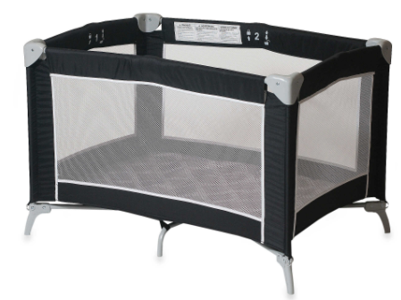

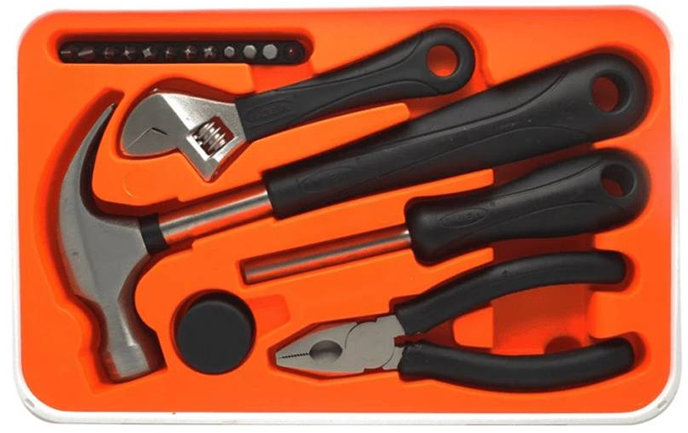

Sharable Goods: Question
portable crib
IKEA toolkit
DVDs
“What do they have in common?”

Slide 3
Sharable Goods: Properties
Used occasionally
Lend to friends
Do not lend to strangers

Slide 4



Social Network: Question
Consider a social network, which is a graph
  Nodes: people
  Edges: friendship
Carol
Alice
Bob
“How many people should buy an
IKEA toolkit for everyone to use it?”

Slide 5
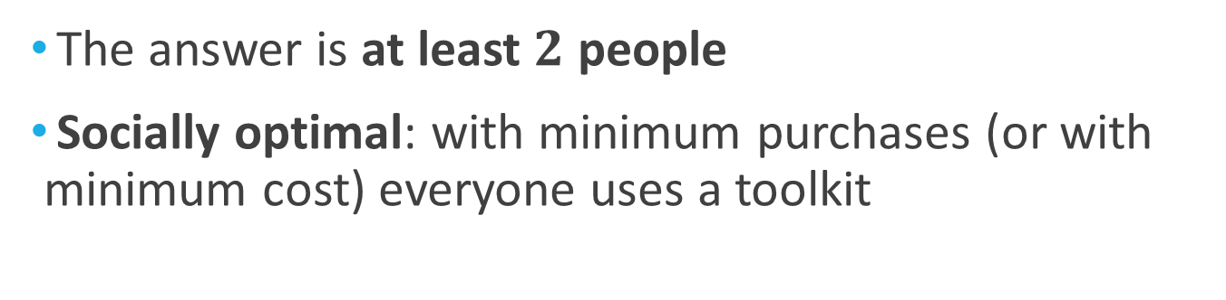
Social Optimal Decision
The answer is at least $2$ people
Socially optimal: with minimum purchases (or with minimum cost) everyone uses a toolkit
Alice
Bob
“Does everyone want to stick to
their current decisions?”

Slide 6
Individually Optimal Decision
The answer is No
Individually optimal: everyone best responses to others’ decisions
Socially inefficient (suboptimal): 4 purchases happen when 2 are enough
Alice
Bob

Slide 7

Social Inefficiency
Individually optimal outcome with 6 purchases
Carol
Dan
“How can we prevent this social inefficiency?”

Slide 8
Moving toward Social Optimum
Recall the socially optimal outcome
Alice
Bob
“How can we make people to stick with
this socially optimal outcome?”

Slide 9

Imposing Access Costs
Renters pay a cost for getting permanent access
Access cost is half the price of a toolkit
Alice
Bob
“Does everyone want to stick to
their current decisions?”

Slide 10
Socially & Individually Optimal
The answer is Yes
  Alice & Bob: are paid more than the price
  The others: renting is cheaper than buying
Individually optimal
Socially optimal with minimum (2) purchases
Alice
Bob

Slide 11
Goal and Approaches
Goal: To examine incentives to buy sharable goods
Approaches: game-theoretic models
with equilibrium analysis and simulations
Questions:
  Q1. How socially inefficient are individually optimal outcomes?
  Q2. Do access costs reduce the social inefficiency?
  Q3. What is the proper access cost?
Sharable good game (SGG)
Sharable good game
with access cost (SGG-AC)

Slide 12


Road Map
Concepts in Game Theory
Game-theoretic Models
  Sharable Good Game
  Sharable Good Game with Access Cost
Simulation
Conclusion

Slide 13
Road Map
Concepts in Game Theory <<
Game-theoretic Models
  Sharable Good Game
  Sharable Good Game with Access Cost
Simulation
Conclusion

Slide 14
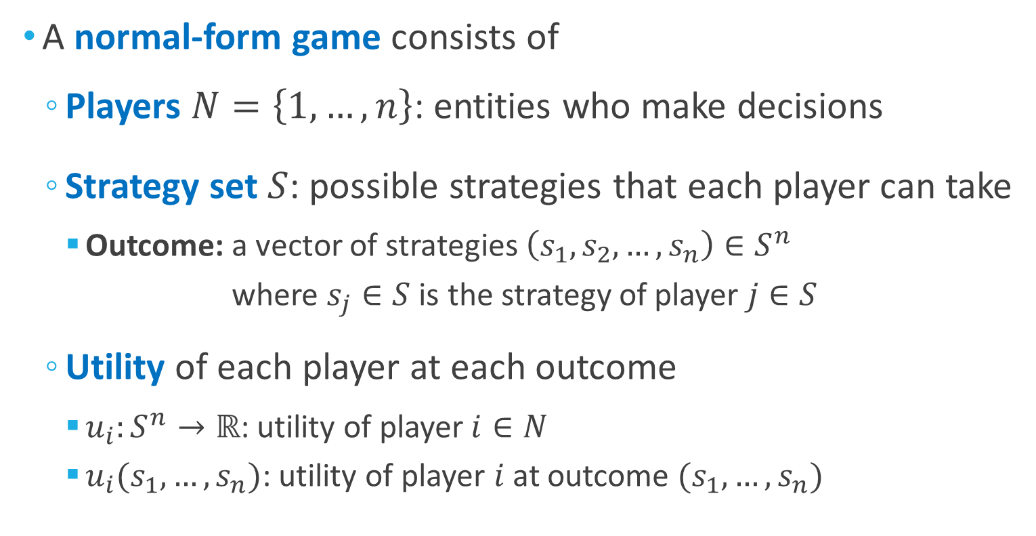
Concept: Game
A normal-form game consists of
  Players $N=\left\{1,…,n\right\}$: entities who make decisions
  Strategy set $S$: possible strategies that each player can take
    Outcome: a vector of strategies $\left(s_{1},s_{2},…,s_{n}\right)∈S^{n}$
    where $s_{j}∈S$is the strategy of player $j∈S$
  Utility of each player at each outcome
    $u_{i}:S^{n}→ℝ$: utility of player$i∈N$
    $u_{i}(s_{1},…,s_{n})$: utility of player $i$ at outcome $(s_{1},…,s_{n})$

Slide 15
Example: Prisoner’s Dilemma
Players: two men who are charged with a crime
Strategy set: {cooperate, defect}
  cooperate: stay silent
  defect: talk to the police and admit their crime
Utility:
  both cooperate: both will be jailed for 1 year
  both defect: both will be jailed for 6 years
  one defects and the other cooperates: one who defects will be freed while the other will be jailed for 9 years

Slide 16
Example: Prisoner’s Dilemma
Player 2’s strategy
Utility of
Player 1
Cooperate
Defect
-1, -1
-9, 0
Cooperate
Utility of
Player 2
Player 1’s strategy
0, -9
-6, -6
Defect

Slide 17

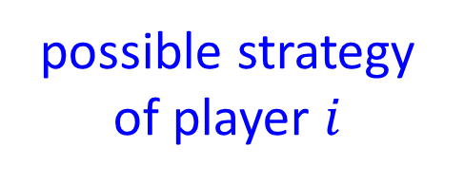
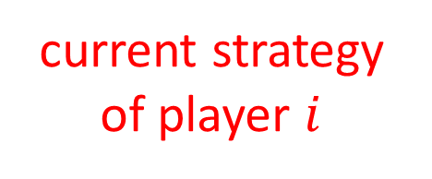
Concept: Nash Equilibrium
Nash Equilibrium (NE):
  is an outcome $\left(s_{1},s_{2},…,s_{n}\right)∈S^{n}$
  where each player’s strategy is a best response
  when fixing the other players’ strategies
Formally, in an NE $\left(s_{1},s_{2},…,s_{n}\right)$, for each player $i$,
$$u_{i}\left(s_{1},…,s_{i},…,s_{n}\right)≥u_{i}\left(s_{1},…,s_{i}^{′},…,s_{n}\right), ∀s_{i}^{′}∈S$$
other players’ current strategies (FIXED)
current strategy of player $i$
possible strategy
of player $i$

Slide 18
Example: Nash Equilibrium
Claim: (Defect, Defect) is an NE in Prisoner’s Dilemma
Player 2’s Strategy
Cooperate
Defect
-1, -1
-9, 0
Cooperate
Utility of
Player 1
Player 1’s Strategy
0, -9
-6, -6
Defect
Utility of
Player 2

Slide 19
Example: Nash Equilibrium
Claim: (Defect, Defect) is an NE in Prisoner’s Dilemma
Player 2’s Strategy
Cooperate
Defect
-1, -1
-9, 0
if Player 1 changes its strategy
Cooperate
Player 1’s Strategy
0, -9
-6, -6
Defect

Slide 20
Example: Nash Equilibrium
Claim: (Defect, Defect) is an NE in Prisoner’s Dilemma
Player 2’s Strategy
Cooperate
Defect
-1, -1
-9, 0
Cooperate
Player 1’s Strategy
0, -9
-6, -6
if Player2 changes its strategy
Defect

Slide 21
Example: Nash Equilibrium
Claim: (Defect, Defect) is an NE in Prisoner’s Dilemma
Player 2’s Strategy
Cooperate
Defect
-1, -1
-9, 0
Cooperate
Player 1’s Strategy
0, -9
-6, -6
Defect

Slide 22
Example: Nash Equilibrium
Claim: (Cooperate, Cooperate) is not an NE
Player 2’s Strategy
Cooperate
Defect
-1, -1
-9, 0
Cooperate
Player 1’s Strategy
0, -9
-6, -6
Defect

Slide 23
Example: Nash Equilibrium
Claim: (Cooperate, Cooperate) is not an NE
Player 2’s Strategy
Cooperate
Defect
-9, 0
-1, -1
-9, 0
if Player 2 changes its strategy
Cooperate
Player 1’s Strategy
0, -9
-6, -6
Defect

Slide 24
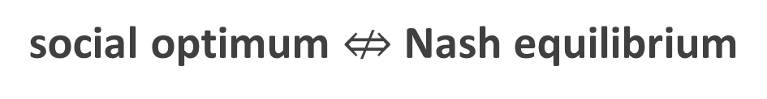
Concept: Social Optimum
Social welfare in an outcome
  sum of utilities of all players in the outcome
Social optimum:
  an outcome where social welfare is maximized
Generally,
social optimum $⇎$ Nash equilibrium

Slide 25
Example: Social Optimum
Claim: (Cooperate, Cooperate) is a social optimum
Player 2’s Strategy
Cooperate
Defect
-1 + -1
= -2
-9 + 0
= -9
Cooperate
Player 1’s Strategy
0 -9
= -9
-6 -6
= -12
Defect

Slide 26

Example: Social Optimum
Nash equilibrium $⇎$ social optimum
Social
optimum
Player 2’s Strategy
Cooperate
Defect
-1, -2
-9, 0
Nash equilibrium
Cooperate
Player 1’s Strategy
0, -9
-6, -6
Defect

Slide 27
Game Theory Concepts: Summary
Nash equilibrium: an outcome where each user best responds to others’ strategies
Social welfare: sum of utilities of all players
Social optimum: an outcome where the social welfare is maximized

Slide 28
Road Map
Concepts in Game Theory
Game-theoretic Models
  Sharable Good Game <<
  Sharable Good Game with Access Cost
Simulation
Conclusion

Slide 29
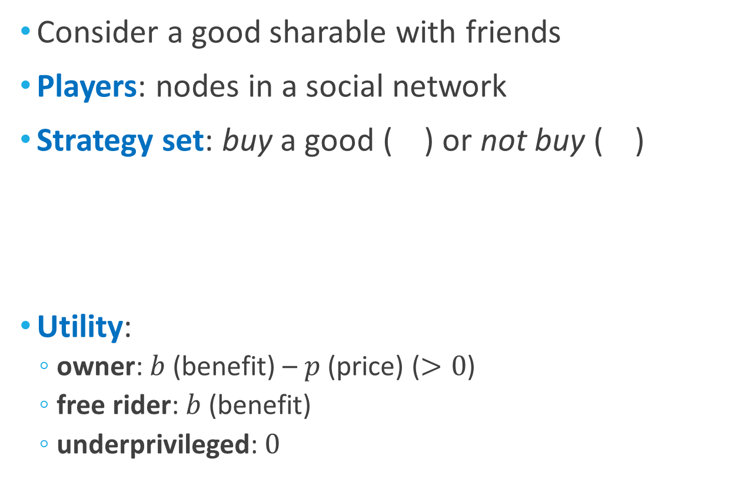
Sharable Good Game (SGG)
Consider a good sharable with friends
Players: nodes in a social network
Strategy set: buy a good ( ) or not buy ( )
Utility:
  owner: $b$ (benefit) – $p$ (price) ($>0$)
  free rider: $b$ (benefit)
  underprivileged: $0$
)
free rider (friends of the owner)
underprivileged
owner

Slide 30
Nash Equilibrium: Conditions
Utility comparison:
free rider > owner > underprivileged
no underprivileged nodes
  underprivileged nodes become owners by changing their strategy to “buy”
owners have no owner friends
  otherwise, owners become free riders by changing their strategy to “not buy”
underprivileged
owner
owner
free rider

Slide 31
Nash Equilibrium: Existence
“Do Nash equilibria exist
in every social network?”
Theorem [Existence of NEs in SGG]:
In any social network, there exists a Nash Equilibrium.
Proof: The following algorithm always gives an NE
initialize the strategy of every node to “not buy”
repeat until there is no underprivileged node
  choose an underprivileged node
  change its strategy to “buy”

Slide 32
Proof of Existence
Detail
initialize the strategy of every node to “not buy”
repeat until there is no underprivileged node
  choose an underprivileged node
  change its strategy to “buy”
Underprivileged

Slide 33
Proof of Existence (cont.)
Detail
initialize the strategy of every node to “not buy”
repeat until there is no underprivileged node
  choose an underprivileged node
  change its strategy to “buy”
Underprivileged

Slide 34
Proof of Existence (cont.)
Detail
initialize the strategy of every node to “not buy”
repeat until there is no underprivileged node
  choose an underprivileged node
  change its strategy to “buy”
Underprivileged
Underprivileged
Free riders

Slide 35
Proof of Existence (cont.)
Detail
initialize the strategy of every node to “not buy”
repeat until there is no underprivileged node
  choose an underprivileged node
  change its strategy to “buy”
Underprivileged
Underprivileged
Underprivileged
Free riders

Slide 36
Proof of Existence (cont.)
Detail
initialize the strategy of every node to “not buy”
repeat until there is no underprivileged node
  choose an underprivileged node
  change its strategy to “buy”
The outcome is a Nash Equilibrium
no underprivileged nodes
  this is the termination condition
owners have no owner friends
  new owners are chosen among underprivileged nodes

Slide 37
Nash Equilibrium: Non-uniqueness
“Is there a unique Nash equilibrium
in every social network?”

Slide 38
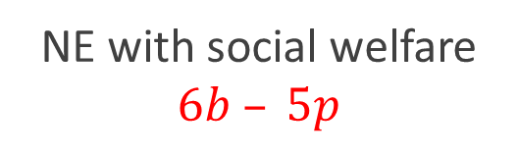
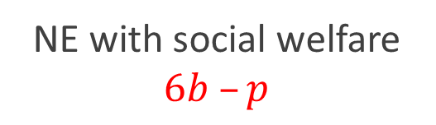
Nash Equilibrium: Non-uniqueness
Theorem [Non-uniqueness of NEs in SGG]:
There can be multiple Nash equilibria
with different social welfare
Example:
Social Optimum
NE with social welfare $6b – 5p$
NE with social welfare $6b –p$

Slide 39
Measuring Inefficiency
  In every NE and social optima
    no underprivileged node
    every node gets benefit from a good
  Use # owners to measure inefficiency of NEs
Fixed
Fixed
  $$social welfare=b × n− p × n_{o}$$
benefit
# nodes
price
# owners

Slide 40

Measuring Inefficiency (cont.)
Given a social network,
Given a social network,
inefficiency
of an NE
# owners in the NE
:=
$$∈[1,n]$$
# owners in a social optimum
PoA
(Price of Anarchy)
maximum inefficiency
over all NEs
:=
PoS
(Price of Stability)
minimum inefficiency
over all NEs
:=

Slide 41

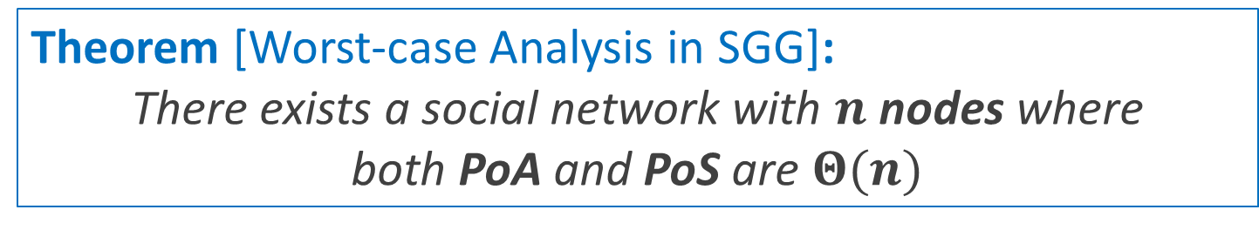

Worst-case Analysis
Theorem [Worst-case Analysis in SGG]:
There exists a social network with $n$ nodes where
both PoA and PoS are $Θ(n)$
Example :
…
…
$$\frac{n−1}{2}$$
$$\frac{n−1}{2}$$

Slide 42
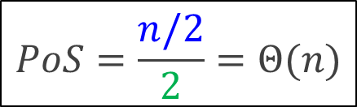
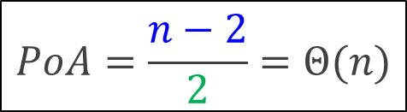
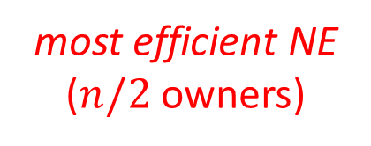
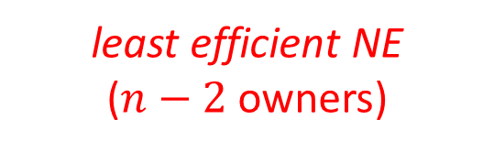
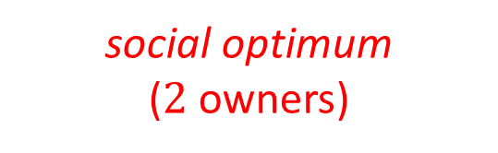
Worst-case Analysis (cont.)
Theorem [Worst-case Analysis in SGG]:
There exists a social network with $n$ nodes where
both PoA and PoS are $Θ(n)$
$$PoS=\frac{n/2}{2}=Θ(n)$$
$$PoA=\frac{n−2}{2}=Θ(n)$$
Example :
…
…
…
…
…
…
social optimum
($2$ owners)
most efficient NE
($n/2$ owners)
least efficient NE
($n−2$ owners)

Slide 43
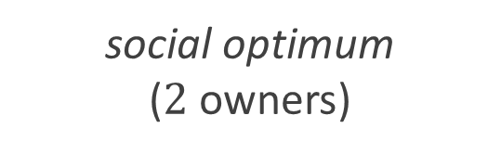
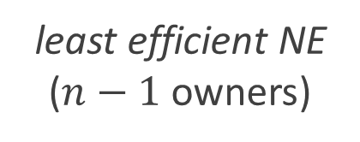
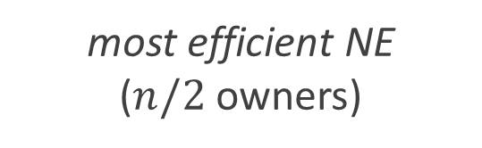
Reason of Inefficiency
A Nash equilibrium is inefficient when
  nodes with many friends free ride
  nodes with few friends buy a good
…
…
…
…
…
…
social optimum
($2$ owners)
most efficient NE
($n/2$ owners)
least efficient NE
($n−1$ owners)
“How can we incentivize nodes
with many friends to buy a good?”

Slide 44
Summary of SGG
Definition:
  Players: nodes in a social network
  Strategy set: “buy”, “not buy”
  Utility: free rider > owner > underprivileged
Nash Equilibrium:
  always exists but not unique
Efficiency of Nash Equilibria:
  both best and worst NEs can be highly inefficient

Slide 45
Road Map
Concepts in Game Theory
Game-theoretic Models
  Sharable Good Game
  Sharable Good Game with Access Cost <<
Simulation
Conclusion

Slide 46
SGG with Access Cost (SGG-AC)
Consider a good sharable with friends
Players: nodes in a social network
Strategy set:
  buy a good ( ) or not buy ( )
  rent a good from a friend by
  paying an access cost ( ) to the friend
)
renter
owner
renter
underprivileged

Slide 47

Utility in SGG-AC
renter
owner
renter
underprivileged
Utility:
  owner: $b$ (benefit) $− p$ (price) $+ a$ (access cost) $× r$ (# its renters)
  renter: $b$ (benefit) $− a$ (access cost)
  underprivileged: $0$ (assumption: $b>p>a$)
Rich owner and poor owner:
  rich owner: owner with at least $T(=\left\lceil p/a\right\rceil −1)$ renters
  poor owner: owner with less than $T$ renter
Utility comparison:
rich owner > renter > poor owner > underprivileged

Slide 48
Nash Equilibrium: Conditions
Utility comparison:
rich owner > renter > poor owner > underprivileged
no underprivileged nodes
  underprivileged nodes become owners by changing their strategy to “buy”
poor owners have no owner friends
  otherwise, poor owners become renters by changing their strategy to “rent”
underprivileged
poor owner
poor owner
renter

Slide 49
Existence and Non-uniqueness
Theorem [Existence of NEs in SGG-AC]:
In any social network, there exists a Nash Equilibrium.
Theorem [Non-uniqueness of NEs in SGG]:
There can be multiple Nash equilibria
with different social welfare
Example :
NE with 5 owners
NE with 1 owner

Slide 50
Measuring Inefficiency: Review
Given a social network,
Given a social network,
inefficiency
of an NE
# owners in the NE
:=
$$∈[1,n]$$
# owners in a social optimum
PoA
(Price of Anarchy)
maximum inefficiency
over all NEs
:=
PoS
(Price of Stability)
minimum inefficiency
over all NEs
:=

Slide 51
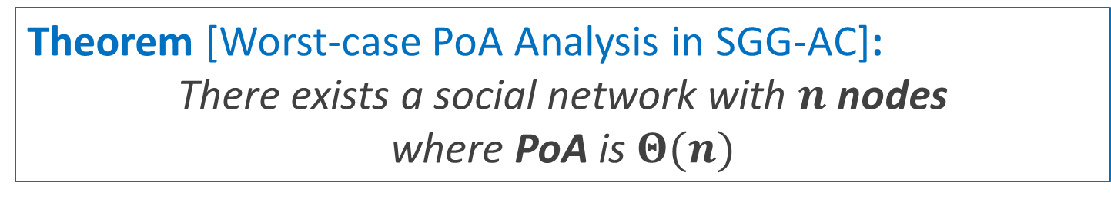
Worst-case Analysis: PoA
Theorem [Worst-case PoA Analysis in SGG-AC]:
There exists a social network with $n$ nodes
where PoA is $Θ(n)$
Worst NEs in SGG-AC are as inefficient as those in SGG
Example :
…
…
$$\frac{n−1}{2}$$
$$\frac{n−1}{2}$$

Slide 52
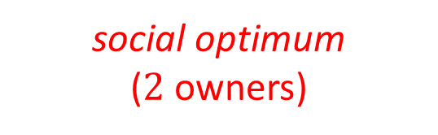
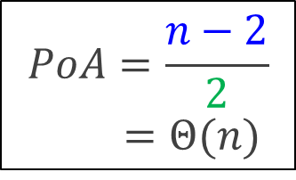

Worst-case Analysis: PoA
Theorem [Worst-case PoA Analysis in SGG-AC]:
There exists a social network with $n$ nodes
where PoA is $Θ(n)$
$$PoA=\frac{n−2}{2}$$
$=Θ(n)$
…
…
…
…
social optimum
($2$ owners)
least efficient NE
($n−2$ owners)

Slide 53
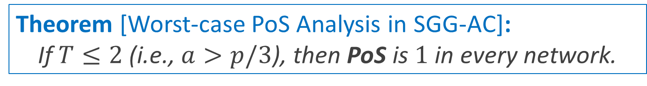
Worst-case Analysis: PoS
Theorem [Worst-case PoS Analysis in SGG-AC]:
If $T≤2$ (i.e., $a>p/3$), then PoS is $1$ in every network.
If $T≤2$, best NEs are socially optimal.
Proof Sketch: we designed an algorithm that
  starts from a social optimum
  reaches a Nash equilibrium
  without increasing the number of owners

Slide 54


Worst-case Analysis: PoS
Theorem [Worst-case PoS Analysis in SGG-AC]:
If $T≤2$ (i.e., $a>p/3$), then PoS is $1$ in every network.
Example:
$$PoS=\frac{2}{2}=1$$
…
…
…
…
$$\frac{n−1}{2}$$
$$\frac{n−1}{2}$$
social optimum,
Nash equilibrium

Slide 55
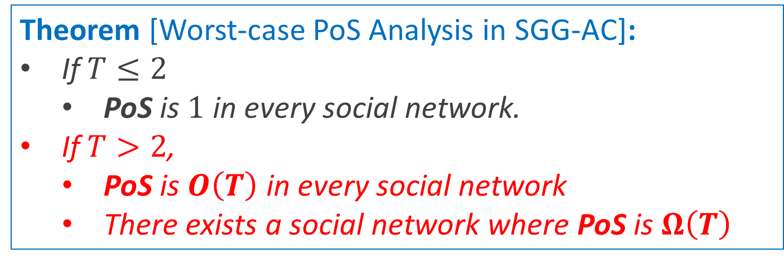
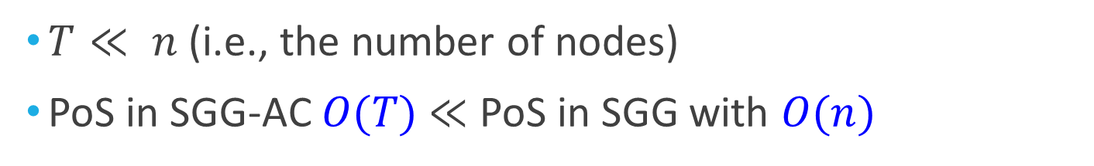
Worst-case Analysis: PoS
Detail
Theorem [Worst-case PoS Analysis in SGG-AC]:
If $T≤2$
  PoS is $1$ in every social network.
If $T>2$,
  PoS is $O\left(T\right)$ in every social network
  There exists a social network where PoS is $Ω\left(T\right)$
$T≪ n$ (i.e., the number of nodes)
PoS in SGG-AC $O(T)$ $≪$ PoS in SGG with $O(n)$

Slide 56
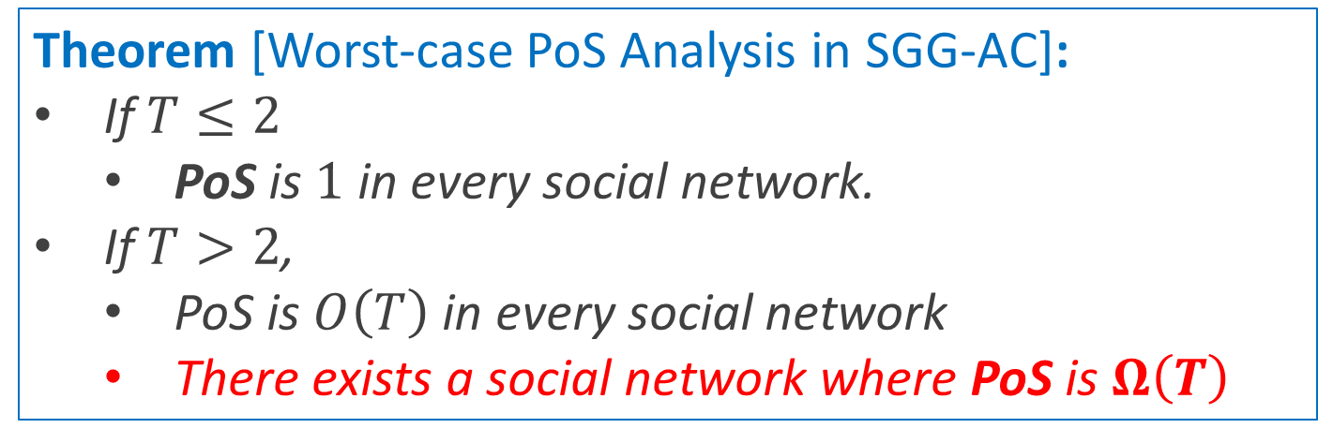


Worst-case Analysis: PoS
Detail
Theorem [Worst-case PoS Analysis in SGG-AC]:
If $T≤2$
  PoS is $1$ in every social network.
If $T>2$,
  PoS is $O\left(T\right)$ in every social network
  There exists a social network where PoS is $Ω\left(T\right)$
Example:
…
…
$$T−1$$
$$T−1$$

Slide 57
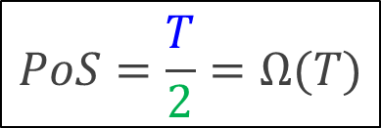

Worst-case Analysis: PoS
Detail
Theorem [Worst-case PoS Analysis in SGG-AC]:
If $T≤2$
  PoS is $1$ in every social network.
If $T>2$,
  PoS is $O\left(T\right)$ in every social network
  There exists a social network where PoS is $Ω\left(T\right)$
$$PoS=\frac{T}{2}=Ω(T)$$
…
…
…
…
social optimum
($2$ owners)
most efficient NE
(T owners)

Slide 58
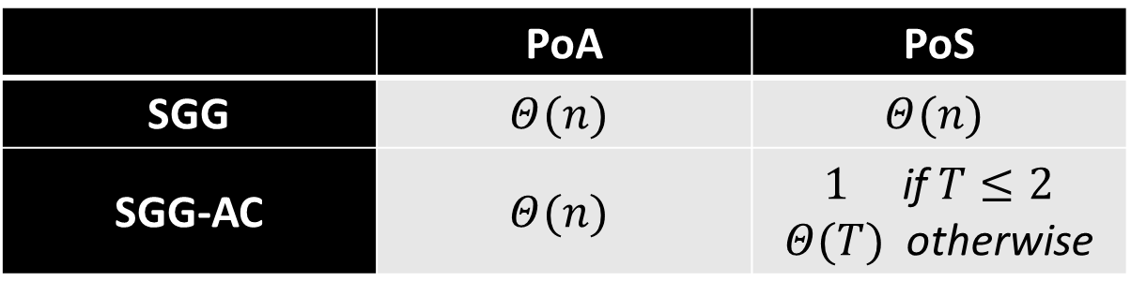

Summary of Theoretic Analysis
 | PoA | PoS
SGG | $$Θ(n)$$ | $$Θ(n)$$
SGG-AC | $$Θ(n)$$ | $1$ if $T≤2$ $Θ(T)$ otherwise
Introducing access costs (SGG $→$SGG-AC):
  Does not reduce inefficiency of worst NEs: $Θ\left(n\right)→Θ(n)$
  Does reduce inefficiency of best NEs: $Θ\left(n\right)→1$ or $Θ(T)$
“How inefficient are other NEs,
which are neither best nor worst?”

Slide 59
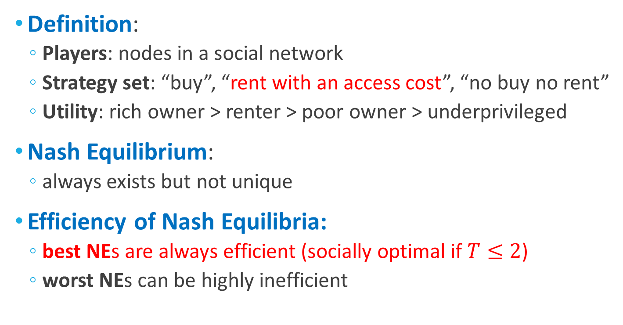
Summary of SGG-AC
Definition:
  Players: nodes in a social network
  Strategy set: “buy”, “rent with an access cost”, “no buy no rent”
  Utility: rich owner > renter > poor owner > underprivileged
Nash Equilibrium:
  always exists but not unique
Efficiency of Nash Equilibria:
  best NEs are always efficient (socially optimal if $T≤2$)
  worst NEs can be highly inefficient

Slide 60
Road Map
Concepts in Game Theory
Game-theoretic Models
  Sharable Good Game
  Sharable Good Game with Access Cost
Simulation <<
Conclusion

Slide 61
Why Simulation?
Complement our theoretical analysis
Real social networks:
  Karate club (34 nodes, 78 edges)
  Hamsterster (1,858 nodes, 12,534 edges)
  Advogato (5,155 nodes, 51,127 edges)
 | Nash Equilibria | Social Network
Theoretical analysis | best and worst NEs | hypothetical social networks
Simulation | realistic NEs | real social networks

Slide 62
Simulation Method
Use best-response dynamics to obtain 1,000 NEs
Measure the average inefficiency of the 1,000 NEs
randomly initialize strategies
repeat
  for each node
    change its strategy to a best response
until an NE is reached
Theorem:
Always terminates
inefficiency
of an NE
# owners in the NE
:=
# owners in a social optimum

Slide 63
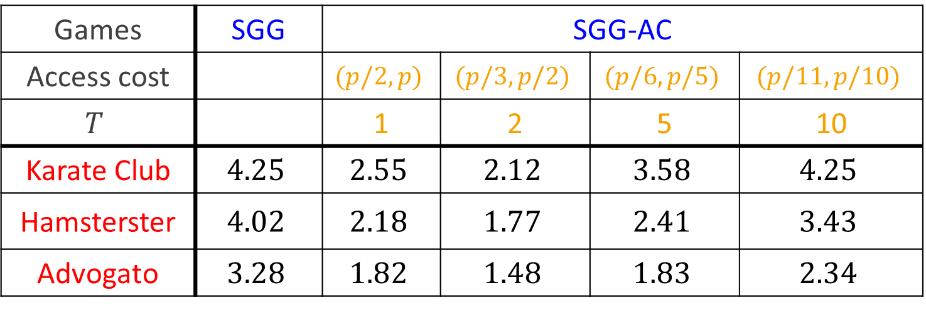
Simulation Results
Average (social) inefficiency
Games | SGG | SGG-AC
Access cost |  | $$(p/2,p)$$ | $$(p/3,p/2)$$ | $$(p/6,p/5)$$ | $$(p/11,p/10)$$
$$T$$ |  | 1 | 2 | 5 | 10
Karate Club | $$4.25$$ | $$2.55$$ | $$2.12$$ | $$3.58$$ | $$4.25$$
Hamsterster | $$4.02$$ | $$2.18$$ | $$1.77$$ | $$2.41$$ | $$3.43$$
Advogato | $$3.28$$ | $$1.82$$ | $$1.48$$ | $$1.83$$ | $$2.34$$

Slide 64
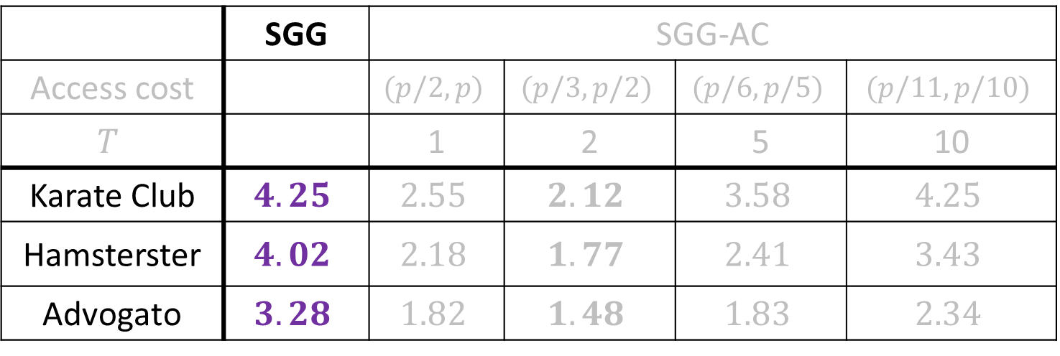
Simulation Results: SGG
Average social inefficiency
 | SGG | SGG-AC
Access cost |  | $$(p/2,p)$$ | $$(p/3,p/2)$$ | $$(p/6,p/5)$$ | $$(p/11,p/10)$$
$$T$$ |  | 1 | 2 | 5 | 10
Karate Club | $$4.25$$ | $$2.55$$ | $$2.12$$ | $$3.58$$ | $$4.25$$
Hamsterster | $$4.02$$ | $$2.18$$ | $$1.77$$ | $$2.41$$ | $$3.43$$
Advogato | $$3.28$$ | $$1.82$$ | $$1.48$$ | $$1.83$$ | $$2.34$$
- In SGG (without access cost), inefficiency was $\sim 4$

Slide 65
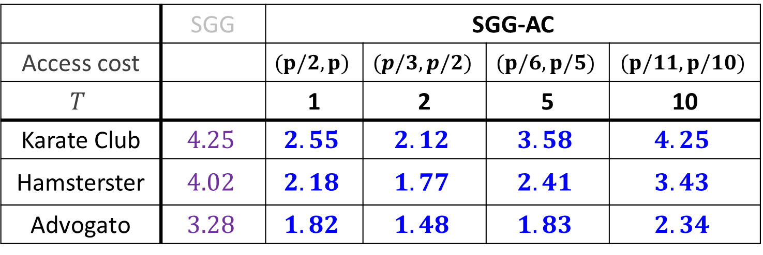
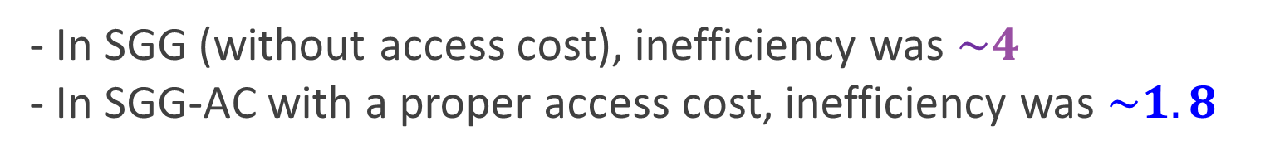
Simulation Results: SGG-AC
Average social inefficiency
 | SGG | SGG-AC
Access cost |  | $$(p/2,p)$$ | $$(p/3,p/2)$$ | $$(p/6,p/5)$$ | $$(p/11,p/10)$$
$$T$$ |  | 1 | 2 | 5 | 10
Karate Club | $$4.25$$ | $$2.55$$ | $$2.12$$ | $$3.58$$ | $$4.25$$
Hamsterster | $$4.02$$ | $$2.18$$ | $$1.77$$ | $$2.41$$ | $$3.43$$
Advogato | $$3.28$$ | $$1.82$$ | $$1.48$$ | $$1.83$$ | $$2.34$$
- In SGG (without access cost), inefficiency was $\sim 4$
- In SGG-AC with a proper access cost, inefficiency was $\sim 1.8$

Slide 66
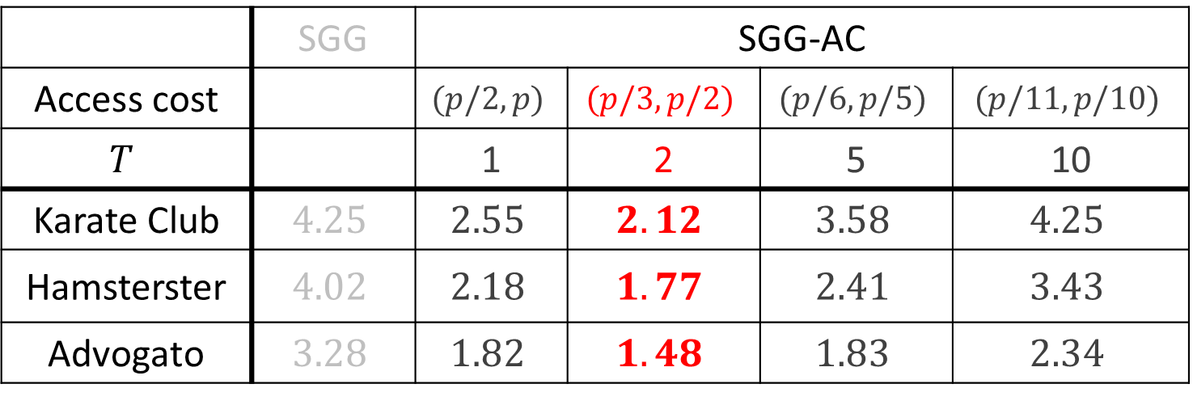
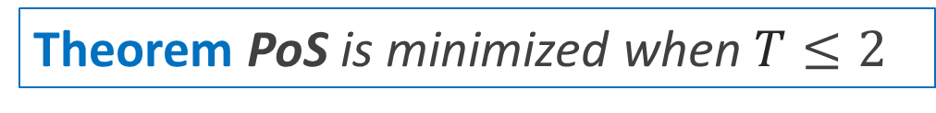
Simulation Results: Proper Cost
Average social inefficiency
 | SGG | SGG-AC
Access cost |  | $$(p/2,p)$$ | $$(p/3,p/2)$$ | $$(p/6,p/5)$$ | $$(p/11,p/10)$$
$$T$$ |  | 1 | 2 | 5 | 10
Karate Club | $$4.25$$ | $$2.55$$ | $$2.12$$ | $$3.58$$ | $$4.25$$
Hamsterster | $$4.02$$ | $$2.18$$ | $$1.77$$ | $$2.41$$ | $$3.43$$
Advogato | $$3.28$$ | $$1.82$$ | $$1.48$$ | $$1.83$$ | $$2.34$$
Inefficiency was minimized when $T=2$ (i.e., $\frac{p}{3}<a<\frac{p}{2}$)
Theorem PoS is minimized when $T≤2$

Slide 67
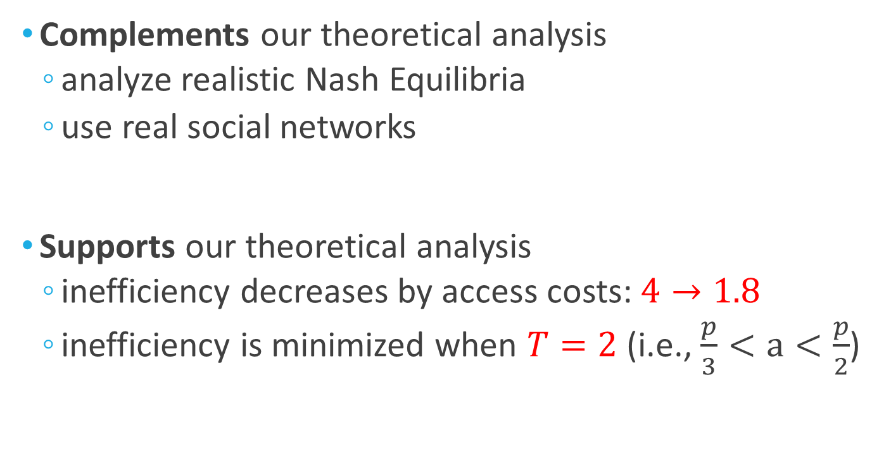
Summary of Simulation
Complements our theoretical analysis
  analyze realistic Nash Equilibria
  use real social networks
Supports our theoretical analysis
  inefficiency decreases by access costs: $4→1.8$
  inefficiency is minimized when $T=2$ (i.e., $\frac{p}{3}<a<\frac{p}{2}$)

Slide 68
Road Map
Concepts in Game Theory
Game-theoretic Models
  Sharable Good Game
  Sharable Good Game with Access Cost
Simulation
Conclusion <<

Slide 69
Summary
Goal: To examine incentives to buy sharable goods
Approaches: game-theoretic models
with equilibrium analysis and simulations
Findings:
  individually optimal purchases can be harmful to society
  access costs significantly reduce social inefficiency
  proper access cost lies between 1/3 and 1/2 of the price
Sharable good game (SGG)
Sharable good game
with access cost (SGG-AC)

Slide 70
Actionable Conclusion
Hard to mandate access costs at a societal level
  IKEA toolkits, DVDs, etc.
Feasible at the level of an organization
Example: University
  researchers share expensive lab equipment
  mandating access costs might reduce cost

Slide 71

Future Work: Coalition
Take coalitions of nodes into account
Analyze coalition-proof equilibria
  E.g., “strong Nash equilibria”

Slide 72
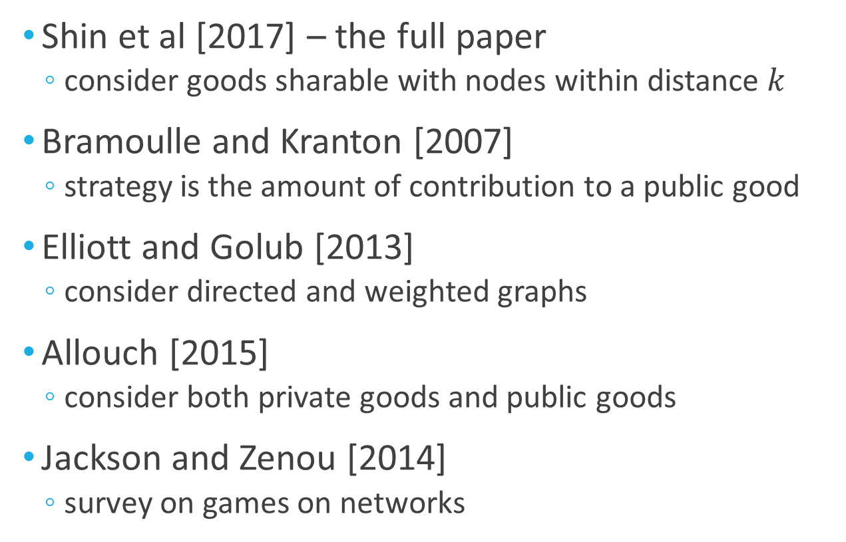
Related Work
Shin et al [2017] – the full paper
  consider goods sharable with nodes within distance $k$
Bramoulle and Kranton [2007]
  strategy is the amount of contribution to a public good
Elliott and Golub [2013]
  consider directed and weighted graphs
Allouch [2015]
  consider both private goods and public goods
Jackson and Zenou [2014]
  survey on games on networks

Slide 73
Thank You
Paper: http://www.cs.cmu.edu/~kijungs/papers/sggIJCAI2017.pdf
Email: kijungs@cs.cmu.edu

