Slide 1






D-Cube: Dense-Block Detection in Terabyte-Scale Tensors
Kijung Shin, Bryan Hooi, Jisu Kim, Christos Faloutsos
Carnegie Mellon University

Slide 2








Motivation: Review Fraud
Introduction
Proposed Method
Experiments
Conclusion
Alice’s
Bob’s
Carol’s
Alice

Slide 3






Fraud Forms Dense Blocks
Introduction
Proposed Method
Experiments
Conclusion
Accounts
Restaurants
Accounts
Restaurants
Adjacency Matrix

Slide 4
Problem: Natural Dense Blocks
Introduction
Proposed Method
Experiments
Conclusion
Accounts
natural dense blocks
(core, community, etc.)
Restaurants
suspicious dense blocks
formed by fraudsters
Question. How can we distinguish them?
Adjacency Matrix

Slide 5
Solution: Tensor Modeling
Introduction
Proposed Method
Experiments
Conclusion
Accounts
Timestamp
natural dense blocks: sparse on the time axis
suspicious dense blocks: dense on the time axis (synchronous behavior)
Restaurants
Sparse
Dense
[Shin et al. 2016, Jiang et al. 2015]

Slide 6



Anomaly/Fraud in Tensors
Introduction
Proposed Method
Experiments
Conclusion
Dense blocks signal anomalies/fraud in many tensor datasets
Timestamp
Timestamp
Timestamp
Dst IP
Page
Dst User
Src IP
User
Src User
Wikipedia
Revision History
Time-evolving
Social Network
TCP Dumps

Slide 7

Research Question
Introduction
Proposed Method
Experiments
Conclusion
Previous methods have limited scalability since they assume tensors fitting in memory
MAF [Maruhashi et al. 2011]
CrossSpot [Jiang et al. 2015]
M-Zoom [Shin et al. 2016]
Question:
How can we find dense blocks in a
large-scale tensor not fitting in memory
or even on a disk?

Slide 8


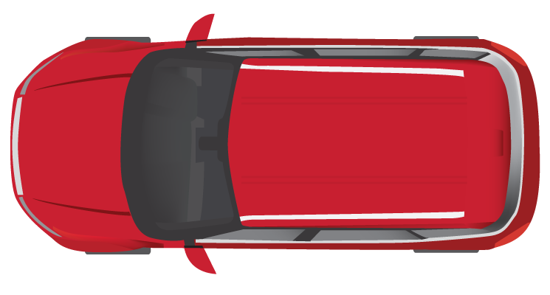
Road Map
Introduction
Proposed Method: D-Cube <<
Problem Definition <<
Algorithm
Experiments
Conclusion

Slide 9
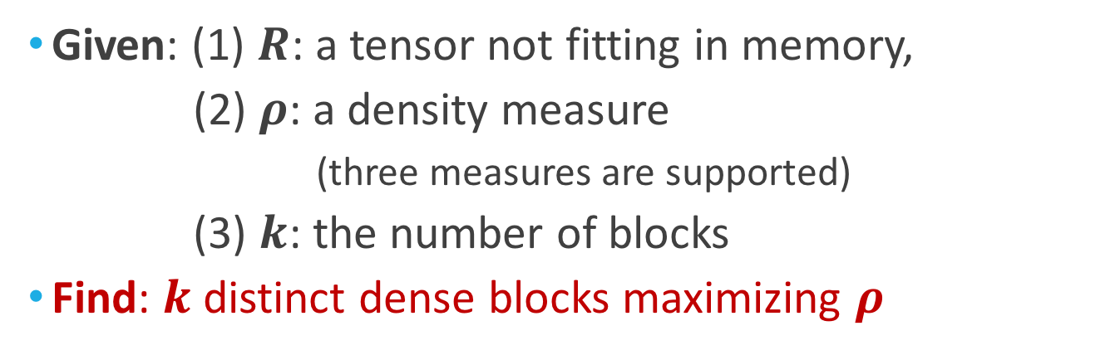






Problem Definition
Introduction
Proposed Method
Experiments
Conclusion
Given: (1) $R$: a tensor not fitting in memory,
(2) $ρ$: a density measure
(three measures are supported)
(3) $k$: the number of blocks
Find: $k$ distinct dense blocks maximizing $ρ$
$$(R=$$
$$,ρ=ρ_{A},k=3)$$
$$\{$$
$$\}$$
$$,$$
$$,$$

Slide 10
Requirements
Introduction
Proposed Method
Experiments
Conclusion
Our goal is to design an algorithm which is
D-Cube, our proposed method, satisfies all the requirements
Out-of-core: handles data not fitting in memory
Fast: runs in near-linear time
Accurate: provides an accuracy guarantee
Effective: produces meaningful results in practice
0

Slide 11
Road Map
Introduction
Proposed Method: D-Cube
Terminologies and Problem Definition
Algorithm <<
Experiments
Conclusion

Slide 12
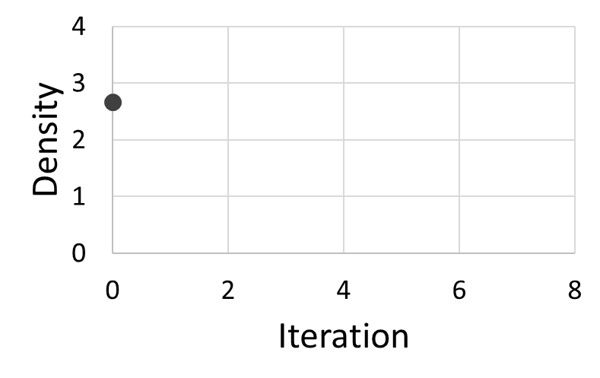


Single Dense Block Detection
Introduction
Proposed Method
Experiments
Conclusion
Search among $2^{(\# slices) }$ possible sub-tensors
Step 1. search starts from the entire tensor
1 0 0
3 0
6 1
0 0
0 0
0
1
0
$$ρ=2.7$$

Slide 13

Single Dense Block Detection (cont.)
Introduction
Proposed Method
Experiments
Conclusion
Step 2. repeat until we reach the empty tensor
choose a mode with the most remaining slices
remove slices with mass at most the average mass
{
2
1 0 0
{
3 0
6 1
0 0
0 0
0
1
0
4
{
3

Slide 14

Single Dense Block Detection (cont.)
Introduction
Proposed Method
Experiments
Conclusion
Step 2. repeat until we reach the empty tensor
choose a mode with the most remaining slices
remove slices with mass at most the average mass
1 0 0
9
11
3
1
(Avg. = 6)
3 0
6 1
0 0
0 0
0
1
0

Slide 15
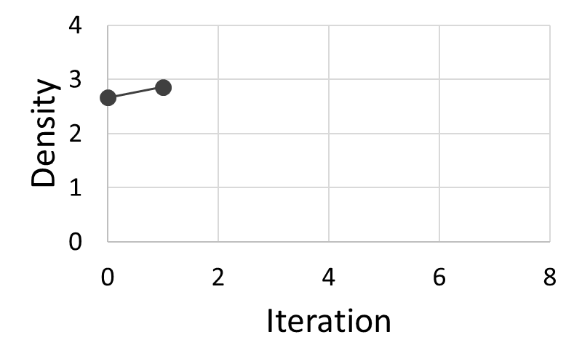

Single Dense Block Detection (cont.)
Introduction
Proposed Method
Experiments
Conclusion
Step 2. repeat until we reach the empty tensor
choose a mode with the most remaining slices
remove slices with mass at most the average mass
1 0 0
3 0
6 1
0
1
0
$$ρ=2.9$$

Slide 16
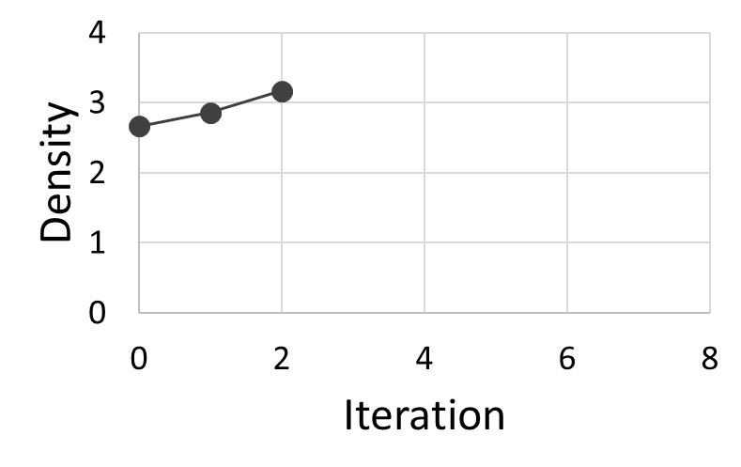

Single Dense Block Detection (cont.)
Introduction
Proposed Method
Experiments
Conclusion
Step 2. repeat until we reach the empty tensor
choose a mode with the most remaining slices
remove slices with mass at most the average mass
1 0 0
3
6
$$ρ=3.2$$

Slide 17
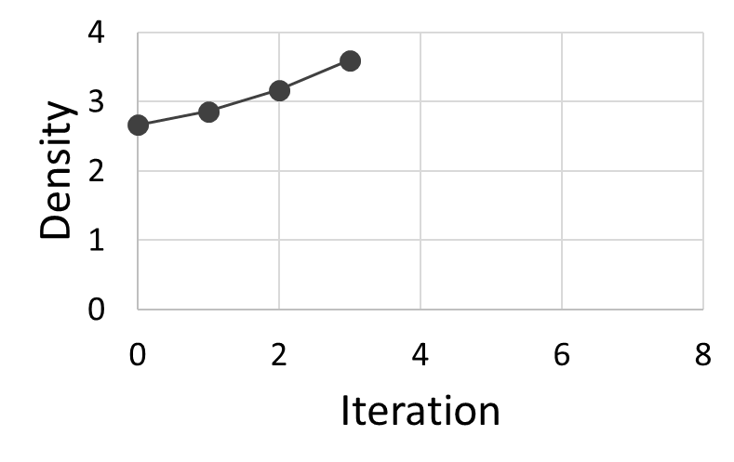

Single Dense Block Detection (cont.)
Introduction
Proposed Method
Experiments
Conclusion
Step 2. repeat until we reach the empty tensor
choose a mode with the most remaining slices
remove slices with mass at most the average mass
3
6
$$ρ=3.6$$

Slide 18
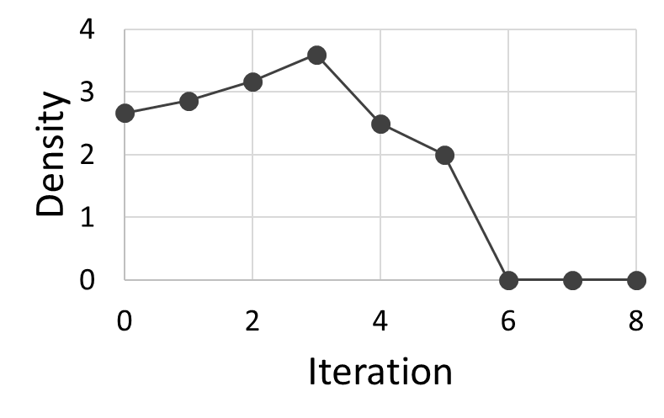

Single Dense Block Detection (cont.)
Introduction
Proposed Method
Experiments
Conclusion
Step 2. repeat until an empty tensor is left
choose a mode with the most remaining slices
remove slices with mass at most the average mass
maximum
$$ρ=0.0$$

Slide 19
Single Dense Block Detection (cont.)
Introduction
Proposed Method
Experiments
Conclusion
Step 3. return the densest block so far
3
6
maximum
$$ρ=3.6$$

Slide 20
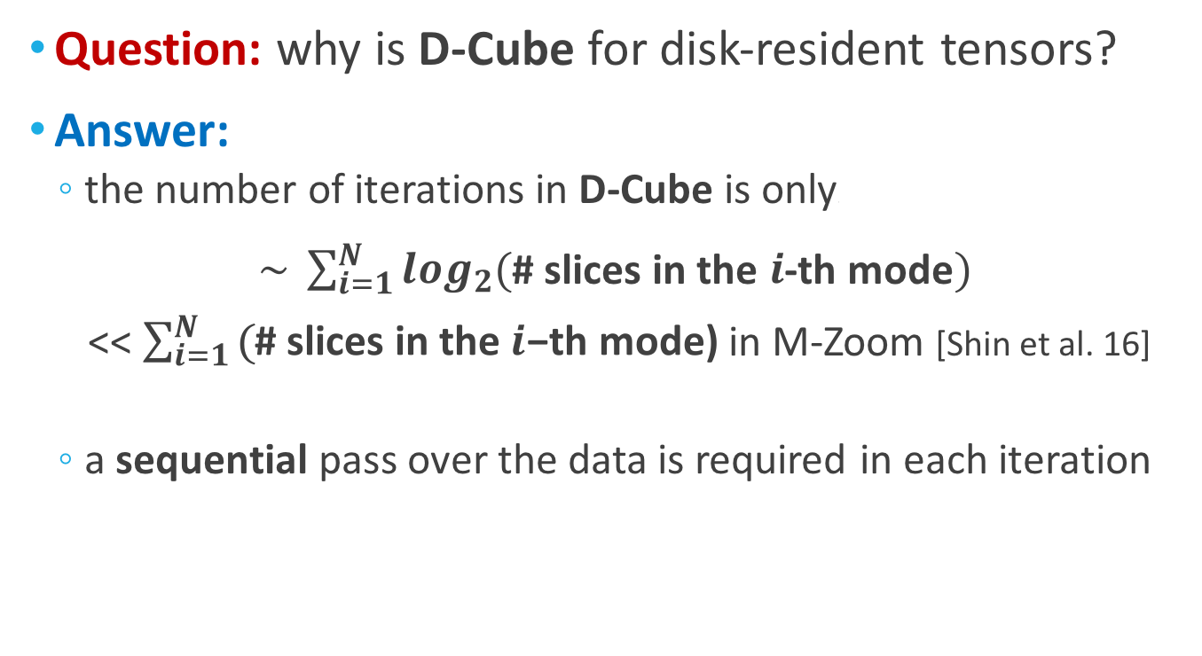
D-Cube for Disk-Resident Tensors
Introduction
Proposed Method
Experiments
Conclusion
Question: why is D-Cube for disk-resident tensors?
Answer:
the number of iterations in D-Cube is only\
$\sim \sum_{i=1}^{N}{\log_{2}{(}}$# slices in the $i$-th mode$)$
<<$\sum_{i=1}^{N}{\text{(}\text{\# }\text{slices} \text{in} \text{the} i\text{−}\text{th} \text{mode}\text{)}}$ in M-Zoom [Shin et al. 16]
a sequential pass over the data is required in each iteration

Slide 21

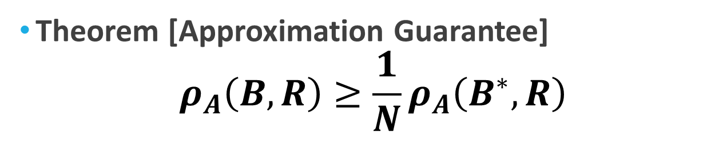
Accuracy Guarantee
Introduction
Proposed Method
Experiments
Conclusion
Theorem [Approximation Guarantee]
$$ρ_{A}\left(B,R\right)≥\frac{1}{N}ρ_{A}\left(B^{∗},R\right)$$
D-Cube Result
Input Tensor
Order
Densest Block
Properties of D-Cube:
0.37
Out-of-core: handles data not fitting in memory
Fast: runs in near-linear time
Accurate: provides an accuracy guarantee
Effective: produces meaningful results in practice
0

Slide 22

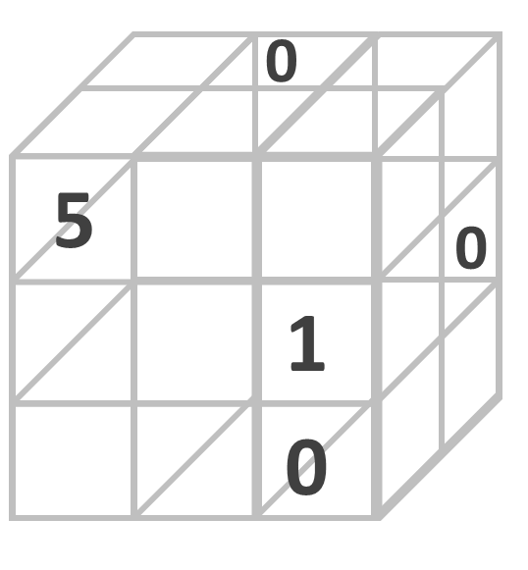
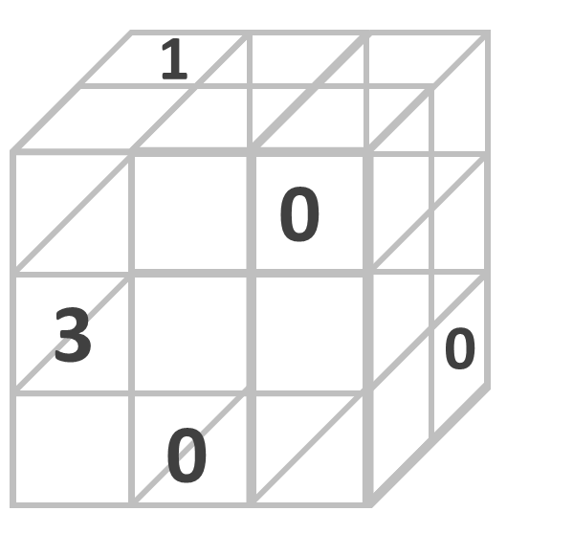
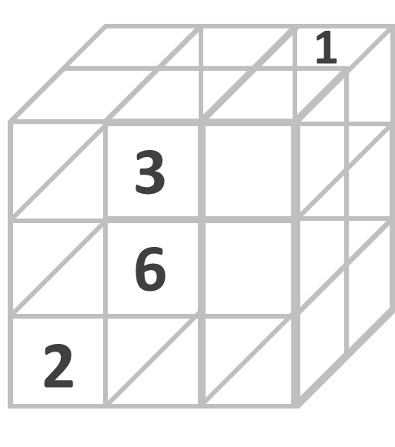
Parallelizing D-Cube
Introduction
Proposed Method
Experiments
Conclusion
Basically, D-Cube repeats
1. computing the masses of the slices
2. removing slices with mass at most the average
Question:
How can these steps be parallelized in a distributed setting?

Slide 23

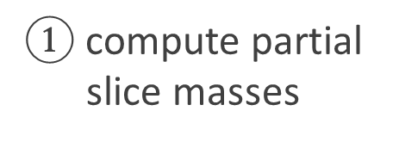
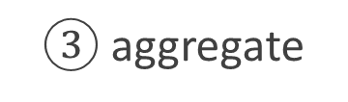
Parallelizing D-Cube
Introduction
Proposed Method
Experiments
Conclusion
Compute the masses of the slices in a distributed way
$③$ aggregate
master
$②$ send to master
$①$ compute partial slice masses
slave
slave
slave
partial input tensor

Slide 24
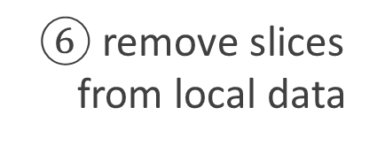
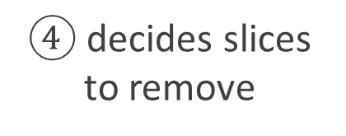
Parallelizing D-Cube (cont.)
Introduction
Proposed Method
Experiments
Conclusion
Remove slices in a distributed way
$④$ decides slices
to remove
master
⑤ broadcast the list
$⑥$ remove slices
from local data
slave
slave
slave
partial input tensor

Slide 25
Handling Multiple Blocks
Introduction
Proposed Method
Experiments
Conclusion
Remove found blocks before finding others
Find & Remove
Find & Remove
Find & Remove
Restore

Slide 26
Road Map
Introduction
Proposed Method: D-Cube
Problem Definition
Algorithm
Experiments <<
Conclusion

Slide 27
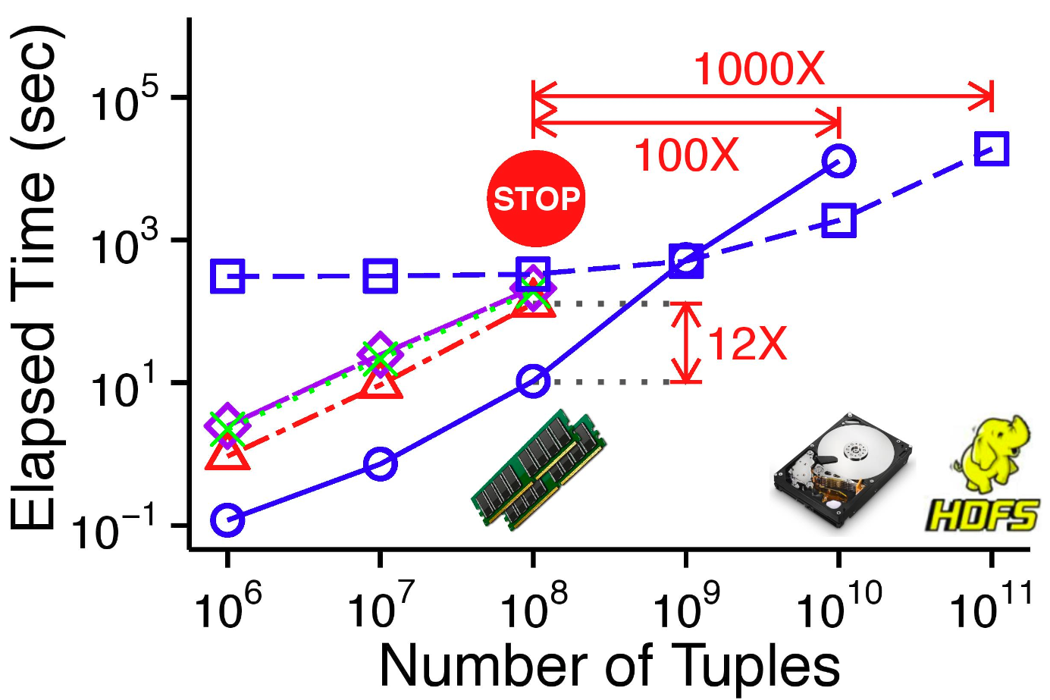
Exp1. Scalability Test
Introduction
Proposed Method
Experiments
Conclusion
D-Cube (Serial)
D-Cube (Hadoop)
#Non-Zeros

Slide 28

Exp1. Scalability Test (cont.)
Introduction
Proposed Method
Experiments
Conclusion
D-Cube handles up to $1000×$ larger data!
Properties of D-Cube:
0.37
Out-of-core: handles data not fitting in memory
Fast: runs in near-linear time
Accurate: provides an accuracy guarantee
Effective: produces meaningful results in practice
0

Slide 29
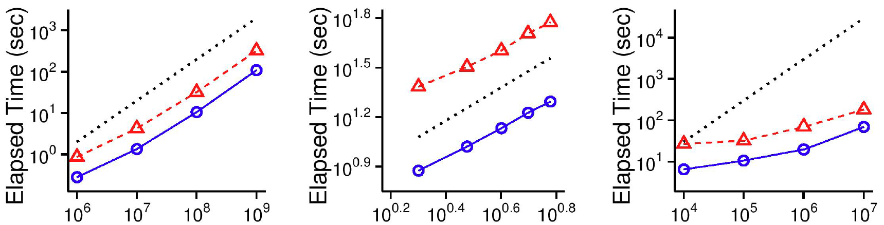
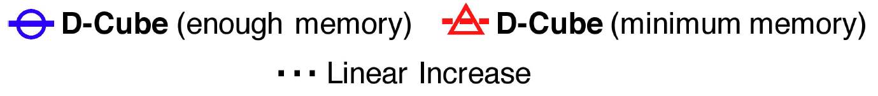
Exp2. Speed Test (cont.)
Introduction
Proposed Method
Experiments
Conclusion
# Non-zeros
Order
Dimensionality

Slide 30
Exp2. Speed Test (cont.)
Introduction
Proposed Method
Experiments
Conclusion
D-Cube scales linearly with each input factor
Properties of D-Cube:
0.37
Out-of-core: handles data not fitting in memory
Fast: runs in near-linear time
Accurate: provides an accuracy guarantee
Effective: produces meaningful results in practice
0

Slide 31
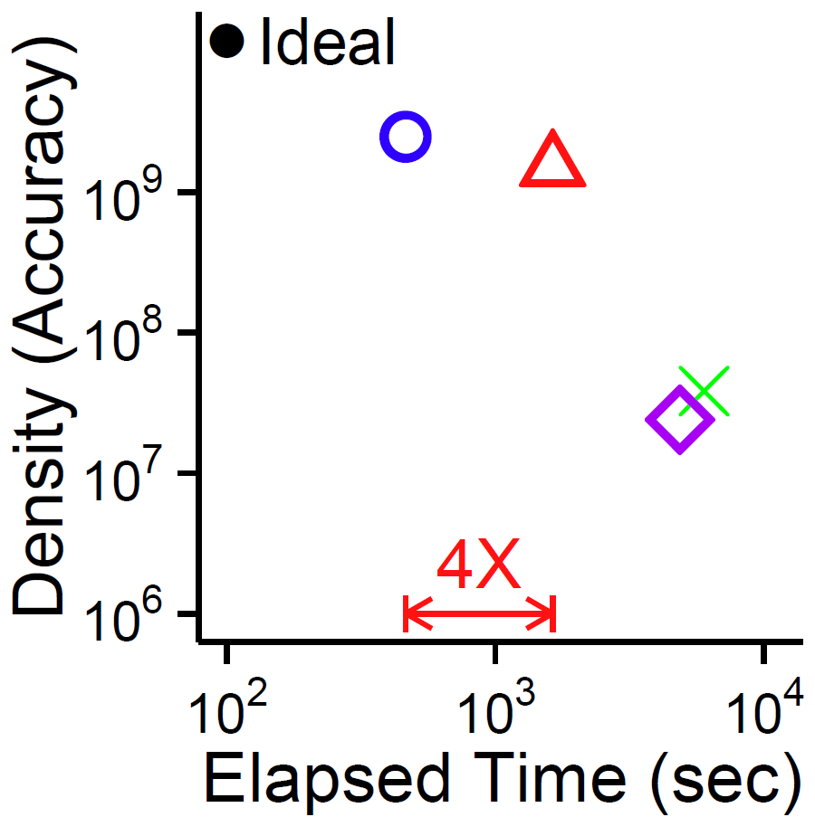

Exp3. Speed-Accuracy Test
Introduction
Proposed Method
Experiments
Conclusion
D-Cube gives a best trade-off
D-Cube

Slide 32
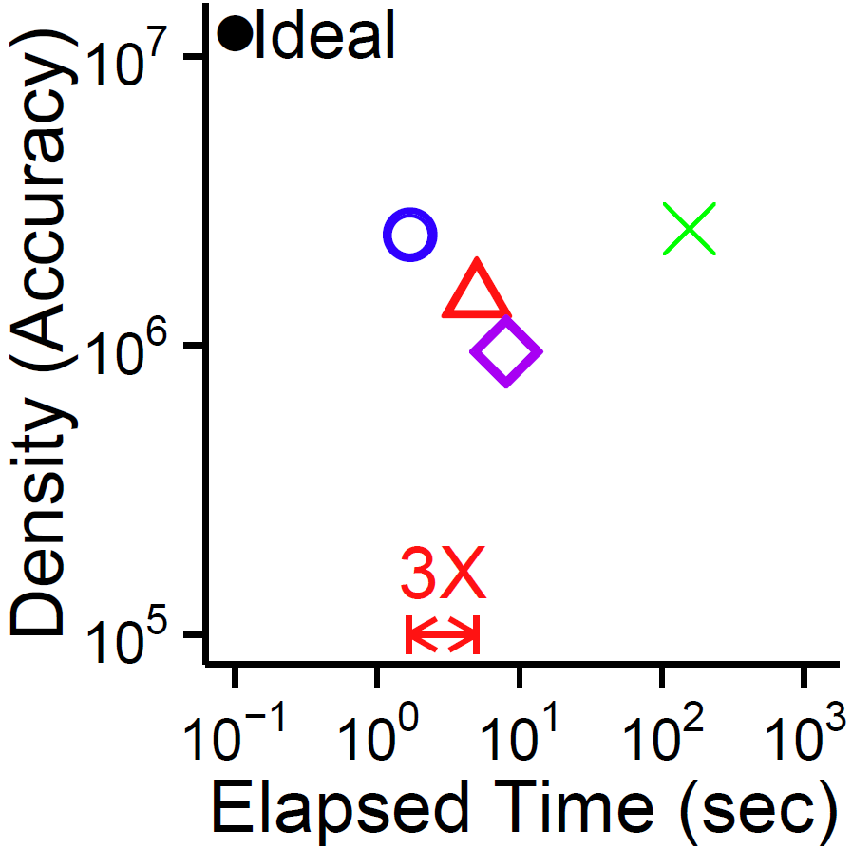
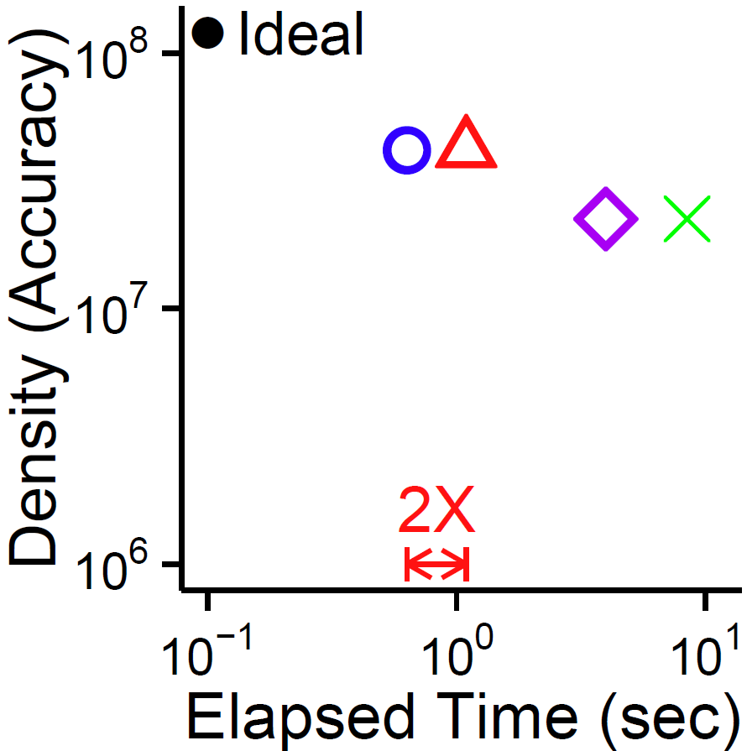

Exp3. Speed-Accuracy Test (cont.)
Introduction
Proposed Method
Experiments
Conclusion
D-Cube gives a best trade-off
D-Cube
D-Cube

Slide 33
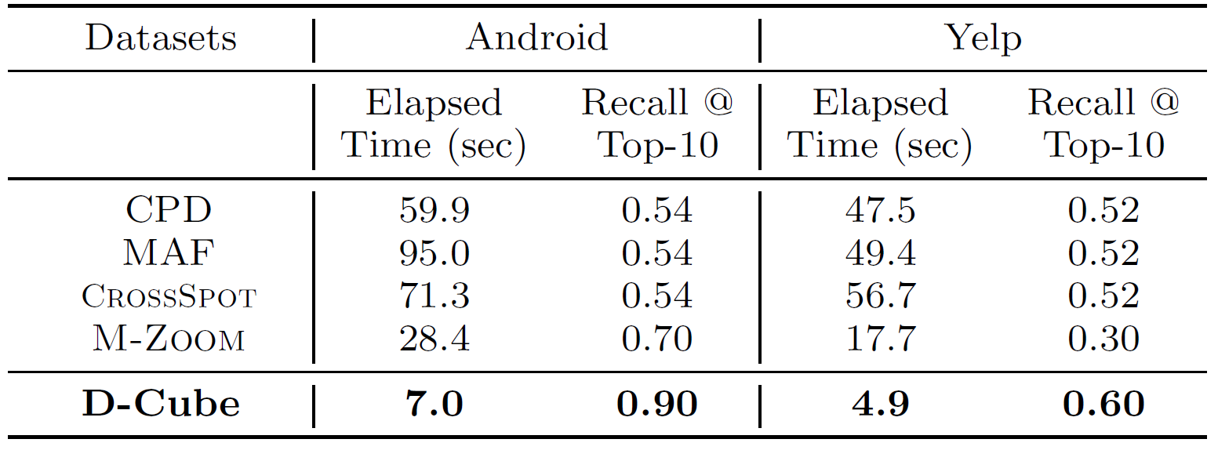

Exp4. Effectiveness Test
Accuracy in rating-manipulation detection
D-Cube Wins
D-Cube Wins

Slide 34
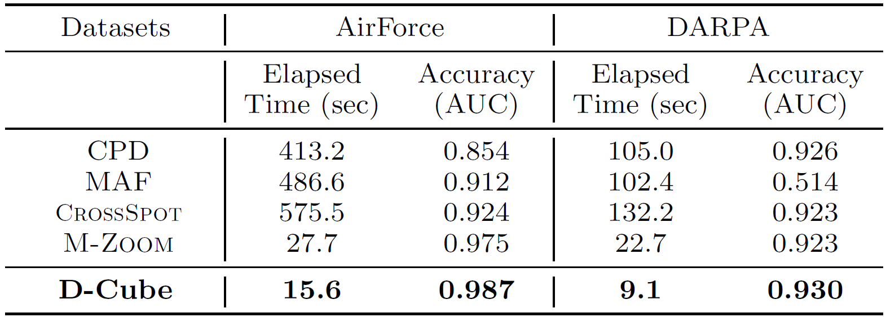


Exp4. Effectiveness Test (cont.)
Accuracy in network-intrusion detection from TCP dumps
D-Cube Wins
D-Cube Wins

Slide 35
Exp4. Effectiveness Test (cont.)
Properties of D-Cube:
0.37
Out-of-core: handles data not fitting in memory
Fast: runs in near-linear time
Accurate: provides an accuracy guarantee
Effective: produces meaningful results in practice
0

Slide 36
Road Map
Introduction
Proposed Method: D-Cube
Problem Definition
Algorithm
Experiments
Conclusion <<

Slide 37
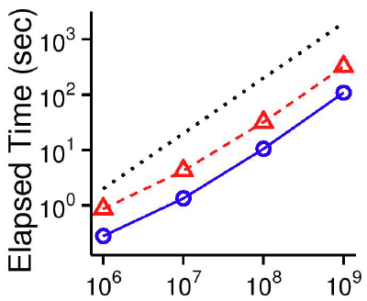

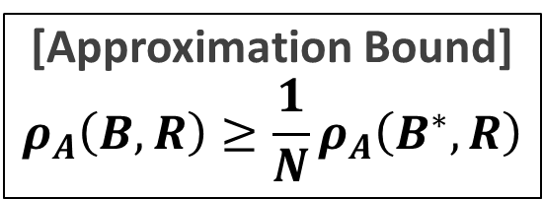
Conclusion
Introduction
Proposed Method
Experiments
Conclusion
D-Cube (Disk-based Dense-block Detection):
Dense-Block Detection in Terabyte-Scale Tensors
Out-of-Core
Fast
Accurate
[Approximation Bound]
$$ρ_{A}\left(B,R\right)≥\frac{1}{N}ρ_{A}\left(B^{∗},R\right)$$
Effective
Reproducible
https://github.com/kijungs/dcube

