Slide 1


Distributed Methods for
High-dimensional and Large-scale
Tensor Factorization
Kijung Shin (Seoul National University)
and U Kang (KAIST)

Slide 2
Overview
Introduction
Problem definition
Proposed method
Experiments
Conclusion
Introduction
Problem definition
Proposed method
Experiments
Conclusion

Slide 3
Overview
Introduction
Problem definition
Proposed method
Experiments
Conclusion
A tensor is a high dimensional array
A tensor is partially observable if it contains missing (or unknown) entries
3 4
2 1
5 3
Mode
length
Observations
A 3-dimensional tensor

Slide 4
Tensor (cont.)
Introduction
Problem definition
Proposed method
Experiments
Conclusion
Tensor data have become large and complex
Example: Movie rating data
2014
Increase in …
Dimension (context information)
Mode length (# users and # movies)
# observations (# reviews)
2013
2012
3
Ann
Tom
Sam
4
5
2
Up Cars Tangled

Slide 5
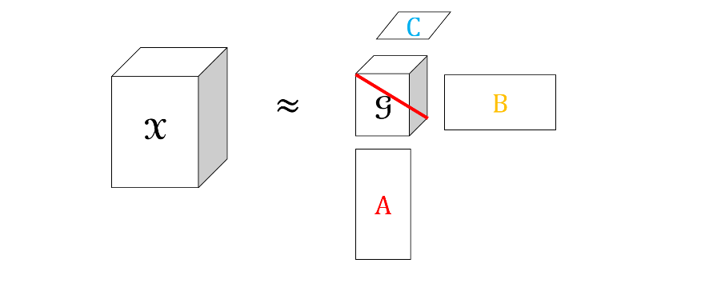
Tensor Factorization
Introduction
Problem definition
Proposed method
Experiments
Conclusion
Given a tensor, decompose the tensor into a core tensor and factor matrices whose product approximates the original tensor

Slide 6
Tensor Factorization (cont.)
Introduction
Problem definition
Proposed method
Experiments
Conclusion
Factorizing partially observable tensors has been used in many data mining applications
Context-aware recommendation (A. Karatzoglou et al., 2010)
Social network analysis (D. M. Dunlavy et al., 2011)
Personalized Web search (J.-T. Sun et al., 2005)
Given a high dimensional and large-scale tensor, how can we factorize the tensor efficiently?

Slide 7
Overview
Introduction
Problem definition
Proposed method
Experiments
Conclusion
Introduction
Problem definition
Proposed method
Experiments
Conclusion

Slide 8
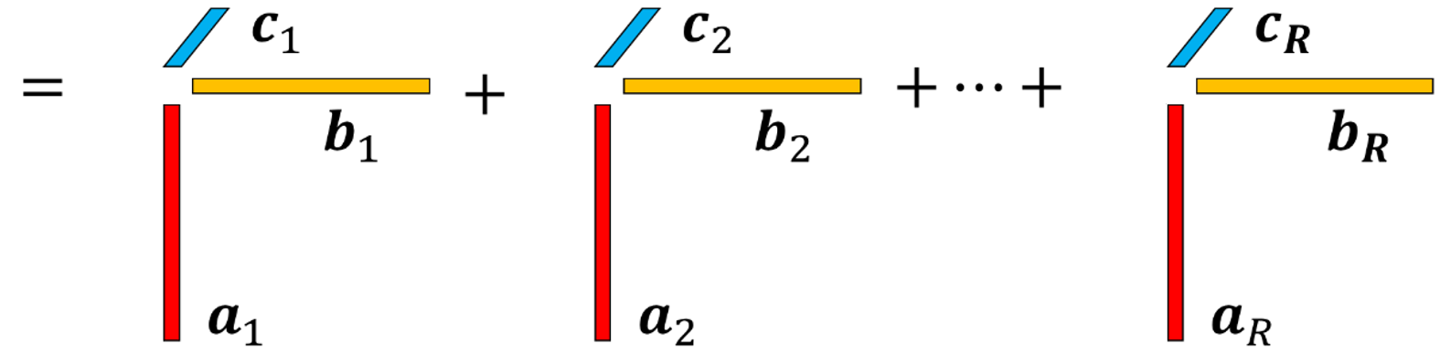

CP Decomposition
Introduction
Problem definition
Proposed method
Experiments
Conclusion
CP decomposition (Harshman et al., 1970)
Widely-used tensor factorization method
Given a tensor, CP decomposition factorizes the tensor into a sum of rank-one tensors
1st column set
2nd column set
rank-$R$ factorization

Slide 9
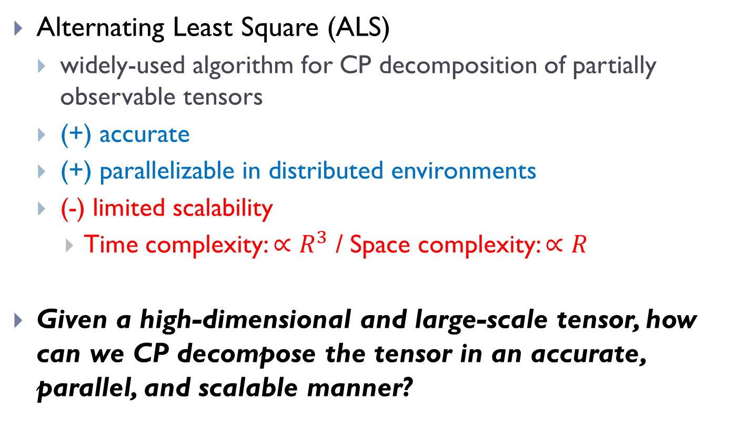
CP Decomposition (cont.)
Introduction
Problem definition
Proposed method
Experiments
Conclusion
Alternating Least Square (ALS)
widely-used algorithm for CP decomposition of partially observable tensors
(+) accurate
(+) parallelizable in distributed environments
(-) limited scalability
Time complexity: $∝R^{3}$ / Space complexity: $∝R$
Given a high-dimensional and large-scale tensor, how can we CP decompose the tensor in an accurate, parallel, and scalable manner?

Slide 10
Overview
Introduction
Problem definition
Proposed method
Experiments
Conclusion
Introduction
Problem definition
Proposed method
Experiments
Conclusion

Slide 11
Proposed methods
Introduction
Problem definition
Proposed method
Experiments
Conclusion
We propose two CP decomposition algorithms
CDTF: Coordinate Descent for Tensor Factorization
SALS: Subset Alternating Least Square
They solve higher-rank factorization through a series of lower-rank factorization
They are scalable with all the following factors:
dimension, # observations, mode length, and rank
They are parallelizable in distributed environments

Slide 12
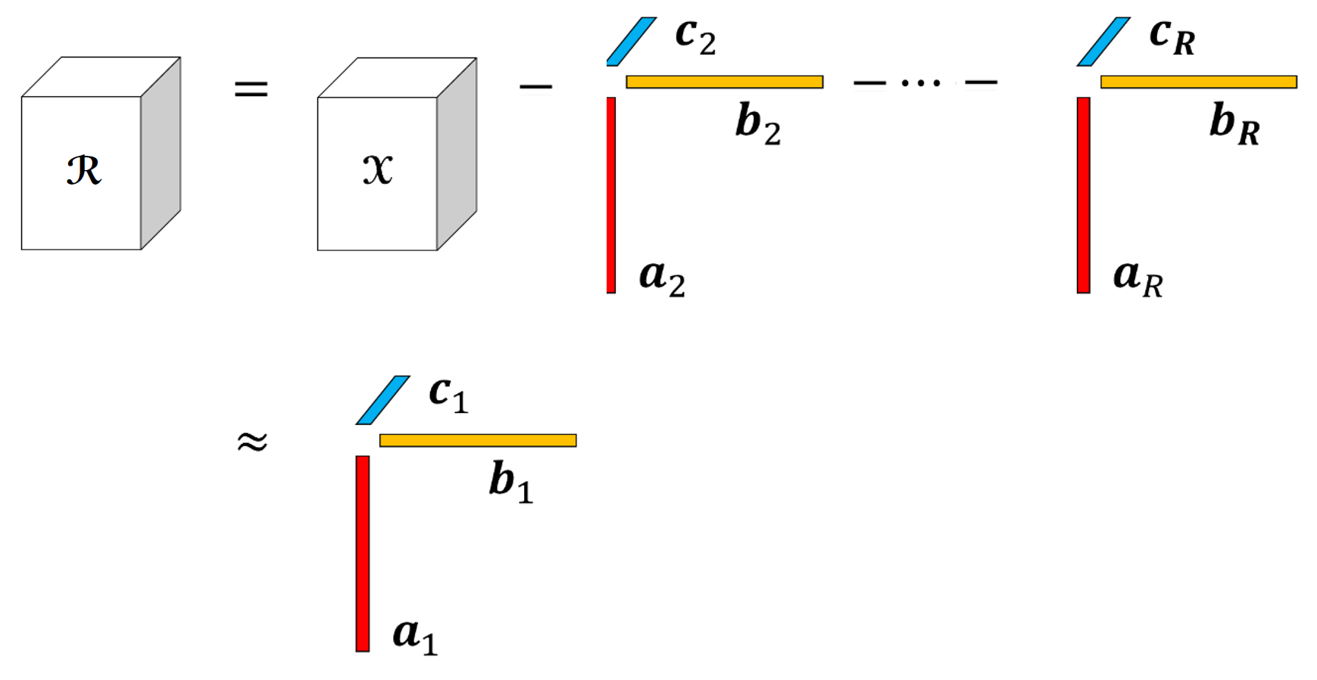

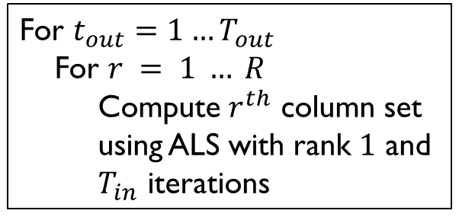

Coordinate Descent for Tensor Factorization (CDTF)
Introduction
Problem definition
Proposed method
Experiments
Conclusion
CDTF solves rank-$R$ factorization through $R$ times rank-$1$ factorization
CDTF computes columns sets one by one
Computing a column set while fixing the other column sets can be seen as rank-$1$ factorization of the residual tensor
Residual tensor
CDTF with rank $R$
For $t_{out}=1…T_{out}$
For $r = 1 … R$
Compute $r^{th}$ column set
using ALS with rank $1$ and
$T_{in}$ iterations
fixed

Slide 13
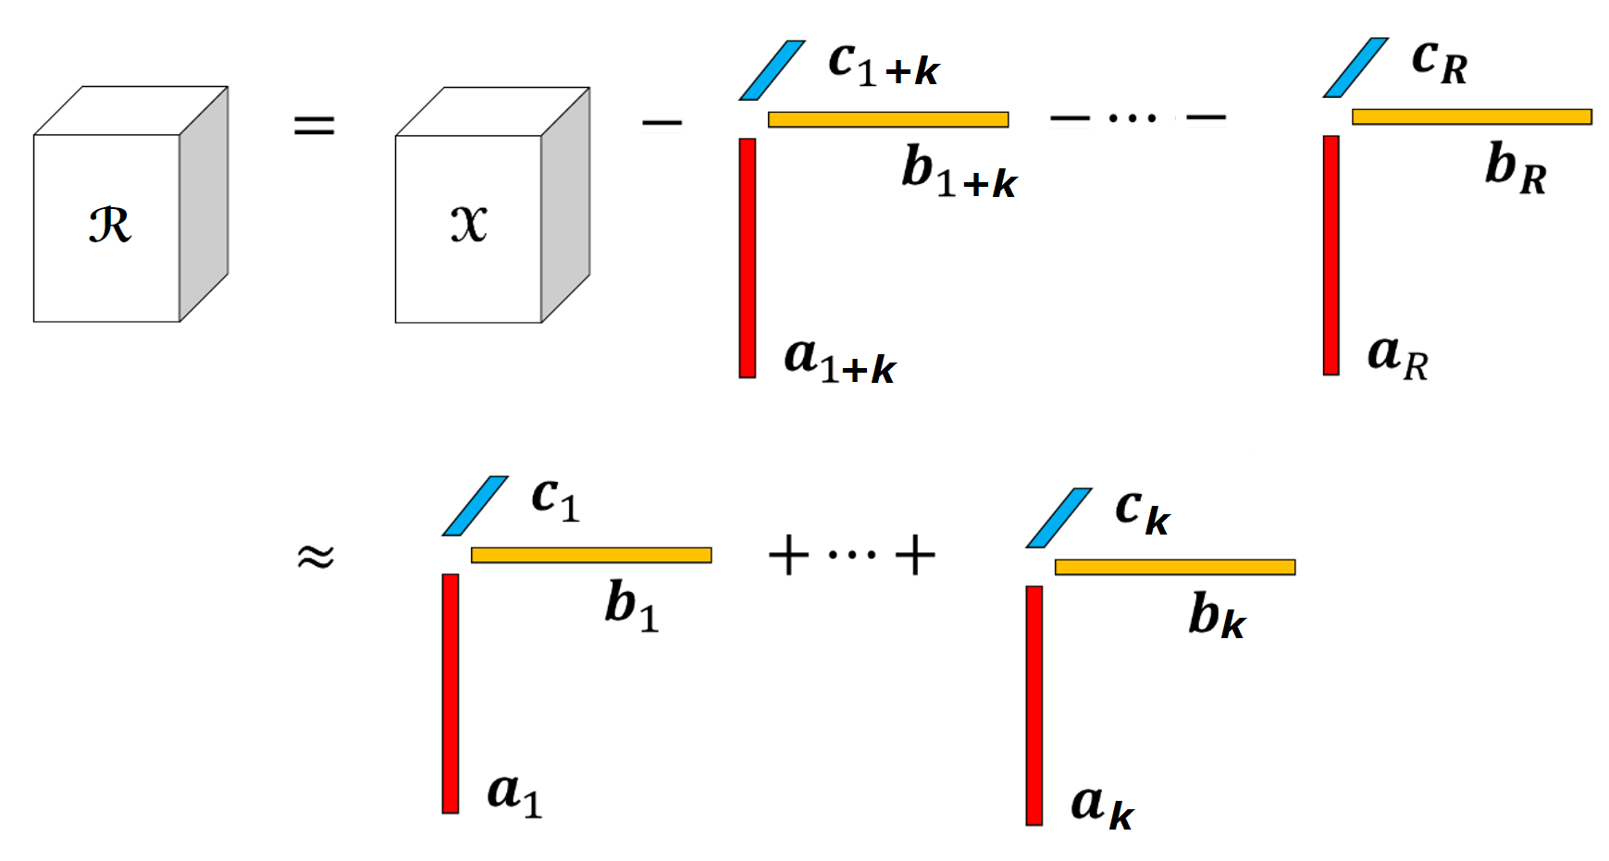


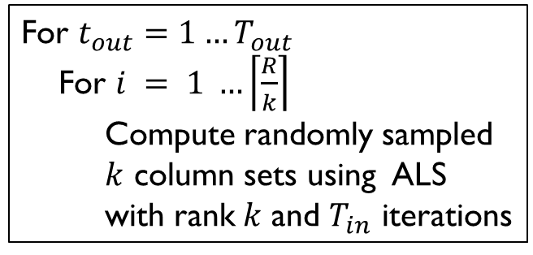
Subset Alternating Least Square (SALS)
Introduction
Problem definition
Proposed method
Experiments
Conclusion
SALS solves rank-$R$ factorization through $\left\lceil R/k\right\rceil$ times rank-$k$ factorization ($k<R$)
SALS computes $k$ column sets at a time
Computing $k$ column sets while fixing the other column sets can be seen as rank-$k$ factorization of the residual tensor
Residual tensor
SALS with rank $R$
For $t_{out}=1…T_{out}$
For $i = 1 …\left\lceil \frac{R}{k}\right\rceil$
Compute randomly sampled
$k$ column sets using ALS
with rank$k$ and $T_{in}$ iterations
fixed

Slide 14
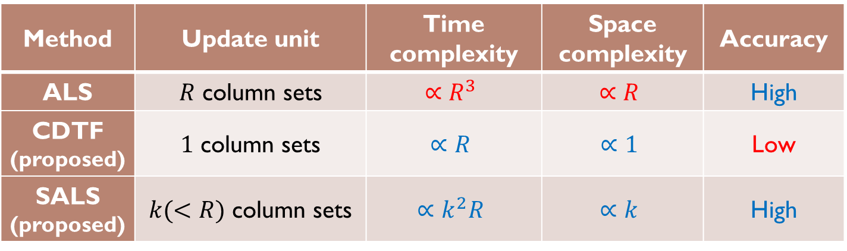
Comparison
Introduction
Problem definition
Proposed method
Experiments
Conclusion
Method | Update unit | Time complexity | Space complexity | Accuracy
ALS | $R$ column sets | $$∝R^{3}$$ | $$∝R$$ | High
CDTF (proposed) | $1$ column sets | $$∝R$$ | $$∝1$$ | Low
SALS (proposed) | $k(<R)$ column sets | $$∝k^{2}R$$ | $$∝k$$ | High
ALS is accurate but is not scalable
CDTF has much better scalability but has lower accuracy
In the view of optimization, CDTF optimizes one column set at a time, while ALS jointly optimizes 𝑅 column sets
SALS can enjoy both scalability and accuracy with proper 𝒌

Slide 15
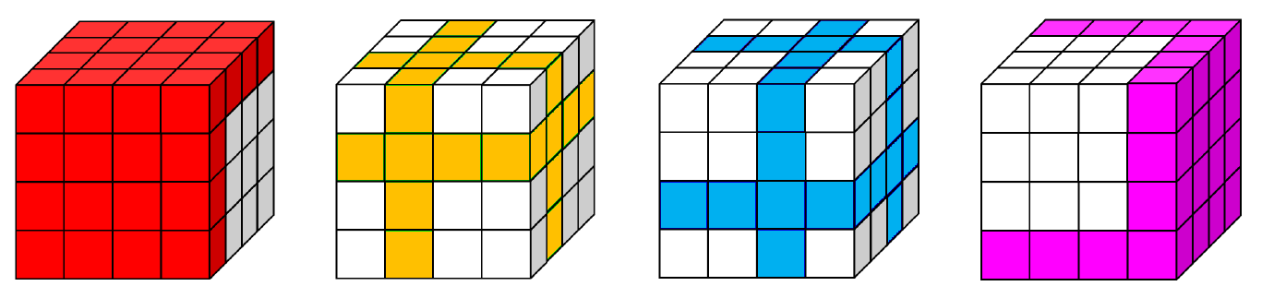

Parallelization in Distributed Environments
Introduction
Problem definition
Proposed method
Experiments
Conclusion
Both CDTF and SALS can be parallelized in distributed environments without affecting their correctness
Data distribution
The entries of a tensor are distributed into each machine
Machine 1
Machine 2
Machine 3
Machine 4

Slide 16
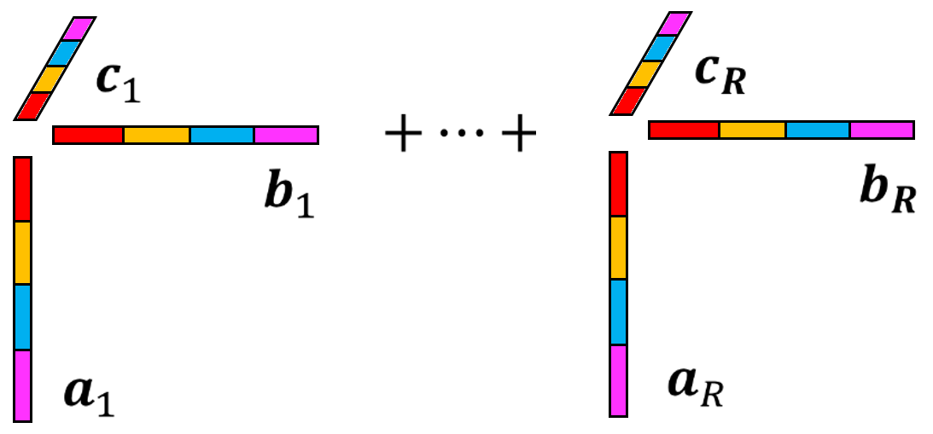
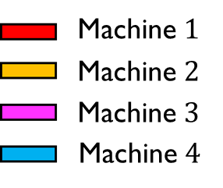
Parallelization in Distributed Environments (cont.)
Introduction
Problem definition
Proposed method
Experiments
Conclusion
Work distribution
Factors in each column are distributed and computed simultaneously
Computed factors are broadcasted to the other machines

Slide 17
Overview
Introduction
Problem definition
Proposed method
Experiments
Conclusion
Introduction
Problem definition
Proposed method
Experiments
Conclusion

Slide 18
Experimental Settings
Introduction
Problem definition
Proposed method
Experiments
Conclusion
Cluster: a 40-node Hadoop cluster with maximum 8GB heap space per reducer
Competitors: distributed methods that can factorize partially observable tensors
ALS (Y. Zhou et al. 2008), FlexiFaCT (A. Beutel et al. 2014), PSGD (R. McDonald et al. 2008)
Datasets:
Size of synthetic datasets
Factor | S1 | S2 | S3 | S4
Dimension | 2 | 3 | 4 | 5
Mode length | 300K | 1M | 3M | 10M
# observations | 30M | 100M | 300M | 1B
Rank | 30 | 100 | 300 | 1K

Slide 19
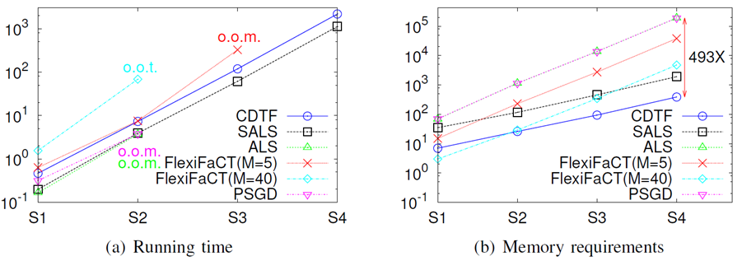
Overall Scalability
Introduction
Problem definition
Proposed method
Experiments
Conclusion
Increase all factors (dimension, mode length, # observations, and rank) from S1 to S4
Only CDTF and SALS scale to S4, while the others fail
They require several orders of less memory space than their competitors
Running time / iter (min)
Required memory / reducer (MB)
Running time
Memory requirements
* M: number of reducers / o.o.m. : out of memory / o.o.t.: out of time

Slide 20
Scalability with Each Factor
Introduction
Problem definition
Proposed method
Experiments
Conclusion
Data scalability: when measuring the scalability w.r.t a factor, the factor is scaled up from S1 to S4, while all other factors are fixed at S2
Machine scalability: increase the number of reducers from 5 to 40
CDTF and ALS are scalable with all the factors
Method | # observations | Mode length | Rank | Dimension | # machines
CDTF | O | O | O | O | O
SALS | O | O | O | O | O
ALS | O | X | X | O | O
PSGD | O | X | X | O | X
FlexiFaCT | O | O | O | X | X
Due to the high
memory requirements
Due to the rapidly increasing communication cost

Slide 21
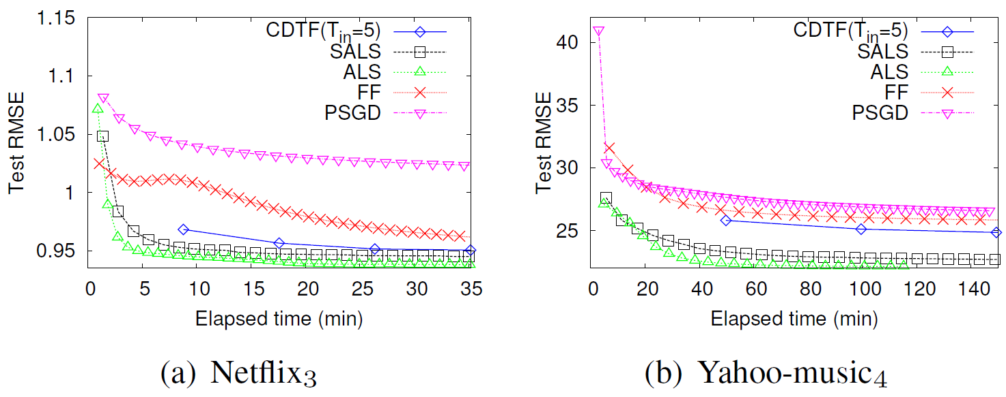

Accuracy
Introduction
Problem definition
Proposed method
Experiments
Conclusion
We apply the tensor factorization algorithms to the context-aware recommendation problem
We use weighted $λ$ regularization to prevent overfitting
Test RMSE is measured in every iteration
SALS is comparable with ALS, which converges fastest to the best solution, and CDTF follows them
Test RMSE
Test RMSE
Elapsed time (min)
Elapsed time (min)

Slide 22
Overview
Introduction
Problem definition
Proposed method
Experiments
Conclusion
Introduction
Problem definition
Proposed method
Experiments
Conclusion

Slide 23
Conclusion
Introduction
Problem definition
Proposed method
Experiments
Conclusion
CDTF and SALS
Distributed algorithms for tensor factorization
Solve higher-rank factorization through a series of lower-rank factorization
Scalable with dimension, # observations, mode length, rank, and # machines
Successfully factorize a 5-dimensional tensor with 10M mode length, 1B observations, and 1K rank

Slide 24
Introduction
Problem definition
Proposed method
Experiments
Conclusion
Thank you!
Questions?

Slide 25
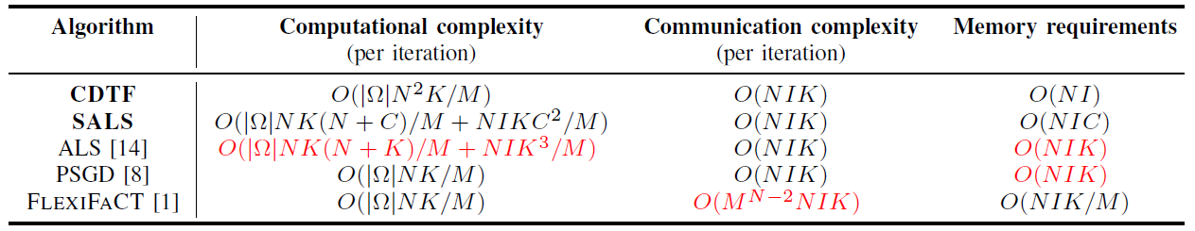

Backup slides: complexity analysis
$|Ω|$: # observations
$N$: dimension
$I$: mode length
$K$: rank
$C$: # column sets updated at a time (SALS only)
$M$: # machines

Slide 26
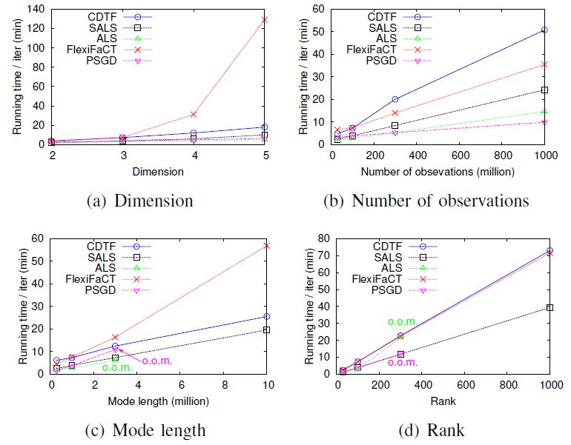
Backup slides: scalability with each factor

Slide 27
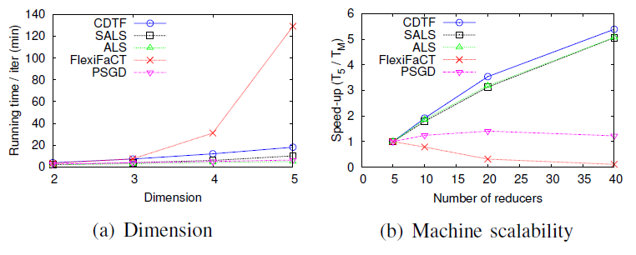
Backup slides: FlexiFaCT

Slide 28
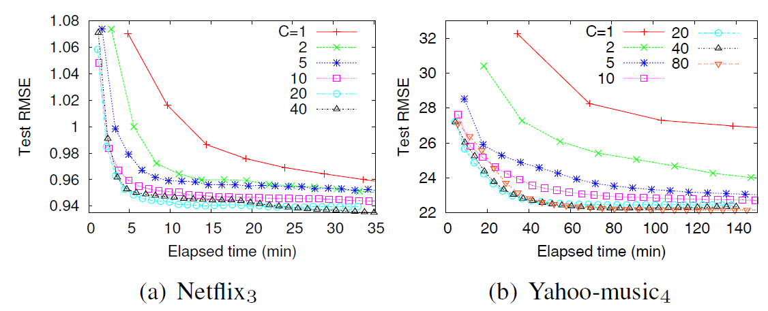

Backup slides: Effects of $k$

