Slide 1
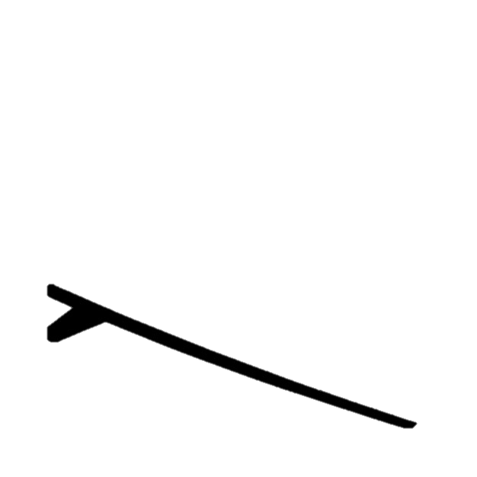



BEAR: Block Elimination Approach for Random Walk With Restart on Large Graphs
Kijung Shin Jinhong Jung Lee Sael U Kang

Slide 2
Introduction
Introduction
Background
Proposed Method
Experiments
Conclusion
How can we measure the relevance (or similarity) between two nodes in a graph?
Example:
1
2
3
4
5

Slide 3


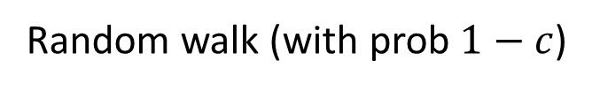
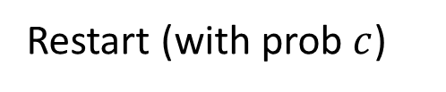

Random Walk with Restart (1)
Introduction
Background
Proposed Method
Experiments
Conclusion
Random Walk with Restart (RWR) assumes a random surfer on a graph
$$S$$
$$S$$
$$S$$
seed node
seed node
Random walk (with prob $1−c$)
Restart (with prob $c$)

Slide 4
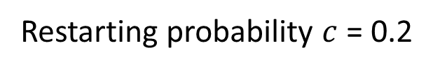
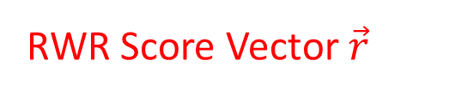
Random Walk with Restart (2)
Introduction
Background
Proposed Method
Experiments
Conclusion
RWR computes the stationary probability that the surfer stays at each node
RWR Score Vector $\vec{r}$
1
0.21
Node | RWR Score (relevance with node 2)
1 | 0.21
2 | -
3 | 0.14
4 | 0.25
5 | 0.09
0.31
0.14
2
3
0.25
seed node
4
0.09
5
Restarting probability $c$ = 0.2

Slide 5
Random Walk with Restart (3)
Introduction
Background
Proposed Method
Experiments
Conclusion
Random Walk with Restart (RWR)
Goal: measures the relevance between two nodes
Properties: accounts for the global network structure and the multi-faceted relationship between nodes
Applications: ranking, community detection, link prediction, and anomaly detection

Slide 6
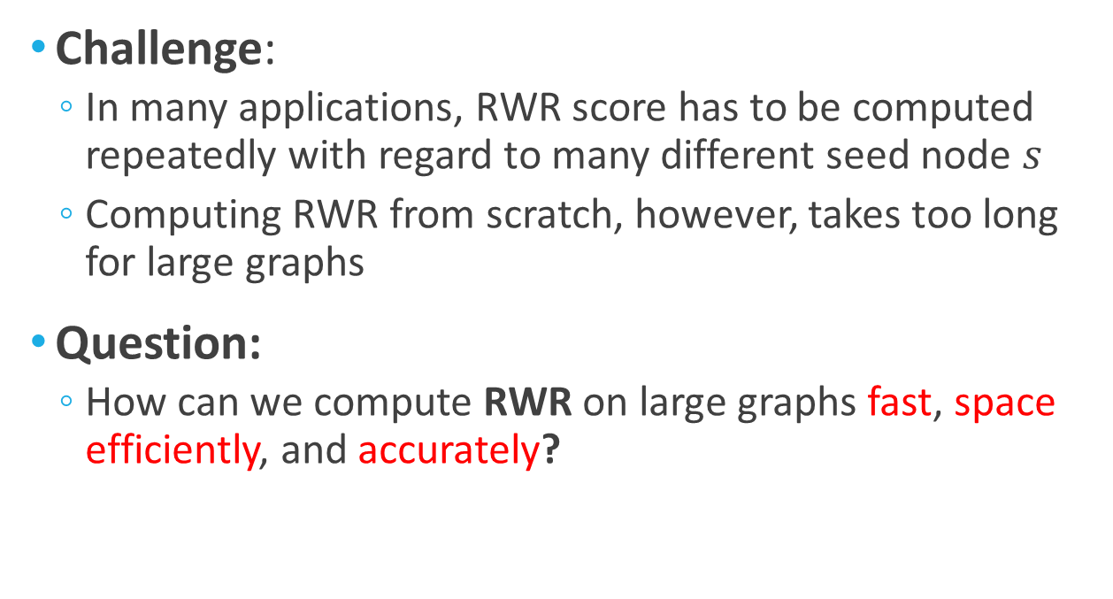
Research Question
Introduction
Background
Proposed Method
Experiments
Conclusion
Challenge:
In many applications, RWR score has to be computed repeatedly with regard to many different seed node $s$
Computing RWR from scratch, however, takes too long for large graphs
Question:
How can we compute RWR on large graphs fast, space efficiently, and accurately?

Slide 7
Outline
Introduction
Background <<<
Proposed Method
Experiments
Conclusion

Slide 8


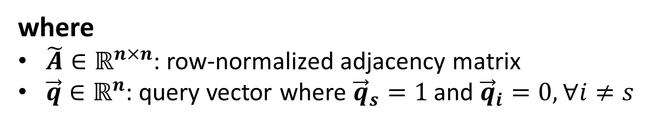
Problem Definition (1)
Introduction
Background
Proposed Method
Experiments
Conclusion
Given: a graph $G$, a seed node $s$, and restarting probability $c$
Goal: find RWR score vector $\vec{r}$ satisfying
$$\vec{r}=\left(1−c\right){\tilde{A}}^{T}\vec{r}+c\vec{q}$$
Probability that the surfer
reaches each node by restart
Probability that the surfer reaches each node
Probability that the surfer reaches each node by random walk
where
$\tilde{A}∈ℝ^{n×n}$: row-normalized adjacency matrix
$\vec{q}∈ℝ^{n}$: query vector where ${\vec{q}}_{s}=1$ and ${\vec{q}}_{i}=0, ∀i≠s$

Slide 9
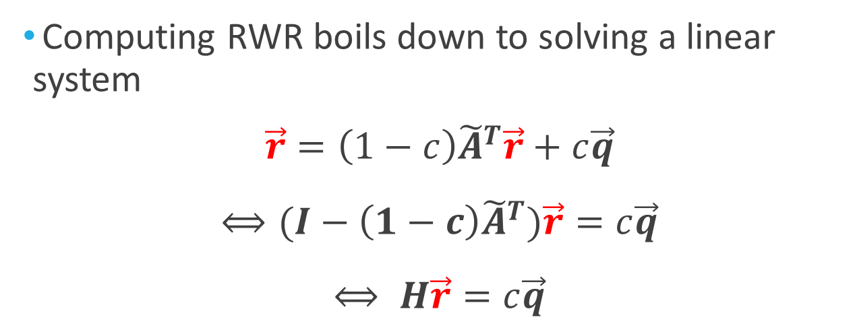

Problem Definition (2)
Introduction
Background
Proposed Method
Experiments
Conclusion
Computing RWR boils down to solving a linear system
$$\vec{r}=\left(1−c\right){\tilde{A}}^{T}\vec{r}+c\vec{q}$$
$$⟺(I−\left(1−c\right){\tilde{A}}^{T})\vec{r}=c\vec{q}$$
$$⟺ H\vec{r}=c\vec{q}$$
Given: $H∈ℝ^{n×n}$, $\vec{q}∈ℝ^{n}$, $c∈ℝ$
Find: $\vec{r}∈ℝ^{n}$

Slide 10
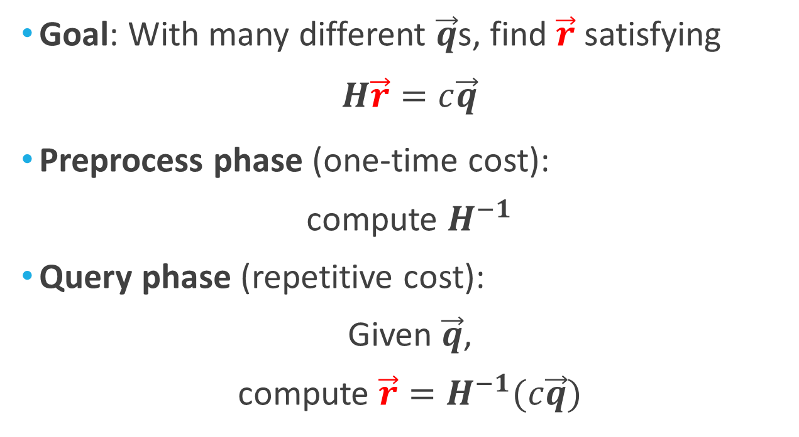
Naïve Method: Inversion (1)
Introduction
Background
Proposed Method
Experiments
Conclusion
Goal: With many different $\vec{q}$s, find $\vec{r}$ satisfying
$$H\vec{r}=c\vec{q}$$
Preprocess phase (one-time cost):
compute $H^{−1}$
Query phase (repetitive cost):
Given $\vec{q}$,
compute $\vec{r}=H^{−1}(c\vec{q})$

Slide 11
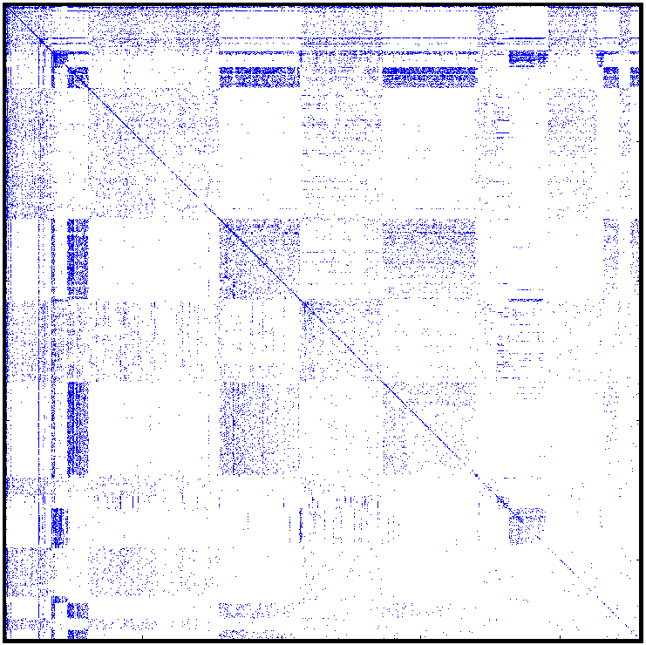

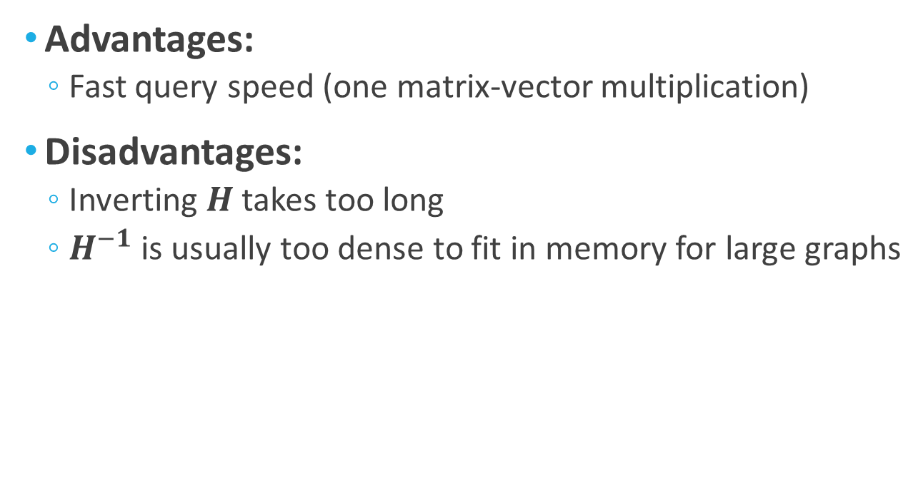


Naïve Method: Inversion (2)
Introduction
Background
Proposed Method
Experiments
Conclusion
Advantages:
Fast query speed (one matrix-vector multiplication)
Disadvantages:
Inverting $H$ takes too long
$H^{−1}$ is usually too dense to fit in memory for large graphs
Input graph
#nz=0.1M
(1) Inversion
Exact, #nz=527M
$$H$$
$$H^{−1}$$
Sparsity pattern of preprocessed matrices on the Routing dataset

Slide 12
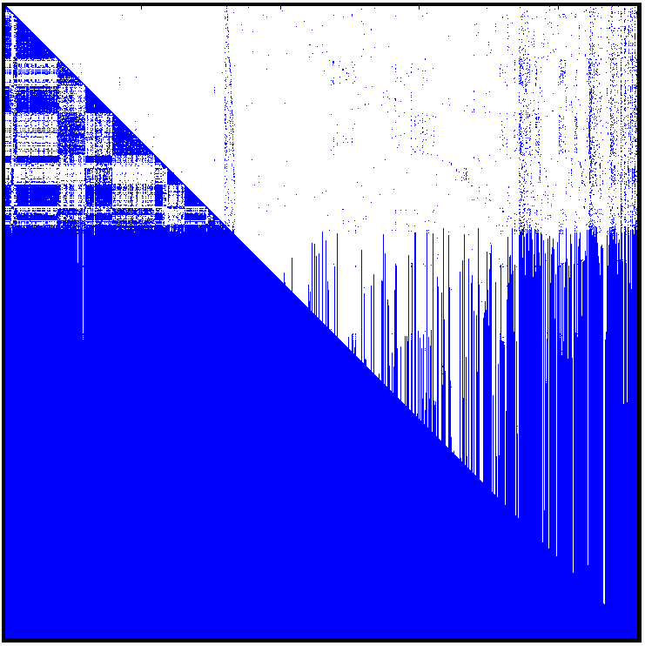
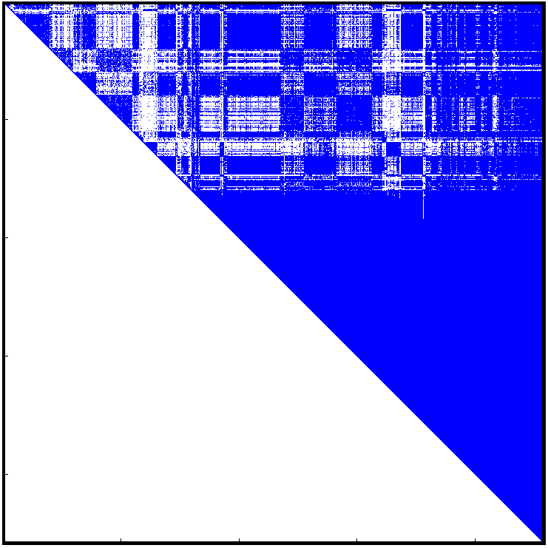
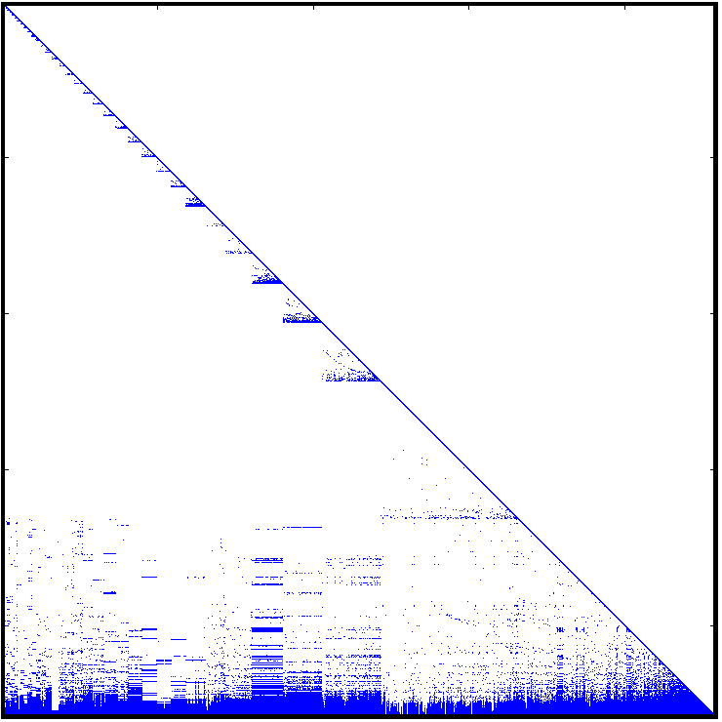
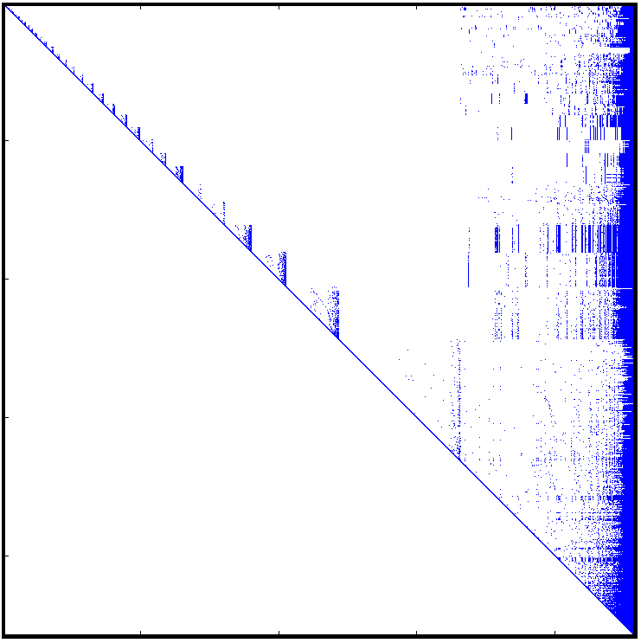





Previous Methods (1)
Introduction
Background
Proposed Method
Experiments
Conclusion
Goal: Replace $H^{−1}$ with sparser matrices by reordering and decomposing $H$
Limitation 1: high memory requirements
(2) QR decomp. (Fujiwara et al. 12)
Exact, #nz=428M
(3) LU decomp. (Fujiwara et al. 12)
Exact, #nz=10M
$$Q^{−1}(=Q^{T})$$
$$R^{−1}$$
$$L^{−1}$$
$$U^{−1}$$
Sparsity pattern of preprocessed matrices on the Routing dataset

Slide 13
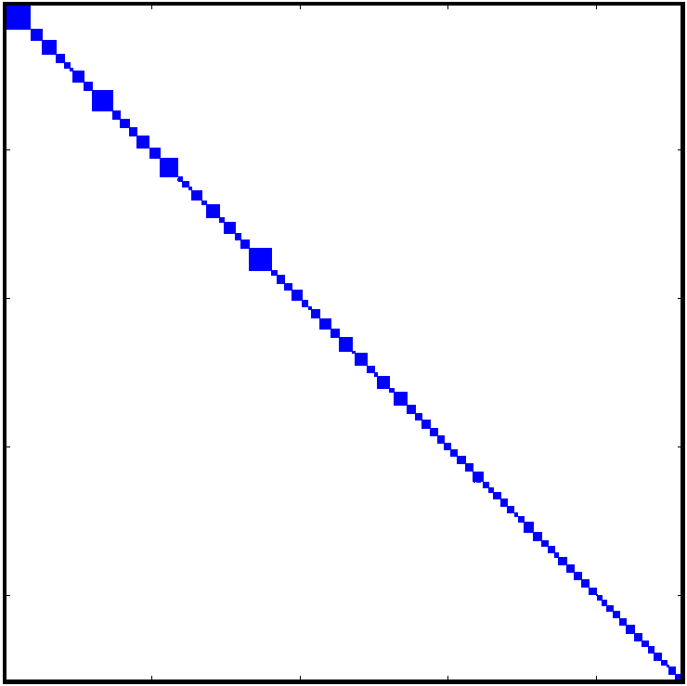
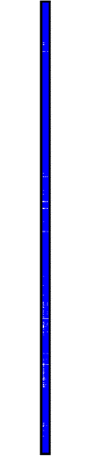
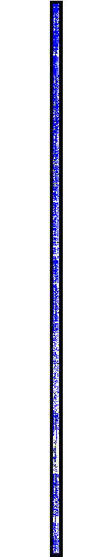
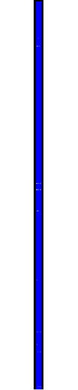
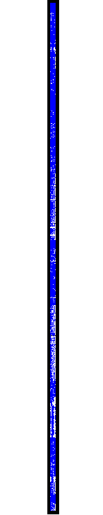



Previous Methods (2)
Introduction
Background
Proposed Method
Experiments
Conclusion
Limitation 2: inaccuracy
Challenge: How can we satisfy both space efficiency and accuracy?
(4) B_LIN (Tong et al. 07)
Approx, #nz=8M
(5) NB_LIN (Tong et al. 07)
Approx, #nz=3M
$$A_{1}^{−1}$$
$$U V \tilde{Λ}$$
$$U V \tilde{Λ}$$
Sparsity pattern of preprocessed matrices on the Routing dataset

Slide 14
Outline
Introduction
Background
Proposed Method <<<
Experiments
Conclusion

Slide 15
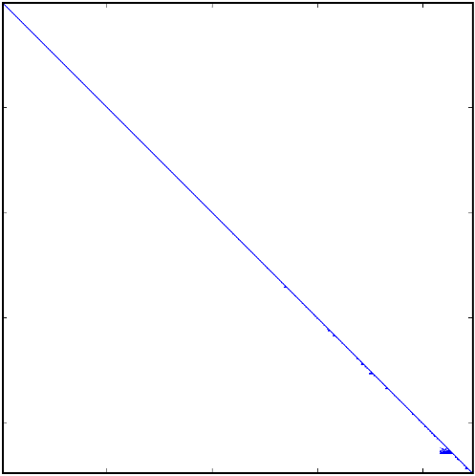
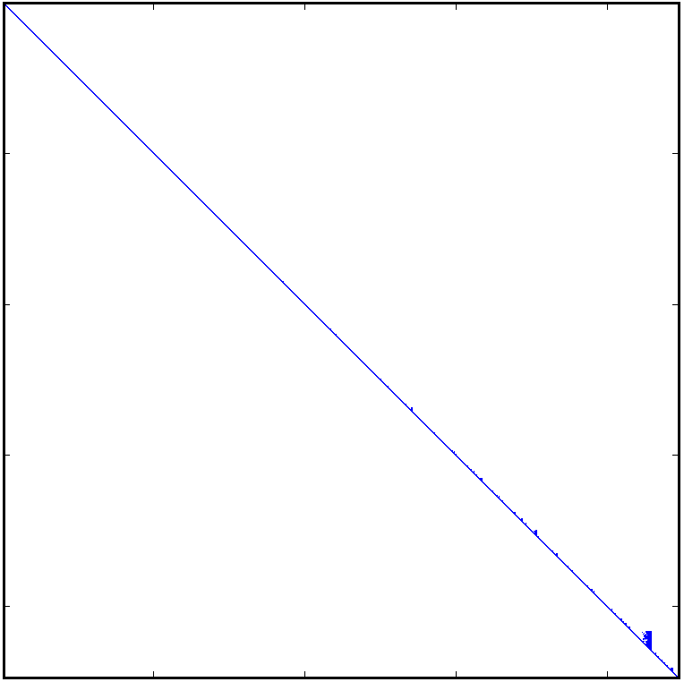
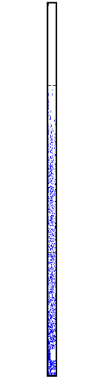
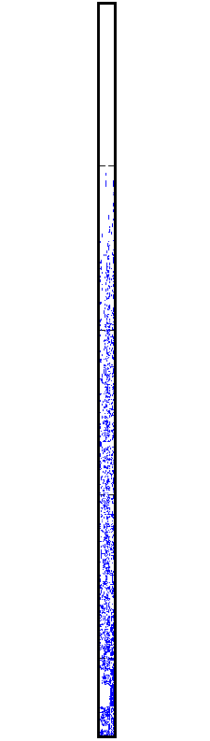



Proposed Method: BEAR
Introduction
Background
Proposed Method
Experiments
Conclusion
We propose BEAR, a fast, space-efficient, and accurate RWR computation method
(6) BEAR-Exact (Proposed)
Exact, #nz=0.4M
Method | Accurate? | #nz
Inversion | Yes | 527M
QR | Yes | 428M
LU | Yes | 10M
NB_LIN | No | 8M
B_LIN | No | 3M
BEAR-Exact | Yes | 0.4M
$$L_{2}^{−1}$$
$$U_{2}^{−1}$$
$L_{1}^{−1} { U}_{1}^{−1}$ $H_{21} H_{12}$
Sparsity pattern of preprocessed
matrices on the Routing dataset

Slide 16
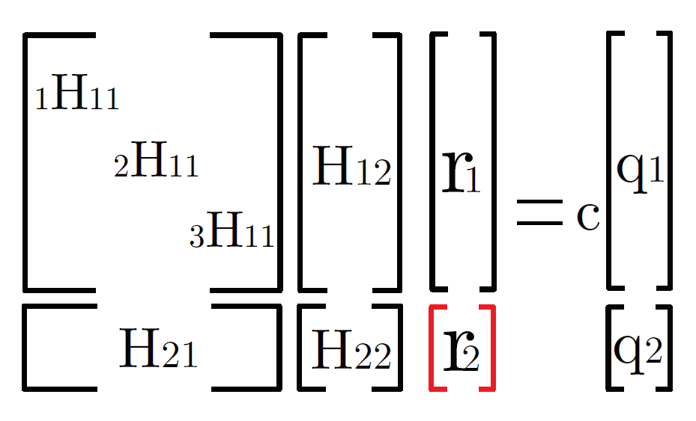
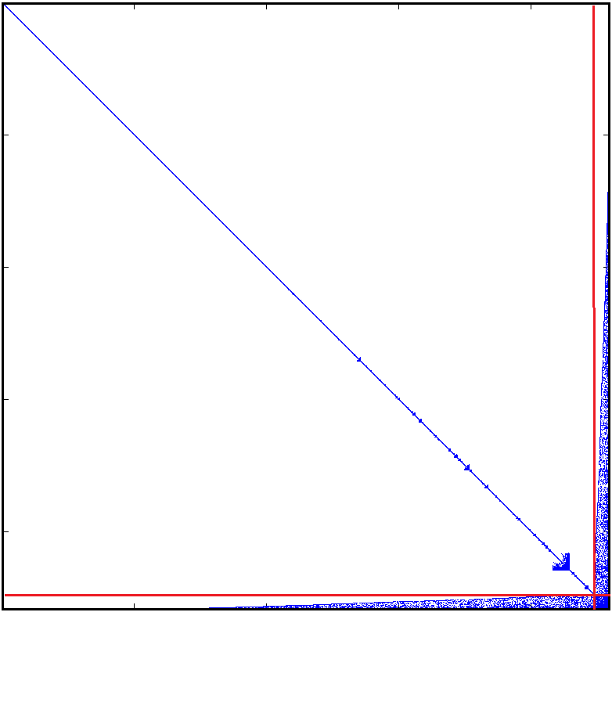
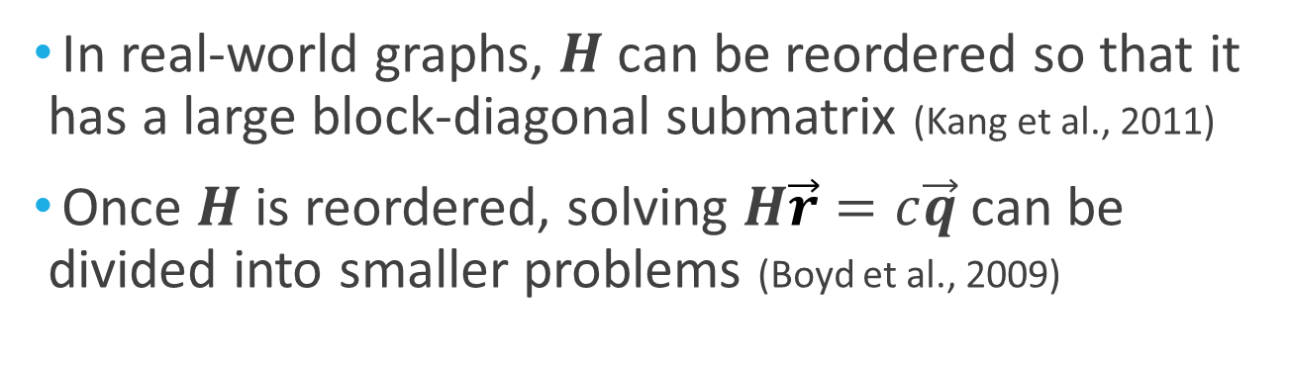

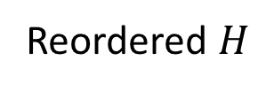

Ideas Behind BEAR (1)
Introduction
Background
Proposed Method
Experiments
Conclusion
In real-world graphs, $H$ can be reordered so that it has a large block-diagonal submatrix (Kang et al., 2011)
Once $H$ is reordered, solving $H\vec{r}=c\vec{q}$ can be divided into smaller problems (Boyd et al., 2009)
$$H$$
Reordered $H$
$$H \vec{r} \vec{q}$$

Slide 17
Ideas Behind BEAR (2)
Dividing into smaller problems improves space efficiency and speed
Space efficiency can be further improved by applying LU decomposition (Fujiwara et al., 2012) to each of the divided problems
Original problem
Divided problems
Space Requirements

Slide 18
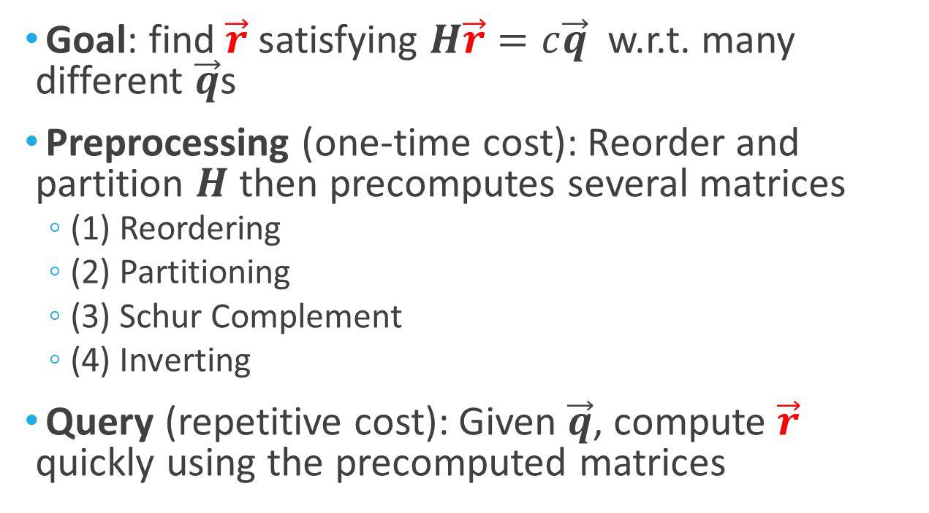
Outline of BEAR
Introduction
Background
Proposed Method
Experiments
Conclusion
Goal: find $\vec{r}$ satisfying $H\vec{r}=c\vec{q}$ w.r.t. many different $\vec{q}$s
Preprocessing (one-time cost): Reorder and partition $H$ then precomputes several matrices
(1) Reordering
(2) Partitioning
(3) Schur Complement
(4) Inverting
Query (repetitive cost): Given $\vec{q}$, compute $\vec{r}$ quickly using the precomputed matrices

Slide 19
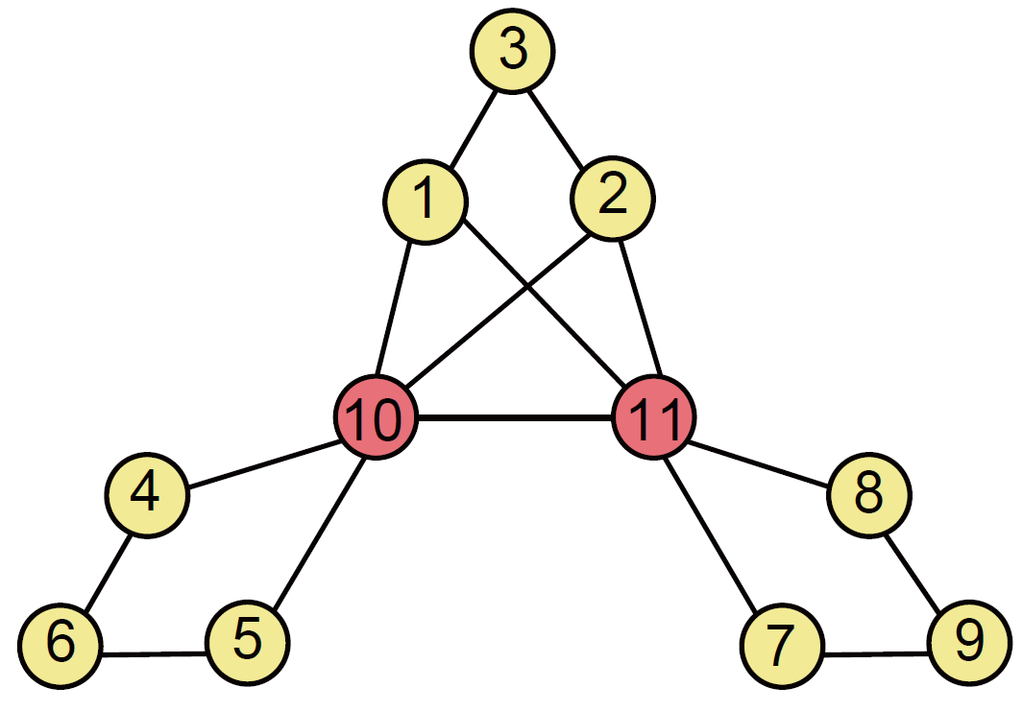
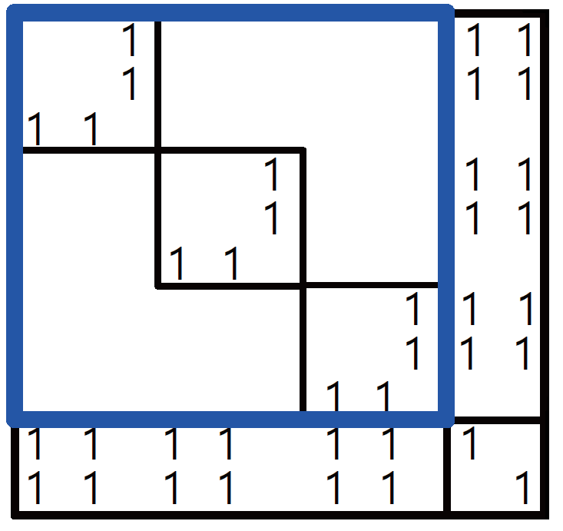

Preprocessing Phase: (1) Reordering
Introduction
Background
Proposed Method
Experiments
Conclusion
Reorder $H$ so that it has a large block-diagonal submatrix
Utilize hub-and-spoke structure of real-world graphs as in SlashBurn (Kang et al., 2011)
real world
spokes
hubs

Slide 20
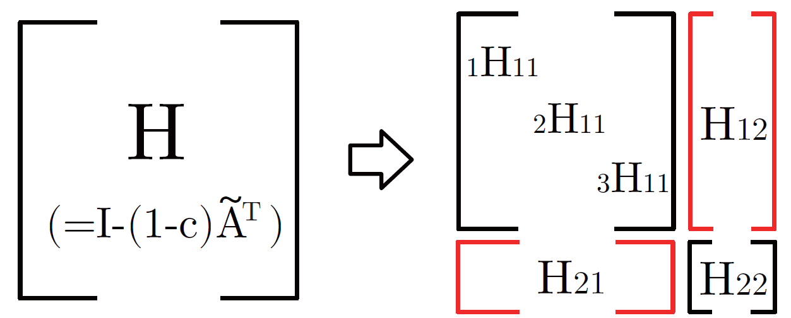
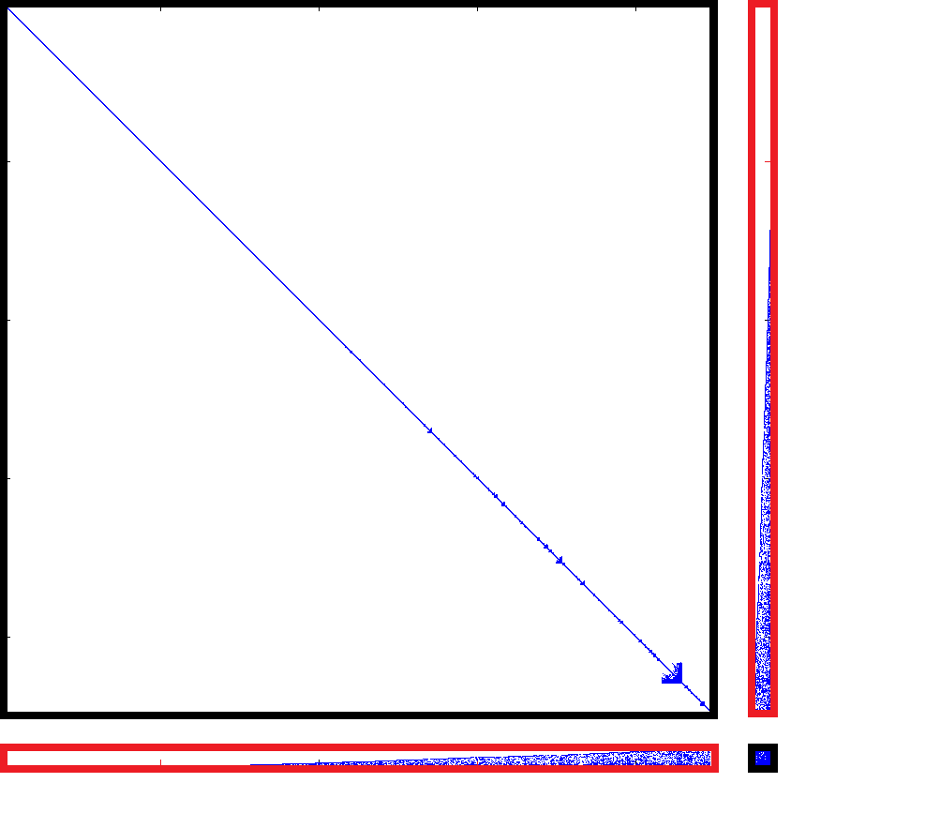


Preprocessing Phase: (2) Partitioning
Introduction
Background
Proposed Method
Experiments
Conclusion
Partition $H$ into four submatrices
$H_{11}$ consists of small diagonal blocks
$H_{11}$
real world

Slide 21
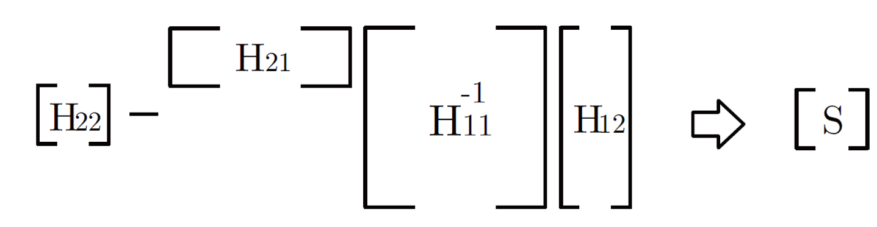


Preprocessing Phase: (3) Schur Complement
Introduction
Background
Proposed Method
Experiments
Conclusion
Compute the Schur Complement $S$ of $H_{11}$
$S$ has the same size of $H_{22}$
real world

Slide 22
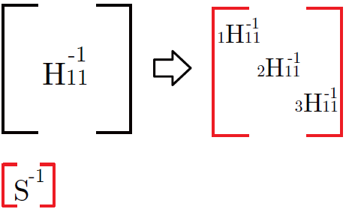
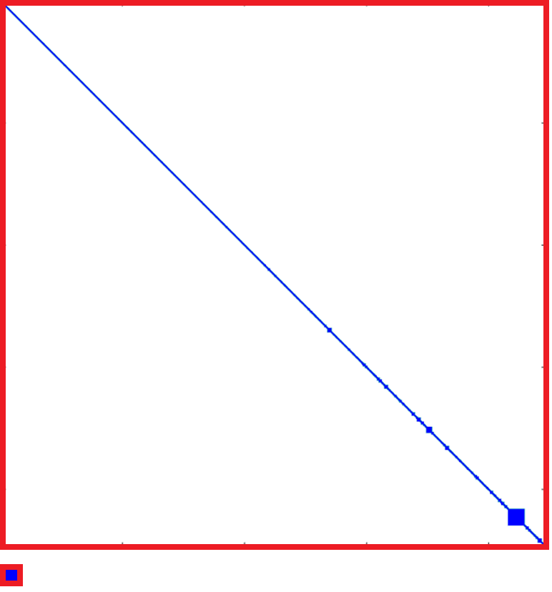

Preprocessing Phase: (4) Inverting
Introduction
Background
Proposed Method
Experiments
Conclusion
Inverting $S$ and each diagonal block of $H_{11}$
Efficient in terms of time and space because $S$ and the diagonal blocks of $H_{11}$ are small
real world

Slide 23
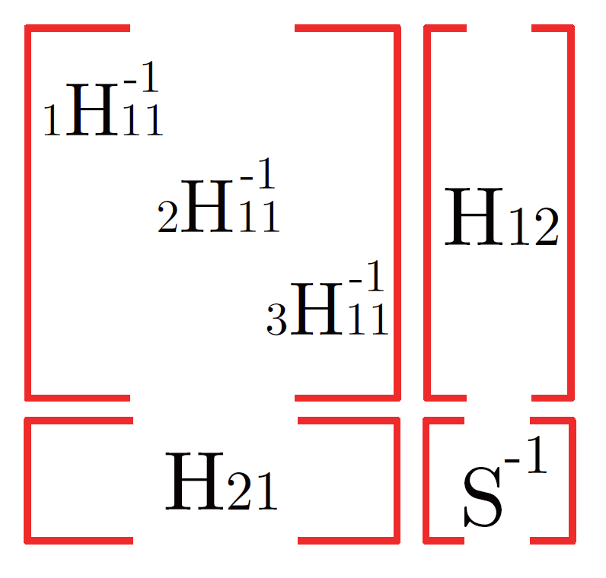
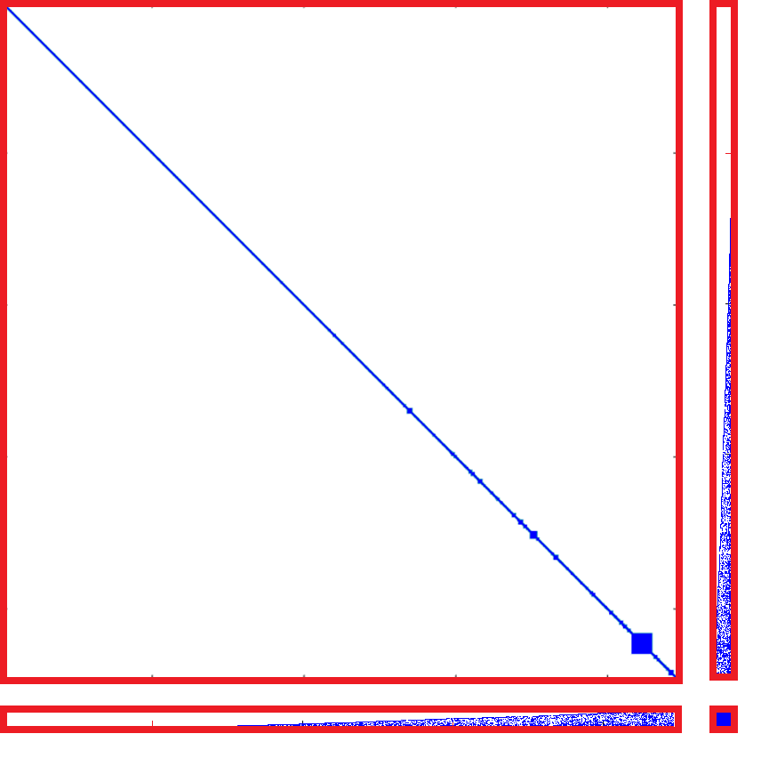
Preprocessing Phase: Output
Introduction
Background
Proposed Method
Experiments
Conclusion
Precomputed matrices are small or composed of small diagonal blocks
Require little storage
real world

Slide 24
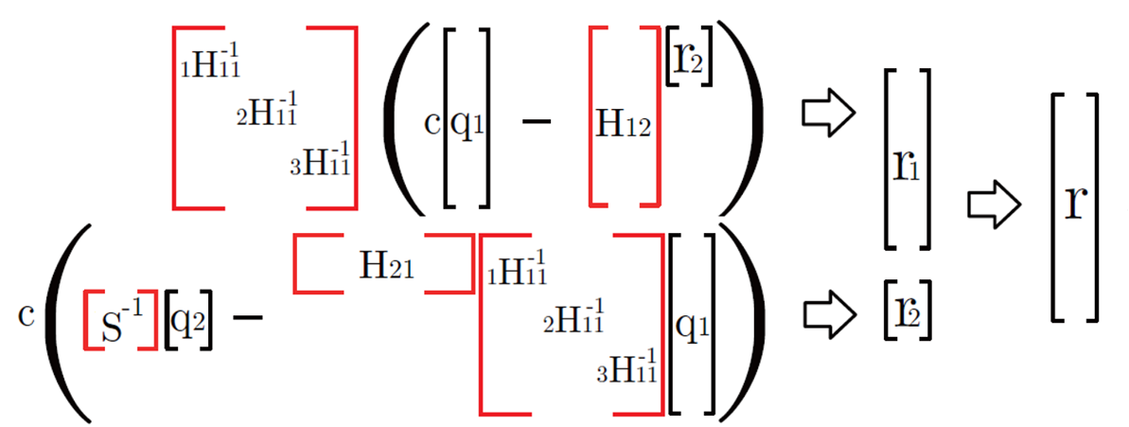

Query Phase
Introduction
Background
Proposed Method
Experiments
Conclusion
Given a query vector $\vec{q}$, compute the RWR score vector $\vec{r}$ using the precomputed matrices
Theorem. Block Elimination (Boyd et al., 2009) : This equation exactly computes RWR scores

Slide 25
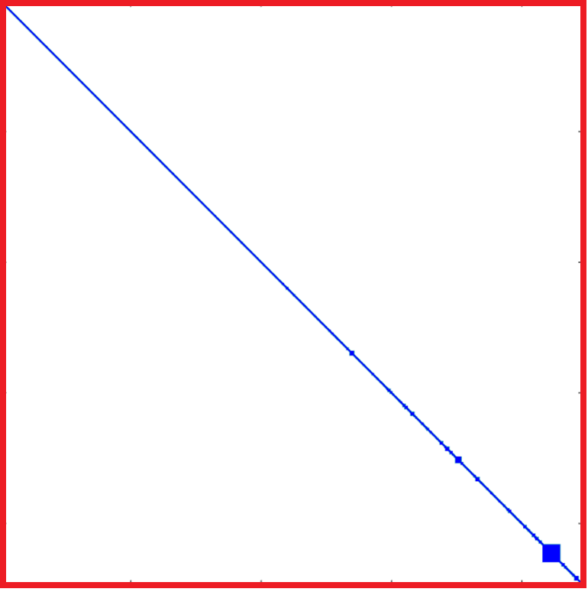




Further Optimization: (1) LU Decomposition
Introduction
Background
Proposed Method
Experiments
Conclusion
Instead of inverting $S$ and each diagonal block of $H_{11}$, invert their LU-decomposed matrices (sparser)
Reduce preprocessing time and space requirements
$$H_{11}^{−1}$$
$$U_{1}^{−1}$$
$$L_{1}^{−1}$$

Slide 26
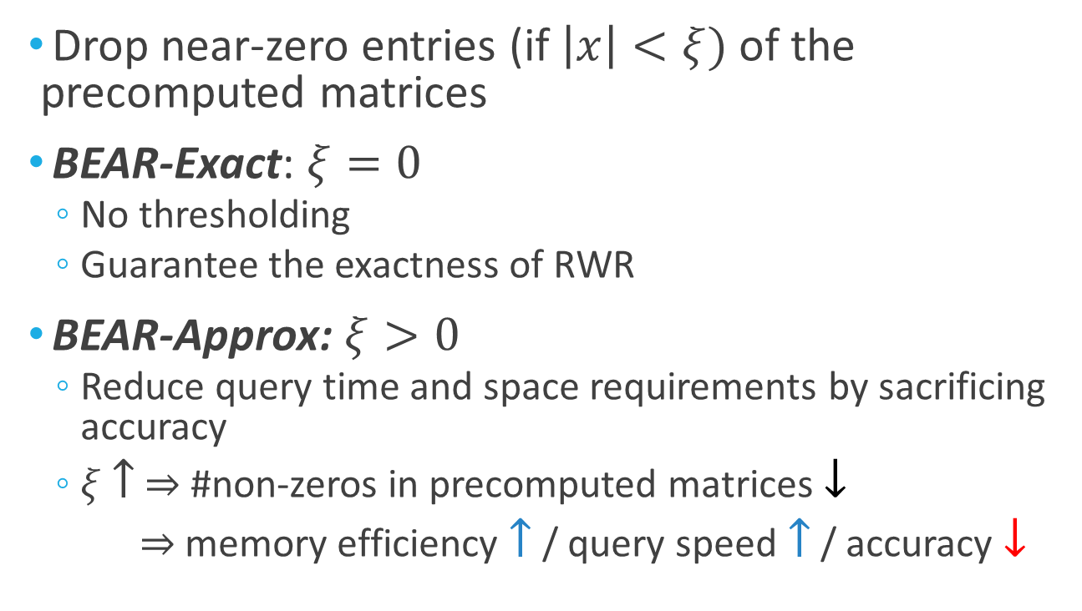
Further Optimization: (2) Thresholding
Introduction
Background
Proposed Method
Experiments
Conclusion
Drop near-zero entries (if $\left|x\right|<ξ)$ of the precomputed matrices
BEAR-Exact: $ξ=0$
No thresholding
Guarantee the exactness of RWR
BEAR-Approx: $ξ>0$
Reduce query time and space requirements by sacrificing accuracy
$ξ$ $↑$ $⇒$ #non-zeros in precomputed matrices $↓$
$⇒$memory efficiency $↑$ / query speed $↑$ / accuracy $↓$

Slide 27
Outline
Introduction
Background
Proposed Method
Experiments <<<
Conclusion

Slide 28
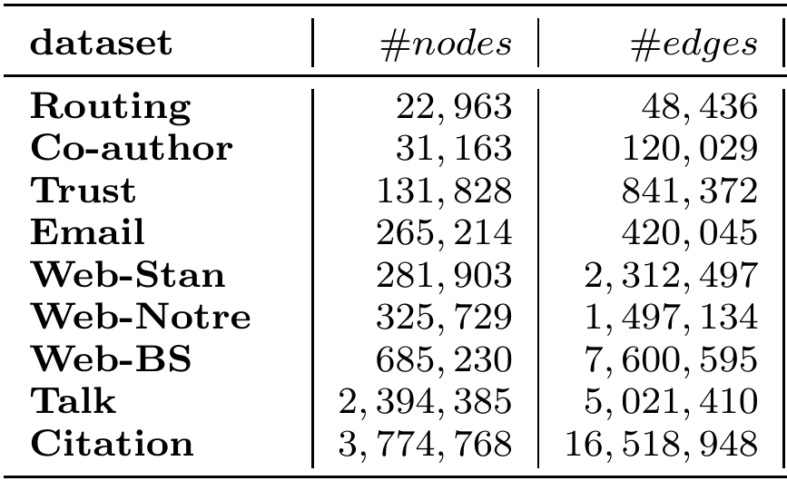
Experimental Settings
Introduction
Background
Proposed Method
Experiments
Conclusion
Machine: single PC with with a 4-core CPU and 16GB memory
Datasets: large-scale real-world network data

Slide 29
Competitors
Introduction
Background
Proposed Method
Experiments
Conclusion
Exact methods
Inversion
Iterative method
LU decomp. (Fujiwara et al., 2012)
QR decomp. (Fujiwara et al., 2012)
Approximate methods
BLIN, NB_LIN (Tong et al., 2008)
RPPR, BRPPR (Gleich et al., 2006)

Slide 30

Q. Space Efficiency
Introduction
Background
Proposed Method
Experiments
Conclusion
How much memory space does BEAR-Exact require for their precomputed matrices?
Up to 22x less memory space than competitors
Space for preprocessed data

Slide 31

Q. Preprocessing Time
Introduction
Background
Proposed Method
Experiments
Conclusion
How long does the preprocessing phase of BEAR-Exact take?
Up to 12x less preprocessing time than other methods
Preprocessing time of exact methods

Slide 32

Q. Query Time
Introduction
Background
Proposed Method
Experiments
Conclusion
How long does the query phase of BEAR-Exact take?
Up to 8x less query time than LU decomp.
Up to 300x less query time than Iterative method
Query time of exact methods

Slide 33

Q. Speed vs Accuracy
Introduction
Background
Proposed Method
Experiments
Conclusion
Does BEAR-Approx provide a better trade-off between speed and accuracy than other methods?
250X
Query speed v.s. Accuracy on the Routing dataset

Slide 34

Q. Space vs Accuracy
Introduction
Background
Proposed Method
Experiments
Conclusion
Does BEAR-Approx provide a better trade-off between space and accuracy than other methods?
50X
Space for preprocessed data v.s. Accuracy on the Routing dataset

Slide 35
Outline
Introduction
Background
Proposed Method
Experiments
Conclusion <<<

Slide 36

Conclusion
Introduction
Background
Proposed Method
Experiments
Conclusion
BEAR (Block Elimination Approach for RWR)
partitions the adjacency matrix into small submatrices using the hub-and-spoke structure of real-world graphs
computes Random Walk with Restart accurately from the submatrices using block elimination
BEAR-Exact
up to 22$×$ less space, 12$×$ less preprocessing time, and 8$×$less query time than other exact methods
BEAR-Approx
better trade-off between time, space, and accuracy than other approximate methods

Slide 37
Reference
Y. Fujiwara, M. Nakatsuji, M. Onizuka, and M. Kitsuregawa. Fast and exact top-k search for random walk with restart. PVLDB, 5(5):442-453, 2012.
Y. Fujiwara, M. Nakatsuji, T. Yamamuro, H. Shiokawa, and M. Onizuka. Ecient personalized pagerank with accuracy assurance. In KDD, pages 15-23, 2012.
D. Gleich and M. Polito. Approximating personalized pagerank with minimal use of web graph data. Internet Mathematics, 3(3):257-294, 2006
U. Kang and C. Faloutsos. Beyond 'caveman communities': Hubs and spokes for graph compression and mining. In ICDM, pages 300-309, 2011
H. Tong, C. Faloutsos, and J.-Y. Pan. Random walk with restart: fast solutions and applications. KAIS, 14(3):327-346, 2008.
S. Boyd and L. Vandenberghe. Convex Optimization. Cambridge University Press, 2009.

Slide 38
Thank you!
The binary codes and datasets are available at http://kdmlab.org/bear

Slide 39


SlashBurn (Kang et al. 11)
SlashBurn with $k=1$

Slide 40

Network Structure

Slide 41


Network Structure

Slide 42


Slide 43


Time complexity:
Space complexity:
$$O(\sum_{i=1}^{b}{n_{1i}^{2}}+\min\left(n_{1}n_{2},m\right)+n_{2}^{2})$$

Slide 44

Preprocessing Time

Slide 45

Iterative Method
Repeats updating $\vec{r}$ until convergence
$$\vec{r}←\left(1−c\right){\tilde{A}}^{T}\vec{r}+c\vec{q}$$
Advantages:
No preprocessing time
Easy to implement
Disadvantages:
Slow (multiple times of matrix-vector multiplication)
Inefficient when $\vec{r}$ is computed w.r.t. many different $\vec{q}$s

