Slide 1
Safe to the Last Instruction: Automated Verification of a Type-Safe Operating System
Jean Yang
MIT CSAIL
Chris Hawblitzel
Microsoft Research

Slide 2
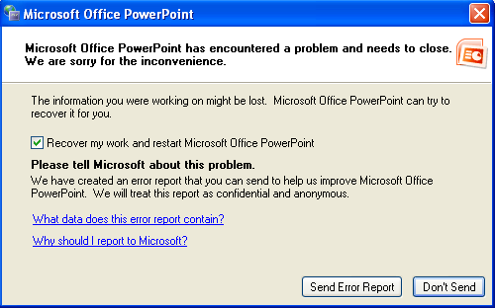
Safe to the Last Instruction: Automated Verification of a Type-Safe Operating System
Jean Yang
MIT CSAIL
Chris Hawblitzel
Microsoft Research

Slide 3
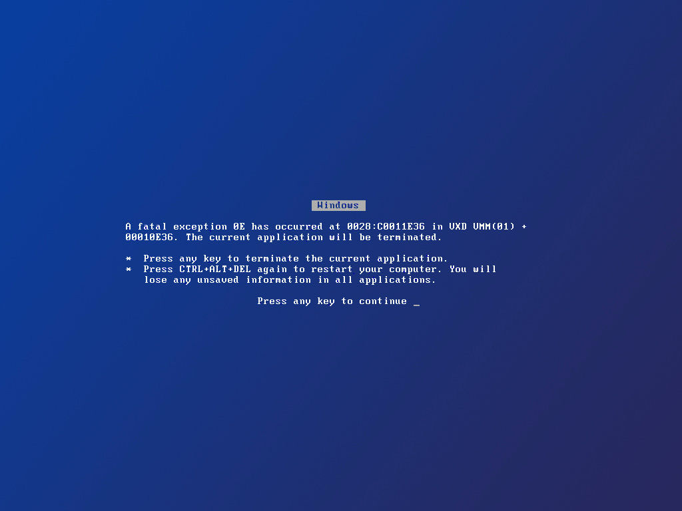

Slide 4


Slide 5


Memory Safety
Notes:
Safe languages give us memory safety, which means that data access will not overflow memory boundaries or dereference dangling pointers.

Slide 6


Type Safety
Notes:
We can also get type safety, which means that all data access adheres to properties of its type.
TRANSITION: What about using safe languages for end-to-end system guarantees?

Slide 7
Previously: “Safe” Systems
Type-checked OS
Applications
Drivers
File System
Microkernel
What currently exists
Untyped
Unsafe code
(GC, stacks, drivers, …)
Hardware
Notes:
Projects such as Singularity and SPIN have taken the approach of writing operating systems in safe languages, with the reasoning that it is important for operating systems to be correct, but it is difficult to fully verify them because they are so large and complex.
All safe languages have a runtime system, however, and this runtime system contains unsafe code.
We are crossing our fingers that this code will not inappropriately access memory, but a bug here can completely subvert our typing guarantees.
Make it clear what the problems are with having the unsafe code.
Make it clear what we are going to verify. [Animate appear.]
Make it clear only hardware instructions are part of the trusted computing base.
TRANSITION: We propose a system design that can give you end-to-end guarantees of type safety.

Slide 8
End-to-End Safe Systems
Type-checked OS
Applications
Drivers
File System
Microkernel
What we want
Untyped
Unsafe code
(GC, stacks, drivers, …)
Verified code
(GC, stacks, drivers, …)
Hardware
Notes:
Projects such as Singularity and SPIN have taken the approach of writing operating systems in safe languages, with the reasoning that it is important for operating systems to be correct, but it is difficult to fully verify them because they are so large and complex.
All safe languages have a runtime system, however, and this runtime system contains unsafe code.
We are crossing our fingers that this code will not inappropriately access memory, but a bug here can completely subvert our typing guarantees.
Make it clear what the problems are with having the unsafe code.
Make it clear what we are going to verify. [Animate appear.]
Make it clear only hardware instructions are part of the trusted computing base.
TRANSITION: We propose a system design that can give you end-to-end guarantees of type safety.

Slide 9
Verve, a Type-Safe OS
Type-checked
Verify partial correctness of low-level Nucleus using Hoare logic based on a hardware spec.
Verify an interface to typed assembly for end-to-end safety.
Applications
Drivers
File System
Microkernel
Verified
Interface specification
Nucleus
Hardware specification
Notes:
We present Verve, an operating system where every assembly instruction in the software stack is mechanically verified for type safety.
At the core of Verve is the Nucleus, which contains the low-level functionality that cannot be expressed within the type system of our safe language
We verify partial correctness properties of the Nucleus using Hoare logic with respect to a specification of device interfaces and assembly instructions.
We hoist the rest of the system, the kernel and applications, into managed C# code we compile to typed assembly. We verify that the low-level code and the managed code interact in a type-safe manner.
TRANSITION: Let us take a closer look at the Verve Nucleus..

Slide 10


The Verve Nucleus
Type-checked
Verified
Applications
Interface specification
Interface specification
Drivers
File System
GC Heap
Interrupt table
Microkernel
Interrupt/error handling
Allocator and GC
[POPL 2009]
Verified
Interface specification
Stacks
Nucleus
x86 instructions
Memory bounds
Devices
Hardware specification
Notes:
The biggest component of our Nucleus is the allocator and garbage collector. We have integrated both the copying and mark-sweep collectors that Hawblitzel and Petrank described their 2009 POPL paper.
The Nucleus also describes the thread context stacks and handles context switching.
The Nucleus exports access to devices such as the screen, keyboard, and timer.
Additionally the Nucleus contains functionality for error and interrupt handling.
The nucleus sits on top of a trusted hardware specification of absolute x86 instructions, memory bounds, and device interfaces.
We verify the partial correctness of Nucleus code. For instance, we verify that we restore the appropriate observed registers when switching back to a context, that the garbage-collected heap to be well-formed, and that thread contexts are pushed onto the stack correctly when there is an interrupt.
Another goal of our verification was to ensure that the low-level code interacts properly with the typed-checked code. Specifically, we verify that the low-level code does not interfere with well-formedness of the garbage-collected heap and that the managed code does not interfere with thread context memory.
The rest of the data structures used by the scheduler are implemented in C#. In the type-checked kernel we have, for example, the ready queue, the GC queue, and the semaphore queues.
TRANSITION: We have written Nucleus invariants in Boogie.

Slide 11
Thread Context Invariant
function StateInv
(s:StackID, state:StackState, …)
returns(bool) {
(!IsEmpty(state) → … && (IsInterrupted(state) → …
&& (IsYielded(state) → …
&& state == StackYielded(
StackEbp(s, tMems)
, StackEsp(s, tMems) + 4
, StackRA(s, tMems, fMems)) && …
}
Notes:
Here we show an invariant that has the goal of describing what it means to be a well-formed thread context for the purpose of allowing us to define what it means to context switch back to an “appropriate” context.
This is a Boogie function, which is mathematical function in that it express relationships between values. I have shown all functions in light green.
This function takes as arguments an identifier ‘s’ specifying the context and a description “state” of the stack state. It also references global variables tMems and fMems, which are mathematical maps used to model the memory.
This invariant says that state must match what we have stored in memory for the context s and that the state should adhere to certain properties depending on whether it is not empty, interrupted, or yielded.
If the stack has yielded, one of the properties that should hold is that we have captured the frame pointer, the stack pointer, and the return address.
TRANSITION: We use invariants such as this one to specify the partial correctness of our Nucleus code, and also to provide trusted specifications of hardware instructions and device interfaces.

Slide 12
“Load” Specification
procedure Load(ptr:int)
returns (val:int);
requires memAddr(ptr);
requires Aligned(ptr);
modifies Eip;
ensures word(val);
ensures val == Mem[ptr];
Notes:
For instance, here is specification for the load instruction, which takes a pointer to a memory address and returns the value in memory at that location.
We have the post-conditions that we have a 32-bit word and that the result matches the memory value at that location.
Note that we need to ensure that the result is a word because Boogie has mathematical integers.
In order to be able to call the Load instruction, we need to also satisfy the precondition that the address we have is in bounds and that it is 4-byte aligned.
Our specification also declares that we modify the instruction pointer eip.
Thus any procedure that calls load can use these postconditions, but they must satisfy the preconditions and cannot make any assumptions about the value of the instruction pointer afterward.
TRANSITION: Our Nucleus consists of Boogie procedures using these specifications.

Slide 13
Assembling Verve
Source file
Verification tool
Compilation tool
Verified
Nucleus.bpl (x86)
Boogie/Z3
Translator/
Assembler
Notes:
We have defined how Boogie procedures correspond to x86 assembly instructions.
We translate Nucleus procedures to x86 to run them.
TRANSITION: Let us take a look at one of these procedures.

Slide 14
Boogie to x86
implementation ReadKeyboard(){
call KeyboardStatusIn8();
call eax := And(eax, 1);
if (eax != 0) { goto proc; }
call eax := mov(256);
return;
proc:
call KeyboardDataIn8();
call eax := And(eax, 255);
return;
}
ReadKeyboard proc
in al, 064h
and eax, 1
cmp eax, 0
jne ReadKeyboard$proc
mov eax, 256
ret
ReadKeyboard$skip:
in al, 060h
and eax, 255
ret
Notes:
Here is an example of a Nucleus procedure we verified for reading keystrokes from a keyboard.
We first call an x86 input instruction to see if a keystroke is available. KeyboardStatusIn8 is the trusted interface for reading from the keyboard.
We get the keyboard status in register eax and we perform a bit-wise and operation to discover the status.
If no input was available, it returns. Otherwise does an input instruction to find out what key it is. [TODO: Why do we have the and here?]
The functions Go() and Ret() update the global state about the location of the instruction pointer. Our translator requires a Go, which states that we modify the instruction pointer, before a conditional. The translator also requires ret, which updates the return address.
It gets translated to the following assembly.
Procedure calls get inlined. The conditional gets turned into a comparison and a jump if not equal.
TRANSITION: We link the generated x86 with typed assembly that is generated from Bartok, and optimizing C# compiler.

Slide 15
Building Verve
Source file
Kernel.cs
Verification tool
Compilation tool
C# compiler
Verified
Nucleus.bpl (x86)
Kernel.obj (x86)
Boogie/Z3
TAL checker
Translator/
Assembler
Linker/ISO generator
Verve.iso
Notes:
In additions to the Nucleus we have the kernel and applications in C#, which we compiled to typed assembly using Bartok. We check this using the Tal checker.
The C# code is untrusted: we do not have to trust its correctness because any C# code that runs goes through the TAL checker.
To create the bootable CD-ROM image, we translate and assembly the Nucleus and link it with the kernel.
Other than the trusted specification, all other instructions in the system have been verified.
TRANSITION: Now we will show that we have indeed built a real system using a scalable approach.

Slide 16
Verve Performance
Verve functionality | Cycles
Round-trip yield | 98
Round-trip wait + signal | 216
Comparisons | Cycles
L4 (IPC) | 224
SeL4 (IPC) | 448
Singularity (yield) | 2156
Linux (yield) | 2390
Windows (yield) | 3554
Notes:
We found that Verve running times compare favorably with other systems.
Round-trip context switching takes 98 cycles and round-trip communication takes 26 cycles. We compare this to interprocess communication on the L4 and SeL4 microkernels and thread yield on monolithic operating systems.
There is the caveat, however, that Verve does much less than each of these systems.
TRANSITION: We are able to verify this system with low annotation overhead.

Slide 17

Low Annotation Burden
 | Copying | Mark-sweep
Specification Boogie lines | 1185
Verified Boogie lines | 4309 | 4854
3x code
x86 instructions | 1377 | 1489
9 person-months
Notes:
We have about a thousand lines of specification, which includes definitions of assembly language instructions and device interfaces. This code sets up the environment that the code lives in rather than describing what the code should do.
This is the same specification for both garbage collectors.
Verification, which includes both executable statements and invariants, preconditions, post-conditions, is approximately 3x the size of the code. The annotation overhead is much lower than systems that use interactive theorem proving.
This implementation took nine person-months between two people.
TRANSITION: How does Verve compare to SeL4, the state of the art in microkernel verification?

Slide 18

Verve vs. SeL4?
Applications
Drivers
File System
120-240 person-months
SeL4
Verified microkernel
8,700 lines of C
Verve
C# kernel
Verified Nucleus
~1500 lines of x86
~600 lines ARM assembly
200,000 lines of Isabelle
20x code
Notes:
SeL4 verifies the L4 microkernel and presents an approach for verifying the correctness of a large body of low-level code. SeL4 consist of 8700 lines of C verified to be equivalent to a Haskell reference implementation, which is verified to satisfy properties specified in the Isabelle theorem prover.
The kernel interfaces with 600 lines of trusted ARM assembly.
[Compare to Verve.]
The verification takes 200,000 lines of proof script in the Isabelle interactive prover, which is 30 times the size of the code. It also took the team 10-20 man-years.
TRANSITION: While SeL4 presents and impressive verification achievement, we are presenting a much lighter-weight approach to verifying important system properties. Verve also verifies the whole system, relying on no lines of trusted assembly.

Slide 19
Contributions
Type-checked
First automatically, mechanically verified OS for type safety.
Real system running on x86 with efficient code.
Approach for using automated techniques to verify safety.
Applications
Drivers
File System
Microkernel
Verified
Interface specification
Verified nucleus
Hardware specification
http://www.codeplex.com/singularity
Notes:
In this talk, we have presented the first mechanically verified operating system ensuring end-to-end type safety.
We have described a real system that we’ve built on top of the x86 architecture with real language features such as classes, virtual methods, arrays, and preemptive threads.
The operating system is efficient: we support typed assembly code generated from C#.
This whole process demonstrates that we can use automated techniques to verify systems with low-level code.
It is exciting that the programming languages and verification community has gotten us to the point where we can combine well-designed languages with efficient verification tools to automatically and mechanically verify important program properties. Here’s to collaborating towards a safer future!

