Slide 1


Learning and Improving Visual Realism
in Image Compositing
Jun-Yan Zhu¹ Philipp Krähenbühl¹
Eli Shechtman² Alexei A. Efros¹
UC Berkeley¹ Adobe²

Slide 2
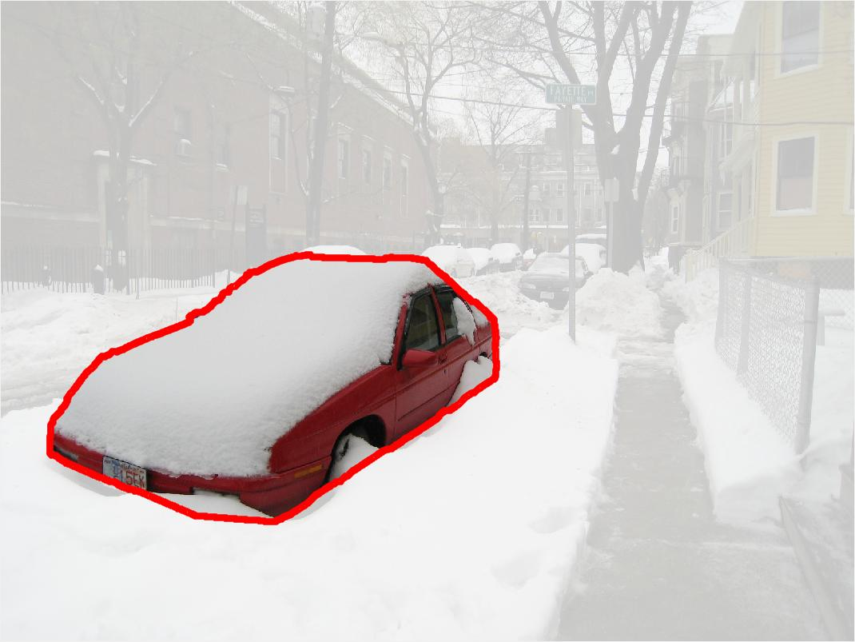
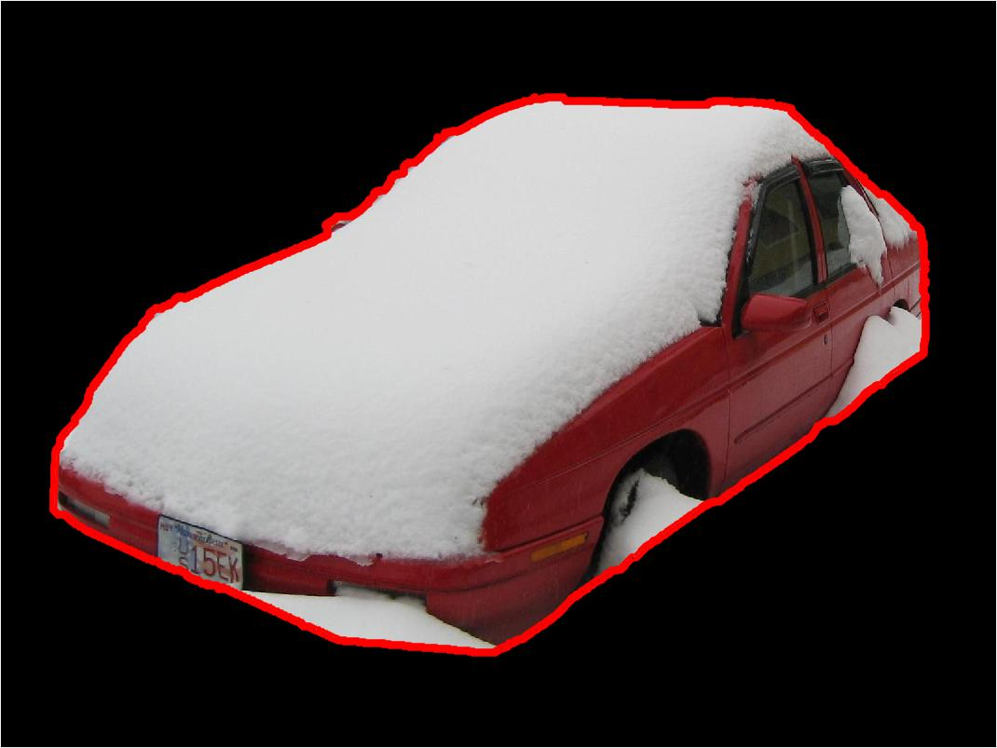
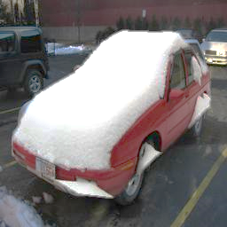
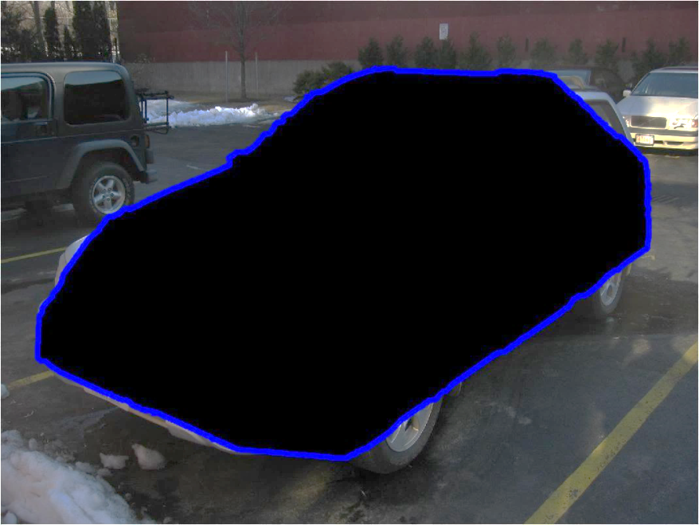
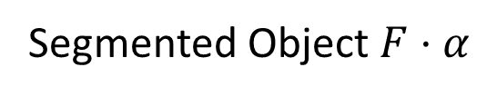
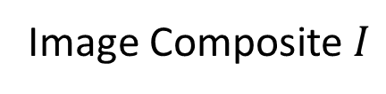
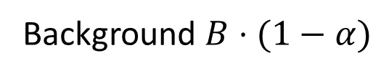
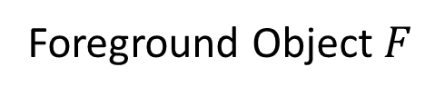
Scale
Translate
Masking
Foreground Object $F$
Segmented Object $F⋅α$
Image Composite $I$
Background $B⋅(1−α)$

Slide 3
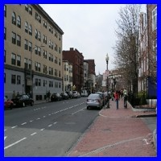
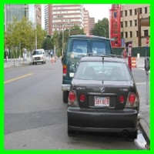
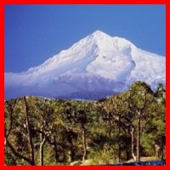
Which Image Looks Realistic?
Which Image is Real?
Natural Photo
Realistic Composite
Unrealistic Composite
Photo Forensics
[Johnson and Farid 2005]
Visual Realism
(This work)

Slide 4
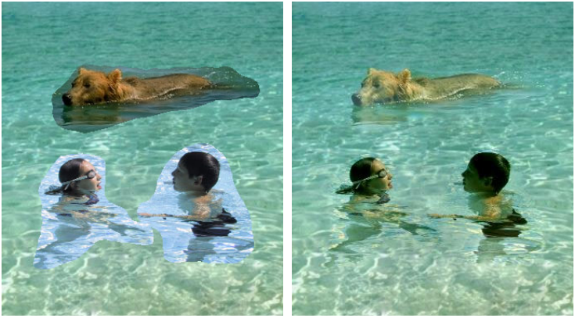
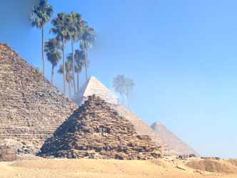
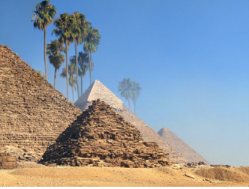
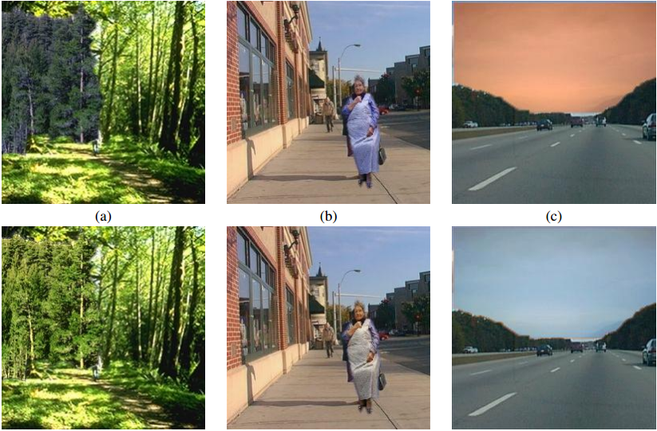
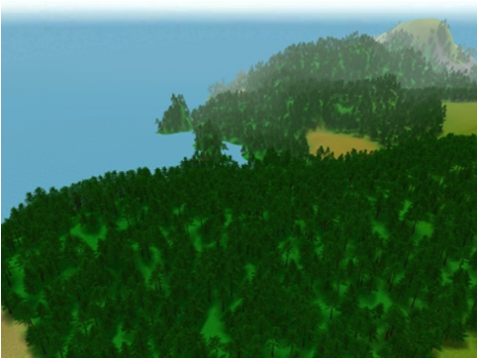
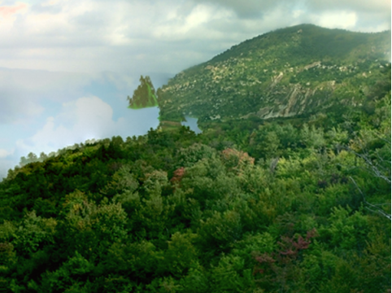
Prior work: Heuristic-based
Gradient [Perez et al. 2003]
“Bleeding” artifacts [Tao et al. 2010]
Color [Reinhard et al. 2004]
Color and Texture [Johnson et al. 2011]

Slide 5
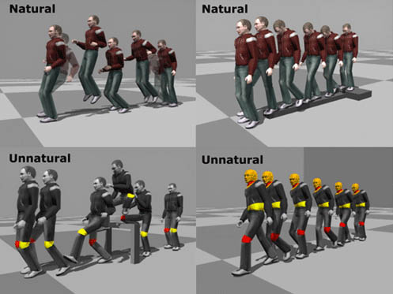
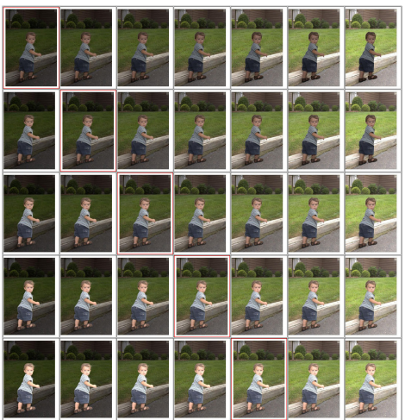
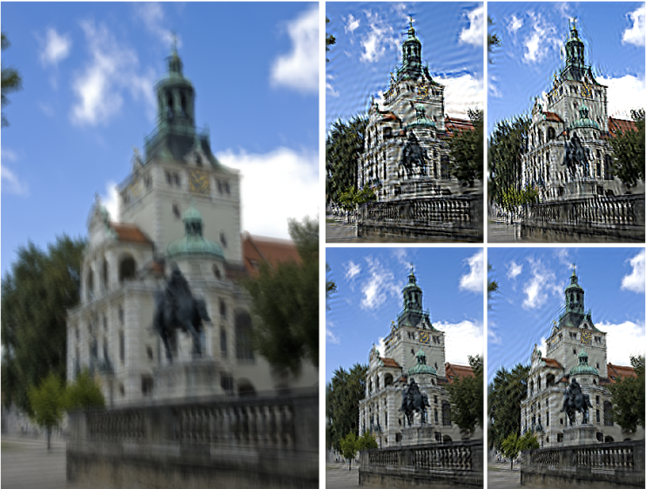
Prior work: Discriminative Learning
Natural Human Motion
(34 subjects)
[Ren et al. 2005]
Image Compositing
(20 images)
[Xue et al. 2012]
Image Deblurring
(40 images)
[Liu et al. 2013]

Slide 6
Our Goal:
Learn a visual realism model without using human annotations
Improve image compositing by optimizing visual realism

Slide 7
Our Pipeline
Realism
CNN
Predict Realism
Image Editing Model
Improve Composites

Slide 8
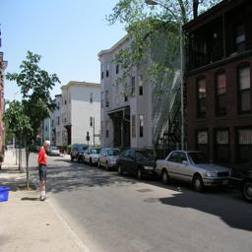
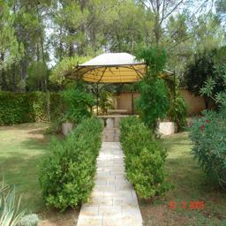
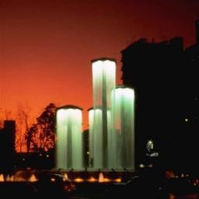
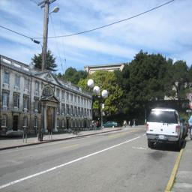
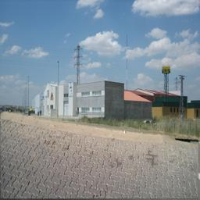
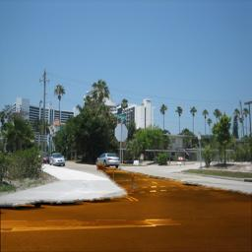
Learning Visual Realism
More Realistic
CNN Training
Classifying
natural photos
vs. composite images
Composite images
Natural Photos

Slide 9
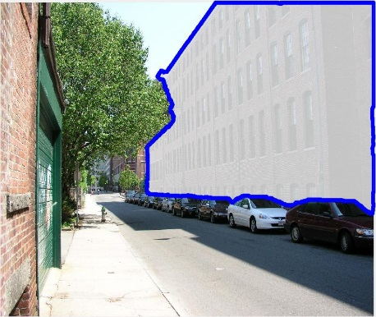
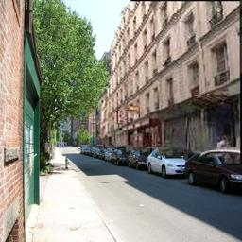
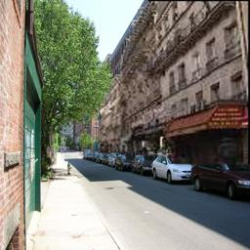
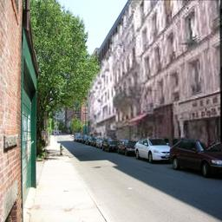
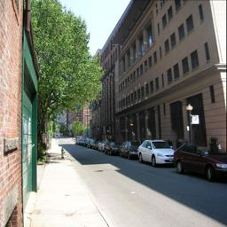
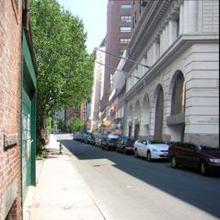

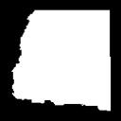


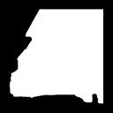

Automatically Generating Composites
Target Object
Composite Images
Object Mask
Object Masks with Similar Shapes
Object Mask: (1) Human Annotation (2) Object Proposal
[Lalonde and Efros 2007]

Slide 10
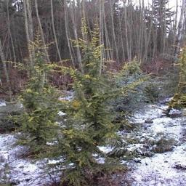
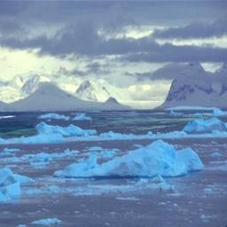
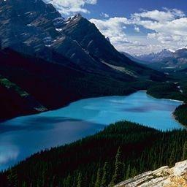
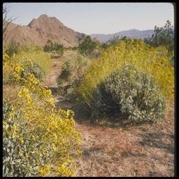
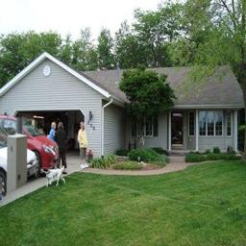
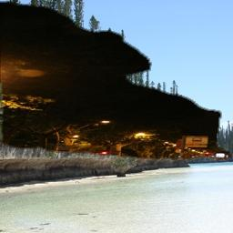
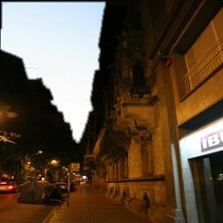
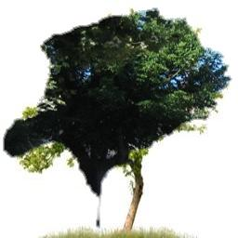
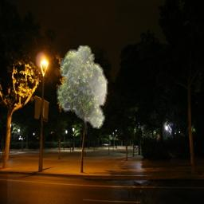
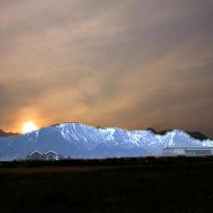
Ranking of Negative Training Examples
Most realistic composites
Least realistic composites

Slide 11
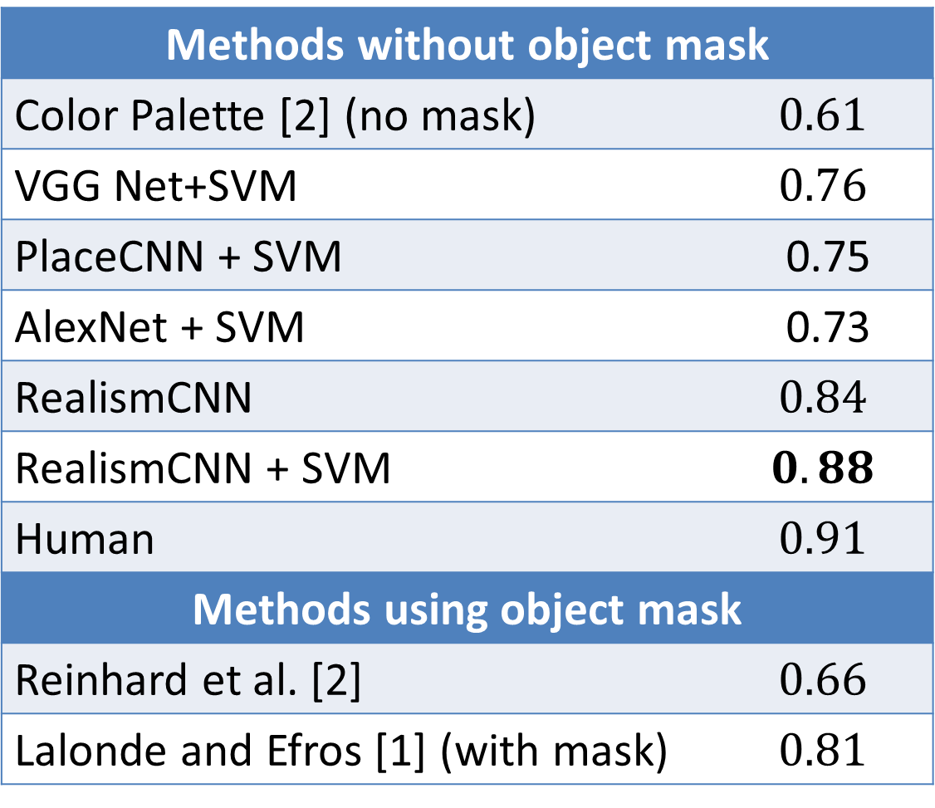
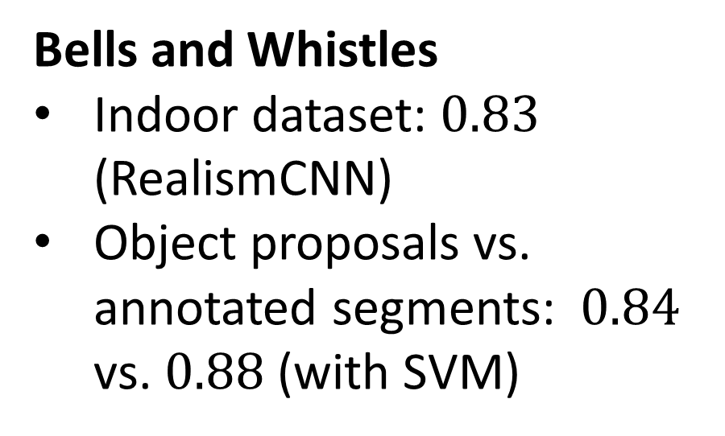
Evaluation
Area under ROC Curve
Dataset [Lalonde and Efros]
Task: binary classification
360 realistic photos (natural images + realistic composites)
360 unrealistic photos
Methods without object mask
Color Palette [2] (no mask) | $$0.61$$
VGG Net+SVM | $$0.76$$
PlaceCNN + SVM | 0.75
AlexNet + SVM | 0.73
RealismCNN | $$0.84$$
RealismCNN + SVM | $$0.88$$
Human | $$0.91$$
Methods using object mask
Reinhard et al. [2] | $$0.66$$
Lalonde and Efros [1] (with mask) | $$0.81$$
Bells and Whistles
Indoor dataset: $0.83$ (RealismCNN)
Object proposals vs. annotated segments: $0.84$ vs. $0.88$ (with SVM)

Slide 12
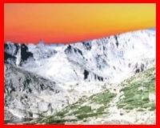
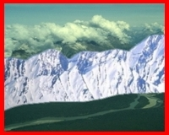
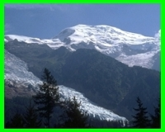
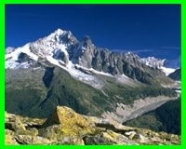











Visual Realism Ranking
Least Realistic
Most Realistic
Snowy
Mountain
Highway
Ocean
Red: unrealistic composite, Green: realistic composite, Blue: natural image

Slide 13





0%
25%
50%
75%
100%

Slide 14
Our Pipeline
Realism
CNN
Predict Realism
Image Editing Model
Improve Composites

Slide 15




Improving Visual Realism
Compositing model
Color adjustment $g$
Foreground object F
Realism
CNN
Original Composite
(Realism score: 0.0)
Improved Composite
(Realism score: 0.8)
$$E(g,F)=E_{CNN}+E_{reg}$$
Quasi-Newton (L-BFGS)

Slide 16










Selecting Suitable Objects
Best-fitting object selected by RealismCNN
Object with most similar shape

Slide 17









Optimizing Color Compatiability
Unrealistic
Object mask
Cut-n-paste
Lalonde et al.
Xue et al.
Ours

Slide 18









Optimizing Color Compatiability
Realistic
Object mask
Cut-n-paste
Lalonde et al.
Xue et al.
Ours

Slide 19










Optimizing Color Compatiability
Natural (real)
Object mask
Cut-n-paste
Lalonde et al.
Xue et al.
Ours

Slide 20

















Visualizing and Localizing Errors ($\frac{∂E}{∂I_{p}}$)
Number of L-BFGS iterations
Result
Gradient
Map
$$E=$$
$$50.73$$
$$9.38$$
$$5.05$$
$$3.44$$
$$3.00$$

Slide 21

















Cut and
Paste
With
$$E_{reg}$$
Without
$$E_{reg}$$

Slide 22











Hard Negative Mining
Realism
$$CNN_{1}$$
Predict Realism
Image Editing Model $g_{1}$
Improve Composites
$$CNN_{1}$$
Natural
Cut-n-Paste

Slide 23








Hard Negative Mining
Realism
$$CNN_{2}$$
Predict Realism
Image Editing Model $g_{2}$
Retraining
Improve Composites
$$CNN_{2}$$
Natural
Cut-n-Paste
Model $g_{1}$

Slide 24








Hard Negative Mining
Realism
$$CNN_{3}$$
Predict Realism
Image Editing Model $g_{3}$
Retraining
Improve Composites
$$CNN_{3}$$
Natural
Cut-n-Paste
Model $g_{1}$
Model $g_{2}$

Slide 25








With Hard Negative Mining (no $E_{reg}$)
Object mask
Cut-n-paste
Iteration 1
Iteration 2
Iteration 3

Slide 26

Evaluation (average Human ratings)
 | Unrealistic Composites | Realistic Composites | Natural Photos
cut-n-paste | -0.024 | 0.263 | 0.287
Lalonde and Efros | $$0.123$$ | -0.299 | -0.247
Xue et al. | $$−0.410$$ | -0.242 | -0.237
Ours | $$0.311$$ | 0.279 | 0.196
Significantly improve the visual realism of unrealistic composites.
Does not alter much color distribution of realistic composites and natural photos.

Slide 27
Thank You

