Slide 1


Learning and Improving Visual Realism
for Image Compositing
Jun-Yan Zhu¹ Philipp Krähenbühl¹
Eli Shechtman² Alexei A. Efros¹
UC Berkeley¹ Adobe²
Notes:
My name is Jun-Yan, working on vision and graphics at UC Berkeley.
In this project, we are interested in learning and improving visual realism for image compositing.

Slide 2
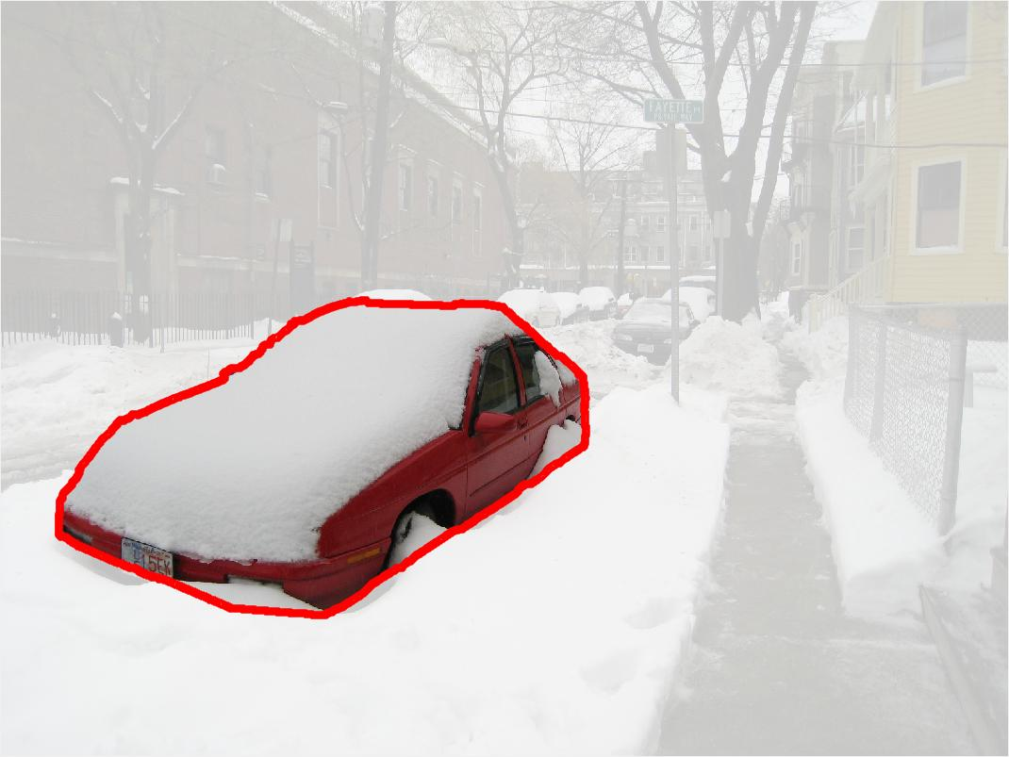
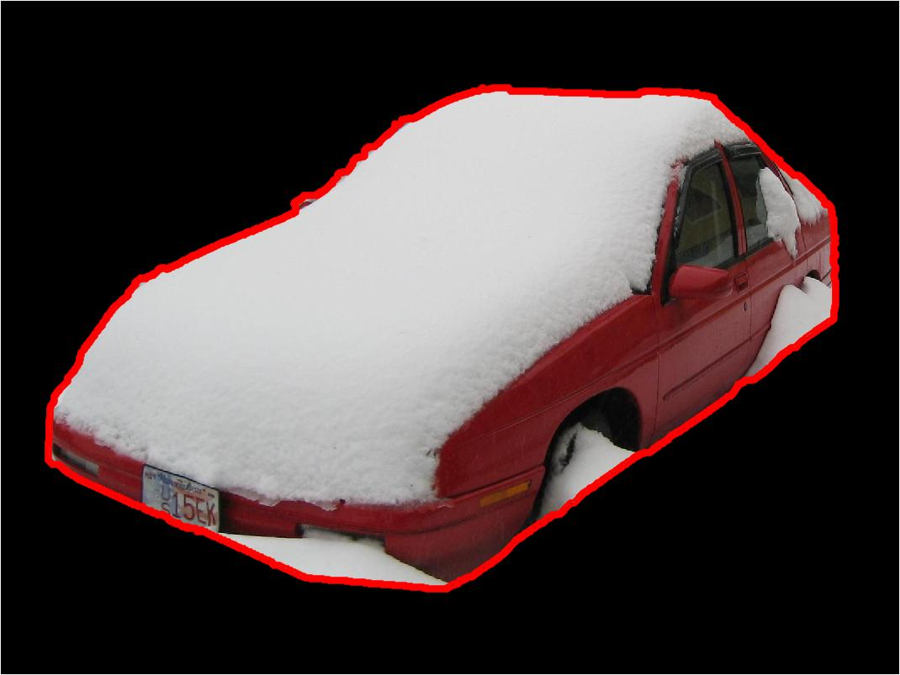
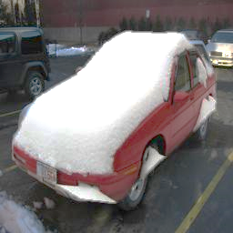
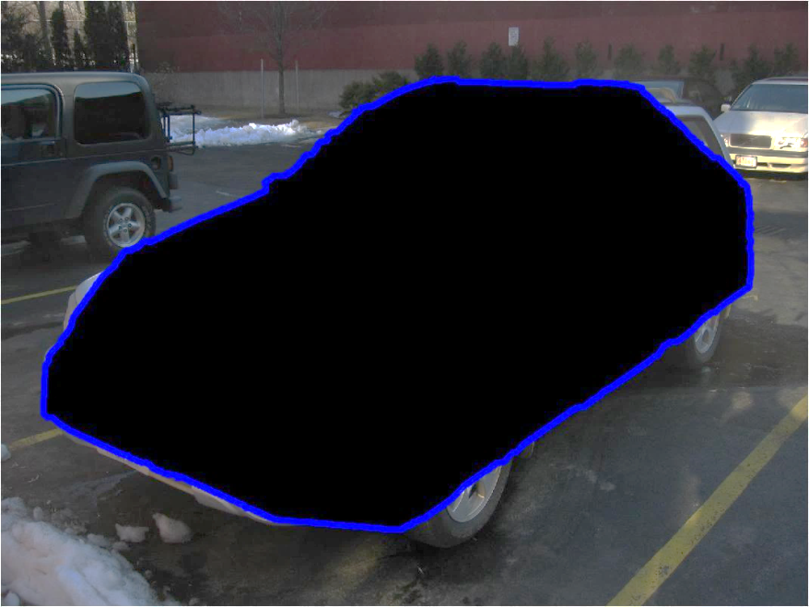
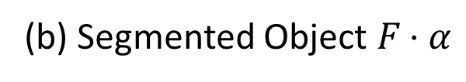
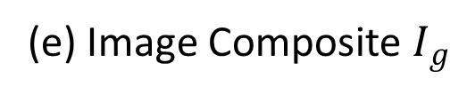
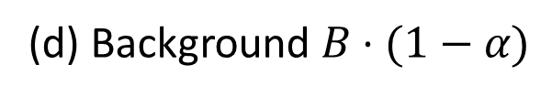
Scale
Translate
Masking
(a) Foreground Object F
(b) Segmented Object $F⋅α$
(e) Image Composite $I_{g}$
(d) Background $B⋅(1−α)$
Notes:
So what is a composite image?
To produce a composite image, we combine a foreground object (such as this red car) with a masked background (such as this parking lot) together.

Slide 3
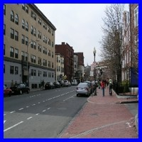
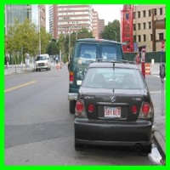
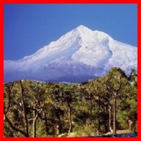
Which Image Looks Realistic?
Which Image is Real?
Natural Photo
Realistic Composite
Unrealistic Composite
Photo Forensics
[Johnson and Farid 2005]
Visual Realism
(This work)
Notes:
Given these three images, one of them is real, and the other two are composites. Anyone provide any guess? There are techniques called photo forensics (or anti-Photoshop) that tries to distinguish between natural photo and fake ones. However, since we are here at Adobe, we differ from them in the sense that we try to tell the difference between realistic looking photos from unrealistic ones. We also try to improve the visual realism of composites.

Slide 4
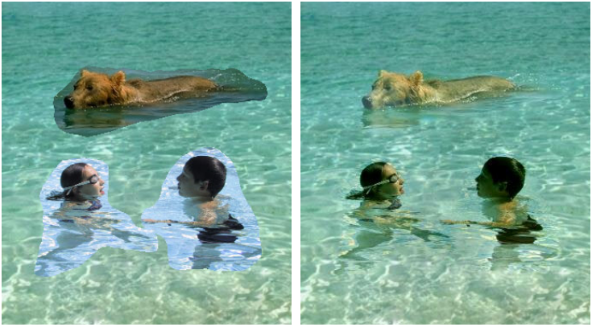
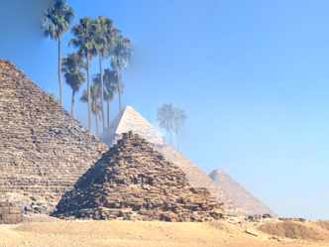
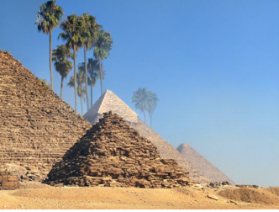
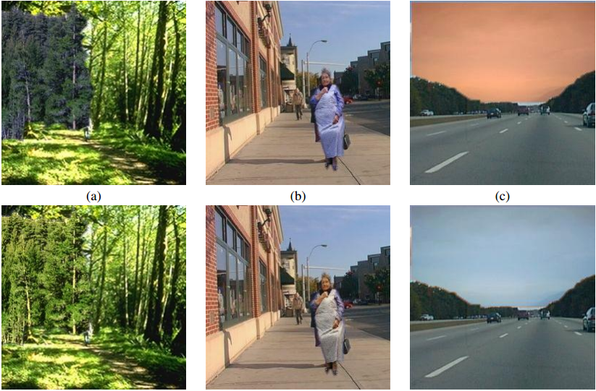
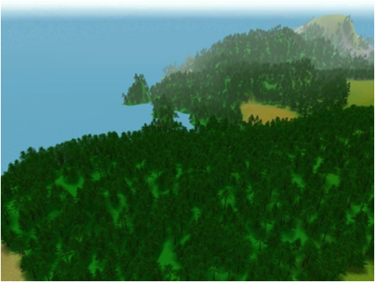
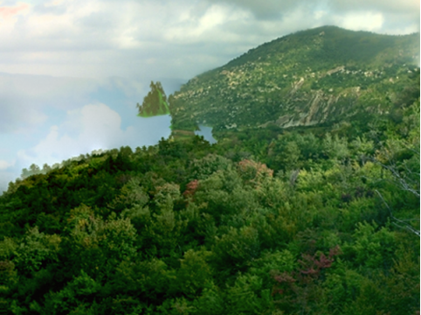
Previous work: heuristic-based
Gradient [Perez et al. 2003]
“Bleeding” artifacts [Tao et al. 2010]
Color [Reinhard et al. 2004]
Color and Texture [Johnson et al. 2011]
Notes:
Lots of work tries to improve image compositing. The first successful idea is to make the boundary look seamless and artifacts-free. Another idea is to make the object’s color and texture compatible with background. However, none of these methods tries to directly improve or measure the realism of their results.

Slide 5
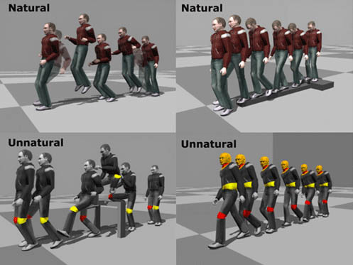
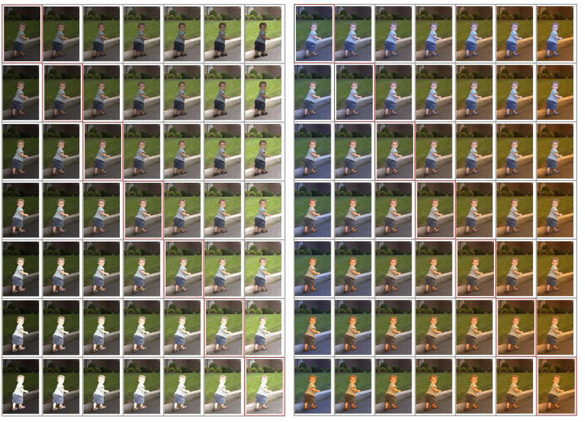
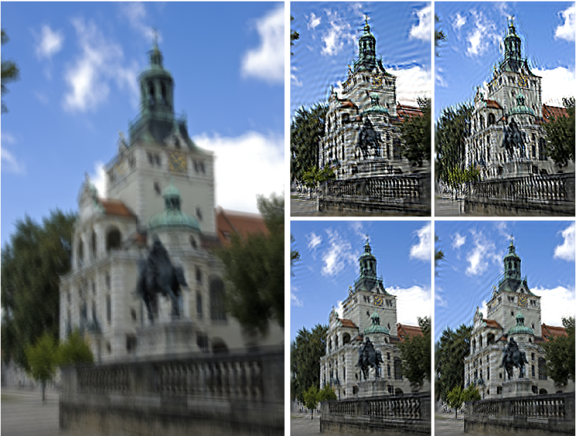
Previous work: discriminative learning
Natural Human Motion
(34 subjects)
[Ren et al. 2005]
Image Compositing
(20 images)
[Xue et al. 2012]
Image Deblurring
(40 images)
[Liu et al. 2013]
Notes:
Other researchers tries to use learning methods to predict the quality of their results. They typically generate a bunch of examples (1,000) with different parameters, and ask a human to label if results look nice or not. Since the space of parameters is exponential, usually a few of images are used. Instead, we try to use large-scale data without requiring expensive human annotation.

Slide 6
Our Goal:
Learn a visual realism model without using human annotations
Improve image editing process by optimizing visual realism
Notes:
The first goal is to predict whether a photo looks realistic or not. Second, once we learn a model of visual realism, we can use this model to further improve image editing tools.

Slide 7

Our Pipeline
Realism Classifier
$$CNN$$
Classify
Image Editing Model
Improve
Notes:
Here is our pipeline. We first train a classifier to tell if a photo is natural or generated by a image editing model. Given the trained classifier, we then improve the image editing model so that the classifier outputs higher realism score.

Slide 8
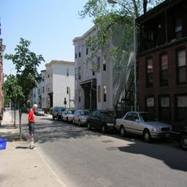
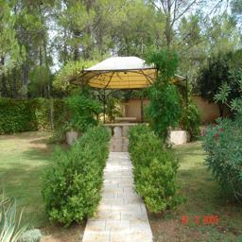
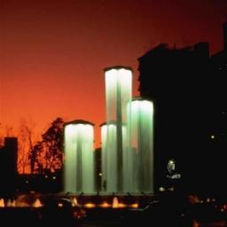
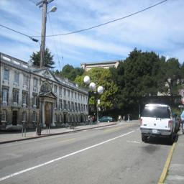
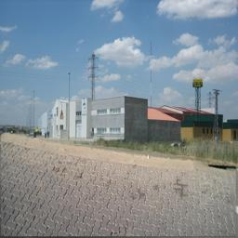
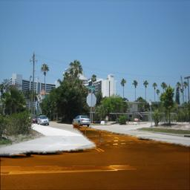
Learning Visual Realism
More Realistic
CNN Training
Classifying
Natural Images
vs. Composite Images
Composite Images
Natural Images
Notes:
In our implementation, we train a convolutional neural network to distinguish natural from automatically generated image composites. In fact, our model seems to pick up on cues about visual realism. For example, our model places these two green composites close to the decision boundary – these turn out to be composites which most of our human subjects thought were real images

Slide 9
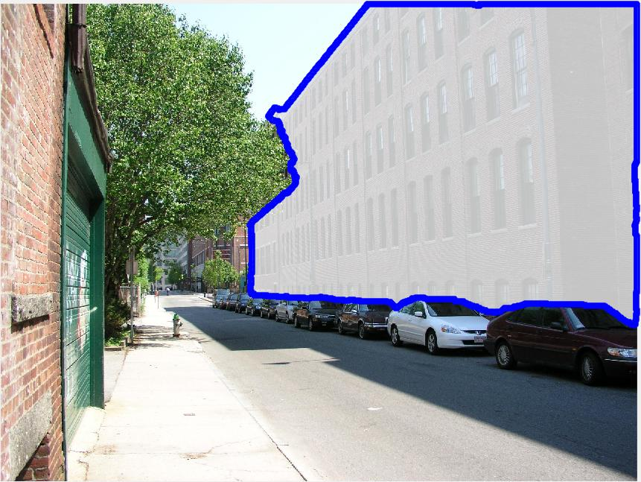
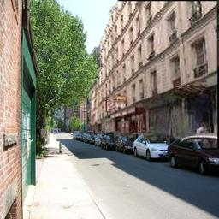
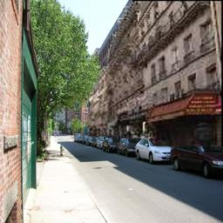
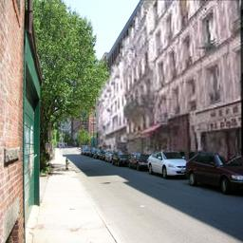




(a) Target Object
(b) Composite Images
(c) Object Mask
(d) Object Masks with Similar Shape
Object Mask: (1) Human Annotation (2) Object Proposal
[Lalonde and Efros 2007]
Notes:
How can we automatically generate composite images for training?
Given an original photo with an object and its object mask, we search for new objects whose object mask matches well the shape of original object, and replace the target object with them.
The object mask comes from either human annotation or region proposal.

Slide 10
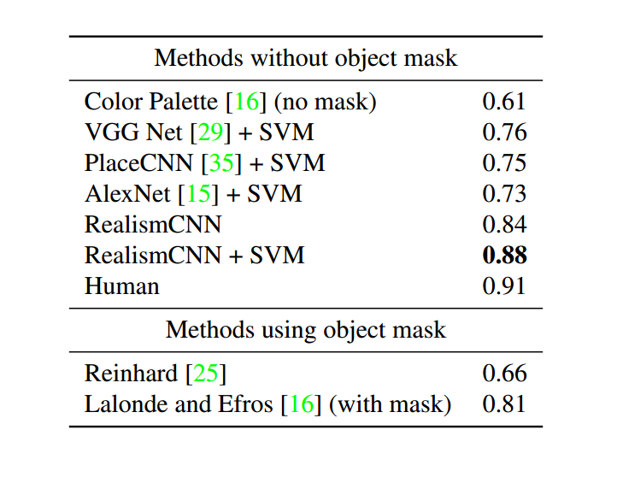
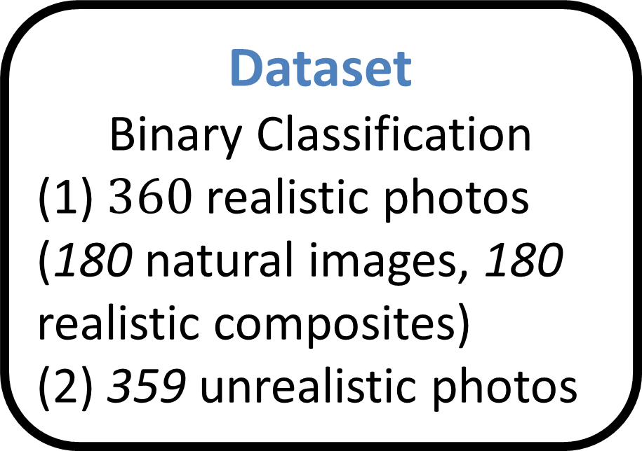
Evaluation
Dataset
Binary Classification
(1) $360$ realistic photos (180 natural images, 180 realistic composites)
(2) 359 unrealistic photos
Notes:
We then evaluate our method in a public dataset with human annotations on a binary classification task of unrealistic photos versus realistic ones. Our model outperforms previous methods, and the results are close to human performance
**** Without any human annotation on visual realism, our model already outperforms previous methods
We then fine-tune our model with additional small amount of human realism labeling, and use the human annotation, and train a linear SVM on top of the fc7 feature, and outperform the previous method by a large margin.

Slide 11
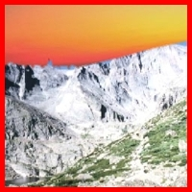
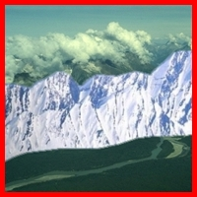
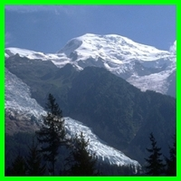
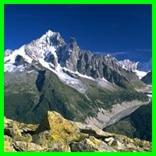
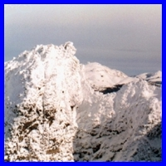
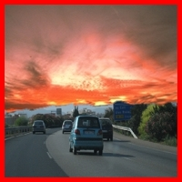
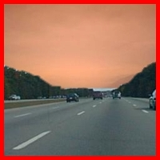
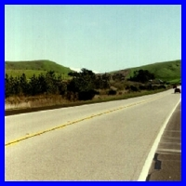
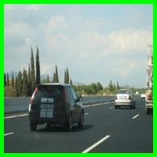
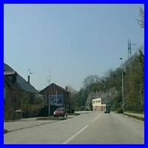
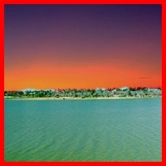

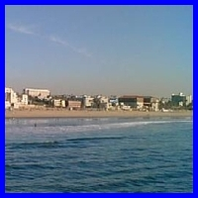
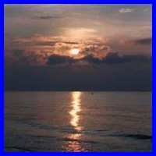
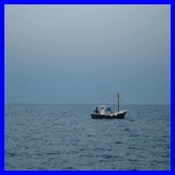
Least Realistic
Most Realistic
Snowy Mountain
Highway
Ocean
Red: unrealistic composite; Green: realistic composite; Blue: natural image
Notes:
Here we show some ranking results from different types of scenes.

Slide 12
Our Pipeline
Realism Classifier
$$CNN$$
Classify
Image Editing Model
Improve
Notes:
Since we have a classifier to predict the visual realism, we can optimize our image editing model so that the final composite looks more realistic according to CNN model.

Slide 13
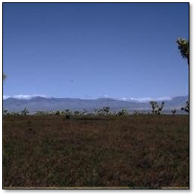
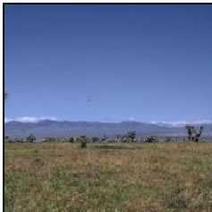
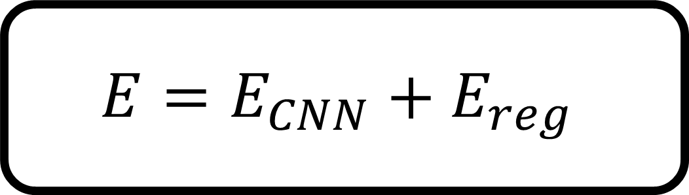
Improving Visual Realism
Composition model:
Object, Color,
Segmentation
CNN
0.0
0.8
$$E=E_{CNN}+E_{reg}$$
Quasi-Newton (L-BFGS)
Notes:
For this, we add a composition layer between original image and CNN model. This composition model encodes the object instance, color and segmenation. This summer, we mainly focus on improving the color, and optimizing the foreground segmentation. We want to minimize the energy function that contains the CNN loss, and added regulation terms for the pareamter prior.
***************************
We believe this pipeline can be used for other graphics algorithm. First, you train a CNN model to tell if a photo is natural or generated by computer graphics algorithm. Then you try to optimize your graphics algorithm so that the CNN model makes mistake.
This is a regulaizatoin term on the color model

Slide 14

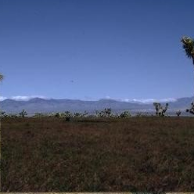
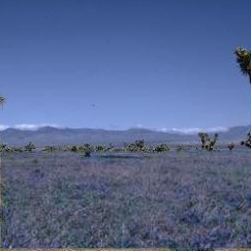







Automatic Color Adjustment
Object mask
Cut-n-paste
Lalonde et al.
Xue et al.
Ours

Slide 15

















Visualizing and Localizing Errors ($\frac{∂E}{∂I_{p}}$)
Number of L-BFGS iterations
Result
Gradient
Map
$$E=$$
$$50.73$$
$$9.38$$
$$5.05$$
$$3.44$$
$$3.00$$
Notes:
One thing suggested last time (by aaron) is to visualize locally what the model captures. Here we show a gradient map (partial of energy with respect to each pixel), Our model seems to mainly capture the color inconsistency along the boundary. we show in each optimization iteration, the result improves as the energy function decreases.
Partial of energy with respect to each pixel

Slide 16

















Cut and
Paste
With
$$E_{reg}$$
Without
$$E_{reg}$$
Notes:
Our E_reg penalizes the large color change between the recolored object and the original object, but we are concerned that our model alone gives poor results. Not a hearlty property

Slide 17











Adversarial Training
Realism Classifier
$$CNN_{1}$$
Classify
Image Editing Model $g_{1}$
Improve
$$CNN_{1}$$
Natural
Cut-n-Paste
Adversarial Networks
[Goodfellow et al. 2014]
Notes:
Do animation more

Slide 18








Adversarial Training
Realism Classifier
$$CNN_{2}$$
Classify
Image Editing Model $g_{2}$
Retraining
Improve
$$CNN_{2}$$
Natural
Cut-n-Paste
Model $g_{1}$
Adversarial Networks
[Goodfellow et al. 2014]
Notes:
Do animation more

Slide 19








Adversarial Training
Realism Classifier
$$CNN_{3}$$
Classify
Image Editing Model $g_{3}$
Retraining
Improve
$$CNN_{3}$$
Natural
Cut-n-Paste
Model $g_{1}$
Model $g_{2}$
Notes:
Do animation more

Slide 20








With Adversarial Training (no $E_{reg}$)
Object mask
Cut-n-paste
Iteration 1
Iteration 2
Iteration 3
Notes:
Look at mturk’s results

Slide 21

With Adversarial Training
 | Cut-and-paste | Lalonde and Efros | Xue et al. | Ours
Unrealistic composites | $$0.026$$ | $$0.110$$ | $$−1.200$$ | $1.064$
Realistic Composites | $$0.895$$ | $$−1.068$$ | $$−1.049$$ | $$1.222$$
Natural Photos | $$0.915$$ | $$−1.373$$ | $$−0.816$$ | $$1.274$$

Slide 22




The Role of Object Segmentation
Object
Background
Composite
Notes:
In addition to color, segmentation also plays an important role on object compositing

Slide 23




Graphcut-based Compositing
Previous Work
Object
Background
Composite
- Various methods: [Kwatra et al. 2003], [Aseem et al. 2004], [Hays and Efros 2007], [Jia et al. 2006], [Rother et al. 2006], [Lalonde et al. 2007], …
- Different seam objectives (colors, gradients, edges, etc.) and unary terms.
- $1\sim 3$ hyper-parameters in each method; Color space?

Slide 24












Generating Graphcut Candidates
Different formulations,
Parameters, Color Space
($50\sim 100$ solutions)
Object
Background
Trimap

Slide 25














Ranking Graphcut Solutions
Most Realistic
Least Realistic
Notes:
Without colirng

Slide 26








Direct Optimization
$$E(α)=E_{CNN}(α)+E_{reg}(α)$$
Challenges:
- Non-convex optimization
- large number of variables (~10,000)
$$\sum{w_{ij}{\left(α_{i}−α_{j}\right)}^{2}}$$
Background
Trimap
Cut-and-paste
Graphcut
CNN
Alpha map
Notes:
Challenges:
Non-convex optimization
with large number of variables (~10,000)

Slide 27
Discussion
Ranking graphcut candidates (suboptimal)
vs. optimizing every pixel (expensive)?
adjust superpixels?
Perspective, scale, location;

Slide 28
Thank You
Notes:
Thank you very much!

