Slide 1
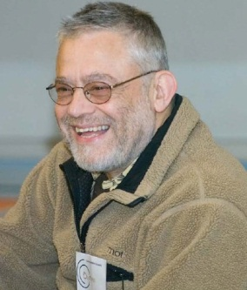
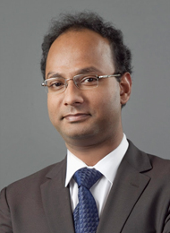
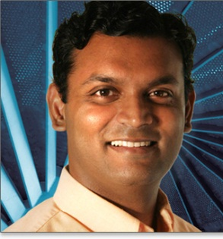
Human Computable Passwords
Jeremiah Blocki
Manuel Blum
Anupam Datta
Santosh Vempala
Theory Lunch – Fall 2014

Slide 2
Outline
Five Minute Version
Actual Talk
Notes:
I am going to do something a bit unusual. I am going to give you the same talk twice. Our human computable password management scheme is very simple while the security proofs are mathematically dense. I am first going to describe how the scheme works and informally state the security properties that we prove. After that then I am going to give the same talk again filling in missing technical details.

Slide 3







Password Management
p₁
p₂
p₃
p₄
p₅
…
p₅
PayPaul.com
Competing Goals:
Security
Usability

Slide 4
Our Scheme: Human Computable Passwords
Passwords computed by responding to public challenges
  Computation done in user’s head
Remains secure many breaches (e.g., 100)
Simple Operations
  Addition modulo 10
  Memorize a random mapping
Notes:
This is where our work comes in. We present a scheme that remains secure even after many breaches (e.g., 100). In light of the recent SSL bug this is a highly desirable security property. In our scheme the user memorizes a short secret which is used to compute all of his different passwords. We stress that all of the computation is done inside the user’s head. Because computations are done in the user’s head we only consider a very restricted set of operations: addition modulo 10 and memorizing the secret random mapping.

Slide 5



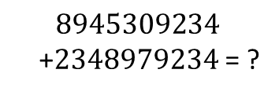

Human Computation
Restricted
  Simple operations (addition, lookup)
  Operations performed in memory (limited space)
$$8945309234$$
+2348979234 = ?
$$9+8=7 mod 10$$
Notes:
In our scheme the user to perform complicated cryptographic operations. In fact, we will not even ask the user to add large numbers. Our scheme is very simple. In fact, in the next minute I can show you exactly how the user computes his passwords.

Slide 6
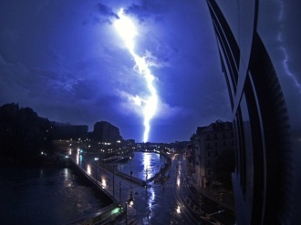
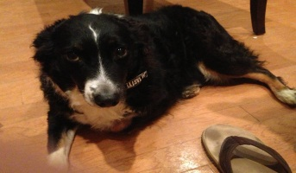
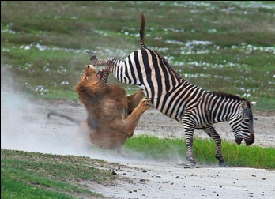
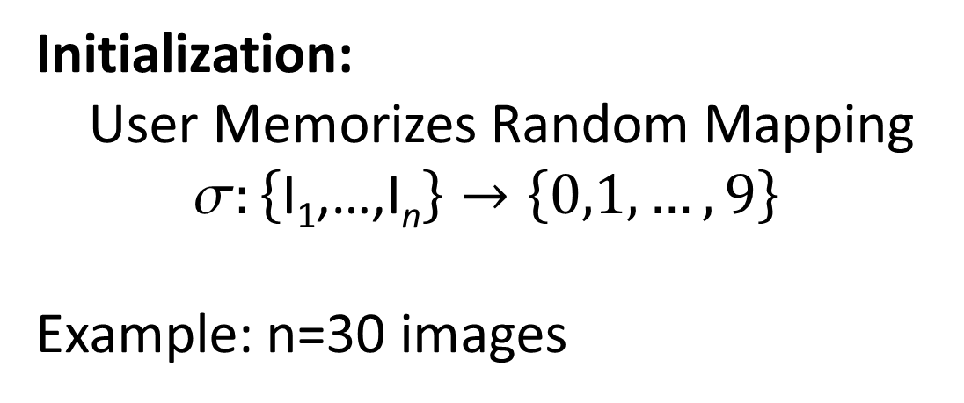
Random Mapping
Image I |  |  | …
(I) | 9 | 3 | … | 6
Initialization:
User Memorizes Random Mapping
$$:\left\{\text{I}\text{1}\text{,…,}\text{I}\text{n}\right\}→\left\{0,1,…,9\right\}$$
Example: n=30 images
Notes:
To begin using our scheme the user first memorizes a secret mapping from pictures to digits. For example, the user must remember that picture of the lightening bolt maps to 9 and the picture of the dog maps to 3. Once the user has memorized this mapping he can compute hundreds of secure passwords by responding to single digit challenges.

Slide 7
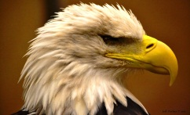
Mnemonics
⬧ = 4
Instruction: Remember that the eagle has a gold beak. There are four letters in “gold” and “beak”.

Slide 8
Mnemonics
⬧ = 7
Instruction: Trace the eagles body from the bottom of the eagle’s beak down to the bottom of the picture. It looks like the number 7.

Slide 9
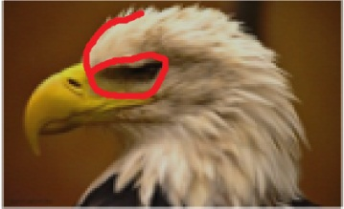
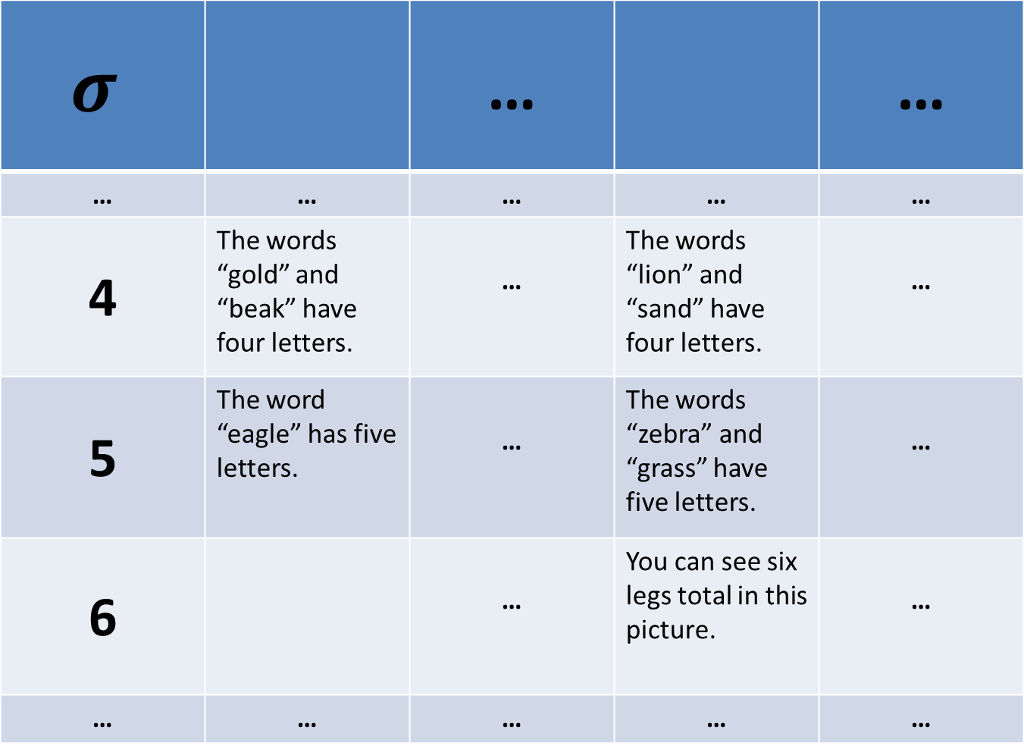
$$σ$$ |  | … |  | …
… | … | … | … | …
4 | The words “gold” and “beak” have four letters. | … | The words “lion” and “sand” have four letters. | …
5 | The word “eagle” has five letters. | … | The words “zebra” and “grass” have five letters. | …
6 |  | … | You can see six legs total in this picture. | …
… | … | … | … | …

Slide 10
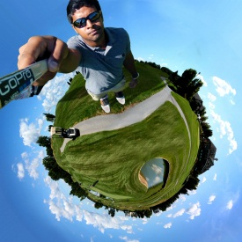
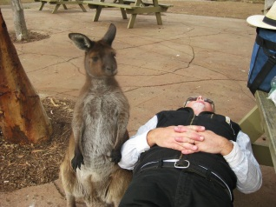
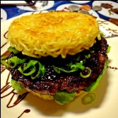

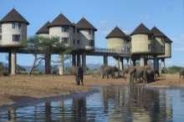


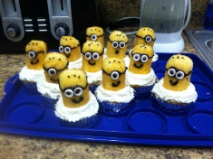
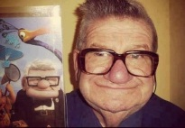
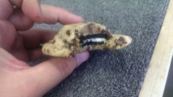
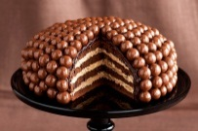
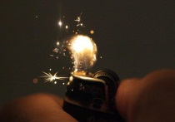
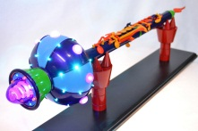
Single-Digit Challenge
0
1
2
3
4
5
6
7
8
9
Computing the Response:
⬧ +  mod 10
= 9+3 mod 10 = 2
Notes:
A single-digit challenge is a list of 14 pictures displayed as follows. The pictures are divided into two groups. The four larger pictures on top and the lookup table with 10 images on the bottom. To compute the response to a single digit challenge the user takes the first two pictures, adds them together to compute an index. In this example, 9+3 is 2 mod 10. (next slide)

Slide 11
Single-Digit Challenge
0
1
2
3
4
5
6
7
8
9
Response:
⬧ +  mod 10
= 9+3 mod 10 = 2
Notes:
The user now looks up the second picture in the table

Slide 12
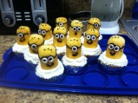

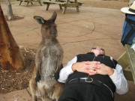
Single-Digit Challenge
0
1
2
3
4
5
6
7
8
9
Final Response:
⬧ +  + 
= 7 + 4 + 5 mod 10 = 6
Notes:
And adds this picture to the remaining to pictures to get the final answer 6.

Slide 13
Passwords
0
1
2
3
4
5
6
7
8
9
Username:
jblocki
Password:
Notes:
Each password is computed by responding to several single-digit challenges. When the user types in the response to the first challenge then the second challenge is displayed.

Slide 14
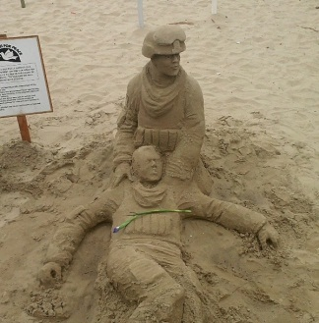
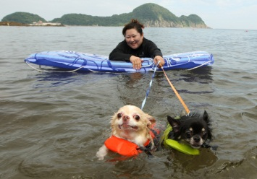
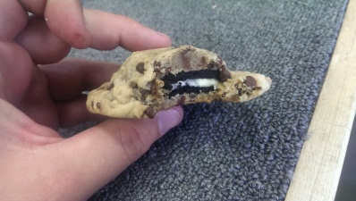
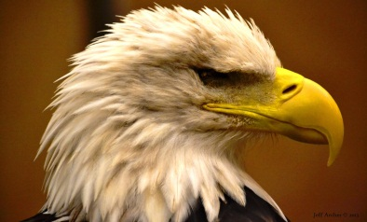

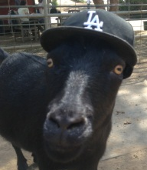
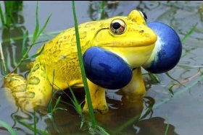






Passwords
0
1
2
3
4
5
6
7
8
9
Username:
jblocki
Password:
*

Slide 15

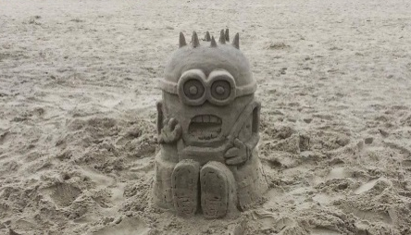

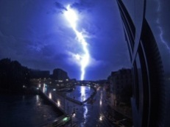


Passwords
0
1
2
3
4
5
6
7
8
9
Username:
jblocki
Password:
**

Slide 16
Usability
My Authentication Time:
7.5 seconds/digit
30 seconds for a 4-digit password
1.25 minutes for a 10-digit password
Memorizing the Secret Mapping:
Memorized 100 image/digit pairs in 2.5 hours
One Time Cost

Slide 17
Usability (Memorization)
 | Human Computable Passwords |  |  | Shared Cues
 | N = 100 | N = 50 | N=30 | SC-1 | SC-0
Active | 0.40 | 0 | 0 | 3.93 | 0
Typical | 2.14 | 0.04 | 0 | 10.89 | 0
Occasional | 2.50 | 0.05 | 0 | 22.07 | 0
Infrequent | 70.7 | 22.3 | 6.1 | 119.77 | 2.44
E[X₃₆₅]: Extra Rehearsals to maintain all passwords over the first year.

Slide 18
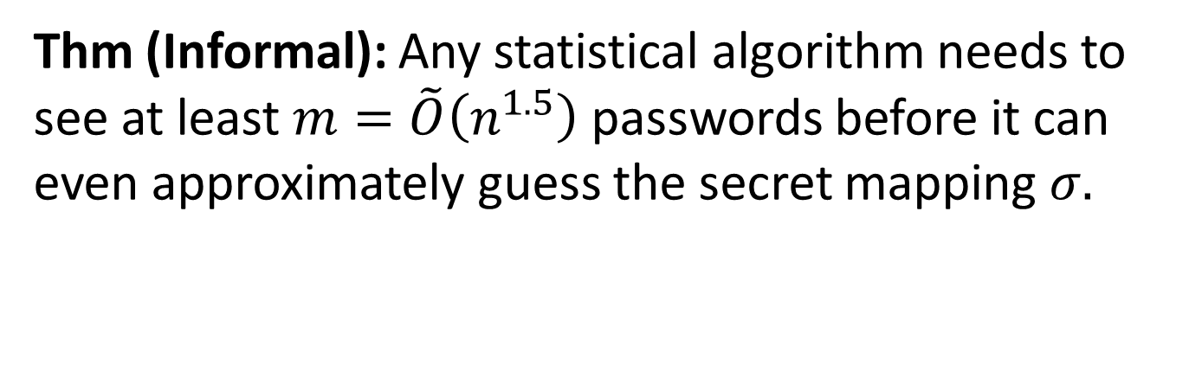
Security
Thm (Informal): Any statistical algorithm needs to see at least $m=\tilde{O}\left(n^{1.5}\right)$ passwords before it can even approximately guess the secret mapping $σ.$
Example: n=30 images
Notes:
We prove that our scheme is secure against the class of statistical adversaries who can see fewer than n^1.5 examples. Our results are significant because most known algorithmic techniques fit within this framework. Guassian elimination is a notable exception, but we also rule out attacks based on Gaussian elimination. While our scheme is simple the analysis is complex. We use generalized hypercontractivity bounds with the fourier decomposition of our function to lower bound the statistical dimension of our induced distribution over challenge response pairs.

Slide 19
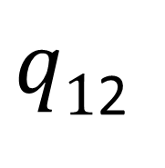
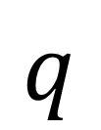
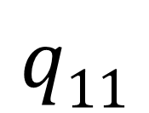
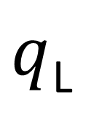
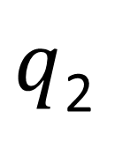
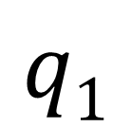
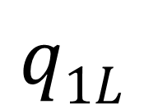
Statistical Algorithm
$$q$$
…
$$q1$$
$q$₂
$q$_{L}
…
…
$$q11$$
$q1$₂
$$q1L$$
…
Notes:
We can think of a statistical algorithm as a tree. Each node of the tree contains a query.

Slide 20
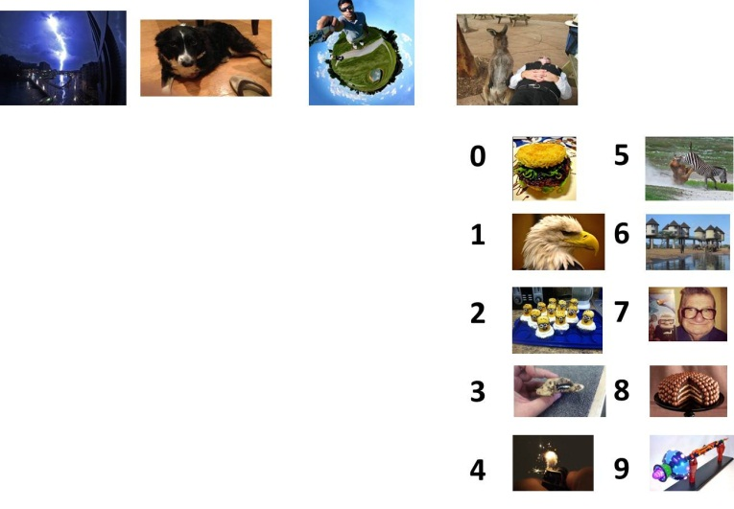
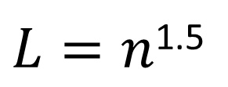
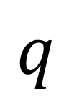
Statistical Algorithm
$$q$$
Response: 6
1
$L=n$^{1.5}
…
2
Notes:
Each query is simply a function that takes as input a randomly chosen challenge response pair and tells us which edge to take.

Slide 21

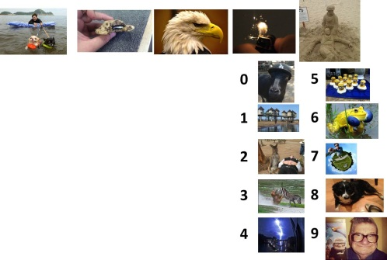
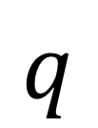
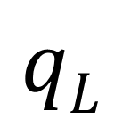
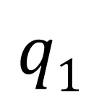
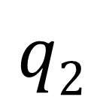
Statistical Algorithm
$$q$$
Response: 6
1
L
2
…
$$q2$$
…
$$qL$$
$$q1$$
Response: 3

Slide 22
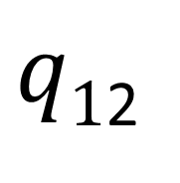
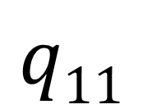
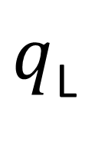




Statistical Algorithm
$$q$$
…
$q$_{L}
$$q1$$
$q$₂
…
…
$$q11$$
$q1$₂
$$q1L$$
…
Guess $σ$
Notes:
We want to prove that this tree must either be deep or the guess is not even close to the real mapping with high probability.

Slide 23
Security
Thm (Informal): Any statistical algorithm needs to see at least $m=\tilde{O}\left(n^{1.5}\right)$ passwords before it can even approximately guess the secret mapping $σ.$
Almost all known algorithmic techniques
Spectral Methods
Local Search
Expectation Maximization
First and Second Order Methods for Convex Optimization
Gaussian Elimination
Example: n=30 images
Notes:
We prove that our scheme is secure against the class of statistical adversaries who can see fewer than n^1.5 examples. Our results are significant because most known algorithmic techniques fit within this framework. Guassian elimination is a notable exception, but we also rule out attacks based on Gaussian elimination. While our scheme is simple the analysis is complex. We use generalized hypercontractivity bounds with the fourier decomposition of our function to lower bound the statistical dimension of our induced distribution over challenge response pairs.

Slide 24


Security
Thm (Informal): Any statistical algorithm needs to see at least $m=\tilde{O}\left(n^{1.5}\right)$ passwords before it can even approximately guess the secret mapping $σ.$
Thm (Informal): Any polynomial time adversary needs to see $m=\tilde{O}\left(n^{3}\right)$ passwords before he can use Gaussian Elimination to approximately guess the secret mapping $σ.$
Thm (Informal): Any polynomial time adversary who can guess the user’s passwords with accuracy much better than random guessing can also approximately recover the secret mapping $σ.$
Notes:
We prove that our scheme is secure against the class of statistical adversaries who can see fewer than n^1.5 examples. Our results are significant because most known algorithmic techniques fit within this framework. Guassian elimination is a notable exception, but we also rule out attacks based on Gaussian elimination. While our scheme is simple the analysis is complex. We use generalized hypercontractivity bounds with the fourier decomposition of our function to lower bound the statistical dimension of our induced distribution over challenge response pairs.

Slide 25

Technical Tools
Discrimination Norm
  On average how much different would the answers to a query q be if we picked a random challenge and a random response?
  Small discrimination norm => Statistical Algorithm must use deep tree. [FPV13]
Fourier Analysis
  Express discrimination norm as a low degree function
Generalized Hypercontractivity Theorem
  Bounds the expected value of low degree functions

Slide 26

Challenge: Break Our Scheme
Goal: Guess one of the user’s secret ten-digit passwords
Given: One-hundred of the user’s other ten-digit passwords.
http://www.cs.cmu.edu/~jblocki/HumanComputablePasswordsChallenge/challenge.htm
Paper: http://arxiv.org/abs/1404.0024
Notes:
The challenges can be found on my webpage along with the paper itself. In first challenge we first give you the responses to 1000 single-digit challenges or 100 ten-digit passwords. Your goal is to guess one of the user’s other passwords. I presented this challenge at two conferences: ASIACRYPT and Oakland. So far nobody has broken any of the passwords.

Slide 27
Outline
Motivation
  Password Management
  Security
  Previous Work
Human Computable Password Scheme
Security Analysis
Future Challenges

Slide 28
Password Management
…
Notes:
Password management scheme is any strategy used to create and remember multiple passwords for multiple accounts.
Increased challenge security/usability analysis should look at the problem wholelistically
Position: This is not the user’s fault!
We want a management scheme which is
1. Easy for the user to manage
2. Secure (hard for adversary to compromise accounts)

Slide 29
Scheme 1: Reuse Strong Password
Pick four random words w₁,w₂,w₃,w₄
Account | Amazon | Ebay
Password | w₁w₂w₃w₄ | w₁w₂w₃w₄

Slide 30
Scheme 2: Strong Random Independent
Four Independent Random Words per Account
Account | Amazon | Ebay
Password | w₁w₂w₃w₄ | x₁x₂x₃x₄

Slide 31


Security as a Game
p₁
p₂
p₃
p₄
p₅
p₅
PayPaul.com

Slide 32

Security
Attacks |  |  |  | …
Reuse | No | No | No | No
Independent | Yes | Yes | Yes | Yes
Usable + Insecure
Unusable + Secure
Notes:
First Column and Third Column:  = 10⁻⁶
Second Column:  = 10⁻²

Slide 33



Previous Work: Shared Cues
Combinatorial Design: Each pairs of accounts has at most 𝛄 secret stories in common.

Slide 34
Security
Attacks |  |  |  | …
Reuse | No | No | No | No
Independent | Yes | Yes | Yes | Yes
Shared Cues (High Security) | Yes | Yes | No | No
Shared Cues (Low Security) | Yes | No | No | No
Usable + Insecure
Unusable + Secure
Usable + Secure
Usable + Secure
Notes:
First Column and Third Column:  = 10⁻⁶
Second Column:  = 10⁻²

Slide 35



Password Managers
Notes:
LastPass
KeePass
1Password

Slide 36






Trusted Computer Assumption?

Slide 37




Stronger Security?
Notes:
Password management scheme is any strategy used to create and remember multiple passwords for multiple accounts.
Increased challenge security/usability analysis should look at the problem wholelistically
Position: This is not the user’s fault!
We want a management scheme which is
1. Easy for the user to manage
2. Secure (hard for adversary to compromise accounts)

Slide 38
Our Scheme: Human Computable Passwords
Remains secure many breaches (e.g., 100)
  Heartbleed
Passwords computed by responding to public challenges
  Computation done entirely in the user’s head
Required Operations
  Addition modulo 10
  Memorize a random mapping
Notes:
This is where our work comes in. We present a scheme that remains secure even after many breaches (e.g., 100). In light of the recent SSL bug this is a highly desirable security property. In our scheme the user memorizes a short secret which is used to compute all of his different passwords. We stress that all of the computation is done inside the user’s head. Because computations are done in the user’s head we only consider a very restricted set of operations: addition modulo 10 and memorizing the secret random mapping.

Slide 39
Outline
Motivation
Human Computable Password Scheme
  Human Computation
  Candidate Scheme
  Usability Analysis
Security Analysis
Future Challenges

Slide 40



What Can We Compute?
Rules: No pen/paper/calculators…
  Compute in our head
  Working Memory: $7±2$ `chunks’
  Computation should be fast…
$$8945309234$$
+2348979234 = ?
$$9+8=7 mod 10$$
Source: The magical number seven, plus or minus two [Miller, 56]
Notes:
In our scheme the user to perform complicated cryptographic operations. In fact, we will not even ask the user to add large numbers. Our scheme is very simple. In fact, in the next minute I can show you exactly how the user computes his passwords.

Slide 41

Human Computation
Restricted
  Simple operations (addition, memory recall)
  Operations performed in memory (limited space)
$$8945309234$$
+2348979234 = ?
$$9+8=7 mod 10$$
Notes:
In our scheme the user to perform complicated cryptographic operations. In fact, we will not even ask the user to add large numbers. Our scheme is very simple. In fact, in the next minute I can show you exactly how the user computes his passwords.

Slide 42
Pre-Computation: Random Mapping
Image I |  |  | …
(I) | 9 | 3 | … | 6
Initialization:
User Memorizes Random Mapping
$$:\left\{\text{I}\text{1}\text{,…,}\text{I}\text{n}\right\}→\left\{0,1,…,9\right\}$$
Example: n=30 images
Notes:
To begin using our scheme the user first memorizes a secret mapping from pictures to digits. For example, the user must remember that picture of the lightening bolt maps to 9 and the picture of the dog maps to 3. Once the user has memorized this mapping he can compute hundreds of secure passwords by responding to single digit challenges.

Slide 43
Mnemonics
⬧ = 4
Instruction: Remember that the eagle has a gold beak. There are four letters in “gold” and “beak”.

Slide 44
Mnemonics
⬧ = 7
Instruction: Trace the eagles body from the bottom of the eagle’s beak down to the bottom of the picture. It looks like the number 7.

Slide 45
$$σ$$ |  | … |  | …
… | … | … | … | …
4 | The words “gold” and “beak” have four letters. | … | The words “lion” and “sand” have four letters. | …
5 | The word “eagle” has five letters. | … | The words “zebra” and “grass” have five letters. | …
6 |  | … | You can see six legs total in this picture. | …
… | … | … | … | …

Slide 46
Human Computation: Formal View
Let P be a small set of primitive operations (e.g., simple operations like addition of digits)
Def: A function f is (P,t,m)-computable if there is a space m streaming algorithm to compute f using only t operations from P.

Slide 47
Our Primitive Operations
Add
  Input: x1 and x2 (digits)
  Output: x1+x2 mod 10
Recall
  Input: An image I
  Output: The secret value (I)
TableLookup
  Input: An index i (digit), 10 images I₀,…,I₉
  Output: I_{i}

Slide 48

Conjecture: Human Computation
Conjecture: Let P = {Add,Recall,TableLookup} for each human H there is a small constant $γ_{H}>0$ such that any (P,t,3)-computable function can be evaluated by H in t$γ_{H}$ seconds.
Remark: I have found that $γ_{Jeremiah}<1$ and I would conjecture that $γ_{You}<1$, where $You∈\left\{Theory Lunch Attendees\right\}$.

Slide 49

$γ_{Jeremiah}≫$ $γ_{kids}$
Notes:
Open Separately

Slide 50
Outline
Motivation
Human Computable Password Scheme
  Human Computation
  Candidate Scheme
  Usability Analysis
Security Analysis
Future Challenges

Slide 51
Single-Digit Challenge
0
1
2
3
4
5
6
7
8
9
Computing the Response:
⬧ +  mod 10
= 9+3 mod 10 = 2
Notes:
A single-digit challenge is a list of 14 pictures displayed as follows. The pictures are divided into two groups. The four larger pictures on top and the lookup table with 10 images on the bottom. To compute the response to a single digit challenge the user takes the first two pictures, adds them together to compute an index. In this example, 9+3 is 2 mod 10. (next slide)

Slide 52
Single-Digit Challenge
0
1
2
3
4
5
6
7
8
9
Response:
⬧ +  mod 10
= 9+3 mod 10 = 2
Notes:
The user now looks up the second picture in the table

Slide 53
Single-Digit Challenge
0
1
2
3
4
5
6
7
8
9
Final Response:
⬧ +  + 
= 7 + 4 + 5 mod 10 = 6
Notes:
And adds this picture to the remaining to pictures to get the final answer 6.

Slide 54
Passwords
0
1
2
3
4
5
6
7
8
9
Username:
jblocki
Password:
Notes:
Each password is computed by responding to several single-digit challenges. When the user types in the response to the first challenge then the second challenge is displayed.

Slide 55
Passwords
0
1
2
3
4
5
6
7
8
9
Username:
jblocki
Password:
*

Slide 56
Passwords
0
1
2
3
4
5
6
7
8
9
Username:
jblocki
Password:
**

Slide 57


Password Management
Account | Public Challenges | Password
Amazon | C_{1,Amazon},…,C_{t,Amazon} | $d_{1,Amazon}$,…,$d_{t,Amazon}$
Ebay | C_{1,Ebay},…,C_{t,Ebay} | $d_{1,Ebay}$,…,$d_{t,Ebay}$
… | … | …
$${where d}_{i,Account}{= f}_{k1,k2}\left(σ\left(C_{i,Account}\right)\right)$$

Slide 58
Challenge Variations
k₁
k₂
0
1
2
3
4
5
6
7
8
9
Before table lookup
After table lookup
Notes:
Greater security with larger k1 and k2. Greater usability with smaller k1 and k2.

Slide 59

Formal View
Secret Mapping: $:\left\{\text{1,…,}\text{n}\right\}→\left\{0,1,…,9\right\}$
Let k₁ (resp. k₂) denotes the number of big pictures added before (resp. after) the table lookup.
  Example: k₁=k₂=2.
A single-digit challenge C is an ordered subset of $\left\{\text{1,…,}\text{n}\right\}$ of size k=10+k₁+k₂.
  Example: k=14 images.
The response to each challenge is a digit${ d=f}_{k1,k2}\left(σ\left(C\right)\right)$, where
$$f_{k1,k2}\left(x0,…,x_{k1+k2+9}\right)=\left(xi+\sum_{j=k1+10}^{k1+k2+9}{xj}\right)mod 10,$$
a$nd$
$i=\sum_{j=10}^{k1+9}{xj} mod 10$.

Slide 60
Outline
Motivation
Human Computable Password Scheme
  Human Computation
  Candidate Scheme
  Usability Analysis
Security Analysis
Future Challenges

Slide 61

Usability (Theoretical)
Fact: ${ f}_{k1,k2}\left(σ\left(C\right)\right)$ is (P,2k₁+2k₂+1,3)-computable
Primitive Operations: {Add,Recall,TableLookup}
  Need 9 primitive operations to compute f_{2,2}
Three memory slots
Conjecture => You can evaluate f_{2,2} in <9 seconds.

Slide 62
Usability (Empirical)
My Authentication Time:
7.5 seconds/digit
30 seconds for a 4-digit password
1.25 minutes for a 10-digit password
Memorizing the Secret Mapping:
2.5 hours to memorize map from n=100 images
One time cost (lots of natural rehearsal)

Slide 63
Usability (Memorization)
 | Human Computable Passwords |  |  | Shared Cues
 | N = 100 | N = 50 | N=30 | SC-1 | SC-0
Active | 0.40 | 0 | 0 | 3.93 | 0
Typical | 2.14 | 0.04 | 0 | 10.89 | 0
Occasional | 2.50 | 0.05 | 0 | 22.07 | 0
Infrequent | 70.7 | 22.3 | 6.1 | 119.77 | 2.44
E[X₃₆₅]: Extra Rehearsals to maintain all passwords over the first year.

Slide 64
Outline
Motivation
Human Computable Password Scheme
Security Analysis
  Empirical Attacks
  Security Parameters
  Password Unforgeability
  Statistical Algorithms
  Proof Overview
Future Challenges

Slide 65
CSP Solver Attack f_{2,2}
m= # challenge response pairs
 | m=50 | 100 | 300 | 500 | 1000 | 10000
n=26 | 23.5 hr | 40 min | 4.5 hr | 29 min | 10 min | 2 min
n=30 | HARD | UNSLV | 2.33 hr | 36 min | 10 min | 20 s
n=50 | HARD | HARD | HARD | HARD | UNSLV | 7 hr
n=100 | HARD | HARD | HARD | HARD | HARD | UNSLV
n = length of secret mapping
UNSLV – Solver did not find secret mapping in 2.5 days
HARD – Instance is harder than unsolved instance

Slide 66
Outline
Motivation
Human Computable Password Scheme
Security Analysis
  Empirical Attacks
  Security Parameters
  Password Unforgeability
  Statistical Algorithms
  Proof Overview
Future Challenges

Slide 67

Security Parameter #1
Def (Informal): g(f) is the minimum number of variables we need to fix to make f linear.
Examples:
f | g(f)
f(x₁,x₂,x₃)= x₁+x₂+x₃ mod 10 | 0
f(x₁,x₂,x₃,x₄)= $\left\{\begin{matrix}x1 & even\left(x3+x4\right) \\ x2 & otherwise\end{matrix}\right.$ | 2
f_{k1,k2} | $$\min\left\{k1,10\right\}$$

Slide 68

Gaussian Elimination
Fact: $g\left(f_{k1,k2}\right)=k1$
Intuition: We add k₁ values before the table lookup operation. If we fix these values then the resulting function is linear.
Security: Our scheme can be broken by an adversary with $m=O\left(n^{k1+1}\right)$ examples using Gaussian Elimination.

Slide 69

Security Parameter #2
Def (Informal): r(f) is the minimum number such that we cannot influence the value of f by fixing the value of r<r(f) variables.
Examples:
f | g(f) | r(f)
f(x₁,x₂,x₃)= x₁+x₂+x₃ mod 10 | 0 | 3
f(x₁,x₂,x₃,x₄)= $\left\{\begin{matrix}x1 & even\left(x3+x4\right) \\ x2 & otherwise\end{matrix}\right.$ | 2 | 1
f_{k1,k2} | $$\min\left\{k1,10\right\}$$ | 1+k₂

Slide 70

Security Parameter
Fact: $r\left(f_{k1,k2}\right)=k2+1$
Intuition: The final result is the sum of k₂+1 terms. Thus, we need to fix at least k₂+1 terms to influence the final results.
Security: Any statistical algorithm needs to see at least $m=\tilde{Ω}\left(n^{r(f)/2}\right)$ examples to (approximately) find the secret mapping.

Slide 71

Fourier Analysis
Given a function $Q{:\left\{0,…,d−1\right\}k→ ℝ}$we can write
$$Q\left(x\right)=\sum_{α∈\left\{0,…,d−1\right\}k}{\hat{Q_{α}}}χ_{α}\left(x\right)$$
$\hat{Q_{α}}$ - fourier coefficients (complex)
$χ_{α}\left(\vec{x}\right)$ - fourier basis functions
$$χ_{α}\left(x\right)≔\exp\left(\frac{−\left(x⋅α\right)2π\sqrt{−1}}{d}\right)$$
This Talk: d = 10

Slide 72

Security Parameter
Def: L$et Q^{f,i}\left(x1,…xk\right)$ be the indicator function for $f\left(x1,…xk\right)=i.$ We define r(f) as follows
$$r\left(f\right)≔\min_{i,α≠\vec{0}}\left\{\begin{matrix}Ham\left(α\right): & 0≠{\hat{Q_{}^{f,i}α }}^{}\end{matrix}\right\}$$
Security: Any statistical algorithm needs to see at least $m=\tilde{Ω}\left(n^{r(f)/2}\right)$ examples to (approximately) find the secret mapping.
Notes:
r(f) is the minimum hamming weight of any non-zero fourier coefficient (excluding the all zero vector).

Slide 73

ε-Correlated
Definition: We say that two mapping σ₁ and σ₂ are ε-Correlated if
$$\frac{Ham\left(σ1,σ2\right)}{n}≤\frac{9}{10}−ε$$
Hamming Distance
Expected Hamming Distance for Random Mappings

Slide 74

Conjecture
Conjecture: Any polynomial time adversary needs to see at least
$$m=n^{\min\left\{r\left(f\right)/2,g\left(f\right)+1−ε′\right\}}$$
challenge response pairs $\left(C,f\left(σ\left(C\right)\right)\right)$to find a mapping $σ$’ that is 𝜀-correlated with the secret mapping ${σ:\left\{0,…,9\right\}}^{n}→\left\{0,…,9\right\}$.
Example: For $f{=f_{k1,k2}}$ this implies that the adversary needs m challenge response pairs for
$$m=n^{\min\left\{\left(k1+1\right)/2,k2+1−ε′\right\}}$$

Slide 75
Outline
Motivation
Human Computable Password Scheme
Security Analysis
  Empirical Attacks
  Security Parameters
  Password Unforgeability
  Statistical Algorithms
  Proof Overview
Future Challenges

Slide 76
Password Forging Game
p₁
p₂
p₃
p₄
p₅
p₂
p₃
p₅
PayPaul.com
Public challenges for all accounts

Slide 77
Forging Passwords vs Learning σ
Conjecture: Hard to learn secret mapping
Could we forge passwords without it?
Analogy: Learning DNF Formulas
  Proper Learning (NP-Hard)
  PAC learnable with linear threshold functions

Slide 78

Conjecture => Unforgeability
Theorem: Suppose that a ppt adversary (after seeing m challenge response pairs) can correctly respond to a sequence of t random challenges with probability at least
$$δ≥{\left(\frac{1}{10}+ε\right)}^{t}$$
then there is a ppt algorithm that extracts ’ that is $\left(\frac{ε}{8}\right)$-correlated using m+t examples with probability at least $\frac{ε^{3}}{{\left(8×10\right)}^{2}}$

Slide 79

Unforgeability
Theorem generalizes to any function f s.t
$$f\left(x1,…,xk\right)=g\left(x1,…,x_{k−1}\right)+xk \operatorname{mod}{d}$$
for some function g and base d.
This includes our functions $f_{k1,k2}$

Slide 80

Conjecture => Unforgeability
Our previous conjecture implies any ppt algorithm needs at least
$$m=n^{\min\left\{\left(k1+1\right)/2,k2+1−ε′\right\}} −t$$
examples to forge passwords with accuracy
$$δ≥{\left(\frac{1}{10}+ε\right)}^{t}$$
Notes:
It is sufficient to argue that it is hard to learn the secret mapping.

Slide 81
Outline
Motivation
Human Computable Password Scheme
Security Analysis
  Empirical Attacks
  Security Parameters
  Password Unforgeability
  Statistical Algorithms
  Proof Overview
Future Challenges
Notes:
Now we present evidence in favor of our conjecture.

Slide 82

Main Result
Theorem: Any statistical adversary needs at least
$$m≥\frac{C_{k,ε,Λ}}{L}{\left(\frac{n}{\log{n}}\right)}^{r\left(f\right)}$$
challenge response pairs to find a mapping that is even 𝜀-correlated with probability at least $Λ$ for a constant $C_{k,ε,Λ}$.
Notes:
Stress that the theorem is general. n is size of the secret mapping and L is a parameter of the statistical algorithm.

Slide 83
Statistical Algorithm
$$q$$
…
$$q1$$
$q$₂
$q$_{L}
…
…
$$q11$$
$q1$₂
$$q1L$$
…
Notes:
We can think of a statistical algorithm as a tree. Each node of the tree contains a query.

Slide 84

Statistical Algorithm
$$q$$
Response: 6
1
$$L$$
…
2
Notes:
Each query is simply a function that takes as input a randomly chosen challenge response pair and tells us which edge to take.

Slide 85
Statistical Algorithm
$$q$$
Response: 6
1
L
2
…
$$q2$$
…
$$qL$$
$$q1$$
Response: 3

Slide 86

Statistical Algorithm
$$q$$
$depth$ _{= m = # challenge response} pairs
…
$q$_{L}
$$q1$$
$q$₂
…
…
$$q11$$
$q1$₂
$$q1L$$
…
Guess $σ$
Notes:
We want to prove that this tree must either be deep or the guess is not even close to the real mapping with high probability.

Slide 87
Main Result
Theorem: Any statistical adversary needs at least
$$m≥\frac{C_{k,ε,Λ}}{L}{\left(\frac{n}{\log{n}}\right)}^{r\left(f\right)}$$
challenge response pairs to find a mapping that is even 𝜀-correlated with probability at least $Λ$ for a constant $C_{k,ε,Λ}$.

Slide 88

Significance
Most known algorithmic techniques can be simulated by a statistical algorithm
Spectral Methods
Local Search,
Expectation Maximization
First and Second Order Methods for Convex Optimization
Gaussian Elimination
A few of these simulations require $L=\tilde{O}\left(n^{r(f)/2}\right)$

Slide 89
Statistical Algorithm
$$q$$
Remark: If L = O(n^{k}) we could use the identity function to store the clause at each layer so a depth m = O(n) tree could find the secret mapping whp.
…
$q$_{L}
$$q1$$
$q$₂
…
…
$$q11$$
$q1$₂
$$q1L$$
…
Guess $σ$
Notes:
We want to prove that this tree must either be deep or the guess is not even close to the real mapping with high probability.

Slide 90

Main Result (Special Case)
Theorem: Let L = $\tilde{O}\left(n^{r(f)/2}\right)$ then any statistical adversary needs at least
$$m≥\tilde{Ω}\left(n^{r\left(f\right)/2}\right)$$
challenge response pairs to find a mapping that is even 𝜀-correlated with probability at least $Λ>0$.
Best Known Algorithms: m = $\tilde{O}\left(n^{r\left(f\right)/2}\right)$

Slide 91
Outline
Motivation
Human Computable Password Scheme
Security Analysis
  Empirical Attacks
  Security Parameters
  Password Unforgeability
  Statistical Algorithms
  Proof Overview
Future Challenges

Slide 92

Warning!
Following slides are mathematically dense!

Slide 93
Technical Tools
Discrimination Norm
  On average how much different would the answers to a query q be if we picked a random challenge and a random response?
  Small discrimination norm => Statistical Algorithm must use deep tree. [FPV13]
Fourier Analysis
  Express discrimination norm as a low degree function
Generalized Hypercontractivity Theorem
  Bounds the expected value of low degree functions

Slide 94


Discrimination Norm
$$2\left(D^{′}\right)≝\max_{h,\left\|h\right\|U=1}\left\{\underset{σ\sim D′}{E}\left[∆\left(σ,h\right)\right]\right\}$$
D’ is a set of mappings
Expected Value Taken Over All Secret Mappings in D’
Maximum over queries h with norm 1.
$$∆\left(σ,h\right)≝\underset{i,C\sim X_{k}}{E}\left[h\left(C,f\left(σ\left(C\right)\right)\right)−h(C,i)\right]$$
Expected value of h applied to random challenge response pair with correct answer.
Expected value of h applied to random challenge response pair with random answer.

Slide 95


Statistical Dimension
Def: The largest integer $SDN\left(κ,η\right)$ such that
For all σ the set D_{σ} has size $≥{\left(1−η\right)10}^{n}$
For all subsets $D′$ D_{σ} where $\left|D′\right|≥\frac{\left|\text{D}\text{σ}\right|}{SDN\left(κ,η\right)}$ we have $2\left(D^{′}\right)≤$ $$.
We want to show that $SDN\left(κ,η\right)$is big even if $$ is small.
$$\left\{σ′ | not ε−correlated with σ\right\}$$

Slide 96

Statistical Dimension
Theorem [FPV13]: Any statistical algorithm needs at least
$$Ω\left(\frac{1}{L}\min\left\{\frac{d′\left(Λ−η\right)}{1−η},\frac{\left(Λ−η\right)2}{κ2}\right\}\right)$$
examples to solve a search problem with probability at least $Λ$, where $d^{′}=SDN\left(κ,η\right)$ is the statistical dimension of our search problem.

Slide 97


Statistical Dimension Bound
Theorem: For some constant c_{Q} we have
$$\operatorname{SDN}\left(\frac{cQ{\left(\log{d′}\right)}^{r(f)/2}}{n^{r(f)/2} },2e^{−nε^{2}/2}\right)≥d′$$
whenever $d′≥n$ and $ε>1/\sqrt{n}$
Main theorem follows easily from [FPV] + above by setting $d′≈n^{r(f)}$
$$κ$$

Slide 98



Statistical Dimension Bound
Theorem [FPV13]: Any statistical algorithm needs at least m examples for
$$m=Ω\left(\frac{1}{L}\min\left\{\frac{d′\left(Λ−η\right)}{1−η},\frac{\left(Λ−η\right)2}{κ2}\right\}\right)$$
$${≈n}^{r(f)}$$
$${≈n}^{−r(f)/2}$$

Slide 99

Main Theorem
Theorem: Any statistical adversary needs at least
$$m≥\frac{C_{k,ε,Λ}}{L}{\left(\frac{n}{\log{n}}\right)}^{r\left(f\right)}$$
challenge response pairs to find a mapping that is even 𝜀-correlated with probability at least $Λ$.

Slide 100

Discrimination Norm
$$2\left(D^{′}\right)≝\max_{h,\left\|h\right\|U=1}\left\{\underset{σ\sim D′}{E}\left[∆\left(σ,h\right)\right]\right\}$$
$$∆\left(σ,h\right)≝\underset{i,C\sim X_{k}}{E}\left[h\left(C,f\left(σ\left(C\right)\right)\right)−h(C,i)\right]$$

Slide 101


Analysis Discrimination Norm
Degree $l$ function*
Lemma:
$∆\left(σ,h\right)=\sum_{l=r(f)}^{k}{\frac{bl\left(σ\right)}{\left({n \atop l}\right)}}$,
*Degree $l$ functions can be expressed as a sum of functions of at most $l$ variables.
Proof: Fourier Analysis + Algebraic Manipulation
(*See the paper*)

Slide 102

General Hypercontractivity
Theorem: Let $b{:{\left\{0,…,9\right\}}^{n}→ℝ }$be a degree $l$ function then for any $t≥{\left(\sqrt{2e/10}\right)}^{l}$,
$$\underset{x\sim {\left\{0,…,9\right\}}^{n}}{Pr}\left[\left|b(x)\right|≥t{\left\|b\right\|}_{2}\right]≤\frac{1}{{10}^{l}}\exp\left(\frac{−l}{20e}t^{2/l}\right)$$
where
$${\left\|b\right\|}_{2} =\sqrt{\underset{x\sim {\left\{0,…,9\right\}}^{n}}{E}\left[b\left(x\right)2\right]}$$
Source: www.analysisofbooleanfunctions.org

Slide 103

Hypercontractivity Application
Lemma: L$et 𝒟⊆{\left\{0,…,9\right\}}^{n}$ be a set of assignments for which $d^{′}={10}^{n}/\left|𝒟\right|$,
$$\underset{x\sim 𝒟}{E}\left[\left|b(x)\right|\right]≤\left(\frac{2{{ \left\|b\right\|}_{2}\left(c ln{d′}\right)}^{l/2}}{{10}^{l}}\right)$$
where $c=\frac{20e}{l}{\& \left\|b\right\|}_{2} =\sqrt{\underset{x\sim {\left\{0,…,9\right\}}^{n}}{E}\left[b\left(x\right)2\right]}$
Notes:
A few technicalities I am skating over

Slide 104

Hypercontractivity Application
Lemma: L$et 𝒟⊆{\left\{0,…,9\right\}}^{n}$ be a set of assignments for which $d^{′}={10}^{n}/\left|𝒟\right|$,
$$\underset{x\sim 𝒟}{E}\left[\left|\frac{bl(x)}{\left({n \atop l}\right)}\right|\right]≤\left(\frac{2{\left(c ln{d′}\right)}^{l/2}}{{10}^{l}}\right)\left(\frac{1}{\sqrt{\left({n \atop l}\right)}}\right)$$
where $c=\frac{20e}{l}$.
Notes:
A few technicalities I am skating over

Slide 105

Bounded Discrimination Norm
Lemma: L$et 𝒟⊆{\left\{0,…,9\right\}}^{n}$ be a set of assignments then
$2\left(D^{′}\right)≤Ok\left({\left(\frac{\ln{d′}}{n}\right)}^{r(f)/2}\right)$.

Slide 106
Outline
Motivation
Human Computable Password Scheme
Security Analysis
Future Challenges

Slide 107

Improving Response Time
Additional map w:digits->words
  Response to challenge C is word $w\left(f\left(σ\left(C\right)\right)\right)$
  Fewer Challenges per Password
    e.g, 2-5 words
  Empirical Security Boost vs SAT Solver
Other primitive operations?
  k-junta?

Slide 108
Other Directions
Eliminate the Semi-Trusted Computer
  URL as challenge for each account?
What other cryptographic protocols could a human execute in his head?
  Bit commitment?

Slide 109

Secure Cryptography under Constant Surveillance
Idea: Obfuscate program P (see [GGHRSW13])
  O(P) contains secret mapping $σ$ as well as private cryptographic keys
  O(P) will only sign/decrypt messages if it is given the solutions $f_{k1,k2}\left(σ\left(Ci\right)\right)$ to several (pseudorandom) challenges (C_{i}).
For larger values of k₁ and k₂ the adversary will never see enough examples to make use of O(P)
Notes:
Candidate Indistinguishability Obfuscation and Functional Encryption for all circuits
Sanjam Garg, Craig Gentry, Shai Halevi, Mariana Raykova, Amit Sahai and Brent Waters

Slide 110
Challenge: Break Our Scheme
Goal: Guess one of the user’s secret ten-digit passwords
Given: One-hundred of the user’s other ten-digit passwords.
http://www.cs.cmu.edu/~jblocki/HumanComputablePasswordsChallenge/challenge.htm
Paper: http://arxiv.org/abs/1404.0024
Notes:
The challenges can be found on my webpage along with the paper itself. In first challenge we first give you the responses to 1000 single-digit challenges or 100 ten-digit passwords. Your goal is to guess one of the user’s other passwords. I presented this challenge at two conferences: ASIACRYPT and Oakland. So far nobody has broken any of the passwords.

Slide 111
Thanks for Listening!
Questions?

