Slide 1




Understanding and Improving Video Quality
Vyas Sekar, Ion Stoica, Hui Zhang

Slide 2
Recap: Main Quality Metrics
Buffering
Bitrate
JoinTime
JoinFailures
Notes:
To recap .. From the previous session there are a few types of quality metrivs we care abt .. Buffering ,bitrate, join times/failures .. We are not going to focus on things like rendering quality here .

Slide 3
Outline
How good is the quality today?
What “causes” the quality problems?
CDN? ISP? Players? Provider?
Can we fix some of these problems?
Better bitrate adaptation
Better CDN/server/bitrate selection?
Global coordination?
Lessons and Takeaways
Notes:
In this part of the tutorial we will cover 3 main topics – measuremnts of videp problems in the wild, trying to understand what are the core causes of difff kinds of problems and what we can do to address these quality issues. Let us start by looking at the state of internet video quality today ..

Slide 4
Non-trivial #sessions have problems
Notes:
Amost 20% of video sessions suffer a bufering ratio of more than 1% .. Vast mahority are ok .. But need to be taken with a grain of salt since many of these are also early quitters

Slide 5
Non-trivial #sessions have problems
Notes:
We see a similar pattern with bitrate also .. Almost 90% of all video is delivered at less than 2mbps .. To put this in context 480p is itself around 2.5mbps acc to youtube .. https://support.google.com/youtube/answer/1722171?hl=en

Slide 6
Problem trends are quite “consistent”
Notes:
One question of course is whether these problems are just isolated in time or if they are more consistently spread oyut .. we actually see that the problems are quite consistently spread out .. Here we defien a problem session based on thresholds from the prvious grpahs (e..g, 700kbps for bitrate, 1% for buffering, 1s for join time etc)

Slide 7




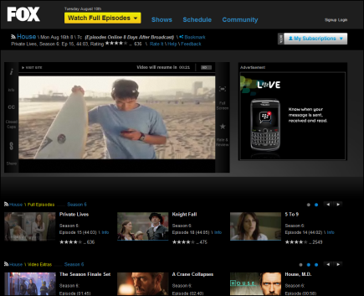
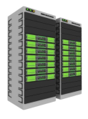
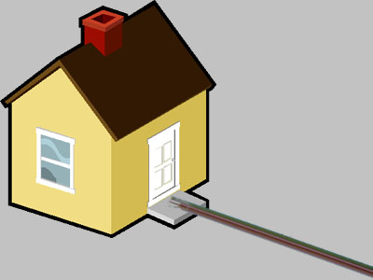










Video ecosystem is quite complex!
Screen
Video Source
Video Player
Encoders & Video Servers
ISP & Home Net
CMS and Hosting
Content Delivery Networks (CDN)
Notes:
Ecosystem is quite complex .. Walk through end to end flow of bits from the content provider to the ultimate viewer . Many moving pieces .. What makes this espeically interesting is that a lot of this has been overlaid on top of existing ip networks.

Slide 8
Quality problems can occur everywhere!
Screen
Video Source
Video Player
Encoders & Video Servers
ISP & Home Net
CMS and Hosting
Content Delivery Networks (CDN)
Notes:
Problems at video source – e.g. content not available .. Encoders – not enough bitrates – cdns not enough capacity or bad peering isp congestion or peering video player buffering/poor adaptation

Slide 9
Shedding light on structure
Longitudinal analysis of “problem sessions”
Look at key session attributes: AS, CDN, Provider, Player, Browser,ConnectionType, Genre
Intuitive “clustering” idea
Notes:
To understand if there is some structure to these quality problems we did a longitudinal analysis of problem sessions over a couple of weeks.. Where we look at key session attributes such as the AS, CDN, content provider, player type etc .. And then we cluster together problems that share one or more attributes and then see if there is anything struturally interesting about these problem clusters.

Slide 10
Many problems are “persistent”
Might even be possible to “reactively” fix problems
Notes:
What we find is these problem clusters are quite persisten over a long period of time .. With the implication being that it might be amenable to reactive fixing !

Slide 11
Breakdown of causes: Buffering

Slide 12
Breakdown of causes: JoinTime

Slide 13
How can we improve the quality?
Dimensions to “Design space”
What knobs can we tune? Bitrate, CDN
Where in the network? Client, Server, Routers, CDNs
When do we change parameters? Startup, midstream
Decentralized vs Coordinated?

Slide 14
Bitrate adaptation

Slide 15
Recap: HTTP Adaptive streaming
2nd Chunk in bitrate A
A2
Client
HTTP Adaptive Player
B1
A1
A2
…
…
HTTP GET A1
A1
A1
A1
A2
B1
B2
…
…
Cache
B1
B2
Web browser
Web server
Web server
HTTP
HTTP
TCP
TCP
Server
Notes:
First let us step back and look at how bitrate adaptation works in the real world in the context of DASH systesm .. The idea here is that u jhav predefined encoding rates and the player decides a bitrate for each chunk..

Slide 16
Abstract Player Model
B/W Estimation
Bitrate Selection
Chunk Scheduling
Video Player
Throughput of a chunk
Bitrate of next chunk
When to request
GET
Internet
HTTP
Chunk
Feedback loop between player and the network
Notes:
Abstracting out details . U can think of a player has a feedback looop across three componetns .. Estimatin, seleciton, scheduling ..

Slide 17
Three Metrics of Goodness
Inefficiency: Fraction of bandwidth un/over used
Unfairness: Discrepancy of bitrates used by multiple players
Instability: The frequency and magnitude of recent switches
Bitrate
(Mbps)
Bottleneck b/w 2Mbps
Player A
1.3
0.7
Bitrate
(Mbps)
time
Player B
0.7
time
Notes:
What do we care abt in the context of an ideal player .. We want it to be effiecient, fair and stable ..

Slide 18
Real World: SmoothStreaming
Setup: total b/w 3Mbps, three SmoothStreaming players
Player A
Visually, SmoothStreaming seems bad.
Player B
Player C
Notes:
Lets look at how the real world is today .. Theis is a controled experiment with smoothsteaming .. And we see visually that the performance is far from optimal . And many other ppl have independently confirmed this ..

Slide 19
Other adaptive players are no better
SmoothStreaming (SS)
Akamai
Adobe
Netflix
Unfairness index
Instability index
Inefficiency index
SmoothStreaming (SS) appears to be better than other players.
Notes:
We have seen SmoothStreaming.
Now, let’s look at other commercial players using these metrics.
Again three players, sharing a stable bottleneck bandwidth of 3Mbps.
It seems that the problem is unique to SmoothStreaming. In fact, it turns out that SmoothStreaming is better than others
The problem is even worse with more players

Slide 20
What makes this problem hard?
Limited control
Overlaid on HTTP
Constrained by browser sandbox
Limited feedback
No packet level feedback, only throughput
Local view
Client-driven adaptation
Independent control loop
S Akshabi et al An Experimental Evaluation of Rate Adaptation .. MMSys 2011
T-Y Huang et al Confused, Timid and Unstable .. IMC 2012
J Jiang et al Improving Fairness .. With FESTIVE .. CoNext 2012
Notes:
We see that all the four commercial player are not good, but why it is hard?
There are three reasons…
Third, each player is interacting with the network independently.

Slide 21
Bias due to chunk scheduling
Many players use this to keep fixed video buffer
e.g., if chunk duration = 2 sec, chunk requests at T= 0,2,4,… sec
Example setup: Total bandwidth: 2Mbps
Bitrate 0.5 Mbps, 2 sec chunks
Chunk size: 0.5 Mbps x 2 sec = 1.0Mb
b/w (Mbps)
2
Throughput: 2 Mbps
1 sec
0.5 sec
1 sec
0.5 sec
1
1 sec
1 sec
Throughput: 1 Mbps
0
1s
2s
time
Throughput: 1 Mbps
Player A, T=0,2,4,…
Player B
T=0,2,4,…
Player C
T=1,3,5,…
Unfair! Start time impacts observed throughput
NOT a TCP problem!

Slide 22
Bias due to bitrate selection
Strawman: Bitrate = f (observed throughput)
Example setup: Total bandwidth 2Mbps
Player A: 0.7 Mbps, Player B: 0.3 Mbps, Player C: 0.3 Mbps
b/w (Mbps)
2
Throughput: ~1.6 Mbps
1
0.6
Throughput: ~1.1 Mbps
0
time
Throughput: ~1.1 Mbps
Player A
Player B
Player C
Unfair! Bitrate impacts observed throughput.
Biased feedback loop implies unfairness

Slide 23
Design space to fix player issues
What layer in “stack” can we change?
HTTP only
TCP only
TCP + HTTP?
Where in the network?
Client-side
Server-side
Network-assisted

Slide 24
What layer in the stack?
HTTP-based
TCP-based
Others?
J Jiang et al Improving Fairness .. With FESTIVE .. CoNext 2012
S. Akhshabi et al. What Happens when HTTP Adaptive Streaming Players Compete for Bandwidth? NOSSDAV, 2012.
M. Ghobadi et al Trickle: Rate Limiting YouTube Video Streaming. USENIX ATC, 2012.
T-Y Huang et al Confused, Timid and Unstable .. IMC 2012
G. Tian and Y. Lu, Towards Agile and Smooth Video Adaptiation … CoNext 2012

Slide 25
Where in the network?
Client-driven
Server-driven
In-network
J Jiang et al Improving Fairness .. With FESTIVE .. CoNext 2012
S. Akhshabi et al. What Happens when HTTP Adaptive Streaming Players Compete for Bandwidth? NOSSDAV, 2012.
S. Akhshabi et al Server-based Traffic Shaping .. NOSSDAV, 2013.
L. De Cicco et al Feedback Control for Adaptive Live Video Streaming MMSys, 2011
R. K. P. Mok et a . QDASH: A QoE-aware DASH system MMSys, 2012.
R. Houdaille and S. Gouache. Shaping http adaptive streams for a better user experience . MMSys, 2012

Slide 26
CDN/Server Selection

Slide 27
CDN Performance varies in “Space”
X Liu et al A Case for a Coordinated Internet Video Control Plane SIGCOMM 2012
H Liu et al Optimizing Cost and Performance for Content Multihoming SIGCOMM 2012

Slide 28
CDN Performance Varies in Time

Slide 29

Potential Improvement via CDN Switching/Multihominh
Partition clients by (ASN, DMA, CDN)
DMA: Designated Market Area
For each partition compute:
Buffering ratio
Start time
Failure ratio
….
DMA
ASN
Akamai (buffering ratio)
DMA
ASN
Level3 (buffering ratio)

Slide 30
Potential Improvement Example
Oracle:
For each partition select best CDN and assume all clients in same partition selected that CDN
Essentially, pick partition with best quality across CDNs
DMA
ASN
Akamai (buffering ratio)
DMA
DMA
ASN
ASN
Best CDN (buffering ratio)
Level3 (buffering ratio)

Slide 31
Case study for potential gains
Customer1: large UGV site
Customer2: large content provider
Between 2.7X and 10X improvement in buffering ratio
Metric | Customer1 |  | Customer2
 | Current | Projected | Current | Projected
Buffering ratio (%) | 6.8 | 2.5 / 1* | 1 | 0.3 / 0.1*
Start time (s) | 6.41 | 2.91 | 1.36 | 0.9
Failure ratio (%) | 16.57 | 2.4 | 1.1 | 0.7

Slide 32
How can we improve the quality?
Dimensions to “Design space”
What knobs can we tune? Bitrate, CDN
Where in the network? Client, Server, Routers, CDNs
When do we change parameters? Startup, midstream
Decentralized vs Coordinated?

Slide 33
Case for Global views?
Akamai
DMA
Bandwidth Fluctuation
ASN
ASN/DMA saturated on all CDNs ➔ Don’t switch CDN; reduce bitrates, instead
Limelight
DMA
Peak Concurrent Viewers
ASN
Bandwidth Fluctuation
Level3
DMA
ASN
Peak Concurrent Viewers

Slide 34
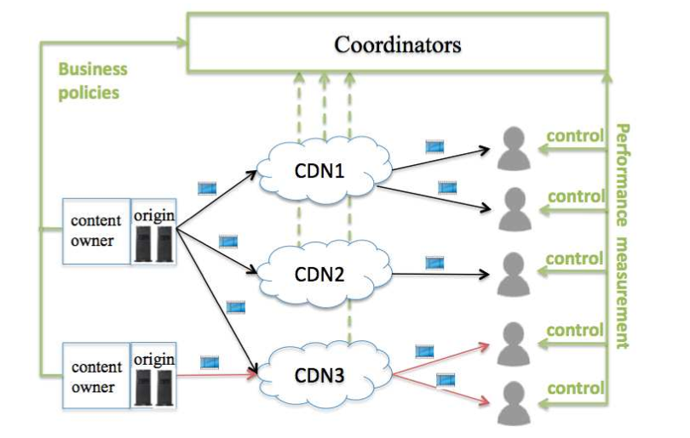
Vision of Video Control Plane
Continuous measurement and optimization
Multi-bit rate streams delivered using multiple CDNs
“Global” optimization algorithms

Slide 35
Open issues in realization
How scalable?
Interactions between controllers?
Interactions with CDN optimizations?
Is “history” reliable?
Oscillations?
Can we get real-time information about the network?
What APIs for coordination? Data sharing?

Slide 36
Lessons/Takeaways

Slide 37
Need a multi-pronged approach
Better player algorithms
Better CDN/server selection
More diverse bitrate encoding
Coordination?

Slide 38
Even simple strategies may work!
Fixing a small number of problems can yield a lot of improvement
Reactively identifying “problem clusters”

Slide 39
There is plenty of room for improvement
Even within scope of “dirty-slate”
i.e., don’t change HTTP/TCP/CDN
Still deliver a lot better quality

Slide 40
Useful references
Check out http://www.cs.cmu.edu/~internet-video

