Slide 1




How does video quality
impact user engagement?
Vyas Sekar, Ion Stoica, Hui Zhang
Acknowledgment: Ramesh Sitaraman (Akamai,Umass)

Slide 2
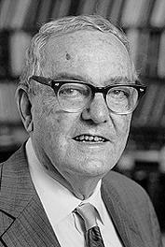
Attention Economics
Overabundance of information
implies a scarcity of user
attention!
Onus on content publishers to
increase engagement
Notes:
Why should we care about engagement in generall – we can go back to gherb simon’s theory of attention economics .. The diminisgh cost of contentn creation and dissemination is increasing the onus on content providers to make users are engaged .. Otehrwise users attention span is pretty short.

Slide 3
Understanding viewer behavior holds the keys to video monetization
VIEWER BEHAVIOR
Abandonment
Engagement
Repeat Viewers
VIDEO MONETIZATION
Subscriber Base
Loyalty
Ad opportunities
Are You Ready?
Notes:
Video providers have a subscription-based, ad-based, or play-per-view based model.

Slide 4



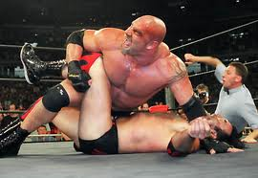
What impacts user behavior?
Content/Personal preference
A Finamore et al, YouTube Everywhere: Impact of Device and Infrastructure Synergies on User Experience IMC 2011
Notes:
The natural question is what factors impact engagement .. The obvious answer from a psychogological point of view is the users personal taste preferences and the
Value of the content itself – some movies are obviously boring others might be more engaging .. For instance one of the largest live broadcass was the moon landing even though video was pretty fuzzy .. Showing he value of content.

Slide 5
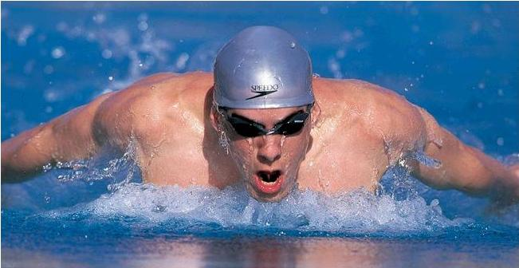

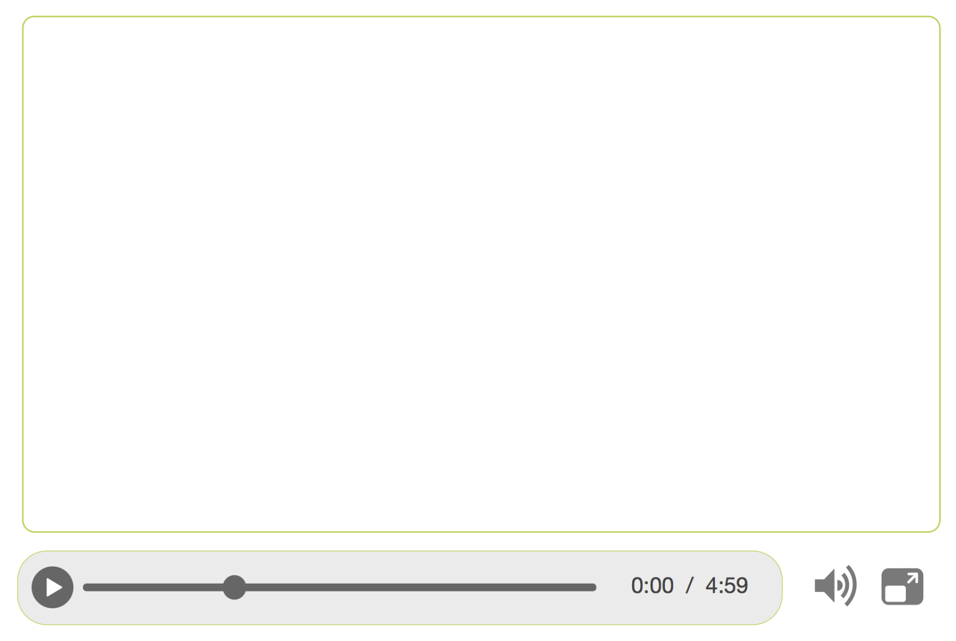

Does Quality Impact Engagement?
How?
Buffering . . . .
Notes:
Our focus in this section is on a slightly different question – content is obviously important but that’s not something we can objectively predict, at least not yet. Our focus is on what we as a net/sys community can help – how does quality impact engagement - -what are the cticial metrics? How much does optimizing a metric help etc.

Slide 6
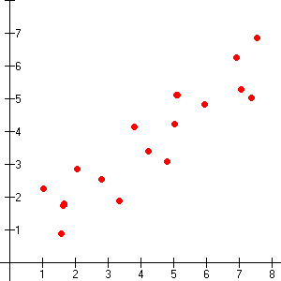
Traditional Video Quality Assessment
Subjective Scores
(e.g., Mean Opinion Score)
Objective Score
(e.g., Peak Signal to Noise Ratio)
S.R. Gulliver and G. Ghinea. Deﬁning user perception of distributed multimedia quality. ACM TOMCCAP 2006.
W. Wu et al. Quality of experience in distributed interactive multimedia environments: toward a theoretical framework. In ACM Multimedia 2009

Slide 7
Internet video quality
Subjective Scores
MOS
Engagement measures
(e.g., Fraction of video viewed)
Objective Scores
PSNR
Join Time, Avg. bitrate, …
Notes:
VISION – PAUSE TAKEAWAY

Slide 8
Key Quality Metrics
JoinFailures(JF)
BufferingRatio(BR)
JoinTime (JT)
RateOfBuffering(RB)
AvgBitrate(AB)
RenderingQuality(RQ)
Notes:
To understand the quality metrics let us look at the life of a video player as it goes through ..

Slide 9
Engagement Metrics
View-level
  Play time
Viewer-level
  Total play time
  Total number of views
Not covered: “heat maps”, “ad views”, “clicks”

Slide 10




Challenges and Opportunities with “BigData”
Streaming
Content
Providers
Video
Measurement
Globally-deployed plugins that runs inside the media player
Visibility into viewer actions and performance metrics from millions of actual end-users

Slide 11
Natural Questions
Which metrics matter most?
Is there a causal connection?
Are metrics independent?
How do we quantify the impact?
Dobrian et al Understanding the Impact of Quality on User Engagement, SIGCOMM 2011.
S Krishnan and R Sitaraman Video Stream Quality Impacts Viewer Behavior: Inferring Causality Using Quasi-Experimental Design IMC 2012
Notes:
What kind of questions do we want to ask here .. And what are the right kinds of data/statistical tools we need to use?

Slide 12
Questions → Analysis Techniques
Which metrics matter most?
→ (Binned) Kendall correlation
Are metrics independent?
→ Information gain
How do we quantify the impact?
→ Regression
Is there a causal connection?
→ QED
Notes:
What kind of questions do we want to ask here .. And what are the right kinds of data/statistical tools we need to use?

Slide 13
“Binned” rank correlation
Traditional correlation: Pearson
  Assumes linear relationship + Gaussian noise
Use rank correlation to avoid this
  Kendall (ideal) but expensive
  Spearman pretty good in practice
Use binning to avoid impact of “samplers”
Notes:
Add a quick definition plus explanation .. Why kendall why not pearson etc

Slide 14
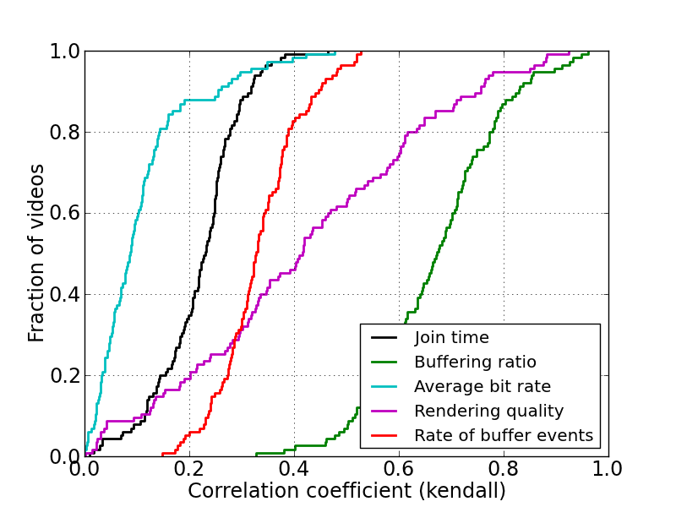
LVoD: BufferingRatio matters most
Join time is pretty weak at this level

Slide 15
Questions → Analysis Techniques
Which metrics matter most?
→ (Binned) Kendall correlation
Are metrics independent?
→ Information gain
How do we quantify the impact?
→ Regression
Is there a causal connection?
→ QED

Slide 16
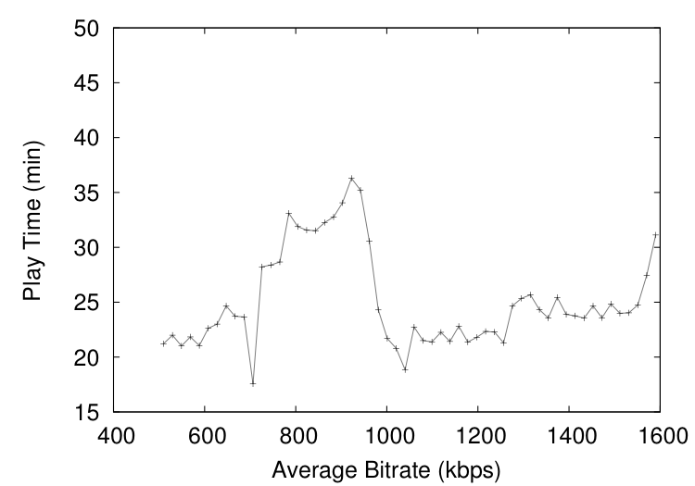
Correlation alone is insufficient
Correlation can miss such interesting phenomena

Slide 17


Information gain background
“high”
“low”
Entropy of a random variable:
X P(X)
A 0.7
B 0.1
C 0.1
D 0.1
X P(X)
A 0.15
B 0.25
C 0.25
D 0.25
Conditional Entropy
“high”
“low”
X Y
A L
A L
B M
B N
X Y
A L
A M
B N
B O
Information Gain
Nice reference: http://www.autonlab.org/tutorials/

Slide 18
Why is information gain useful?
Makes no assumption about “nature” of relationship (e.g., monotone, inc/dec)
  Just exposes that there is some relation
Commonly used in feature selection
Very useful to uncover hidden relationships between variables!

Slide 19
LVoD: Combination of two metrics
BR, RQ combination doesn’t add value

Slide 20
Questions → Analysis Techniques
Which metrics matter most?
→ (Binned) Kendall correlation
Are metrics independent?
→ Information gain
How do we quantify the impact?
→ Regression
Is there a causal connection?
→ QED

Slide 21
Why naïve regression will not work
Not all relationships are “linear”
  E.g., average bitrate vs engagement?
Use only after confirming roughly linear relationship

Slide 22
Quantitative Impact
1% increase in buffering reduces engagement by 3 mins

Slide 23
Viewer-level
Join time is critical for user retention

Slide 24
Questions → Analysis Techniques
Which metrics matter most?
→ (Binned) Kendall correlation
Are metrics independent?
→ Information gain
How do we quantify the impact?
→ Regression
Is there a causal connection?
→ QED

Slide 25
Randomized Experiments
Idea: Equalize the impact of confounding variables using randomness. (R.A. Fisher 1937)
Randomly assign individuals to receive “treatment” A.
Compare outcome B for treated set versus the “untreated” control group.
Treatment = Degradation in Video Performance
Hard to do:
Operationally
Cost Effectively
Legally
Ethically

Slide 26
Idea: Quasi Experiments
Idea: Isolate the impact of video performance and by equalizing confounding factors such as content, geography, connectivity.
Treated
(Poor video perf)
Control or Untreated
(Good video perf)
Randomly pair up
viewers with same values
for the confounding factors
Hypothesis:
Performance➔Behavior
Statistically highly significant results:100,000+ randomly matched pairs
Outcome
+1: supports hypothesis
-1: rejects hypothesis
0: Neither
Notes:
Talk about adapting the technique from social and medical sciences.
No control over who gets treatment.
Examples:
1854: John Snow: water contaminants -> cholera (natural experiement)
1992: Kreuger Schooling -> Salary. Every year of schooling is 12-18% extra 298 twins.
Also Campbell & Stanley 1963
Must know which are the confounding variables.
Contrast with users studies or surveys that only have 100s or 1000s.
Also say this technique is of independent interest applicable for other areas of network measurement.

Slide 27
Quasi-Experiment for Viewer Engagement
Treated
(video froze for ≥ 1% of duration)
Control or Untreated
(No Freezes)
Same geography,
connection type,
same point in time
within same video
Hypothesis:
More Rebuffers ➔Smaller Play time
Outcome
For each pair, outcome = playtime(untreated) – playtime(treated)
S Krishnan and R Sitaraman Video Stream Quality Impacts Viewer Behavior: Inferring Causality Using Quasi-Experimental Design IMC 2012

Slide 28
Results of Quasi-Experiment
Normalized Rebuffer Delay (γ%) | Net Outcome
1 | 5.0%
2 | 5.5%
3 | 5.7%
4 | 6.7%
5 | 6.3%
6 | 7.4%
7 | 7.5%
A viewer experiencing rebuffering for 1% of the video duration watched 5% less of the video compared to an identical viewer who experienced no rebuffering.
Notes:
The findings from earlier are not just incidental there does seem to be a causation effect in place.

Slide 29
Are we done?
Unified?
Quantiative?
Predictive?
Subjective Scores
MOS
Engagement
(e.g., Fraction of video viewed)
Objective Scores
PSNR
Join Time, Avg. bitrate,..
A Balachandran et al A Quest for an Internet Video QoE Metric, HotNets 2012

Slide 30
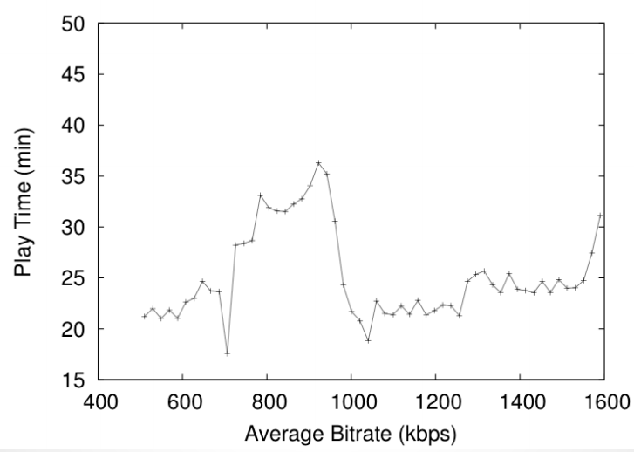
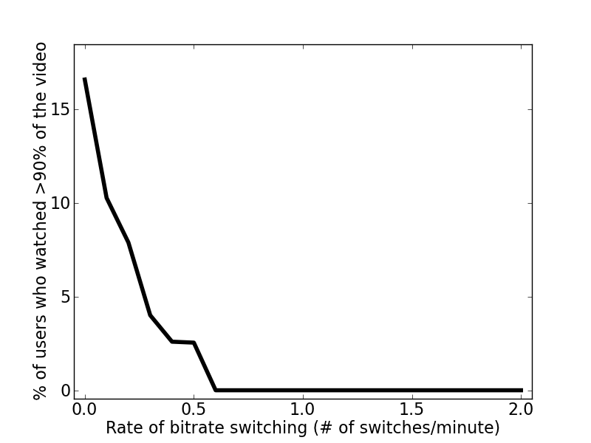
Challenge: Capture complex relationships
Non-monotonic
Engagement
Engagement
Average bitrate
Quality Metric
Engagement
Threshold
Rate of switching
Notes:
And rate of switching and engagement – threshold effect
Measurement study by Dobrian et al. in Sigcomm 2011 show many of these relationships.

Slide 31
Challenge: Capture interdependencies
Join Time
Avg. bitrate
Rate of
buffering
Rate of
switching
Buffering
Ratio
Notes:
There might be several other dependencies.

Slide 32







Challenge: Confounding factors
Devices
Connectivity
User Interest

Slide 33
Some lessons…

Slide 34
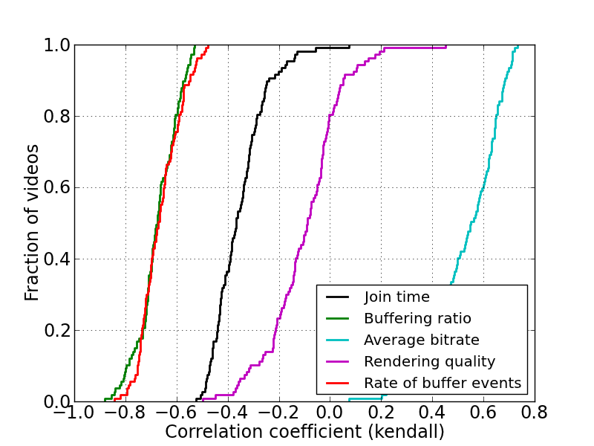
Importance of systems context
RQ is negative, but effect of player optimizations!

Slide 35
Need for multiple lenses
Correlation alone can miss such interesting phenomena

Slide 36
Watch out for confounding factors
Lots of them!
  due to user behaviors,
  due to delivery system artifact
Need systematic frameworks
  for identifying
    E.g., QoE, learning techniques
  For incorporating impacts
    E.g., refined machine learning model

Slide 37
Useful references
Check out:
http://www.cs.cmu.edu/~internet-video
For an updated bibliography

