Slide 1
HISTORY OF LOGIC
BY JOHN NAGUIB

Slide 2
What is Logic?
The science or study of how to evaluate arguments and reasoning.
“Logic is new and necessary reasoning” -Aristotle
Studied within
  Philosophy
  Mathematics
  Computer Science

Slide 3
When did it start??
A very long time ago…
It started with Aristotle (the father of Logic), around 335 BC …

Slide 4
Other Logic
Logic in India
- Formal Logic started independently in India and continued to develop to early modern times.
  It started in the 6th Century BC by Medhatithi Gautama.

Slide 5
Islamic Logicians
Al Farabi (872 – 950/951)
Ibn Rushd
Ibn Sina

Slide 6
Aristotle the father of logic
The first who created systematic criteria for doing it.
His conception of remains a cornerstone of the study of logic even today.

Slide 7
In the early 1st Century AD, Aristotle’s logical works were compiled into 6 books (the Organon)
They changed a bit through time because of Commentaries on Aristotle by his pupils

Slide 8
Modern Logic Periods
Metamathematical Period
Algebraic Period
Aristotle
After WWII
Embryonic Period
350 BC
1500
1600
1700
1800
1900
2000
1660
1847
1940
1 AD
1910
1850
Logicist Period

Slide 9
Embryonic Logic
The beginning of the Modern Logic.
Started with Leibniz.
Starting of creation of a formalized universal language.

Slide 10
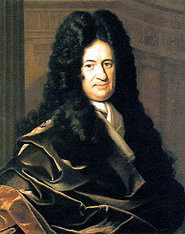
Gottfried Wilhelm Leibniz (1646 - 1716):
      Human reasoning could be reduced to calculations of a sort, and that such calculations could resolve many differences of opinion.
      Leibniz enunciated the principal properties of what we now call conjunction, disjunction and negation.
      All our complex ideas are compounded from a small number of simple ideas

Slide 11
Algebraic Period
Originating with Boole.
Algebraic formulae can be used to express logical relations.
The introduction of De Morgan’s Laws.
Venn Diagrams.

Slide 12
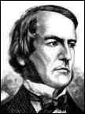
George Boole (1815-1864):
- Invented Boolean Logic
- Provided a general symbolic method of logical inference

Slide 13
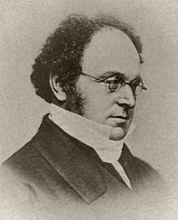
Augustus De Morgan (1806 – 1871):
  He formulated De Morgan’s laws which are ,
  The negation of a conjunction is the disjunction of the negations.
  The negation of a disjunction is the conjunction of the negations.
¬(A ^ B) ↔ (¬A) v (¬B)
¬(A v B) ↔ (¬A) ^ (¬B)

Slide 14
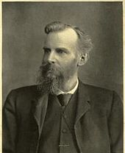
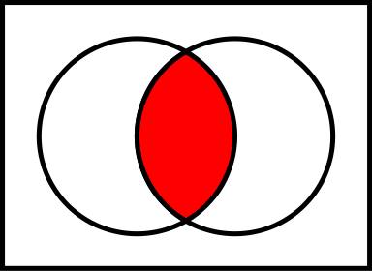
John Venn (1834-1923):
  Introduced the Venn diagram which is used in probability, logic, computer science and other fields.
Venn Diagram
U
A
B
A ∩ B

Slide 15
The Logicist Period
The next great advances were made by the German mathematician Gottlob Frege.
Axiomatic Predicate Logic.
Problem of Multiple Generality is solved.
Russell’s Paradox.

Slide 16
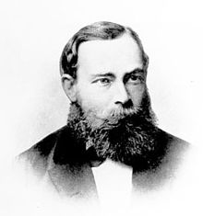
The Logicist Period
Gottlob Frege (1848 – 1925):
  Considered to be the father of Analytic Philosophy.
  His Objective was demonstrating that arithmetic is identical with logic.
  He invented axiomatic predicate logic and quantified variables, which solved the problem of multiple generality.

Slide 17
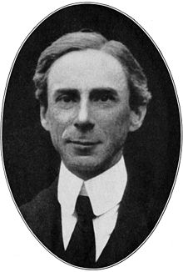
Bertrand Russell (1872- 1970):
  He is widely held to be one of the 20th century's premier logicians.
  Russell’s Paradox:
    If the "List of all lists that do not contain themselves" contains itself, then it does not belong to itself and should be removed. However, if it does not list itself, then it should be added to itself.

Slide 18
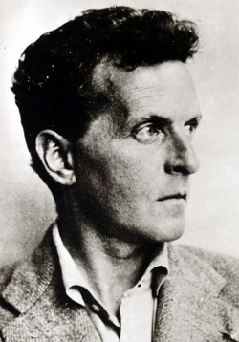
Ludwig Wittgenstein (1889 – 1951):
  In his lifetime, he published just one book review, one article, a children's dictionary, and the 75-page Tractatus Logico-Philosophicus (1921)
  One of the most influential philosophers of the 20th Century.

Slide 19
Metamathematical Period
The names of Gödel and Tarski dominate the 1930s, a crucial period in the development of metamathematics
The study of mathematics using mathematical methods to produce Metatheories.
Alonzo Church and Alan Turing give negative solutions to Hilbert’s Entsheidungsproblem.

Slide 20
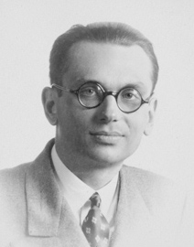
Kurt Gödel:
  Gödel Completeness Theorem: first-order sentence is deducible if and only if it is logically valid.
  Gödel's Incompleteness theorems

Slide 21
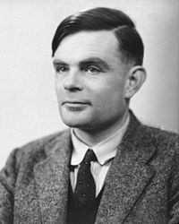
Alan Turing (1912 – 1954):
  Introduced the concept of ordinal logic and the notion of relative computing.
  Turing Machine.
  Turing test for Artificial Intelligence.

Slide 22
What happened after the World War II to Mathematical Logic?
Mathematical
Logic
Set Theory
Model Theory
Proof Theory
Computability Theory
They are called the 4 pillars of
the Foundation of Mathematics

Slide 23
Set Theory
Set theory is the branch of mathematics that studies sets, which are collections of objects
The modern study of set theory was initiated by Georg Cantor and Richard Dedekind in the 1870s

Slide 24
Computability Theory
Computability theory had its roots in the work of Turing, Church, Kleene, and Post in the 1930s and 40s.
Developed to Recursion.
Computation Complexity Theory, was also characterized in logical terms as a result of investigations into descriptive complexity.

Slide 25
Model Theory
Is the study of mathematical Structures using tools from Mathematical Logic.
Intersection between Mathematics, Philosophy, and Computer Science.
Gödel's Incompleteness Theorem.
The upward and downward Löwenheim-Skolem Theorems.

Slide 26
Proof Theory
Branch of Mathematical Logic.
Modern Proof theory established by David Hilbert.

Slide 27
Thank You

