Slide 1
Chapter 9 Normal Distribution
Notes:
https://www.gettyimages.co.uk/detail/illustration/creative-light-bulb-cartoon-royalty-free-illustration/115066830?phrase=light%20bulb (repeated from prior chpt)

Slide 2
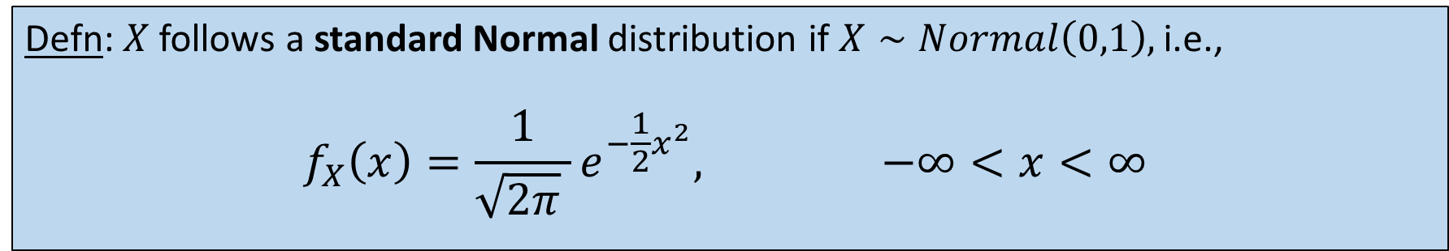
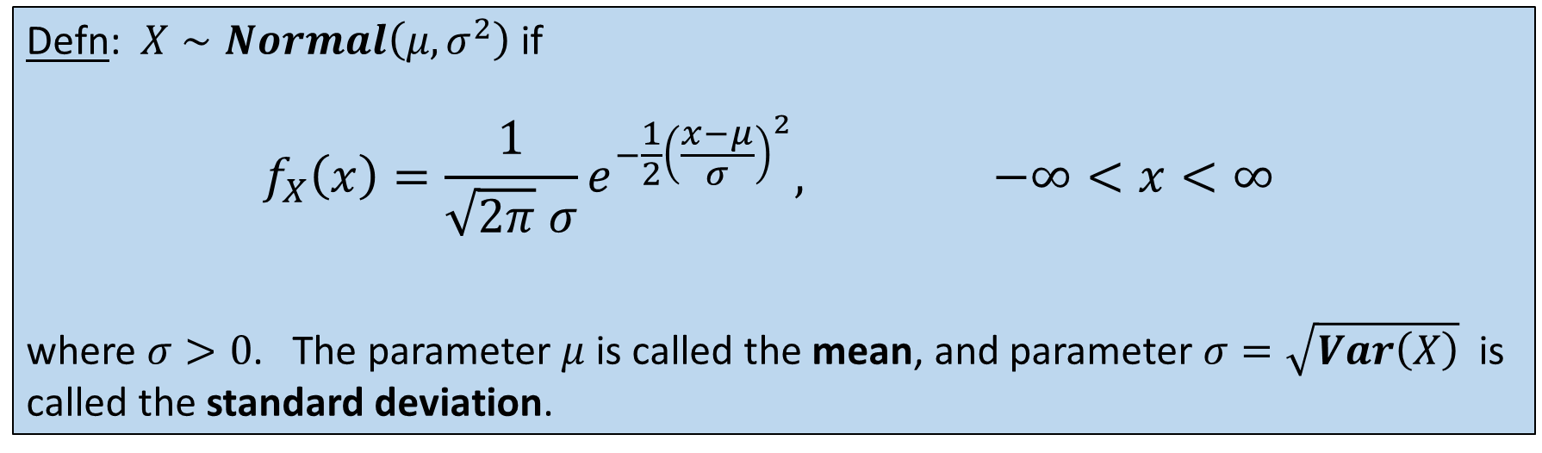
Normal (a.k.a. Gaussian) distribution
Defn: $X∼Normal\left(μ, σ^{2}\right)$ if
$${\begin{aligned}f_{X}\left(x\right)=\frac{1}{\sqrt{2π} σ}e^{−\frac{1}{2}{\left(\frac{x−μ}{σ}\right)}^{2}}, −∞<x<∞ \\ \end{aligned}}_{ }$$
where $σ>0$. The parameter $μ$is called the mean, and parameter $σ=\sqrt{Var\left(X\right)}$is called the standard deviation.
Defn: $X$follows a standard Normal distribution if $X∼Normal\left(0,1\right),$i.e.,
$${\begin{aligned}f_{X}\left(x\right)=\frac{1}{\sqrt{2π} }e^{−\frac{1}{2}x^{2}}, −∞<x<∞ \\ \end{aligned}}_{ }$$

Slide 3
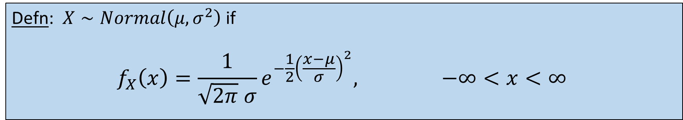
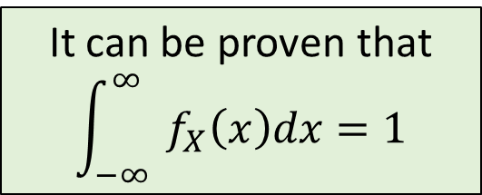
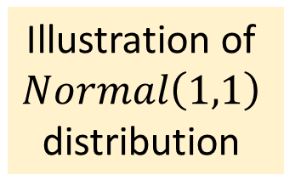
Bell shape of Normal distribution
Defn: $X∼Normal\left(μ, σ^{2}\right)$ if
$${\begin{aligned}f_{X}\left(x\right)=\frac{1}{\sqrt{2π} σ}e^{−\frac{1}{2}{\left(\frac{x−μ}{σ}\right)}^{2}}, −∞<x<∞ \\ \end{aligned}}_{ }$$
It can be proven that
$${\int_{−∞}^{∞}{ }f}_{X}\left(x\right)dx=1$$
Illustration of
$$Normal\left(1,1\right)$$
distribution

Slide 4

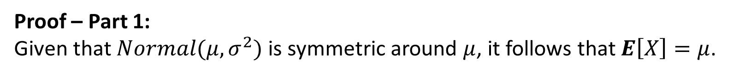
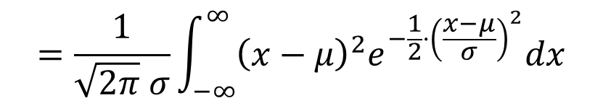
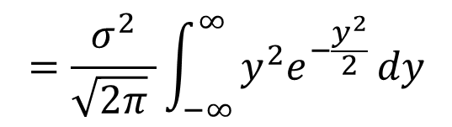
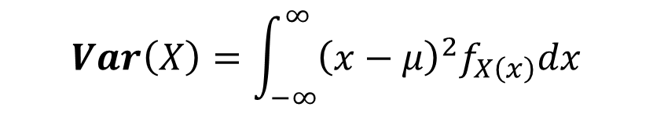
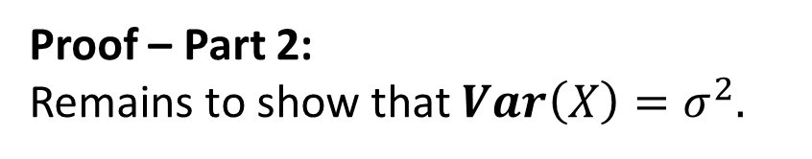

Mean and Variance of Normal distribution
Theorem: Let $X∼Normal\left(μ, σ^{2}\right),$then $E\left[X\right]=μ$ and $Var\left(X\right)=σ^{2}$.
Proof – Part 1:
Given that $Normal(μ, σ^{2})$ is symmetric around $μ$, it follows that $E\left[X\right]=μ$.
Proof – Part 2:
Remains to show that $Var\left(X\right)=σ^{2}.$
$$Var\left(X\right)=\int_{−∞}^{∞}{{\left(x−μ\right)}^{2}f_{X\left(x\right)}dx}$$
$$=\frac{1}{\sqrt{2π} σ}\int_{−∞}^{∞}{{\left(x−μ\right)}^{2}e^{−\frac{1}{2}⋅{\left(\frac{x−μ}{σ}\right)}^{2}}dx}$$
$$y=\frac{x−μ}{σ }$$
$$=\frac{σ^{2}}{\sqrt{2π} }\int_{−∞}^{∞}{y^{2}e^{−\frac{y^{2}}{2} }dy}$$
$$dx=σ dy$$

Slide 5

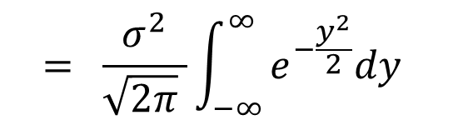
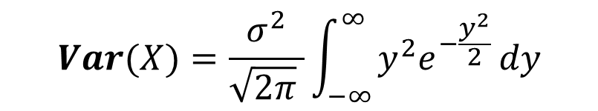
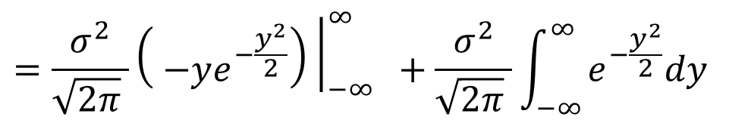
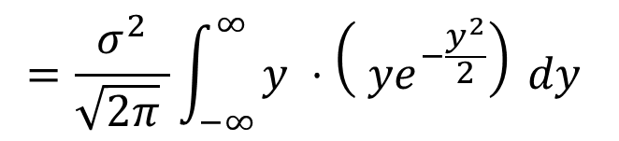

Variance of Normal distribution
Theorem: Let $X∼Normal\left(μ, σ^{2}\right),$then $E\left[X\right]=μ$ and $Var\left(X\right)=σ^{2}$.
Continued:
$$=\frac{σ^{2}}{\sqrt{2π} }\int_{−∞}^{∞}{y^{ }{⋅{\left( ye^{−\frac{y^{2}}{2}}\right)}^{ }dy}^{ }}$$
$$Var(X)=\frac{σ^{2}}{\sqrt{2π} }\int_{−∞}^{∞}{y^{2}e^{−\frac{y^{2}}{2} }dy}$$
via integration by parts
$$=\frac{σ^{2}}{\sqrt{2π} }{\left.{\left( −ye^{−\frac{y^{2}}{2}}\right)}^{ }\right|}_{−∞}^{∞} ^{ }+\frac{σ^{2}}{\sqrt{2π} }\int_{−∞}^{∞}{e^{−\frac{y^{2}}{2}}{dy}^{ }}$$
$$y=\frac{x−μ}{σ }$$
$$= ^{ }\frac{σ^{2}}{\sqrt{2π} }\int_{−∞}^{∞}{e^{−\frac{y^{2}}{2}}{dy}^{ }}$$
$$={{ σ}^{2}}^{ }$$
$$dx=σ dy$$
WHY?

Slide 6
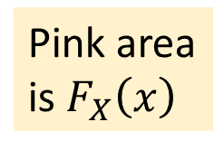

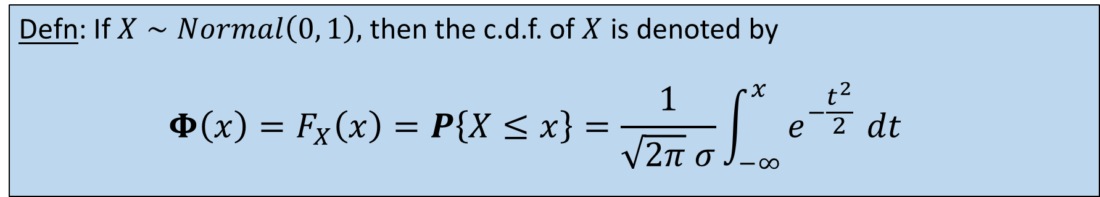


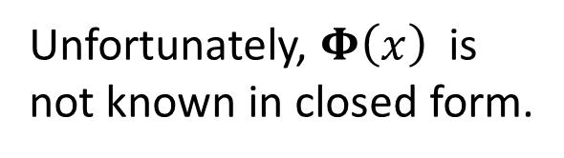
c.d.f. of Normal distribution
Defn: If $X∼Normal\left(0, 1\right),$ then the c.d.f. of $X$ is denoted by
$${\begin{aligned}{Φ\left(x\right)=F}_{X}\left(x\right)=P\left\{X≤x\right\}=\frac{1}{\sqrt{2π} σ}{\int_{−∞}^{x}{e^{−\frac{t^{2}}{2} }}dt }^{ } \\ \end{aligned}}_{ }$$
$$f_{X}(t)$$
Unfortunately, $Φ\left(x\right)$ is
not known in closed form.
Pink area
is $F_{X}\left(x\right)$
We compute it numerically,
or look it up in a table of
pre-computed values.
$$t$$
$$x$$

Slide 7

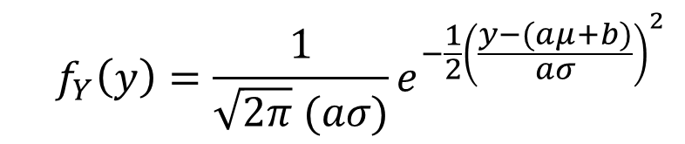
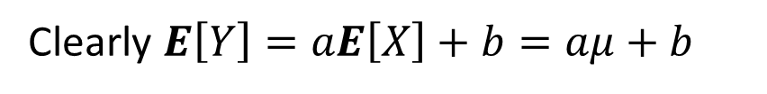
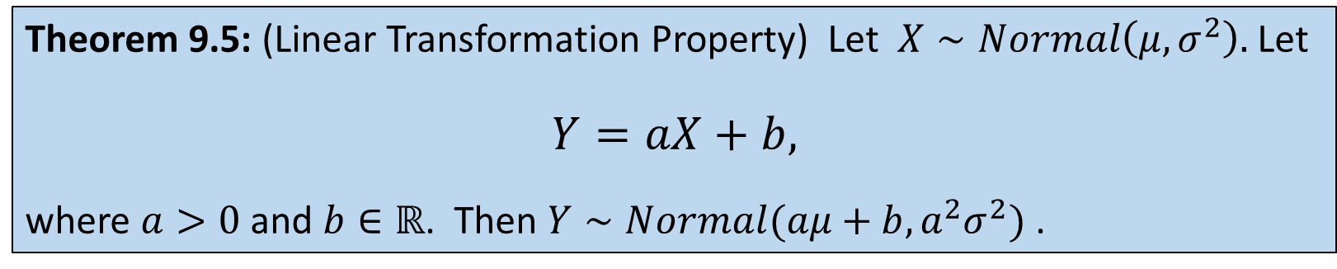
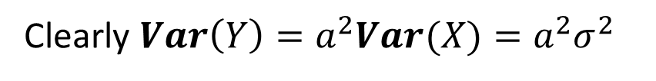
Linear Transformation Property
Theorem 9.5: (Linear Transformation Property) Let $X∼Normal\left(μ, σ^{2}\right).$ Let
$$Y=aX+b,$$
where $a>0$ and $b∈ℝ$. Then $Y∼Normal(aμ+b, a^{2}σ^{2})$ .
Proof:
Clearly $E\left[Y\right]=aE\left[X\right]+b=aμ+b$
Clearly $Var\left(Y\right)=a^{2}Var(X)=a^{2}σ^{2}$
All that’s left: Show $f_{Y}\left(y\right)$ has Normal shape.
$${ f}_{Y}\left(y\right)=\frac{1}{\sqrt{2π} (aσ)}e^{−\frac{1}{2}{\left(\frac{y−(aμ+b)}{aσ}\right)}^{2}}$$
WTS:

Slide 8
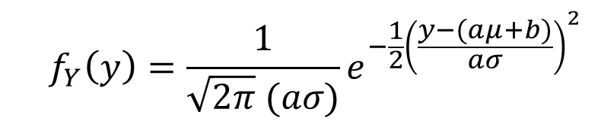
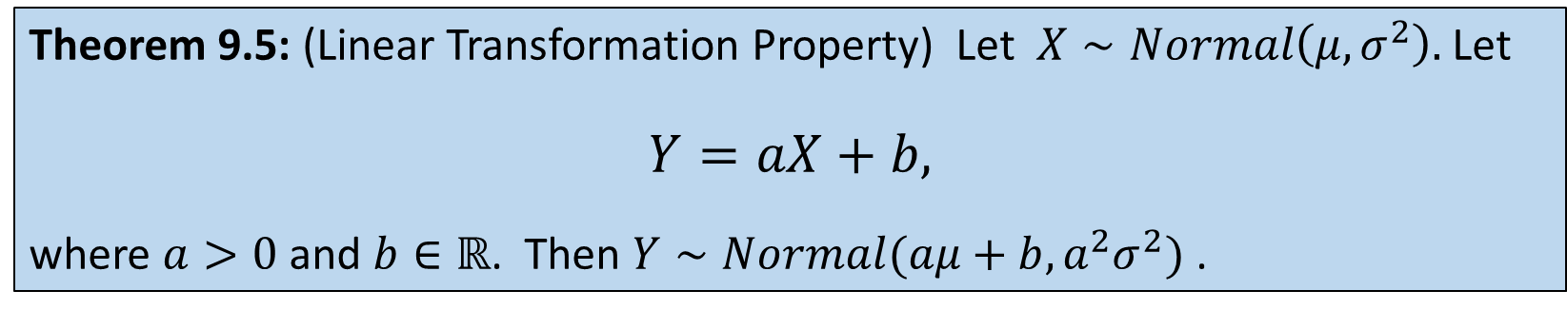
Linear Transformation Property
Theorem 9.5: (Linear Transformation Property) Let $X∼Normal\left(μ, σ^{2}\right).$ Let
$$Y=aX+b,$$
where $a>0$ and $b∈ℝ$. Then $Y∼Normal(aμ+b, a^{2}σ^{2})$ .
Proof cont:
$${ f}_{Y}\left(y\right)=\frac{1}{\sqrt{2π} (aσ)}e^{−\frac{1}{2}{\left(\frac{y−(aμ+b)}{aσ}\right)}^{2}}$$
WTS:
Q: Do you see the flaw?
Attempt 1:
$${ f}_{Y}\left(y\right)=P\left\{Y=y\right\}=P\left\{aX+b=y\right\}=P\left\{X=\frac{y−b}{a}\right\}=f_{X}\left(\frac{y−b}{a}\right)$$

Slide 9
Linear Transformation Property
Theorem 9.5: (Linear Transformation Property) Let $X∼Normal\left(μ, σ^{2}\right).$ Let
$$Y=aX+b,$$
where $a>0$ and $b∈ℝ$. Then $Y∼Normal(aμ+b, a^{2}σ^{2})$ .
Proof cont:
$${ f}_{Y}\left(y\right)=\frac{1}{\sqrt{2π} (aσ)}e^{−\frac{1}{2}{\left(\frac{y−(aμ+b)}{aσ}\right)}^{2}}$$
WTS:
Attempt 1:
$${ f}_{Y}\left(y\right)=P\left\{Y=y\right\}=P\left\{aX+b=y\right\}=P\left\{X=\frac{y−b}{a}\right\}=f_{X}\left(\frac{y−b}{a}\right)$$
FALSE!

Slide 10
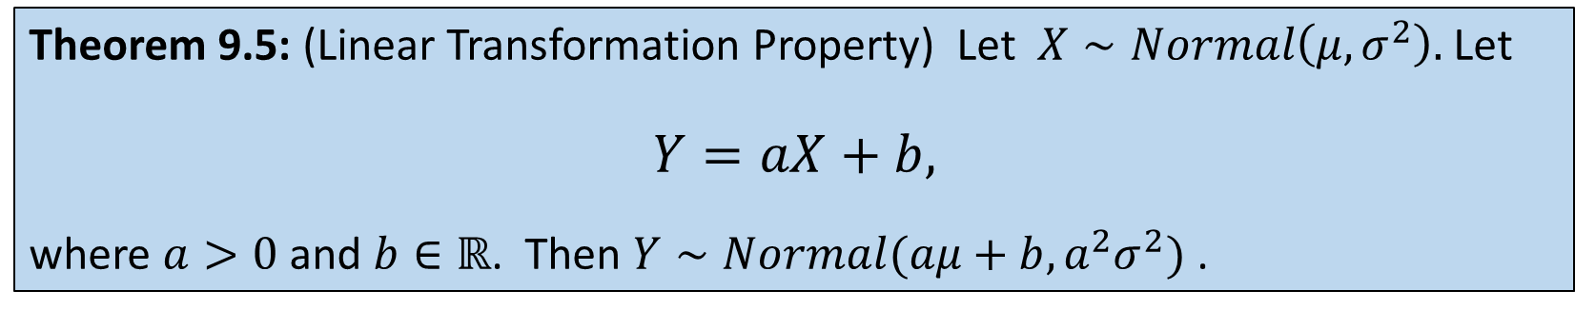
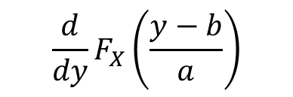
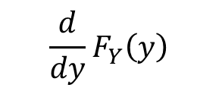
Linear Transformation Property
Theorem 9.5: (Linear Transformation Property) Let $X∼Normal\left(μ, σ^{2}\right).$ Let
$$Y=aX+b,$$
where $a>0$ and $b∈ℝ$. Then $Y∼Normal(aμ+b, a^{2}σ^{2})$ .
Proof cont:
$${ f}_{Y}\left(y\right)=\frac{1}{\sqrt{2π} (aσ)}e^{−\frac{1}{2}{\left(\frac{y−(aμ+b)}{aσ}\right)}^{2}}$$
Correct solution requires going through
c.d.f., which represents valid probability
WTS:
$${ F}_{Y}\left(y\right) =P\left\{Y≤y\right\}=P\left\{aX+b≤y\right\}=P\left\{X≤\frac{y−b}{a}\right\}= F_{X}\left(\frac{y−b}{a}\right)$$
$${ \frac{d}{dy}F}_{Y}\left(y\right)$$
These two derivatives must be equal!
$${\frac{d}{dy}F}_{X}\left(\frac{y−b}{a}\right)$$

Slide 11
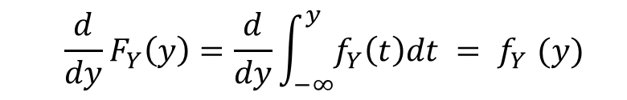
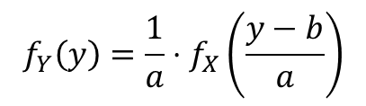

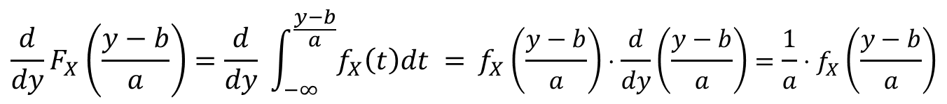
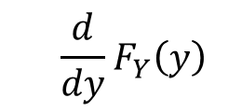
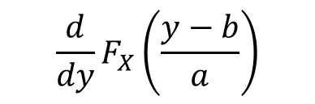
Linear Transformation Property
Theorem 9.5: (Linear Transformation Property) Let $X∼Normal\left(μ, σ^{2}\right).$ Let
$$Y=aX+b,$$
where $a>0$ and $b∈ℝ$. Then $Y∼Normal(aμ+b, a^{2}σ^{2})$ .
Proof cont:
$${ \frac{d}{dy}F}_{Y}\left(y\right)$$
These two derivatives must be equal!
$${\frac{d}{dy}F}_{X}\left(\frac{y−b}{a}\right)$$
$${ \frac{d}{dy}F}_{Y}\left(y\right)=\frac{d}{dy}\int_{−∞}^{y}{f_{Y}\left(t\right)dt {= f}_{Y}(y)}$$
FTC
Hence,
$$f_{Y}\left(y\right)=\frac{1}{a}⋅f_{X}\left(\frac{y−b}{a}\right)$$
$${\frac{d}{dy}F}_{X}\left(\frac{y−b}{a}\right)=\frac{d}{dy} \int_{−∞}^{\frac{y−b}{a}}{f_{X}\left(t\right)dt ={ f}_{X}}\left(\frac{y−b}{a}\right)⋅\frac{d}{dy}\left(\frac{y−b}{a}\right)=\frac{1}{a}⋅f_{X}\left(\frac{y−b}{a}\right)$$
FTC

Slide 12
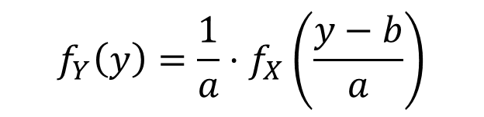


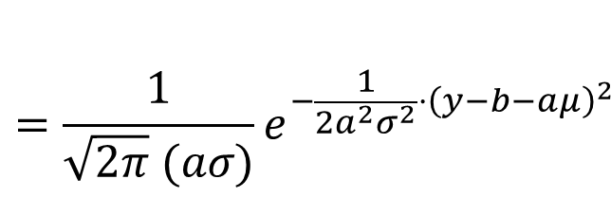
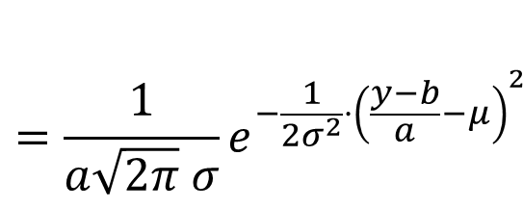
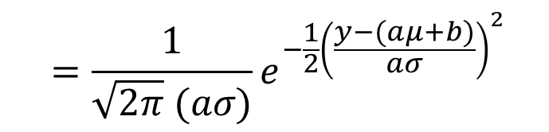
Linear Transformation Property
Theorem 9.5: (Linear Transformation Property) Let $X∼Normal\left(μ, σ^{2}\right).$ Let
$$Y=aX+b,$$
where $a>0$ and $b∈ℝ$. Then $Y∼Normal(aμ+b, a^{2}σ^{2})$ .
Proof cont:
$$=\frac{1}{a\sqrt{2π} σ}e^{−\frac{1}{2σ^{2}}{⋅\left(\frac{y−b}{a}−μ\right)}^{2}}$$
$$f_{Y}\left(y\right)=\frac{1}{a}⋅f_{X}\left(\frac{y−b}{a}\right)$$
$$=\frac{1}{\sqrt{2π} (aσ)}e^{−\frac{1}{2a^{2}σ^{2}}{⋅\left(y−b−aμ\right)}^{2}}$$
$$=\frac{1}{\sqrt{2π} (aσ)}e^{−\frac{1}{2}{\left(\frac{y−(aμ+b)}{aσ}\right)}^{2}}$$
$$Y∼Normal(aμ+b, a^{2}σ^{2})$$

Slide 13



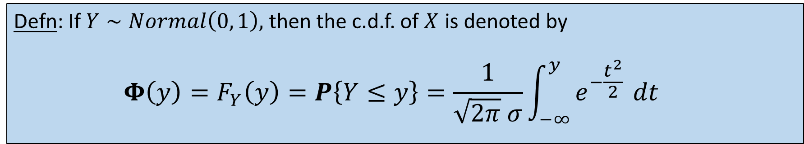













Back to $Φ\left(x\right)$
Defn: If $Y∼Normal\left(0, 1\right),$ then the c.d.f. of $X$ is denoted by
$${\begin{aligned}{Φ\left(y\right)=F}_{Y}\left(y\right)=P\left\{Y≤y\right\}=\frac{1}{\sqrt{2π} σ}{\int_{−∞}^{y}{e^{−\frac{t^{2}}{2} }}dt }^{ } \\ \end{aligned}}_{ }$$
Unfortunately, $Φ\left(y\right)$ is
not known in closed form.
$$y$$
$$0.5$$
$$1.0$$
$$1.5$$
$$2.0$$
$$2.5$$
$$3.0$$
We compute it numerically,
or look it up in a table of
pre-computed values.
$$0.999$$
$$Φ(y)$$
$$0.69$$
$$0.84$$
$$0.93$$
$$0.97$$
$$0.99$$
Values are rounded.

Slide 14














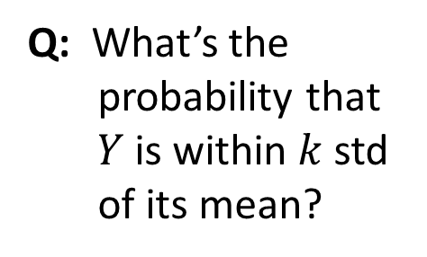






Q: If $Y∼Normal\left(0, 1\right)$, what is the probability that $Y$ is within 1 std of its mean?
$$y$$
$$0.5$$
$$1.0$$
$$1.5$$
$$2.0$$
$$2.5$$
$$3.0$$
$$Φ(y)$$
$$0.69$$
$$0.84$$
$$0.93$$
$$0.97$$
$$0.99$$
$$0.999$$
A:
$$P\left\{−1<Y<1\right\}=P\left\{Y<1\right\}−P\{Y<−1\}$$
$$=P\left\{Y<1\right\}−P\left\{Y>1\right\}$$
(by symmetry)
Q: What’s the
probability that
$Y$ is within $k$std
of its mean?
$$=P\left\{Y<1\right\}−(1 − P\left\{Y<1\right\} )$$
$$=2P\left\{Y<1\right\}−1$$
$$=2Φ\left(1\right)−1$$
$$2Φ\left(k\right)−1$$
A:
$$≈2⋅0.84−1 = 0.68$$

Slide 15
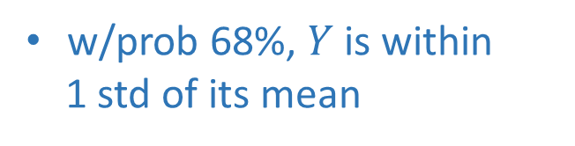
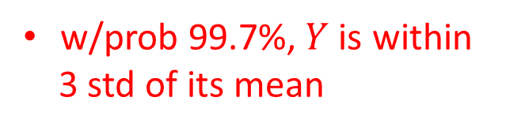

Deviation from mean
If $Y∼Normal\left(0, 1\right)$, then $P\left\{−k<Y<k\right\}= 2Φ\left(k\right)−1$
w/prob 68%, $Y$is within
1 std of its mean
w/prob 95%, $Y$is within
2 std of its mean
w/prob 99.7%, $Y$is within
3 std of its mean
-3
-2
-1
0
1
2
3

Slide 16

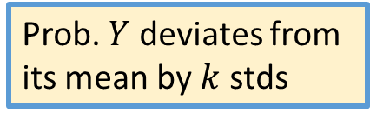
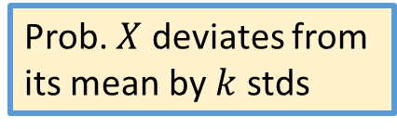
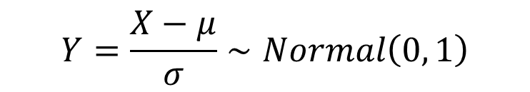

But what if we don’t have a standard Normal?
Bottom line: Everything that you saw for a standard Normal holds for general Normal
(provided it’s phrased in terms of stds).
Key Idea:
$$Y=\frac{X−μ}{σ}∼Normal\left(0, 1\right)$$
$$X∼Normal\left(μ, σ^{2}\right)$$
$$P\left\{−kσ<X −μ<kσ\right\}=P\left\{−k<\frac{X−μ}{σ}<k\right\}=P\{−k<Y<k\}$$
Prob. $X$ deviates from
its mean by $k$ stds
Prob. $Y$ deviates from
its mean by $k$ stds

Slide 17

Example: Gifted Folks
Human intelligence (IQ) is thought to be Normally distributed with mean 100 and std 15.
The “gifted cutoff” is 130.
Q: What fraction of people have IQ greater than the gifted cutoff?
A: Phrased in terms of stds, we’re asking what fraction of people have IQ
which is more than 2 stds above the mean.
$$1 −Φ\left(2\right)≈0.023$$
So about 2.3%

Slide 18
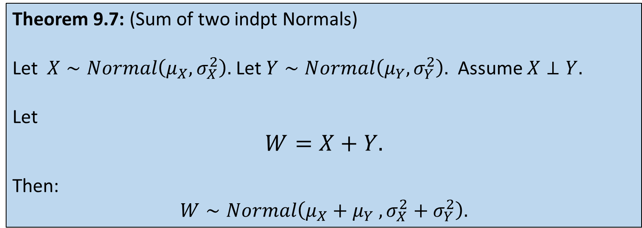
Sum of two independent Normals
Theorem 9.7: (Sum of two indpt Normals)
Let $X∼Normal\left(μ_{X}, σ_{X}^{2}\right).$ Let $Y∼Normal\left(μ_{Y}, σ_{Y}^{2}\right).$ Assume $X⊥Y.$
Let
$$W=X+Y.$$
Then:
$$W∼Normal\left(μ_{X}+μ_{Y} , σ_{X}^{2}+σ_{Y}^{2}\right).$$
The proof depends on Laplace transforms. See Exercise 11.10 for the proof.

Slide 19
Central Limit Theorem (CLT)
The CLT is about what happens when we sum up a large number of i.i.d. random variables.
The common example is many i.i.d. sources of noise that occur at once.
CLT (at a high level) says that the distribution of the average tends towards Normal, even though the original distributions are NOT Normal.

Slide 20




Central Limit Theorem (CLT)
Let $X_{1}, X_{2}, X_{3}, …, X_{n}$be i.i.d. random variables with mean $μ$ and variance $σ^{2}$.
Let
$$S_{n}=X_{1}+X_{2}+⋯+X_{n}$$
Q: What is the mean and std of $S_{n}$?
A: $E\left[S_{n}\right]=nμ \text{;} Var\left(S_{n}\right)=n σ^{2}$ $\text{;} Std\left(S_{n}\right)=σ\sqrt{n}$
Let
$$Z_{n}=\frac{S_{n}−nμ}{σ\sqrt{n}}$$
$Z_{n}$is a normalized
version of $S_{n}$
Q: What is the mean and std of $Z_{n}$?
A: $E\left[Z_{n}\right]=0 \text{;} Var\left(S_{n}\right)=1$ $\text{;} Std\left(S_{n}\right)=1$

Slide 21
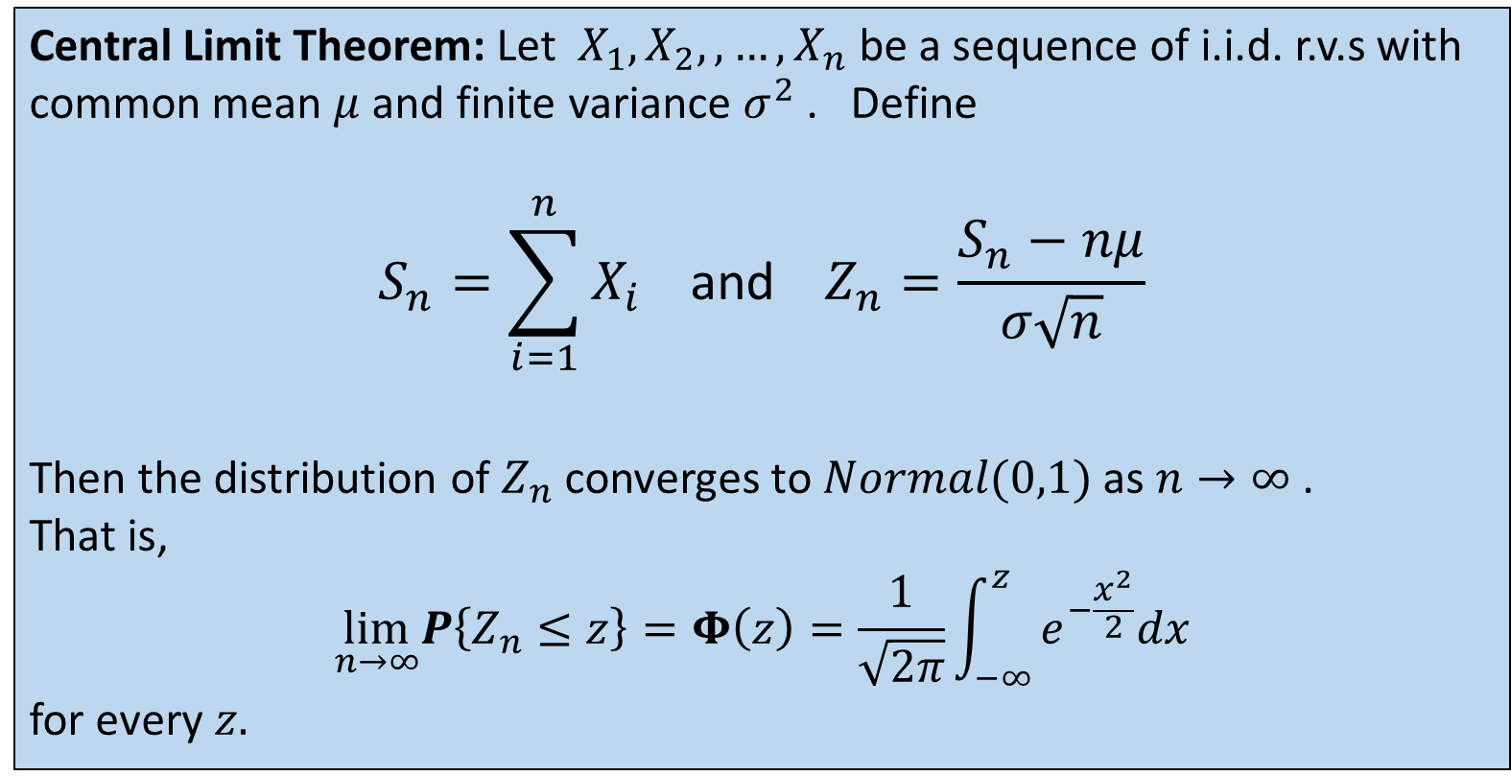
Central Limit Theorem (CLT)
Central Limit Theorem: Let $X_{1}, X_{2},, …, X_{n}$be a sequence of i.i.d. r.v.s with common mean $μ$ and finite variance $σ^{2}$ . Define
$${S_{n}=\sum_{i=1}^{n}{X_{i}} \text{and} Z}_{n}=\frac{S_{n}−nμ}{σ\sqrt{n}}$$
Then the distribution of $Z_{n}$ converges to $Normal(0,1)$ as $n→∞$ .
That is,
$$\lim_{n→∞}P\left\{Z_{n}≤z\right\}=Φ\left(z\right)=\frac{1}{\sqrt{2π}}\int_{−∞}^{z}{e^{−\frac{x^{2}}{2}}dx}$$
for every $z.$
$$Z_{n}=\frac{S_{n}−nμ}{σ\sqrt{n}}$$
Proof uses Laplace transforms so it is deferred to Chpt 11.

Slide 22
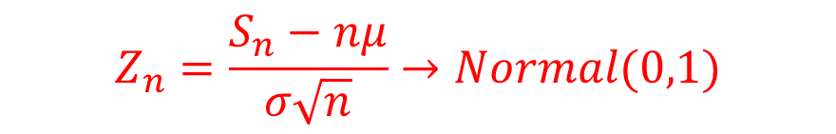

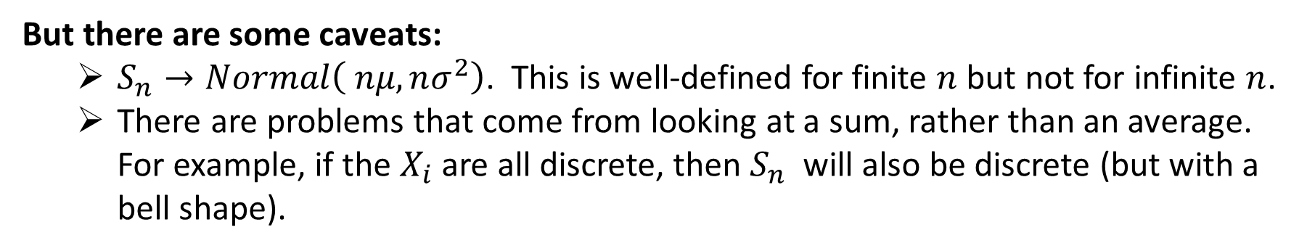
Central Limit Theorem (CLT)
$$Z_{n}=\frac{S_{n}−nμ}{σ\sqrt{n}}→Normal(0,1)$$
Q: What does this say about the distribution of $S_{n}=\sum_{i=1}^{n}{X_{i}}$?
A: By the Linear Transformation Property, $S_{n}$should also be getting closer to a Normal distribution as $n→∞.$
But there are some caveats:
$S_{n}→Normal\left( nμ, nσ^{2}\right)$. This is well-defined for finite $n$ but not for infinite $n$.
There are problems that come from looking at a sum, rather than an average. For example, if the $X_{i}$are all discrete, then $S_{n}$ will also be discrete (but with a bell shape).

Slide 23


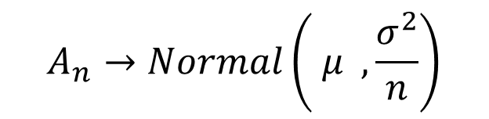
Central Limit Theorem (CLT)
$$Z_{n}=\frac{S_{n}−nμ}{σ\sqrt{n}}→Normal(0,1)$$
Q: What does this say about the distribution of $A_{n}=\frac{1}{n}\sum_{i=1}^{n}{X_{i}}$?
A: By the Linear Transformation Property, $A_{n}$should also be getting closer to a Normal distribution as $n→∞.$
Note this doesn’t
have the issues of
$$S_{n}$$
$$A_{n}→Normal\left( μ , \frac{σ^{2}}{n}\right)$$
What happens
to $Var(A_{n})$
as $n→∞ ?$

Slide 24
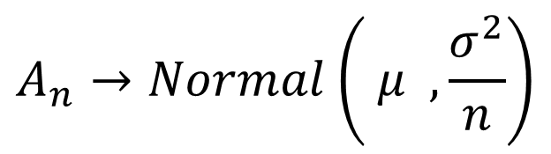
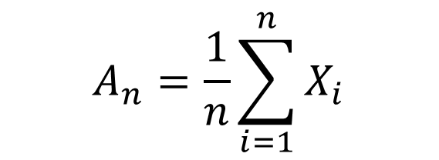

Central Limit Theorem (CLT)
$$A_{n}=\frac{1}{n}\sum_{i=1}^{n}{X_{i}}$$
$$A_{n}→Normal\left( μ , \frac{σ^{2}}{n}\right)$$
How can the above be correct?
Suppose that the $X_{i}$ are people’s heights. They can’t be negative!
With extremely high probability, the value of $A_{n}$is near 5.5 ft,
where the shape looks Normal.

Slide 25

CLT Example
Problem:
We’re trying to transmit a signal.
During transmission there are 100 indpt sources of noise, each $∼Uniform\left(−1, 1\right).$
If
$$\left|Total Noise\right|<10$$
then the signal is not corrupted.
What is the probability that the signal is not corrupted?

Slide 26








CLT Example
Problem: We’re trying to transmit a signal. During transmission there are 100 indpt sources of noise, each $∼Uniform\left(−1, 1\right).$ If
$$\left|Total Noise\right|<10$$
then the signal is not corrupted. What is the probability of this?
Let $X_{i}$ denote the noise from source $i$.
Q: What is ${E[X}_{i}$]?
$$E\left[X_{i}\right]=0$$
$$Var\left(X_{i}\right)=\frac{{\left(b−a\right)}^{2}}{12}=\frac{1}{3}$$
Q: What is $Var\left(X_{i}\right)$?
$$σ_{X_{i}}=\frac{1}{\sqrt{3}}$$
Q: What is $σ_{X_{i}}$?

Slide 27










CLT Example
Problem: We’re trying to transmit a signal. During transmission there are 100 indpt sources of noise, each $∼Uniform\left(−1, 1\right).$ If
$$\left|Total Noise\right|<10$$
then the signal is not corrupted. What is the probability of this?
Let $S_{100}=X_{1}+X_{2}+⋯+X_{100}$
Want: $P\left\{−10<S_{100}<10\right\}$
$$E\left[X_{i}\right]=0$$
$$Var\left(X_{i}\right)=\frac{1}{3}$$
$$P\left\{−10<S_{100}<10\right\}=P\left\{−\frac{10}{10/\sqrt{3}}<\frac{S_{100}−0}{10/\sqrt{3}}<\frac{10}{10/\sqrt{3}}\right\}$$
$$E\left[S_{100}\right]=0$$
$$≈P\left\{−\sqrt{3}<Normal(0,1)<\sqrt{3}\right\}$$
$$Var\left(S_{100}\right)=\frac{100}{3}$$
$$=2Φ\left(\sqrt{3}\right)−1$$
$$≈0.91$$
$$σ_{S_{100}}=\frac{10}{\sqrt{3}}$$

