Slide 1
Chapter 8
Continuous Random Variables:
Joint distributions
Notes:
https://www.gettyimages.co.uk/detail/illustration/dog-ate-my-homework-cartoon-pet-reading-royalty-free-illustration/165721801?phrase=homework
https://www.gettyimages.co.uk/detail/illustration/happy-children-playing-in-playground-royalty-free-illustration/1327359799?phrase=cute%20toddlers%20
https://www.gettyimages.co.uk/detail/illustration/server-illustration-royalty-free-illustration/1088374244?phrase=server%20white%20background

Slide 2
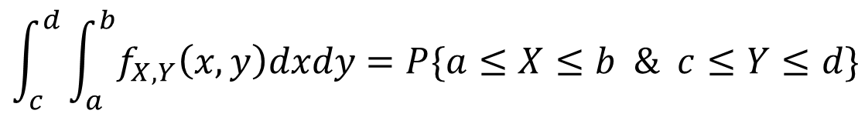
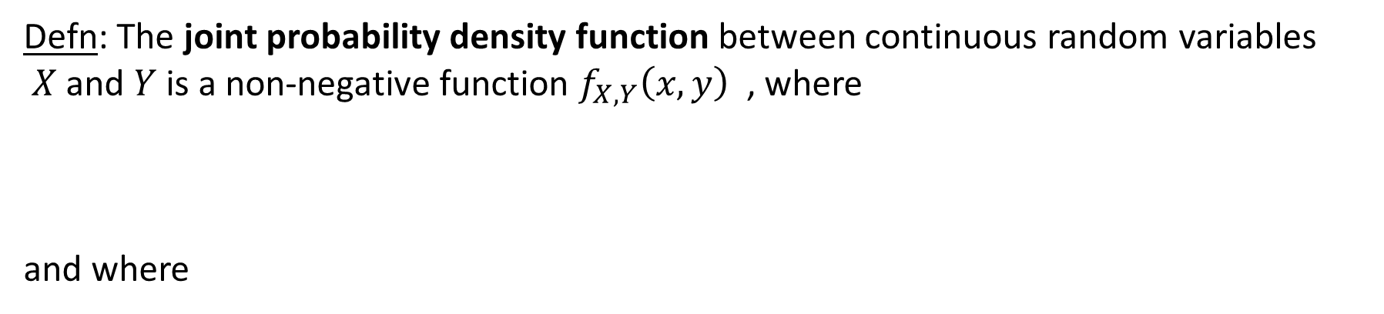
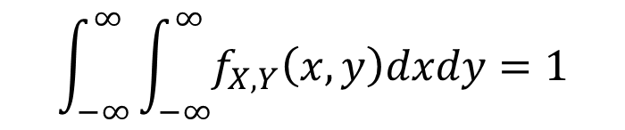
Joint Densities
Defn: The joint probability density function between continuous random variables
$X$and $Y$is a non-negative function $f_{X,Y}\left(x,y\right)$ , where
and where
$$\int_{c}^{d}{\int_{a}^{b}{f_{X,Y}\left(x,y\right)dxdy=P\{a≤X≤b \& c≤Y≤d\}}}$$
$$\int_{−∞}^{∞}{\int_{−∞}^{∞}{f_{X,Y}\left(x,y\right)dxdy=1}}$$

Slide 3
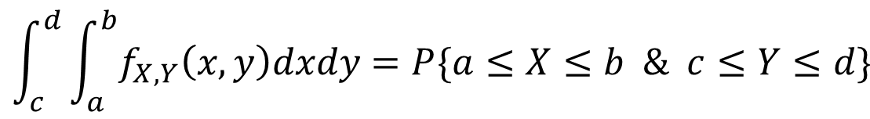
Joint Densities
Volume under the curve equals:
$$\int_{c}^{d}{\int_{a}^{b}{f_{X,Y}\left(x,y\right)dxdy=P\{a≤X≤b \& c≤Y≤d\}}}$$

Slide 4
Example
Two-year-olds range in weight from 15 – 35 pounds.
They range in height from 25 – 40 inches.
$f_{W,H}(w,h)$denotes the joint p.d.f. of weight and height.
Q: What is the fraction of two-year-olds with weight > 30 pounds but height < 30 inches?
A:
$\int_{h=−∞}^{h=30}{\int_{w=30}^{w=∞}{f_{W,H}\left(w,h\right)dwdh=}}$ $\int_{25}^{30}{\int_{30}^{35}{f_{W,H}\left(w,h\right)dwdh}}$
Why are these the same?

Slide 5
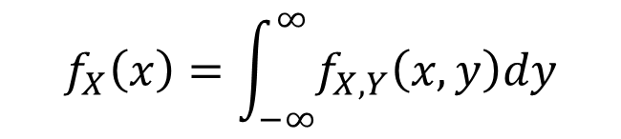
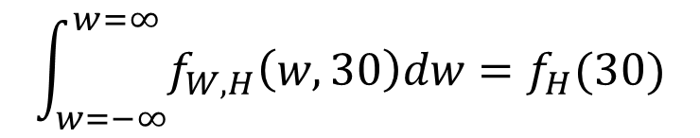
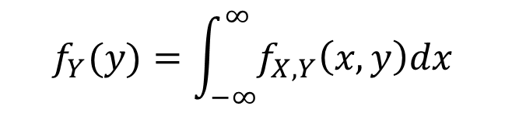
Marginal densities
Defn: The marginal densities $f_{X}(x)$and $f_{Y}(y)$ are defined as:
$$f_{X}\left(x\right)=\int_{−∞}^{∞}{f_{X,Y}\left(x,y\right)dy}$$
$$f_{Y}(y)=\int_{−∞}^{∞}{f_{X,Y}\left(x,y\right)dx}$$
Note that $f_{X}(x)$and $f_{Y}(y)$ are densities and not probabilities.
Q: I$f f_{W,H}(w,h)$is the joint p.d.f. of weight and height in two-year-olds, what is the fraction of two-year-olds whose height is exactly 30 inches?
A:
$$\int_{w=−∞}^{w=∞}{f_{W,H}\left(w,30\right)dw=f_{H}(30)}$$
This is a zero-probability event!

Slide 6
Independence
Defn: Continuous random variables $X$and $Y$are i$ndependent$, written $X⊥Y$, if:
$$f_{X,Y}\left(x,y\right)=f_{X}\left(x\right)⋅f_{Y}\left(y\right) ∀x,y$$
Let’s consider some joint p.d.f.s to determine whether $X$and $Y$are independent.

Slide 7



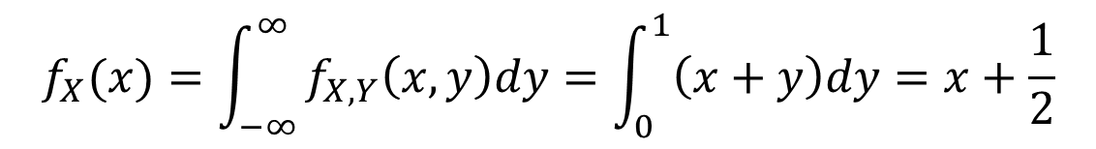
Example
$$f_{X,Y}(x,y)=\left\{\begin{matrix}x+y & \text{if} 0≤x,y≤1 & \\ \begin{aligned} \\ 0\end{aligned} & \begin{aligned} \\ \text{otherwise}\end{aligned} & \end{matrix}\right.$$
Q: (a) What is $E[X]$? (b) Is $X⊥Y?$
A: part (a)
$$f_{X}(x)=\int_{−∞}^{∞}{f_{X,Y}\left(x,y\right)dy=\int_{0}^{1}{\left(x+y\right)dy=x+\frac{1}{2}}}$$
$$E\left[X\right]=\int_{−∞}^{∞}{f_{X}\left(x\right)⋅xdx=\int_{0}^{1}{\left(x+\frac{1}{2}\right)⋅x dx=\frac{7}{12}}}$$

Slide 8



Example
$$f_{X,Y}(x,y)=\left\{\begin{matrix}x+y & \text{if} 0≤x,y≤1 & \\ \begin{aligned} \\ 0\end{aligned} & \begin{aligned} \\ \text{otherwise}\end{aligned} & \end{matrix}\right.$$
Q: (a) What is $E[X]$? (b) Is $X⊥Y?$
A: part (b)
$$f_{X}(x)=\int_{−∞}^{∞}{f_{X,Y}\left(x,y\right)dy=x+\frac{1}{2}}$$
$$f_{Y}(y)=\int_{−∞}^{∞}{f_{X,Y}\left(x,y\right)dx=y+\frac{1}{2}}$$
Clearly, $f_{X,Y}\left(x,y\right)≠f_{X}\left(x\right)⋅f_{Y}\left(y\right)$

Slide 9
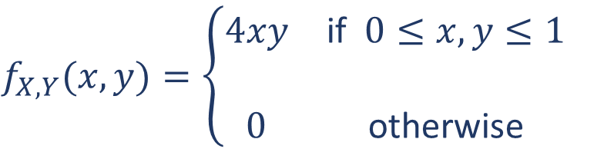




Example
$$f_{X,Y}(x,y)=\left\{\begin{matrix}4xy & \text{if} 0≤x,y≤1 & \\ \begin{aligned} \\ 0\end{aligned} & \begin{aligned} \\ \text{otherwise}\end{aligned} & \end{matrix}\right.$$
Q: Is $X⊥Y?$
A:
$$f_{X}(x)=\int_{0}^{1}{4xy dy=2x}$$
$$f_{Y}(y)=\int_{0}^{1}{4xy dx=2y}$$
Clearly, $f_{X,Y}\left(x,y\right)=f_{X}\left(x\right)⋅f_{Y}\left(y\right)$

Slide 10


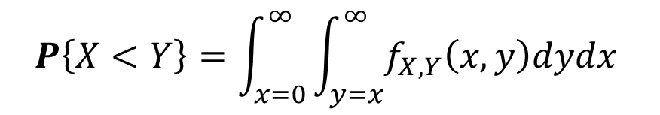
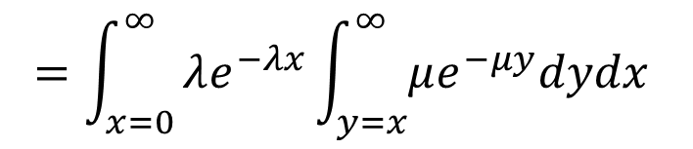

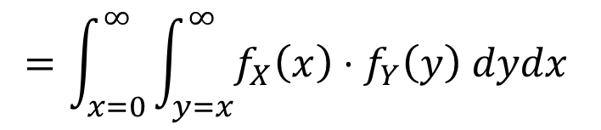


Example: Which Exponential happens first?
The time until server 1 crashes is $X∼Exp\left(λ\right)$
The time until server 2 crashes is $Y∼Exp(μ)$
$X∼Exp\left(λ\right)$
$Y∼Exp(μ)$
Q: What is the probability that server 1 crashes before server 2? Assume $X⊥Y.$
A:
$$P\left\{X<Y\right\}=\int_{x=0}^{∞}{\int_{y=x}^{∞}{f_{X,Y}\left(x,y\right)dydx }}$$
$$=\int_{x=0}^{∞}{\int_{y=x}^{∞}{f_{X}\left(x\right)⋅f_{Y}\left(y\right) dydx }}$$
$$=\int_{x=0}^{∞}{λe^{−λx}\int_{y=x}^{∞}{μe^{−μy}dydx }}$$
$$=\frac{λ}{λ+μ}$$
What happens when $λ=μ$ ?

Slide 11
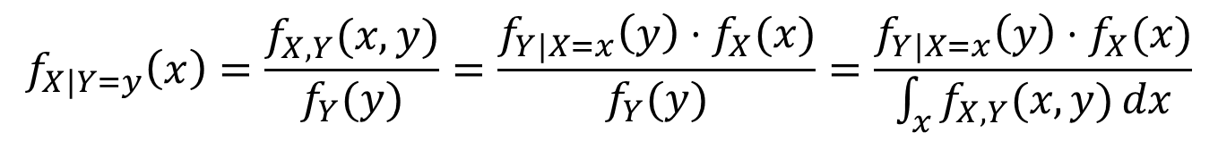
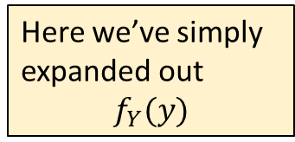
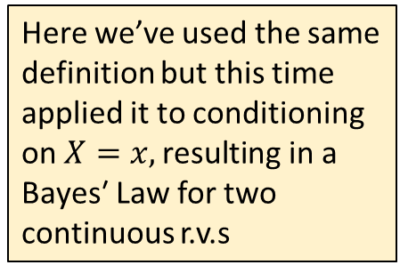
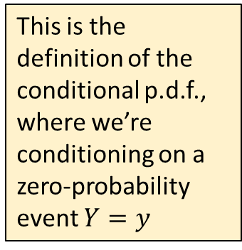
Conditional p.d.f. and Bayes’ Law
Defn: Given two continuous random variables, $X$and $Y,$ we define the conditional
p.d.f. of r.v. $X$ given event $Y=y$ as:
$$f_{X|Y=y}\left(x\right)=\frac{f_{X,Y}(x,y)}{f_{Y}(y)}=\frac{f_{Y|X=x}\left(y\right)⋅f_{X}(x)}{f_{Y}(y)}=\frac{f_{Y|X=x}\left(y\right)⋅f_{X}(x)}{\int_{x}{f_{X,Y}(x,y)}dx}$$
This is the definition of the conditional p.d.f., where we’re conditioning on a zero-probability event $Y=y$
Here we’ve used the same definition but this time applied it to conditioning on $X=x,\text{resulting} \text{in} \text{a} \text{Bayes}\text{′ }\text{Law}$ for two continuous r.v.s
Here we’ve simply expanded out
$$f_{Y}(y)$$
Observe that the conditional p.d.f. is still a proper p.d.f., i.e., ${\int_{−∞}^{∞}{ }f}_{X|Y=y}\left(x\right) dx=1$

Slide 12

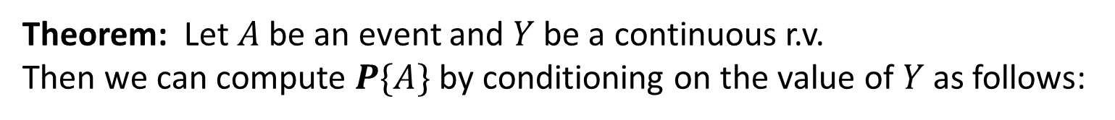

Law of Total Probability Generalized
Recall the Law of Total Probability, repeated below:
Theorem: Let $A$be an event and $Y$be a continuous r.v.
Then we can compute $P\{A\}$ by conditioning on the value of $Y$ as follows:
$$P\left\{A\right\}=\int_{−∞}^{∞}{f_{Y}\left(y∩A\right)dy=\int_{−∞}^{∞}{P\left\{A \right|Y=y\} f_{Y}\left(y\right)dy}}$$
Using the definition for the conditional p.d.f. from the prior slide, we can similarly express $f_{X}\left(x\right)$ by conditioning on the value of $Y$:
Theorem: Let $X$and $Y$be continuous random variables. Then, from the definition of
the conditional p.d.f., we have:
$$f_{X}\left(x\right)=\int_{y}{f_{X,Y}\left(x,y\right)dy=\int_{y}{f_{X|Y=y}\left(x\right)f_{Y}\left(y\right)dy} }$$

Slide 13







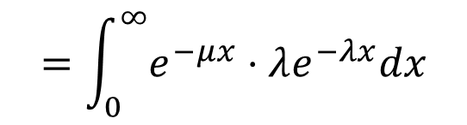
Example: Which Exponential happens first?
The time until server 1 crashes is $X∼Exp\left(λ\right)$
The time until server 2 crashes is $Y∼Exp(μ)$
$X∼Exp\left(λ\right)$
$Y∼Exp(μ)$
Q: What is the probability that server 1 crashes before server 2? Assume $X⊥Y.$
$$P\left\{X<Y\right\}=\int_{0}^{∞}{P\left\{X<Y \right| X=x\}⋅f_{X}\left(x\right)dx}$$
A:
$$=\int_{0}^{∞}{P\left\{Y>x \right|X=x\}⋅λe^{−λx}dx}$$
$$=\int_{0}^{∞}{P\{Y>x\}⋅λe^{−λx}dx}$$
Where did we use independence?
$$=\int_{0}^{∞}{e^{−μx}⋅λe^{−λx}dx}$$
$$=\frac{λ}{λ+μ}$$

Slide 14





From Midterm 2020
Random variables $X$and $Y$ are NOT independent. Their joint density is:
$$f_{X,Y}\left(x,y\right) \text{where} 0≤x,y≤∞$$
All your answers should be in terms of $f_{X,Y}\left(x,y\right)$ or prior results.
a. Write an expression for $f_{Y}(y)$
b. Write an expression for $f_{X|Y=5}(x)$
c. Write an expression for $P\left\{X+Y<10 \right| Y=5\}$
d. Write an expression for $f_{Y|X<6}(y)$
e. Write an expression for $f_{Y|Y<6}(y)$

Slide 15



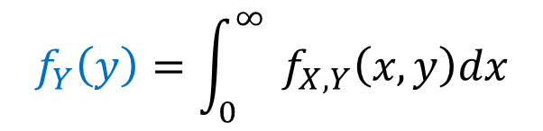

From Midterm 2020
Random variables $X$and $Y$ are NOT independent. Their joint density is:
$$f_{X,Y}\left(x,y\right) \text{where} 0≤x,y≤∞$$
All your answers should be in terms of $f_{X,Y}\left(x,y\right)$ or prior results.
Q: What is the mass of the blue event, relative
to the “world?”
a. Write an expression for $f_{Y}(y)$
$$Y$$
The World
$${f_{Y}\left(y\right)=\int_{0}^{∞}{ }f}_{X,Y}\left(x,y\right)dx$$
$${y }_{ }$$
$${f_{Y}\left(y\right) }_{ }$$
$$X$$
A: Blue event has zero probability

Slide 16


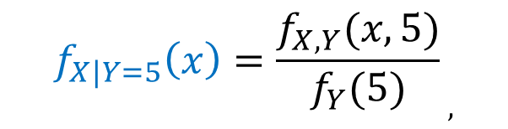

From Midterm 2020
Random variables $X$and $Y$ are NOT independent. Their joint density is:
$$f_{X,Y}\left(x,y\right) \text{where} 0≤x,y≤∞$$
Q: What is the mass of the blue event, relative
to the “world?”
All your answers should be in terms of $f_{X,Y}\left(x,y\right)$ or prior results.
b. Write an expression for $f_{X|Y=5}(x)$
$$Y$$
$${f_{X|Y=5}\left(x\right)=\frac{f_{X,Y}(x,5)}{f_{Y}(5)}}_{ ,}$$
$${5 }_{ }$$
The World
$$X$$
$${x }_{ }$$
A: Blue event has zero probability

Slide 17

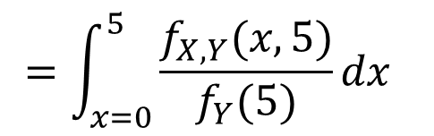
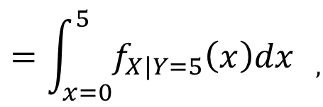

From Midterm 2020
Random variables $X$and $Y$ are NOT independent. Their joint density is:
$$f_{X,Y}\left(x,y\right) \text{where} 0≤x,y≤∞$$
All your answers should be in terms of $f_{X,Y}\left(x,y\right)$ or prior results.
Q: What is the mass of the blue event, relative
to the “world?”
$$Y$$
c. Write an expression for $P\left\{X+Y<10 \right| Y=5\}$
$${=\int_{x=0}^{5}{f_{X|Y=5}\left(x\right)dx} }_{ ,}$$
$${P\left\{X+Y<10 \right| Y=5\} }_{ ,}$$
$${5 }_{ }$$
The World
$${ =\int_{x=0}^{5}{\frac{f_{X,Y}(x,5)}{f_{Y}(5)}dx} }_{ }$$
$$X$$
$${5 }_{ }$$
A: Blue event has
non-zero probability

Slide 18
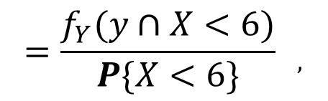
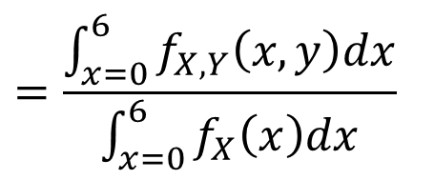



From Midterm 2020
Random variables $X$and $Y$ are NOT independent. Their joint density is:
$$f_{X,Y}\left(x,y\right) \text{where} 0≤x,y≤∞$$
Q: What is the mass of the blue event, relative
to the “world?”
All your answers should be in terms of $f_{X,Y}\left(x,y\right)$ or prior results.
d. Write an expression for $f_{Y|X<6}(y)$
$$Y$$
The World
$${=\frac{f_{Y}(y∩X<6)}{P\{X<6\}} }_{ ,}$$
$${f_{Y|X<6}(y) }_{ ,}$$
$$y$$
$${=\frac{\int_{x=0}^{6}{f_{X,Y}\left(x,y\right)dx}}{\int_{x=0}^{6}{f_{X}\left(x\right)dx}} }_{ }$$
$$X$$
A: Blue event has
zero probability
$${6 }_{ }$$

Slide 19

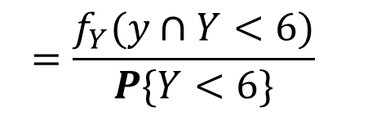
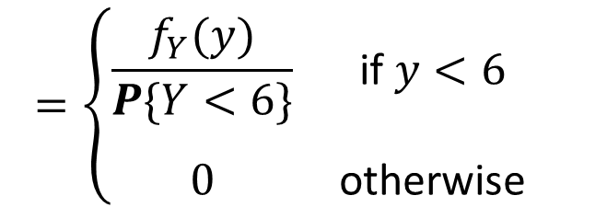


From Midterm 2020
Random variables $X$and $Y$ are NOT independent. Their joint density is:
$$f_{X,Y}\left(x,y\right) \text{where} 0≤x,y≤∞$$
All your answers should be in terms of $f_{X,Y}\left(x,y\right)$ or prior results.
Q: What is the mass of the blue event, relative
to the “world?”
e. Write an expression for $f_{Y|Y<6}(y)$
$$Y$$
$${=\frac{f_{Y}(y∩Y<6)}{P\{Y<6\}} }_{ }$$
$${6 }_{ }$$
$${f_{Y|X<6}(y) }_{ ,}$$
The World
$$y$$
$$=\left\{\begin{matrix}\frac{f_{Y}(y)}{P\{Y<6\}} & \text{if} y<6 & \\ \begin{aligned} \\ 0\end{aligned} & \begin{aligned} \\ \text{otherwise}\end{aligned} & \end{matrix}\right.$$
$$X$$
A: Blue event has
zero probability

Slide 20
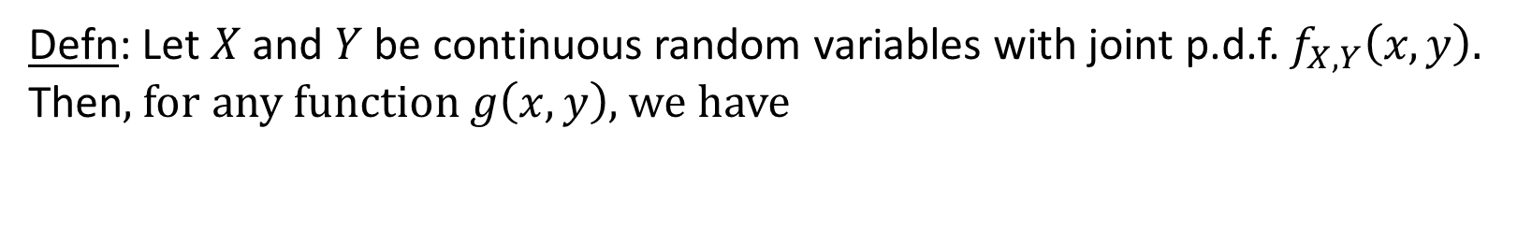
Expectation with multiple r.v.s
Defn: Let $X$and $Y$ be continuous random variables with joint p.d.f. $f_{X,Y}\left(x,y\right).$
Then$,$for any function $g\left(x,y\right)$, we have
$${E\left[g\left(X,Y\right)\right]=\int_{−∞}^{∞}{\int_{−∞}^{∞}{g\left(x,y\right)⋅}}f}_{X,Y}\left(x,y\right)dxdy$$

Slide 21
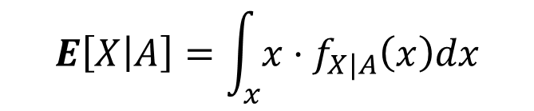

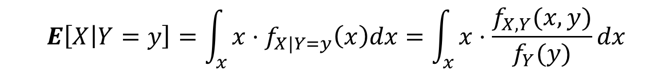
Conditional expectation with multiple RVs
For a continuous r.v. $X$and an event $A,$where $P\left\{A\right\}>0,$the conditional expectation of $X \text{given} A \text{is}$:
Recall Defn:
$$E\left[X | A\right]=\int_{x}{x⋅f_{X|A}\left(x\right)dx}$$
Defn:
For continuous r.v.s $X$and $Y$
$$E\left[X | Y=y\right]=\int_{x}{x⋅f_{X|Y=y}\left(x\right)dx=\int_{x}{x⋅\frac{f_{X,Y}(x,y)}{f_{Y}(y)}dx}}$$
Theorem: We can derive $E[X]$ by conditioning on the value of continuous r.v. $Y$ :
$$E\left[X\right]=\int_{y}{E\left[X \right|Y=y]⋅f_{Y}\left(y\right)dy }$$

Slide 22


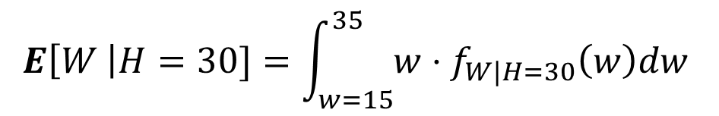


Example
Two-year-olds range in weight from 15 – 35 pounds.
They range in height from 25 – 40 inches.
Q: My 2-year old is 30 inches tall.
What is their expected weight?
$$Y$$
The World
A:
$$E\left[W \right|H=30]=\int_{w=15}^{35}{w⋅f_{W|H=30}\left(w\right)dw }$$
$$=\int_{w=15}^{35}{w⋅\frac{f_{W,H}(w,30)}{f_{H}(30)}dw }$$
Why are these the same?
$$X$$
$${30 }_{ }$$

Slide 23

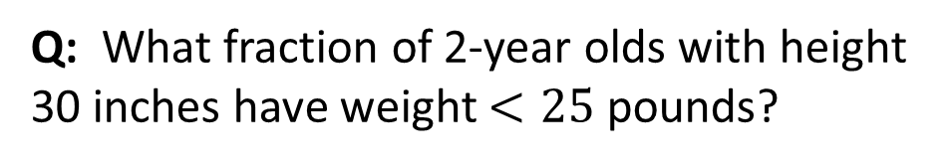


Example
Two-year-olds range in weight from 15 – 35 pounds.
They range in height from 25 – 40 inches.
Q: What fraction of 2-year olds with height 30 inches have weight $<25 \text{pounds}\text{?}$
$$Y$$
The World
A:
$$P\left\{W<25 \right|H=30\}=\int_{w=15}^{25}{f_{W|H=30}\left(w\right)dw }$$
$${25 }_{ }$$
$$=\int_{w=15}^{25}{\frac{f_{W,H}(w,30)}{f_{H}(30)}dw }$$
$$X$$
$${30 }_{ }$$

Slide 24

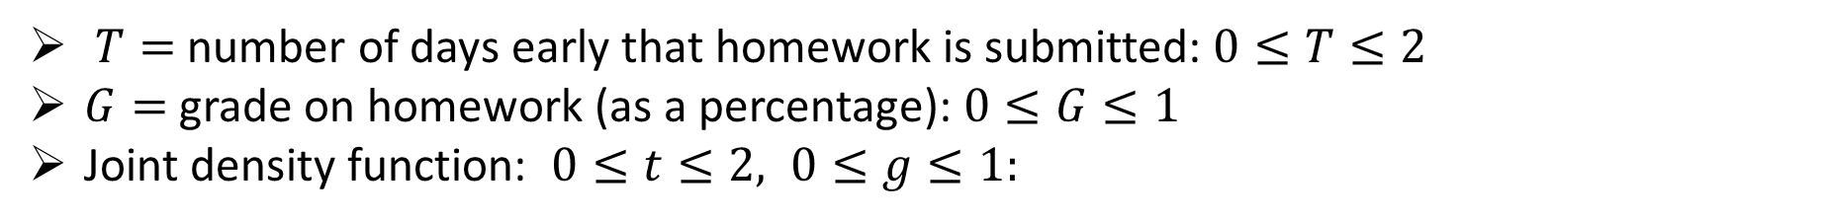
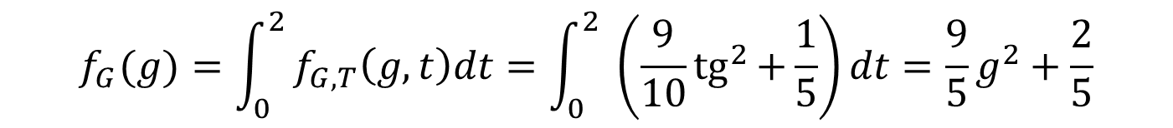
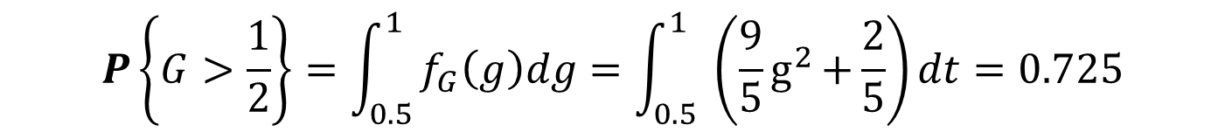

Example: Hand-in Time versus Grade
$T=$number of days early that homework is submitted: $0≤T≤2$
$G=$grade on homework (as a percentage): $0≤G≤1$
Joint density function: $0≤t≤2, 0≤g≤1:$
$$f_{G,T}\left(g,t\right)=\frac{9}{10}{tg}^{2}{+\frac{1}{5}}$$
Q: What is the probability that a random student gets a grade above 50%$?$
A:
$$f_{G}(g)=\int_{0}^{2}{f_{G,T}\left(g,t\right)dt=\int_{0}^{2}{ \left(\frac{9}{10}{tg}^{2}{+\frac{1}{5}}\right)dt=\frac{9}{5}g^{2}+\frac{2}{5}}}$$
$$P\left\{G>\frac{1}{2}\right\}=\int_{0.5}^{1}{f_{G}\left(g\right)dg=\int_{0.5}^{1}{ \left(\frac{9}{5}g^{2}{+\frac{2}{5}}\right)dt=0.725}}$$

Slide 25

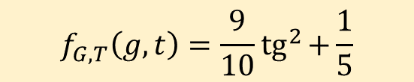
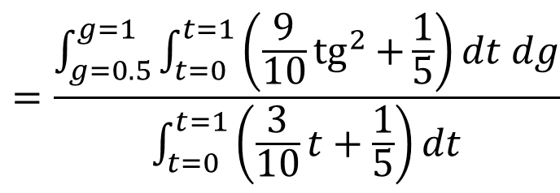
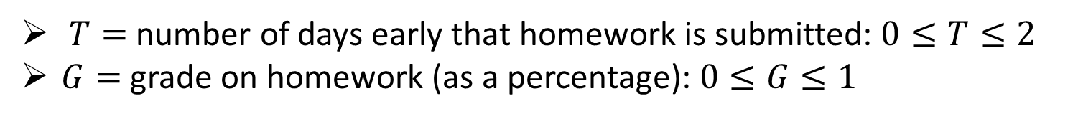
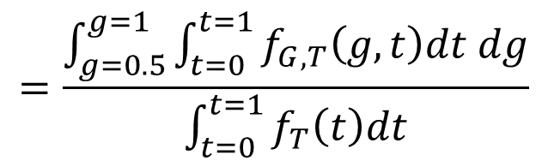
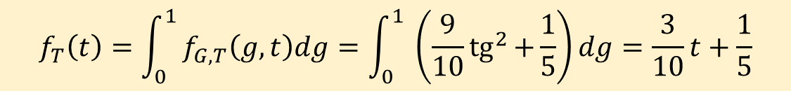
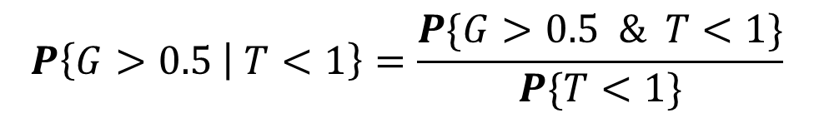
Example: Hand-in Time versus Grade
$T=$number of days early that homework is submitted: $0≤T≤2$
$G=$grade on homework (as a percentage): $0≤G≤1$
Q: Given that a student submitted less than a day before the deadline,
does the probability of getting a grade >50% go down?
$$=\frac{\int_{g=0.5}^{g=1}{\int_{t=0}^{t=1}{f_{G,T}\left(g,t\right)dt dg}}}{\int_{t=0}^{t=1}{f_{T}\left(t\right)dt}}$$
$$P\left\{G>0.5 | T<1\right\}=\frac{P\{G>0.5 \& T<1\}}{P\{T<1\}}$$
A:
$$=\frac{\int_{g=0.5}^{g=1}{\int_{t=0}^{t=1}{\left(\frac{9}{10}{tg}^{2}{+\frac{1}{5}}\right)dt dg}}}{\int_{t=0}^{t=1}{\left(\frac{3}{10}t+\frac{1}{5}\right)dt}}$$
$$=0.66$$
$$f_{G,T}\left(g,t\right)=\frac{9}{10}{tg}^{2}{+\frac{1}{5}}$$
$$f_{T}\left(t\right)=\int_{0}^{1}{f_{G,T}\left(g,t\right)dg=\int_{0}^{1}{ \left(\frac{9}{10}{tg}^{2}{+\frac{1}{5}}\right)dg=\frac{3}{10}t+\frac{1}{5}}}$$

Slide 26
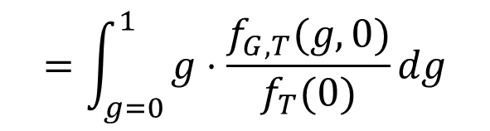


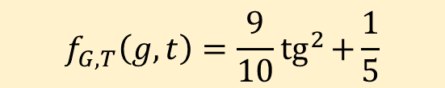
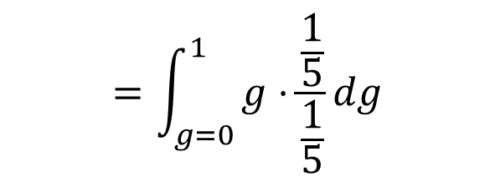
Example: Hand-in Time versus Grade
$T=$number of days early that homework is submitted: $0≤T≤2$
$G=$grade on homework (as a percentage): $0≤G≤1$
Q: A student submits at $T=0,$ i.e., exactly when the homework is due.
What is their expected grade?
$$E\left[G \right| T=0]=\int_{g=0}^{1}{g⋅f_{G|T=0}\left(g\right)dg}$$
$$=\int_{g=0}^{1}{g⋅\frac{f_{G,T}(g,0)}{f_{T}(0)}dg}$$
A:
$$=\int_{g=0}^{1}{g⋅\frac{\frac{1}{5}}{\frac{1}{5}}dg}$$
$$=0.5$$
$$f_{G,T}\left(g,t\right)=\frac{9}{10}{tg}^{2}{+\frac{1}{5}}$$
$$f_{T}\left(t\right)=\int_{0}^{1}{f_{G,T}\left(g,t\right)dg=\int_{0}^{1}{ \left(\frac{9}{10}{tg}^{2}{+\frac{1}{5}}\right)dg=\frac{3}{10}t+\frac{1}{5}}}$$

Slide 27
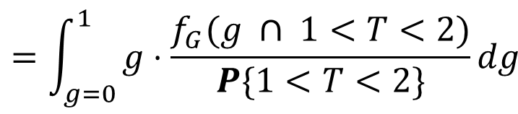

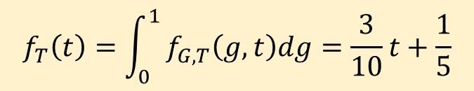
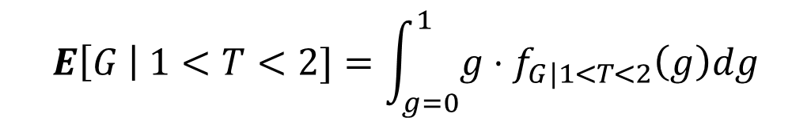
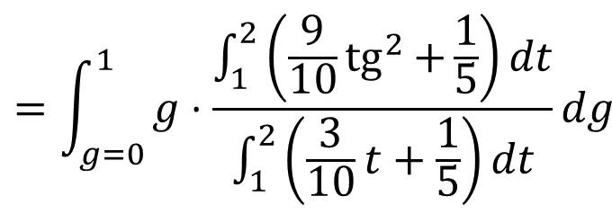

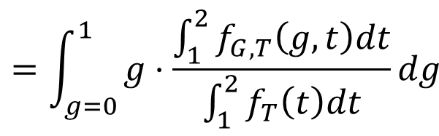
Example: Hand-in Time versus Grade
$T=$number of days early that homework is submitted: $0≤T≤2$
$G=$grade on homework (as a percentage): $0≤G≤1$
Q: By contrast, what is the expected grade of a student who submits $>1$day early?
$$E\left[G \right| 1<T<2]=\int_{g=0}^{1}{g⋅f_{G|1<T<2}\left(g\right)dg}$$
$$=\int_{g=0}^{1}{g⋅\frac{f_{G}(g ∩ 1<T<2)}{P\{1<T<2\}}dg}$$
A:
$$f_{G,T}\left(g,t\right)=\frac{9}{10}{tg}^{2}{+\frac{1}{5}}$$
$$=\int_{g=0}^{1}{g⋅\frac{\int_{1}^{2}{f_{G,T}\left(g,t\right)dt}}{\int_{1}^{2}{f_{T}\left(t\right)dt}}dg}$$
$$f_{T}\left(t\right)=\int_{0}^{1}{f_{G,T}\left(g,t\right)dg=\frac{3}{10}t+\frac{1}{5}}$$
$$=\int_{g=0}^{1}{g⋅\frac{\int_{1}^{2}{\left(\frac{9}{10}{tg}^{2}{+\frac{1}{5}}\right)dt}}{\int_{1}^{2}{\left(\frac{3}{10}t+\frac{1}{5}\right)dt}}dg}$$
$$=0.673$$

