Slide 1
Chapter 7 Continuous Random Variables
Notes:
https://www.gettyimages.co.uk/detail/illustration/happy-children-playing-in-playground-royalty-free-illustration/1327359799?phrase=cute%20toddlers%20
https://www.gettyimages.co.uk/detail/photo/lottery-balls-royalty-free-image/131683283?phrase=lottery%20balls
https://www.gettyimages.co.uk/detail/illustration/post-office-icon-royalty-free-illustration/1273924984?phrase=post%20office
https://www.gettyimages.co.uk/detail/illustration/yellow-light-bulb-icon-royalty-free-illustration/165766463?phrase=Yellow%20light%20bulb
https://www.gettyimages.co.uk/detail/illustration/three-dimensional-render-of-modern-server-royalty-free-illustration/1264510922?phrase=datacenter
https://www.gettyimages.co.uk/detail/illustration/creative-light-bulb-cartoon-royalty-free-illustration/115066830?phrase=light%20bulb
https://www.gettyimages.co.uk/detail/photo/united-states-coins-royalty-free-image/157532065 (repeated from prior chpt)

Slide 2
Continuous Random Variable
Defn: A continuous random variable (r.v.) has a continuous range of values that it can
take on. This might be an interval or set of intervals.
Thus a continuous r.v. can take on an uncountable set of possible values.
Examples:
Time of an event
Response time of a job
Speed of a device
Location of a satellite
Distance between people’s eyeballs

Slide 3
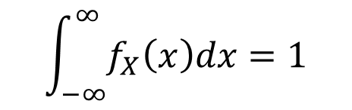
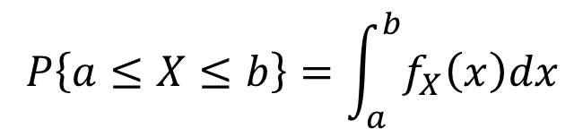
Probability for Continuous Random Variable
The probability that a continuous r.v. is equal to any particular value is defined to be 0.
Probability for a continuous r.v. is defined via a density function.
Defn 7.2: The probability density function (p.d.f.) of a continuous r.v. $X$is a non-negative
function $f_{X}\left(⋅\right),$where
$$P\left\{a≤X≤b\right\}=\int_{a}^{b}{f_{X}\left(x\right)dx}$$
$$\int_{−∞}^{∞}{f_{X}\left(x\right)dx=1}$$
and

Slide 4




Probability for Continuous Random Variable
$$x$$
$$x+dx$$
$$f\left(x\right)dx≈P\left\{x≤X≤x+dx\right\}$$
How do $P\left\{5≤X≤6\right\}$ and $P\left\{5<X<6\right\}$compare?
Can $f_{X}(x)$ be larger than 1?

Slide 5

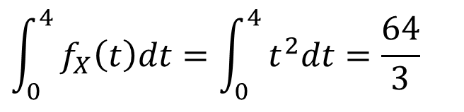
Density as a rate
Density functions are not necessarily related to probability.
Example: Filling a bathtub at rate $f_{X}\left(t\right)=t^{2} \text{gallons}\text{/}\text{sec}\text{, }\text{where} t≥0$
Q: How much water after 4 seconds?
Q: Is ${f_{X}}_{ }(t)$ a p.d.f.?
A:
$${\int_{0}^{4}{f_{X}\left(t\right)dt=\int_{0}^{4}{t^{2}dt=\frac{64}{3}}}}_{ }$$
gallons

Slide 6
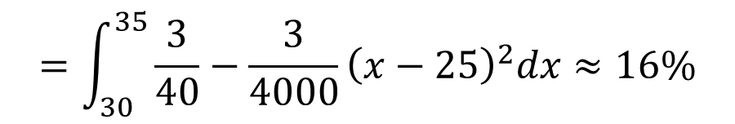
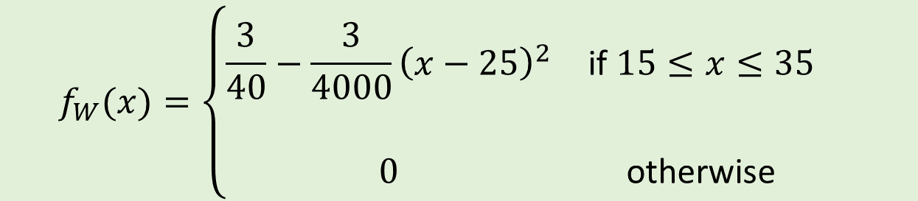
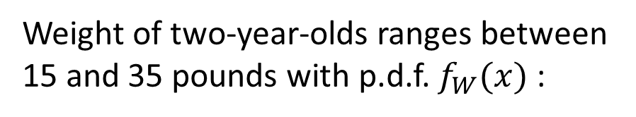


Example: Computing probability from p.d.f.
Weight of two-year-olds ranges between
15 and 35 pounds with p.d.f. $f_{W}(x)$:
$$f_{W}(x)=\left\{\begin{matrix}\frac{3}{40}−\frac{3}{4000}{\left(x−25\right)}^{2} & \text{if} 15≤x≤35 & \\ \begin{aligned} \\ 0\end{aligned} & \begin{aligned} \\ \text{otherwise}\end{aligned} & \end{matrix}\right.$$
Q: What is the fraction of two-year-olds
that weigh $>30$ pounds?
A:
$$\int_{30}^{∞}{f_{W}\left(x\right)dx}$$
$$=\int_{30}^{35}{\frac{3}{40}−\frac{3}{4000}{\left(x−25\right)}^{2}dx≈16\%}$$

Slide 7

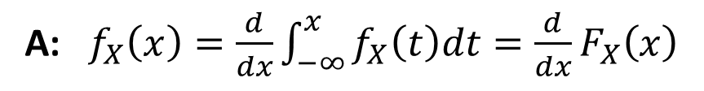



Cumulative distribution function
Defn: The cumulative distribution function (c.d.f.) of a continuous r.v. $X$is given by:
$$F_{X}\left(a\right)=P\left\{−∞<X≤a\right\}= \int_{−∞}^{a}{f_{X}\left(x\right)dx}$$
The tail of $X$is given by:
$${\overline{F}}_{X}\left(a\right)=1 −F_{X}\left(a\right)=P\{X>a\}$$
Q: How do we get $f_{X}(x)$ from $F_{X}(x)$ ?
F.T.C.
A: $f_{X}\left(x\right)=\frac{d}{dx}\int_{−∞}^{x}{f_{X}\left(t\right)dt=\frac{d}{dx}F_{X}\left(x\right)}$
(See Section 1.3 of your book)

Slide 8





Uniform distribution
Defn: Uniform$\left(a,b\right),$often written $U(a,b)$, models the fact that any interval of
length $δ$between $a$and $b$is equally likely. Specifically, if $X∼U\left(a,b\right),$then
$$\begin{matrix}\frac{1}{b−a } & \text{if} a≤x≤b \\ & \\ 0 & \text{otherwise} \end{matrix}$$
$$f_{X}\left(x\right)=$$
Q: If $X∼U(a,b)$, what is $F_{X}(x)$?
A: $F_{X}\left(x\right)=\int_{a}^{x}{\frac{1}{b−a}dt=\frac{x−a}{b−a}}$
$$\text{if} a≤x≤b$$

Slide 9
Graphical depiction of Uniform distribution
Area of shaded pink region on left $=$Height of blue line on right

Slide 10


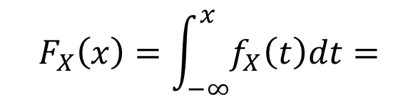
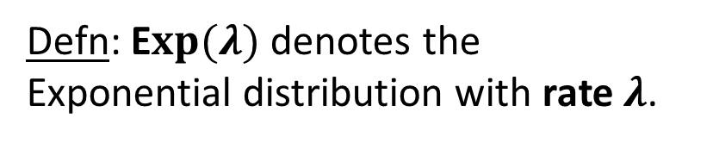
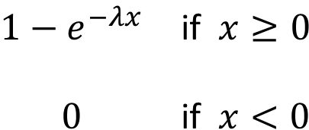


Exponential distribution
The p.d.f. and tail both drop off by a constant factor, $e^{−λx}$, with each unit increase in $x.$
Defn: E$xp(λ)$denotes the
Exponential distribution with rate $λ$.
$$\begin{matrix}λe^{−λx} & \text{if} x≥0 \\ & \\ 0 & \text{if} x<0\end{matrix}$$
$$f_{X}\left(x\right)=$$
$$F_{X}\left(x\right)=\int_{−∞}^{x}{f_{X}\left(t\right)dt=}$$
$$\begin{matrix}1−e^{−λx} & \text{if} x≥0 \\ & \\ 0 & \text{if} x<0\end{matrix}$$
$${\overline{F}}_{X}\left(x\right)=e^{−λx}, x≥0$$

Slide 11
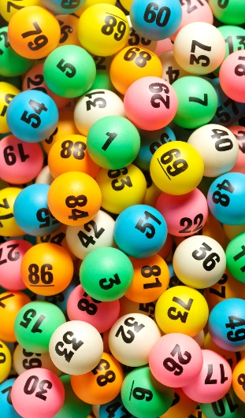





Memorylessness
Defn: Random variable $X$has the memoryless property if
$$P\left\{X>t+s \right| X>s\}=P\{X>t\}$$
$$∀s, t≥0$$
$$X=\text{Time} \text{to} \text{win} \text{lottery}\text{.}$$
$\text{Suppose} \text{I} \text{haven}\text{′}\text{t} \text{won} \text{the} \text{lottery} \text{by} \text{time} s\text{. }\text{Then} \text{the} \text{pro}$bability that I’ll need $>t$ more time to win is independent of $s$.
Equivalently: $X$has the memoryless property if
$$\left[X \right| X>s] =^{d} s+X$$
$$∀s≥0$$
That is, the r.v.s $\left[X \right| X>s]$and $s+X$ have the same distribution.

Slide 12






Memorylessness
Defn: Random variable $X$has the memoryless property if
$$P\left\{X>t+s \right| X>s\}=P\{X>t\}$$
$$∀s, t≥0$$
Q: Prove that if $X∼Exp(λ)$, then $X$has the memoryless property.
A: First recall that:
$${\overline{F}}_{X}\left(x\right)=e^{−λx}, x≥0$$
$$=\frac{P\{X>t+s\}}{P\{X>s\}}$$
$$=\frac{e^{−λ(t+s)}}{e^{−λs}}$$
$$P\left\{X>t+s \right| X>s\}$$
$$=e^{−λt }=P\{X>t\}$$

Slide 13
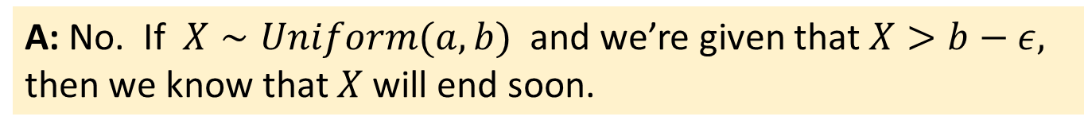
Memorylessness
Defn: Random variable $X$has the memoryless property if
$$P\left\{X>t+s \right| X>s\}=P\{X>t\}$$
$$∀s, t≥0$$
Q: What other distribution has the memoryless property?
A: The Geometric distribution
Q: Does $X∼Uniform(a,b)$ also have the memoryless property?
A: No. If $X∼Uniform(a,b)$ and we’re given that $X>b−ε,$
then we know that $X$will end soon.

Slide 14
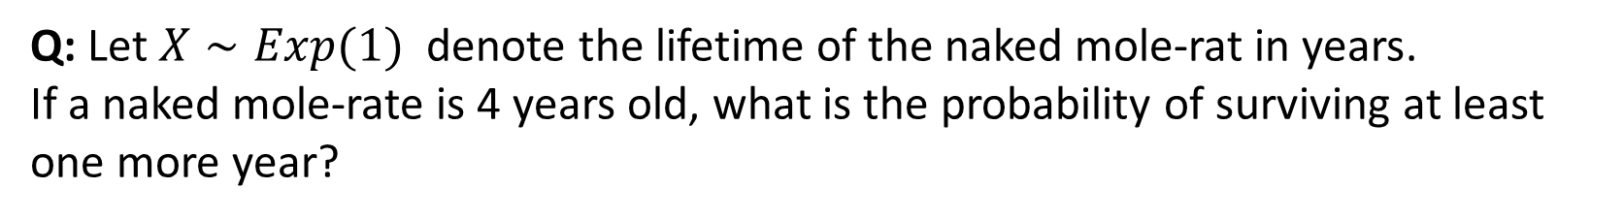
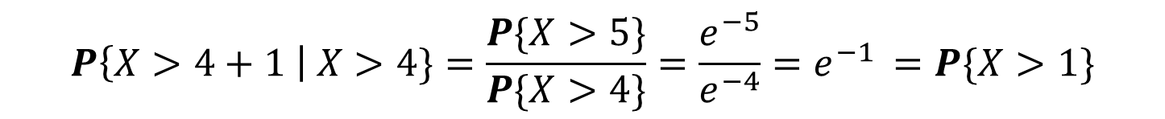
Memorylessness Example
Mortality rate normally increases with age.
But not for the naked mole-rat!
Its remaining lifetime is independent of its age.
Q: Let $X∼Exp(1)$ denote the lifetime of the naked mole-rat in years.
If a naked mole-rate is 4 years old, what is the probability of surviving at least one more year?
$$P\left\{X>4+1 \right| X>4\}=\frac{P\{X>5\}}{P\{X>4\}}=\frac{e^{−5}}{e^{−4}}=e^{−1 }=P\{X>1\}$$
A:

Slide 15


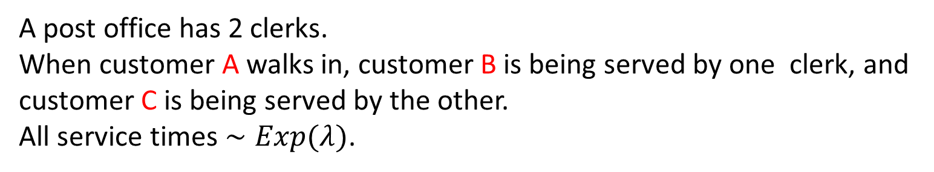

Post Office Example
A post office has 2 clerks.
When customer A walks in, customer B is being served by one clerk, and customer C is being served by the other.
All service times $∼Exp(λ)$.
B
C
Q: What is $P\{\text{A} \text{is} \text{last} \text{to} \text{leave}\}$?
A:
$$\frac{1}{2}$$
One of B or C will leave first. At that point, the remaining customer’s lifetime restarts. A will then compete with that remaining customer.

Slide 16
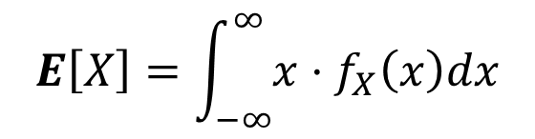
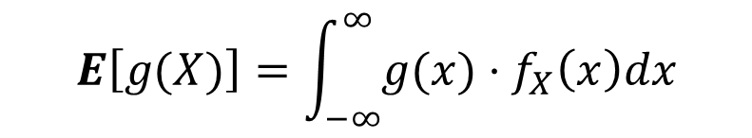
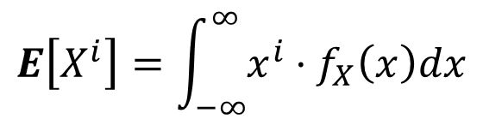
Expectation, Variance, and Higher Moments
Defn: For a continuous r.v. $X$with p.d.f. $f_{X}(⋅)$, we have:
$$E\left[X\right]=\int_{−∞}^{∞}{{x⋅f}_{X}\left(x\right)dx}$$
$$E\left[X^{i}\right]=\int_{−∞}^{∞}{{x^{i}⋅f}_{X}\left(x\right)dx}$$
$$E\left[g(X)\right]=\int_{−∞}^{∞}{g({x)⋅f}_{X}\left(x\right)dx}$$
$$Var\left(X\right)=E\left[{\left(X−E\left[X\right]\right)}^{2} \right]=\int_{−∞}^{∞}{{\left(x −E\left[X\right]\right)}^{2}f_{X}(x)dx}=E\left[X^{2}\right]−E{\left[X\right]}^{2}$$

Slide 17
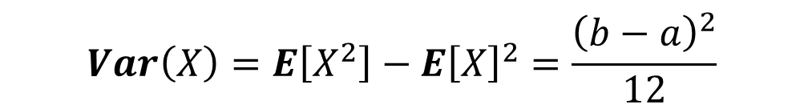

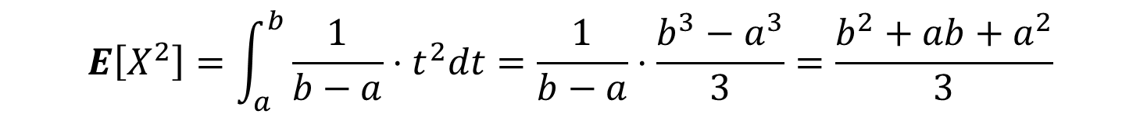
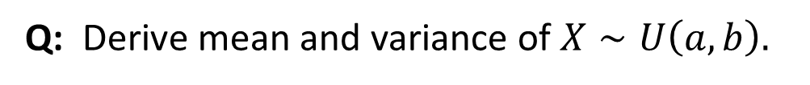
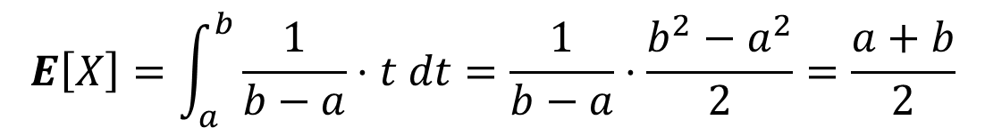


Uniform distribution: Mean and Variance
$$X∼Uniform\left(a,b\right)$$
Q: Derive mean and variance of $X∼U\left(a,b\right).$
$$\begin{matrix}\frac{1}{b−a } & \text{if} a≤x≤b \\ & \\ 0 & \text{otherwise} \end{matrix}$$
$$f_{X}\left(x\right)=$$
A:
$$E\left[X\right]=\int_{a}^{b}{\frac{1}{b−a}⋅t dt=\frac{1}{b−a}⋅\frac{b^{2}−a^{2}}{2}=\frac{a+b}{2}}$$
$$E\left[X^{2}\right]=\int_{a}^{b}{\frac{1}{b−a}⋅t^{2}dt=\frac{1}{b−a}⋅\frac{b^{3}−a^{3}}{3}=\frac{b^{2}+ab+a^{2}}{3}}$$
$$Var\left(X\right)=E\left[X^{2}\right]−E{\left[X\right]}^{2}=\frac{{\left(b−a\right)}^{2}}{12}$$

Slide 18



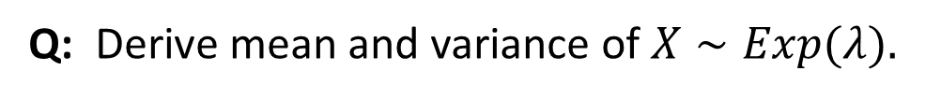


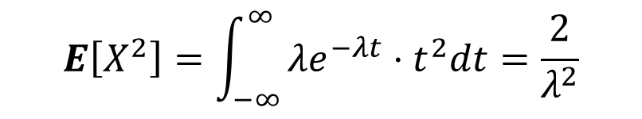
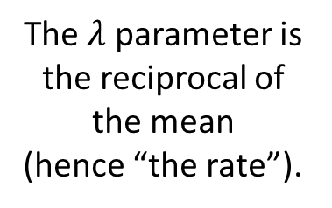
Exponential distribution: Mean and Variance
Q: Derive mean and variance of $X∼Exp(λ).$
$$X∼Exp(λ)$$
$$\begin{matrix}λe^{−λx} & \text{if} x≥0 \\ & \\ 0 & \text{if} x<0\end{matrix}$$
A:
$$f_{X}\left(x\right)=$$
$$E\left[X\right]=\int_{−∞}^{∞}{λe^{−λt }t dt=\frac{1}{λ}}$$
$$E\left[X^{2}\right]=\int_{−∞}^{∞}{λe^{−λt}⋅t^{2}dt=\frac{2}{λ^{2}}}$$
The $λ$ parameter is the reciprocal of the mean
(hence “the rate”).
$$Var\left(X\right)=E\left[X^{2}\right]−E{\left[X\right]}^{2}=\frac{1}{λ^{2}}$$

Slide 19

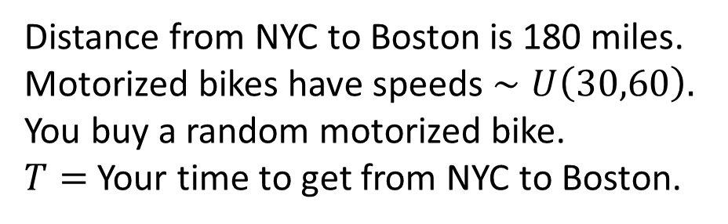

Example: Time to get from NYC to Boston
Distance from NYC to Boston is 180 miles.
Motorized bikes have speeds $∼U\left(30,60\right).$
You buy a random motorized bike.
$T=$ Your time to get from NYC to Boston.
Goal: Derive $E\left[T\right].$
Idea 1: Avg. speed is 45 mph. Thus $E\left[T\right]=\frac{180}{45}=4 \text{hours}\text{.}$
Idea 2: $E\left[T\right] \text{is} \text{the} \text{average} \text{of} \frac{180}{ 30 }=6 \text{and}\frac{180}{ 60 }\text{= 3}\text{. }\text{So} E\left[T\right]=4.5 \text{hours}\text{.}$
Q: Which is correct, Idea 1 or Idea 2?
A: Neither!

Slide 20

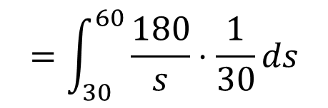
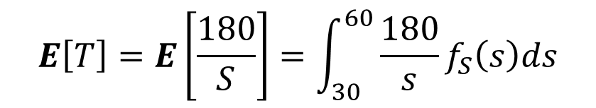
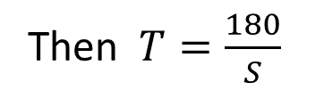


Example: Time to get from NYC to Boston
Distance from NYC to Boston is 180 miles.
Motorized bikes have speeds $∼U\left(30,60\right).$
You buy a random motorized bike.
$T=$ Your time to get from NYC to Boston.
Q: What is $E\left[T\right]?$
A:
Then $T=\frac{180}{S}$
Let $S∼U(30,60)$ represent the speed of your bike.
$$E\left[T\right]=E\left[\frac{180}{S}\right]=\int_{30}^{60}{\frac{180}{s}f_{S}\left(s\right)ds}$$
$$=\int_{30}^{60}{\frac{180}{s}⋅\frac{1}{30}ds}$$
$$=6 (\ln{60 −\ln{30)}}$$
$$=6 (\ln{2)≈4.15 }\text{hours}$$

Slide 21
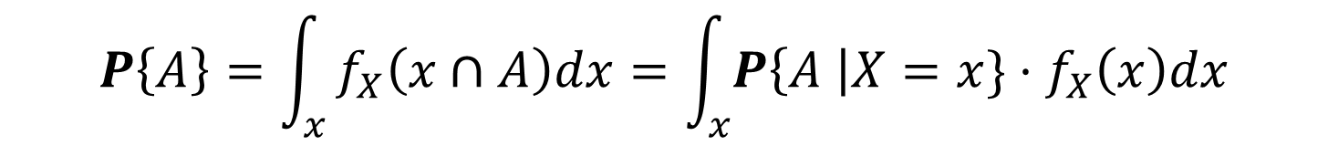
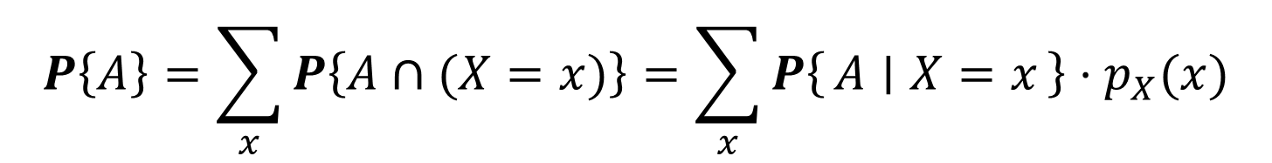
Law of Total Probability for Continuous
Recall the Law of Total Probability for event $A$and discrete r.v. $X$:
$$P\left\{A\right\}=\sum_{x}{P\left\{A∩(X=x)\right\}=\sum_{x}{P\left\{A ∣ X=x\right\}⋅p_{X}(x)}}$$
The same Law of Total Probability holds for event $A$and continuous r.v. $X$:
$$P\left\{A\right\}=\int_{x}{f_{X}\left(x∩A\right)dx=\int_{x}{P\left\{A \right|X=x\}⋅f_{X}\left(x\right)dx}}$$
$$\text{Here} f_{X}\left(x∩A\right) \text{denotes} \text{the} \text{density} \text{of} \text{the} \text{intersection} \text{of} \text{the} \text{event} A \text{with} X=x.$$

Slide 22
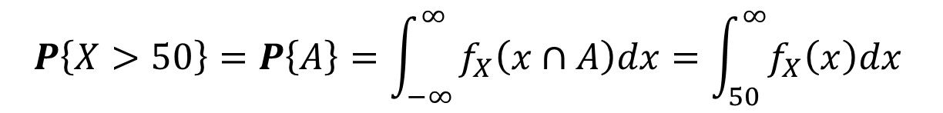
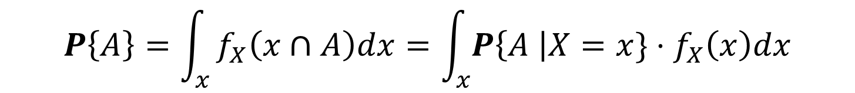
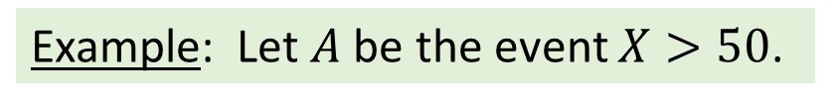


Law of Total Probability for Continuous
$$P\left\{A\right\}=\int_{x}{f_{X}\left(x∩A\right)dx=\int_{x}{P\left\{A \right|X=x\}⋅f_{X}\left(x\right)dx}}$$
$$\text{Here} f_{X}\left(x∩A\right) \text{denotes} \text{the} \text{density} \text{of} \text{the} \text{intersection} \text{of} \text{the} \text{event} A \text{with} X=x.$$
Example: Let $A$be the event $X>50$.
$$\begin{matrix}f_{X}(x) & \text{if} x>50 \\ & \\ 0 & \text{otherwise} \end{matrix}$$
$$f_{X}\left(x∩A\right)=$$
$$P\left\{X>50\right\}=P\left\{A\right\}=\int_{−∞}^{∞}{f_{X}\left(x∩A\right)dx=\int_{50}^{∞}{f_{X}\left(x\right)dx}}$$
Likewise,
$$P\left\{X>50\right\}=\int_{−∞}^{∞}{P\left\{X>50 \right| X=x\}⋅f_{X}(x)dx=\int_{50}^{∞}{{1⋅f}_{X}\left(x\right)dx}}$$

Slide 23
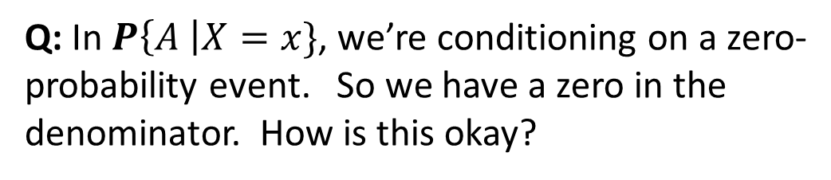
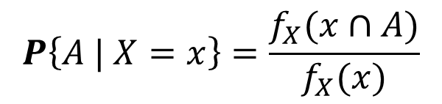

Conditioning on a Zero-Probability Event
$$P\left\{A\right\}=\int_{x}{f_{X}\left(x∩A\right)dx=\int_{x}{P\left\{A \right|X=x\}⋅f_{X}\left(x\right)dx}}$$
$$\text{Here} f_{X}\left(x∩A\right) \text{denotes} \text{the} \text{density} \text{of} \text{the} \text{intersection} \text{of} \text{the} \text{event} A \text{with} X=x.$$
Q: In $P\left\{A \right|X=x\}$, we’re conditioning on a zero-probability event. So we have a zero in the denominator. How is this okay?
$$\begin{matrix}f_{X}(x) & \text{if} x∈A \\ & \\ 0 & \text{otherwise} \end{matrix}$$
$$f_{X}\left(x∩A\right)=$$
A:
$$P\left\{A | X=x\right\}=\frac{f_{X}(x∩A)}{f_{X}(x)}$$
The ratio is between densities, not probabilities,
and the densities are not zero!

Slide 24
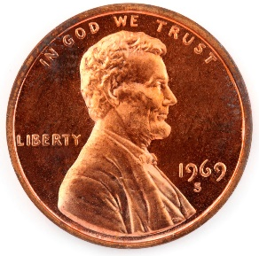


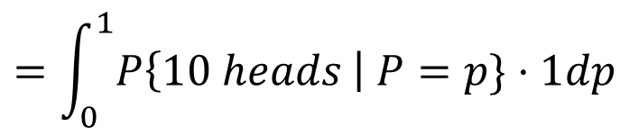
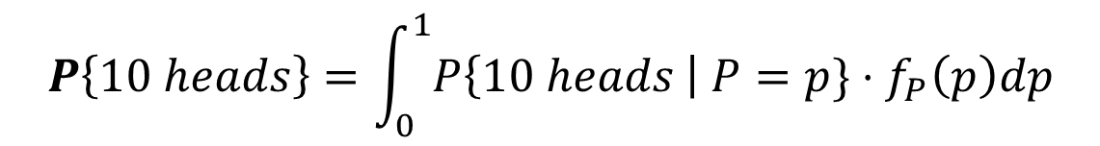


Conditioning on a Zero-Probability Event
Example: We have a coin with unknown bias.
Specifically, the coin has probability $P$of heads where $P∼Uniform\left(0,1\right).$
Q: What is $P\{\text{Next}\text{ 10 }\text{flips} \text{are} \text{all} \text{heads}\text{\}}$?
$$P\left\{10 heads\right\}=\int_{0}^{1}{P\left\{10 heads \right| P=p\}⋅f_{P}\left(p\right)dp}$$
A:
$$=\int_{0}^{1}{P\left\{10 heads \right| P=p\}⋅1dp}$$
$$=\int_{0}^{1}{p^{10}⋅1dp}$$
$$=\frac{1}{11}$$

Slide 25




Conditional p.d.f. and Bayes’ Law
Defn: For a continuous r.v. $X$and an event $A,$
the conditional p.d.f. of r.v. $X \text{given} A \text{is}$:
$$f_{X|A}\left(x\right)=\frac{f_{X}(x∩A)}{P\{A\}}=\frac{P\left\{A \right|X=x\}⋅f_{X}(x) }{P\{A\}}$$
Comments:
Conditional p.d.f $f_{X|A}\left(x\right)$has value $0$ outside of $A$.
The conditional p.d.f. is still a proper p.d.f. in that
$$\int_{x}{f_{X|A}\left(x\right)dx=1}$$

Slide 26




Conditional p.d.f. and Bayes’ Law
Defn: For a continuous r.v. $X$and an event $A,$
the conditional p.d.f. of r.v. $X \text{given} A \text{is}$:
$$f_{X|A}\left(x\right)=\frac{f_{X}(x∩A)}{P\{A\}}=\frac{P\left\{A \right|X=x\}⋅f_{X}(x) }{P\{A\}}$$
Example:
$X$ has p.d.f. $f_{X}\left(x\right)$defined on $0<x<100.$
$A$ is the event $X>50.$
$f_{X|A}\left(x\right)$is a scaled-up version of $f_{X}\left(x\right)$,
allowing it to integrate to $1.$
$$f_{X|X>50}\left(x\right)=\frac{f_{X}(x∩X>50)}{P\{X>50\}}=$$
$$\begin{matrix}\frac{f_{X}(x)}{P\{X>50\}} & \text{if} x>50 \\ & \\ 0 & \text{otherwise} \end{matrix}$$

Slide 27



Conditional expectation
Defn:
For a discrete r.v. $X$and an event $A,$where $P\left\{A\right\}>0,$ the conditional expectation of $X \text{given} A \text{is}$:
$$E\left[X | A\right]=\sum_{x}{x⋅p_{X|A}(x)}$$
For a continuous r.v. $X$and an event $A,$where $P\left\{A\right\}>0,$ the conditional expectation of $X \text{given} A \text{is}$:
$$E\left[X | A\right]=\int_{x}{x⋅f_{X|A}\left(x\right)dx}$$

Slide 28



Conditional expectation example
Example: Pittsburgh Supercomputing Center (PSC)
At the PSC, jobs are grouped into different bins based on their size.
Suppose job sizes are Exponentially distributed with
mean $1000$CPU-hours.
Suppose all jobs of size $<500$ CPU-hours are sent to bin 1.
a. What is $P\left\{\text{Job} \text{is} \text{sent} \text{to} \text{bin}\text{ 1}\right\}?$
b. What is $P\left\{\text{Job} \text{size}<200 | \text{job} \text{is} \text{in} \text{bin}\text{ 1}\right\}?$
c. What is $f_{X|A}(x)$, where $X$is the job size and $A$is the event that the job is in bin 1?
d. What is $E[\text{Job} \text{size} | \text{job} \text{is} \text{in} \text{bin}\text{ 1}]?$

Slide 29









Conditional expectation example
$$X∼Exp\left(\frac{1}{1000}\right)$$
Example: Pittsburgh Supercomputing Center (PSC)
At the PSC, jobs are grouped into bins based on their size.
Suppose job sizes are Exponentially distributed with
mean $1000$CPU-hours.
Suppose all jobs of size $<500$ CPU-hours are sent to bin 1.
$$\begin{matrix}\frac{1}{1000}e^{−\frac{1}{1000}x} & \text{if} x≥0 \\ & \\ 0 & \text{if} x<0\end{matrix}$$
$$f_{X}\left(x\right)=$$
a. What is $P\left\{\text{Job} \text{is} \text{sent} \text{to} \text{bin}\text{ 1}\right\}?$
$${{\overline{F}}_{X}}_{ }\left(x\right)=P\left\{X>x\right\}= e^{−\frac{1}{1000}x}$$
$$=1 −e^{−\frac{500}{1000}}=1 −e^{−\frac{1}{2}}≈0.39$$
$$P\left\{\text{Job} \text{is} \text{sent} \text{to} \text{bin}\text{ 1}\right\}$$
$=F_{X}(500)$

Slide 30





Conditional expectation example
$$X∼Exp\left(\frac{1}{1000}\right)$$
Example: Pittsburgh Supercomputing Center (PSC)
At the PSC, jobs are grouped into bins based on their size.
Suppose job sizes are Exponentially distributed with
mean $1000$CPU-hours.
Suppose all jobs of size $<500$ CPU-hours are sent to bin 1.
$$\begin{matrix}\frac{1}{1000}e^{−\frac{1}{1000}x} & \text{if} x≥0 \\ & \\ 0 & \text{if} x<0\end{matrix}$$
$$f_{X}\left(x\right)=$$
b. What is $P\left\{\text{Job} \text{size}<200 | \text{job} \text{is} \text{in} \text{bin}\text{ 1}\right\}?$
$${{\overline{F}}_{X}}_{ }\left(x\right)=P\left\{X>x\right\}= e^{−\frac{1}{1000}x}$$
$$=\frac{P\{X<200∩\text{bin} 1\}}{P\{\text{bin} 1\}}$$
$$=\frac{F_{X}(200)}{F_{X}(500)}≈0.46$$
$$P\left\{\text{Job} \text{size}<200 | \text{job} \text{is} \text{in} \text{bin}\text{ 1}\right\}$$

Slide 31




Conditional expectation example
$$X∼Exp\left(\frac{1}{1000}\right)$$
Example: Pittsburgh Supercomputing Center (PSC)
At the PSC, jobs are grouped into bins based on their size.
Suppose job sizes are Exponentially distributed with
mean $1000$CPU-hours.
Suppose all jobs of size $<500$ CPU-hours are sent to bin 1.
$$\begin{matrix}\frac{1}{1000}e^{−\frac{1}{1000}x} & \text{if} x≥0 \\ & \\ 0 & \text{if} x<0\end{matrix}$$
$$f_{X}\left(x\right)=$$
c. What is $f_{X|A}(x)$, where $X$is the job size and $A$is the event that the job is in bin 1?
$${{\overline{F}}_{X}}_{ }\left(x\right)=P\left\{X>x\right\}= e^{−\frac{1}{1000}x}$$
$$\begin{matrix}\frac{f_{X}(x)}{F_{X}(500)}=\frac{1}{1−e^{−\frac{1}{2}}}⋅\frac{1}{1000}e^{−\frac{1}{1000}x} & \text{if} x<500 \\ & \\ \begin{aligned} \\ 0\end{aligned} & \text{otherwise} \end{matrix}$$
$$f_{X|A}\left(x\right)=\frac{f_{X}(x∩A)}{P\{A\}}=\frac{f_{X}(x∩A)}{F_{X}(500)}=$$

Slide 32

Conditional expectation example
$$X∼Exp\left(\frac{1}{1000}\right)$$
Example: Pittsburgh Supercomputing Center (PSC)
At the PSC, jobs are grouped into bins based on their size.
Suppose job sizes are Exponentially distributed with
mean $1000$CPU-hours.
Suppose all jobs of size $<500$ CPU-hours are sent to bin 1.
$$\begin{matrix}\frac{1}{1000}e^{−\frac{1}{1000}x} & \text{if} x≥0 \\ & \\ 0 & \text{if} x<0\end{matrix}$$
$$f_{X}\left(x\right)=$$
d. What is $E[\text{Job} \text{size} | \text{job} \text{is} \text{in} \text{bin}\text{ 1}]?$
$${{\overline{F}}_{X}}_{ }\left(x\right)=P\left\{X>x\right\}= e^{−\frac{1}{1000}x}$$
$${E\left[\text{Job} \text{size} \right| \text{job} \text{is} \text{in} \text{bin} 1]=\int_{−∞}^{∞}{x}f}_{X|A}\left(x\right)dx=\int_{0}^{500}{x⋅\frac{1}{1−e^{−\frac{1}{2}}}⋅\frac{1}{1000}e^{−\frac{1}{1000}x}dx}≈229$$

Slide 33



Conditional expectation example
$$X∼Exp\left(\frac{1}{1000}\right)$$
Example: Pittsburgh Supercomputing Center (PSC)
At the PSC, jobs are grouped into bins based on their size.
Suppose job sizes are Exponentially distributed with
mean $1000$CPU-hours.
Suppose all jobs of size $<500$ CPU-hours are sent to bin 1.
d. What is $E[\text{Job} \text{size} | \text{job} \text{is} \text{in} \text{bin}\text{ 1}]?$
$$E\left[\text{Job} \text{size} \right| \text{job} \text{is} \text{in} \text{bin} 1]≈229$$
Why is the expected job
size for bin 1
$$<250?$$

Slide 34

Conditional expectation example
$$X∼Exp\left(\frac{1}{1000}\right)$$
Example: Pittsburgh Supercomputing Center (PSC)
At the PSC, jobs are grouped into bins based on their size.
Suppose job sizes are Exponentially distributed with
mean $1000$CPU-hours.
Suppose all jobs of size $<500$ CPU-hours are sent to bin 1.
d. What is $E[\text{Job} \text{size} | \text{job} \text{is} \text{in} \text{bin}\text{ 1}]?$
$$E\left[\text{Job} \text{size} \right| \text{job} \text{is} \text{in} \text{bin} 1]≈229$$
How would the above answer change if
$$X∼Uniform(0,2000)?$$

Slide 35




Learning the bias of a coin, or a human
Example:
We’re trying to estimate the likelihood that a human will click on an ad.
We model the human as coin with unknown bias $P∼Uniform\left(0,1\right).$
T$he coin \text{has} \text{resulted} \text{in}\text{ 10 }\text{heads} \text{out} \text{of} \text{the} \text{first}\text{ 10 }\text{flips}\text{ (}\text{call} \text{this} \text{event} A\text{)}.$
Q: What is $E\left[P \right| A]?$
The best estimator of $P$ is the fraction of heads obtained so far!
But this seems shaky …

Slide 36







Learning a person’s bias
Example:
We’re trying to estimate the likelihood that a human will click on an ad.
We model the human as coin with unknown bias $P∼Uniform\left(0,1\right).$
T$he coin \text{has} \text{resulted} \text{in}\text{ 10 }\text{heads} \text{out} \text{of} \text{the} \text{first}\text{ 10 }\text{flips}\text{ (}\text{call} \text{this} \text{event} A\text{)}.$
Q: What is $E\left[P \right| A]?$
A:
$$E\left[P \right| A]=\int_{0}^{1}{f_{P|A}\left(p\right)⋅p dp}$$
$f_{P|A}\left(p\right)=\frac{P\left\{A \right|P=p\}⋅f_{P}(p)}{P\{A\}}$ $=\frac{p^{10}⋅1}{P\{A\}}$
$${\text{So} f}_{P|A}\left(p\right)=11p^{10}$$
$$P\left\{A\right\}=\int_{0}^{1}{P\left\{A\right| P=p\}⋅f_{P}\left(p\right)dp}$$
$$=\int_{0}^{1}{p^{10}⋅1dp}$$
$$=\frac{1}{11}$$

Slide 37



Learning a person’s bias
Example:
We’re trying to estimate the likelihood that a human will click on an ad.
We model the human as coin with unknown bias $P∼Uniform\left(0,1\right).$
T$he coin \text{has} \text{resulted} \text{in}\text{ 10 }\text{heads} \text{out} \text{of} \text{the} \text{first}\text{ 10 }\text{flips}\text{ (}\text{call} \text{this} \text{event} A\text{)}.$
Q: What is $E\left[P \right| A]?$
A:
$$E\left[P \right| A]=\int_{0}^{1}{f_{P|A}\left(p\right)⋅p dp}$$
$=\int_{0}^{1}{11p^{10}⋅pdp= \frac{11}{12}}$
Not 1 but close. The answer depends on the initial assumption
that $P∼Uniform\left(0,1\right)$, which is referred to as the prior (see Chpt 17).
$${\text{So} f}_{P|A}\left(p\right)=11p^{10}$$

