Slide 1
Chapter 6 z-Transforms

Slide 2
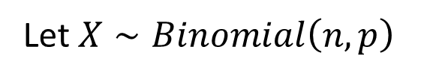
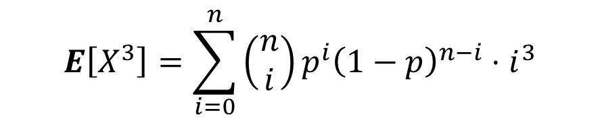

Motivation
Let $X∼Binomial\left(n,p\right)$
What is $E\left[X^{3}\right]?$
$$E\left[X^{3}\right]=\sum_{i=0}^{n}{\left(\begin{matrix}n \\ i\end{matrix}\right)p^{i}{\left(1−p\right)}^{n−i}⋅i^{3}}$$
Seems complicated to evaluate!

Slide 3



Motivation
Let $X∼Poisson(λ)$
What is $E\left[X^{5}\right]?$
$$E\left[X^{5}\right]=\sum_{i=0}^{∞}{\frac{e^{−λ} λ^{i}}{i!}⋅i^{5}}$$
Seems complicated to evaluate!

Slide 4
The wonderful world of transforms
Laplace transforms
Fourier transforms
z-transforms
characteristic functions
moment-generating functions
Two common uses:
  Computing higher moments of random variables
  Solving recurrence relations

Slide 5

The z-transform as an onion
Onion represents z-transform of r.v. $X$
Lower moments are in the outer layers → less effort/tears
Higher moments are deeper inside → more effort/tears

Slide 6
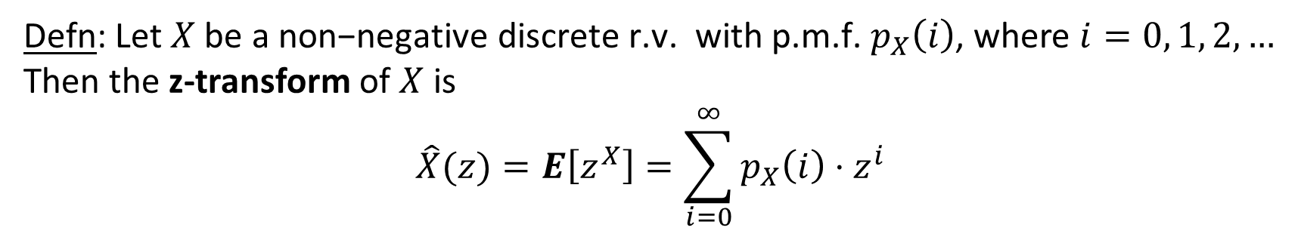

z-transform of discrete r.v.
Defn: Let$X \text{be} \text{a} \text{non}\text{−}\text{negative} \text{discrete} \text{r}\text{.}\text{v}\text{. }\text{with} \text{p}\text{.}\text{m}\text{.}\text{f}\text{.}{ p}_{X}\left(i\right)$, where $i=0, 1, 2, …$
Then the z-transform of $X$ is
$$\hat{X}(z)=E\left[z^{X}\right]=\sum_{i=0}^{∞}{p_{X}\left(i\right)⋅z^{i}}$$
Assume$z \text{is} \text{a} \text{constant} \text{and} \left|z\right|≤1.$
$$\text{Note}\text{: }\text{The} \text{z}\text{−}\text{transform} \text{can} \text{be} \text{defined} \text{for} \text{any} \text{r}\text{.}\text{v}\text{., }\text{or} \text{even} \text{for} \text{just} \text{a} \text{sequence} \text{of} p{\left(i\right)}^{′}s.$$
$\text{However} \text{convergence} \text{is} \text{only}$guaranteed when $X$is a non-negative r.v. and $\left|z\right|≤1$.

Slide 7



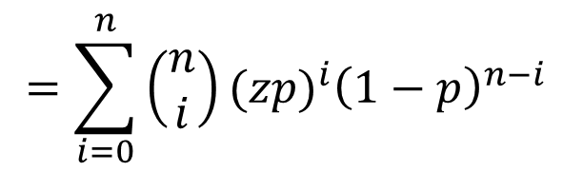

Example of Onion Building
$$X∼Binomial(n,p)$$
$$\text{Create} \text{the} \text{onion}\text{!}$$
$$\hat{X}(z)=E\left[z^{X}\right]=\sum_{i=0}^{n}{\left(\begin{matrix}n \\ i\end{matrix}\right)p^{i}{\left(1−p\right)}^{n−i}z^{i}}$$
$$=\sum_{i=0}^{n}{\left(\begin{matrix}n \\ i\end{matrix}\right){(zp)}^{i}{\left(1−p\right)}^{n−i}}$$
$$={\left(zp+\left(1−p\right)\right)}^{n}$$

Slide 8



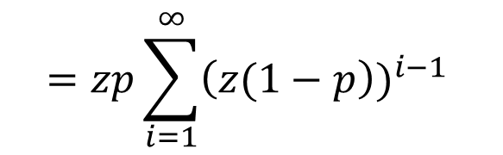
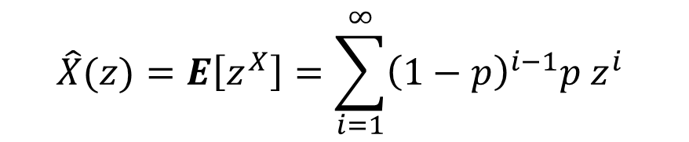
Example of Onion Building
$$X∼Geometric(p)$$
$$\text{Create} \text{the} \text{onion}\text{!}$$
$$\hat{X}(z)=E\left[z^{X}\right]=\sum_{i=1}^{∞}{{\left(1−p\right)}^{i−1}{p z}^{i}}$$
$$=zp\sum_{i=1}^{∞}{{\left(z(1−p\right))}^{i−1}}$$
$$\text{Where} \text{did} \text{we} \text{use} \text{the} \text{fact} \text{that}$$
$$\left|z\right|≤1 ?$$
$$=\frac{zp}{1−z(1−p)}$$

Slide 9

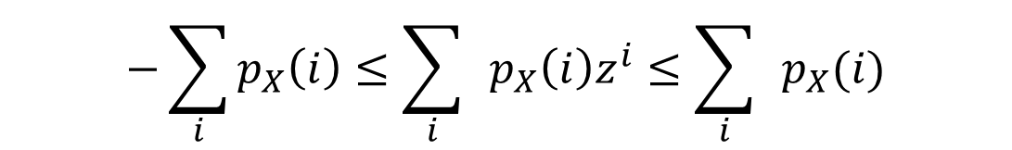


Convergence of z-transform
Theorem: $\hat{X}\left(z\right) \text{i}\text{s} \text{bounded} \text{for} \text{any} \text{non}\text{−}\text{negative} \text{discrete} \text{r}\text{.}\text{v}\text{.} X\text{, }\text{assuming} \left|z\right|≤1.$
Proof:
$$−1≤z≤1$$
$$−1≤z^{i}≤1$$
$$−p_{X}(i)≤{p_{X}\left(i\right)z}^{i}≤p_{X}(i)$$
$$−\sum_{i}{p_{X}\left(i\right)}≤{{\sum_{i}{ }p}_{X}\left(i\right)z}^{i}≤{\sum_{i}{ }p}_{X}(i)$$
$$−1≤\hat{X }\left(z\right)≤1$$

Slide 10



Getting moments: Onion peeling
Theorem: (Onion Peeling) $\text{Let}$ $X \text{be} \text{a} \text{discrete}\text{, }\text{integer}\text{−}\text{valued}\text{, }\text{non}\text{−}\text{negative} \text{r}\text{.}\text{v}\text{. }$
$\text{with} \text{p}\text{.}\text{m}\text{.}\text{f}\text{.} { p}_{X}\left(i\right)\text{,} \text{i}\text{ = 0, 1, 2, }…$Then,
${\left.\hat{X }′\left(z\right)\right|}_{z=1}=E[X]$
${\left.\hat{X }′′\left(z\right)\right|}_{z=1}=E[X(X−1)]$
${\left.{\hat{X }}^{′′}′\left(z\right)\right|}_{z=1}=E[X(X−1)(X−2)]$
${\left.{\hat{X }}^{′′}′′\left(z\right)\right|}_{z=1}=E[X(X−1)(X−2)(X−3)]$
$$\text{If} \text{can}\text{′}\text{t} \text{evaluate} \text{at} z=1\text{, }\text{instead} \text{consider} \text{limit} \text{as} z→1 (\text{use} \text{L}\text{′}\text{Hospital}\text{′}\text{s} \text{Rule}\text{).}$$

Slide 11



Proof of onion peeling theorem
$$\hat{X }\left(z\right)=p_{X}\left(0\right)z^{0}+p_{X}\left(1\right)z^{1}+p_{X}\left(2\right)z^{2}+p_{X}\left(3\right)z^{3}+p_{X}\left(4\right)z^{4}+p_{X}\left(5\right)z^{5}+⋯$$
$$\hat{X ′}\left(z\right)=p_{X}\left(1\right)+2p_{X}\left(2\right)z^{1}+{3p}_{X}\left(3\right)z^{2}+{4p}_{X}\left(4\right)z^{3}+{5p}_{X}\left(5\right)z^{4}+⋯$$
${\left.\hat{X }′\left(z\right)\right|}_{z=1}=1⋅p_{X}\left(1\right)+2p_{X}\left(2\right)+3 p_{X}\left(3\right)+4p_{X}\left(4\right)+5 p_{X}\left(5\right)+⋯$
$$=E[X]$$
$$\hat{X ′}′\left(z\right)=2p_{X}\left(2\right)+{3⋅2 p}_{X}\left(3\right)z+{4⋅3 p}_{X}\left(4\right)z^{2}+{5⋅4 p}_{X}\left(5\right)z^{3}+⋯$$
$${\left.\hat{X }′′\left(z\right)\right|}_{z=1}=2⋅1p_{X}(2) +3⋅2{⋅p}_{X}\left(3\right)+4⋅3⋅ p_{X}\left(4\right)+5⋅4p_{X}\left(4\right)+⋯$$
$$=E[X(X−1)]$$
$$\hat{X ′}′′\left(z\right)={3⋅2 p}_{X}\left(3\right)+{4⋅3⋅2 p}_{X}\left(4\right)z+{5⋅4⋅3 p}_{X}\left(5\right)z^{2}+⋯$$
$${\left.\hat{X }′′′\left(z\right)\right|}_{z=1}=3⋅2⋅1 p_{X}(3)+4⋅3⋅2 p_{X}\left(4\right)+5⋅4{⋅3 p}_{X}\left(5\right)+⋯$$
$$=E[X(X−1)(X−2)]$$

Slide 12
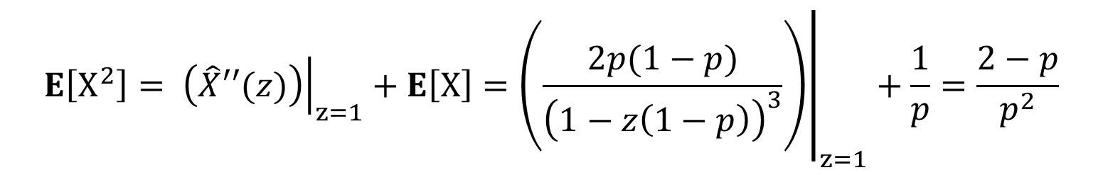
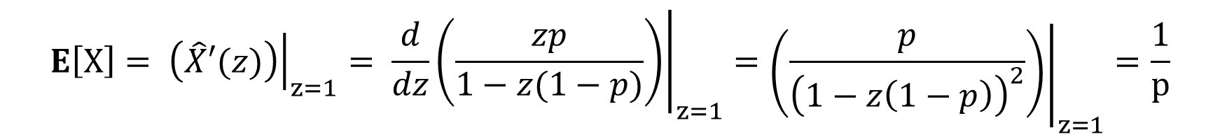

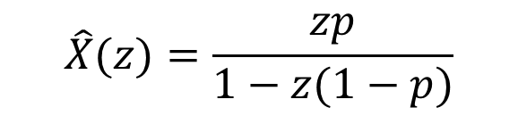
Example of onion peeling
$$\hat{X}(z)=\frac{zp}{1−z(1−p)}$$
$$X∼Geometric(p)$$
$$\text{Q}\text{:} \text{Peel} \text{the} \text{onion} \text{to} \text{get} E\left[X\right] \text{and} E[X^{2}]$$
$$E\left[X\right]= {\left.\left(\hat{X}′(z)\right)\right|}_{z=1}= {\left.\frac{d}{dz}\left(\frac{zp}{1−z(1−p)}\right)\right|}_{z=1}={\left.\left(\frac{p}{{\left(1−z\left(1−p\right)\right)}^{2}}\right)\right|}_{z=1}=\frac{1}{p}$$
$$E\left[X^{2}\right]= {\left.\left(\hat{X}′′(z)\right)\right|}_{z=1}+E\left[X\right]={\left.\left(\frac{2p(1−p)}{{\left(1−z\left(1−p\right)\right)}^{3}}\right)\right|}_{z=1}+\frac{1}{p}=\frac{2−p}{p^{2}}$$

Slide 13

Onion to distribution
$$\text{The} \text{z}\text{−}\text{transform} \text{of} X \text{is} \text{an} \text{onion} \text{that} \text{contains} \text{all} \text{moments} \text{of} X\text{. }$$
$$\text{But} \text{does} \text{it} \text{also} \text{contain} \text{the} \text{distribution} \text{of} X?$$
$$\text{Where} \text{did} \text{we} \text{use} \text{the} \text{fact} \text{that}$$
$$\left|z\right|≤1 ?$$
$$\text{The} \text{answer} \text{is} \text{YES}\text{! }\text{The} \text{distribution} \text{of} X \text{can} \text{be} \text{extracted} \text{from} \text{its} \text{z}\text{−}\text{transform}\text{. }\text{See} \text{Exercise}\text{ 6.14 }\text{in} \text{your} \text{book}\text{. }$$

Slide 14


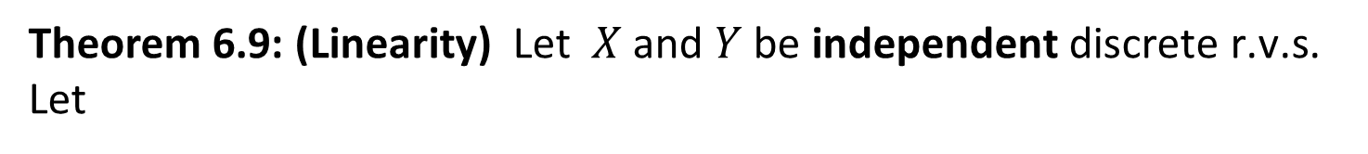




Linearity of Transforms
Theorem 6.9: (Linearity) $\text{Let}$ $X \text{and} Y \text{be} \text{independent} \text{discrete} \text{r}\text{.}\text{v}\text{.}\text{s}\text{. }$
Let
$$W=X+Y$$
$$\text{Then} \text{the} \text{z}\text{−}\text{transform} \text{of} W \text{is}\text{: }$$
$$\hat{W}\left(z\right)=\hat{X}\left(z\right)⋅\hat{Y}\left(z\right)$$
Proof:
$$\hat{W}\left(z\right)=E\left[z^{W}\right]=E[z^{X+Y}]$$
$$=E[z^{X}⋅z^{Y}]$$
$$=E\left[z^{X}\right]⋅E\left[z^{Y}\right]$$
$$=\hat{X}\left(z\right)⋅\hat{Y}\left(z\right)$$

Slide 15

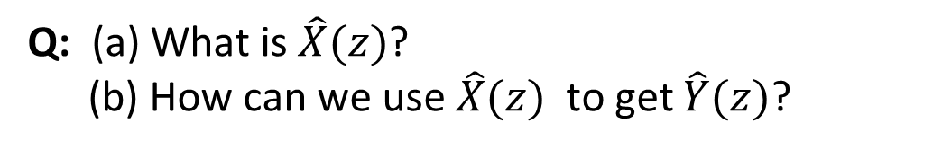


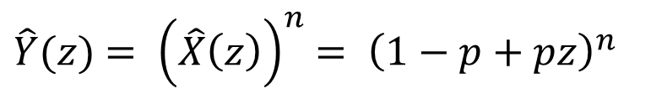
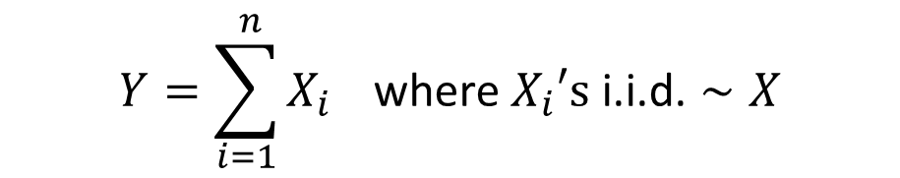

Example: From Bernoulli to Binomial
$$X∼Bernoulli(p)$$
$$Y∼Binomial(n, p)$$
Q: (a) What is $\hat{X}(z)$?
(b) How can we use $\hat{X}(z)$ to get $\hat{Y}(z)$?
A:
$$\hat{X}\left(z\right)=\left(1−p\right)⋅z^{0}+p⋅z^{1}$$
$$=1−p+pz$$
$$Y=\sum_{i=1}^{ n}{X_{i}} \text{where} X_{i}\text{′}\text{s} \text{i}\text{.}\text{i}\text{.}\text{d}\text{.}∼X$$
$\hat{Y}(z)$ $= {\left(\hat{X}\left(z\right)\right)}^{n}$ $= {\left(1−p+pz\right)}^{n}$

Slide 16

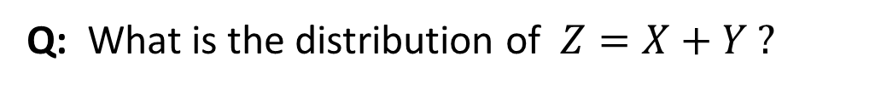





Example: Sum of Binomials
$$X∼Binomial(n,p)$$
$$Y∼Binomial(m, p)$$
$$X⊥Y$$
Q: What is the distribution of $Z=X+Y ?$
A:
$$\hat{Z}\left(z\right)=\hat{X}\left(z\right)⋅\hat{Y}\left(z\right)$$
$$={\left(zp+\left(1−p\right)\right)}^{n}⋅{\left(zp+\left(1−p\right)\right)}^{m}$$
$$={\left(zp+\left(1−p\right)\right)}^{n+m}$$
$$⇒Z∼Binomial(n+m, p)$$

Slide 17
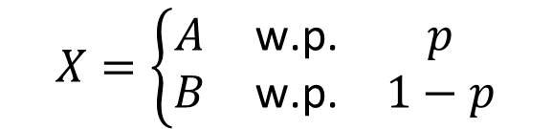





Conditioning with Transforms
Theorem 6.12: $\text{Let}$ $X, A, \text{and} B \text{be} \text{discrete} \text{r}\text{.}\text{v}\text{.}\text{s}\text{. }\text{where}$
$$X=\left\{\begin{matrix}A & \text{w}\text{.}\text{p}\text{.} & p \\ B & \text{w}\text{.}\text{p}\text{.} & 1−p\end{matrix}\right.$$
$$\text{Then}\text{, }$$
$$\hat{X}\left(z\right)=p⋅\hat{A}\left(z\right)+\left(1−p\right)⋅\hat{B}\left(z\right)$$
Proof:
$$\hat{X}\left(z\right)=E\left[z^{X}\right]$$
$$=E\left[z^{X}\right|X=A]⋅p+E\left[z^{X}\right|X=B]⋅(1−p)$$
$$=E\left[z^{A}\right]⋅p+ E\left[z^{B}\right]⋅(1−p)$$
$$=p\hat{A}\left(z\right)+(1−p)\hat{B}\left(z\right)$$

Slide 18
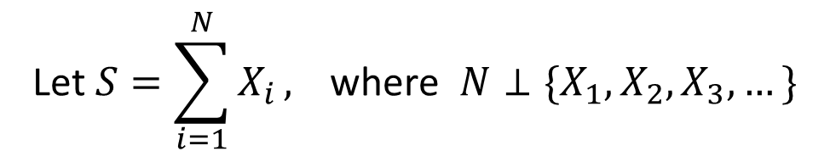


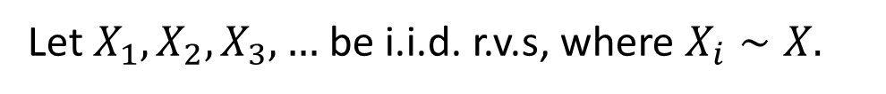
Sum of random number of random variables
Theorem 6.13:
Let $X_{1}, X_{2},X_{3}, …$ be i.i.d. r.v.s, where $X_{i}∼X.$
$$\text{Let} S=\sum_{i=1}^{N}{X_{i}}\text{, }\text{where} {N⊥\{X}_{1}, X_{2},X_{3}, …\}$$
$$N is the number$$
$of$spins of the wheel.
Then
$\hat{S}\left(z\right)=$ $\hat{N}\left(\hat{X}(z)\right)$
Proof: See Exercise 6.10.
Get new prize every day,
until wheel says stop.
o

Slide 19
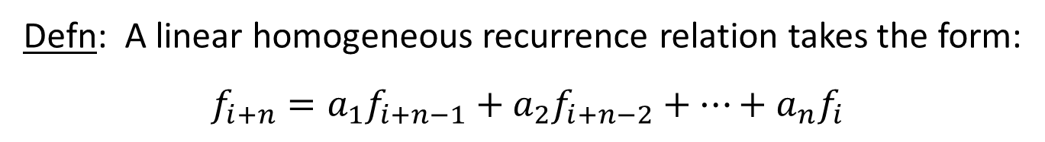
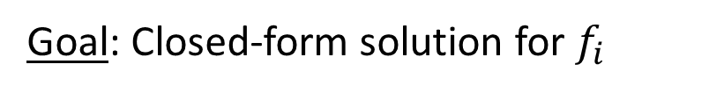
Solving recurrence relations
Defn: A linear homogeneous recurrence relation takes the form:
$$f_{i+n}={a_{1}f}_{i+n−1}+{a_{2}f}_{i+n−2}+⋯+{a_{n}f}_{i}$$
Such recurrences come up in many fields
Example:
$$f_{i+2}=f_{i+1}+f_{i}, f_{0}=0, f_{1}=1$$
Goal: Closed-form solution for $f_{i}$

Slide 20
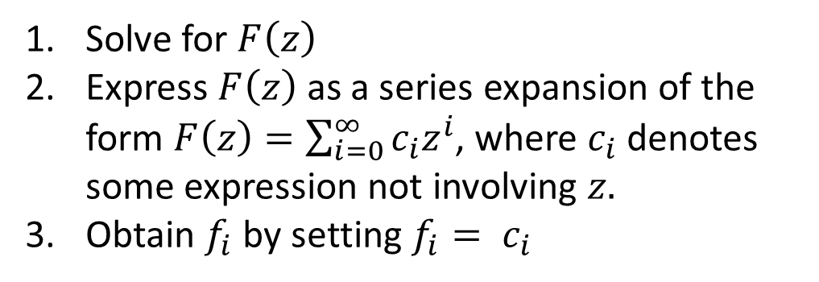

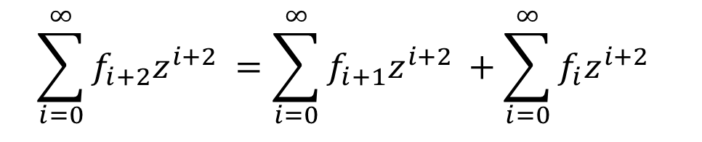


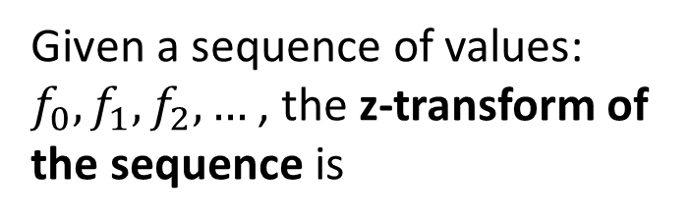
Solving recurrence relations: general approach
Defn 6.14:
$$f_{i+2}=f_{i+1}+f_{i}$$
Given a sequence of values: ${f_{0}, f_{1},f_{2}, …}_{ }$, the z-transform of the sequence is
$$f_{i+2}z^{i+2}=f_{i+1}z^{i+2}+f_{i}z^{i+2}$$
$${\sum_{i=0}^{∞}{f_{i+2}z^{i+2}}}_{ }={{\sum_{i=0}^{∞}{f_{i+1}z^{i+2}}}_{ }+{\sum_{i=0}^{∞}{f_{i}z^{i+2}}}_{ }}_{ }$$
$$F\left(z\right)=\sum_{i=0}^{∞}{f_{i}z^{i}}$$
$$F\left(z\right)−f_{1}z −f_{0}=z\left(F\left(z\right)−f_{0}\right)+z^{2}F(z)$$
Solve for $F\left(z\right)$
Express $F\left(z\right)$ as a series expansion of the form $F\left(z\right)=\sum_{i=0}^{∞}{c_{i}z^{i}}$, where $c_{i}$ denotes some expression not involving $z.$
Obtain $f_{i}$ by setting ${f_{i}= c}_{i}$
z-transform approach is the best approach for solving recurrences.

