Slide 1
Chapter 4 Expectation of Discrete R.V.s
Notes:
https://www.gettyimages.co.uk/detail/illustration/circular-shiny-artistic-vector-illustration-royalty-free-illustration/1331739902
https://www.gettyimages.co.uk/detail/photo/united-states-coins-royalty-free-image/157532065 (repeated from prior chpt)

Slide 2
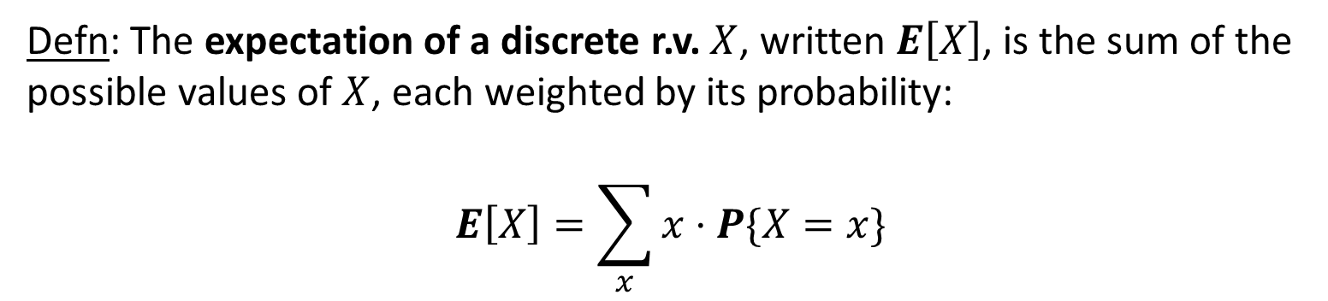
Expectation
Defn: The expectation of a discrete r.v. $X$, written $E\left[X\right]$, is the sum of the
possible values of $X$, each weighted by its probability:
$$E\left[X\right]=\sum_{x}{x⋅P\{X=x\}}$$
$E\left[X\right]$also represents the mean of the distribution from which $X$is drawn.

Slide 3
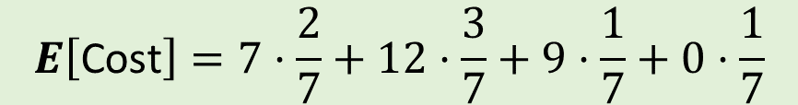
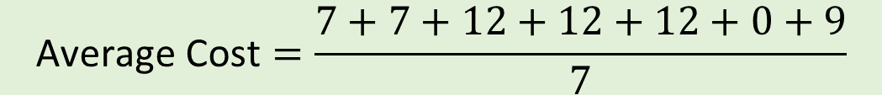

Average Cost of Lunch
MON | TUES | WED | THUR | FRI | SAT | SUN
$7 | $7 | $12 | $12 | $12 | $0 | $9
$$\text{Average} \text{Cost}=\frac{7+7+12+12+12+0+9}{7}$$
$$$$
$$E\left[\text{Cost}\right]=7⋅\frac{2}{7}+12⋅\frac{3}{7}+9⋅\frac{1}{7}+0⋅\frac{1}{7}$$

Slide 4
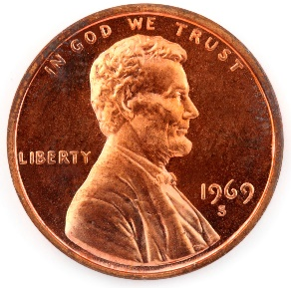
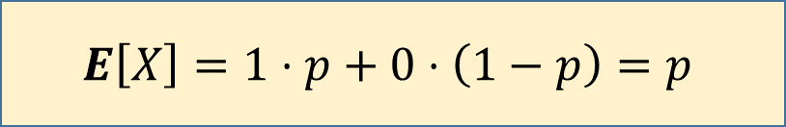
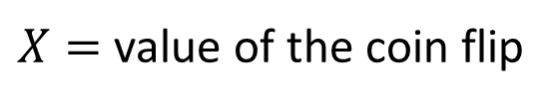
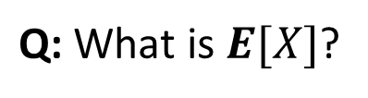

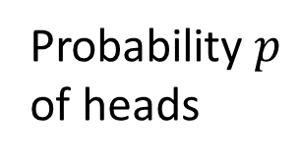

Expectation of Bernoulli($p$)
Probability$p$
of heads
$X=$ value of the coin flip
$\text{Q}\text{:} \text{What} \text{is} E[X]$?
$$E\left[X\right]=1⋅p+0⋅\left(1−p\right)=p$$
Remember!
Mean of
Bernoulli($p$)
is $p.$

Slide 5

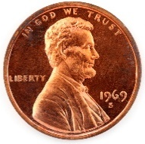


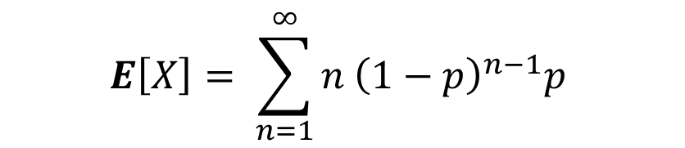

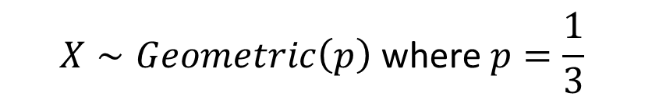




Expected Time Until Disk Fails
Disk has probability $\frac{1}{3}$of failing each year.
$$\text{Q}\text{: }\text{On} \text{average}\text{, }\text{how} \text{many} \text{years} \text{will} \text{it} \text{be} \text{until} \text{the} \text{disk} \text{fails}\text{? }$$
$$X∼Geometric\left(p\right) \text{where} p=\frac{1}{3}$$
$$E\left[X\right]= \sum_{n=1}^{∞}{n {\left(1−p\right)}^{n−1}p}$$
$$q=1−p$$
$$=p\sum_{n=1}^{∞}{n q^{n−1}}$$
Remember me
from Chapter 1?
Remember!
Mean of
Geometric($p$)
is $\frac{1}{p}.$
$$=p⋅\frac{1}{{\left(1−q\right)}^{2}}$$
$$=\frac{1}{p}$$
$$=p⋅\left(1+2q+3q^{2}+4q^{3}+⋯\right)$$

Slide 6

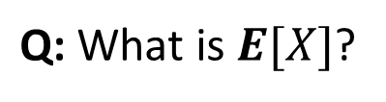


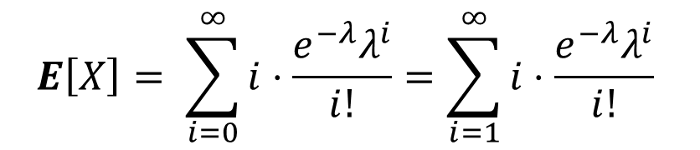
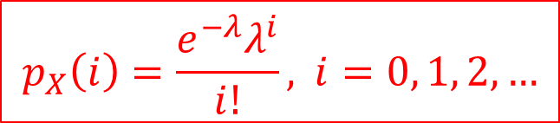



Expectation of Poisson($λ$)
$$X∼Poisson(λ)$$
$$p_{X}\left(i\right)=\frac{e^{−λ}λ^{i}}{i!}\text{, } i=0, 1, 2, …$$
$\text{Q}\text{:} \text{What} \text{is} E[X]$?
$$E\left[X\right]= \sum_{i=0}^{∞}{i⋅\frac{e^{−λ}λ^{i}}{i!}}=\sum_{i=1}^{∞}{i⋅\frac{e^{−λ}λ^{i}}{i!}}$$
$$=λe^{−λ}\sum_{i=1}^{∞}{\frac{λ^{i−1}}{(i−1)!}}$$
Remember me
from Chpt 1?
$$=λe^{−λ}\sum_{k=0}^{∞}{\frac{λ^{k}}{k!}}$$
Remember!
Mean of
Poisson($λ$)
is $λ.$
$$=λe^{−λ}⋅e^{λ}=λ$$

Slide 7




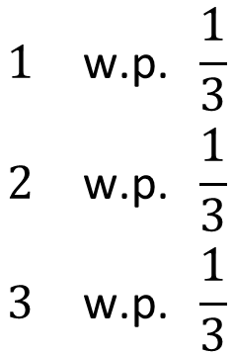
Expectation of a Function of a R.V.
Defn: A expectation of a function $g(⋅)$of a discrete r.v. $X$is defined as follows:
$$E\left[g\left(X\right)\right]= \sum_{x}^{ }{g\left(x\right)⋅p_{X}(x)}$$
Consider a sphere, whose radius is a random variable $R:$
$$R$$
$$\begin{matrix}1 & \text{w}\text{.}\text{p}\text{. }\frac{1}{3} \\ 2 & \text{w}\text{.}\text{p}\text{. }\frac{1}{3} \\ 3 & \text{w}\text{.}\text{p}\text{. }\frac{1}{3}\end{matrix}$$
$$R=$$
Q: What is the expected volume of the sphere?

Slide 8



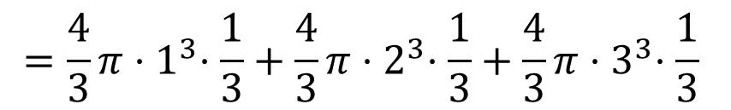
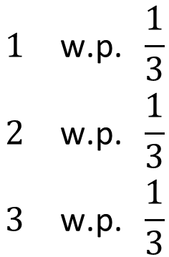

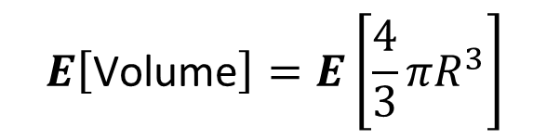

Expectation of a Function of a R.V.
Defn: A expectation of a function $g(⋅)$of a discrete r.v. $X$is defined as follows:
$$E\left[g\left(X\right)\right]= \sum_{x}^{ }{g\left(x\right)⋅p_{X}(x)}$$
$$R$$
$$E\left[\text{Volume}\right]=E\left[\frac{4}{3}πR^{3}\right]$$
$$\begin{matrix}1 & \text{w}\text{.}\text{p}\text{. }\frac{1}{3} \\ 2 & \text{w}\text{.}\text{p}\text{. }\frac{1}{3} \\ 3 & \text{w}\text{.}\text{p}\text{. }\frac{1}{3}\end{matrix}$$
$$=\frac{4}{3}π{⋅1}^{3}⋅\frac{1}{3}+\frac{4}{3}π{⋅2}^{3}⋅\frac{1}{3}+\frac{4}{3}π{⋅3}^{3}⋅\frac{1}{3}$$
$$R=$$
$$=16 π$$
Q: Is $E\left[R^{3}\right]=\left(E{\left[R\right]}^{3}\right) ?$

Slide 9
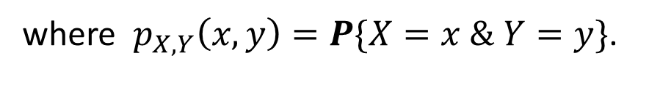
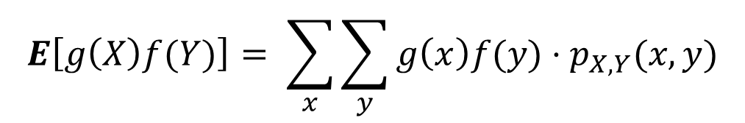

Expectation of a Product
Defn: Let $X \text{and} Y$be r.v.s. The expectation of the product $XY$is defined as follows:
$$E\left[XY\right]= \sum_{x}^{ }{\sum_{y}^{ }{xy⋅p_{X,Y}(x,y)}}$$
$$E\left[g\left(X\right)f(Y)\right]= \sum_{x}^{ }{\sum_{y}^{ }{g\left(x\right)f(y)⋅p_{X,Y}(x,y)}}$$
where $p_{X,Y}\left(x,y\right)=P\{X=x \& Y=y\}$.

Slide 10
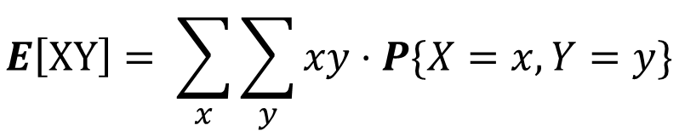

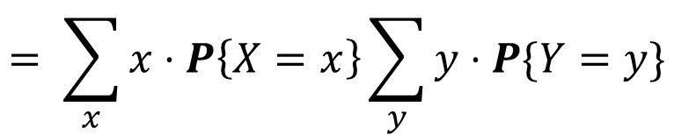
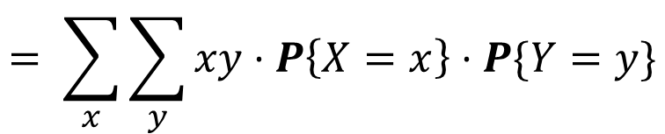
Expectation of Product under Independence
Theorem 4.8: (Expectation of a product) If $X⊥Y,$ then $E\left[XY\right]=E\left[X\right]⋅E\left[Y\right].$
$$E\left[XY\right]= \sum_{x}{\sum_{y}{xy⋅P\{X=x, Y=y\}}}$$
Proof:
$$= \sum_{x}{\sum_{y}{xy⋅P\left\{X=x\right\}⋅P\{Y=y\}}}$$
$$= \sum_{x}{x⋅P\left\{X=x\right\}\sum_{y}{y⋅P\{Y=y\}}}$$
$$= E\left[X\right]⋅E[Y]$$
Via the same proof: If $X⊥Y,$ then $E\left[g\left(X\right)f(Y)\right]=E\left[g(X)\right]⋅E\left[f(Y)\right].$

Slide 11
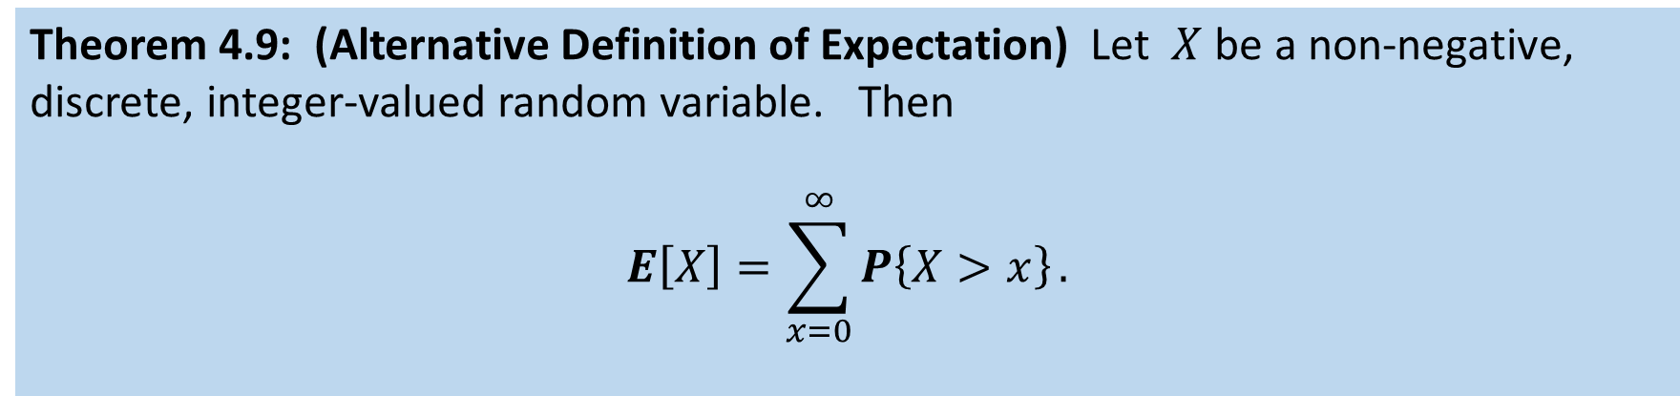
Alternative Definition of Expectation
Theorem 4.9: (Alternative Definition of Expectation) Let $X$ be a non-negative, discrete, integer-valued random variable. Then
$$E\left[X\right]=\sum_{x=0}^{∞}{P\left\{X>x\right\}}.$$
This alternative
formulation can
be very useful.
Proof: See exercise in textbook. Hint: Rewrite the inside probability as a sum.

Slide 12
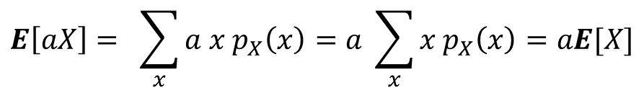
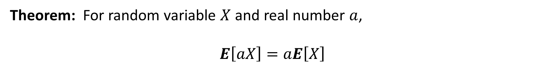
Expectation Property
Theorem: For random variable $X$ and real number $a$,
$E\left[aX\right]=aE\left[X\right]$
Proof:
$$E\left[aX\right]= \sum_{x}{a x p_{X}\left(x\right)=a \sum_{x}{x p_{X}\left(x\right)=aE[X]}}$$

Slide 13

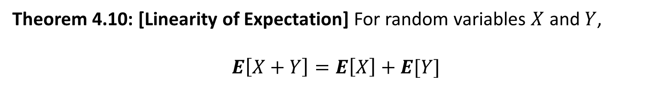
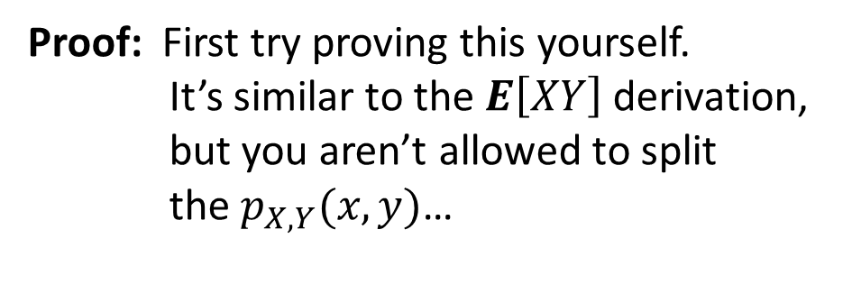
Linearity of Expectation
The following theorem greatly simplifies the computation of an expectation by breaking up the random variable into smaller pieces.
Theorem 4.10: [Linearity of Expectation] For random variables $X$ and $Y$,
$E\left[X+Y\right]=E\left[X\right]+E[Y]$
Proof: First try proving this yourself.
It’s similar to the $E\left[XY\right]$derivation,
but you aren’t allowed to split
the $p_{X,Y}(x,y)$…
Note this theorem does not require $X⊥Y$

Slide 14

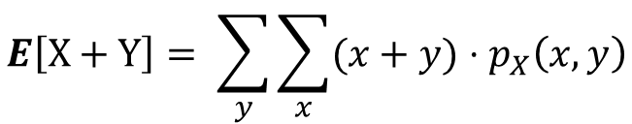
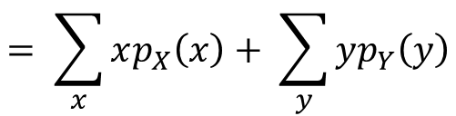
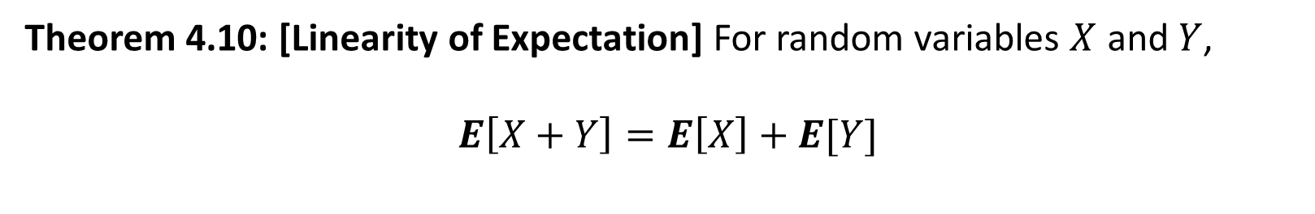
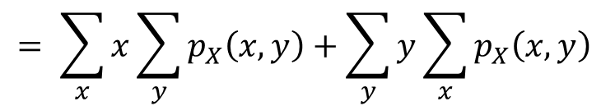
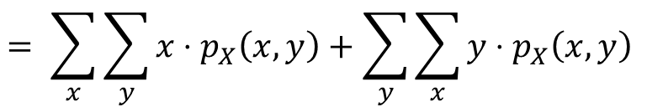
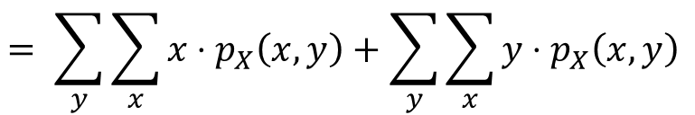
Linearity of Expectation
Theorem 4.10: [Linearity of Expectation] For random variables $X$ and $Y$,
$E\left[X+Y\right]=E\left[X\right]+E[Y]$
Proof:
$$E\left[X+Y\right]= \sum_{y}{\sum_{x}{(x+y)⋅p_{X}\left(x,y\right)}}$$
$$= \sum_{y}{\sum_{x}{x⋅p_{X}\left(x,y\right)+\sum_{y}{\sum_{x}{y⋅p_{X}\left(x,y\right) }}}}$$
$$= \sum_{x}{\sum_{y}{x⋅p_{X}\left(x,y\right)+\sum_{y}{\sum_{x}{y⋅p_{X}\left(x,y\right) }}}}$$
$$= \sum_{x}{x\sum_{y}{p_{X}\left(x,y\right)+\sum_{y}{y\sum_{x}{p_{X}\left(x,y\right) }}}}$$
$$= \sum_{x}{xp_{X}\left(x\right)+ \sum_{y}{{yp}_{Y}\left(y\right)}}$$
$$=E\left[X\right]+E[Y]$$

Slide 15

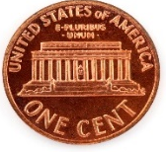



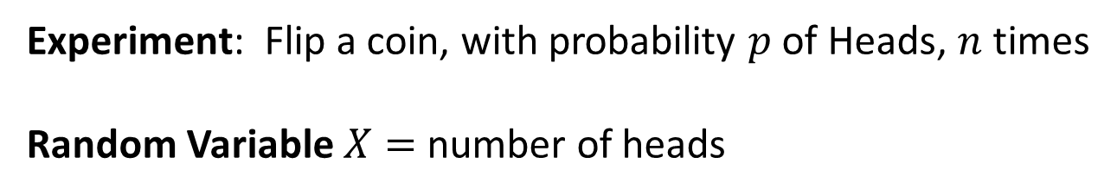


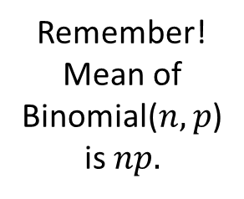
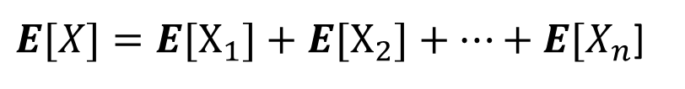
Expectation of Binomial($n,p$)
Experiment: Flip a coin, with probability $p$ of Heads, $n$ times
Random Variable $X=$ number of heads
$$n$$
Key Observation:
What is $E\left[X_{i}\right] ?$
$X=X_{1}+X_{2}+⋯+X_{n}$ , where $X_{i}∼\text{Bernoulli}(p)$
Applying Linearity of Expectation:
Remember!
Mean of
Binomial($n,p$)
is $np.$
$E[X]={E[X}_{1}]+{E[X}_{2}]+⋯+{E[X}_{n}$]
Should make intuitive sense
$$=p+p+⋯+p$$
$$=np$$

Slide 16

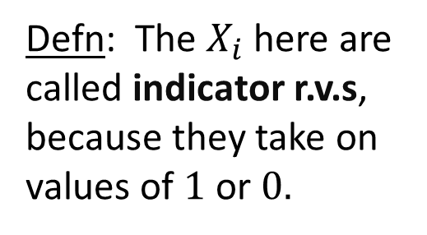

Expectation of Binomial($n,p$)
Experiment: Flip a coin, with probability $p$ of Heads, $n$ times
Random Variable $X=$ number of heads
$$n$$
Key Observation:
Defn: The $X_{i}$here are called indicator r.v.s, because they take on values of $1$ or $0.$
$X=X_{1}+X_{2}+⋯+X_{n}$ , where $X_{i}∼\text{Bernoulli}(p)$
Applying Linearity of Expectation:
$E[X]={E[X}_{1}]+{E[X}_{2}]+⋯+{E[X}_{n}$]
Q: Were the $X_{i}^{′}s$ indpt in here?
$$=p+p+⋯+p=np$$
16

Slide 17
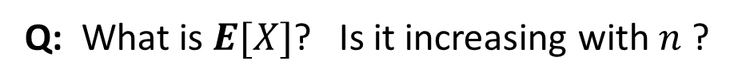
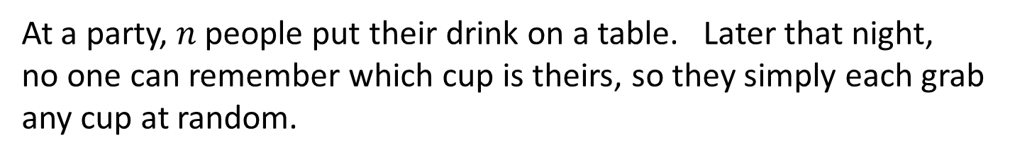
Drinking from your own Cup
At a party, $n$people put their drink on a table. Later that night,
no one can remember which cup is theirs, so they simply each grab any cup at random.
Let $X=$ number of people who get back their own cup.
Q: What is $E[X]$? Is it increasing with $n$ ?

Slide 18
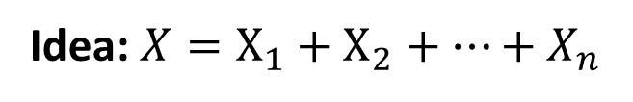

Drinking from your own Cup
At a party, $n$people put their drink on a table. Later that night,
no one can remember which cup is theirs, so they simply each grab any cup at random.
Let $X=$ number of people who get back their own cup.
Q: What is $E[X]$? Is it increasing with $n$ ?
Idea: $X=X_{1}+X_{2}+⋯+X_{n}$
Q: What do the $X_{i}$ represent?

Slide 19


Drinking from your own Cup
At a party, $n$people put their drink on a table. Later that night,
no one can remember which cup is theirs, so they simply each grab any cup at random.
Let $X=$ number of people who get back their own cup.
Q: What is $E[X]$?
$$X_{i}=\left\{ \begin{matrix}1 & \text{w}\text{.}\text{p}. 1/n \\ 0 & \text{o}\text{.}\text{w}. \end{matrix}\right.$$
Idea: $X=X_{1}+X_{2}+⋯+X_{n}$
$$X_{i}=1 ⇔ \text{person} i \text{got} \text{back} \text{their} \text{own} \text{cup}$$
Q: Are the $X_{i}$independent Bernoulli distributions? If so, is $X$Binomially distributed?

Slide 20



Drinking from your own Cup
At a party, $n$people put their drink on a table. Later that night,
no one can remember which cup is theirs, so they simply each grab any cup at random.
Let $X=$ number of people who get back their own cup.
Q: What is $E[X]$?
$$X_{i}=\left\{ \begin{matrix}1 & \text{w}\text{.}\text{p}. 1/n \\ 0 & \text{o}\text{.}\text{w}. \end{matrix}\right.$$
Idea: $X=X_{1}+X_{2}+⋯+X_{n}$
$$X_{i}=1 ⇔ \text{person} i \text{got} \text{back} \text{their} \text{own} \text{cup}$$
A: The $X_{i}$‘s are NOT independent. Nevertheless, Linearity of Expectation applies:
$E[X]={E[X}_{1}]+E[X_{2}]+⋯+{E[X}_{n}]$
$$=n⋅\frac{1}{n}=1.$$
regardless of $n$
$$=nE[X_{i}]$$

Slide 21


Coupon Collector
There are$n$coupons we’re trying to collect.
Each draw we get a random coupon
(sampling with replacement).
Let $D=$ number of draws until we’ve collected all the coupons.
Q: What is $E[D]$?

Slide 22



Coupon Collector
There are$n$coupons we’re trying to collect.
Each draw we get a random coupon
(sampling with replacement).
Let $D=$ number of draws until we’ve collected all the coupons.
Q: What is $E[D]$?
What’s wrong with letting $D_{i}$ represent number of draws to get coupon $i$ ?
Idea: $D=D_{1}+D_{2}+D_{3}+⋯+D_{n}$
Q: But what do the $D_{i}$ represent?

Slide 23


Coupon Collector
There are$n$coupons we’re trying to collect.
Each draw we get a random coupon
(sampling with replacement).
Let $D=$ number of draws until we’ve collected all the coupons.
Q: What is $E[D]$?
$D_{i}=$number of draws needed to get $i$th distinct coupon, given already have $i−1$distinct coupons
Idea: $D=D_{1}+D_{2}+D_{3}+⋯+D_{n}$
# draws to get 1st
distinct coupon
Additional draws needed to reach 2
distinct coupons
Additional draws needed to reach 3
distinct coupons

Slide 24




Coupon Collector
There are$n$coupons we’re trying to collect.
Each draw we get a random coupon
(sampling with replacement).
Let $D=$ number of draws until we’ve collected all the coupons.
Q: What is $E[D]$?
$D_{i}=$number of draws needed to get $i$th distinct coupon, given already have $i−1$distinct coupons
Idea: $D=D_{1}+D_{2}+D_{3}+⋯+D_{n}$
$$D_{1}∼Geometric\left(1\right)$$
# draws to get 1st
distinct coupon
Additional draws needed to reach 2
distinct coupons
Additional draws needed to reach 3
distinct coupons
$$D_{2}∼Geometric\left(\frac{n−1}{n}\right)$$
$$D_{3}∼Geometric\left(\frac{n−2}{n}\right)$$
$$D_{n}∼Geometric\left(\frac{1}{n}\right)$$
24

Slide 25



Coupon Collector
There are$n$coupons we’re trying to collect.
Each draw we get a random coupon
(sampling with replacement).
Let $D=$ number of draws until we’ve collected all the coupons.
Q: What is $E[D]$?
Idea: $D=D_{1}+D_{2}+D_{3}+⋯+D_{n}$
$$D_{1}∼Geometric\left(1\right)$$
$E[D]={E[D}_{1}]+{E[D}_{2}]+{E[D}_{3}]+⋯+{E[D}_{n}]$
$$D_{2}∼Geometric\left(\frac{n−1}{n}\right)$$
$$={1+\frac{n}{n−1}+\frac{n}{n−2}+⋯+n}_{ }$$
$$D_{3}∼Geometric\left(\frac{n−2}{n}\right)$$
$$={n⋅\left(\frac{1}{n}+\frac{1}{n−1}+\frac{1}{n−2}+⋯+1\right)}_{ }$$
$$D_{n}∼Geometric\left(\frac{1}{n}\right)$$

Slide 26

Coupon Collector
There are$n$coupons we’re trying to collect.
Each draw we get a random coupon
(sampling with replacement).
Let $D=$ number of draws until we’ve collected all the coupons.
Q: What is $E[D]$?
Idea: $D=D_{1}+D_{2}+D_{3}+⋯+D_{n}$
$E[D]={E[D}_{1}]+{E[D}_{2}]+{E[D}_{3}]+⋯+{E[D}_{n}]$
$$={1+\frac{n}{n−1}+\frac{n}{n−2}+⋯+n}_{ }$$
$$={n⋅\left(\frac{1}{n}+\frac{1}{n−1}+\frac{1}{n−2}+⋯+1\right)}_{ }$$
$$={n⋅H_{n}≈n ln⁡(n)}_{ }$$

Slide 27




Conditional p.m.f.
We often want the expected value of a r.v. $X$conditioned on some event, $A$, e.g.
$$E[\text{Price} \text{of} \text{hotel} \text{room}\text{ | }\text{Month} \text{is} \text{March}]$$
To define $E[X|A]$ we will need to define a conditional p.m.f., $p_{X|A}\left(x\right).$
Defn 4.14: Let $X$ be a discrete r.v. with p.m.f. $p_{X}\left(x\right)$.
Let $A$ be an event s.t. $P\left\{A\right\}>0$.
Then $p_{X|A}\left(x\right)$ is the conditional p.m.f. of $X$ given event $A$ where:
$$=\frac{P\{\left(X=x\right)∩A\}}{P\{A\}}$$
$$p_{X|A}\left(x\right)$$
$$=P\left\{X=x | A\right\}$$

Slide 28

Conditioning on an Event
Let r.v. $X$denote the size of a job:
$$X= \left\{ \begin{aligned}1 \text{w}\text{.}\text{p}\text{.} 0.1 \\ 2 \text{w}\text{.}\text{p}\text{.} 0.2 \\ 3 \text{w}\text{.}\text{p}\text{.} 0.3 \\ 4 \text{w}\text{.}\text{p}\text{.} 0.2 \\ 5 \text{w}\text{.}\text{p}\text{.} 0.2\end{aligned}\right.$$
Let $A$denote the event that the job is “small,” meaning its size is $≤3$.
Q: What is $p_{X|A}\left(1\right)?$ How does this compare with $p_{X}\left(1\right)$?

Slide 29





Conditioning on an Event
Let r.v. $X$denote the size of a job:
$$X= \left\{ \begin{aligned}1 \text{w}\text{.}\text{p}\text{.} 0.1 \\ 2 \text{w}\text{.}\text{p}\text{.} 0.2 \\ 3 \text{w}\text{.}\text{p}\text{.} 0.3 \\ 4 \text{w}\text{.}\text{p}\text{.} 0.2 \\ 5 \text{w}\text{.}\text{p}\text{.} 0.2\end{aligned}\right.$$
Let $A$denote the event that the job is “small,” meaning its size is $≤3$.
Q: What is $p_{X|A}\left(1\right)?$ How does this compare with $p_{X}\left(1\right)$?
$$=\frac{\frac{1}{10}}{\frac{6}{10}}=\frac{1}{6}$$
$$=\frac{P\{X=1 \& A\}}{P\{A\}}$$
$$=\frac{P\{X=1\}}{P\{A\}}$$
A:
$$p_{X|A}\left(1\right)=P\left\{X=1 \right| A\}$$
$$=$$

Slide 30


Conditioning on an Event
Let r.v. $X$denote the size of a job:
$$X= \left\{ \begin{aligned}1 \text{w}\text{.}\text{p}\text{.} 0.1 \\ 2 \text{w}\text{.}\text{p}\text{.} 0.2 \\ 3 \text{w}\text{.}\text{p}\text{.} 0.3 \\ 4 \text{w}\text{.}\text{p}\text{.} 0.2 \\ 5 \text{w}\text{.}\text{p}\text{.} 0.2\end{aligned}\right.$$
Let $A$denote the event that the job is “small,” meaning its size is $≤3$.
Answer: $0$
Q: What is $p_{X|A}\left(x\right) \text{if} x∉A?$
Lemma 4.16: A conditional p.m.f. is a p.m.f., i.e.,
$$\sum_{x}{p_{X|A}\left(x\right)=\sum_{x∈A}{p_{X|A}\left(x\right)=1 }}$$
$$=$$

Slide 31


















Example: Conditioning on an Event
$${\text{Table} \text{shows} p}_{X,Y}\left(x,y\right)$$
$$X=0$$
$$X=1$$
$$X=2$$
$$Y=0$$
$$1/6$$
$$1/8$$
$$0$$
$$Y=1$$
$$1/8$$
$$1/6$$
1/8
$$Y=2$$
$$0$$
$$1/6$$
1/8
Q: What is $p_{X|Y=2}\left(1\right)?$
$$=\frac{\frac{1}{6}}{\frac{1}{6}+\frac{1}{8}}$$
$$=\frac{P\{X=1 \& Y=2\}}{P\{Y=2\}}$$
$$=\frac{4}{7}$$
A:
$$p_{X|Y=2}\left(1\right)=P\left\{X=1 \right| Y=2\}$$
$$=$$

Slide 32

Conditional Expectation
The conditional expectation, $E[X|A]$, is based on the conditional p.m.f., $p_{X|A}\left(x\right).$
Defn: Let $X$ be a discrete r.v.
The conditional expectation of $X$ given event $A$ is defined as:
$$E\left[X | A\right]=\sum_{x}{x⋅}{ p}_{X|A}\left(x\right)=\sum_{x}{x⋅}\frac{P\{\left(X=x\right)∩A\}}{P\{A\}}$$

Slide 33

Conditional Expectation Example
Let r.v. $X$denote the size of a job:
$$X= \left\{ \begin{aligned}1 \text{w}\text{.}\text{p}\text{.} 0.1 \\ 2 \text{w}\text{.}\text{p}\text{.} 0.2 \\ 3 \text{w}\text{.}\text{p}\text{.} 0.3 \\ 4 \text{w}\text{.}\text{p}\text{.} 0.2 \\ 5 \text{w}\text{.}\text{p}\text{.} 0.2\end{aligned}\right.$$
Let $A$denote the event that the job is “small,” meaning its size is $≤3$.
Q: What is $E[X|A]?$

Slide 34

Conditional Expectation Example
Let r.v. $X$denote the size of a job:
$$X= \left\{ \begin{aligned}1 \text{w}\text{.}\text{p}\text{.} 0.1 \\ 2 \text{w}\text{.}\text{p}\text{.} 0.2 \\ 3 \text{w}\text{.}\text{p}\text{.} 0.3 \\ 4 \text{w}\text{.}\text{p}\text{.} 0.2 \\ 5 \text{w}\text{.}\text{p}\text{.} 0.2\end{aligned}\right.$$
Let $A$denote the event that the job is “small,” meaning its size is $≤3$.
Q: What is $E[X|A]?$
A:
$E\left[X | A\right]=1⋅p_{X|A}\left(1\right)+2⋅p_{X|A}\left(2\right)+$ $3⋅p_{X|A}\left(3\right)$
$=1⋅\frac{1}{6}+2⋅\frac{2}{6}+$ $3⋅\frac{3}{6}=\frac{14}{6}$
$$=$$

Slide 35

Conditional Expectation Example
$${\text{Table} \text{shows} p}_{X,Y}\left(x,y\right)$$
$$X=0$$
$$X=1$$
$$X=2$$
$$Y=0$$
$$1/6$$
$$1/8$$
$$0$$
$$Y=1$$
$$1/8$$
$$1/6$$
1/8
$$Y=2$$
$$0$$
$$1/6$$
1/8
Q: What $E\left[X \right| Y=2]?$
$$=$$

Slide 36

Conditional Expectation Example
$${\text{Table} \text{shows} p}_{X,Y}\left(x,y\right)$$
$$X=0$$
$$X=1$$
$$X=2$$
$$Y=0$$
$$1/6$$
$$1/8$$
$$0$$
$$Y=1$$
$$1/8$$
$$1/6$$
1/8
$$Y=2$$
$$0$$
$$1/6$$
1/8
Q: What $E\left[X \right| Y=2]?$
A:
$E\left[X | Y=2\right]=0⋅p_{X|Y=2}\left(0\right)+1⋅p_{X|Y=2}\left(1\right)+$ $2⋅p_{X|Y=2}\left(2\right)$
$=1⋅\frac{4}{7}+$ $2⋅\frac{3}{7}=\frac{10}{7}$
$$=$$

Slide 37




Computing Expectations via Conditioning
Theorem 4.22: Let $X$be a discrete r.v.
Let events $F_{1},F_{2},…,F_{n}$partition the space Ω. Then
$$E[X] =\sum_{i=1}^{n}{E[X |F_{i}]⋅P\{F_{i}\} }$$
For a discrete r.v. $Y$:
$$E[X] =\sum_{y}^{ }{E[X |Y=y]⋅P\{Y=y\} }$$
$$=$$

Slide 38
Expected Value of Geometric, Revisited
$X∼Geometric\left(p\right)\text{. }\text{Derive} E\left[X\right] \text{by} \text{conditioning}$.
Q: What should we condition on?

Slide 39

Expected Value of Geometric, Revisited
$X∼Geometric\left(p\right)\text{. }\text{Derive} E\left[X\right] \text{by} \text{conditioning}$.
Q: What should we condition on?
A: Condition on the value of the first flip, $Y$.
What is this?
$E\left[X\right]=E\left[X \right|Y=1]⋅P\left\{Y=1\right\}+$ $E\left[X \right|Y=0]⋅P\left\{Y=0\right\}$
$=E\left[X \right|Y=1]⋅p+$ $E\left[X \right|Y=0]⋅(1−p)$

Slide 40


Expected Value of Geometric, Revisited
$X∼Geometric\left(p\right)\text{. }\text{Derive} E\left[X\right] \text{by} \text{conditioning}$.
Q: What should we condition on?
A: Condition on the value of the first flip, $Y$.
$E\left[X\right]=E\left[X \right|Y=1]⋅P\left\{Y=1\right\}+$ $E\left[X \right|Y=0]⋅P\left\{Y=0\right\}$
$=E\left[X \right|Y=1]⋅p+$ $E\left[X \right|Y=0]⋅(1−p)$
$=1⋅p+$ $(1+E\left[X\right])⋅(1−p)$
$$⇒E\left[X\right]=\frac{1}{p}$$

Slide 41
Simpson’s Paradox
Consider two treatments for kidney stones: Treatment A and Treatment B
Treatment A is more effective on small kidney stones
Treatment A is also more effective on large kidney stones
But if we ignore the type of stones, Treatment B is more effective!

Slide 42
Simpson’s Paradox
Q: How is this possible?
Treatment A
Treatment B
90% effective
80% effective
small stones
60% effective
50% effective
large stones
63% effective
77% effective
aggregate mix

Slide 43
Simpson’s Paradox
Treatment A
Treatment B
90% effective
80% effective
small stones
(successful on 90 out of 100)
(successful on 800 out of 1000)
60% effective
50% effective
large stones
(successful on 600 out of 1000)
(successful on 50 out of 100)
63% effective
77% effective
aggregate mix
(successful on 690 out of 1100)
(successful on 850 out of 1100)

Slide 44
Treatment A
Treatment B
90% effective
80% effective
small stones
(successful on 90 out of 100)
(successful on 800 out of 1000)
60% effective
50% effective
large stones
(successful on 600 out of 1000)
(successful on 50 out of 100)
63% effective
77% effective
aggregate mix
(successful on 690 out of 1100)
(successful on 850 out of 1100)
Is treatment B better?
No! Treatment A is better on both small stones and on large stones. It is the better treatment!
But because A is better, it is given more “hard cases” – the large stone cases – and hence has lower average scores.

