Slide 1
Chapter 3
Discrete Random Variables
Notes:
https://www.gettyimages.co.uk/detail/illustration/says-royalty-free-illustration/165633427
https://www.gettyimages.co.uk/detail/photo/united-states-coins-royalty-free-image/157532065
https://www.gettyimages.co.uk/detail/photo/hard-disk-drive-inside-royalty-free-image/888080160
https://www.gettyimages.co.uk/detail/illustration/flat-doodle-icon-design-royalty-free-illustration/1191418678?phrase=cpu%20clipart

Slide 2

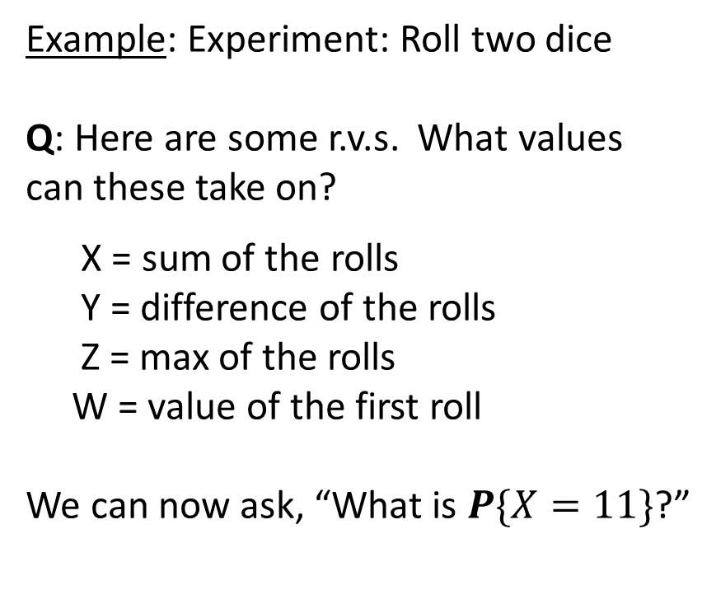
Random Variables
Defn: A random variable (r.v.) is a real-valued function of the outcome
of an experiment involving randomness.
Example: Experiment: Roll two dice
Q: Here are some r.v.s. What values
can these take on?
X = sum of the rolls
Y = difference of the rolls
Z = max of the rolls
W = value of the first roll
We can now ask, “What is $P\{X=11\}$?”

Slide 3

Random Variables
Defn: A random variable (r.v.) is a real-valued function of the outcome
of an experiment involving randomness.
Example: Throw 2 darts uniformly at random at unit interval
Here are some random variables:
D = difference in location of the 2 darts
L = location of leftmost dart
Q: Can you define some more r.v.s?
0
1

Slide 4
Random Variables
Defn: A discrete random variable can take on at most a countably infinite
number of possible values, whereas a continuous random variable can
take on an uncountable set of possible values.
Q: Which of these random variables is discrete and which is continuous?
  The sum of the rolls of two dice
  The number of arrivals at a website by time t
  The time until the next arrival at a website
  The CPU time requirement of an HTTP request

Slide 5



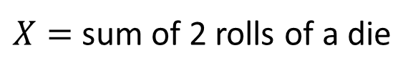

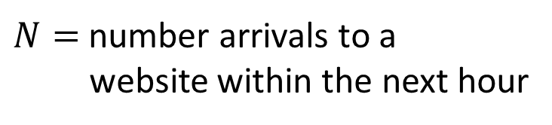


From Random Variables to Events
We use CAPITAL letters to denote random variables.
When we set a random variable (r.v.) equal to a value, we get an event, and all the theorems
we learned about events and their probabilities now apply.
Random Variable (R.V.)
Event
Probability of Event
$X=$ sum of 2 rolls of a die
$$X=7$$
$$\frac{1}{6}$$
$N=$ number arrivals to a
website within the next hour
$$N>10$$
$$P\left\{N>10\right\}=$$
$$P\left\{N>10 |\text{weekday}\right\}⋅\frac{5}{7}$$
$$+ P\left\{N>10 |\text{weekend}\right\}⋅\frac{2}{7}$$

Slide 6
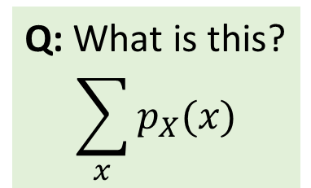
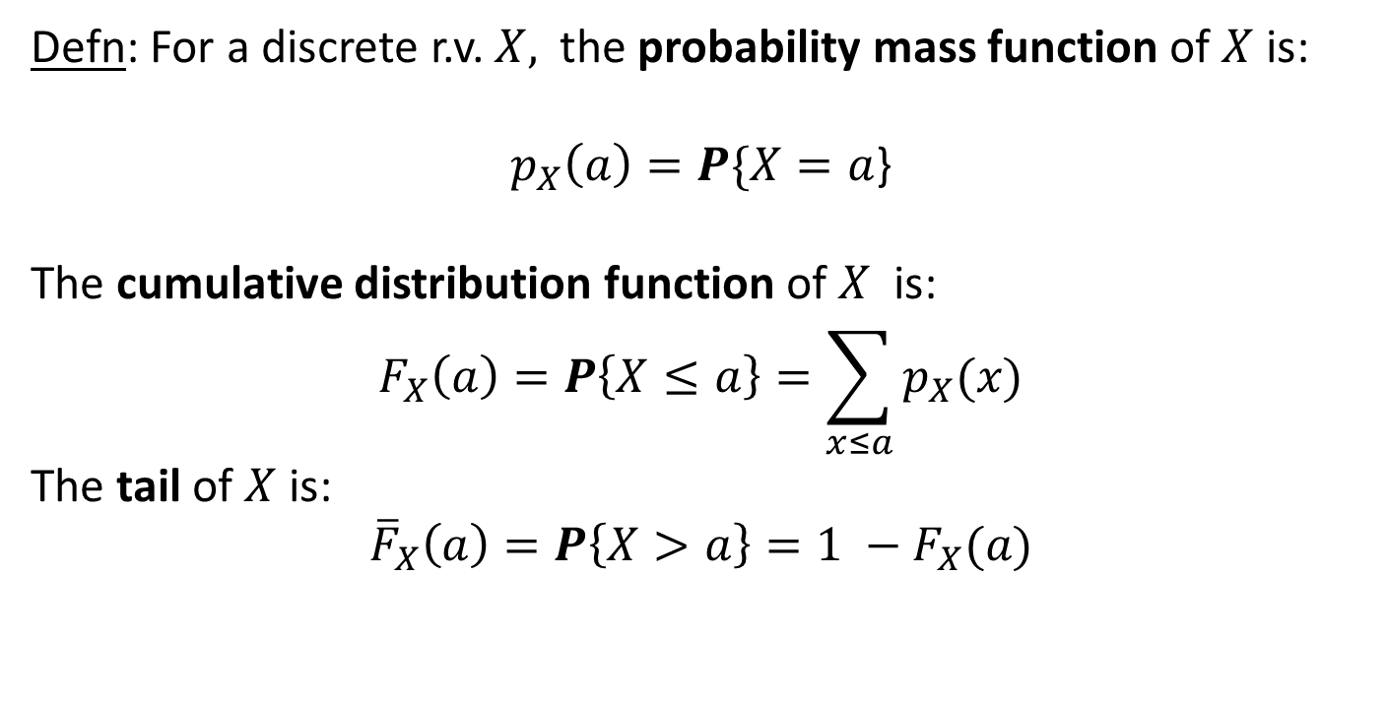
Discrete Random Variables
Defn: A discrete r.v. takes on a countable number of values, each with some probability.
A discrete r.v. is associated with a discrete distribution that represents the likelihood of each of these values occurring. We sometimes define a r.v. by its associated distribution.
Defn: For a discrete r.v. $X,$the probability mass function of $X$ is:
$p_{X}\left(a\right)=P\{X=a$}
The cumulative distribution function of $X$ is:
$$F_{X}\left(a\right)=P\left\{X≤a\right\}=\sum_{x≤a}{p_{X}(x)}$$
The tail of $X$ is:
$${\overline{F}}_{X}\left(a\right)=P\left\{X>a\right\}=1 −F_{X}(a)$$
Q: What is this?
$$\sum_{x}{p_{X}(x)}$$

Slide 7
Common Discrete R.V.s / Distributions

Slide 8
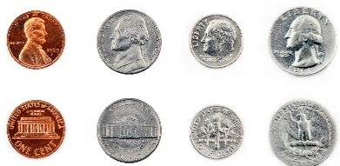

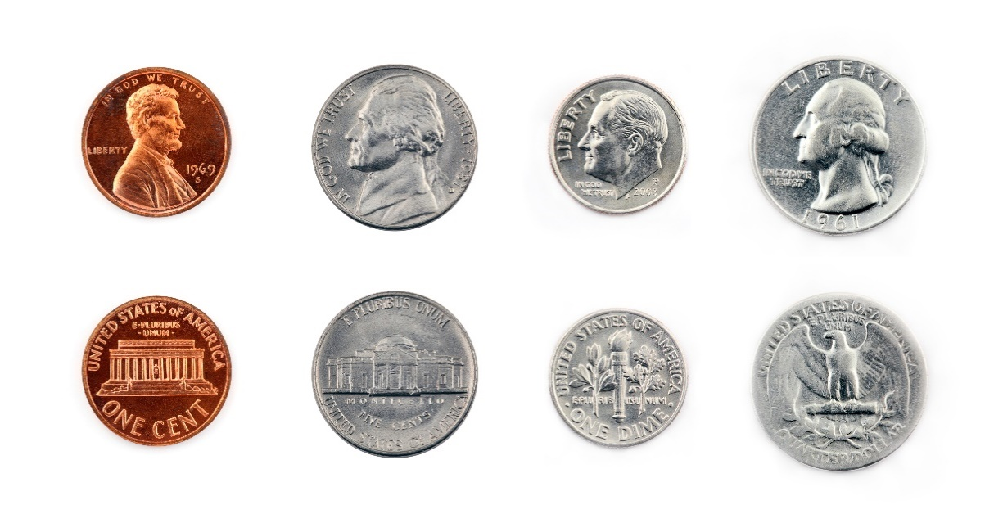
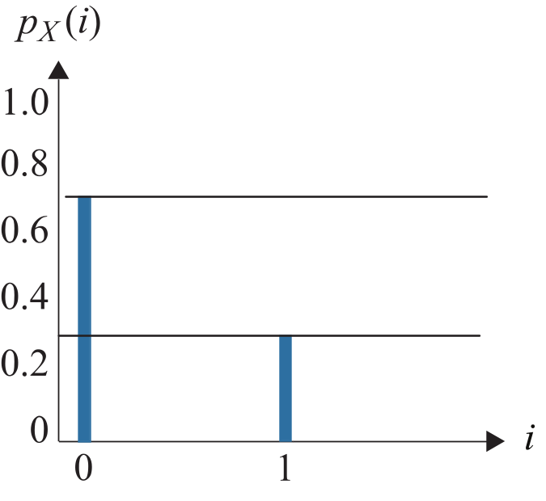

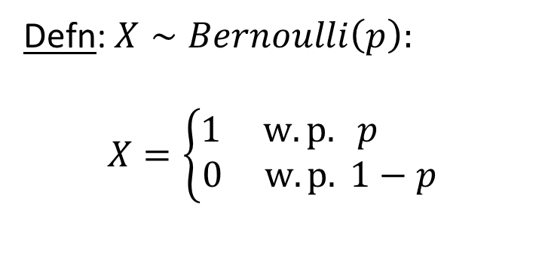

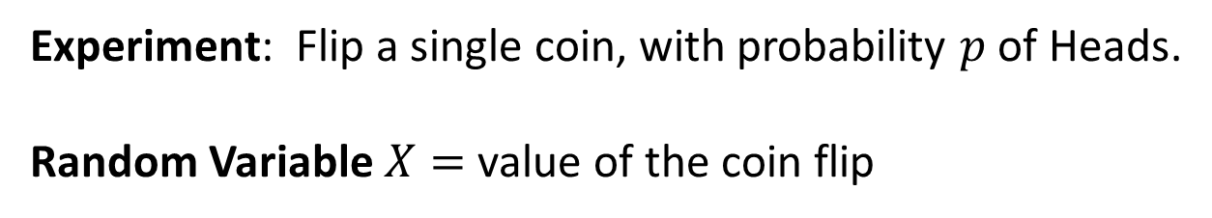
Bernoulli($p$)
Experiment: Flip a single coin, with probability $p$ of Heads.
Random Variable $X=$ value of the coin flip
Defn: $X∼Bernoulli\left(p\right):$
$X=\left\{\begin{matrix}1 w.p. p \\ 0 w.p. 1−p \end{matrix}\right.$
Q: What distribution is shown above, with what parameter?

Slide 9
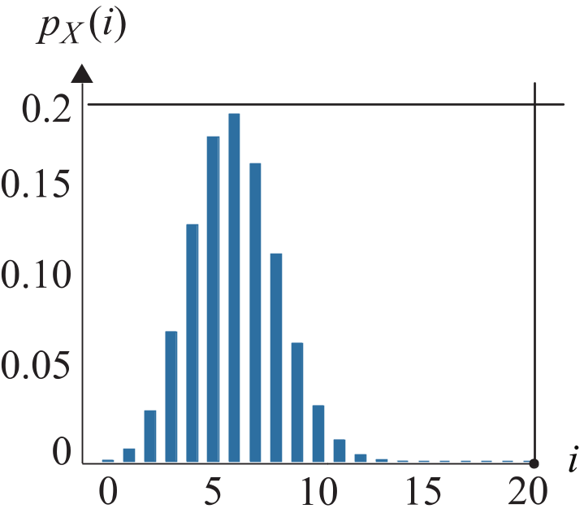
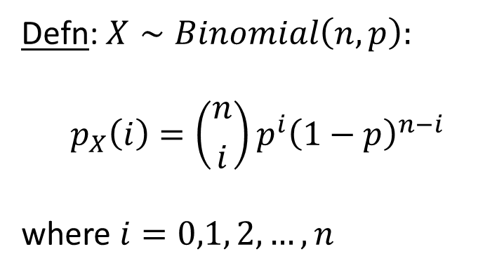


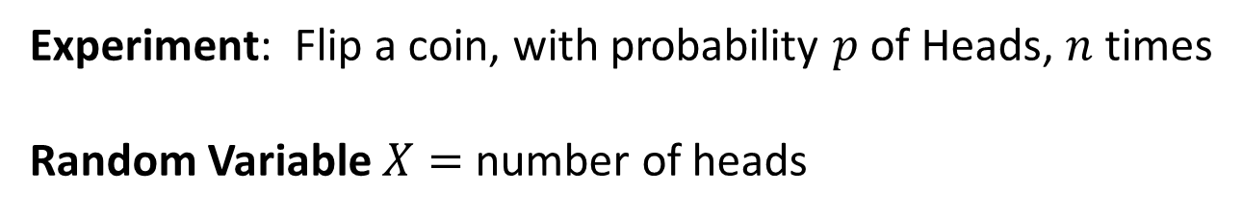
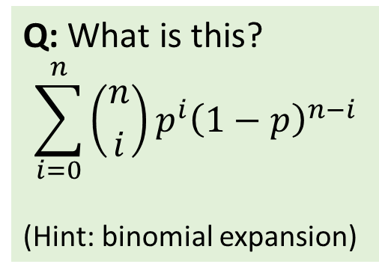
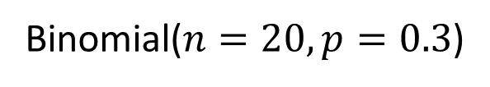
Binomial($n,p$)
Experiment: Flip a coin, with probability $p$ of Heads, $n$ times
Random Variable $X=$ number of heads
$$n$$
Defn: $X∼Binomial\left(n,p\right):$
$$p_{X}\left(i\right)=\left({n \atop i}\right)p^{i}{\left(1−p\right)}^{n−i}$$
where $i=0,1, 2, …, n$
Q: What is this?
$$\sum_{i=0}^{n}{\left({n \atop i}\right)p^{i}{\left(1−p\right)}^{n−i}}$$
(Hint: binomial expansion)
Binomial($n=20,p=0.3$)

Slide 10
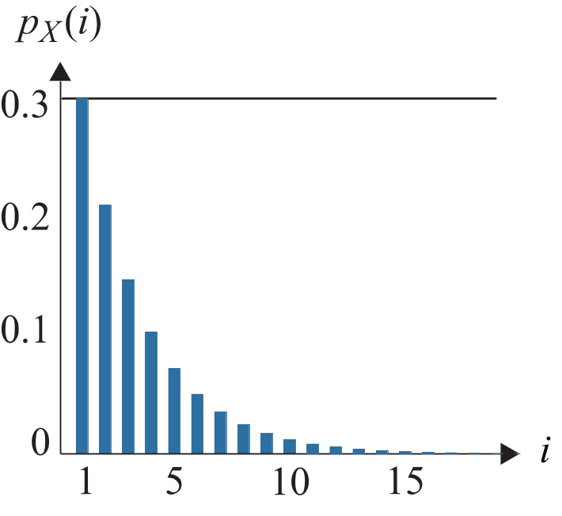
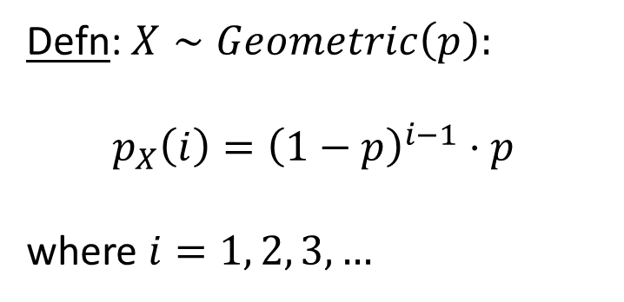

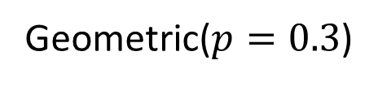
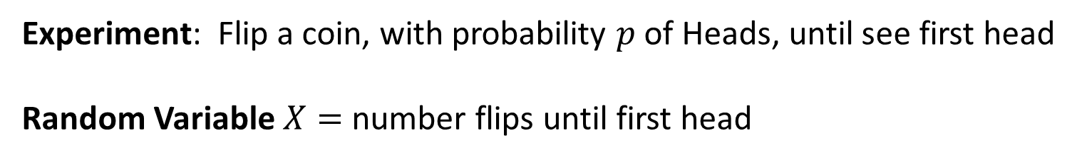
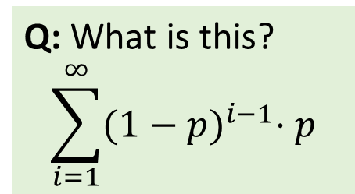
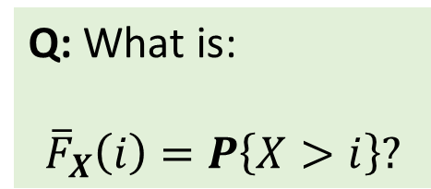
Geometric($p$)
Experiment: Flip a coin, with probability $p$ of Heads, until see first head
Random Variable $X=$ number flips until first head
Q: What is:
$${\overline{F}}_{X}\left(i\right)=P\left\{X>i\right\}?$$
Defn: $X∼Geometric\left(p\right):$
$$p_{X}\left(i\right)={\left(1−p\right)}^{i−1}⋅p$$
where $i=1, 2, 3, …$
Q: What is this?
$$\sum_{i=1}^{∞}{{(1−p)}^{i−1}⋅p}$$
Geometric($p=0.3$)

Slide 11


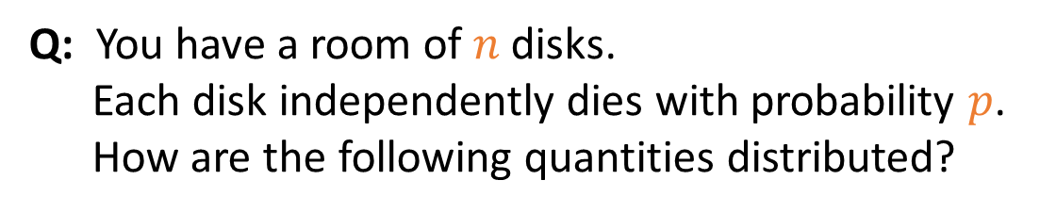
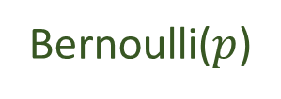
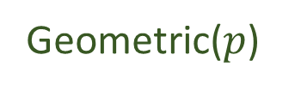
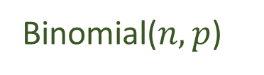
Pop Quiz
Q: You have a room of $n$disks.
Each disk independently dies with probability $p$.
How are the following quantities distributed?
$$n$$
The number of disks that die in the first year
The number of years until a particular disk dies
The state of a particular disk after one year
Binomial($n,p$)
Geometric($p$)
Bernoulli($p$)

Slide 12
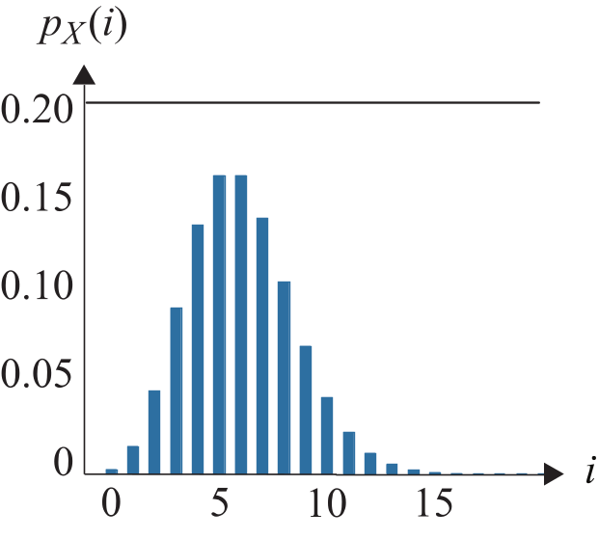
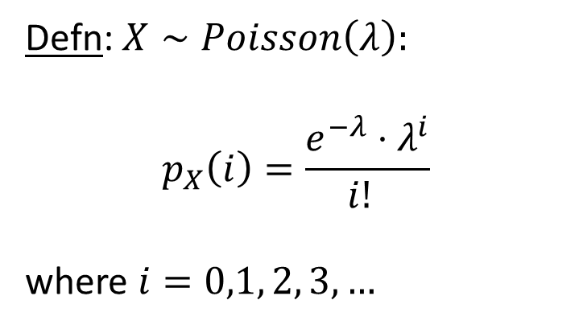

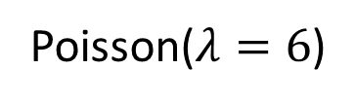
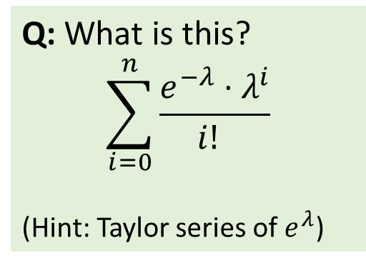
Poisson($λ$)
The Poisson distribution occurs naturally when looking at a mixture of a large number of
independent sources.
Defn: $X∼Poisson\left(λ\right):$
$$p_{X}\left(i\right)=\frac{e^{−λ}⋅λ^{i}}{i! }$$
where $i=0,1, 2, 3, …$
Q: What is this?
$$\sum_{i=0}^{n}{\frac{e^{−λ}⋅λ^{i}}{i! }}$$
(Hint: Taylor series of $e^{λ}$)
Poisson($λ=6$)
Q: Does the shape of the Poisson p.m.f. remind you of another distribution?

Slide 13
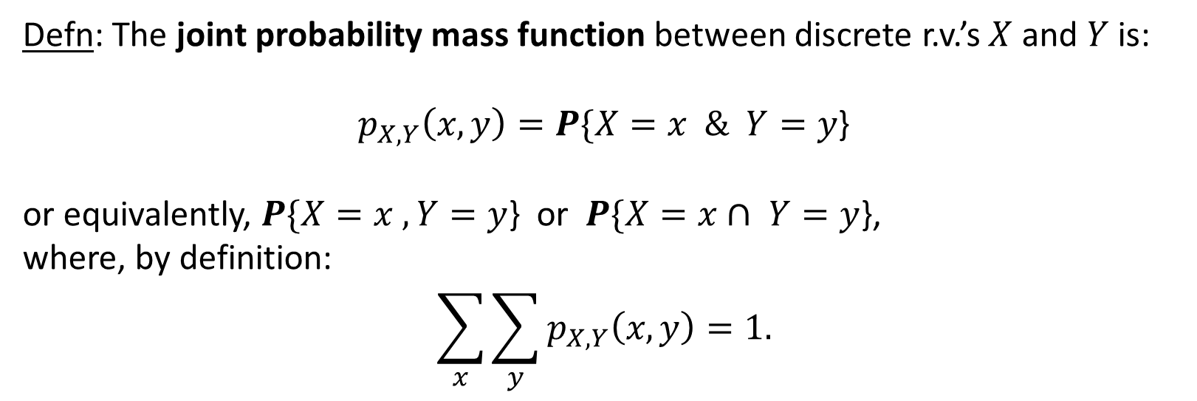
Two Random Variables
Defn: The joint probability mass function between discrete r.v.’s $X$ and $Y$ is:
$p_{X,Y}\left(x,y\right)=P\{X=x \& Y=y$}
or equivalently, $P\{X=x , Y=y$} or $P\{X=x∩ Y=y$},
where, by definition:
$$\sum_{x}{\sum_{y}{p_{X,Y}\left(x,y\right)=1.}}$$

Slide 14




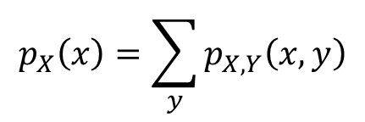



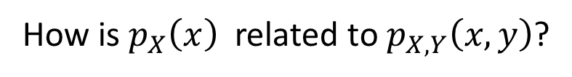

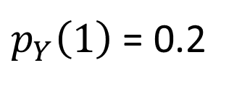





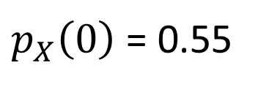



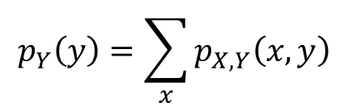
Marginal Probability Mass Function
How is $p_{X}\left(x\right)$ related to $p_{X,Y}\left(x,y\right)$?
$${\text{Table} \text{shows} p}_{X,Y}\left(x,y\right)$$
$$X=0$$
$$X=1$$
$$X=2$$
$$Y=0$$
$$0.4$$
$$0.05$$
$$0.05$$
$$Y=1$$
$$0.05$$
$$0.05$$
$$0.1$$
$p_{Y}\left(1\right)$ = 0.2
$$Y=2$$
$$0.1$$
$$0.2$$
$$0$$
$$p_{Y}\left(y\right)=\sum_{x}{p_{X,Y}\left(x,y\right)}$$
$p_{X}\left(0\right)$ = 0.55
$$p_{X}\left(x\right)=\sum_{y}{p_{X,Y}\left(x,y\right)}$$
Called “marginal probabilities”
because written in the margins.

Slide 15
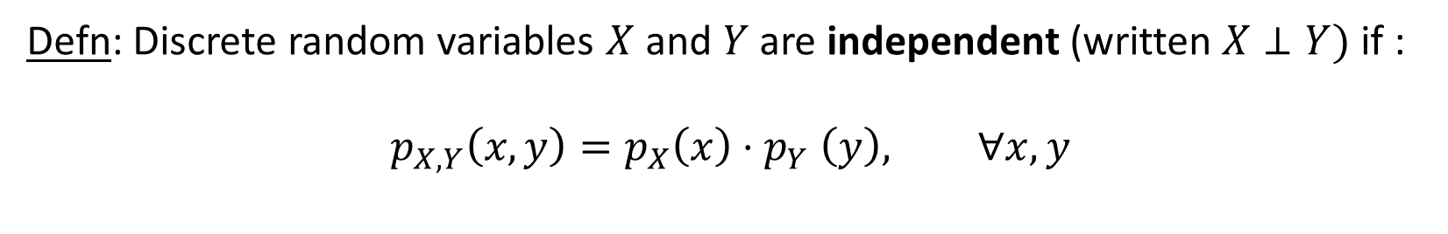
Independence
Defn: Discrete random variables $X$ and $Y$are independent (written $X⊥Y)$ if :
$$p_{X,Y}\left(x,y\right)=p_{X}\left(x\right){⋅p}_{Y}\left(y\right), ∀x, y$$
Q: If $X$ and $Y$are independent, what does this say about$P\left\{X=x \right| Y=y$}?

Slide 16

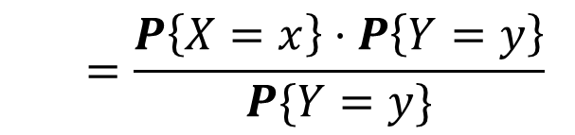
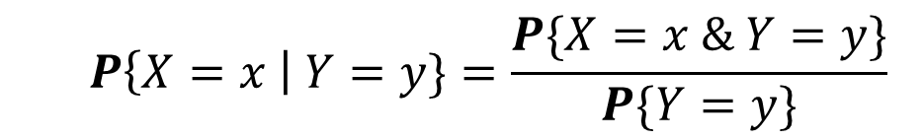
Independence
Defn: Discrete random variables $X$ and $Y$are independent (written $X⊥Y)$ if :
$$p_{X,Y}\left(x,y\right)=p_{X}\left(x\right){⋅p}_{Y}\left(y\right), ∀x,y$$
Q: If $X$ and $Y$are independent, what does this say about$P\left\{X=x \right| Y=y$}?
  $$P\left\{X=x \right| Y=y\}=\frac{P\{X=x \& Y=y\}}{P\{Y=y\}}$$
  $$=\frac{P\left\{X=x\right\}⋅P\left\{Y=y\right\}}{P\{Y=y\}}$$
  $$=P\left\{X=x\right\}$$

Slide 17





Who Fails First?
You have a disk with probability $p_{1}$of failing each day, and a CPU which independently has probability $p_{2}$of failing each day.
$$p_{1}$$
$$p_{2}$$
Q: What is the probability that the disk fails before the CPU?
Intuitively, what answer makes sense?

Slide 18

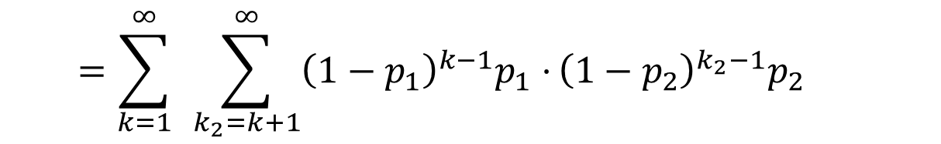


Who Fails First?
You have a disk with probability $p_{1}$of failing each day, and a CPU which independently has probability $p_{2}$of failing each day.
Q: What is the probability that the disk fails before the CPU?
$$X_{1}=\text{days} \text{until} \text{disk} \text{fails}∼Geometric(p_{1})$$
$$X_{1}⊥X_{2}$$
$$X_{2}=\text{days} \text{until} \text{CPU} \text{fails}∼Geometric(p_{2})$$
  $$P\{X_{1}<X_{2}\}=\sum_{k=1}^{∞}{ }\sum_{k_{2}=k+1}^{∞}{p_{X_{1},X_{2}}\left(k,k_{2}\right)=}\sum_{k=1}^{∞}{ }\sum_{k_{2}=k+1}^{∞}{p_{X_{1}}\left(k\right)⋅}p_{X_{2}}(k_{2})$$
  $$=\sum_{k=1}^{∞}{ }\sum_{k_{2}=k+1}^{∞}{{\left(1−p_{1}\right)}^{k−1}p_{1}⋅}{\left(1−p_{2}\right)}^{k_{2}−1}p_{2}$$

Slide 19
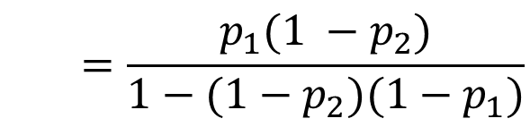
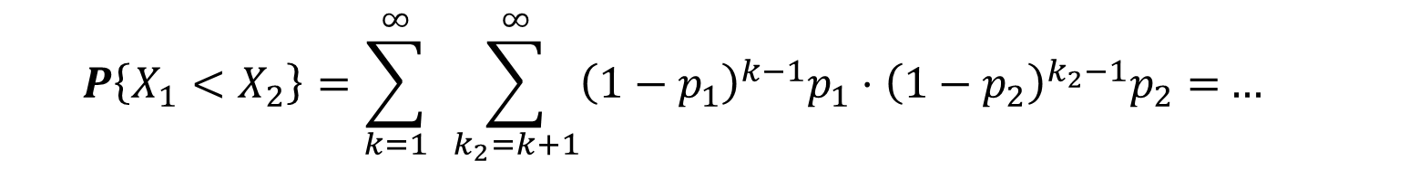

Who Fails First?
You have a disk with probability $p_{1}$of failing each day, and a CPU which independently has probability $p_{2}$of failing each day.
Q: What is the probability that the disk fails before the CPU?
$$X_{1}=\text{days} \text{until} \text{disk} \text{fails}∼Geometric(p_{1})$$
$$X_{1}⊥X_{2}$$
$$X_{2}=\text{days} \text{until} \text{CPU} \text{fails}∼Geometric(p_{2})$$
  $$P\left\{X_{1}<X_{2}\right\}=\sum_{k=1}^{∞}{ }\sum_{k_{2}=k+1}^{∞}{{\left(1−p_{1}\right)}^{k−1}p_{1}⋅{\left(1−p_{2}\right)}^{k_{2}−1}p_{2}=}…$$
$$\text{after} \text{some} \text{algebra}$$
  $$=\frac{p_{1}(1 −p_{2})}{1−(1−p_{2})(1−p_{1})}$$

Slide 20


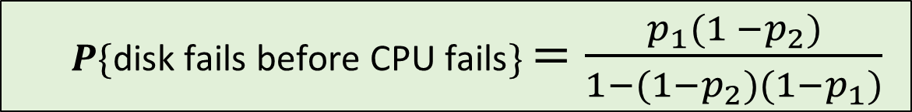
Who Fails First?
You have a disk with probability $p_{1}$of failing each day, and a CPU which independently has probability $p_{2}$of failing each day.
$$p_{1}$$
$$p_{2}$$
  $P\{\text{disk} \text{fails} \text{before} \text{CPU} \text{fails}\}$ $=\frac{p_{1}(1 −p_{2})}{1−(1−p_{2})(1−p_{1})}$
But WHY?

Slide 21


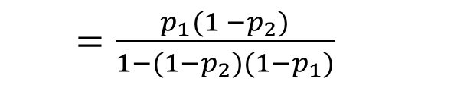
Who Fails First?
You have a disk with probability $p_{1}$of failing each day, and a CPU which independently has probability $p_{2}$of failing each day.
  $P\{\text{disk} \text{fails} \text{before} \text{CPU} \text{fails}\}$ $=\frac{p_{1}(1 −p_{2})}{1−(1−p_{2})(1−p_{1})}$
Intuition: Think about flipping 2 coins each day.
There may be many days where both coins are tails.
We only care about the first day where the coins are not both tails.
Given that both coins are not tails, what’s the probability that coin 1 is H and coin 2 is T?
  $P\{\text{coin}\text{ 1 }\text{is} \text{H}\text{ \& }\text{coin}\text{ 2 }\text{is} \text{T}\text{ | }\text{not} \text{both} \text{tails}\}$ $=\frac{P\{\text{coin}\text{ 1 }\text{is} \text{H}\text{ \& }\text{coin}\text{ 2 }\text{is} \text{T}\}}{P\{\text{not} \text{both} \text{tails}\}}$
  $=\frac{p_{1}(1 −p_{2})}{1−(1−p_{2})(1−p_{1})}$

Slide 22
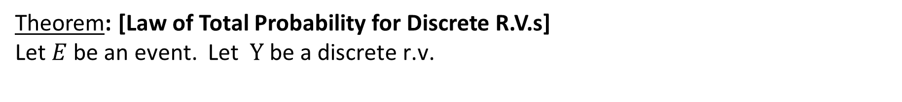
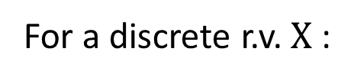
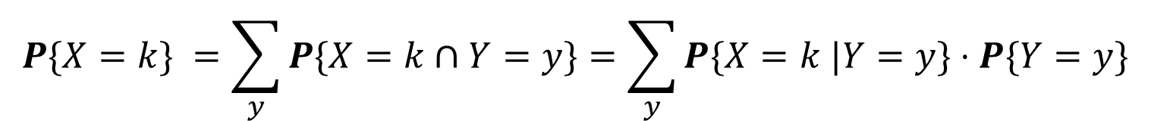
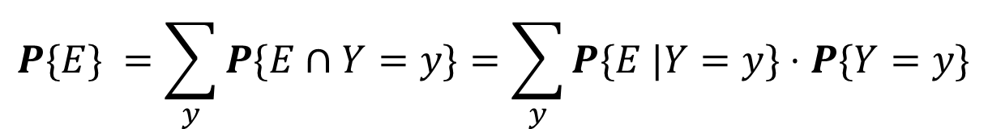
Law of Total Probability
Theorem: [Law of Total Probability for Discrete R.V.s]
Let $E$be an event. Let$Y \text{be} \text{a} \text{discrete} \text{r}\text{.}\text{v}\text{.}$
$$P\{E\} =\sum_{y}^{ }{P\{E∩Y=y\}=\sum_{y}^{ }{P\{E |Y=y\}⋅P\{Y=y\}}}$$
For a discrete r.v. $X$:
$$P\{X=k\} =\sum_{y}^{ }{P\{X=k∩Y=y\}=\sum_{y}^{ }{P\{X=k |Y=y\}⋅P\{Y=y\}}}$$
Proof: Follows immediately from Law of Total Probability for Events, if we realize
that $Y=y$ represents an event and the set of events $Y=y$ over all $y$ form a partition.

Slide 23
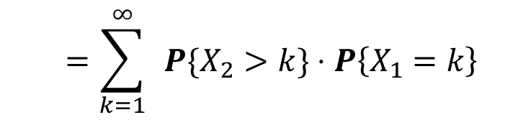
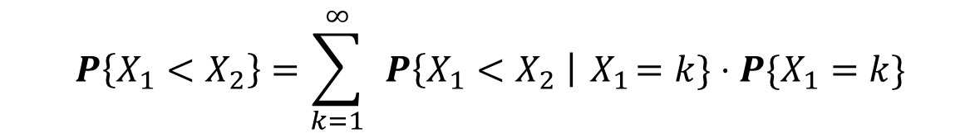
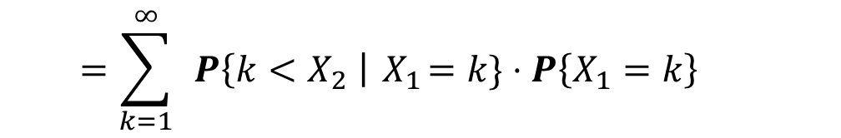



Who Fails First?
Disk with prob. $p_{1}$of failing each day, and a CPU with indpt. prob. $p_{2}$of failing each day.
Q: What is the probability that the disk fails before the CPU? (Redo using conditioning!)
$$X_{1}=\text{days} \text{until} \text{disk} \text{fails}∼Geometric(p_{1})$$
$$X_{2}=\text{days} \text{until} \text{CPU} \text{fails}∼Geometric(p_{2})$$
  $$P\left\{X_{1}<X_{2}\right\}=\sum_{k=1}^{∞}{ }P\left\{X_{1}<X_{2} \right|{ X}_{1}=k\}⋅P\{X_{1}=k\}$$
$$X_{1}⊥X_{2}$$
  $$=\sum_{k=1}^{∞}{ }P\left\{k<X_{2} \right|{ X}_{1}=k\}⋅P\left\{X_{1}=k\right\}$$
  $$=\sum_{k=1}^{∞}{ }P\{X_{2}>k\}⋅P\left\{X_{1}=k\right\}$$
  $$=\sum_{k=1}^{∞}{ }{\left(1−p_{2}\right)}^{k}⋅{\left(1−p_{1}\right)}^{k−1}⋅p_{1}$$
  $$=\frac{p_{1}(1 −p_{2})}{1−(1−p_{2})(1−p_{1})}$$

