Slide 1
Chapter 2
Probability on Events
Notes:
https://www.gettyimages.co.uk/detail/photo/says-royalty-free-image/173682323?phrase=die%20isolated
https://www.gettyimages.co.uk/detail/illustration/dart-royalty-free-illustration/165767268
https://www.gettyimages.co.uk/detail/illustration/grilled-cheese-royalty-free-illustration/165636239
https://www.gettyimages.co.uk/detail/illustration/girl-meets-boy-royalty-free-illustration/165077921

Slide 2

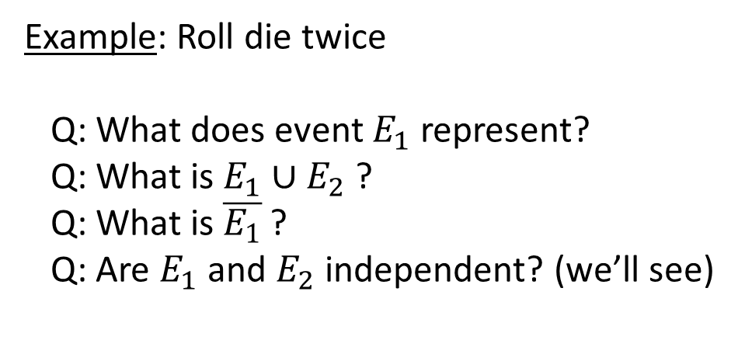
Sample Space and Events
Probability is defined in terms of some experiment.
= Sample space of the experiment = Set of all possible outcomes
Defn: An event, $E,$is any subset of the sample space, Ω.
Example: Roll die twice
Q: What does event $E_{1}$represent?
Q: What is $E_{1}∪E_{2}$ ?
Q: What is $\overline{E_{1}}$ ?
Q: Are $E_{1}$ and $E_{2}$ independent? (we’ll see)

Slide 3
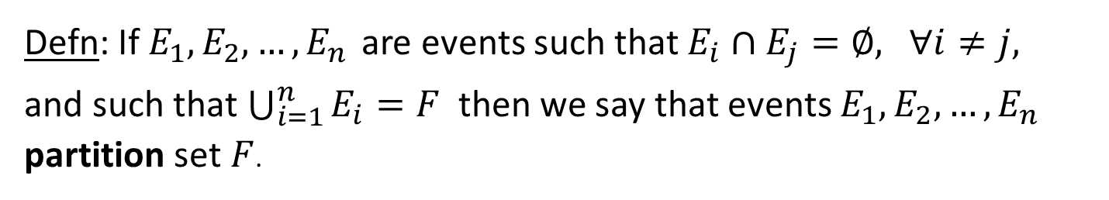
Sample Space and Events
Defn: If $E_{1}∩E_{2}=∅$, then $E_{1}$ and $E_{2}$ are mutually exclusive.
Defn: If $E_{1},E_{2},…,E_{n}$ are events such that $E_{i}∩E_{j}=∅,$ $∀i≠j,$
and such that $\bigcup_{i=1}^{n}{E_{i}=F}$then we say that events $E_{1},E_{2},…,E_{n}$ partition set $F$.
Q: What is an example of events that
partition Ω for 2 rolls of a die?

Slide 4
Sample Space and Events
Defn: A sample space is discrete if the number of outcomes is:
__________________.
A sample space is continuous if the number of outcomes is:
__________________.
  countable
  uncountable
Q: Which of these experiments have a discrete/continuous sample space?
  Roll a die 2 times
  Throw a dart at a unit interval.
  Flip a coin until we see the first head.
  Mark the time when the 100th email arrives.
  discrete
  continuous
  discrete
  continuous

Slide 5
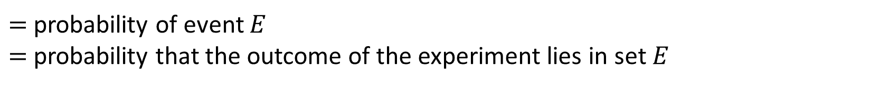

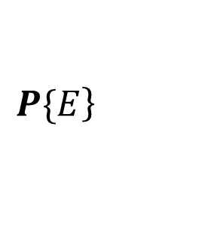
Probability Defined on Events
$$\left.P\{E\right\}$$
$=$probability of event $E$
$=$probability that the outcome of the experiment lies in set $E$
The 3 Probability Axioms:
Non-negativity: $P\{E\}≥0$ for any event $E.$
Additivity: If $E_{1},E_{2},E_{3}, …$ is a countable sequence of disjoint events, then
$$P\{E_{1}∪E_{2}∪E_{3}∪…\}=P\{E_{1}\}+P\{E_{2}\}+P\{E_{3}\}+⋯$$
Normalization: $P\{\}=1$

Slide 6
Consequences of the 3 Probability Axioms
Lemma 2.5: $P\{E∪F\}=$ $P\{E\}+P\{F\}−P\{E∩F\}$
Proof: (Hint: Think about Additivity Axiom)

Slide 7
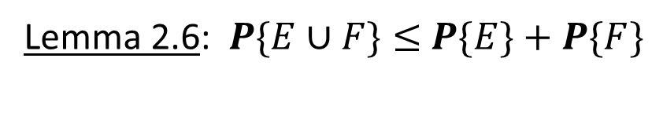

Consequences of the 3 Probability Axioms
Lemma 2.5: $P\{E∪F\}=$ $P\{E\}+P\{F\}−P\{E∩F\}$
Proof:
Express $E∪F$ as a union of mutually exclusive sets
  $E∪F=$ $E∪\left(F \backslash \left(E∩F\right)\right)$
Then, by the Additivity Axiom we have 2 observations:
  $P\{E∪F\}=$ $P\left\{E\right\}+P\{F \backslash \left(E∩F\right)$}
  $P\{F\}=$ $P\left\{F \backslash \left(E∩F\right)\right\}+P\left\{E∩F\right\}$
Now substitute the 2nd equation into the 1st .
Lemma 2.6: $P\{E∪F\}≤$ $P\{E\}+P\{F\}$
Proof: WHY??

Slide 8

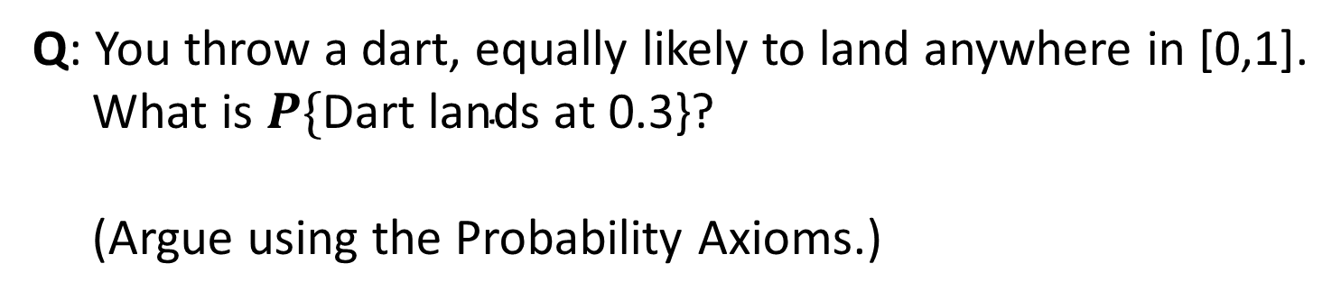
Consequences of the 3 Probability Axioms
Q: You throw a dart, equally likely to land anywhere in [0,1].
What is $P\{\text{Dart} \text{lands} \text{at}\text{ 0.3\}?}$
(Argue using the Probability Axioms.)
0
0.3
1

Slide 9
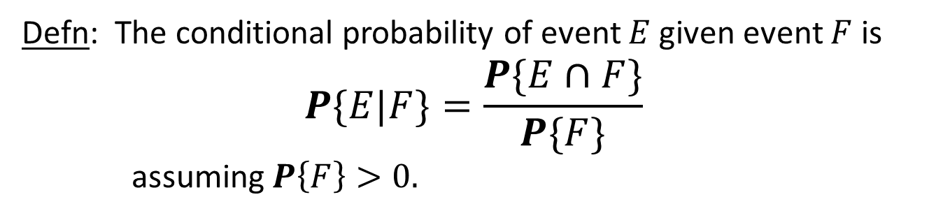
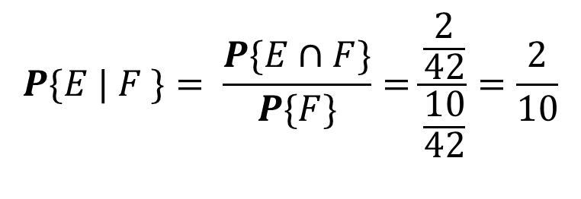
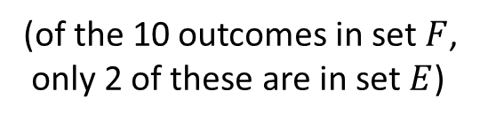
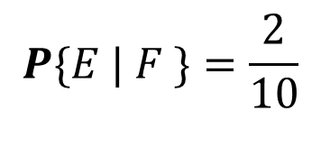
Conditional Probability on Events
Defn: The conditional probability of event $E$given event $F$ is
$$P\{E|F\}=\frac{P\{E∩F\}}{P\{F\}}$$
assuming $P\left\{F\right\}>0.$
Two equivalent views:
$$P\{E | F \}=\frac{2}{10}$$
(of the 10 outcomes in set $F$,
only 2 of these are in set $E$)
$$P\{E | F \}= \frac{P\{E∩F\}}{P\{F\}}=\frac{\frac{2}{42}}{\frac{10}{42}}=\frac{2}{10}$$

Slide 10
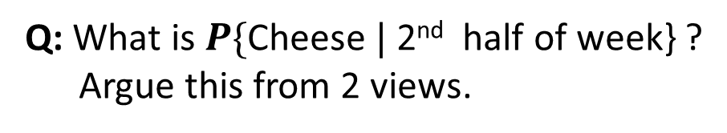
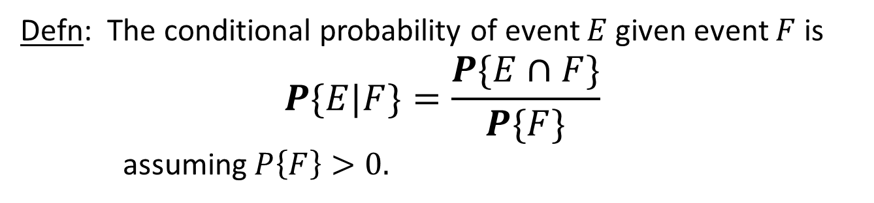
Conditional Probability on Events
Defn: The conditional probability of event $E$given event $F$ is
$$P\{E|F\}=\frac{P\{E∩F\}}{P\{F\}}$$
assuming $P\left\{F\right\}>0.$
Sandwich choices:
Q: What is $P\{\text{Cheese} | \text{2}\text{nd} \text{half} \text{of} \text{week}\text{\}}$ ?
Argue this from 2 views.
Mon – Jelly
Tues – Cheese
Wed – Turkey
Thur – Cheese
Fri – Turkey
Sat – Cheese
Sun – None
1st half
of week
2nd half
of week

Slide 11
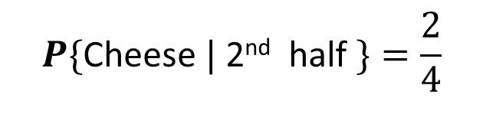

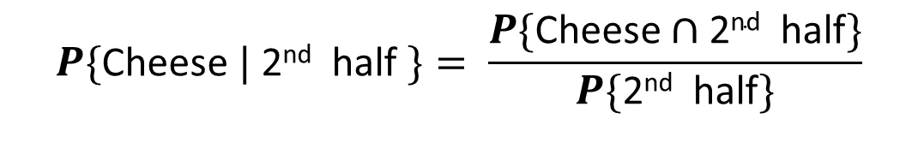
Conditional Probability on Events
Defn: The conditional probability of event $E$given event $F$ is
$$P\{E|F\}=\frac{P\{E∩F\}}{P\{F\}}$$
assuming $P\left\{F\right\}>0.$
Sandwich choices:
Q: What is $P\{\text{Cheese} | \text{2}\text{nd} \text{half} \text{of} \text{week}\text{\}}$ ?
Argue this from 2 views.
Mon – Jelly
Tues – Cheese
Wed – Turkey
Thur – Cheese
Fri – Turkey
Sat – Cheese
Sun – None
1st half
of week
$$P\{\text{Cheese} | \text{2}\text{nd} \text{half} \}=\frac{2}{4}$$
(of the 4 days in 2nd half,
2 are cheese sandwiches)
2nd half
of week
$$=\frac{\frac{2}{7}}{\frac{4}{7}}=\frac{2}{4}$$
$$P\{\text{Cheese} | \text{2}\text{nd} \text{half} \}= \frac{P\{\text{Cheese}∩\text{2}\text{nd} \text{half}\}}{P\{\text{2}\text{nd} \text{half}\}}$$

Slide 12

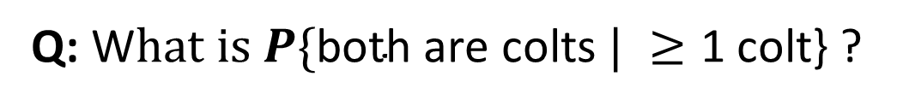
Conditional Probability on Events
Q: W$hat is P\{\text{both} \text{are} \text{colts} | ≥\text{1 }\text{colt}\text{\}}$ ?
The offspring of a horse is called a foal.
Horse couples have one foal at a time.
Each foal is equally likely to be a “colt” or a “filly.”
We’re told that a horse couple had 2 foals,
and at least one of these is a colt.

Slide 13



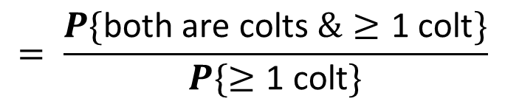
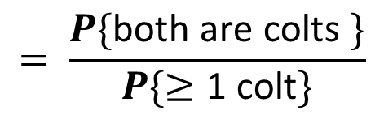
Conditional Probability on Events
$$P\{\text{both} \text{are} \text{colts} | ≥\text{1 }\text{colt}\text{\}}$$
$$= \frac{P\{\text{both} \text{are} \text{colts} \&≥\text{1 }\text{colt}\}}{P\{≥\text{1 }\text{colt}\}}$$
The offspring of a horse is called a foal.
Horse couples have one foal at a time.
Each foal is equally likely to be a “colt” or a “filly.”
We’re told that a horse couple had 2 foals,
and at least one of these is a colt.
$$= \frac{P\{\text{both} \text{are} \text{colts} \}}{P\{≥\text{1 }\text{colt}\}}$$
$$=\frac{\frac{1}{4}}{\frac{3}{4}}$$
$$= \frac{1}{3}$$

Slide 14



Conditional Probability on Events
$$P\{\text{both} \text{are} \text{colts} | ≥\text{1 }\text{colt}\text{\}}$$
$$= \frac{1}{3}$$
The offspring of a horse is called a foal.
Horse couples have one foal at a time.
Each foal is equally likely to be a “colt” or a “filly.”
We’re told that a horse couple had 2 foals,
and at least one of these is a colt.

Slide 15
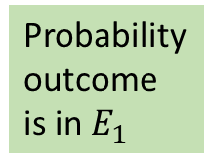
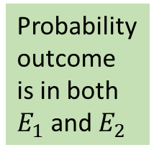
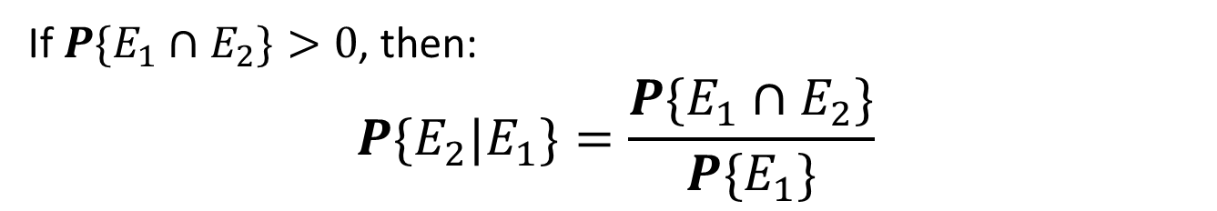



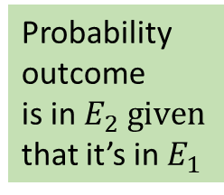
Conditional Probability on Events
If $P\{E_{1}∩E_{2}\}>0$, then:
$$P\{E_{2}|E_{1}\}=\frac{P\{E_{1}∩E_{2}\}}{P\{E_{1}\}}$$
Equivalently, we can write:
If $P\{E_{1}∩E_{2}\}>0$, then:
$$P\{E_{1}∩E_{2}\}=P\{E_{1}\}⋅P\{E_{2}|E_{1}\}$$
$$\text{Likewise}\text{:}$$
$$P\{E_{1}∩E_{2}\}=P\{E_{2}\}⋅P\{E_{1}|E_{2}\}$$
Probability
outcome
is in both
$E_{1}$ and $E_{2}$
Probability
outcome
is in $E_{1}$
Probability
outcome
is in $E_{2} given$
that it’s in $E_{1}$

Slide 16
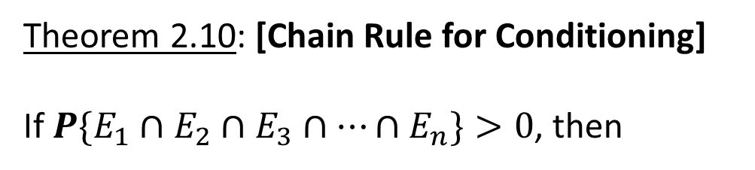
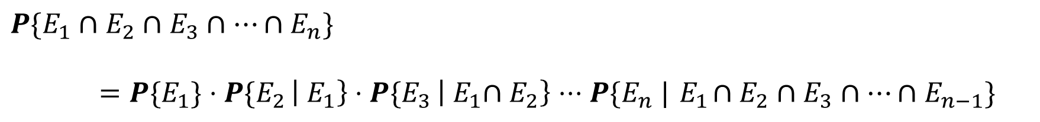
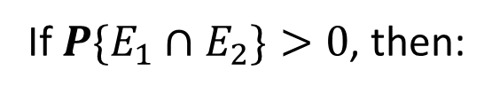

Chain Rule for Conditioning
If $P\{E_{1}∩E_{2}\}>0$, then:
If $P\{E_{1}∩E_{2}\}>0$, then:
$$P\{E_{1}∩E_{2}\}=P\{E_{1}\}⋅P\{E_{2}|E_{1}\}$$
This can be generalized!
Theorem 2.10: [Chain Rule for Conditioning]
If $P\{E_{1}∩E_{2}∩E_{3}∩⋯∩E_{n}\}>0$, then
$$P\{E_{1}∩E_{2}∩E_{3}∩⋯∩E_{n}\}$$
$=P\{E_{1}\}⋅P\{E_{2 }\left|{ E}_{1}\right\}⋅P\{E_{3 }\left|{{ E}_{1}∩E}_{2}\right\}⋅⋅⋅P\{E_{n} |{ E}_{1}∩E_{2}∩E_{3}∩⋯∩E_{n−1}\}$

Slide 17


Independent Events
Defn: Events $E$and $F$are independent, written $E⊥F,$if:
$P\{E∩F\}=P\{E\}⋅P\{F\}$
Here’s an equivalent and more intuitive definition:
Defn: Assuming $P\{F\}>0$, Events $E$and $F$are independent, if:
$P\{E | F\}=P\{E\}$
See the book for a proof of the equivalence.

Slide 18
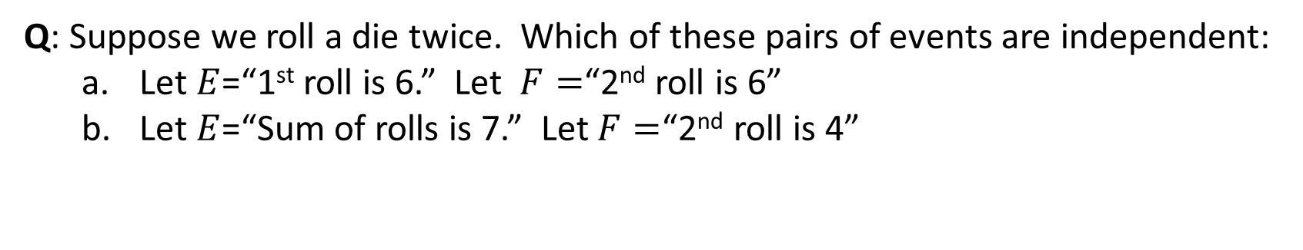

Practice with Independent Events
Defn: Events $E$and $F$are independent, written $E⊥F,$if:
$P\{E∩F\}=P\{E\}⋅P\{F\}$
Defn: Assuming $P\{F\}>0$, Events $E$and $F$are independent, if:
$P\{E | F\}=P\{E\}$
Q: Can two mutually exclusive, non-null events be independent?
No!
Q: Suppose we roll a die twice. Which of these pairs of events are independent:
  Let $E$=“1st roll is 6.” Let $F=$“2nd roll is 6”
  Let $E$=“Sum of rolls is 7.” Let $F=$“2nd roll is 4”
Both!

Slide 19
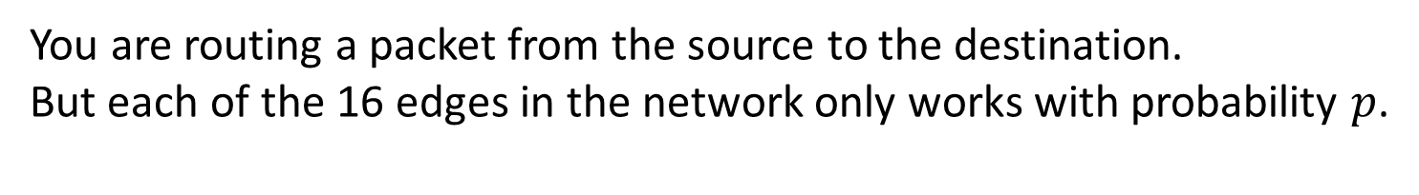
Practice with Independent Events
You are routing a packet from the source to the destination.
But each of the 16 edges in the network only works with probability $p$.
Q: What is the probability that you can get the packet from the source to the destination?

Slide 20
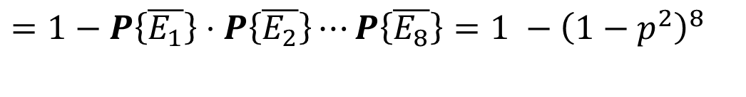

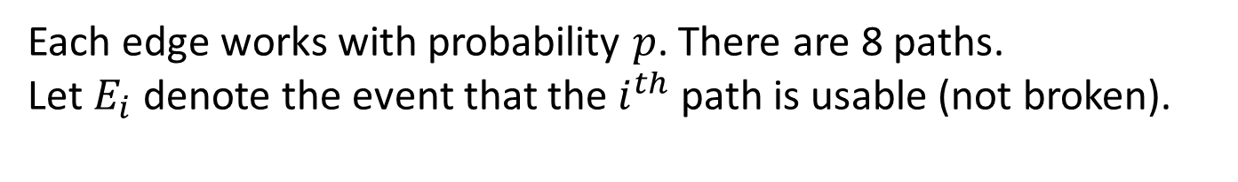

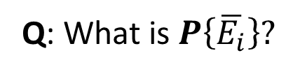
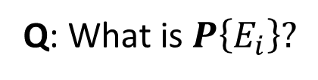
Practice with Independent Events
Each edge works with probability $p$. There are 8 paths.
Let $E_{i}$ denote the event that the $i^{th}$ path is usable (not broken).
Q: What is $P\left\{E_{i}\right\}?$
Q: What is $P\left\{\overline{E_{i}}\right\}?$
Q: What is $P\left\{\text{Can} \text{get} \text{from} \text{source} \text{to} \text{destination}\right\}?$
$$P\left\{\text{Can} \text{get} \text{from} \text{source} \text{to} \text{destination}\right\}= P\left\{\text{At} \text{least} \text{one} \text{path} \text{works}\right\}$$
$$=P\left\{E_{1}∪E_{2}∪⋯∪E_{8}\right\}$$
$$=1−P\left\{\text{All} \text{paths} \text{are} \text{broken}\right\}$$
$=1−P\left\{\overline{E_{1}}\right\}⋅$ $P\left\{\overline{E_{2}}\right\}⋯P\left\{\overline{E_{8}}\right\}=1 −{\left(1−p^{2}\right)}^{8}$

Slide 21

More Independence Definitions
Defn 2.15: Events $A_{1},A_{2},…, A_{n}$are independent if, for every subset $S$of $\left\{1, 2, …,n\right\}:$
$$P\left\{\bigcap_{i∈S}^{ }{A_{i}}\right\}=\prod_{i ∈S }{P\{A_{i}\} }$$
Defn 2.16: Events $A_{1},A_{2},…, A_{n}$are pairwise independent if every pair of events is independent.
Defn 2.17: Two events $E$and $F$are said to be conditionally independent given $G,$
$$\text{where} P\{G\}>0\text{, }\text{if}$$
$P\{E∩F \left| G\right\}=P\{E \left| G\right\}⋅P\{F \left| G\right\}$

Slide 22
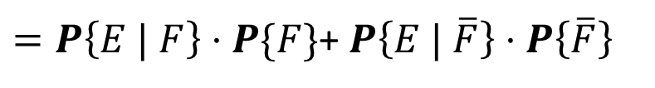
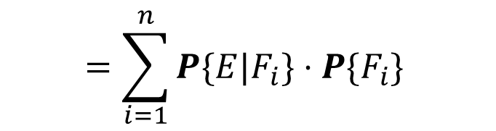
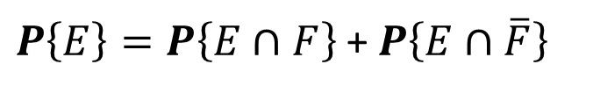
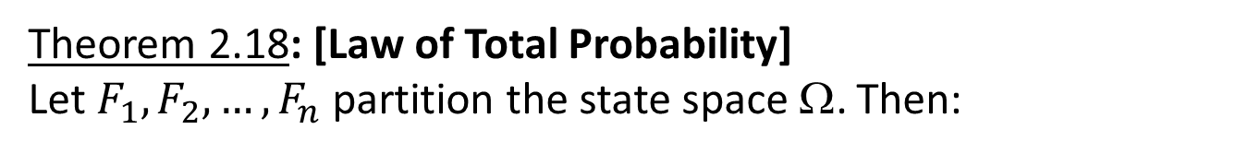

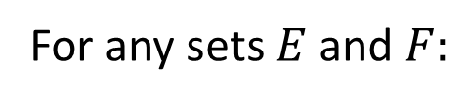

Law of Total Probability
For any sets $E$and $F:$
$$E=\left(E∩F\right)∪(E∩\overline{F})$$
$P\left\{E\right\}=P\left\{E∩F\right\}$ + $P\left\{E∩\overline{F}\right\}$
$=P\left\{E | F\right\}⋅P\{F\}$+ $P\left\{E | \overline{F}\right\}⋅P\left\{\overline{F}\right\}$
Generalizing, we have:
Theorem 2.18: [Law of Total Probability]
Let $F_{1},F_{2},…, F_{n}$ partition the state space Ω. Then:
$$P\{E\} =\sum_{i=1}^{n}{P\{E∩F_{i}\}}$$
$$=\sum_{i=1}^{n}{P\{E|F_{i}\}⋅P\{F_{i}\} }$$

Slide 23
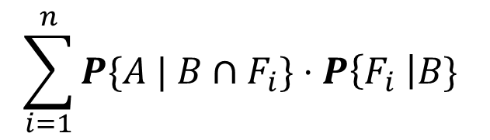
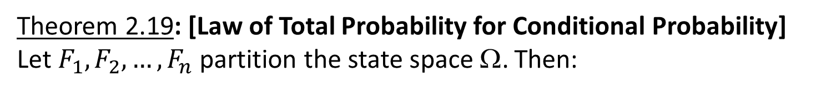

Law of Total Probability
The Law of Total Probability applies to conditional probability as well:
Theorem 2.19: [Law of Total Probability for Conditional Probability]
Let $F_{1},F_{2},…, F_{n}$ partition the state space Ω. Then:
$$\sum_{i=1}^{n}{P\{A |{ B∩F}_{i}\}⋅P\left\{F_{i} \right|B\} }$$
$$P\left\{A \right|B\}=$$

Slide 24
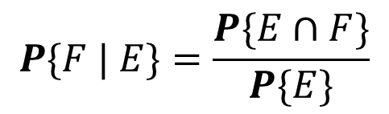
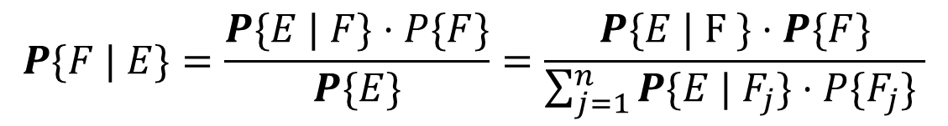

Bayes’ Law
Sometimes we want to know $P\{F | E\}$ but all we know is the reverse direction, $P\{E | F\}$.
Theorem 2.20 : [Bayes’ Law] Assuming $P\left\{E\right\}>0$ ,
$$P\{F | E\}=\frac{P\{E∩F\}}{P\{E\}}$$
$$=\frac{P\{E | F \}⋅P\{F\}}{P\{E\}}$$
Theorem 2.21: [Extended Bayes’ Law] Let $F_{1}, F_{2}, …, F_{n}$partition Ω. Assuming $P\left\{E\right\}>0$ ,
$$P\{F | E\}=\frac{P\{E | F\}⋅P\{F\}}{P\{E\}}=\frac{P\{E | F \}⋅P\{F\}}{\sum_{j=1}^{n}{P\{E |{ F}_{j}\}⋅P\{F_{j}\} }}$$

Slide 25
Bayes’ Law Example
There’s a rare child cancer that occurs in one out of a million kids.
There’s a test for this cancer that is 99.9% effective:
Q: Suppose my child’s test result is positive. How worried should I be?

Slide 26

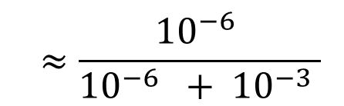
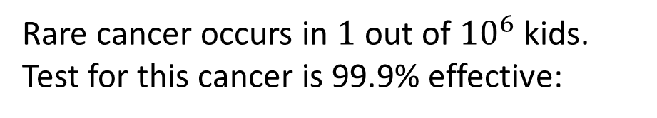


Bayes’ Law Example
Rare cancer occurs in $1$ out of ${10}^{6}$ kids.
Test for this cancer is 99.9% effective:
Q: My child’s test result is positive.
How worried should I be?
$$P\{\text{Cancer} | \text{Test} \text{Pos}\}$$
$$=\frac{P\{\text{Test} \text{pos} | Cancer\}⋅P\{\text{Cancer}\}}{P\{\text{Test} \text{pos} \left| Cancer\right\}⋅P\left\{\text{Cancer}\}+P\{\text{Test} \text{pos} \right|No cancer\}⋅P\{\text{No} \text{cancer}\} }$$
Why so low?
$$=\frac{0.999⋅{10}^{−6} }{0.999⋅{10}^{−6} +{ 10}^{−3}⋅{(1 − 10}^{−6}\text{) }}$$
$$≈\frac{{10}^{−6} }{{10}^{−6} +{ 10}^{−3} }$$
$$=\frac{1 }{1001}$$

