Slide 1
Chapter 16 Classical Statistical Inference
Notes:
https://www.gettyimages.co.uk/detail/illustration/yellow-light-bulb-icon-royalty-free-illustration/165766463?phrase=Yellow%20light%20bulb -- reusing lightbulb from Chpt 7. No need to rebuy.
https://www.gettyimages.co.uk/detail/illustration/tug-of-war-royalty-free-illustration/539323917?adppopup=true – tug of war picture -- BUY
https://www.gettyimages.co.uk/detail/illustration/girl-holding-a-large-homework-book-royalty-free-illustration/188016370?searchscope=image%2Cfilm&adppopup=true
BUY
https://www.gettyimages.co.uk/detail/illustration/teacher-royalty-free-illustration/487846580?searchscope=image%2Cfilm&adppopup=true -- BUY
h

Slide 2

This chapter and the next …
This chapter and the next are about creating many more estimators.
Keep in mind: estimation is an art, not a science.
There is no mathematical proof for the “best” estimator.
We pick our favorite estimator subjectively.
Lots of room for you to create your own!

Slide 3

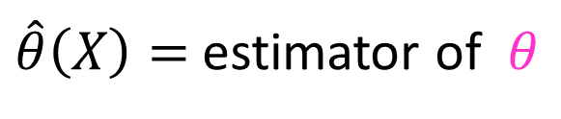
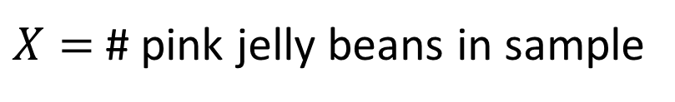

Estimating the number of pink jelly beans
Given: Jar has 1000 jelly beans.
Goal: Estimate $θ=$Number of pink jelly beans (unknown)
Experiment: Randomly sample $n=20$ jelly beans
with replacement
Why is this a random variable?
$X=$# pink jelly beans in sample
Why is this a random variable?
$\hat{θ}\left(X\right)=$estimator of $θ$

Slide 4


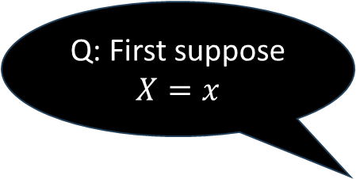

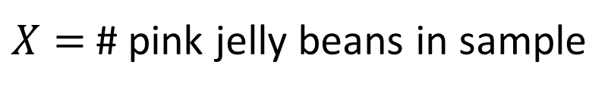
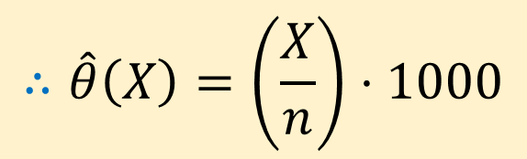
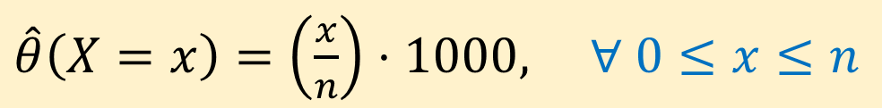
Estimating the number of pink jelly beans
Goal: Estimate $θ=$Number of pink jelly beans
Experiment: Randomly sample $n=20$ beans w/ replacement
$X=$# pink jelly beans in sample
$\hat{θ}\left(X\right)=$estimator of $θ$
Q: What’s a reasonable $\hat{θ}\left(X\right)$?
1000 jelly beans total
$\hat{θ}\left(X=x\right)=\left(\frac{x}{n}\right)$ $⋅1000, ∀ 0≤x≤n$
Q: First suppose
$$X=x$$
$$∴\hat{θ}\left(X\right)=\left(\frac{X}{n}\right)⋅1000$$

Slide 5

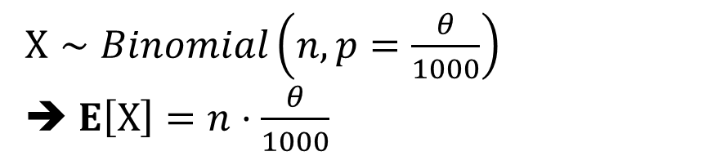


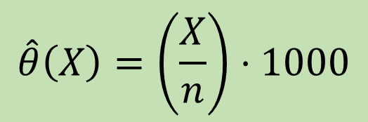

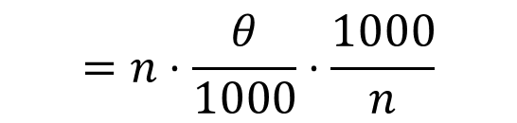
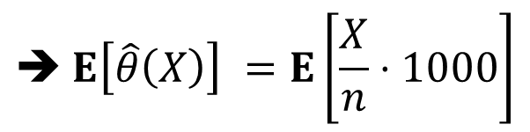
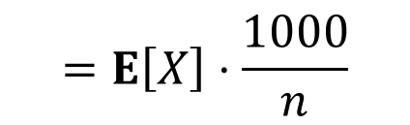
Is our estimator unbiased?
Goal: Estimate $θ=$Number of pink jelly beans
Experiment: Randomly sample $n=20$ beans w/ replacement
$X=$# pink jelly beans in sample
1000 jelly beans total
$$\hat{θ}\left(X\right)=\left(\frac{X}{n}\right)⋅1000$$
$X∼Binomial\left(n,p=\frac{θ}{1000}\right)$
➔ $E\left[X\right]=n⋅\frac{θ}{1000}$
Q: Is $\hat{θ}\left(X\right)$ unbiased?
$$\text{➔} E\left[\hat{θ}\left(X\right)\right] =E\left[\frac{X}{n}⋅1000\right]$$
$$=E\left[X\right]⋅\frac{1000}{n}$$
Hint: How is $X$
distributed?
$$=n⋅\frac{θ}{1000}⋅\frac{1000}{n}$$
$$= θ$$

Slide 6
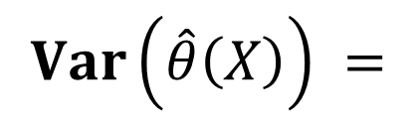
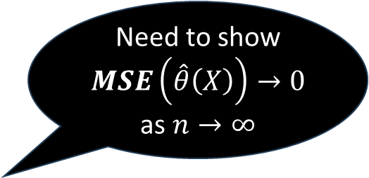

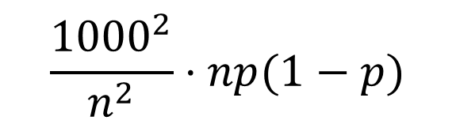
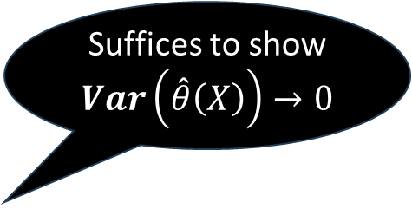
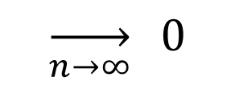
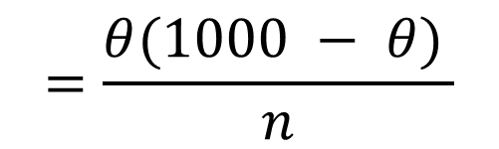
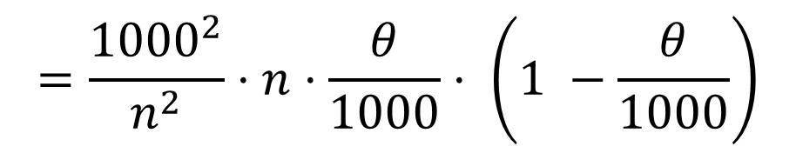
Is our estimator consistent?
$\hat{θ}\left(X\right)=\left(\frac{X}{n}\right)⋅1000$, where $X∼Binomial\left(n,p=\frac{θ}{1000}\right)$
Need to show $MSE\left(\hat{θ}\left(X\right)\right)→0$
as $n→∞$
$$\frac{{1000}^{2}}{n^{2}}⋅np(1−p)$$
$$Var\left(\hat{θ}\left(X\right)\right) =$$
$$=\frac{{1000}^{2}}{n^{2}}⋅n⋅\frac{θ}{1000}⋅ \left(1 −\frac{θ}{1000}\right)$$
Suffices to show
$$Var\left(\hat{θ}\left(X\right)\right)→0$$
$$=\frac{{θ(1000 − θ)}^{ }}{n}$$
$$\overset{→}{n→∞} 0$$
Why??

Slide 7



So far we’ve had no “method” for coming up with estimators.
We now introduce a methodology, called Maximum Likelihood Estimation (MLE), for deriving estimators.
We frequentists love Maximum Likelihood estimation
We Bayesians hate it!
See Chpt 17 for a better way!

Slide 8
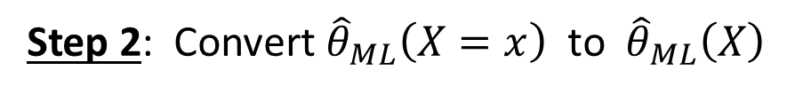


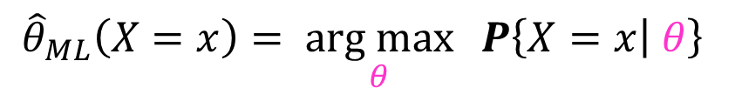
Creating an ML estimator
Goal: Estimate an unknown value $θ$, given sample data $X$
This is the “likelihood function”
Step 1: Define
$${\hat{θ}}_{ML}\left(X=x\right)= \underset{θ}{arg max}{ P\left\{X=x | θ\right\} }$$
Our estimator is the value of $θ$ that maximizes the likelihood function
Step 2: Convert ${\hat{θ}}_{ML}\left(X=x\right)$ to ${\hat{θ}}_{ML}\left(X\right)$

Slide 9


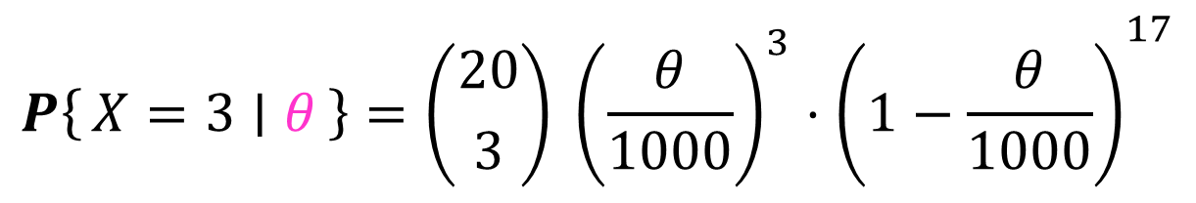
Example of MLE
Goal: Estimate $θ=$Number of pink jelly beans
Experiment: Randomly sample $n=20$ beans w/ replacement
1000 jelly beans total
$X=$# pink jelly beans in sample
Q: Suppose we observe $X=3$ pinks in our sample.
What is $P\left\{X=3 \right| θ\} ?$
What value of $θ$
maximizes this?
$$P\left\{X=3 ∣ θ\right\}={\left({20 \atop 3}\right)}^{ }{{\left(\frac{θ}{1000}\right)}^{3}⋅\left(1−\frac{θ}{1000}\right)}^{17}$$

Slide 10
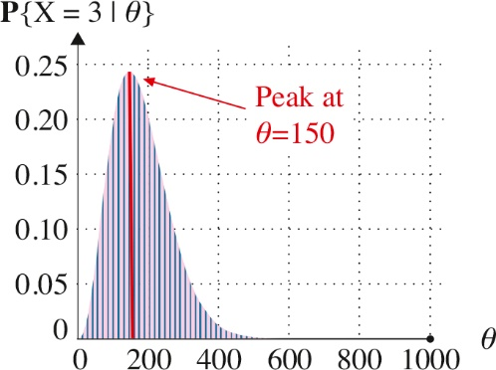


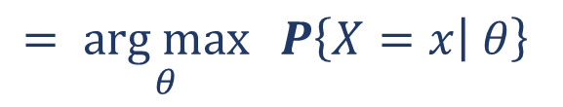


Example of MLE
Goal: Estimate $θ=$Number of pink jelly beans
Experiment: Randomly sample $n=20$ beans w/ replacement
1000 jelly beans total
$X=$# pink jelly beans in sample
Q: Suppose we observe $X=3$ pinks in our sample. What is $P\left\{X=3 \right| θ\} ?$
What value of $θ$
maximizes this?
$${\hat{θ}}_{ML}\left(X=3\right)$$
$$= \underset{θ}{arg max}{ P\left\{X=x | θ\right\} }$$
$$θ=150$$
$$=150$$

Slide 11
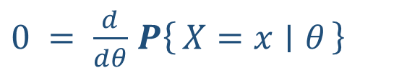
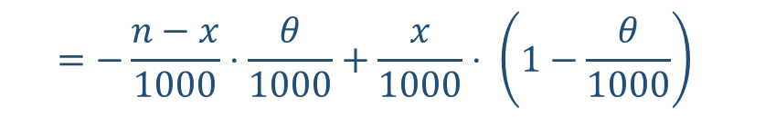
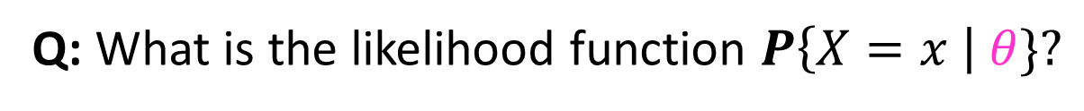
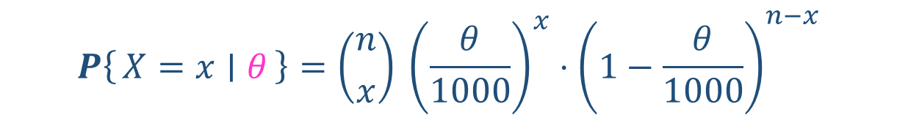
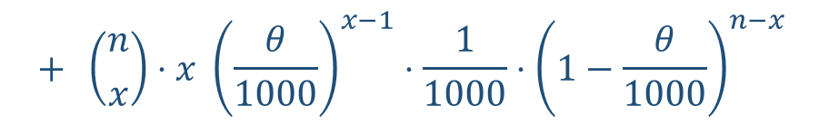

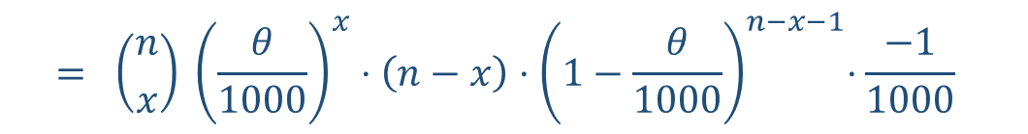
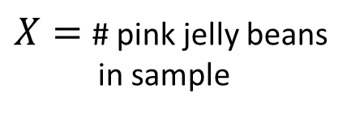
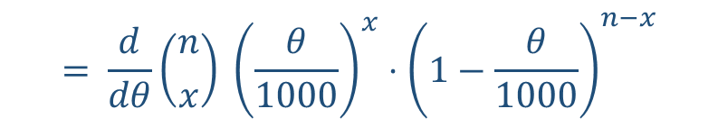
Example of MLE
Q: What is the likelihood function $P\left\{X=x \right| θ\}?$
$$P\left\{X=x ∣ θ\right\}={\left({n \atop x}\right)}^{ }{{\left(\frac{θ}{1000}\right)}^{x}⋅\left(1−\frac{θ}{1000}\right)}^{n−x}$$
1000 jelly beans total
$X=$# pink jelly beans
in sample
Q: What is ${\hat{θ}}_{ML}\left(X=x\right)=$ $\underset{θ}{arg max}{ P\left\{X=x | θ\right\} ?}$
$$= \frac{d}{dθ}{\left({n \atop x}\right)}^{ }{{\left(\frac{θ}{1000}\right)}^{x}⋅\left(1−\frac{θ}{1000}\right)}^{n−x}$$
$0 = \frac{d}{dθ}$ $P\left\{X=x ∣ θ\right\}$
$$= {\left({n \atop x}\right)}^{ }{{\left(\frac{θ}{1000}\right)}^{x}⋅\left(n−x\right){⋅\left(1−\frac{θ}{1000}\right)}^{n−x−1}⋅\frac{−1}{1000} }^{ }$$
$$+ {\left({n \atop x}\right)⋅x}^{ }{{\left(\frac{θ}{1000}\right)}^{x−1}⋅\frac{1}{1000}{⋅\left(1−\frac{θ}{1000}\right)}^{n−x} }^{ }$$
$$=−\frac{n−x}{1000}{⋅\frac{θ}{1000}+\frac{x}{1000}⋅}^{ }{{\left(1−\frac{θ}{1000}\right)}^{ }}^{ }$$
2nd derivative is
negative,
so this is a max
Solving, we get:
$$θ=\frac{1000x}{n}$$

Slide 12
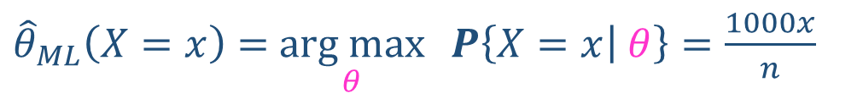


Example of MLE
Q: What is the likelihood function $P\left\{X=x \right| θ\}?$
$$P\left\{X=x ∣ θ\right\}={\left({n \atop x}\right)}^{ }{{\left(\frac{θ}{1000}\right)}^{x}⋅\left(1−\frac{θ}{1000}\right)}^{n−x}$$
1000 jelly beans total
$X=$# pink jelly beans
in sample
Q: What is ${\hat{θ}}_{ML}\left(X=x\right)=$ $\underset{θ}{arg max}{ P\left\{X=x | θ\right\} ?}$
${\hat{θ}}_{ML}\left(X=x\right)=$ $\underset{θ}{arg max}{ P\left\{X=x | θ\right\}=\frac{1000x}{n}}$
This holds
$$∀x$$
Hey, this is what we got before!
➔
${\hat{θ}}_{ML}\left(X\right)=$ $\underset{ }{\frac{1000X}{n}}{ }$

Slide 13

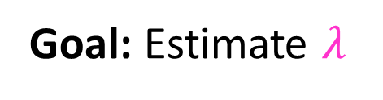
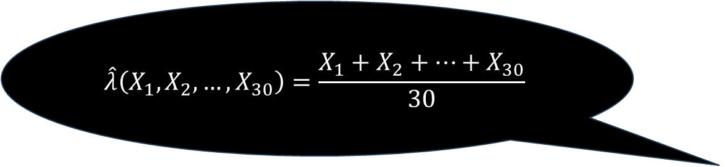
PSC Example
#jobs submitted daily to Pittsburgh Supercomputing Center $∼Poisson(λ)$
Goal: Estimate $λ$
Experiment: Sample #job submissions each day for a month: $X_{1}, X_{2}, …, X_{30}$
(assume independent)
What d$o you think$
$\hat{λ}\left(X_{1}, X_{2}, …, X_{30}\right) will be$?
$$\hat{λ}\left(X_{1}, X_{2}, …, X_{30}\right)=\frac{X_{1}+X_{2}+⋯+X_{30}}{30}$$

Slide 14


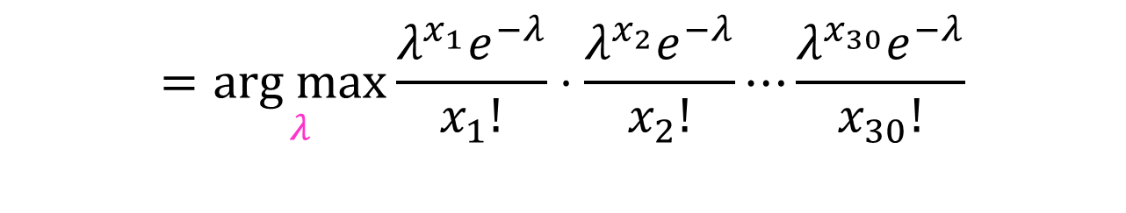
PSC Example: MLE method
#jobs submitted daily to Pittsburgh Supercomputing Center $∼Poisson(λ)$
$${\hat{λ}}_{ML}(X_{1}=x_{1},X_{2}=x_{2},…, X_{30}=x_{30})$$
$=\underset{λ}{arg max}{ P\left\{X_{1}=x_{1},X_{2}=x_{2},…, X_{30}=x_{30} | λ\right\} }$
$$=\underset{λ}{arg max}\frac{λ^{x_{1}}e^{−λ}}{x_{1}!}⋅\frac{λ^{x_{2}}e^{−λ}}{x_{2}!}⋯\frac{λ^{x_{30}}e^{−λ}}{x_{30}!}$$
What should we do to find the maximizing $λ$?
$$=\underset{λ}{arg max}\frac{λ^{x_{1}+x_{2}+⋯+x_{30}}e^{−30λ}}{x_{1}!x_{2}!⋯x_{30}!}$$

Slide 15
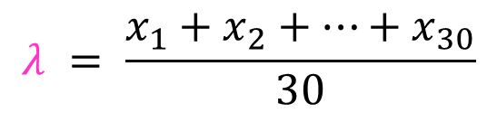
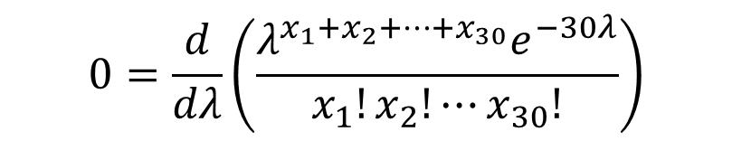
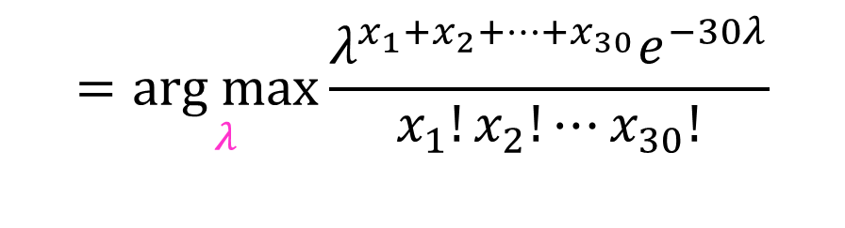
PSC Example: MLE method
$$=\underset{λ}{arg max}\frac{λ^{x_{1}+x_{2}+⋯+x_{30}}e^{−30λ}}{x_{1}!x_{2}!⋯x_{30}!}$$
$${\hat{λ}}_{ML}(X_{1}=x_{1},X_{2}=x_{2},…, X_{30}=x_{30})$$
$$0=\frac{d}{dλ}\left(\frac{λ^{x_{1}+x_{2}+⋯+x_{30}}e^{−30λ}}{x_{1}!x_{2}!⋯x_{30}!}\right)$$
set derivative
equal to 0
$$=\frac{\left(x_{1}+x_{2}+⋯+x_{30}\right)λ^{x_{1}+x_{2}+⋯+x_{30}−1}e^{−30λ}+λ^{x_{1}+x_{2}+⋯+x_{30}}{⋅\left(−30\right)⋅e}^{−30λ}}{x_{1}!x_{2}!⋯x_{30}!}$$
➔
$0 =$ $\left(x_{1}+x_{2}+⋯+x_{30}\right)+λ⋅(−30)$
$$λ = \frac{x_{1}+x_{2}+⋯+x_{30}}{30}$$
➔

Slide 16
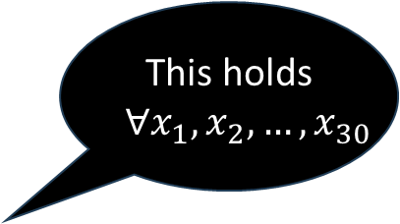
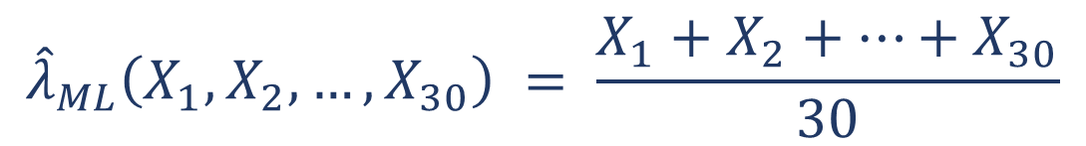
PSC Example: MLE method
We have shown:
This holds
$$∀x_{1},x_{2}, …, x_{30}$$
$${\hat{λ}}_{ML}\left(X_{1}=x_{1},X_{2}=x_{2},…, X_{30}=x_{30}\right) = \frac{x_{1}+x_{2}+⋯+x_{30}}{30}$$
$${\hat{λ}}_{ML}\left(X_{1},X_{2},…, X_{30}\right) = \frac{X_{1}+X_{2}+⋯+X_{30}}{30}$$
➔
unsurprising

Slide 17
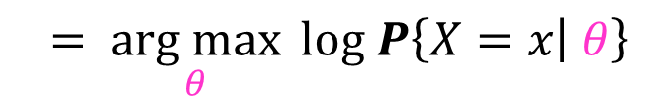
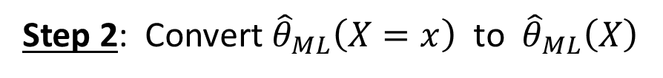
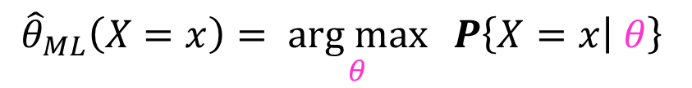
Log likelihood estimation
Goal: Estimate an unknown value $θ$, given sample data $X$
Step 1: Define
This is the
likelihood
function
This is the
log likelihood
function
$${\hat{θ}}_{ML}\left(X=x\right)= \underset{θ}{arg max}{ P\left\{X=x | θ\right\} }$$
$${=\underset{θ}{arg max}{ log P\left\{X=x | θ\right\} }}$$
equivalent
Why??
Step 2: Convert ${\hat{θ}}_{ML}\left(X=x\right)$ to ${\hat{θ}}_{ML}\left(X\right)$

Slide 18
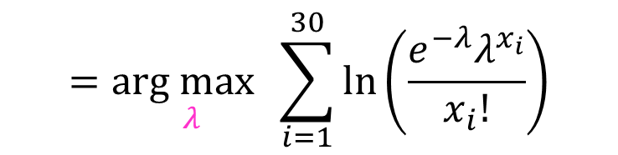
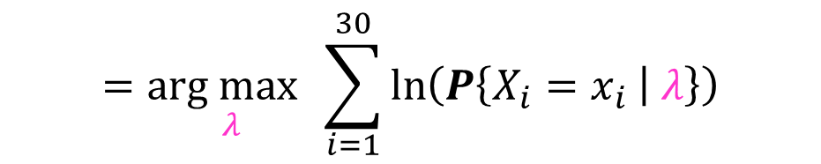
PSC example revisited with log likelihood
#jobs submitted daily to Pittsburgh Supercomputing Center $∼Poisson(λ)$
the unknown
$${\hat{λ}}_{ML}(X_{1}=x_{1},X_{2}=x_{2},…, X_{30}=x_{30})$$
$=\underset{λ}{arg max}{\ln\left(P\left\{X_{1}=x_{1},X_{2}=x_{2},…, X_{30}=x_{30} | λ\right\}\right) }$
$=\underset{λ}{arg max}{\ln\left(P\left\{X_{1}=x_{1} | λ\right\}⋅P\left\{X_{2}=x_{2} | λ\right\}⋯P\left\{X_{30}=x_{30} | λ\right\}\right) }$
$$=\underset{λ}{arg max}\sum_{i=1}^{30}{\ln\left(P\left\{X_{i}=x_{i} | λ\right\}\right)}$$
$$=\underset{λ}{arg max}\sum_{i=1}^{30}{\ln\left(\frac{e^{−λ}λ^{x_{i}}}{x_{i}!}\right)}$$

Slide 19
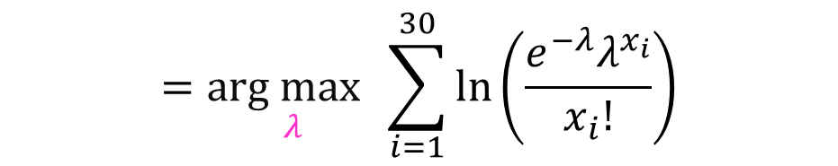
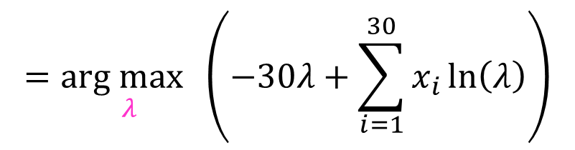
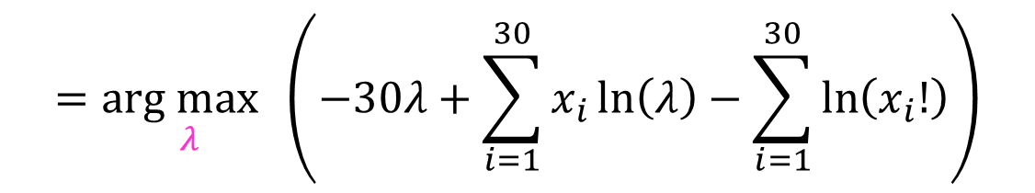
PSC example revisited with log likelihood
$${\hat{λ}}_{ML}(X_{1}=x_{1},X_{2}=x_{2},…, X_{30}=x_{30})$$
$$=\underset{λ}{arg max}\sum_{i=1}^{30}{\ln\left(\frac{e^{−λ}λ^{x_{i}}}{x_{i}!}\right)}$$
$$=\underset{λ}{arg max}\left(−30λ+\sum_{i=1}^{30}{x_{i}\ln\left(λ\right)}−\sum_{i=1}^{30}{\ln\left(x_{i}!\right)}\right)$$
$$=\underset{λ}{arg max}\left(−30λ+\sum_{i=1}^{30}{x_{i}\ln\left(λ\right)}\right)$$
Why can we drop this?

Slide 20

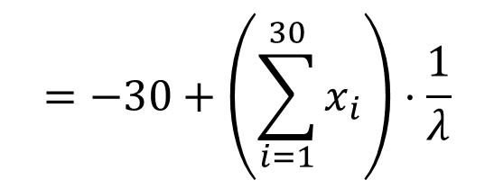



PSC example revisited with log likelihood
$${\hat{λ}}_{ML}\left(X_{1}=x_{1},X_{2}=x_{2},…, X_{30}=x_{30}\right)=\underset{λ}{arg max}\left(−30λ+\sum_{i=1}^{30}{x_{i}\ln\left(λ\right)}\right)$$
What should we do to find the maximizing $λ$?
set derivative
equal to 0
$$0=\frac{d}{dλ}\left(−30λ+\sum_{i=1}^{30}{x_{i}\ln\left(λ\right)}\right)$$
$$=−30+\left(\sum_{i=1}^{30}{x_{i}}\right)⋅\frac{1}{λ}$$
$$λ = \frac{x_{1}+x_{2}+⋯+x_{30}}{30}$$
➔
$${\hat{λ}}_{ML}(X_{1}=x_{1}X_{2}=x_{2},…, X_{30}=x_{30}) = \frac{x_{1}+x_{2}+⋯+x_{30}}{30}$$
➔

Slide 21



MLE with data from continuous distribution
MLE single variable:
We wish to estimate an unknown value $θ.$
If the sample data is represented by discrete r.v. $X$, then we define:
$${\hat{θ}}_{ML}\left(X=x\right)= \underset{θ}{arg max}{ P\left\{X=x | θ\right\} }$$
If the sample data is represented by continuous r.v. $X$, then we define:
$${\hat{θ}}_{ML}\left(X=x\right)= \underset{θ}{arg max}{ f_{X∣θ}(x) }$$

Slide 22

MLE with data from continuous distribution
MLE multiple variables:
We wish to estimate an unknown value $θ.$
If the sample data is represented by discrete r.v.s $X_{1}, X_{2}, …, X_{n}$, then we define:
$${\hat{θ}}_{ML}\left(X_{1}=x_{1}, X_{2}=x_{2},…, X_{n}=x_{n}\right)= \underset{θ}{arg max}{ P\left\{X_{1}=x_{1}, X_{2}=x_{2}, …, X_{n}=x_{n} | θ\right\} }$$
If the sample data is represented by continuous r.v.s $X_{1}, X_{2}, …, X_{n}$, then we define:
$${\hat{θ}}_{ML}\left(X_{1}=x_{1}, X_{2}=x_{2},…, X_{n}=x_{n}\right)= \underset{θ}{arg max}{ f_{X_{1}, X_{2}, …, X_{n}∣θ}(x_{1}, x_{2}, …, x_{n})}$$

Slide 23




MLE Example: time spent on homework
How long can I expect to work on homework?
Intro to
Probability
for
Computing
Harchol-
Balter
The distribution is
$$Uniform(0,b)$$
Great, but what is $b?$
Sample some students and estimate it!

Slide 24



MLE Example: time spent on homework
Given: Time students spend on homework each week $∼Uniform(0,b)$
Goal: Estimate the unknown $b$
Experiment: Sample 3 students independently at random: $X_{1}, X_{2}, X_{3}$
Estimator: $\hat{b}(X_{1},X_{2},X_{3})$
Start by deriving
$\hat{b}(X_{1}=x_{1},{ X}_{2}=x_{2},{ X}_{3}=x_{3})$

Slide 25





MLE Example: time spent on homework
Given: Time students spend on homework each week $∼Uniform(0,b)$
$${\hat{b}}_{ML}\left(X_{1}=x_{1}, X_{2}=x_{2}, X_{3}=x_{3}\right)= \underset{b}{arg max}{ f_{X_{1}, X_{2},X_{3}∣b}(x_{1}, x_{2}, x_{3})}$$
$${ f_{X_{1}, X_{2},X_{3}∣b}\left(x_{1}, x_{2}, x_{3}\right)=\left\{ \begin{matrix}\frac{1}{b^{3}} & \text{if} 0<x_{1},x_{2},x_{3}≤b \\ 0 & \text{o}\text{.}\text{w}\text{.}\end{matrix} \right.}$$
Is $\left(x_{1}, x_{2}, x_{3}\right)$ possible here?
What value of $b$ maximizes this?
$${ =\left\{\begin{matrix} \frac{1}{b^{3}} & \text{if} b≥max⁡(x_{1},x_{2},x_{3}) \\ 0 & \text{o}\text{.}\text{w}\text{.}\end{matrix} \right.}$$
$$b=max⁡(x_{1},x_{2},x_{3})$$

Slide 26



MLE Example: time spent on homework
Given: Time students spend on homework each week $∼Uniform(0,b)$
Huh??
I asked 3 random students:
$$X_{1}=10, { X}_{2}=5, { X}_{3}=15$$
Should $b=15?$
${\hat{b}}_{ML}\left(X_{1}=x_{1}, X_{2}=x_{2}, X_{3}=x_{3}\right)=$ $max⁡(x_{1},x_{2},x_{3})$
➔
${\hat{b}}_{ML}\left(X_{1}, X_{2}, X_{3}\right)=$ $max⁡(X_{1},X_{2},X_{3})$
The MLE is just one possible estimator, and not always the best one.
What if I only have 1 sample?!
Intro to
Probability
for
Computing
Harchol-
Balter
In Exercise 16.5, you’ll show that ${\hat{b}}_{ML}$ is a biased estimator, but can be made into an unbiased estimator pretty easily.
(assume independent)

Slide 27





MLE Example: estimating std of temperature
Given: The high temp in Pittsburgh in June $∼Normal(μ=79,σ^{2})$
Goal: Estimate the unknown $σ^{ }$via MLE
Experiment: Observe temperature on $n$ randomly sampled
independent June days: $X_{1}, X_{2}, …, X_{n}$
$${\hat{σ}}_{ML}\left(X_{1}=x_{1}, X_{2}=x_{2}, {…, X}_{n}=x_{n}\right)= \underset{σ}{arg max}{ f_{X_{1}, X_{2},{…, X}_{n}∣σ}(x_{1}, x_{2}, {…,x}_{n})}$$
$$= \underset{σ}{arg max}{ {\ln\left({ f}_{X_{1}, X_{2},{…, X}_{n}∣σ}(x_{1}, x_{2}, {…,x}_{n})\right) }_{ }}$$
$$= \underset{σ}{arg max}{ {\ln\left(\prod_{i=1}^{n}{f_{X_{i}|σ}(x_{i})}\right) }_{ }}$$

Slide 28




MLE Example: estimating std of temperature
Given: The high temp June $∼Normal\left(μ=79,σ^{2}\right),$ where $σ^{ }$ is unknown
$${\hat{σ}}_{ML}\left(X_{1}=x_{1}, X_{2}=x_{2}, {…, X}_{n}=x_{n}\right)=\underset{σ}{arg max}{ {\ln\left(\prod_{i=1}^{n}{f_{X_{i}|σ}(x_{i})}\right) }_{ }}$$
$$= \underset{σ}{arg max}{ {\sum_{i=1}^{n}{\ln\left(f_{X_{i}|σ}(x_{i})\right)} }_{ }}$$
$$= \underset{σ}{arg max}{ {\sum_{i=1}^{n}{\ln\left(\frac{1}{\sqrt{2π}σ}e^{−\frac{{\left(x_{i}−μ\right)}^{2}}{2σ^{2}}}\right)} }_{ }}$$
$$= \underset{σ}{arg max}{ {\sum_{i=1}^{n}{\left(−\frac{{\left(x_{i}−μ\right)}^{2}}{2σ^{2}}−\ln{σ−\ln{\sqrt{2π}}}\right)} }_{ }}$$

Slide 29



MLE Example: estimating std of temperature
Given: The high temp June $∼Normal\left(μ=79,σ^{2}\right),$ where $σ^{ }$ is unknown
$${\hat{σ}}_{ML}\left(X_{1}=x_{1}, X_{2}=x_{2}, {…, X}_{n}=x_{n}\right)=\underset{σ}{arg max}{ {\sum_{i=1}^{n}{\left(−\frac{{\left(x_{i}−μ\right)}^{2}}{2σ^{2}}−\ln{σ−\ln{\sqrt{2π}}}\right)} }_{ }}{ }$$
$$= \underset{σ}{arg max}{ {−\frac{1}{2σ^{2}}\sum_{i=1}^{n}{{\left(x_{i}−μ\right)}^{2}−n\ln{σ−n\ln{\sqrt{2π}}}} }_{ }}$$
Set the derivative to 0
$$0=\frac{d}{dσ}\left(−\frac{1}{2σ^{2}}\sum_{i=1}^{n}{{\left(x_{i}−μ\right)}^{2}−n\ln{σ−n\ln{\sqrt{2π}}}}\right)$$
$$=\frac{1}{σ^{3}}\sum_{i=1}^{n}{{\left(x_{i}−μ\right)}^{2}−\frac{n}{σ}}$$

Slide 30





MLE Example: estimating std of temperature
Given: The high temp June $∼Normal\left(μ=79,σ^{2}\right),$ where $σ^{ }$ is unknown
$$0=\frac{1}{σ^{2}}\sum_{i=1}^{n}{{\left(x_{i}−μ\right)}^{2}−n}$$
(We multiplied both sides by $n.$)
$$σ=\sqrt{\frac{\sum_{i=1}^{n}{{\left(x_{i}−μ\right)}^{2}}}{n}}$$
➔
$${\hat{σ}}_{ML}\left(X_{1}=x_{1}, X_{2}=x_{2}, {…, X}_{n}=x_{n}\right)=\sqrt{\frac{\sum_{i=1}^{n}{{\left(x_{i}−μ\right)}^{2}}}{n}}{ }$$
➔
$${\hat{σ}}_{ML}\left(X_{1}, X_{2}, {…, X}_{n}\right)=\sqrt{\frac{\sum_{i=1}^{n}{{\left(X_{i}−μ\right)}^{2}}}{n}}{ }$$
➔

Slide 31





MLE estimation of > 1 parameter
Given: The high temp in Pittsburgh in June $∼Normal(μ,σ^{2})$
Goal: Estimate both unknowns $μ$ and $σ^{ }$via MLE
Experiment: Observe temperature on $n$ randomly sampled
independent June days: $X_{1}, X_{2}, …, X_{n}$
$$\left(\begin{matrix}{{\hat{μ}}_{ML}}_{ }\left(X_{1}=x_{1}, X_{2}=x_{2}, {…, X}_{n}=x_{n}\right) \\ {\hat{σ}}_{ML}\left(X_{1}=x_{1}, X_{2}=x_{2}, {…, X}_{n}=x_{n}\right)\end{matrix}\right)= \underset{μ,σ}{arg max}{ {\ln\left({ f}_{X_{1}, X_{2},{…, X}_{n}∣μ,σ}\left(x_{1}, x_{2}, {…,x}_{n}\right)\right) }_{ }}$$
Likelihood function
$$g(μ,σ)$$
$$\frac{∂\ln{g(μ,σ)}}{∂μ}=0$$
$$\frac{∂\ln{g(μ,σ)}}{∂σ}=0$$
AND

Slide 32








MLE estimation of > 1 parameter
$$\left(\begin{matrix}{{\hat{μ}}_{ML}}_{ }\left(X_{1}=x_{1}, X_{2}=x_{2}, {…, X}_{n}=x_{n}\right) \\ {\hat{σ}}_{ML}\left(X_{1}=x_{1}, X_{2}=x_{2}, {…, X}_{n}=x_{n}\right)\end{matrix}\right)= \underset{μ,σ}{arg max}{ {\ln\left({ f}_{X_{1}, X_{2},{…, X}_{n}∣μ,σ}\left(x_{1}, x_{2}, {…,x}_{n}\right)\right) }_{ }}$$
Likelihood function $g(μ,σ)$
$${ {\ln\left(g(μ,σ\right)=−\frac{1}{2σ^{2}}\sum_{i=1}^{n}{{\left(x_{i}−μ\right)}^{2}−n\ln{σ−n\ln{\sqrt{2π}}}}}_{ }}$$
$$=\frac{1}{σ^{2}}\sum_{i=1}^{n}{{\left(x_{i}−μ\right)}^{ }}$$
$$=\frac{1}{σ^{3}}\sum_{i=1}^{n}{{{\left(x_{i}−μ\right)}^{2}−\frac{n}{σ}}^{ }}$$
$$0=\frac{∂\ln{g(μ,σ)}}{∂μ}$$
$$0=\frac{∂\ln{g(μ,σ)}}{∂σ}$$
AND
$$σ=\sqrt{\frac{1}{n }\sum_{i=1}^{n}{{\left(x_{i}−μ\right)}^{2}}}$$
$$μ=\frac{x_{1}+x_{2}+⋯+x_{n}}{n}$$
➔
➔

Slide 33




MLE estimation of > 1 parameter
$$\left(\begin{matrix}{{\hat{μ}}_{ML}}_{ }\left(X_{1}=x_{1}, X_{2}=x_{2}, {…, X}_{n}=x_{n}\right) \\ {\hat{σ}}_{ML}\left(X_{1}=x_{1}, X_{2}=x_{2}, {…, X}_{n}=x_{n}\right)\end{matrix}\right)= \underset{μ,σ}{arg max}{ {\ln\left({ f}_{X_{1}, X_{2},{…, X}_{n}∣μ,σ}\left(x_{1}, x_{2}, {…,x}_{n}\right)\right) }_{ }}$$
$$σ=\sqrt{\frac{1}{n }\sum_{i=1}^{n}{{\left( x_{i }− μ \right)}^{2}}}$$
$$μ=\frac{x_{1}+x_{2}+⋯+x_{n}}{n}$$
need to
substitute in $μ$
$$σ=\sqrt{\frac{1}{n }\sum_{i=1}^{n}{{\left( x_{i }−\frac{x_{1}+x_{2}+⋯+x_{n}}{n}\right)}^{2}}}$$

Slide 34



MLE estimation of > 1 parameter
$${{\hat{μ}}_{ML}}_{ }\left(X_{1}=x_{1}, X_{2}=x_{2}, {…, X}_{n}=x_{n}\right)=\frac{x_{1}+x_{2}+⋯+x_{n}}{n}$$
$${\hat{σ}}_{ML}\left(X_{1}=x_{1}, X_{2}=x_{2}, {…, X}_{n}=x_{n}\right)=\sqrt{\frac{1}{n }\sum_{i=1}^{n}{{\left( x_{i }−\frac{x_{1}+x_{2}+⋯+x_{n}}{n}\right)}^{2}}}$$
$${{\hat{μ}}_{ML}}_{ }\left(X_{1}, X_{2}, {…, X}_{n}\right)=\frac{X_{1}+X_{2}+⋯+X_{n}}{n}$$
➔
$${\hat{σ}}_{ML}\left(X_{1}, X_{2}, {…, X}_{n}\right)=\sqrt{\frac{1}{n }\sum_{i=1}^{n}{{\left( X_{i }−\frac{X_{1}+X_{2}+⋯+X_{n}}{n}\right)}^{2}}}$$
➔

Slide 35




Linear Regression: a new kind of optimization
Experiment: Obtain $n_{ }$data points generated through some experiment,
represented by random variables: $\left(X_{1},Y_{1}\right), \left(X_{2},Y_{2}\right), …, (X_{n},Y_{n})$
Goal: Given specific instance, $\left(x_{1},y_{1}\right), \left(x_{2},y_{2}\right), …, \left(x_{n},y_{n}\right),$
find the line that best this.
This will NOT be Maximum Likelihood Estimation!
Seeking
$$y=ax+b$$
line

Slide 36







Linear Regression
Defn: (Linear Regression) Let $\left(X_{1},Y_{1}\right), \left(X_{2},Y_{2}\right), …, (X_{n},Y_{n})$
be a set of data sample points.
Define $\hat{a}$ and $\hat{b}$ to be estimators for line parameters.
Define:
$\hat{Y_{i}}$is an estimated dependent r.v.
$$\hat{Y_{i}}≡{\hat{a}X}_{i}+\hat{b}$$
The point-wise error is defined as:
$$Err_{i}= Y_{i} −\hat{Y_{i}}$$
$$y=ax+b$$
The sample average squared error (SASE) is then:
$$SASE(\hat{Y_{1}},\hat{Y_{2}}, …,\hat{Y_{n}})=\frac{1}{n }\sum_{i=1}^{n}{{Err_{i}}^{2}=\frac{1}{n }\sum_{i=1}^{n}{{\left(Y_{i} −\hat{Y_{i}}\right)}^{2}}}$$
The goal of linear regression is to find estimates $\hat{a}$ and $\hat{b}$ that minimize $SASE(\hat{Y_{1}},\hat{Y_{2}}, …,\hat{Y_{n}})$.

Slide 37





Linear Regression
Goal: Derive estimators
which minimize $SASE\left(\hat{Y_{1}},\hat{Y_{2}}, …,\hat{Y_{n}}\right)$, where $\hat{Y_{i}}≡{\hat{a}X}_{i}+\hat{b}$.
$$\hat{a}(\left(X_{1},Y_{1}\right), …, \left(X_{n},Y_{n}\right))$$
and
$$\hat{b}(\left(X_{1},Y_{1}\right), …, \left(X_{n},Y_{n}\right))$$
Why can’t we define $\hat{a}$ and $\hat{b}$ to be ML estimators, where we find $a$and $b$ which maximize
$${ P\left\{\left(X_{1}=x_{1}, Y_{1}=y_{1}\right), …,(X_{n}=x_{n}, Y_{n}=y_{n}) | a,b\right\} ?}$$
There’s no probability in this problem. Once you specify the $X_{i}^{′}s$and $a$and $b$, then the $Y_{i}^{′}s$ are also fully specified.
We’re not doing MLE, just trying to minimize the SASE. But the methodology will feel like MLE.

Slide 38





Linear Regression
Goal: Derive estimators
which minimize $SASE\left(\hat{Y_{1}},\hat{Y_{2}}, …,\hat{Y_{n}}\right)$, where $\hat{Y_{i}}≡{\hat{a}X}_{i}+\hat{b}$.
$$\hat{a}(\left(X_{1},Y_{1}\right), …, \left(X_{n},Y_{n}\right))$$
and
$$\hat{b}(\left(X_{1},Y_{1}\right), …, \left(X_{n},Y_{n}\right))$$
Given: set of specific points: $\left(x_{1}, y_{1}\right), …, (x_{n},y_{n})$
Given: specific choice of $a$and $b$
Define:
$$g(a,b)= SASE=\frac{1}{n}\sum_{i=1}^{n}{{\left(y_{i} −(ax_{i}+b)\right)}^{2}}$$
$$\left(\begin{matrix}\hat{a}(\left(X_{1}=x_{1},Y_{1}=y_{1}\right), …, \left(X_{n}=x_{n},Y_{n}=y_{n}\right)) \\ \hat{b}(\left(X_{1}=x_{1},Y_{1}=y_{1}\right), …, \left(X_{n}=x_{n}, Y_{n}=y_{n}\right))\end{matrix}\right)= \underset{a,b}{arg min}{ {g(a,b) }_{ }}$$

Slide 39





Linear Regression
$$\left(\begin{matrix}\hat{a}(\left(X_{1}=x_{1},Y_{1}=y_{1}\right), …, \left(X_{n}=x_{n},Y_{n}=y_{n}\right)) \\ \hat{b}(\left(X_{1}=x_{1},Y_{1}=y_{1}\right), …, \left(X_{n}=x_{n}, Y_{n}=y_{n}\right))\end{matrix}\right)= \underset{a,b}{arg min}{ {g(a,b) }_{ }}$$
$$= \underset{a,b}{arg min}{ {\frac{1}{n}\sum_{i=1}^{n}{{\left(y_{i} −(ax_{i}+b)\right)}^{2}}}_{ }}$$
$$= \underset{a,b}{arg min}{ {\sum_{i=1}^{n}{{\left(y_{i} −(ax_{i}+b)\right)}^{2}}}_{ }}$$
$$\frac{∂g(a,b)}{∂a}=0$$
AND
Set both partial derivatives to 0
$$\frac{∂g(a,b)}{∂b}=0$$

Slide 40







Linear Regression
$$g\left(a,b\right)={ {\sum_{i=1}^{n}{{\left(y_{i} −(ax_{i}+b)\right)}^{2}}}_{ }}$$
$$\frac{∂g(a,b)}{∂b}=0$$
$${0= {\sum_{i=1}^{n}{{\frac{∂}{∂b}\left(y_{i} −(ax_{i}+b)\right)}^{2}}}_{ }}$$
$${0= {−2\sum_{i=1}^{n}{{\left(y_{i} −(ax_{i}+b)\right)}^{ }}}_{ }}$$
$${0= {\sum_{i=1}^{n}{{\left(y_{i} −(ax_{i}+b)\right)}^{ }}}_{ }}$$
$${= _{ }\sum_{i=1}^{n}{y_{i}−a}\sum_{i=1}^{n}{x_{i}−nb}}$$
$${b= {\frac{\sum_{i=1}^{n}{y_{i}}}{n}}_{ }−a{\frac{\sum_{i=1}^{n}{x_{i}}}{n}}_{ }}$$

Slide 41




Linear Regression
$$g\left(a,b\right)={ {\sum_{i=1}^{n}{{\left(y_{i} −(ax_{i}+b)\right)}^{2}}}_{ }}$$
$$\frac{∂g(a,b)}{∂b}=0$$
$${b= {\frac{\sum_{i=1}^{n}{y_{i}}}{n}}_{ }−a{\frac{\sum_{i=1}^{n}{x_{i}}}{n}}_{ }}$$
$${b= {\overline{y}}_{ }−a{\overline{x}}_{ }}$$
where:
$${\overline{x}= {\frac{x_{1}+x_{2}+⋯+x_{n}}{n}}_{ }}$$
$${\overline{y}= {\frac{y_{1}+y_{2}+⋯+y_{n}}{n}}_{ }}$$

Slide 42






Linear Regression
$$g\left(a,b\right)={ {\sum_{i=1}^{n}{{\left(y_{i} −(ax_{i}+b)\right)}^{2}}}_{ }}$$
$$\frac{∂g(a,b)}{∂a}=0$$
$${0= {\sum_{i=1}^{n}{{\frac{∂}{∂a}\left(y_{i} −(ax_{i}+b)\right)}^{2}}}_{ }}$$
$${0= {−2\sum_{i=1}^{n}{\left(y_{i}−\left(ax_{i}+b\right)\right)⋅x_{i}}}_{ }}$$
$${0= {\sum_{i=1}^{n}{\left(y_{i}−\left(ax_{i}+b\right)\right)⋅x_{i}}}_{ }}$$
To solve for $a$ ,
let’s first substitute in:
$b= {\overline{y}}_{ }−a{\overline{x}}_{ }$
$$={\sum_{i=1}^{n}{y_{i}x_{i}}−b}_{ }{\sum_{i=1}^{n}{x_{i}}−a{\sum_{i=1}^{n}{x_{i}^{2}}}_{ }}_{ }$$

Slide 43






Linear Regression
$$0={\sum_{i=1}^{n}{y_{i}x_{i}}−b}_{ }{\sum_{i=1}^{n}{x_{i}}−a{\sum_{i=1}^{n}{x_{i}^{2}}}_{ }}_{ }$$
$${b= {\overline{y}}_{ }−a{\overline{x}}_{ }}$$
$$0={\sum_{i=1}^{n}{y_{i}x_{i}}−({\overline{y}}_{ }−a{\overline{x}}_{ })}_{ }{\sum_{i=1}^{n}{x_{i}}−a{\sum_{i=1}^{n}{x_{i}^{2}}}_{ }}_{ }$$
$$0={\sum_{i=1}^{n}{x_{i}}\left(y_{i} −{\overline{y}}_{ }\right)+}_{ }{\sum_{i=1}^{n}{x_{i}a{\overline{x}}_{ }}−a{\sum_{i=1}^{n}{x_{i}^{2}}}_{ }}_{ }$$
$${\sum_{i=1}^{n}{x_{i}}\left(y_{i} −{\overline{y}}_{ }\right)=}_{ }{a\left(\sum_{i=1}^{n}{x_{i}^{2}}−\sum_{i=1}^{n}{x_{i}{\overline{x}}_{ }}\right)}_{ }$$
$${a=}_{ }{\frac{\sum_{i=1}^{n}{x_{i}}\left(y_{i} −{\overline{y}}_{ }\right)}{\sum_{i=1}^{n}{x_{i}(x_{i}−}{\overline{x})}_{ }}}_{ }$$

Slide 44






Linear Regression
$${a=}_{ }{\frac{\sum_{i=1}^{n}{x_{i}}\left(y_{i} −{\overline{y}}_{ }\right)}{\sum_{i=1}^{n}{x_{i}(x_{i}−}{\overline{x})}_{ }}}_{ }$$
$${b= {\overline{y}}_{ }−a{\overline{x}}_{ }}$$
$$=_{ }{\frac{\sum_{i=1}^{n}{x_{i}}\left(y_{i} −{\overline{y}}_{ }\right)−\sum_{i=1}^{n}{{\overline{x}}_{ }}\left(y_{i} −{\overline{y}}_{ }\right)}{\sum_{i=1}^{n}{x_{i}(x_{i}−}{\overline{x})}_{ }−\sum_{i=1}^{n}{{\overline{x}}_{ }}\left(x_{i} −{\overline{x}}_{ }\right)}}_{ }$$
because
$$\sum_{i=1}^{n}{(y_{i} −{\overline{y}}_{ })=0=\sum_{i=1}^{n}{ _{ }}\left(x_{i} −{\overline{x}}_{ }\right)}$$
$${= }_{ }{\frac{\sum_{i=1}^{n}{{(x}_{i}−\overline{x})}\left(y_{i} −{\overline{y}}_{ }\right)}{\sum_{i=1}^{n}{(x_{i}−}\overline{x})^{2}}}_{ }$$
substitute in $\hat{a}$
$\hat{b}\left(\left(X_{1}=x_{1},Y_{1}=y_{1}\right), …, \left(X_{n}=x_{n}, Y_{n}=y_{n}\right)\right)$ ${= {\overline{y}}_{ }−\hat{a}{\overline{x}}_{ }}$
These hold
$∀(x_{i},y_{i})$
$\hat{a}\left(\left(X_{1}=x_{1},Y_{1}=y_{1}\right), …, \left(X_{n}=x_{n},Y_{n}=y_{n}\right)\right)$ $={\frac{\sum_{i=1}^{n}{{(x}_{i}−\overline{x})}\left(y_{i} −{\overline{y}}_{ }\right)}{\sum_{i=1}^{n}{(x_{i}−}\overline{x})^{2}}}_{ }$

Slide 45







Linear Regression: Interpretation
$\hat{b}\left(\left(X_{1},Y_{1}\right), …, \left(X_{n}, Y_{n}\right)\right)$ ${= {\overline{Y}}_{ }−\hat{a}{\overline{X}}_{ }}$
$\hat{a}\left(\left(X_{1},Y_{1}\right), …, \left(X_{n},Y_{n}\right)\right)$ $={\frac{\sum_{i=1}^{n}{{(X}_{i}−\overline{X})}\left(Y_{i} −\overline{Y}\right)}{\sum_{i=1}^{n}{(X_{i}−\overline{X}})^{2}}}_{ }$
$$y=\hat{a}x+\hat{b}$$
has minimal SASE
Makes perfect sense: ${\overline{Y}}_{ }=\hat{a}{\overline{X}+\hat{b}}_{ }$
Positive slope if $X$and Y are positively correlated
Also has interpretation:
$\hat{a}\left(\left(X_{1},Y_{1}\right), …, \left(X_{n},Y_{n}\right)\right)$ $={\frac{\frac{1}{n−1}\sum_{i=1}^{n}{{(X}_{i}−\overline{X})}\left(Y_{i} −\overline{Y}\right)}{\frac{1}{n−1}\sum_{i=1}^{n}{(X_{i}−\overline{X}})^{2}}}_{ }$
$${=\frac{Cov(X,Y)}{Var(X)}}_{ }$$
Unbiased sample variance of $X_{i}^{′}s$

Slide 46








$R^{2}$Goodness of Fit
To evaluate our linear regression, we use the $R^{2}$ measure.
Defn: ($R^{2}$ goodness of fit) Given a set of data sample points $\left(X_{1}=x_{1},Y_{1}=y_{1}\right), …, \left(X_{n}=x_{n},Y_{n}=y_{n}\right)$with estimated linear fit:
$$y=\hat{a}x+\hat{b}$$
our estimated linear fit
$$y=\hat{a}x+\hat{b}$$
Define
$$\hat{y_{i}}=\hat{a}x_{i}+\hat{b}$$
to be the estimated dependent value for the $i^{th }$point.
$$\overline{x}=\frac{x_{1}+x_{2}+⋯+x_{n}}{n}$$
Then we define the goodness of fit of the line by
$$R^{2}=1 −\frac{\sum_{i=1}^{n}{{\left(y_{i}−\hat{y_{i}}\right)}^{2}}}{\sum_{i=1}^{n}{{\left(y_{i}−\overline{y}\right)}^{2}}}$$
$$\overline{y}=\frac{y_{1}+y_{2}+⋯+y_{n}}{n}$$

Slide 47



$R^{2}$Goodness of Fit
To evaluate our linear regression, we use the $R^{2}$ measure.
Defn: ($R^{2}$ goodness of fit) Given a set of data sample points $\left(X_{1}=x_{1},Y_{1}=y_{1}\right), …, \left(X_{n}=x_{n},Y_{n}=y_{n}\right)$with estimated linear fit:
$$y=\hat{a}x+\hat{b}$$
our estimated linear fit
$$y=\hat{a}x+\hat{b}$$
Define
$$\hat{y_{i}}=\hat{a}x_{i}+\hat{b}$$
to be the estimated dependent value for the $i^{th }$point.
$$\overline{x}=\frac{x_{1}+x_{2}+⋯+x_{n}}{n}$$
$$R^{2} =1 −\frac{\sum_{i=1}^{n}{{\left(y_{i}−\hat{y_{i}}\right)}^{2}}}{\sum_{i=1}^{n}{{\left(y_{i}−\overline{y}\right)}^{2}}}$$
$$\overline{y}=\frac{y_{1}+y_{2}+⋯+y_{n}}{n}$$
Goal is that this should be near 1.
$=1 −\frac{\frac{1}{n}\sum_{i=1}^{n}{{\left(y_{i}−\hat{y_{i}}\right)}^{2}}}{\frac{1}{n}\sum_{i=1}^{n}{{\left(y_{i}−\overline{y}\right)}^{2}}}$ =
$$1−\frac{sample avg. sqrd error}{sample variance}$$

Slide 48








How do we know $0≤R^{2}≤1?$
$$R^{2} =1 −\frac{\frac{1}{n}\sum_{i=1}^{n}{{\left(y_{i}−\hat{y_{i}}\right)}^{2}}}{\frac{1}{n}\sum_{i=1}^{n}{{\left(y_{i}−\overline{y}\right)}^{2}}}$$
$$y=\hat{a}x+\hat{b}$$
our estimated linear fit
Suffices to show that:
This is SASE
where the estimator is ${\hat{y}}_{i}$
$$\frac{\frac{1}{n}\sum_{i=1}^{n}{{\left(y_{i}−\hat{y_{i}}\right)}^{2}}}{\frac{1}{n}\sum_{i=1}^{n}{{\left(y_{i}−\overline{y}\right)}^{2}}}<1$$
${\hat{y}}_{i}=$ $\hat{a}x_{i}+\hat{b}$
This is SASE
where the estimator is $\overline{y}$
But, by definition, ${\hat{y}}_{i}$
is the estimator that minimizes SASE! So the numerator is smaller than the denominator!
$$\overline{y}=\frac{y_{1}+y_{2}+⋯+y_{n}}{n}$$

