Slide 1
Chapter 15
Estimators for Mean & Variance
Notes:
https://www.gettyimages.co.uk/detail/photo/women-in-a-police-lineup-royalty-free-image/168858007?phrase=heights+of+women&adppopup=true

Slide 2
Probability vs. Statistics
PROBABILITY
generate
Probabilistic Model
Data
infer
STATISTICS
This chapter: Given some data, infer the mean and variance
of the underlying distribution.

Slide 3
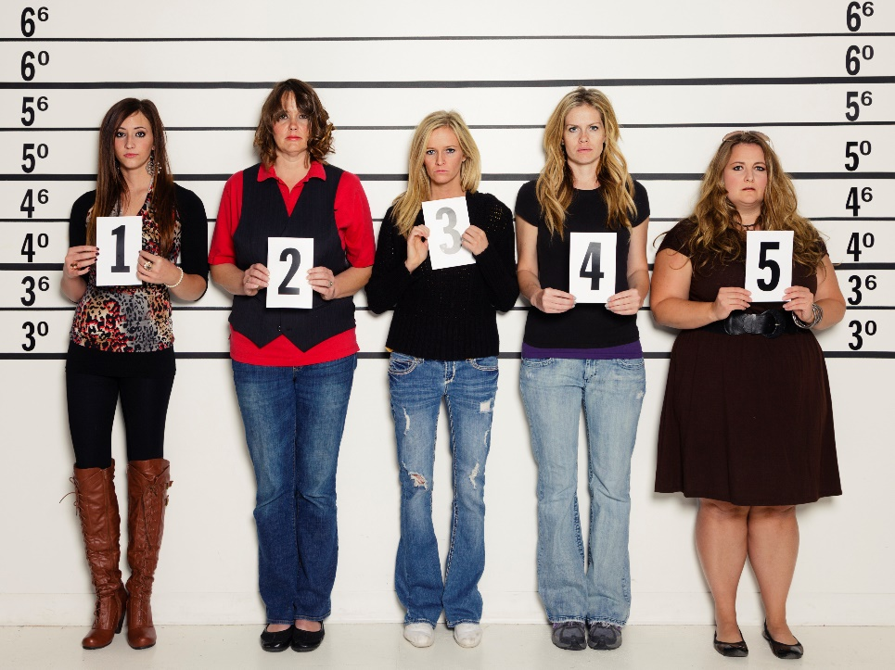

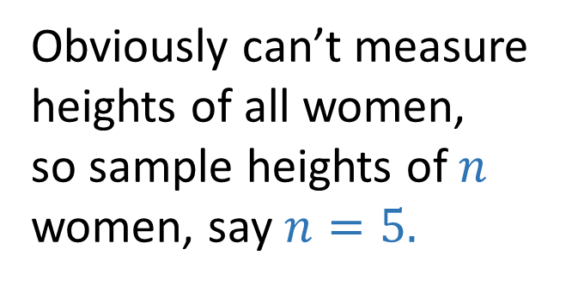
Motivation for Estimation
Call this unknown $θ$
Goal: Estimate the mean height of women
Obviously can’t measure
heights of all women,
so sample heights of $n$
women, say $n=5.$
$$Use sample average as estimation of θ.$$

Slide 4
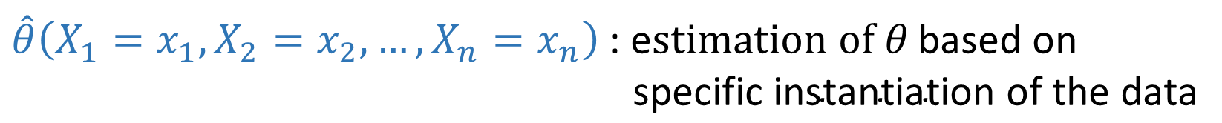
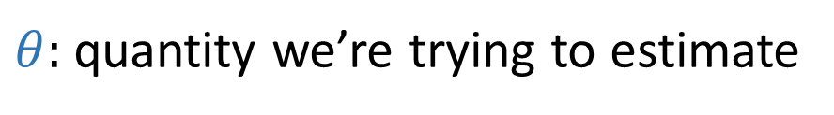
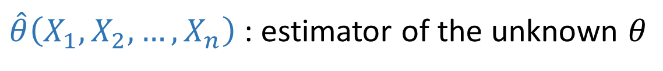

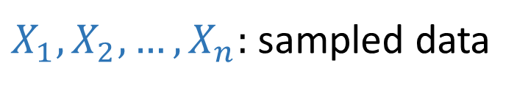
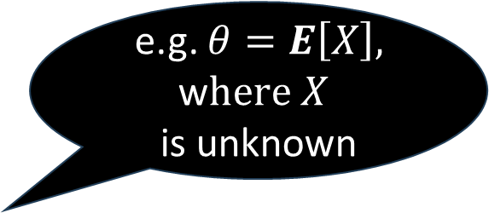
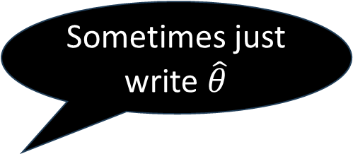
Definition of Estimator
e.g. $θ=E\left[X\right],$
w$here X$
is unknown
$θ:$quantity we’re trying to estimate
think of these as
$$i.i.d. instances of X$$
This is a r.v. because it’s a function of r.v.s
$X_{1}, X_{2}, …, X_{n}:$sampled data
Sometimes just write $\hat{θ}$
This is a
constant
$\hat{θ}\left(X_{1}, X_{2}, …, X_{n}\right)$: estimator of the unknown $θ$
$\hat{θ}\left(X_{1}=x_{1}, X_{2}=x_{2}, …, X_{n}=x_{n}\right)$: e$stimation of θ \text{based} \text{on}$
$\text{specific} \text{instantiation} \text{of} \text{the} \text{data}$

Slide 5
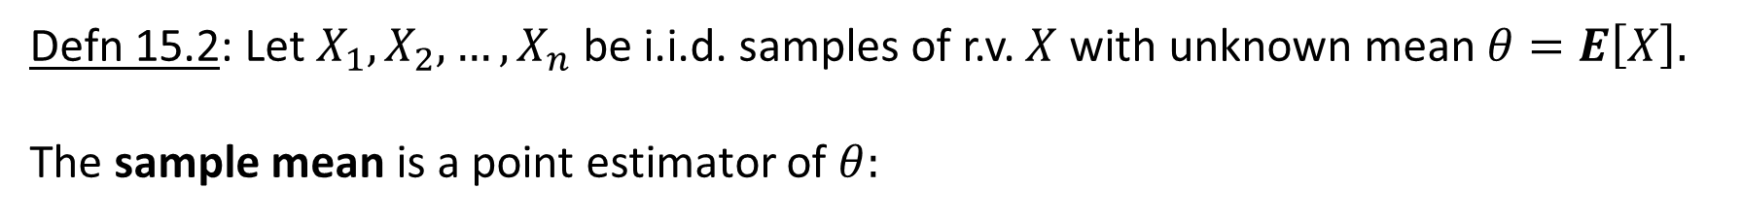
Sample Mean Estimator
Defn 15.2: Let $X_{1}, X_{2},…, X_{n}$ be i.i.d. samples of r.v. $X$ with unknown mean $θ=E\left[X\right].$
The sample mean is a point estimator of $θ:$
$$\hat{θ}\left(X_{1}=x_{1}, X_{2}=x_{2}, …, X_{n}=x_{n}\right){= M}_{n}=\overline{X}=\frac{X_{1}+X_{2}+⋯+X_{n}}{n}$$
Alternate name for sample mean
Alternate name for sample mean

Slide 6

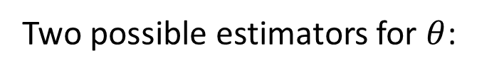
Choices of estimators
Let $X_{1}, X_{2},…, X_{n}$ be i.i.d. samples of r.v. $X$ with unknown finite mean $θ=E\left[X\right]$
and unknown finite variance $σ^{2}=Var\left(X\right).$
Two possible estimators for $θ$:
$${\hat{θ}}_{A}=\overline{X}=\frac{X_{1}+X_{2}+⋯+X_{n}}{n}$$
$${\hat{θ}}_{B}=X_{2}$$
Q: How do we choose between estimators?

Slide 7

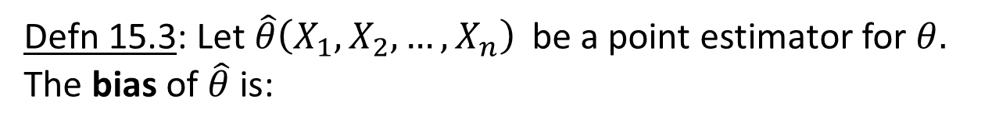

Desirable properties of a point estimator
Defn 15.3: Let ${\hat{θ}\left(X_{1}, X_{2}, …, X_{n}\right) }_{ }$be a point estimator for $θ.$
The bias of $\hat{θ}$ is:
unbiased estimator is desirable
property #1
$$B\left(\hat{θ}\right)=E\left[\hat{θ}\right]−θ$$
If $B\left(\hat{θ}\right)=0,$we say that $\hat{θ}$ is and unbiased estimator of $θ.$
Which of ${\hat{θ}}_{A}$ $=\overline{X}$ and ${\hat{θ}}_{B}$ $=X_{2}$are unbiased estimators?
Both!
So why do we prefer ${\hat{θ}}_{A}$?

Slide 8
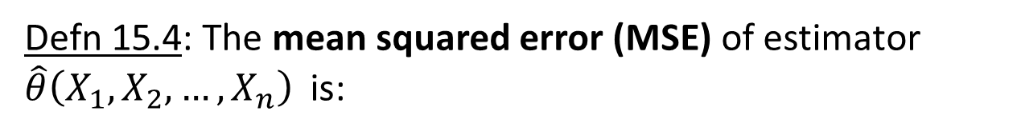
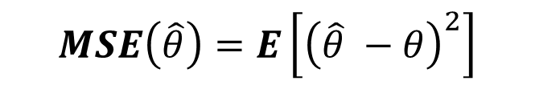
Desirable properties of a point estimator
Defn 15.4: The mean squared error (MSE) of estimator ${\hat{θ}\left(X_{1}, X_{2}, …, X_{n}\right) }_{ }$is:
Low MSE is desirable
property #2
$$MSE\left(\hat{θ}\right)=E\left[{\left(\hat{θ} −θ\right)}^{2}\right]$$
What metric does this remind you of?

Slide 9
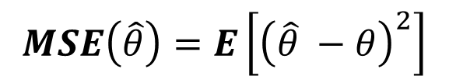



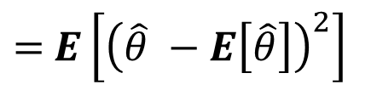
Desirable properties of a point estimator
Defn 15.4: The mean squared error (MSE) of estimator ${\hat{θ}\left(X_{1}, X_{2}, …, X_{n}\right) }_{ }$is:
Low MSE is desirable
property #2
$$MSE\left(\hat{θ}\right)=E\left[{\left(\hat{θ} −θ\right)}^{2}\right]$$
Lemma 15.5: If ${\hat{θ}\left(X_{1}, X_{2}, …, X_{n}\right) }_{ }$is an unbiased estimator, then
$$MSE\left(\hat{θ}\right)=Var\left(\hat{θ}\right)$$
$$\text{Proof}\text{:}$$
$$MSE\left(\hat{θ}\right)=E\left[{\left(\hat{θ} −θ\right)}^{2}\right]$$
$=$ $E\left[{\left(\hat{θ} −E\left[\hat{θ}\right]\right)}^{2}\right]$
$$=Var\left(\hat{θ}\right)$$

Slide 10
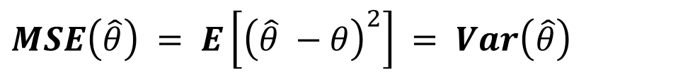
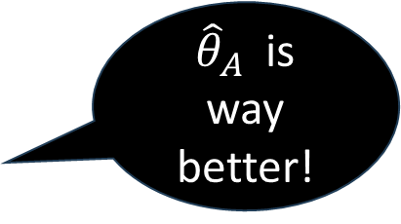
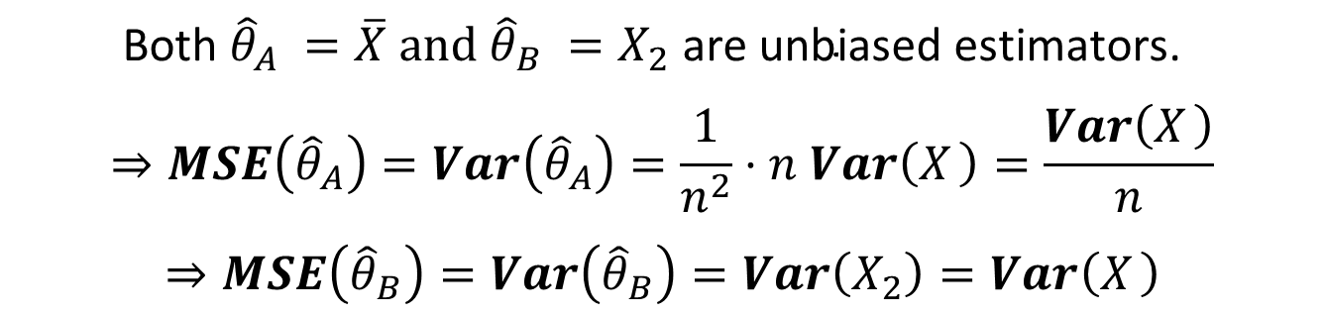
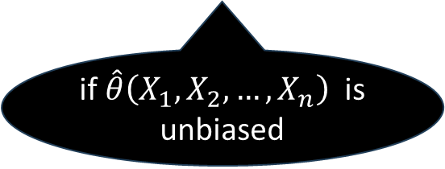
Desirable properties of a point estimator
$MSE\left(\hat{θ}\right) = E\left[{\left(\hat{θ} −θ\right)}^{2}\right]$ $= Var\left(\hat{θ}\right)$
if ${\hat{θ}\left(X_{1}, X_{2}, …, X_{n}\right) }_{ }$is unbiased
Q: Which of ${\hat{θ}}_{A}$ $=\overline{X}$ and ${\hat{θ}}_{B}$ $=X_{2}$have lower MSE?
$$\text{Both} {\hat{θ}}_{A} =\overline{X} \text{and} {\hat{θ}}_{B} =X_{2} \text{are} \text{unbiased} \text{estimators}\text{. }$$
$$⇒MSE\left({\hat{θ}}_{A}\right)=Var\left({\hat{θ}}_{A}\right)=\frac{1}{n^{2}}⋅n Var\left(X_{ }\right)=\frac{Var\left(X_{ }\right)}{n}$$
$$⇒MSE\left({\hat{θ}}_{B}\right)=Var\left({\hat{θ}}_{B}\right)=Var\left(X_{2}\right)=Var\left(X_{ }\right)$$
${\hat{θ}}_{A}$ is way better!

Slide 11

Desirable properties of a point estimator
We also want our estimator to become more accurate as the sample size increases.
Defn 15.6: Let ${\hat{θ}}_{1}\left(X_{1}\right),{\hat{θ}}_{2 }\left(X_{1},X_{2}\right),{\hat{θ}}_{3 }\left(X_{1},X_{2},X_{3}\right), …$
be a sequence of point estimators of $θ,$ where
${\hat{θ}}_{n }\left(X_{1},X_{2},{…, X}_{n}\right)$ is a function of $n$i.i.d. samples.
We say that r.v. ${\hat{θ}}_{n }$is a consistent estimator of $θ$ if,
$∀ε>0$,
$\lim_{n→∞} P\left\{\left|{\hat{θ}}_{n }−θ\right|≥ε\right\}=0$
consistency is desirable
property #3
Seems hard to prove that our estimator is consistent ….
Fortunately, there’s a helpful lemma!

Slide 12
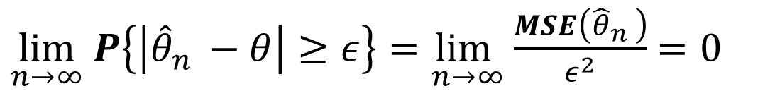
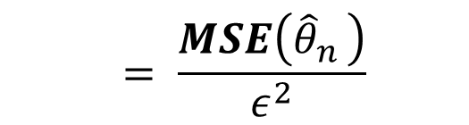
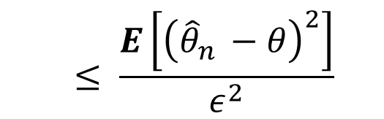
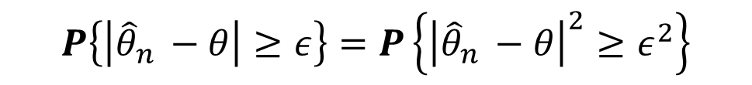
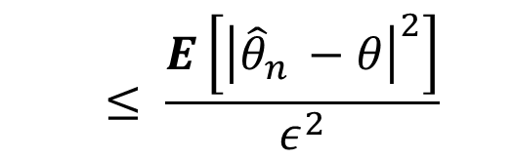
Desirable properties of a point estimator
Lemma 15.7: If $\lim_{n→∞} MSE\left({\hat{θ}}_{n }\right)=0,$then ${\hat{θ}}_{n }$is a consistent estimator.
Proof:
$$≤ \frac{E\left[{\left|{\hat{θ}}_{n }−θ\right|}^{2}\right]}{ε^{2}}$$
$$P\left\{\left|{\hat{θ}}_{n }−θ\right|≥ε\right\}=P\left\{{\left|{\hat{θ}}_{n }−θ\right|}^{2}≥ε^{2}\right\}$$
$$≤ \frac{E\left[{\left({\hat{θ}}_{n }−θ\right)}^{2}\right]}{ε^{2}}$$
$$= \frac{MSE\left({\hat{θ}}_{n }\right)}{ε^{2}}$$
$\lim_{n→∞} P\left\{\left|{\hat{θ}}_{n }−θ\right|≥ε\right\}=\lim_{n→∞}$ $\frac{MSE\left({\hat{θ}}_{n }\right)}{ε^{2}}$ $=0$

Slide 13

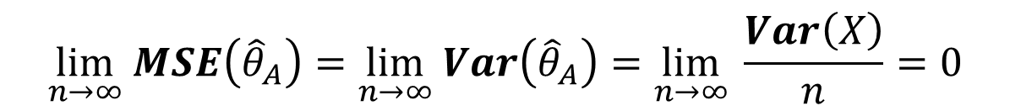

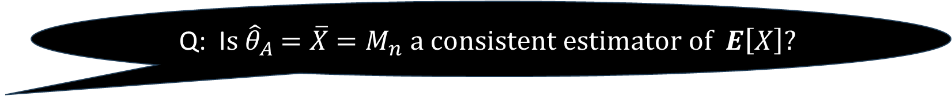
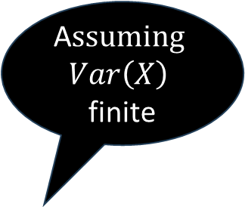
Desirable properties of a point estimator
Lemma 15.7: If $\lim_{n→∞} MSE\left({\hat{θ}}_{n }\right)=0,$then ${\hat{θ}}_{n }$is a consistent estimator.
Q: I$s {\hat{θ}}_{A}$ $=\overline{X}$ $=M_{n} a consistent estimator of$ $E\left[X\right]?$
A$ssuming$
$$Var\left(X\right)$$
finite
$$Yes!$$
$$MSE\left({\hat{θ}}_{A}\right)=Var\left({\hat{θ}}_{A}\right)=\frac{Var\left(X\right)}{n}$$
$$\lim_{n→∞} MSE\left({\hat{θ}}_{A}\right)=\lim_{n→∞} Var\left({\hat{θ}}_{A}\right)=\lim_{n→∞} \frac{Var\left(X\right)}{n}=0$$
${\hat{θ}}_{A}$ $is a consistent estimator$

Slide 14
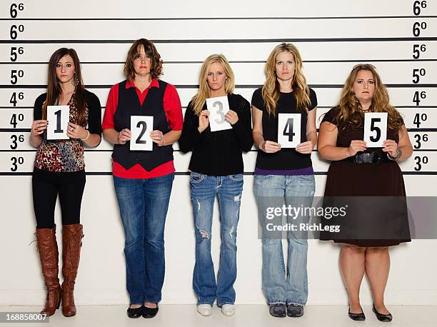

An estimator for Variance
Call this unknown $θ$
Goal: Estimate the variance of height of women
Obviously can’t measure
heights of all women,
so sample heights of $n$
women, say $n=5.$
$$Q:Can we use sample variance as an estimation of θ?$$
$$Q: And how do we define sample variance ?$$

Slide 15
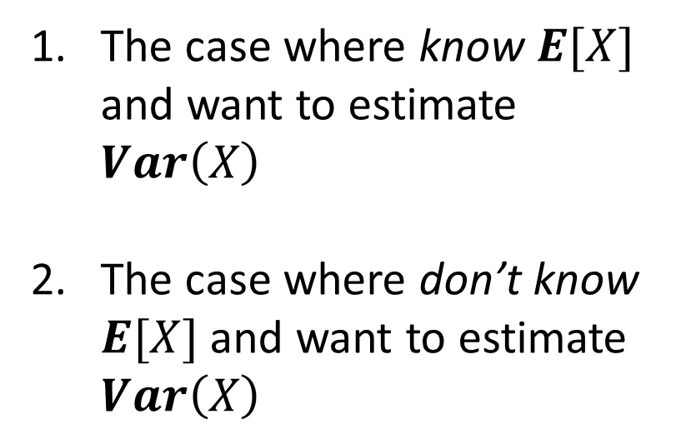
An estimator for Variance
Two cases:
The case where know $E[X]$ and want to estimate $Var\left(X\right)$
The case where don’t know $E[X]$ and want to estimate $Var\left(X\right)$

Slide 16
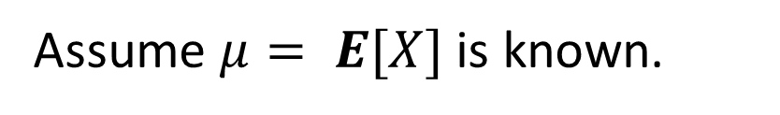

Estimating Variance when Mean is Known
Assume $μ= E[X]$ is known.
Let $\hat{θ}$be an estimator of $θ=Var\left(X\right):$
$$\hat{θ}\left(X_{1}, X_{2}, …, X_{n}\right) = \overline{S^{2}}≡ \frac{1}{n} \sum_{i=1}^{n}{{\left(X_{i}−μ\right)}^{2}}$$
mean squared distance from mean
sample variance

Slide 17

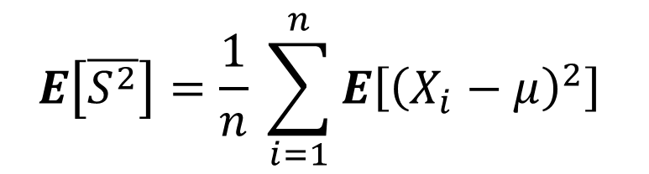
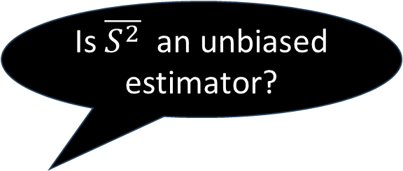


Estimating Variance when Mean is Known
Assume $μ= E[X]$ is known.
Let $\hat{θ}$be an estimator of $θ=Var\left(X\right):$
$$\hat{θ}\left(X_{1}, X_{2}, …, X_{n}\right) = \overline{S^{2}}≡ \frac{1}{n} \sum_{i=1}^{n}{{\left(X_{i}−μ\right)}^{2}}$$
Is $\overline{S^{2}}$ an unbiased estimator?
$$Yes!$$
$$E\left[\overline{S^{2}}\right]=\frac{1}{n} \sum_{i=1}^{n}{{E\left[{\left(X_{i}−μ\right)}^{2}\right]}^{ }}$$
$$=\frac{1}{n} \sum_{i=1}^{n}{{Var\left(X_{i}\right)}^{ }}$$
$$=Var\left(X\right)$$

Slide 18

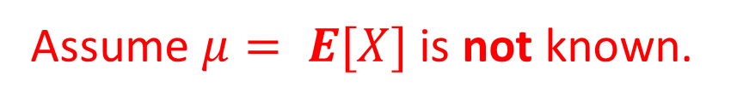
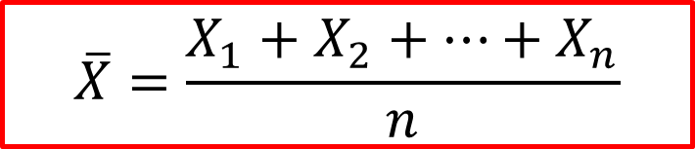


Estimating Variance when Mean is UNknown
How about we replace μ by $\overline{X}$?
Assume $μ= E[X]$ is not known.
Let $\hat{θ}$be an estimator of $θ=Var\left(X\right):$
$$\hat{θ}\left(X_{1}, X_{2}, …, X_{n}\right) = \overline{S^{2}}≡ \frac{1}{n} \sum_{i=1}^{n}{{\left(X_{i}−μ\right)}^{2}}$$
$$\hat{θ}\left(X_{1}, X_{2}, …, X_{n}\right) = \overline{S^{2}}≡ \frac{1}{n} \sum_{i=1}^{n}{{\left(X_{i}−\overline{X}\right)}^{2}}$$
$$\overline{X}=\frac{X_{1}+X_{2}+⋯+X_{n}}{n}$$

Slide 19
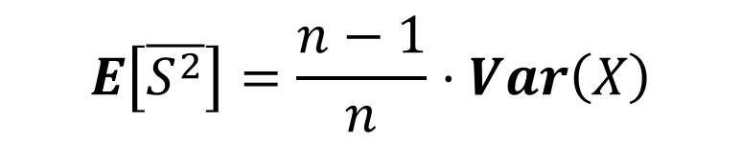
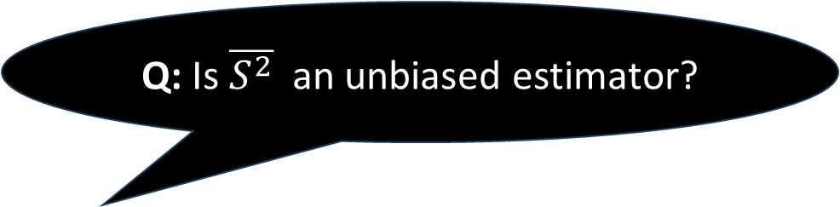


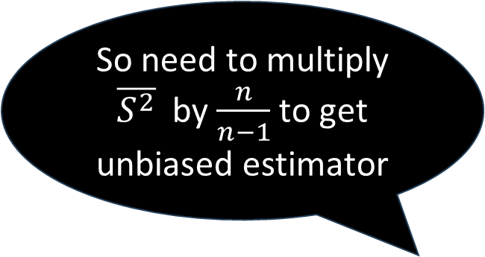
Estimating Variance when Mean is UNknown
Assume $μ= E[X]$ is not known.
$$\overline{X}=\frac{X_{1}+X_{2}+⋯+X_{n}}{n}$$
Let $\hat{θ}$be an estimator of $θ=Var\left(X\right):$
$$\hat{θ}\left(X_{1}, X_{2}, …, X_{n}\right) = \overline{S^{2}}≡ \frac{1}{n} \sum_{i=1}^{n}{{\left(X_{i}−\overline{X}\right)}^{2}}$$
Q: Is $\overline{S^{2}}$ an unbiased estimator?
So need to multiply $\overline{S^{2}}$ by $\frac{n}{n−1}$ to get unbiased estimator
A: Not quite. In Exercise 15.4, you will prove that:
$$E\left[\overline{S^{2}}\right]=\frac{n−1}{n}⋅Var\left(X\right)$$

Slide 20
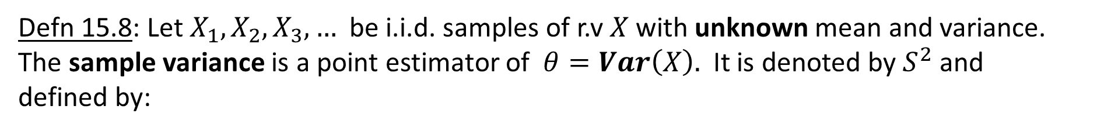
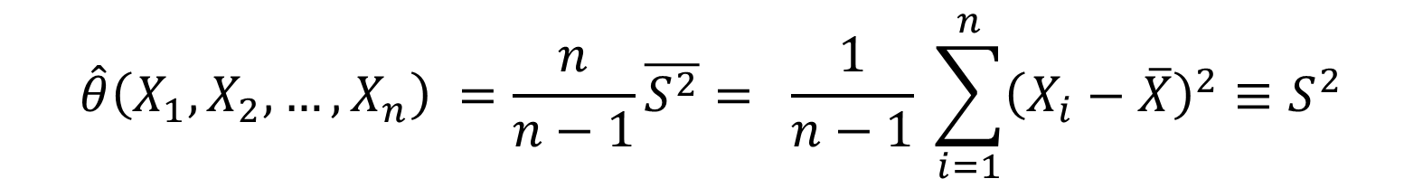
Estimating Variance when Mean is UNknown
Defn 15.8: Let $X_{1}, X_{2},X_{3}, …$be i.i.d. samples of r.v $X$with unknown mean and variance. The sample variance is a point estimator of $θ=Var\left(X\right).$It is denoted by $S^{2}$and
defined by:
$$\hat{θ}\left(X_{1}, X_{2}, …, X_{n}\right) =\frac{n}{n−1}\overline{S^{2}}= \frac{1}{n−1} \sum_{i=1}^{n}{{\left(X_{i}−\overline{X}\right)}^{2}≡S^{2}}$$
sample variance

Slide 21

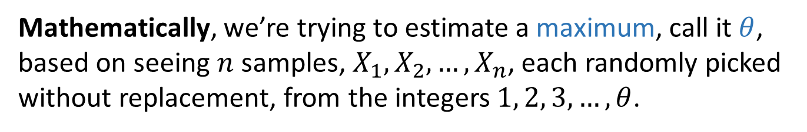
More complex estimators
The sample mean estimator is often a component of more complex estimators.
Consider the following example:
Goal: Estimate # German tanks in WW II.
Each tank has serial number. Below are the tanks we’ve seen so far …
Mathematically, we’re trying to estimate a maximum, call it $θ$,
based on seeing $n$ samples, $X_{1}, X_{2}, …, X_{n}$, each randomly picked
without replacement, from the integers $1, 2, 3, …, θ$.

Slide 22

Estimating the max
Mathematically, we’re trying to estimate a maximum, call it $θ$,
based on seeing $n$ samples, $X_{1}, X_{2}, …, X_{n}$, each randomly picked
without replacement, from the integers $1, 2, 3, …, θ$.
We know how to estimate the mean. Can we write the max in terms of the sample mean?

Slide 23

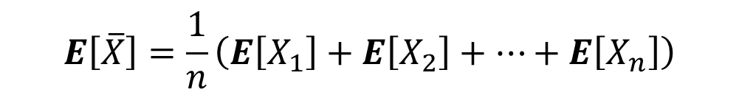

Estimating the max
Mathematically, we’re trying to estimate a maximum, call it $θ$,
based on seeing $n$ samples, $X_{1}, X_{2}, …, X_{n}$, each randomly picked
without replacement, from the integers $1, 2, 3, …, θ$.
$$\overline{X}=\frac{X_{1}+X_{2}+⋯+X_{n}}{n}$$
$$E\left[\overline{X}\right]=\frac{1}{n}\left(E\left[X_{1}\right]+E\left[X_{2}\right]+⋯+E\left[X_{n}\right]\right)$$
$$=\frac{ θ+1}{2}$$
$$E\left[X_{i}\right]=1⋅\frac{1}{θ}+2⋅\frac{1}{θ}+3⋅\frac{1}{θ}+⋯+θ⋅\frac{1}{θ}=\frac{θ+1}{2}$$

Slide 24
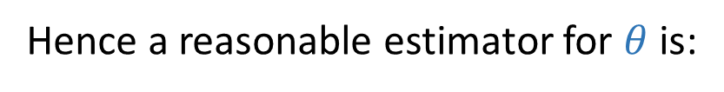

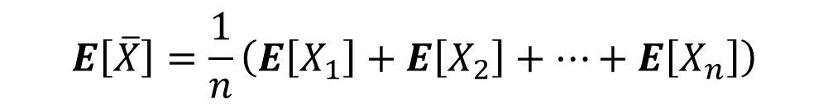
Estimating the max
Mathematically, we’re trying to estimate a maximum, call it $θ$,
based on seeing $n$ samples, $X_{1}, X_{2}, …, X_{n}$, each randomly picked
without replacement, from the integers $1, 2, 3, …, θ$.
$$E\left[\overline{X}\right]=\frac{1}{n}\left(E\left[X_{1}\right]+E\left[X_{2}\right]+⋯+E\left[X_{n}\right]\right)$$
$$=\frac{ θ+1}{2}$$
Hence a reasonable estimator for $θ$ is:
$$\hat{θ}\left(X_{1}, X_{2}, …, X_{n}\right)=2\overline{X}−1$$

Slide 25
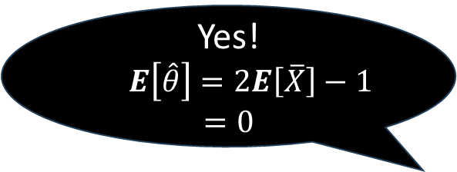

Estimating the max
Mathematically, we’re trying to estimate a maximum, call it $θ$,
based on seeing $n$ samples, $X_{1}, X_{2}, …, X_{n}$, each randomly picked
without replacement, from the integers $1, 2, 3, …, θ$.
$$E\left[\overline{X}\right]=\frac{1}{n}\left(E\left[X_{1}\right]+E\left[X_{2}\right]+⋯+E\left[X_{n}\right]\right)$$
$$=\frac{ θ+1}{2}$$
Is $\hat{θ}$unbiased?
Hence a reasonable estimator for $θ$ is:
Yes!
$E\left[\hat{θ}\right]=2E\left[\overline{X}\right]−1$
$$=0$$
$$\hat{θ}\left(X_{1}, X_{2}, …, X_{n}\right)=2\overline{X}−1$$

Slide 26
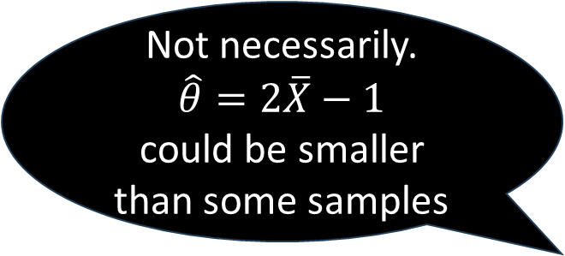

Estimating the max
Mathematically, we’re trying to estimate a maximum, call it $θ$,
based on seeing $n$ samples, $X_{1}, X_{2}, …, X_{n}$, each randomly picked
without replacement, from the integers $1, 2, 3, …, θ$.
$$E\left[\overline{X}\right]=\frac{1}{n}\left(E\left[X_{1}\right]+E\left[X_{2}\right]+⋯+E\left[X_{n}\right]\right)$$
$$=\frac{ θ+1}{2}$$
Is $\hat{θ} goo$d?
Hence a reasonable estimator for $θ$ is:
Not necessarily.
$$\hat{θ}=2\overline{X}−1$$
could be smaller than some samples
$$\hat{θ}\left(X_{1}, X_{2}, …, X_{n}\right)=2\overline{X}−1$$

