Slide 1
Chapter 14 Event-Driven Simulation
Notes:
https://www.gettyimages.co.uk/detail/photo/spaghetti-bolognese-royalty-free-image/1360347881?phrase=spaghetti+bolognese&adppopup=true
https://www.gettyimages.com/detail/illustration/monkey-scratching-its-head-royalty-free-illustration/1213154404 -- reusing from Chpt 18. No need to rebuy.
https://www.gettyimages.co.uk/detail/illustration/man-get-the-idea-light-bulb-as-symbol-of-royalty-free-illustration/1358666737?phrase=idea%20clipart%20bulb%20with%20face – reusing from Chpt 5. No need to rebuy.
https://www.gettyimages.co.uk/detail/illustration/creative-light-bulb-cartoon-royalty-free-illustration/115066830?phrase=light%20bulb -- reusing form Chpt 5. No need to rebuy.

Slide 2
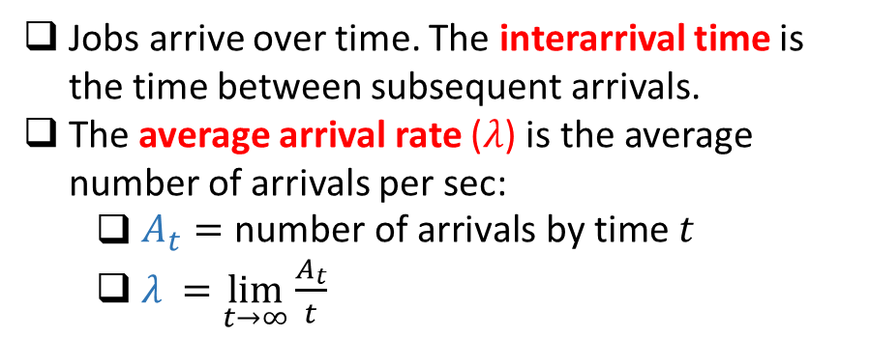
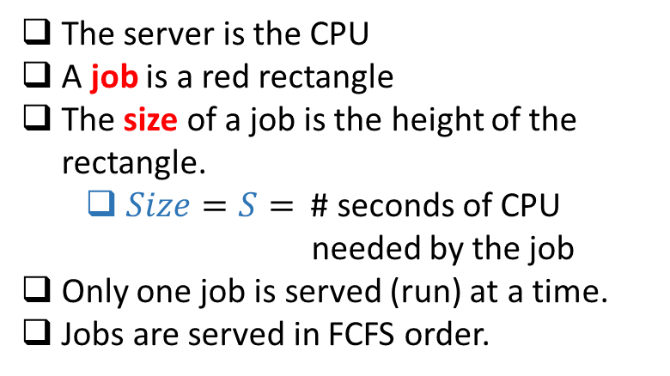
Queueing Theory Terminology: Simplest Model
“the queue”
“the server”
FCFS
The server is the CPU
A job is a red rectangle
The size of a job is the height of the rectangle.
$Size=S=$ # seconds of CPU
needed by the job
Only one job is served (run) at a time.
Jobs are served in FCFS order.
Jobs arrive over time. The interarrival time is the time between subsequent arrivals.
The average arrival rate ($λ$) is the average number of arrivals per sec:
$\begin{aligned}A_{t}=\text{number} \text{of} \text{arrivals} \text{by} \text{time}\# t\end{aligned}$
$λ_{ }=\lim_{t→∞}\frac{A_{t}}{t}$

Slide 3
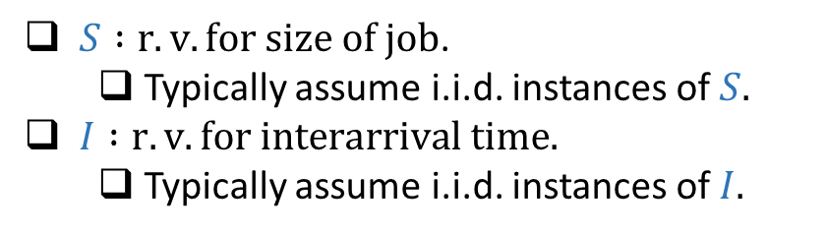
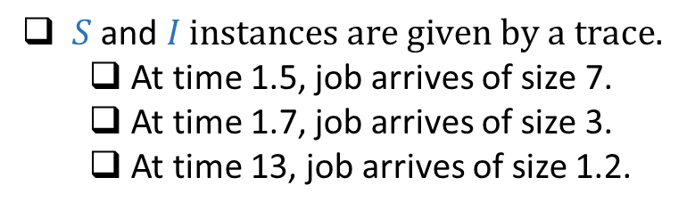
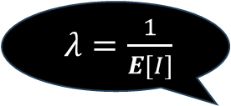
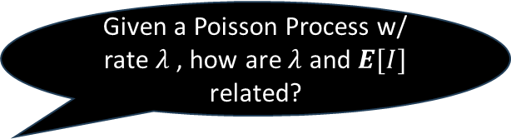
Stochastic Setting vs. Trace-driven Simulation
Stochastic Setting
Trace-driven Simulation
$S :r.v. for size of job$.
Typically assume i.i.d. instances of $S.$
$I :r.v. for interarrival time.$
Typically assume i.i.d. instances of $I.$
$S \text{and} I instances are given by a trace.$
At time 1.5, job arrives of size 7.
At time 1.7, job arrives of size 3.
At time 13, job arrives of size 1.2.
Given a Poisson Process w/ rate $λ$ , how are $λ$ and $E[I]$ related?
$λ=\frac{1}{E[I]}$

Slide 4

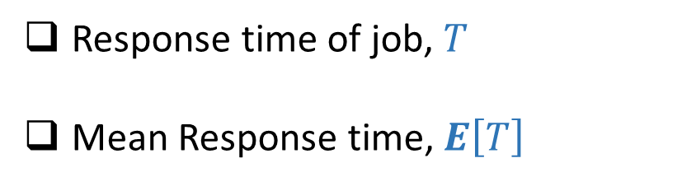
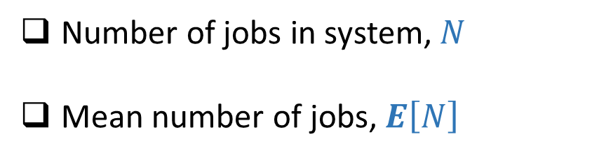
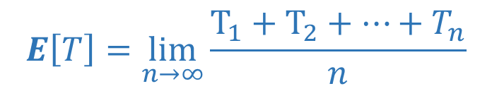
Queueing Metrics
$$T$$
Response time of job, $T$
Mean Response time, $E\left[T\right]$
Number of jobs in system, $N$
Mean number of jobs, $E\left[N\right]$
$$E\left[T\right]=\lim_{n→∞}\frac{T_{1}+T_{2}+⋯+T_{n}}{n}$$

Slide 5

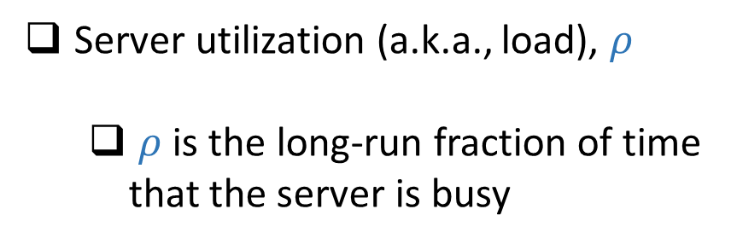
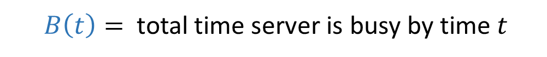

Queueing Metrics
Server utilization (a.k.a., load), $ρ$
$ρ$is the long-run fraction of time that the server is busy
$B\left(t\right)=$ total time server is busy by time $t$
Express $ρ$ in terms of $B\left(t\right)$
$ρ=\lim_{t→∞}\frac{B(t)}{t}$

Slide 6








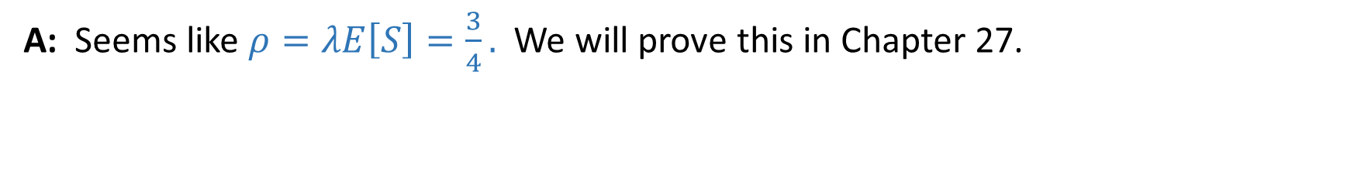









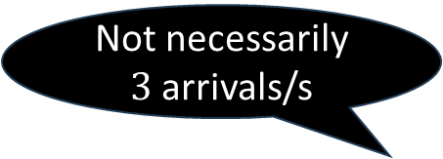
Queueing Metrics
Q: Suppose $λ=3$jobs/sec and $E\left[S\right]=\frac{1}{4}$ sec. What is $ρ$? Will there be queueing?
$$1/4$$
$$1/4$$
$$1/4$$
$$1/4$$
$$1/4$$
$$1/4$$
$$1/4$$
$$1/4$$
$$1/4$$
$$1/4$$
$$1/4$$
$$1/4$$
$$0s$$
$$1s$$
$$2s$$
$$3s$$
$$4s$$
Not necessarily $3$ arrivals/s
A: Seems like $ρ=λE\left[S\right]=\frac{3}{4}.$ We will prove this in Chapter 27.
If$I$, $S$are Deterministic ➔ no queueing
If$I$, $S$have high variability ➔ lots of queueing

Slide 7

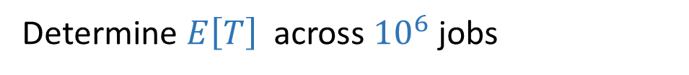

Running a Simulation – Single Queue
GOAL: Simulate this queue, where interarrival times $∼I$ and service times $∼S$
Determine $E\left[T\right]$ across ${10}^{6} \text{jobs}$
Do you start by generating ${10}^{6}$instances of $I$and $S$ ?
No! Generate as needed

Slide 8

Running a Simulation – Single Queue
GOAL: Simulate this queue, where interarrival times $∼I$ and service times $∼S$
Determine $E\left[T\right]$ across ${10}^{6} \text{jobs}$
If a job takes $5s$, do we wait $5s$on computer clock?
No! Simulate the clock!

Slide 9
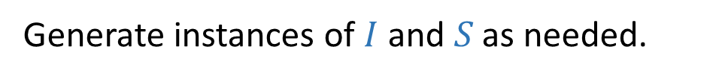
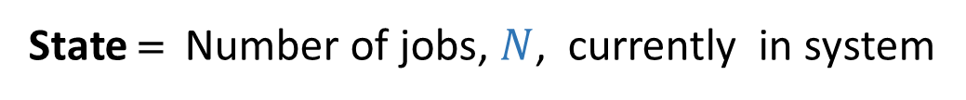
Event-driven Simulation
State = Number of jobs, $N$, currently in system
What are these events?
Track only events that change the state!
Arrivals & Completions!
Generate instances of $I$and $S \text{as} \text{needed}\text{.}$

Slide 10


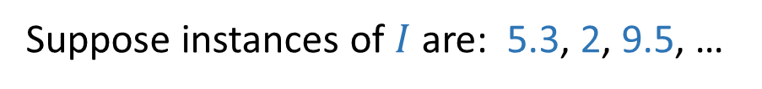








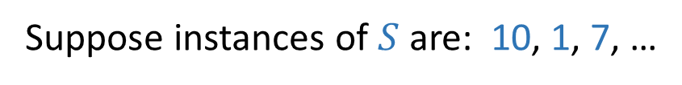


Event-driven Simulation Example
Suppose instances of $I$ are: 5.3, 2, 9.5, …
Suppose instances of $S$ are: 10, 1, 7, …
Iteration 1
Iteration 2
CLOCK $=0$
CLOCK $=5.3$
State $=N=0$
State $=N=1$
Time-to-next-Compl $=∞$
Time-to-next-Compl $=Generate\left(S\right)=10$
Time-to-next-Arrival $=Generate\left(I\right)=5.3$
Time-to-next-Arrival $=Generate\left(I\right)=2$
Next-Event $=\min\left(\text{T}\text{−}\text{C},\text{T}\text{−}\text{A}\right)=\text{T}\text{−}\text{A}=5.3$
Next-Event $=\min\left(\text{T}\text{−}\text{C},\text{T}\text{−}\text{A}\right)=\text{T}\text{−}\text{A}=2$
Event $=\text{Arrival}\text{ @5.3}$
Event $=\text{Arrival}\text{ @7.3}$

Slide 11












Event-driven Simulation Example
Suppose instances of $I$ are: 5.3, 2, 9.5, …
Suppose instances of $S$ are: 10, 1, 7, …
Iteration 2
Iteration 3
CLOCK $=5.3$
CLOCK $=7.3$
State $=N=1$
State $=N=2$
Time-to-next-Compl $=Generate\left(S\right)=10$
Time-to-next-Compl $=10−2=8$
Time-to-next-Arrival $=Generate\left(I\right)=2$
Time-to-next-Arrival $=Generate\left(I\right)=9.5$
Next-Event $=\min\left(\text{T}\text{−}\text{C},\text{T}\text{−}\text{A}\right)=\text{T}\text{−}\text{A}=2$
Next-Event $=\min\left(\text{T}\text{−}\text{C},\text{T}\text{−}\text{A}\right)=\text{T}\text{−}\text{C}=8$
Event $=\text{Arrival}\text{ @7.3}$
Event $=\text{Completion}\text{ @15.3}$

Slide 12











Event-driven Simulation Example
Suppose instances of $I$ are: 5.3, 2, 9.5, …
Suppose instances of $S$ are: 10, 1, 7, …
Iteration 3
Iteration 4
CLOCK $=7.3$
CLOCK $=15.3$
State $=N=2$
State $=N=1$
Time-to-next-Compl $=10−2=8$
Time-to-next-Compl $=Generate(S)=1$
Time-to-next-Arrival $=Generate\left(I\right)=9.5$
Time-to-next-Arrival $=9.5−8=1.5$
Next-Event $=\min\left(\text{T}\text{−}\text{C},\text{T}\text{−}\text{A}\right)=\text{T}\text{−}\text{C}=8$
Next-Event $=\min\left(\text{T}\text{−}\text{C},\text{T}\text{−}\text{A}\right)=\text{T}\text{−}\text{C}=1$
Event $=\text{Completion}\text{ @15.3}$
Event $=\text{Completion}\text{ @16.3}$

Slide 13











Event-driven Simulation Example
Suppose instances of $I$ are: 5.3, 2, 9.5, …
Suppose instances of $S$ are: 10, 1, 7, …
Iteration 4
Iteration 5
CLOCK $=15.3$
CLOCK $=16.3$
State $=N=1$
State $=N=0$
Time-to-next-Compl $=Generate(S)=1$
Time-to-next-Compl $=∞$
Time-to-next-Arrival $=9.5−8=1.5$
Time-to-next-Arrival $=1.5−1=0.5$
Next-Event $=\min\left(\text{T}\text{−}\text{C},\text{T}\text{−}\text{A}\right)=\text{T}\text{−}\text{C}=1$
Next-Event $=\min\left(\text{T}\text{−}\text{C},\text{T}\text{−}\text{A}\right)=\text{T}\text{−}\text{A}=0.5$
Event $=\text{Completion}\text{ @16.3}$
Event $=\text{Arrival}\text{ @16.8}$

Slide 14
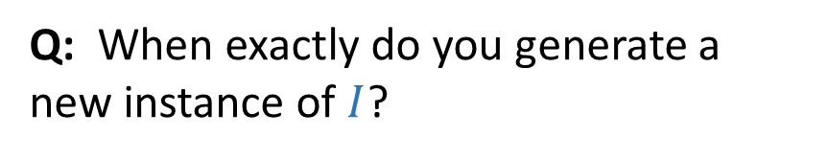
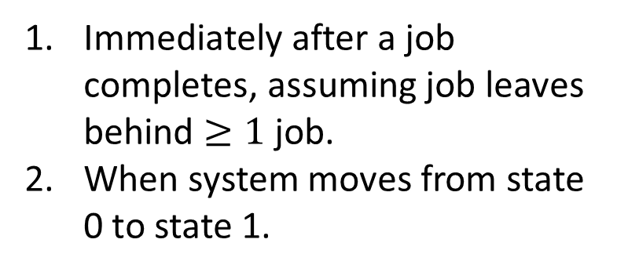
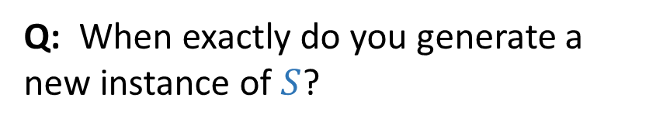
Event-driven Simulation Quiz
Q: When exactly do you generate a new instance of $I$?
Immediately after a job arrives
When drop to 0 jobs
Q: In an event-driven simulation,
what are the 4 variables you track?
Q: When exactly do you generate a new instance of $S$?
Global Clock
State = Number jobs in system
Time-to-next-Arrival
Time-to-next-Completion
Immediately after a job completes, assuming job leaves behind $≥1$job.
When system moves from state 0 to state 1.

Slide 15


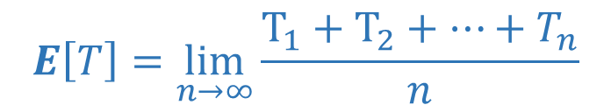
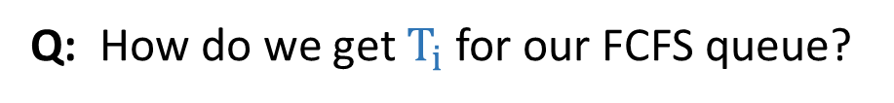
Getting $E[T]$
$$E\left[T\right]=\lim_{n→∞}\frac{T_{1}+T_{2}+⋯+T_{n}}{n}$$
Q: How do we get $T_{i}$for our FCFS queue?
A: Log arrival times as they happen on this list:
$$5.3 →7.3 →16.8$$
When completions happen:
Subtract earliest arrival on list from current clock time.
Delete earliest arrival from list
Example:
Completion at 15.3 ➔ $T_{1}=15.3 −5.3=10$
Completion at 16.3 ➔ $T_{2}=16.3 −7.3=9$

Slide 16
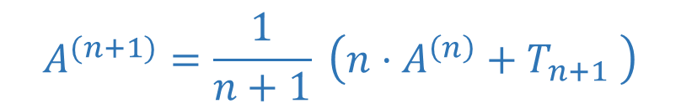

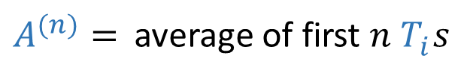
Getting $E[T]$
$$E\left[T\right]=\lim_{n→∞}\frac{T_{1}+T_{2}+⋯+T_{n}}{n}$$
Q: To get $E\left[T\right]$do I need to store all ${10}^{6} T_{i}^{ }s$?
A: No!
Let
$$=\frac{1}{n} \sum_{i=1}^{n}{T_{i}}$$
${A^{(n)}= }^{ }$average of first $n$ $T_{i}^{ }s$
$$A^{(n+1)}=\frac{1}{n+1} \left(n⋅A^{\left(n\right)}+T_{n+1} \right)$$

Slide 17



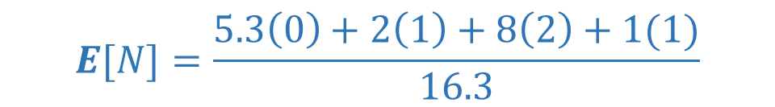


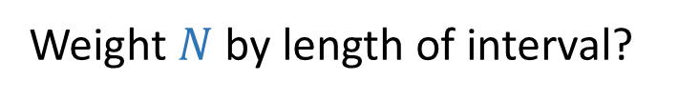

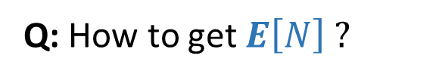






Getting $E[N]$
Let $N\left(s\right)=Number of jobs in the system at time s$
$$E[N]=\lim_{t→∞}\frac{\int_{0}^{t}{N\left(s\right)ds}}{t}$$
Q: How to get $E\left[N\right] ?$
$$N=0$$
$$N=1$$
$$N=2$$
$$N=1$$
Idea 1: (Time Average)
$$0$$
$$5.3$$
$$7.3$$
$$15.3$$
$$16.3$$
Weight $N$ by length of interval?
$$E[N]=\frac{5.3\left(0\right)+2\left(1\right)+8\left(2\right)+1(1)}{16.3}$$

Slide 18
Getting $E[N]$
Let $N\left(s\right)=Number of jobs in the system at time s$
$$E[N]=\lim_{t→∞}\frac{\int_{0}^{t}{N\left(s\right)ds}}{t}$$
Q: How to get $E\left[N\right] ?$
Idea 2: (Ensemble Average)
Whenever arrival happens, record how many jobs arrival sees in the system
Take average over all these observations

Slide 19
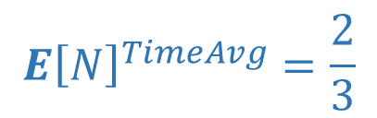


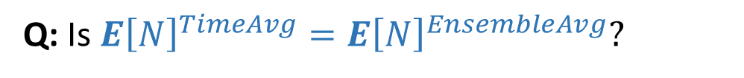





Getting $E[N]$
Let $N\left(s\right)=Number of jobs in the system at time s$
$$E[N]=\lim_{t→∞}\frac{\int_{0}^{t}{N\left(s\right)ds}}{t}$$
Every arrival walks into empty system
Q: Is $E{\left[N\right]}^{TimeAvg}=E{\left[N\right]}^{EnsembleAvg}?$
Suppose $I∼Uniform\left(1,2\right)$and$S=1$. Are your answers the same?
$$S=1$$
$$S=1$$
$$S=1$$
$$S=1$$
$$E{\left[N\right]}^{TimeAvg}=\frac{2}{3}$$
$$0$$
Correct $E[N]$
$$E{\left[N\right]}^{EnsembleAvg}=0$$

Slide 20


Getting $E[N]$
Why was $E{\left[N\right]}^{TimeAvg}≠E{\left[N\right]}^{EnsembleAvg}$ ?
Arrival times were bad times to measure # jobs
Is it ever true that $E{\left[N\right]}^{TimeAvg}=E{\left[N\right]}^{EnsembleAvg}$ ?
Need arrival times to be “random.”
Poisson Process!

Slide 21
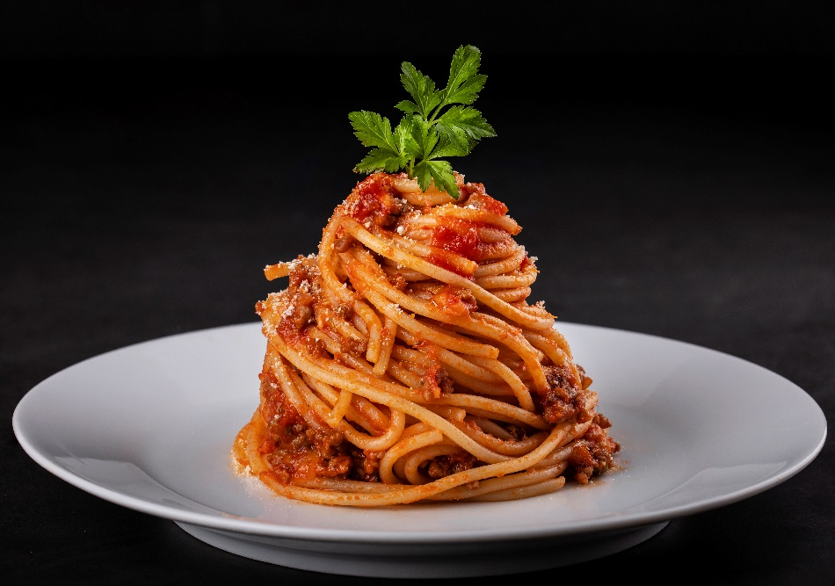


PASTA
PASTA = Poisson Arrivals See Time Averages
$$E{\left[N\right]}^{TimeAvg}=E{\left[N\right]}^{EnsembleAvg}$$
Q: But what if arrival process is not Poisson.
Can we still average over what arrivals see?
A: No, but you can simulate a
Poisson Process in the background,
and record number of jobs at times
of those events!

Slide 22
Running simulations: one long run?
# jobs
time
restart
restart
restart
Q: When running simulations, is it better to consider time-average over
one long run, or many short runs?
A: Turns out these are the same, provided simulation
empties (restarts) infinitely often.
See Chpt 25
of your book!

Slide 23
Running simulations: convergence
# jobs
time
restart
restart
restart
Q: How long should we run our simulation? How many arrivals?
A: Run long enough to meet both these conditions:
Performance metric is no longer biased by initial state
Performance metric is no longer changing much (has converged)

