Slide 1
Chapter 13 Generating Random Variables for Simulation
Notes:
https://www.gettyimages.co.uk/detail/illustration/yellow-light-bulb-icon-royalty-free-illustration/165766463?phrase=Yellow%20light%20bulb -- reusing lightbulb from Chpt 7. No need to rebuy.
https://www.gettyimages.co.uk/detail/illustration/man-get-the-idea-light-bulb-as-symbol-of-royalty-free-illustration/1358666737?phrase=idea%20clipart%20bulb%20with%20face -- reusing lightbulb with face from Chpt 5. No need to rebuy.
https://www.gettyimages.com/detail/illustration/right-and-wrong-royalty-free-illustration/482378456
https://www.gettyimages.com/detail/illustration/right-and-wrong-royalty-free-illustration/482378456

Slide 2
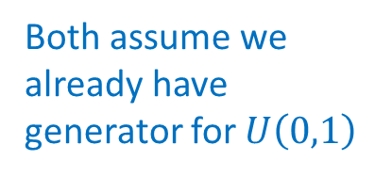
We’ve seen many examples of distributions.
How do we generate instances of a given distribution?
Two methods:
Inverse Transform method
Accept-Reject method
Both assume we
already have
generator for $U\left(0,1\right)$

Slide 3
Inverse Transform Method
Requirement: To generate instances of r.v. $X:$
1. Need to know c.d.f. of $X,$ that is, $F_{X}(x)= P\{X≤x\}$
Need to be able to easily invert $F_{X}(x),\text{i}\text{.}\text{e}\text{. }\text{get} x \text{from}$ $F_{X}(x)$

Slide 4
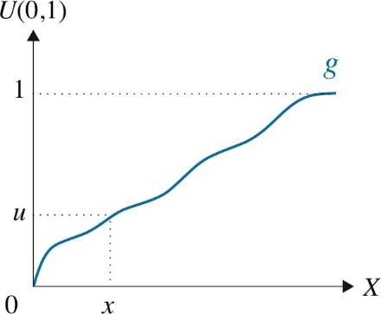


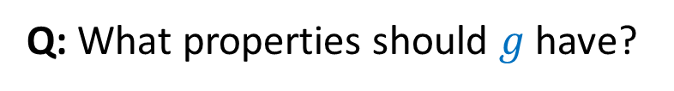

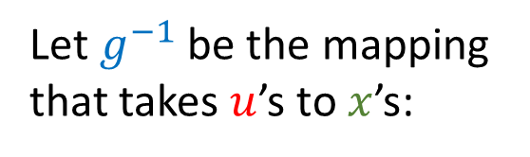


Inverse Transform Method
Let $u$ be our random instance of $U(0,1)$. Want to map $u$to an instance $x$of the r.v. $X$.
Let $g^{−1}$ be the mapping that takes $u$’s to $x$’s:
Q: What properties should $g$ have?
$$F_{X}\left(x\right)$$
A value in $\left[0,x\right]$ should be output with probability: ________
$$u$$
A value in $\left[0,x\right]$ is output with probability: _______
$$u=F_{X}\left(x\right)$$
$$x={F_{X}^{−1}}_{ }\left(u\right)$$
$$g(⋅)=F_{X}\left(⋅\right)$$

Slide 5

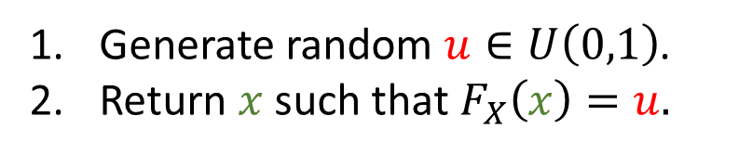
Inverse Transform Method
Let $u$ be our random instance of $U(0,1)$. Want to map $u$to an instance $x$of the r.v. $X$.
$${{g\left(x\right)= F}_{X}\left(x\right)}_{ }^{ }$$
Let $g^{−1}$ be the mapping that takes $u$’s to $x$’s:
Inverse Transform method to generate continuous r.v. $X:$
Generate random $u∈U\left(0,1\right)$.
Return $x$such that ${F_{X}\left(x\right)=u. }_{ }^{ }$

Slide 6

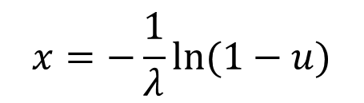



Inverse Transform Method: Example
Q: Generate $X∼Exp\left(λ\right)$, given $u∈U\left(0,1\right).$
$$F_{X}\left(x\right)=u$$
$$1−e^{−λx}=u$$
$$e^{−λx}=1−u$$
$$−λx=ln⁡(1−u)$$
$$x=−\frac{1}{λ}ln⁡(1−u)$$
Return

Slide 7
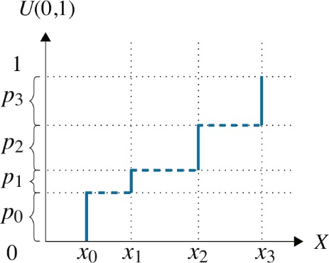
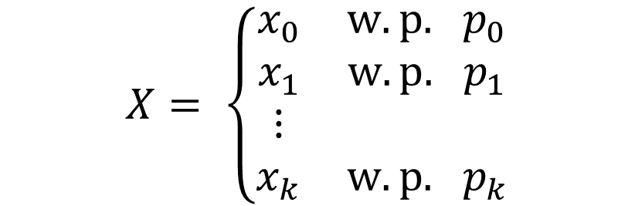
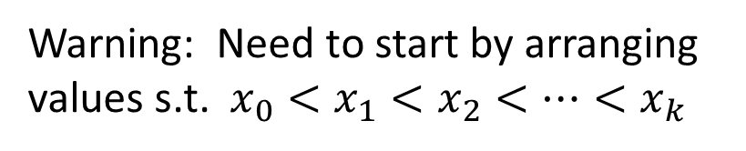

Inverse Transform Method for Discrete R.V.
Same idea applies to discrete r.v.s.
Let $u$ be our random instance of $U(0,1)$. Want to map $u$to an instance $x$of the r.v. $X$.
$g$function
shown
in blue.
$$X= \left\{\begin{matrix}\begin{matrix}x_{0} & w.p. { p}_{0} \\ x_{1} & w.p. { p}_{1}\end{matrix} \\ \begin{matrix}⋮ & \\ x_{k} & w.p. { p}_{k}\end{matrix}\end{matrix}\right.$$
Warning: Need to start by arranging
values s.t. $x_{0}<x_{1}<x_{2}<⋯<x_{k}$

Slide 8

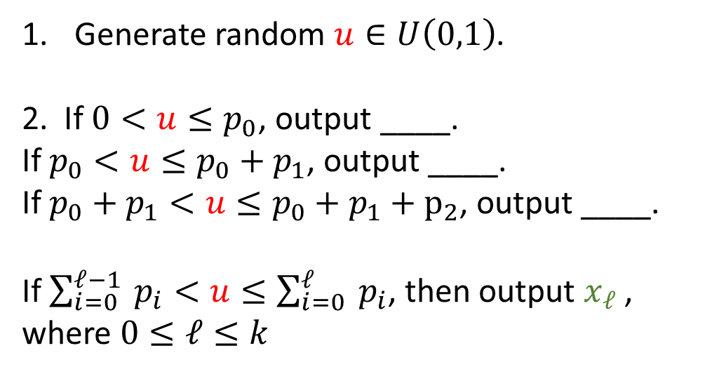

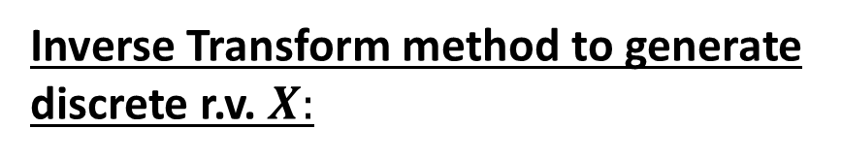
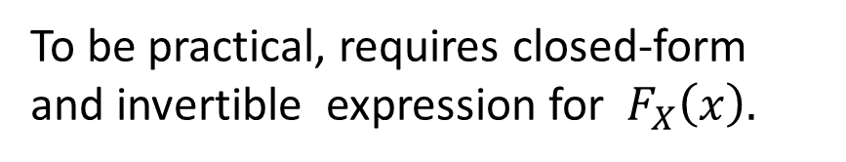

Inverse Transform Method for Discrete R.V.
Inverse Transform method to generate discrete r.v. $X:$
Generate random $u∈U\left(0,1\right)$.
2. If $0<u≤p_{0}$, output ____.
If $p_{0}<u≤p_{0}+p_{1}$, output ____.
If $p_{0}+p_{1}<u≤p_{0}+p_{1}+p_{2}$, output ____.
If $\sum_{i=0}^{ℓ−1}{{ p}_{i}}<u≤\sum_{i=0}^{ℓ}{{ p}_{i}}$, then output $x_{ℓ}$ ,
where $0≤ℓ≤k$
$g$function
shown
in blue.
$x_{0}$
$x_{1}$
$x_{2}$
To be practical, requires closed-form and invertible expression for $F_{X}\left(x\right).$

Slide 9

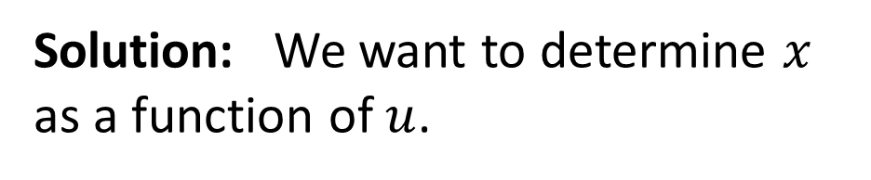
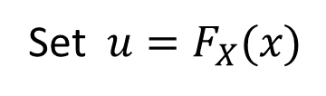
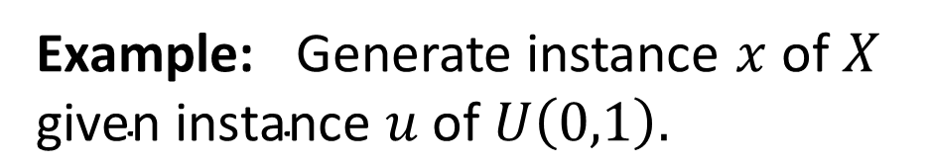
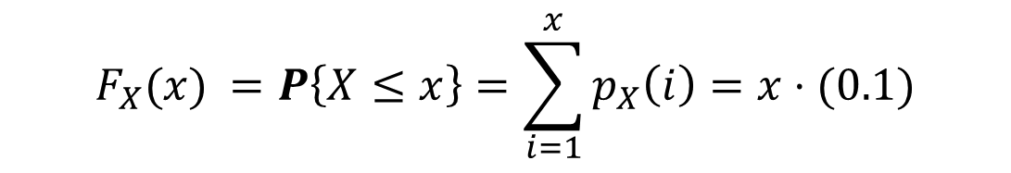


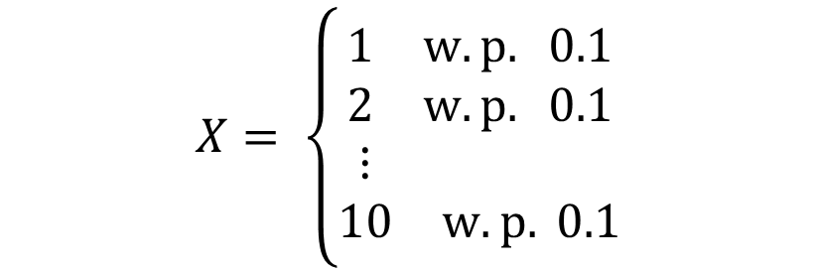
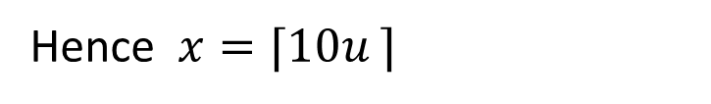
Inverse Transform Method for Discrete R.V.
Example: Generate instance $x$of $X$
$\text{given} \text{instance} u$ $\text{of} U\left(0,1\right).$
Solution: We want to determine $x$
as a function of $u$.
$$X= \left\{\begin{matrix}\begin{matrix}1 & w.p. 0.1 \\ 2 & w.p. 0.1\end{matrix} \\ \begin{matrix}⋮ & \\ 10 & w.p. 0.1\end{matrix}\end{matrix}\right.$$
$${p_{X}(i)}_{ }=0.1$$
$${F_{X}(x)}_{ }=P\left\{X≤x\right\}=\sum_{i=1}^{x}{p_{X}\left(i\right)=x⋅(0.1)}$$
Set $u=F_{X}(x)$
$$= x⋅(0.1)$$
Hence $x={⌈10u ⌉}_{ }$
Note we need ceiling.

Slide 10
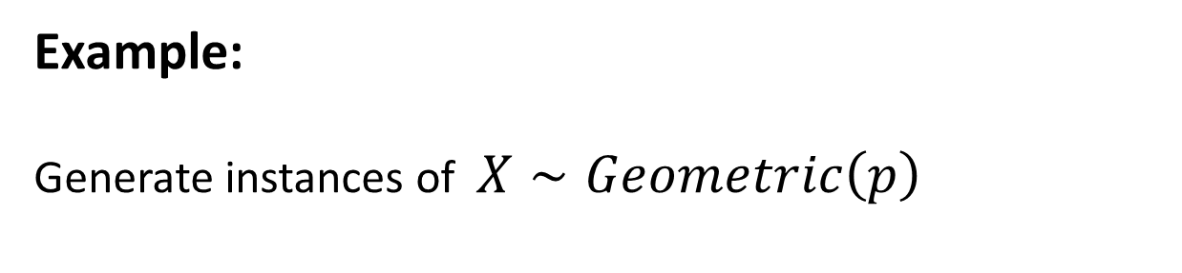
Inverse Transform Method for Discrete R.V.
Example:
Generate instances of $X∼Geometric\left(p\right)$
Solution:
See Exercise 13.3 in your textbook.

Slide 11
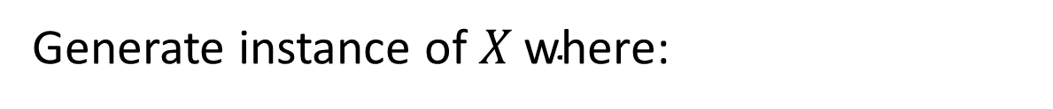
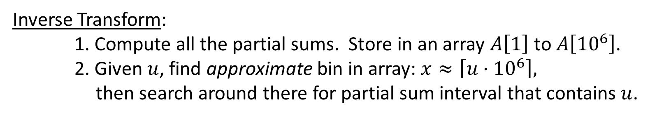
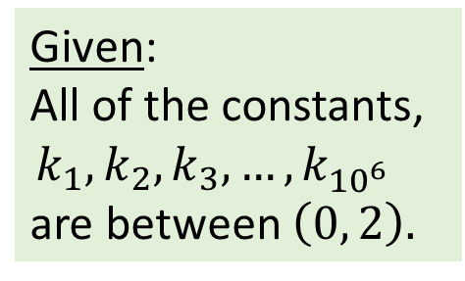
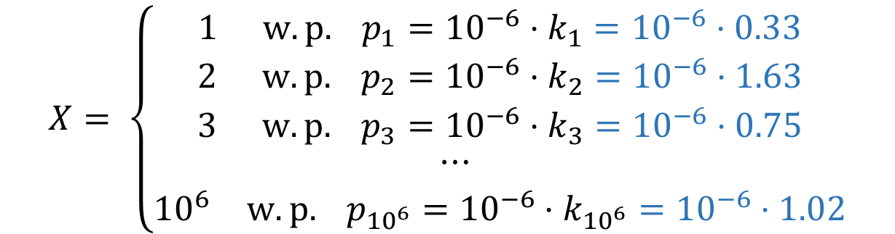
Interview Question
Generate instance of $X \text{where}\text{:}$
$$X= \left\{\begin{matrix}\begin{matrix}1 & w.p. p_{1}={10}^{−6}⋅k_{1}={10}^{−6}⋅0.33\end{matrix} \\ \begin{matrix}2 & w.p. p_{2}={10}^{−6}⋅k_{2}={10}^{−6}⋅1.63\end{matrix} \\ \begin{matrix}\begin{matrix}\begin{matrix}3 & w.p. p_{3}={10}^{−6}⋅k_{3}={10}^{−6}⋅0.75\end{matrix} \\ \begin{matrix}\begin{matrix}⋯ & \end{matrix} & \end{matrix}\end{matrix} \\ \begin{matrix}{10}^{6} & w.p. p_{{10}^{6}}={10}^{−6}⋅k_{{10}^{6}}={10}^{−6}⋅1.02\end{matrix}\end{matrix}\end{matrix}\right.$$
Given:
All of the constants,
$${k_{1}, k_{2}, k_{3}, …, k}_{{10}^{6 }}$$
are between $\left(0, 2\right).$
Question: Suppose you know all the $p_{i}\text{′}\text{s}\text{. }\text{How} \text{do} \text{you} \text{generate} \text{an} \text{instance} \text{of} X\text{?}$
Inverse Transform:
1. Compute all the partial sums. Store in an array $A\left[1\right] \text{to} A\left[{10}^{6}\right]$.
2. Given $u$, find approximate bin in array: $x≈\left\lceil u⋅{10}^{6}\right\rceil ,$
then search around there for partial sum interval that contains $u$.

Slide 12
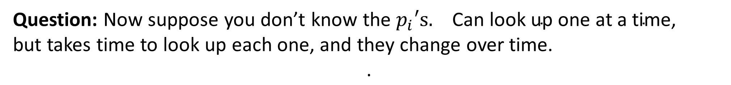
Interview Question
Generate instance of $X \text{where}\text{:}$
$$X= \left\{\begin{matrix}\begin{matrix}1 & w.p. p_{1}={10}^{−6}⋅k_{1}={10}^{−6}⋅0.33\end{matrix} \\ \begin{matrix}2 & w.p. p_{2}={10}^{−6}⋅k_{2}={10}^{−6}⋅1.63\end{matrix} \\ \begin{matrix}\begin{matrix}\begin{matrix}3 & w.p. p_{3}={10}^{−6}⋅k_{3}={10}^{−6}⋅0.75\end{matrix} \\ \begin{matrix}\begin{matrix}⋯ & \end{matrix} & \end{matrix}\end{matrix} \\ \begin{matrix}{10}^{6} & w.p. p_{{10}^{6}}={10}^{−6}⋅k_{{10}^{6}}={10}^{−6}⋅1.02\end{matrix}\end{matrix}\end{matrix}\right.$$
Given:
All of the constants,
$${k_{1}, k_{2}, k_{3}, …, k}_{{10}^{6 }}$$
are between $\left(0, 2\right).$
Question: Now suppose you don’t know the $p_{i}\text{′}\text{s}\text{.} \text{Can} \text{look} \text{up} \text{one} \text{at} \text{a} \text{time}\text{, }$
but takes time to look up each one, and they change over time.
$$\text{.}$$
Can’t get partial sums ➔ Can’t use Inverse Transform Method
➔ Need new approach!

Slide 13

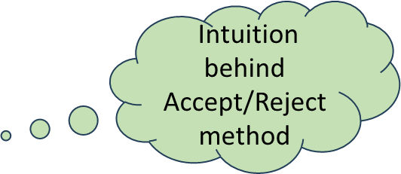
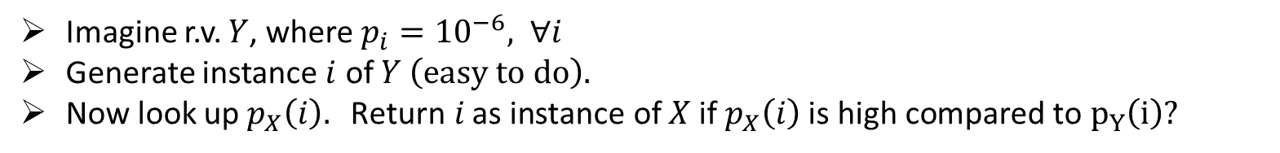
Interview Question
Generate instance of $X \text{where}\text{:}$
$$X= \left\{\begin{matrix}\begin{matrix}1 & w.p. p_{1}={10}^{−6}⋅k_{1}={10}^{−6}⋅0.33\end{matrix} \\ \begin{matrix}2 & w.p. p_{2}={10}^{−6}⋅k_{2}={10}^{−6}⋅1.63\end{matrix} \\ \begin{matrix}\begin{matrix}\begin{matrix}3 & w.p. p_{3}={10}^{−6}⋅k_{3}={10}^{−6}⋅0.75\end{matrix} \\ \begin{matrix}\begin{matrix}⋯ & \end{matrix} & \end{matrix}\end{matrix} \\ \begin{matrix}{10}^{6} & w.p. p_{{10}^{6}}={10}^{−6}⋅k_{{10}^{6}}={10}^{−6}⋅1.02\end{matrix}\end{matrix}\end{matrix}\right.$$
Given:
All of the constants,
$${k_{1}, k_{2}, k_{3}, …, k}_{{10}^{6 }}$$
are between $\left(0, 2\right).$
Question: Now suppose you don’t know the $p_{i}\text{′}\text{s}\text{.} \text{Can} \text{look} \text{up} \text{one} \text{at} \text{a} \text{time}\text{, }$
but takes time to look up each one, and they change over time.
$$\text{.}$$
Intuition behind
Accept/Reject method
Imagine r.v. $Y$, where $p_{i}={10}^{−6}, ∀i$
Generate instance $i$ of $Y \left(easy to do\right).$
Now look up $p_{X}\left(i\right). \text{Return} i \text{as} \text{instance} \text{of} X \text{if}{ p}_{X}\left(i\right) \text{is} \text{high} \text{compared} \text{to} p_{Y}\left(i\right)?$

Slide 14
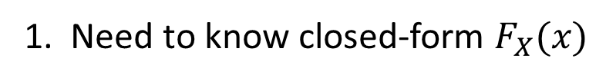
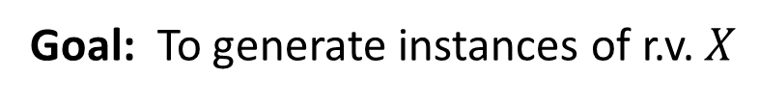
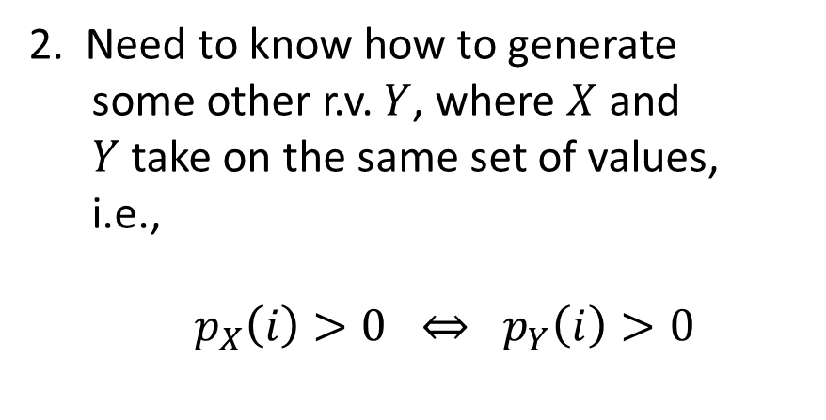
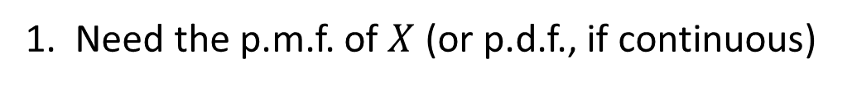
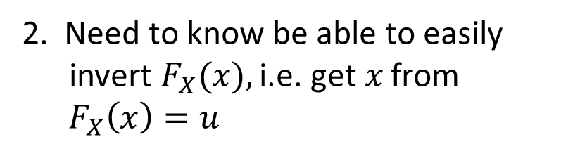
A method with fewer requirements …
Goal: To generate instances of r.v. $X$
Inverse Transform Method
Accept-Reject Method
1. Need the p.m.f. of $X$ (or p.d.f., if continuous)
1. Need to know closed-form $F_{X}(x)$
2. Need to know be able to easily
invert $F_{X}(x),\text{i}\text{.}\text{e}\text{. }\text{get} x \text{from}$ ${ F}_{X}\left(x\right)=u$
2. Need to know how to generate
some other r.v. $Y$, where $X$ and
$Y$take on the same set of values,
i.e.,
${ p}_{X}\left(i\right)>0 ⇔ p_{Y}\left(i\right)>0$

Slide 15

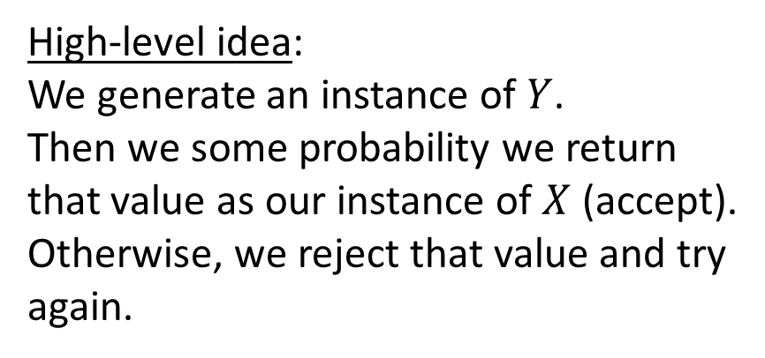
A method with fewer requirements …
Goal: To generate instances of r.v. $X$
Accept-Reject Method
1. Need the p.m.f. of $X$ (or p.d.f., if continuous)
2. Need to know how to generate
some other r.v. $Y$, where $X$ and
$Y$take on the same set of values,
i.e.,
${ p}_{X}\left(i\right)>0 ⇔ p_{Y}\left(i\right)>0$
High-level idea:
We generate an instance of $Y$.
Then we some probability we return that value as our instance of $X$ (accept).
Otherwise, we reject that value and try again.

Slide 16

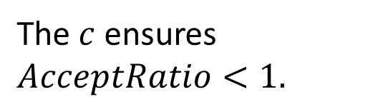
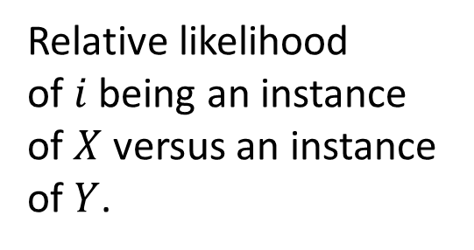
Accept-Reject Method
Accept-Reject method to generate discrete r.v. $X:$
1. Find a discrete r.v. $Y$ which we already know how to generate, where
$${ p}_{X}(i)>0 ⇔ p_{Y}\left(i\right)>0$$
2. Let $c>1$ be the smallest constant s.t.
$$\frac{p_{X}(i)}{p_{Y}(i)}≤c, ∀i \text{s}\text{.}\text{t}\text{. }{ p}_{X}\left(i\right)>0.$$
3. Generate an instance of $Y$. Call this instance $i$.
4. With probability $AcceptRatio\left(i\right)=\frac{p_{X}(i)}{cp_{Y}(i)}$ , accept $i$ and return $X=i$ .
Else, reject $i$ and return to step 3.
Relative likelihood
of $i$ being an instance
of $X$ versus an instance
of $Y$.
$\text{The} c$ ensures $AcceptRatio<1.$

Slide 17




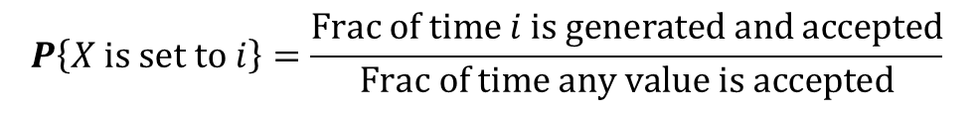
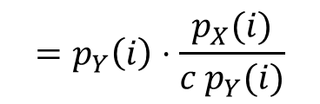

Accept-Reject Method: Correctness
Claim: $P\left\{X is set to i\right\}=p_{X}(i)$
Proof:
$$Frac of time i is generated \& accepted=P\left\{i is generated\right\}⋅P\left\{i is accepted \right| i is generated\}$$
$$=p_{Y}\left(i\right)⋅\frac{p_{X}(i)}{c p_{Y}(i)}$$
$$= \frac{p_{X}(i)}{c }$$
$$Frac of time any value is accepted=\sum_{i}{Frac of time i is generated \& accepted}$$
$$=\sum_{i}{\frac{p_{X}(i)}{c }}$$
$$= \frac{1}{c}$$
$${= \frac{\frac{p_{X}(i)}{c}}{\frac{1}{c}}}_{ }$$
$$P\left\{X is set to i\right\}={\frac{Frac of time i is generated and accepted}{Frac of time any value is accepted}}_{ }$$
$${= p}_{X}(i)$$

Slide 18

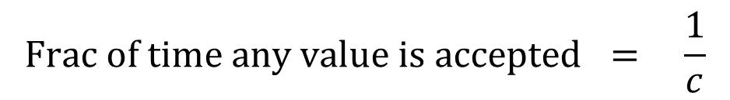
Accept-Reject Method
Theorem: On average, only need to generate $c$values of $Y$ before one is accepted.
Proof:
This is easy. Use what we just proved!
$$Frac of time any value is accepted = \frac{1}{c}$$
$$⇒E\left[\# values generated until one is accepted\right]= c$$

Slide 19

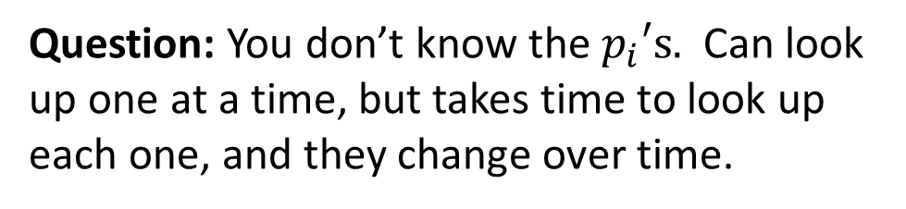

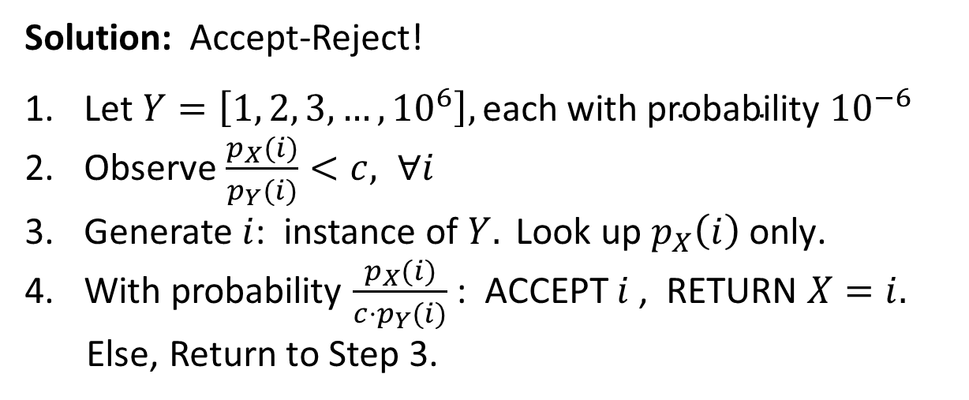
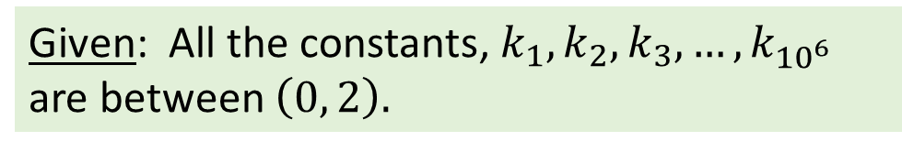
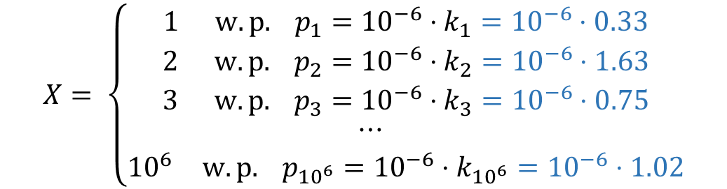

Back to the Interview Question
Generate instance of $X \text{where}\text{:}$
Given: All the constants, ${k_{1}, k_{2}, k_{3}, …, k}_{{10}^{6 }}$
are between $\left(0, 2\right).$
$$X= \left\{\begin{matrix}\begin{matrix}1 & w.p. p_{1}={10}^{−6}⋅k_{1}={10}^{−6}⋅0.33\end{matrix} \\ \begin{matrix}2 & w.p. p_{2}={10}^{−6}⋅k_{2}={10}^{−6}⋅1.63\end{matrix} \\ \begin{matrix}\begin{matrix}\begin{matrix}3 & w.p. p_{3}={10}^{−6}⋅k_{3}={10}^{−6}⋅0.75\end{matrix} \\ \begin{matrix}\begin{matrix}⋯ & \end{matrix} & \end{matrix}\end{matrix} \\ \begin{matrix}{10}^{6} & w.p. p_{{10}^{6}}={10}^{−6}⋅k_{{10}^{6}}={10}^{−6}⋅1.02\end{matrix}\end{matrix}\end{matrix}\right.$$
Question: You don’t know the $p_{i}\text{′}\text{s}\text{.} \text{Can} \text{look} \text{up} \text{one} \text{at} \text{a} \text{time}\text{, }$but takes time to look up each one, and they change over time$\text{.}$
Solution: Accept-Reject!
Let $Y=\left[1, 2, 3, …, {10}^{6}\right],\text{each} \text{with} \text{probability} {10}^{−6}$
Observe $\frac{p_{X}(i)}{p_{Y}(i)}<c, ∀i$
Generate $i$: instance of $Y. \text{Look} \text{up} p_{X}\left(i\right) \text{only}\text{.}$
With probability $\frac{p_{X}(i)}{{c⋅p}_{Y}(i)}$ : ACCEPT $i$ , RETURN $X=i.$
Else, Return to Step 3.
$$\text{What} \text{is} c?$$
$$c=2$$
How many lookups are
required in expectation?
$$2$$

Slide 20

Accept-Reject Method: Continuous
Accept-Reject method to generate continuous r.v. $X \text{with} \text{p}\text{.}\text{d}\text{.}\text{f}\text{.}{ f}_{X}(t):$
1. Find a discrete r.v. $Y$ which we already know how to generate, where
$${ f}_{X}(t)>0 ⇔ f_{Y}\left(t\right)>0$$
2. Let $c>1$ be the smallest constant s.t.
$$\frac{f_{X}(t)}{f_{Y}(t)}≤c, ∀t \text{s}\text{.}\text{t}\text{. }{ f}_{X}\left(t\right)>0.$$
Generate an instance $t$of $Y$.
4. With probability $AcceptRatio\left(t\right)=\frac{f_{X}(t)}{cf_{Y}(t)}$ , accept $t$ and return $X=t.$
Else, reject $t$ and return to step 3.

Slide 21
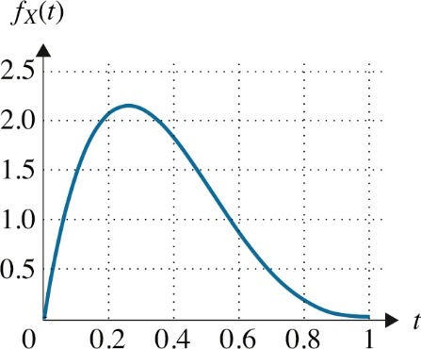
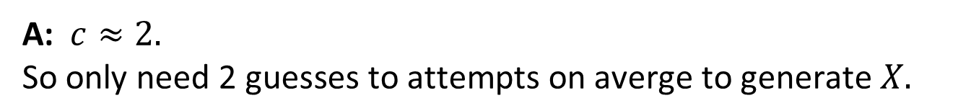
Accept-Reject Method: Example 1
GOAL: Generate r.v. $X$ where $f_{X}\left(t\right)=20t{\left(1−t\right)}^{3}, 0<t<1$
Q: Given this image of $f_{X}\left(t\right)$ , what’s a good choice for $Y ?$
A: $f_{Y}\left(t\right)=1, 0<t<1 \text{has} \text{same} \text{range} \text{and} \text{is} \text{easy} \text{to} \text{generate}\text{.}$
Q: Looking at the picture, how high is $c$ approximately$?$
A: $c≈2.$
$\text{So} \text{only} \text{need}\text{ 2 }\text{guesses} \text{to} \text{attempts} \text{on} \text{averge} \text{to} \text{generate}$ $X.$

Slide 22




Accept-Reject Method: Example 1
GOAL: Generate r.v. $X$ where $f_{X}\left(t\right)=20t{\left(1−t\right)}^{3}, 0<t<1$
$$\text{More} \text{precisely}\text{:}$$
$$c=\max_{t}\left\{\frac{f_{X}(t)}{f_{Y}(t)}\right\}=\max_{t} 20t{\left(1−t\right)}^{3}$$
$$\frac{d}{dt}(20t{\left(1−t\right)}^{3})=0 ⇔ t=\frac{1}{4}$$
$$c=\frac{f_{X}\left(\frac{1}{4}\right)}{f_{Y}\left(\frac{1}{4}\right)}=20\left(\frac{1}{4}\right){\left(\frac{3}{4}\right)}^{3}=\frac{135}{64}$$

Slide 23



Accept-Reject Method: Example 2
GOAL: Generate r.v. $N$ where $N∼Normal(0,1)$
Suffices to generate $X=\left|N\right|$ and then multiply $X \text{by}−1 \text{with} \text{probability} \frac{1}{2}$
Q: What’s a good choice for r.v. $Y \text{with} \text{range} 0 \text{to} ∞?$
A: Let $Y∼Exp\left(1\right). f_{Y}\left(t\right)=e^{−t}, 0<t<∞$
Q: From the picture, how high is $c$ approximately$?$
A: $c≈1.3.$
$\text{So} \text{only} \text{need}\text{ 1.3 }\text{guesses} \text{to} \text{attempts} \text{on} \text{averge} \text{to} \text{generate}$ $X.$

Slide 24




Accept-Reject Method: Example 2
More precisely:
$$c=\max_{t}\left\{\frac{f_{X}(t)}{f_{Y}(t)}\right\}=\max_{t} \sqrt{\frac{2}{π}} e^{t−\frac{t^{2}}{2}}$$
Suffices to maximize $t−\frac{t^{2}}{2}$
$$0=\frac{d}{dt}\left(t−\frac{t^{2}}{2}\right){=1−t ⇔ t=1 }^{ }$$
$$c=\frac{f_{X}\left(1\right)}{f_{Y}\left(1\right)}=\sqrt{\frac{2e}{π}}≈1.3$$

