Slide 1


Chapter 12 The Poisson Process
Notes:
https://www.gettyimages.co.uk/detail/photo/united-states-coins-royalty-free-image/157532065 -- reusing from Chpt 3. No need to rebuy.
https://www.gettyimages.co.uk/detail/illustration/yellow-light-bulb-icon-royalty-free-illustration/165766463?phrase=Yellow%20light%20bulb -- reusing lightbulb from Chpt 7. No need to rebuy.
https://www.gettyimages.co.uk/detail/photo/hard-disk-drive-inside-royalty-free-image/888080160 – reusing from Chpt 3.
https://www.gettyimages.co.uk/detail/illustration/electricity-icon-royalty-free-illustration/1061291518
https://www.gettyimages.co.uk/detail/illustrateon/swaddling-clothes-royalty-free-illustration/647060744
https://www.gettyimages.co.uk/detail/illustration/high-street-shoppers-during-pandemic-royalty-free-illustration/1250472227
https://www.gettyimages.co.uk/detail/illustration/happy-soccer-player-royalty-free-illustration/472287397
For Chpt 12:
https://www.gettyimages.co.uk/detail/illustration/electricity-icon-royalty-free-illustration/1061291518
https://www.gettyimages.co.uk/detail/illustrateon/swaddling-clothes-royalty-free-illustration/647060744
https://www.gettyimages.co.uk/detail/illustration/high-street-shoppers-during-pandemic-royalty-free-illustration/1250472227
https://www.gettyimages.co.uk/detail/illustration/happy-soccer-player-royalty-free-illustration/472287397

Slide 2
Where we’re heading …
Goal of the next 3 chapters:
How to model and simulate computer systems
Chapter 12: The Poisson Process – how to model an arrival process
(jobs arriving to a data center, requests arriving to a web server, etc.)
Chapter 13: Generating r.v.s for simulation – methods for generating instances
of different distributions
Chapter 14: Event-driven simulation – simulating systems with queues and
networks of queues

Slide 3
Chapter 12 outline
The Poisson process is intimately related to the Exponential distribution.
Before discussing the Poisson process, we must revisit the Exponential.
STEP 1: Revisiting the Exponential distribution
Relating the Exponential distribution to the Geometric
More properties of the Exponential distribution
STEP 2: The celebrated Poisson Process
First definition vs. Second definition
Properties of the Poisson Process

Slide 4

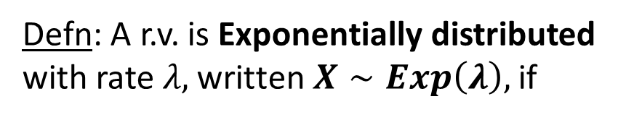
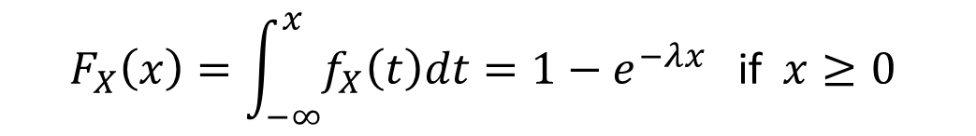

Review of the Exponential distribution
Defn: A r.v. is Exponentially distributed
with rate$λ\text{, }\text{written} X∼Exp\left(λ\right),$if
The p.d.f. and tail both drop off by a constant factor, $e^{−λx}$, with each unit increase in $x.$
$$\begin{matrix}λe^{−λx} & \text{if} x≥0 \\ & \\ 0 & \text{if} x<0\end{matrix}$$
$$f_{X}\left(x\right)=$$
$$F_{X}\left(x\right)=\int_{−∞}^{x}{f_{X}\left(t\right)dt=1−e^{−λx} \text{if} x≥0 }$$
$$\overline{F_{X}}\left(x\right)=e^{−λx} \text{if} x≥0$$

Slide 5

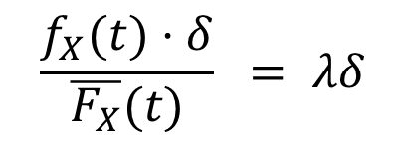


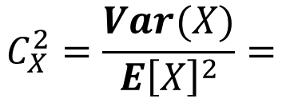





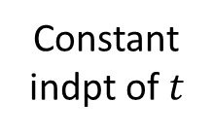
Review of the Exponential distribution
$$X∼Exp\left(λ\right)$$
$$\frac{1}{λ}$$
$$\frac{1}{λ^{2}}$$
$$C_{X}^{2}=\frac{Var(X)}{E{\left[X\right]}^{2}}=$$
$$E\left[X\right]=$$
$$Var(X)=$$
$$1$$
Memoryless Property
$$P\left\{X>s+t \right| X>s\}=$$
$$P\{X>t\}$$
Failure
rate
Constant Failure Rate
$$\frac{f_{X}(t)⋅δ}{\overline{F_{X}}(t)} = λδ$$
$$P\left\{X∈(t, t+δ) \right| X>t\}=$$
Constant
indpt of $t$

Slide 6
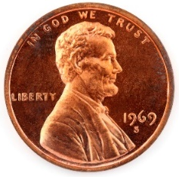
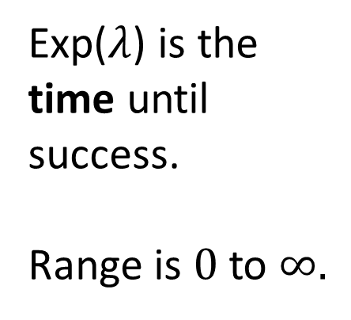

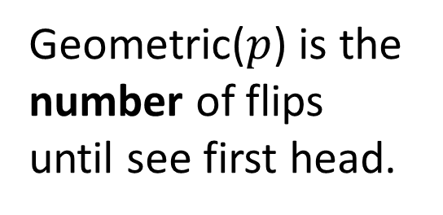

Relating Exponential distribution to Geometric
$$\text{The} \text{Exponential} \text{and} \text{Geometric} \text{are} \text{the} \text{only} \text{memoryless} \text{distributions}\text{. }\text{How} \text{are} \text{they} \text{related}\text{?}$$
Geometric($p$) is the
number of flips
until see first head.
Exp($λ$) is the
time until
success.
Range is $0$ to $∞.$
$$\text{How} \text{to}$$
relate
these?
$$p$$
discrete
continuous

Slide 7

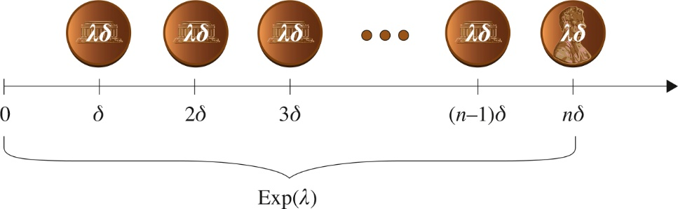
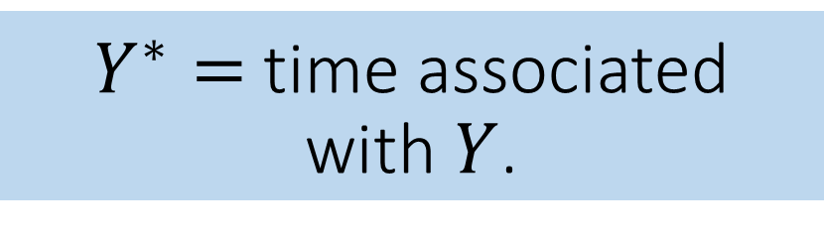
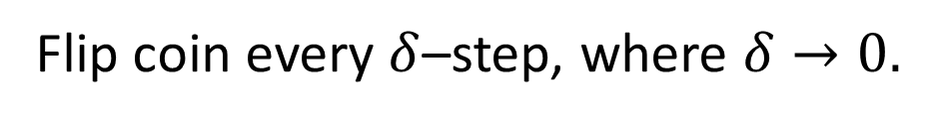
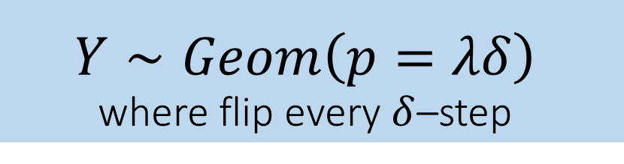
Relating Exponential distribution to Geometric
Flip coin every $δ$–step, where $δ→0.$
Coin has very small probability, $λδ$, of heads.
$$Y∼Geom\left(p=λδ\right)$$
where flip every $δ$–step
$Y^{∗}=$time associated
with $Y$.
discrete
continuous

Slide 8
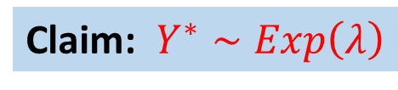
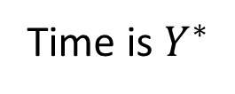
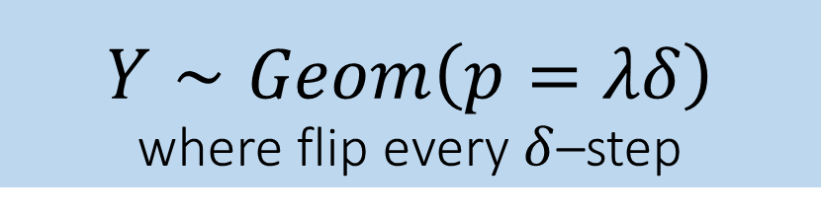
Relating Exponential distribution to Geometric
Time is $Y^{∗}$
Claim: $Y^{∗}∼Exp\left(λ\right)$
$$Y∼Geom\left(p=λδ\right)$$
where flip every $δ$–step
$Y^{∗}=$time associated
with $Y$.
discrete
continuous

Slide 9

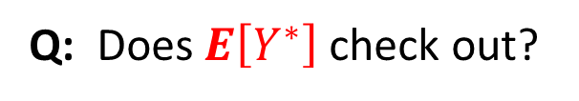



Relating Exponential distribution to Geometric
Claim: $Y^{∗}∼Exp\left(λ\right)$
Time is $Y^{∗}$
Q: Does $E\left[Y^{∗}\right]$check out?
$$E\left[Y^{∗}\right]= \left(avg. \# flips until H\right)⋅(time per flip)$$
$= \frac{1}{λδ}⋅(δ)$
$= \frac{1}{λ}$

Slide 10




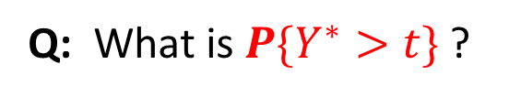

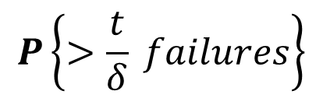

Relating Exponential distribution to Geometric
Claim: $Y^{∗}∼Exp\left(λ\right)$
Time is $Y^{∗}$
Q: What is $P\{Y^{∗}>t\}$?
$$={\left(1−\frac{1}{\frac{1}{λδ}}\right)}^{\frac{t}{δ}}$$
$$P\left\{>\frac{t}{δ} failures\right\}$$
$$={\left(1−λδ\right)}^{\frac{t}{δ}}$$
$$P\left\{Y^{∗}>t\right\}=$$
$$={\left(1−\frac{1}{\frac{1}{λδ}}\right)}^{\frac{1}{λδ} ⋅ λ⋅t}$$
$={\left(e^{−1}\right)}^{λt}$
$=e^{−λt}$

Slide 11

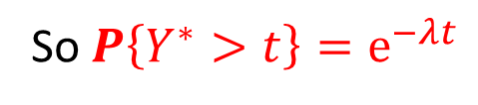
Relating Exponential distribution to Geometric
Claim: $Y^{∗}∼Exp\left(λ\right)$
Time is $Y^{∗}$
So $P\left\{Y^{∗}>t\right\}=e^{−λt}$
$$Y^{∗}∼Exp(λ)$$
Theorem 12.1: Let $X∼Exp(λ)$. Then $X$ represents the time to get a H,
given we flip every $δ$-step, and a flip is successful with probability $λδ$, where $δ→0$ .

Slide 12
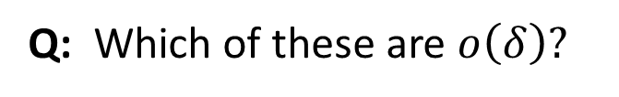
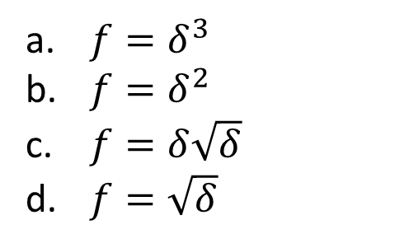



A new view of asymptotic notation
Defn:
Rather than
$$n→∞$$
we have
$$δ→0$$
$$\lim_{δ→0}{\frac{f}{δ}=0}$$
$$f=o\left(δ\right)$$
if
Q: Which of these are $o\left(δ\right)?$
$f=δ^{3}$
$f=δ^{2}$
$f={δ\sqrt{δ}}^{ }$
$f=\sqrt{δ}$
A: (a), (b), (c)

Slide 13

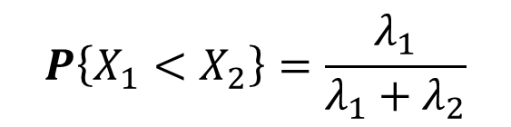
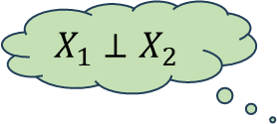



Properties of Exponential
Theorem 12.3: Given $X_{1}∼Exp(λ_{1})$, $X_{2}∼Exp(λ_{2})$, $X_{1}⊥X_{2}$,
$$P\left\{X_{1}<X_{2}\right\}=\frac{λ_{1}}{λ_{1}+λ_{2}}$$
Pf: (traditional algebraic proof)
$P\left\{X_{1}<X_{2}\right\}=\int_{0}^{∞}{P\left\{X_{1}<X_{2} | X_{2}=x\right\}⋅f_{X_{2}}\left(x\right)dx}$
$=\int_{0}^{∞}{P\left\{X_{1}<X_{2} | X_{2}=x\right\}⋅λ_{2}e^{−λ_{2}x}dx}$
after integration
$$X_{1}⊥X_{2}$$
$$=\frac{λ_{1}}{λ_{1}+λ_{2}}$$
$=\int_{0}^{∞}{P\left\{X_{1}<x\right\}⋅λ_{2}e^{−λ_{2}x}dx}$
$=\int_{0}^{∞}{(1−e^{−λ_{1}x})⋅λ_{2}e^{−λ_{2}x}dx}$

Slide 14

Properties of Exponential
Theorem 12.3: Given $X_{1}∼Exp(λ_{1})$, $X_{2}∼Exp(λ_{2})$, $X_{1}⊥X_{2}$,
$$P\left\{X_{1}<X_{2}\right\}=\frac{λ_{1}}{λ_{1}+λ_{2}}$$
Pf: (δ-step proof)
Success of type 1 occurs with probability $λ_{1}δ$on each $δ$-step.
Success of type 2 occurs with probability $λ_{2}δ$on each $δ$-step.
Q: What is$P\left\{X_{1}<X_{2}\right\}$ saying?
A: Given that a success of type 1 or type 2 has occurred,
what is the probability that it is a success of type 1?

Slide 15
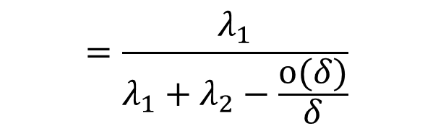

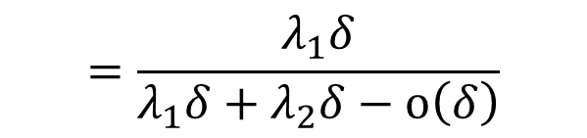
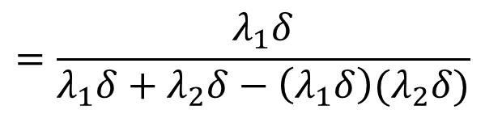
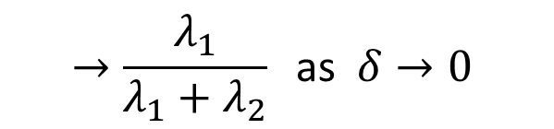
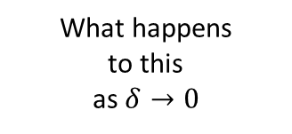
Properties of Exponential
Theorem 12.3: Given $X_{1}∼Exp(λ_{1})$, $X_{2}∼Exp(λ_{2})$, $X_{1}⊥X_{2}$,
$$P\left\{X_{1}<X_{2}\right\}=\frac{λ_{1}}{λ_{1}+λ_{2}}$$
$$=\frac{λ_{1}δ}{λ_{1}δ+λ_{2}δ−o\left(δ\right)}$$
Pf: (δ-step proof)
$$P\left\{X_{1}<X_{2}\right\}=P\left\{type 1 \right| type 1 or type 2\}$$
What happens
to this
as $δ→0$
$$=\frac{λ_{1}}{λ_{1}+λ_{2}−\frac{o(δ)}{δ}}$$
$$= \frac{P\{type 1\}}{P\{type 1 or 2\}}$$
What do we
call this product?
$$=\frac{λ_{1}δ}{λ_{1}δ+λ_{2}δ−\left(λ_{1}δ\right)(λ_{2}δ)}$$
$$→\frac{λ_{1}}{λ_{1}+λ_{2}} \text{as} δ→0$$

Slide 16






Properties of Exponential
Theorem 12.5: Given $X_{1}∼Exp(λ_{1})$, ${ X}_{2}∼Exp(λ_{2})$, $X_{1}⊥X_{2}.$
Let $X=min⁡(X_{1}, X_{2})$. Then $X∼Exp\left(λ_{1}+λ_{2}\right).$
Pf: (traditional algebraic proof)
$$P\left\{X>t\right\}=P\{\min\left(X_{1}, X_{2}\right)>t\text{\}}$$
$$=P\{X_{1}\text{ > }t{ \text{and} X}_{2} \text{>} t\text{\}}$$
$$X_{1}⊥X_{2}$$
$$=P\{X_{1}\text{ > }t{\}⋅P\{X}_{2} \text{>} t\text{\}}$$
$$=e^{−λ_{1}t}⋅e^{−λ_{2}t}=e^{−(λ_{1}+λ_{2})}$$
$$X∼Exp\left(λ_{1}+λ_{2}\right).$$

Slide 17
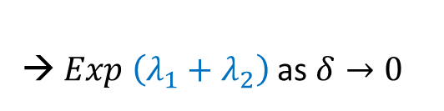

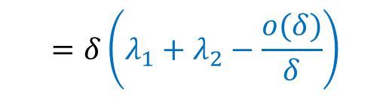
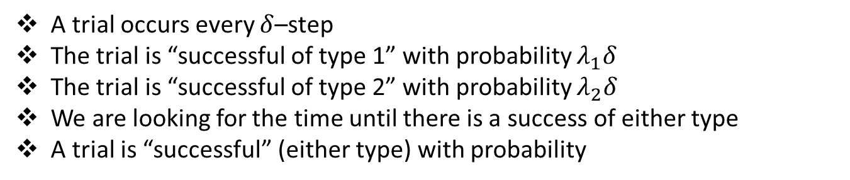

Properties of Exponential
Theorem 12.5: Given $X_{1}∼Exp(λ_{1})$, ${ X}_{2}∼Exp(λ_{2})$, $X_{1}⊥X_{2}.$
Let $X=min⁡(X_{1}, X_{2})$. Then $X∼Exp\left(λ_{1}+λ_{2}\right).$
Pf: (δ-step proof)
A trial occurs every $δ$–step
The trial is “successful of type 1” with probability $λ_{1}δ$
The trial is “successful of type 2” with probability $λ_{2}δ$
We are looking for the time until there is a success of either type
A trial is “successful” (either type) with probability
$$=δ\left(λ_{1}+λ_{2}−\frac{o(δ)}{δ}\right)$$
$$λ_{1}δ+λ_{2}δ−\left(λ_{1}δ\right)\left(λ_{2}δ\right)$$
→ $Exp$ $\left(λ_{1}+λ_{2}\right)$ as $δ→0$
So time until success $∼Exp$ $\left(λ_{1}+λ_{2}−\frac{o(δ)}{δ}\right)$

Slide 18



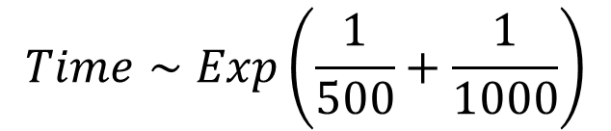
Example
Our system has 2 potential points of failure (assume these are independent):
Time to failure is Exponentially-distributed with mean 500
Time to failure is Exponentially-distributed with mean 1000
$$Time∼Exp\left(\frac{1}{500}+\frac{1}{1000}\right)$$
Q: What is the time until there is a system failure
of either type?
$$\frac{\frac{1}{500}}{\frac{1}{500}+\frac{1}{1000}}$$
Q: What is $P\left\{system failure caused by power supply\right\}?$

Slide 19
The Poisson Process (P.P.)
x
The Poisson process is the most widely used model for the arrivals into a system
x = “arrival time” or “event time”
x
x
x
x
x
x
x
x
time
P.P. is analytically tractable
P.P. occurs in nature whenever look at aggregate stream from a large number of independent users (as is typical for mail server, web server, data center, etc.)

Slide 20


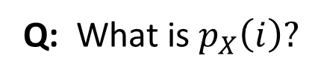
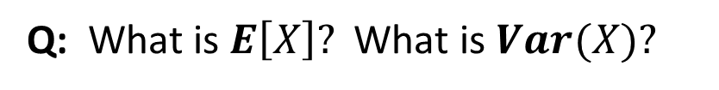
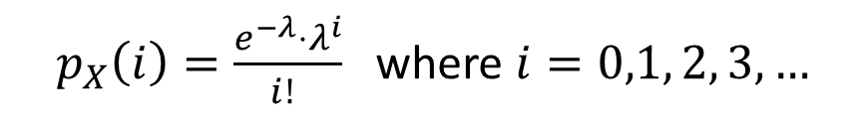
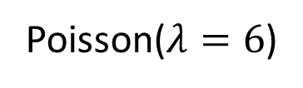
Before we start … recall the Poisson distribution
$$X∼Poisson(λ)$$
$p_{X}\left(i\right)=\frac{e^{−λ}⋅λ^{i}}{i! }$where $i=0,1, 2, 3, …$
Q: What is $p_{X}\left(i\right)?$
Q: What is $E\left[X\right]?$ What is $Var(X)?$
$E\left[X\right]=Var\left(X\right)=λ$
Like a Normal,
but starts at 0.
Q: What is the shape of the Poisson?
Poisson($λ=6$)

Slide 21
2 Properties of the Poisson process
Independent Increments
2. Stationary Increments
These two properties
define the
Poisson Process

Slide 22


Independent Increments
x = “arrival time” or “event time”
x
x
x
x
x
x
x
x
time
0
$$N_{blue}=\# events in blue interval$$
$$N_{pink}=\# events in pink interval$$
If blue and pink intervals
are non-overlapping
$${⇒ N}_{blue} ⊥ N_{pink}$$

Slide 23







Independent Increments
x = “arrival time” or “event time”
x
x
x
x
x
x
x
x
time
$$t_{0}$$
$$t_{1}$$
$$t_{2}$$
$$t_{3}$$
$$t_{4}$$
$$N\left(t\right)=\# events occurring by time t$$
Defn 12.7: An event sequence has independent increments if the numbers of
events that occur in disjoint time intervals are independent. Specifically, for all
$t_{0}<t_{1}<t_{2}<⋯<t_{n}$:
$N\left(t_{1}\right)−N\left(t_{0}\right) ⊥ N\left(t_{2}\right)−N\left(t_{1}\right)$ $⊥ …⊥ N\left(t_{n}\right)−N\left(t_{n−1}\right)$

Slide 24



Independent Increments
x = “arrival time” or “event time”
x
x
x
x
x
x
x
x
time
$$t_{0}$$
$$t_{1}$$
$$t_{2}$$
$$t_{3}$$
$$t_{4}$$
For discussion: Which of these event sequences have independent increments?
Births of children
2. People entering a store
3. Goals scored by a particular soccer player

Slide 25



Stationary Increments
x = “arrival time” or “event time”
x
x
x
x
x
x
x
x
time
$$0$$
Defn 12.9: An event sequence has stationary increments if the number of
events during a time period depends only on the length of the time period and not on
its starting point. That is:
$$N\left(t+s\right)−N\left(s\right)$$
has the same distribution for all $s$.

Slide 26

Poisson Process: First definition
The rate of an event sequence refers to the
average number of events per unit time.
x = “arrival time” or “event time”
x
x
x
x
x
x
x
x
time
$$0$$
First definition of the Poisson Process:
A Poisson Process with rate $λ$ is a sequence of events s.t.
$N\left(0\right)=0$
The process has independent increments
The number of events in any interval of length $t$is Poisson distributed with mean $λt$.
$$∀s, t≥0, P\left\{N\left(t+s\right)−N\left(s\right)=n\right\}=\frac{e^{−λt}⋅{\left(λt\right)}^{n}}{n!} n=0, 1, 2, …$$

Slide 27
Q: Why only
independent
increments?
A:
Third item implies
stationary increments.
x
x
x
x
x
x
x
x
time
$$0$$
First definition of the Poisson Process:
A Poisson Process with rate $λ$ is a sequence of events s.t.
$N\left(0\right)=0$
The process has independent increments
The number of events in any interval of length $t$is Poisson distributed with mean $λt$.
$$∀s, t≥0, P\left\{N\left(t+s\right)−N\left(s\right)=n\right\}=\frac{e^{−λt}⋅{\left(λt\right)}^{n}}{n!} n=0, 1, 2, …$$

Slide 28


Q: What do we
know about
$$N\left(t\right)?$$
A:
$$N\left(t\right)∼Poisson(λt)$$
x
x
x
x
x
x
x
x
time
$$0$$
First definition of the Poisson Process:
A Poisson Process with rate $λ$ is a sequence of events s.t.
$N\left(0\right)=0$
The process has independent increments
The number of events in any interval of length $t$is Poisson distributed with mean $λt$.
$$∀s, t≥0, P\left\{N\left(t+s\right)−N\left(s\right)=n\right\}=\frac{e^{−λt}⋅{\left(λt\right)}^{n}}{n!} n=0, 1, 2, …$$

Slide 29


Q: Why is $λ$
called the “rate”
of the process?
A:
$$Avg. rate of events=\frac{E[N\left(t\right)]}{t}=\frac{λt}{t}=λ.$$
x
x
x
x
x
x
x
x
time
$$0$$
First definition of the Poisson Process:
A Poisson Process with rate $λ$ is a sequence of events s.t.
$N\left(0\right)=0$
The process has independent increments
The number of events in any interval of length $t$is Poisson distributed with mean $λt$.
$$∀s, t≥0, P\left\{N\left(t+s\right)−N\left(s\right)=n\right\}=\frac{e^{−λt}⋅{\left(λt\right)}^{n}}{n!} n=0, 1, 2, …$$

Slide 30
Q: What does an event process with both
stationary and independent increments look like?
A: At any point in time, the process probabilistically restarts itself.
Independent Increments ➔ From any point on, the process is independent of all that occurred previously.
Stationary Increments ➔ When the process restarts itself, it has the same distribution as the original process
So the process has no memory!

Slide 31






Poisson Process: Second definition
The rate of an event sequence refers to the
average number of events per unit time.
x = “arrival time” or “event time”
x
x
x
x
x
x
x
time
$$0$$
$Exp\left(λ\right)$
$Exp\left(λ\right)$
$Exp\left(λ\right)$
Second definition of the Poisson Process:
A Poisson Process with rate $λ$ is a sequence of events s.t.
$N\left(0\right)=0$
The sequence of inter-event times are i.i.d. $Exp\left(λ\right)$ random variables.

Slide 32





























Poisson Process: Second definition
x
x
x
x
$$λδ$$
$$λδ$$
$$λδ$$
$$λδ$$
$$λδ$$
$$λδ$$
$$λδ$$
$$λδ$$
$$λδ$$
$$λδ$$
$$λδ$$
time
$$0$$
$$δ$$
$$2δ$$
$$3δ$$
$$4δ$$
$$5δ$$
$$6δ$$
$$7δ$$
$$8δ$$
$$9δ$$
$$10δ$$
$$11δ$$
$Exp\left(λ\right)$
$Exp\left(λ\right)$
$Exp\left(λ\right)$
Every $δ$-step, flip a coin with probability $λδ$ of heads.
The sequence of heads forms a Poisson process!

Slide 33








Definition 1 ➔ Definition 2
Let $τ_{1}, τ_{2}, τ_{3},…$be the inter-event times of a sequence of events.
WTS: ${ τ}_{i}∼Exp\left(λ\right)$
PF:
$$=\frac{e^{−λt}⋅{\left(λt\right)}^{0}}{0!}$$
$$P\left\{τ_{1}>t\right\}$$
$$=P\left\{N\left(t\right)=0\right\}$$
$$=e^{−λt}$$
$$P\left\{τ_{n+1}>t | { ∑}_{i=1 }^{n}τ_{i}=s\right\}$$
$$=P\left\{0 events in \left(s, s+t\right)\right|{ ∑}_{i=1 }^{n}τ_{i}=s\}$$
indpt incr.
$$=P\{0 events in (s, s+t)\}$$
stat. incr.
$$=e^{−λt}$$

Slide 34

































Definition 2 ➔ Definition 1
By Defn 2:
$$λδ$$
$$λδ$$
$$λδ$$
$$λδ$$
$$λδ$$
$$λδ$$
$$λδ$$
$$λδ$$
$$λδ$$
$$λδ$$
$$λδ$$
x
x
x
time
$$0$$
$$δ$$
$$2δ$$
$$3δ$$
$$4δ$$
$$5δ$$
$$6δ$$
$$7δ$$
$$8δ$$
$$9δ$$
$$δ$$
$$2δ$$
$Exp\left(λ\right)$
$Exp\left(λ\right)$
$Exp\left(λ\right)$
WTS: $N\left(t\right)∼Poisson\left(λt\right), and also stationary increments$
$$N\left(t\right)=Number of successes by time t$$
Q: What do we know about
$Binomial\left(n,p\right)$for large
$n$and tiny $p$?
$$∼Binomial \left(\#flips , probability of success of each flip\right)$$
$$∼Binomial \left(\frac{t}{δ}, λδ\right)$$
A: By Exercise 3.8,
$$Binomial\left(n,p\right)→Poisson\left(np\right)$$
$$→Poisson\left(\frac{t}{δ}⋅λδ\right) as δ→0$$
$$=Poisson\left(λt\right)$$

Slide 35







Number Poisson Arrivals during a Random Time
Jobs arrive to a system according to a Poisson process with rate$λ$.
Let $A_{S}=$ # arrivals occur during random time $S$ $($assume $S$ is independent of the arrival process)
Q: What is $E\left[A_{S}\right]?$
Q: How is $A_{t}$ distributed?
Let $A_{t}=$ # arrivals occur during $t$
$$A_{t}∼Poisson\left(λt\right) ⇒ E\left[A_{t}\right]=λt$$
$$E\left[A_{S}\right]=\int_{t=0}^{∞}{E\left[A_{S} \right| S=t]⋅} f_{S}\left(t\right)dt$$
$$=\int_{t=0}^{∞}{E[A_{t}]⋅} f_{S}\left(t\right)dt$$
$$=\int_{t=0}^{∞}{λt⋅} f_{S}\left(t\right)dt$$
$$=λ E[S]$$

Slide 36




Merging Independent Poisson processes
Theorem 12.13 (Poisson Merging): Given two independent Poisson processes, where process 1 has rate $λ_{1}$ and process 2 has rate $λ_{2}$, the merge of these is a single Poisson process with rate $λ_{1}+λ_{2}$.
2 proofs
at least!
Proof:
Alternate Proof:
Time to next event of merged process
$$N_{1}\left(t\right)∼Poisson(λ_{1}t)$$
$$N_{2}\left(t\right)∼Poisson(λ_{2}t)$$
$$=\min\left(Exp\left(λ_{1}\right), Exp\left(λ_{2}\right)\right)∼Exp(λ_{1}+λ_{2})$$
$$N_{merge}\left(t\right)=N_{1}\left(t\right)+N_{2}(t)∼Poisson({λ_{1}t+ λ}_{2}t)$$

Slide 37


Poisson Splitting
Theorem 12.14 (Poisson Splitting): Given a Poisson process with rate ${λ,}_{ }$suppose each event is independently classified “type A” with probability $p$and “type B” with probability $1−p.$ Then the A’s form a Poisson process with rate $λp$ and the B’s form a Poisson process with rate $λ(1−p)$, and these processes are independent
Hard to believe because time between A’s doesn’t look Exponentially distributed!

Slide 38



Poisson Splitting
Intuition:
Type A success
happens only when
both coins are heads!
Time to next type A is
time until Heads for coin
with probability $(λp)δ$.
∴$Time∼Exp(λp)$
See your textbook
for full proof.

Slide 39







Uniformity
Theorem 12.15 (Uniformity): Given that one event of a Poisson process has occurred by time $t$, that event is equally likely to have occurred anywhere in $[0,t].$
Proof:
Let $T_{1}$ be the time of that one event:
$$=\frac{P\{T_{1}<s \& N\left(t\right)=1\}}{P\{N\left(t\right)=1\}}$$
$$=\frac{P\{1 event in \left[0,s\right] \& 0 events in [s,t]\} }{\frac{e^{−λt}{\left(λt\right)}^{1}}{1!}}$$
$$P\left\{T_{1}<s \right| N\left(t\right)=1\}$$
$$=\frac{P\left\{1 event in \left[0,s\right]\right\}⋅P\{0 events in [s,t]\} }{e^{−λt}⋅(λt)}$$
$$=\frac{e^{−λs}⋅λs⋅e^{−λ(t−s)}⋅{\left(λ\left(t−s\right)\right)}^{0} }{e^{−λt}⋅λt}$$
$$=\frac{s}{t}$$
Theorem 12.15 (Uniformity -- Generalization): If $k$events of a Poisson process occur by time $t$, the $k$ events are distributed independently and uniformly in $[0,t].$

