Slide 1
Chapter 11 Laplace Transforms

Slide 2
There are different types of transforms
Back in Chapter 6 we covered a type of generating function called the z-transform.
The z-transform is particularly well suited to discrete, integer-valued random variables.
In this chapter we introduce a new generating function called the Laplace transform,
which is well suited to common continuous random variables.
The structure of this chapter will closely mimic that of Chapter 6.

Slide 3
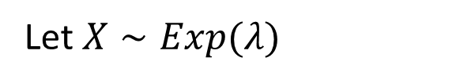


Motivation
Let $X∼Exp(λ)$
What is $E\left[X^{3}\right]?$
$$E\left[X^{3}\right]=\int_{0}^{∞}{t^{3}⋅λe^{−λt}dt}$$
Seems complicated to evaluate!
The Laplace transform will make this very easy!

Slide 4

The Laplace transform as an onion
Onion represents Laplace transform of r.v. $X$
Lower moments are in the outer layers → less effort/tears
Higher moments are deeper inside → more effort/tears

Slide 5
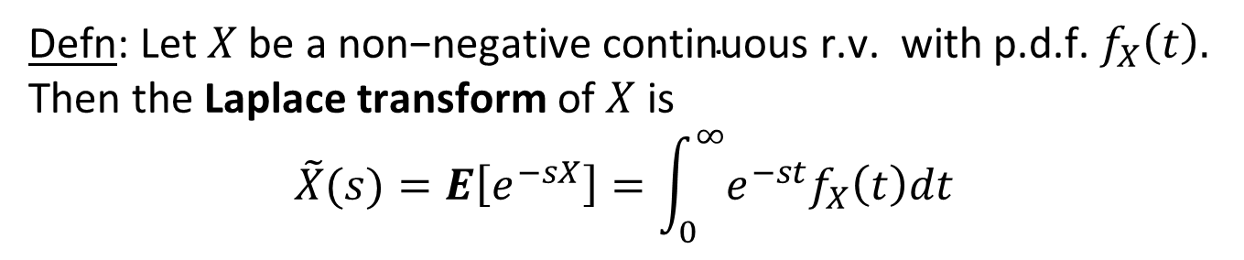
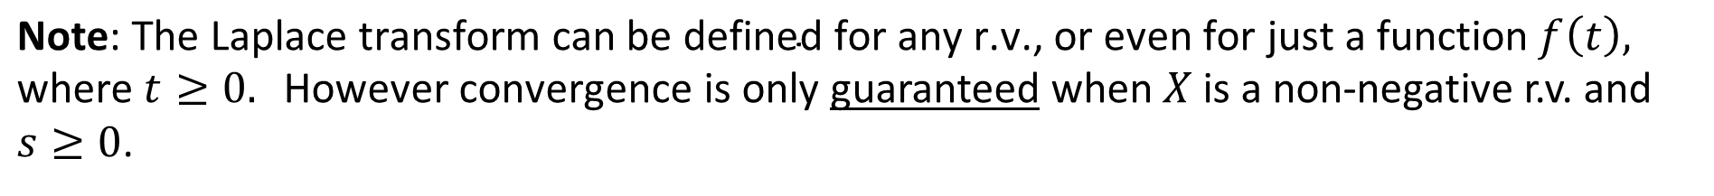

Laplace transform of continuous r.v.
Defn: Let$X \text{be} \text{a} \text{non}\text{−}\text{negative} \text{continuous} \text{r}\text{.}\text{v}\text{. }\text{with} \text{p}\text{.}\text{d}\text{.}\text{f}\text{.}{ f}_{X}\left(t\right).$
Then the Laplace transform of $X$ is
$$\tilde{X}(s)=E\left[e^{−sX}\right]=\int_{0}^{∞}{e^{−st}f_{X}\left(t\right)dt}$$
Assume$s \text{is} \text{a} \text{constant} \text{where} s≥0.$
$\text{Note}\text{: }\text{The} \text{Laplace} \text{transform} \text{can} \text{be} \text{defined} \text{for} \text{any} \text{r}\text{.}\text{v}\text{., }\text{or} \text{even} \text{for} \text{just} \text{a} \text{function} f\left(t\right), \text{where} t≥0. \text{However} \text{convergence} \text{is} \text{only}$guaranteed when $X$is a non-negative r.v. and $s≥0$.

Slide 6
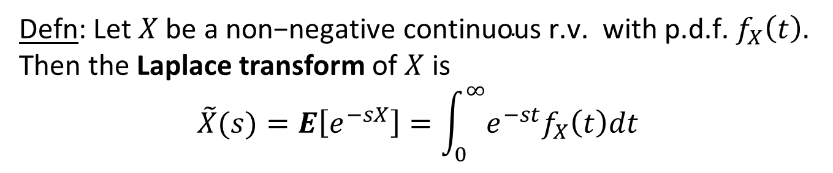


Pop Quiz
Defn: Let$X \text{be} \text{a} \text{non}\text{−}\text{negative} \text{continuous} \text{r}\text{.}\text{v}\text{. }\text{with} \text{p}\text{.}\text{d}\text{.}\text{f}\text{.}{ f}_{X}\left(t\right).$
Then the Laplace transform of $X$ is
$$\tilde{X}(s)=E\left[e^{−sX}\right]=\int_{0}^{∞}{e^{−st}f_{X}\left(t\right)dt}$$
Assume$s \text{is} \text{a} \text{constant} \text{where} s≥0.$
$$\text{Q}\text{: }\text{What} \text{is}\tilde{ X}\left(0\right)?$$
$$\text{A}\text{: }\tilde{ X}\left(0\right)=E\left[e^{−0⋅X}\right]=1$$

Slide 7



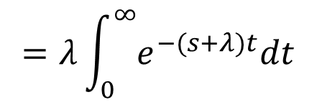
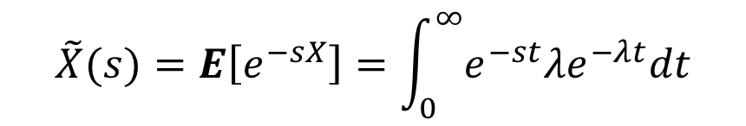
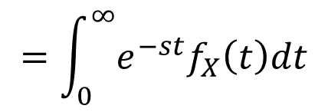

Example of Onion Building
$$X∼Exp(λ)$$
$$\text{Create} \text{the} \text{onion}\text{!}$$
$$\tilde{X}(s)=E\left[e^{−sX}\right]=\int_{0}^{∞}{e^{−st}λe^{−λt}dt}$$
$$\tilde{X}\left(s\right)=E\left[e^{−sX}\right]$$
$$=\int_{0}^{∞}{e^{−st}f_{X}\left(t\right)dt}$$
$$=λ\int_{0}^{∞}{e^{−(s+λ)t}dt}$$
$$=\frac{λ}{s+λ}$$

Slide 8





Example of Onion Building
$$X=3$$
$$\text{Create} \text{the} \text{onion}\text{!}$$
$$\tilde{X}\left(s\right)=E\left[e^{−sX}\right]$$
$$\tilde{X}(s)=E\left[e^{−sX}\right]$$
$$=\int_{0}^{∞}{e^{−st}f_{X}\left(t\right)dt}$$
$$=E[e^{−3s}]$$
$$=e^{−3s}$$

Slide 9
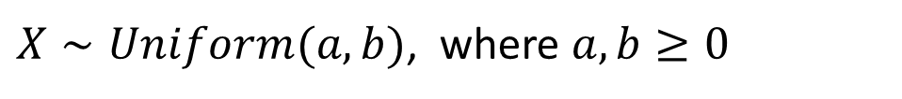

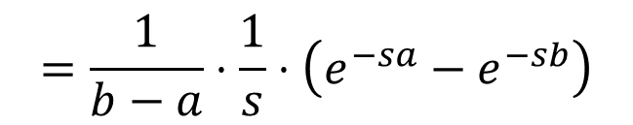
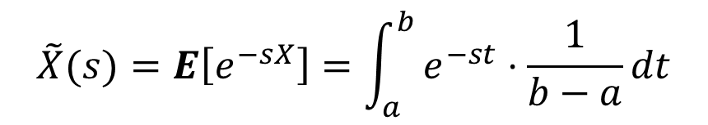
Example of Onion Building
$X∼Uniform(a,b)$, where $a,b≥0$
$$\text{Create} \text{the} \text{onion}\text{!}$$
$$\tilde{X}(s)=E\left[e^{−sX}\right]=\int_{a}^{b}{e^{−st}⋅\frac{1}{b−a}dt}$$
$$\tilde{X}\left(s\right)=E\left[e^{−sX}\right]$$
$$=\int_{0}^{∞}{e^{−st}f_{X}\left(t\right)dt}$$
$$=\frac{1}{b−a}⋅\frac{1}{s}⋅\left(e^{−sa}−e^{−sb}\right)$$

Slide 10

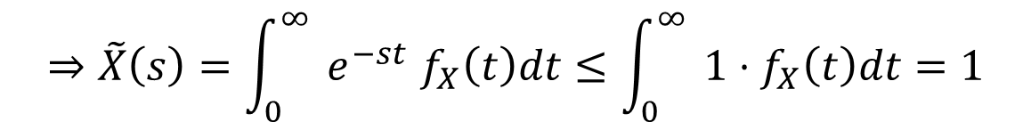


Convergence of Laplace transform
Theorem 11.7: $\tilde{X}\left(s\right) \text{i}\text{s} \text{bounded} \text{for} \text{any} \text{non}\text{−}\text{negative} \text{continuous} \text{r}\text{.}\text{v}\text{.} X\text{, }\text{assuming} s≥0.$
Proof:
$$e^{−t}≤1, ∀t≥0$$
$${⇒\left(e^{−t}\right)}^{s}≤1, ∀s≥0$$
$${⇒e}^{−st}≤1, ∀t,s≥0$$
$${⇒\tilde{X}\left(s\right)=\int_{0}^{∞}{ }e}^{−st}f_{X}\left(t\right)dt≤\int_{0}^{∞}{ }1⋅f_{X}\left(t\right)dt=1$$

Slide 11




Getting moments: Onion peeling
Theorem 11.8: (Onion Peeling) $\text{Let}$ $X \text{be} \text{a} \text{non}\text{−}\text{negative}\text{, }\text{continuous} \text{r}\text{.}\text{v}\text{. }$
$\text{with} \text{p}\text{.}\text{d}\text{.}\text{f}\text{.} { f}_{X}\left(t\right)\text{,} t≥0.$Then,
${\left.\tilde{X}′\left(s\right)\right|}_{s=0}=−E[X]$
${\left.\tilde{X}′′\left(s\right)\right|}_{s=0}=E[X^{2}]$
${\left.{\tilde{X}}^{′′}′\left(s\right)\right|}_{s=0}=−E[X^{3}]$
$${\left.{\tilde{X}}^{′′}′′\left(s\right)\right|}_{s=0}=E[X^{4}]$$
$$\text{If} \text{can}\text{′}\text{t} \text{evaluate} \text{at} s=0\text{, }\text{instead} \text{consider} \text{limit} \text{as} s→0 (\text{use} \text{L}\text{′}\text{Hospital}\text{′}\text{s} \text{Rule}\text{).}$$

Slide 12
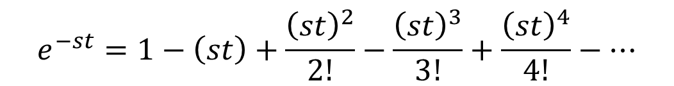
Proof of onion peeling theorem
$$e^{−st}=1−\left(st\right)+\frac{{\left(st\right)}^{2}}{2!}−\frac{{\left(st\right)}^{3}}{3!}+\frac{{\left(st\right)}^{4}}{4!}−⋯$$
(Taylor Series Expansion)
$$e^{−st}f\left(t\right)=f\left(t\right)−\left(st\right)f\left(t\right)+\frac{{\left(st\right)}^{2}}{2!}f\left(t\right)−\frac{{\left(st\right)}^{3}}{3!}f\left(t\right)+\frac{{\left(st\right)}^{4}}{4!}f\left(t\right)−⋯$$
$${\int_{0}^{∞}{ }e}^{−st}f\left(t\right)dt=\int_{0}^{∞}{ }f\left(t\right)dt−\int_{0}^{∞}{ }\left(st\right)f\left(t\right)dt+\int_{0}^{∞}{ }\frac{{\left(st\right)}^{2}}{2!}f\left(t\right)dt−\int_{0}^{∞}{ }\frac{{\left(st\right)}^{3}}{3!}f\left(t\right)dt+⋯$$
$$\tilde{X}\left(s\right)=1 −s E\left[X\right]+\frac{s^{2}}{2!}E\left[X^{2}\right]−\frac{s^{3}}{3!}E\left[X^{3}\right]+\frac{s^{4}}{4!}E\left[X^{4}\right]−\frac{s^{5}}{5!}E\left[X^{5}\right]+⋯$$

Slide 13


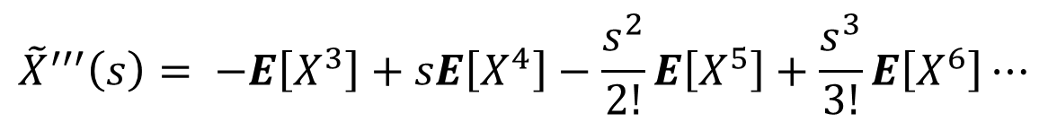


Proof of onion peeling theorem
$$\tilde{X}\left(s\right) = 1 −s E\left[X\right]+\frac{s^{2}}{2!}E\left[X^{2}\right]−\frac{s^{3}}{3!}E\left[X^{3}\right]+\frac{s^{4}}{4!}E\left[X^{4}\right]−\frac{s^{5}}{5!}E\left[X^{5}\right]+\frac{s^{6}}{6!}E\left[X^{6}\right] ⋯$$
$${\tilde{X}}^{′}\left(s\right) = − E\left[X\right]+sE\left[X^{2}\right]−\frac{s^{2}}{2!}E\left[X^{3}\right]+\frac{s^{3}}{3!}E\left[X^{4}\right]−\frac{s^{4}}{4!}E\left[X^{5}\right]+\frac{s^{5}}{5!}E[X^{6}]⋯$$
$${\tilde{X}}^{′}\left(0\right)= − E\left[X\right]$$
$${\tilde{X}}^{′′}\left(s\right)= E\left[X^{2}\right]−sE\left[X^{3}\right]+\frac{s^{2}}{2!}E\left[X^{4}\right]−\frac{s^{3}}{3!}E\left[X^{5}\right]+\frac{s^{4}}{4!}E\left[X^{6}\right]⋯$$
$${\tilde{X}}^{′′}\left(0\right)= E[X^{2}]$$
$${\tilde{X}}^{′′′}\left(s\right)= −E\left[X^{3}\right]+sE\left[X^{4}\right]−\frac{s^{2}}{2!}E\left[X^{5}\right]+\frac{s^{3}}{3!}E\left[X^{6}\right]⋯$$
$${\tilde{X}}^{′′′}\left(0\right) = −E[X^{3}]$$

Slide 14



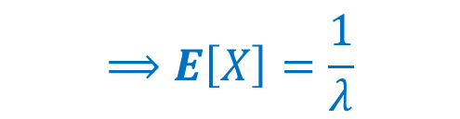
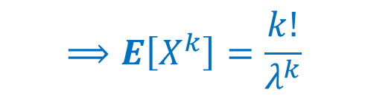

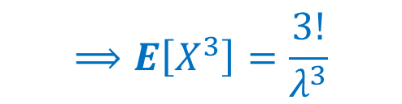
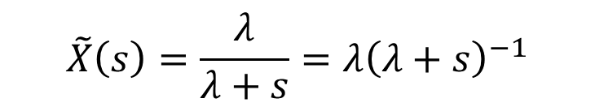
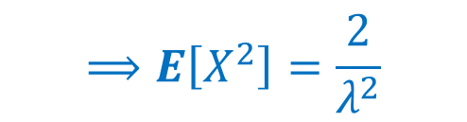
Example of onion peeling
$$\tilde{X}\left(s\right)=\frac{λ}{λ+s}=λ{\left(λ+s\right)}^{−1}$$
$$X∼Exp(λ)$$
$\text{Q}\text{:} \text{Peel} \text{the} \text{onion} \text{to} \text{get} E\left[X\right]\text{, }E[X^{2}]$, $E\left[X^{3}\right]\text{, }E[X^{4}]$,…
$$⟹E\left[X\right]=\frac{1}{λ}$$
$${\tilde{X}}^{′}\left(s\right) = −λ{\left(λ+s\right)}^{−2}$$
$$⟹E\left[X^{2}\right]=\frac{2}{λ^{2}}$$
$${\tilde{X}}^{′′}\left(s\right)=2λ{\left(λ+s\right)}^{−3}$$
$$⟹E\left[X^{3}\right]=\frac{3!}{λ^{3}}$$
$${\tilde{X}}^{′′′}\left(s\right)= −3!λ{\left(λ+s\right)}^{−4}$$
$$⟹E\left[X^{k}\right]=\frac{k!}{λ^{k}}$$
14

Slide 15


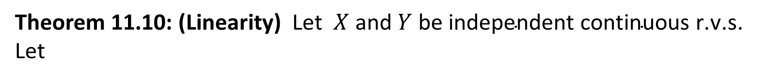



Linearity of Transforms
Theorem 11.10: (Linearity) $\text{Let}$ $X \text{and} Y \text{be} \text{independent} \text{continuous} \text{r}\text{.}\text{v}\text{.}\text{s}\text{. }$
Let
$$Z=X+Y$$
$$\text{Then} \text{the} \text{Laplace} \text{transform} \text{of} Z \text{is}\text{: }$$
$\tilde{Z}\left(s\right)=$ $\tilde{X}\left(s\right)⋅$ $\tilde{Y}\left(s\right)$
Proof:
$$\tilde{Z}\left(s\right)=E\left[e^{−sZ}\right]=E[e^{−s\left(X+Y\right)}]$$
$$=E[e^{−sX}⋅e^{−sY}]$$
$$=E\left[e^{−sX}\right]⋅E\left[e^{−sY}\right]$$
$=$ $\tilde{X}\left(s\right)⋅$ $\tilde{Y}\left(s\right)$

Slide 16
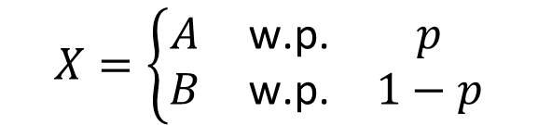




Conditioning with Transforms
Theorem 11.11: $\text{Let}$ $X, A, \text{and} B \text{be} \text{continuous} \text{r}\text{.}\text{v}\text{.}\text{s}\text{. }\text{where}$
$$X=\left\{\begin{matrix}A & \text{w}\text{.}\text{p}\text{.} & p \\ B & \text{w}\text{.}\text{p}\text{.} & 1−p\end{matrix}\right.$$
$$\text{Then}\text{, }$$
$$\tilde{X}(s)=p⋅\tilde{A}(s)+\left(1−p\right)⋅\tilde{B}(s)$$
Proof:
$$\tilde{X}(s)= E\left[e^{−sX}\right]$$
$$=E\left[e^{−sX}\right|X=A]⋅p+E\left[e^{−sX}\right|X=B]⋅(1−p)$$
$$=E[e^{−sA}]⋅p+E[e^{−sB}]⋅(1−p)$$
$$=p⋅\tilde{A}(s)+\left(1−p\right)⋅\tilde{B}(s)$$

Slide 17
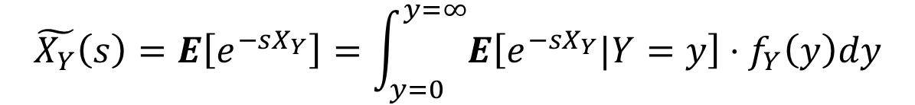
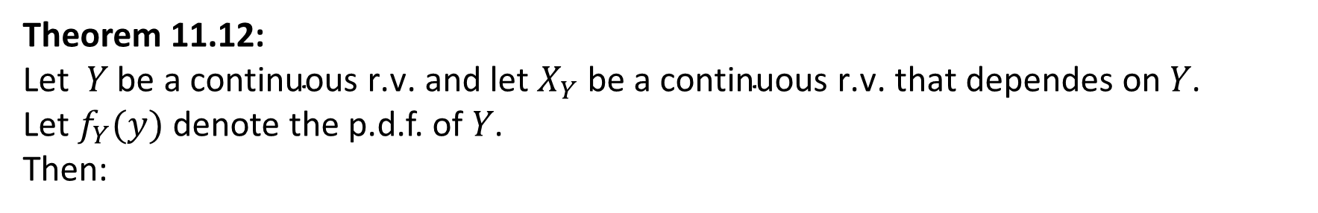
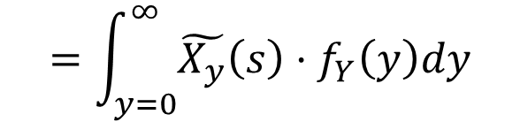
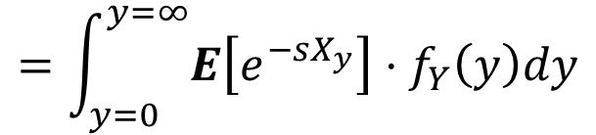
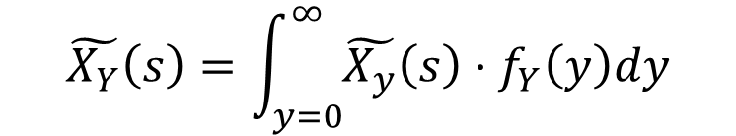
Conditioning
Theorem 11.12:
$\text{Let}$ $Y \text{be} \text{a} \text{continuous} \text{r}\text{.}\text{v}\text{. }\text{and} \text{let}{ X}_{Y} \text{be} \text{a} \text{continuous} \text{r}\text{.}\text{v}\text{. }\text{that} \text{dependes} \text{on} Y\text{.}$
Let $f_{Y}(y)$ denote the p.d.f. of $Y\text{.}$
Then:
$$\tilde{X_{Y}}\left(s\right)=\int_{y=0}^{∞}{\tilde{X_{y}}\left(s\right)⋅f_{Y}\left(y\right)dy}$$
Proof:
$$\tilde{X_{Y}}\left(s\right)=E\left[e^{−sX_{Y}}\right]=\int_{y=0}^{y=∞}{E\left[e^{−sX_{Y}}|Y=y\right]}⋅f_{Y}\left(y\right)dy$$
$$=\int_{y=0}^{y=∞}{E\left[e^{−sX_{y}}\right]}⋅f_{Y}\left(y\right)dy$$
$$=\int_{y=0}^{∞}{\tilde{X_{y}}\left(s\right)⋅f_{Y}\left(y\right)dy}$$

