Slide 1
Chapter 10 Heavy Tails: the distributions of computing
Notes:
https://www.gettyimages.co.uk/detail/illustration/retro-halloween-royalty-free-illustration/165747184

Slide 2
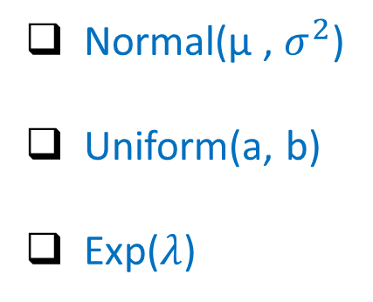
Distributions we’ve seen so far
We’ve studied several continuous distributions so far:
Normal(μ , $σ^{2}$)
Uniform(a, b)
Exp($λ$)
Q: Which of these represents CS distributions?
distribution of file sizes
distribution of IP flow durations
distribution of job CPU usage

Slide 3
Distributions we’ve seen so far
We’ve studied several continuous distributions so far:
Normal(μ , $σ^{2}$)
Uniform(a, b)
Exp($λ$)
Q: Which of these represents CS distributions?
distribution of file sizes
distribution of IP flow durations
distribution of job CPU usage
None!

Slide 4
Distributions of CS were studied in 1990’s …
It all started with a computer science question…
[Harchol-Balter & Downey, “Exploiting Process Lifetimes for CPU Load Balancing,” SIGMETRICS 1996]
CPU load balancing:
Migrate jobs from
heavily-loaded
to lightly-loaded
machines
Q: In CPU load balancing, which kind of job migration makes sense?
P: Preemptive migration
Preempt/migrate jobs after they’ve started running.
“Active process migration.”
NP: Non-preemptive only Don’t preempt job once it starts running. Only load balance newborns.
VS.

Slide 5
Distributions of CS were studied in 1990’s …
It all started with a computer science question…
[Harchol-Balter & Downey, “Exploiting Process Lifetimes for CPU Load Balancing,” SIGMETRICS 1996]
CPU load balancing:
Migrate jobs from
heavily-loaded
to lightly-loaded
machines
Q: In CPU load balancing, which kind of job migration makes sense?
Why is NP
preferred?
P: Preemptive migration
Preempt/migrate jobs after they’ve started running.
“Active process migration.”
NP: Non-preemptive only Don’t preempt job once it starts running. Only load balance newborns.
VS.

Slide 6
Distributions of CS were studied in 1990’s …
It all started with a computer science question…
[Harchol-Balter & Downey, “Exploiting Process Lifetimes for CPU Load Balancing,” SIGMETRICS 1996]
CPU load balancing:
Migrate jobs from
heavily-loaded
to lightly-loaded
machines
Q: In CPU load balancing, which kind of job migration makes sense?
P: Preemptive migration
Preempt/migrate jobs after they’ve started running.
“Active process migration.”
NP: Non-preemptive only Don’t preempt job once it starts running. Only load balance newborns.
NP is cheap!
VS.
P is costly!

Slide 7
To better understand how to think about this question, let’s introduce some vocabulary …
CPU load balancing:
Migrate jobs from
heavily-loaded
to lightly-loaded
machines

Slide 8
Some vocabulary
A job’s size is its total CPU requirement (a.k.a. CPU lifetime)
job
A job’s age is its total CPU usage so far
A job’s remaining size is its remaining CPU needs
remaining
size
size
age

Slide 9
Some vocabulary
A job’s size is its total CPU requirement (a.k.a. CPU lifetime)
job
A job’s age is its total CPU usage so far
A job’s remaining size is its remaining CPU needs
remaining
size
size
Q: Which of these do
we know?
age
Q: Which of these do
we NOT know?
Q: Which of these is relevant to migration?

Slide 10
Some vocabulary
A job’s size is its total CPU requirement (a.k.a. CPU lifetime)
job
A job’s age is its total CPU usage so far
A job’s remaining size is its remaining CPU needs
remaining
size
size
We only know a job’s age …
But what we need is its remaining size.
If remaining size is high,
then pays to migrate,
even if migration is costly.
If remaining size is low,
then doesn’t pay to migrate.
age

Slide 11
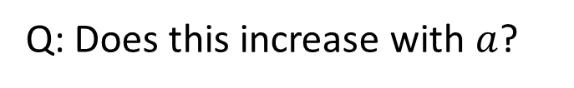



What does age tell us about remaining size?
Q: Which of these jobs likely has higher remaining size?
job A
job B
$$P\left\{Size>x+a \right| Size>a\}$$
age
30s
Q: Does this increase with $a$?
age
10s
or decrease with $a$?
Q: What would the
answer be if
$$Size∼Exp\left(μ\right)$$

Slide 12
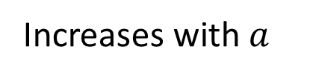
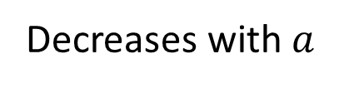
Failure rate: informally
$$P\left\{Size>x+a \right| Size>a\}$$
Increases with $a$
Decreases with $a$
Decreasing Failure Rate D.F.R.
Increasing Failure Rate I.F.R.
The longer you’ve lived, the longer you’ll live …
The longer you’ve lived, the sooner you’ll die …
Q: Examples?
Q: Examples?

Slide 13
Failure rate: informally
$$P\left\{Size>x+a \right| Size>a\}$$
Increases with $a$
Decreases with $a$
Decreasing Failure Rate D.F.R.
Increasing Failure Rate I.F.R.
The longer you’ve lived, the longer you’ll live …
The longer you’ve lived, the sooner you’ll die …
Time you’ve been friends with someone.
Time you’ve lived in your home.
Lifetime of a car.
Lifetime of a washing machine.

Slide 14

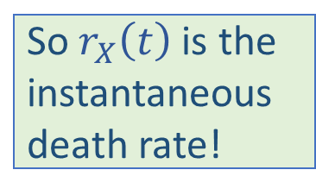
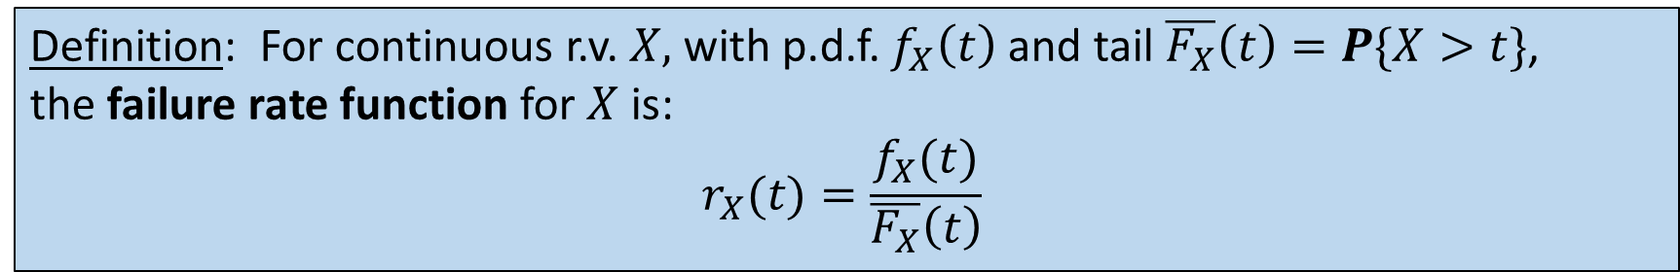

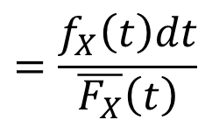

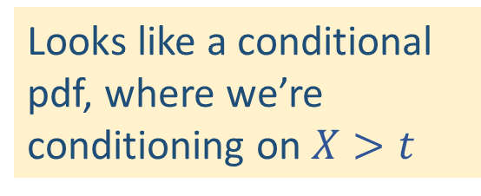
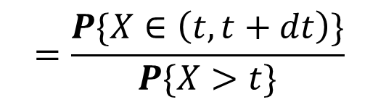
Failure rate: definition
Definition: For continuous r.v. $X,$with p.d.f. $f_{X}\left(t\right)$ and tail ${\overline{F_{X}}\left(t\right)=P\{X>t\}\text{,} }_{ }$
the failure rate function for $X$ is:
$${r_{X}(t)=\frac{f_{X}(t)}{\overline{F_{X}}\left(t\right)}}_{ }$$
Looks like a conditional pdf, where we’re conditioning on $X>t$
$${=\frac{P\{X∈\left(t,t+dt\right)\}}{P\{X>t\}}}_{ }$$
$${P\left\{X∈\left(t , t+dt\right) \right| X>t\}}_{ }$$
$${=\frac{f_{X}\left(t\right)dt}{\overline{F_{X}}\left(t\right)}}_{ }$$
So $r_{X}\left(t\right)$is the instantaneous
death rate!
$${=r_{X}(t)dt}_{ }$$
Notes:
https://www.gettyimages.co.uk/detail/illustration/retro-halloween-royalty-free-illustration/165747184

Slide 15


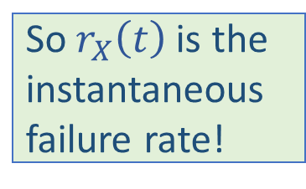

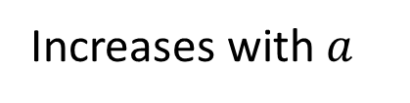
Failure rate: definition
So $r_{X}\left(t\right)$is the instantaneous
failure rate!
$${P\left\{X∈\left(t , t+dt\right) \right| X>t\}=r_{X}(t)}_{ }$$
Increases with $a$
$r_{X}\left(t\right) increases with$ $t$
$r_{X}\left(t\right) decreases with$ $t$
Decreasing Failure Rate D.F.R.
Increasing Failure Rate I.F.R.
Decreasing Failure Rate D.F.R.
Lifetime of friendship.
Time lived in home.
Lifetime of a car.
Lifetime of a washing machine.
Q: Is there a distribution with constant failure rate?

Slide 16
How does failure rate of job size affect P vs NP?
CPU load balancing:
Migrate jobs from
heavily-loaded
to lightly-loaded
machines
Q: In CPU load balancing, which kind of job migration makes sense?
P: Preemptive migration
Preempt/migrate jobs after they’ve started running.
“Active process migration.”
NP: Non-preemptive only Don’t preempt job once it starts running.
Only load balance newborns.
VS.
If Job Size (CPU reqt.) has DFR
If Job Size (CPU reqt.) has IFR or CFR

Slide 17
So what is the distribution of job size?
Results of measurements of millions of jobs [Sigmetrics 1996]
Q: What distribution
is this?
Looks like Exponential, but NOT!

Slide 18
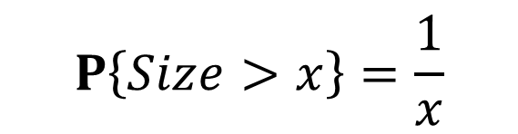

Let’s replot on a log-log scale
$$P\left\{Size>x\right\}=\frac{1}{x}$$
$$(x≥1)$$

Slide 19




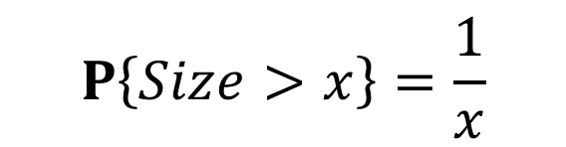




Properties of the job size distribution
$$P\left\{Size>x\right\}=\frac{1}{x}$$
where
$$x≥1$$
Q: is this a valid distribution?
$$\overline{F_{X}}(x)=x^{−1}$$
$$F_{X}\left(x\right)=1 −x^{−1}$$
$$f_{X}(x)=x^{−2}$$
$$\int_{1}^{∞}{f_{X}\left(x\right)dx }$$
$$=\int_{1}^{∞}{x^{−2}dx}$$
$$=1$$

Slide 20
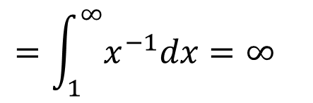

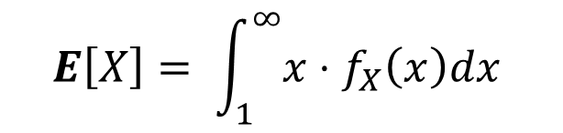
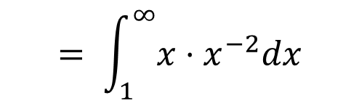
Properties of the job size distribution
$$P\left\{Size>x\right\}=\frac{1}{x}$$
where
$$x≥1$$
Q: What is the mean of this distribution?
$$f_{X}(x)=x^{−2}$$
$$E\left[X\right]= \int_{1}^{∞}{{x⋅f}_{X}\left(x\right)dx }$$
$$= \int_{1}^{∞}{{x⋅x}^{−2}dx}$$
$$=\int_{1}^{∞}{x^{−1}dx=∞ }$$
All moments
are infinite!

Slide 21

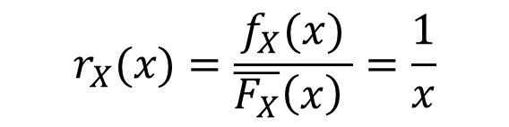
Properties of the job size distribution
$$P\left\{Size>x\right\}=\frac{1}{x}$$
where
$$x≥1$$
Q: What is the failure rate?
$$f_{X}(x)=x^{−2}$$
$$\overline{F_{X}}(x)=x^{−1}$$
$$r_{X}(x)=\frac{f_{X}(x)}{\overline{F_{X}}\left(x\right) }=\frac{1}{x}$$
D.F.R.

Slide 22



Properties of the job size distribution
$$P\left\{Size>x\right\}=\frac{1}{x}$$
where
$$x≥1$$
Q: Doubling property?
$$=\frac{\frac{1}{2a}}{\frac{1}{a}}$$
$$=\frac{1}{2}$$
$$P\left\{X>2a \right| X>a\}$$
Job of age $a$will make it to age 2$a$with probability half.

Slide 23
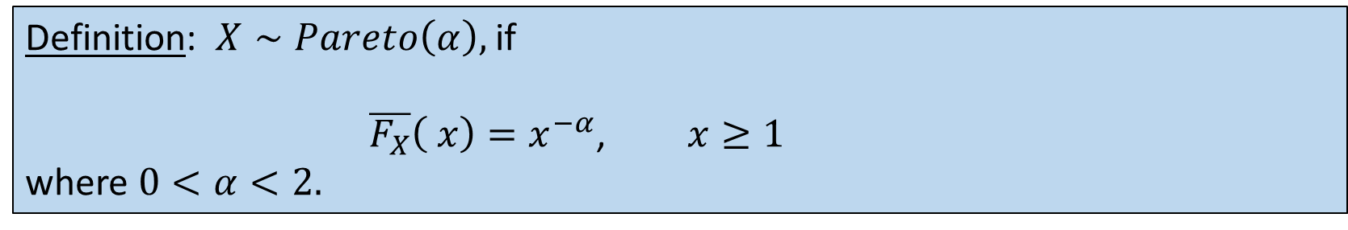

Pareto Distribution
Definition: $X∼Pareto\left(α\right),$if
$\overline{F_{X}}\left( x\right)=x_{ }^{−α}$, $x≥1$
where $0<α<2.$
Pareto was an economist in 1900.
Q: What is the distiribution of
UNIX job sizes from 1996?
A: $Pareto\left(α=1\right)$

Slide 24
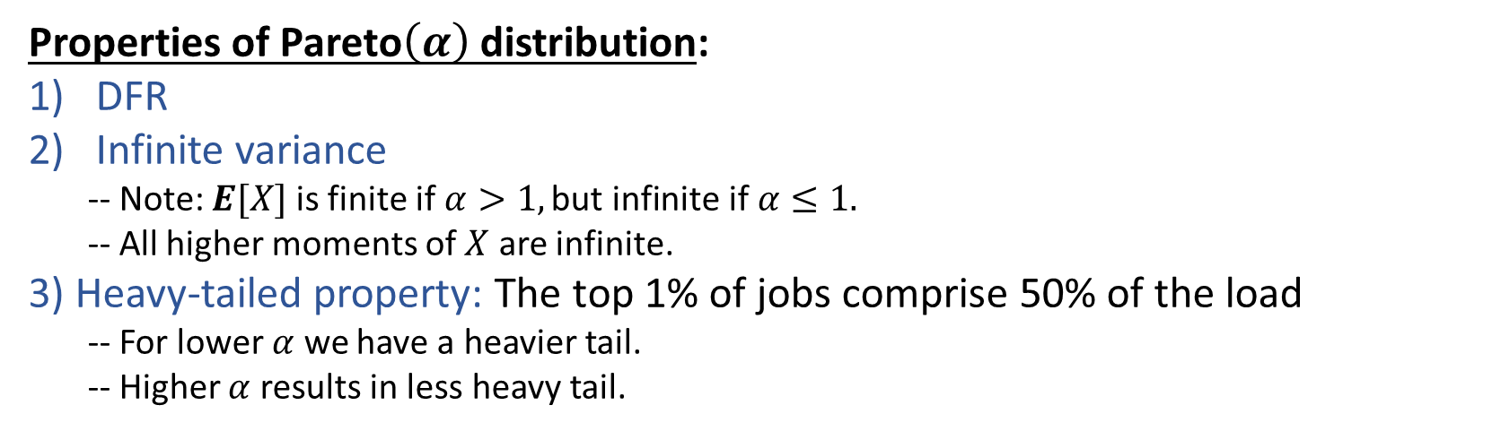
Pareto Distribution
Definition: $X∼Pareto\left(α\right),$if
$\overline{F_{X}}\left( x\right)=x_{ }^{−α}$, $x≥1$
where $0<α<2.$
Pareto was an economist in 1900.
Properties of Pareto$\left(α\right)$distribution:
DFR
Infinite variance
-- Note: $E[X]$ is finite if $α>1,\text{but} \text{infinite} \text{if} α≤1.$
-- All higher moments of $X$ are infinite.
3) Heavy-tailed property: The top 1% of jobs comprise 50% of the load
-- For lower $α$ we have a heavier tail.
-- Higher $α$ results in less heavy tail.
Q: Where do heavy tails come up in economics?

Slide 25
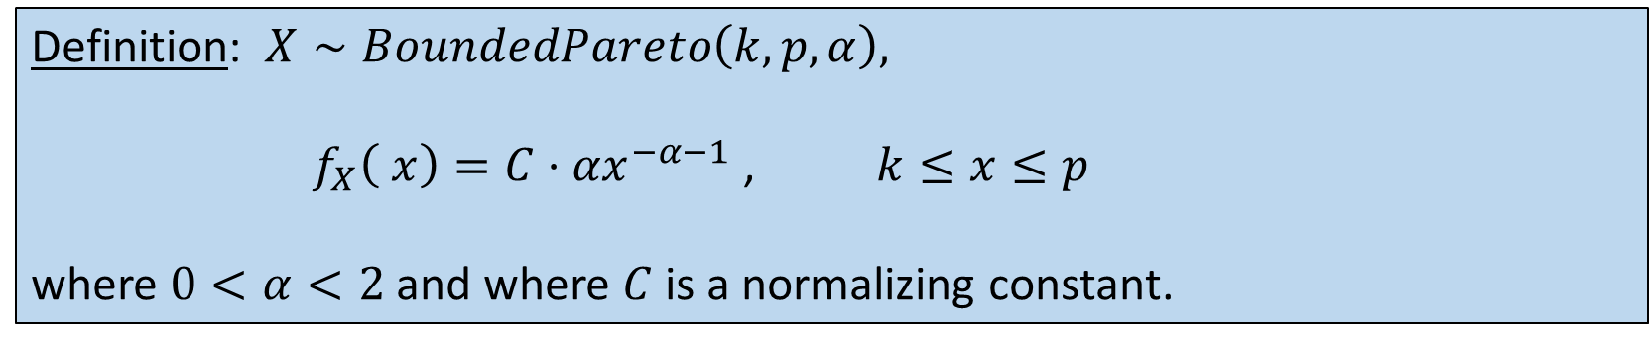
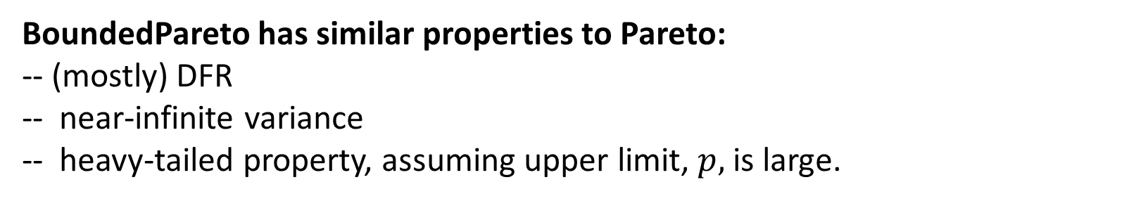
Bounded-Pareto Distribution
Empirical distributions are always bounded.
The Bounded-Pareto distribution has a Pareto shape but is finite.
lower
limit
upper
limit
Definition: $X∼BoundedPareto\left(k, p, α\right),$
$f_{X}\left( x\right)={C⋅αx}_{ }^{−α−1}$ , $k≤x≤p$
where $0<α<2$ and where $C$ is a normalizing constant.
BoundedPareto has similar properties to Pareto:
-- (mostly) DFR
-- near-infinite variance
-- heavy-tailed property, assuming upper limit, $p,$ is large.

Slide 26
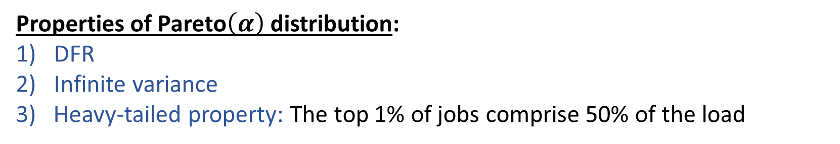
What does all this mean for CPU load balancing?
Properties of Pareto$\left(α\right)$distribution:
DFR
Infinite variance
3) Heavy-tailed property: The top 1% of jobs comprise 50% of the load
DFR implies:
Older jobs have higher remaining sizes
Pays to migrate older jobs
Heavy-tailed property implies:
Can get significant load balancing benefit from only migrating 1% of jobs

Slide 27
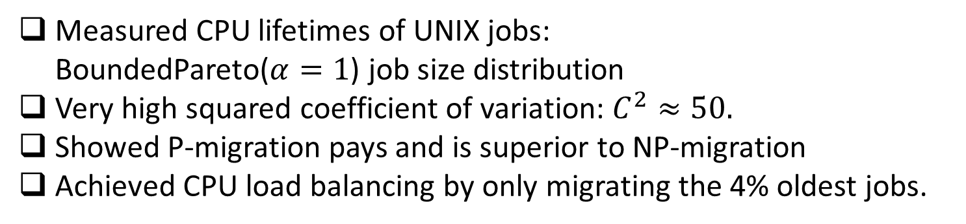
What does all this mean for CPU load balancing?
[Harchol-Balter, Downey “Exploiting process lifetime distributions for CPU load balancing.” SIGMETRICS 1996 Best Paper.
Measured CPU lifetimes of UNIX jobs:
BoundedPareto($α=1$) job size distribution
Very high squared coefficient of variation: $C^{2}≈50.$
Showed P-migration pays and is superior to NP-migration
Achieved CPU load balancing by only migrating the 4% oldest jobs.

Slide 28
What do jobs look like today?
2020 study of jobs at Google run in Google Borg scheduler:
[Tirmazi et al., “Borg: The Next Generation,” USENIX 2020.]
# CPUs
CPU-hours
time
# MB
MB-hours

Slide 29

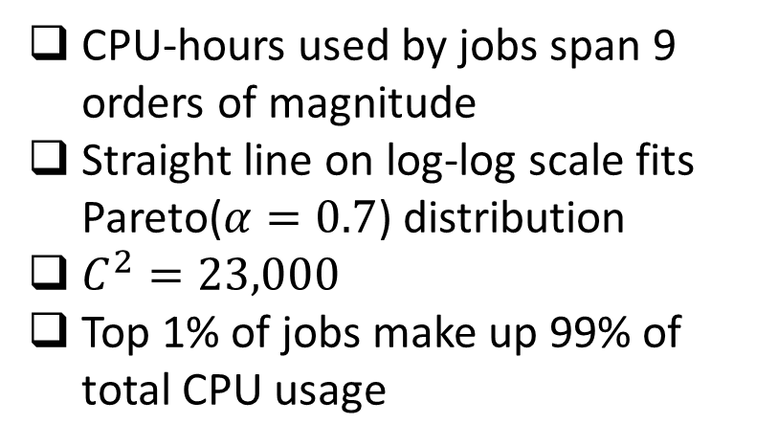

Compute usage today
2020 study of jobs at Google run in Google Borg scheduler:
$$P⁡\{\text{CPU}\text{−}\text{hours}>x\}$$
CPU-hours used by jobs span 9 orders of magnitude
Straight line on log-log scale fits Pareto($α=0.7$) distribution
$C^{2}=23,000$
Top 1% of jobs make up 99% of total CPU usage
$$x$$
* For privacy reasons, all numbers shown are
normalized by unknown constant.

Slide 30



Memory usage today
2020 study of jobs at Google run in Google Borg scheduler:
MB-hours used by jobs span 10 orders of magnitude
Straight line on log-log scale fits Pareto($α=0.7$) distribution
$C^{2}=43,000$
Top 1% of jobs make up >99% of total CPU usage
$$P⁡\{\text{MB}\text{−}\text{hours}>x\}$$
$$x$$
* For privacy reasons, all numbers shown are
normalized by unknown constant.

Slide 31
Pareto distributions are everywhere!
Job compute usage
Job memory usage
Web file sizes
IP flow durations
Wireless session times
Phone call durations
National wealth
Damage due to earthquakes
Damage due to forest fires
The question is WHY?

