Slide 1
Chapter 1
Some Mathematical Basics
Notes:
https://www.gettyimages.co.uk/detail/photo/little-piggy-banks-on-ascending-stacks-of-coins-royalty-free-image/1072593728
https://www.gettyimages.co.uk/detail/illustration/tall-ice-cream-cone-royalty-free-illustration/472288463?phrase=tall+ice+cream+cone&adppopup=true

Slide 2
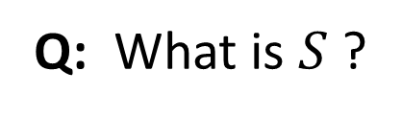
Review of Simple Series
$$S=1+x+x^{2}+x^{3}+⋯+x^{n}$$
Q: What is $S$ ?

Slide 3



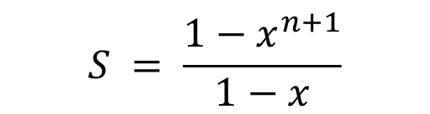

Review of Simple Series
$$S=1+x+x^{2}+x^{3}+⋯+x^{n}$$
$$\left(1−x\right)S$$
$$= 1+x+x^{2}+x^{3}+⋯+x^{n}$$
$$−x−x^{2}−x^{3}+⋯−x^{n}−x^{n+1}$$
$$= 1−x^{n+1}$$
$$S = \frac{1−x^{n+1}}{1−x}$$
$$\text{(}\text{assuming} x≠1\text{)}$$

Slide 4
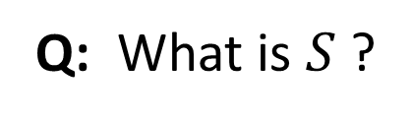
Review of Simple Series
$$S=1+x+x^{2}+x^{3}+⋯, where \left|x\right|<1$$
Q: What is $S$ ?

Slide 5
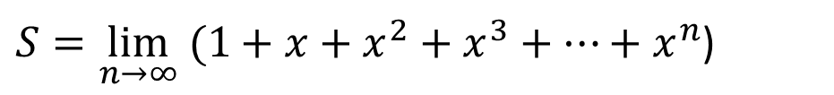


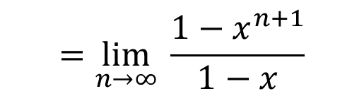
Review of Simple Series
$$S=1+x+x^{2}+x^{3}+⋯, where \left|x\right|<1$$
$S=\lim_{n→∞} (1+x+x^{2}+x^{3}+⋯+x^{n}$)
$$=\lim_{n→∞} \frac{1−x^{n+1}}{1−x}$$
$$= \frac{1}{1−x}$$
(because $\left|x\right|<1$)

Slide 6
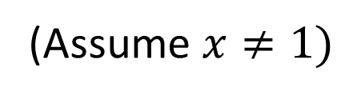
Review of Simple Series
$$S=1+2x+{3x}^{2}+{4x}^{3}+⋯+{nx}^{n−1}$$
Q: What is $S$ ?
(Assume $x≠1)$

Slide 7

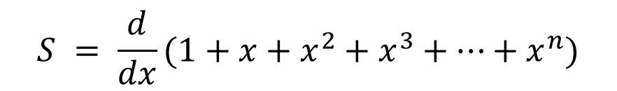
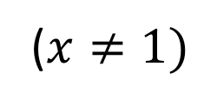
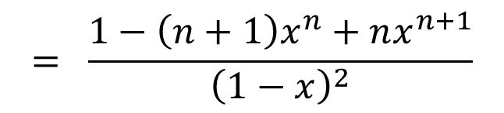
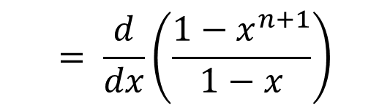
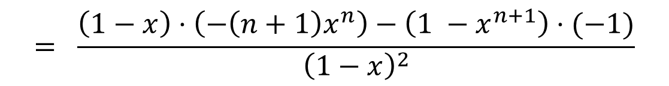
Review of Simple Series
$$S=1+2x+{3x}^{2}+{4x}^{3}+⋯+{nx}^{n−1}$$
($x≠1)$
$$S = \frac{d}{dx}(1+x+x^{2}+x^{3}+⋯+x^{n})$$
$$\frac{d}{dx}\frac{f(x)}{g(x)}=\frac{g\left(x\right)⋅\frac{d}{dx}f\left(x\right)−f\left(x\right)⋅\frac{d}{dx}g\left(x\right)}{g{\left(x\right)}^{2}}$$
$$= \frac{d}{dx}\left(\frac{1−x^{n+1}}{1−x}\right)$$
$$= \frac{\left(1−x\right)⋅\left(−\left(n+1\right)x^{n}\right)−\left(1 −x^{n+1}\right)⋅(−1)}{{\left(1−x\right)}^{2}}$$
$$= \frac{1−\left(n+1\right)x^{n}+nx^{n+1}}{{\left(1−x\right)}^{2}}$$

Slide 8
Review of Simple Series
$$S=1+2x+{3x}^{2}+{4x}^{3}+⋯, where \left|x\right|<1$$
Q: What is $S$ ?

Slide 9
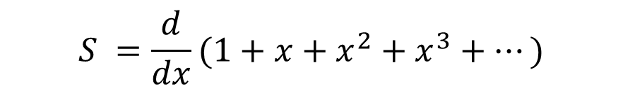

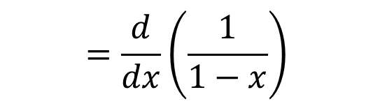
Review of Simple Series
$$S=1+2x+{3x}^{2}+{4x}^{3}+⋯, where \left|x\right|<1$$
$$S =\frac{d}{dx}(1+x+x^{2}+x^{3}+⋯)$$
$$=\frac{d}{dx}\left(\frac{1}{1−x}\right)$$
$$= \frac{1}{{\left(1−x\right)}^{2}}$$
9

Slide 10
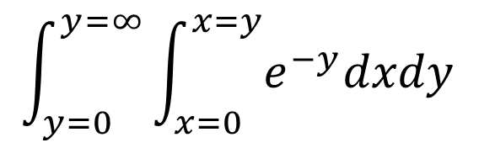
Review of Double Integrals
$$\int_{y=0}^{y=∞}{\int_{x=0}^{x=y}{e^{−y}dxdy }}$$
Q: Derive:

Slide 11
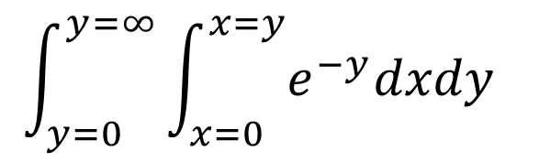


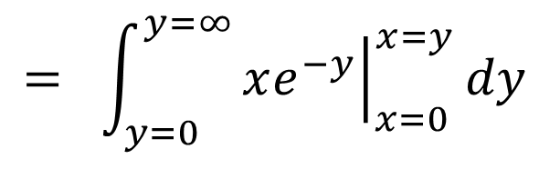
Review of Double Integrals
$$\int_{y=0}^{y=∞}{\int_{x=0}^{x=y}{e^{−y}dxdy }}$$
Q: Derive:
$$\int_{y=0}^{y=∞}{\int_{x=0}^{x=y}{e^{−y}dxdy }}$$
$$= {\int_{y=0}^{y=∞}{{\left.xe^{−y}\right|}_{x=0}^{x=y}dy}}_{ }^{ }$$
Do inner
integral
first
$$= {\int_{y=0}^{y=∞}{ye^{−y}dy}}_{ }^{ }$$
$$= 1_{ }^{ }$$
(via integration by parts)

Slide 12

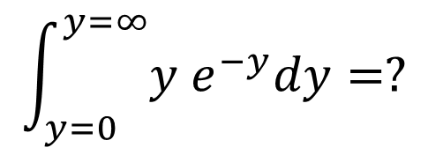




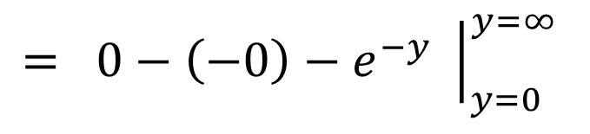
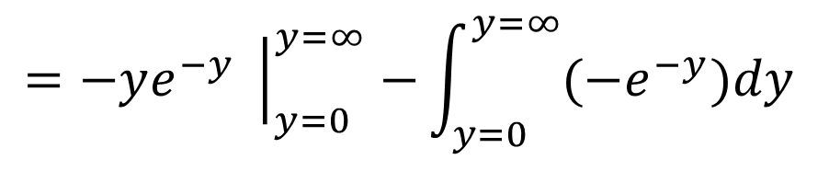

Integration by parts
$$\int_{y=0}^{y=∞}{y e^{−y}dy=?}$$
$$\int_{a}^{b}{udv=uv{\left. \right|}_{y=a}^{y=b}−\int_{a}^{b}{vdu}}$$
$$\int_{y=0}^{y=∞}{y e^{−y}dy}$$
$$=−ye^{−y}{\left. \right|}_{y=0}^{y=∞}{−\int_{y=0}^{y=∞}{{(−e}^{−y})dy}}_{ }^{ }$$
$$u$$
$$dv$$
$$= {0−\left(−0\right)−e^{−y}{\left. \right|}_{y=0}^{y=∞}}_{ }^{ }$$
$$= {0−\left(0−1\right)}_{ }^{ }$$
$$= 1_{ }^{ }$$

Slide 13
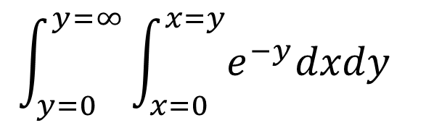
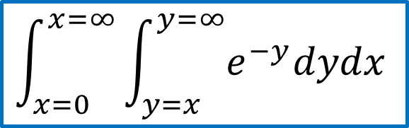
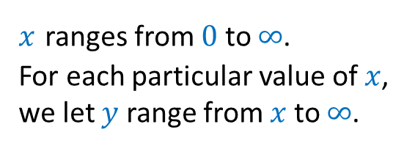
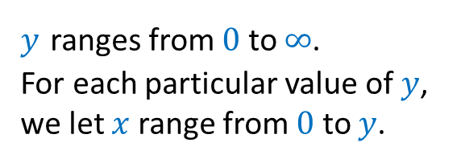
Review of Double Integrals
$$\int_{y=0}^{y=∞}{\int_{x=0}^{x=y}{e^{−y}dxdy }}$$
Q: Derive:
by first reversing the order of integration
Original integration space
Equivalent integration space
$$\int_{x=0}^{x=∞}{\int_{y=x}^{y=∞}{e^{−y}dydx }}$$
$y$ ranges from $0$ to $∞$.
For each particular value of $y$,
we let $x$ range from $0$ to $y$.
$x$ ranges from $0$ to $∞$.
For each particular value of $x$,
we let $y$ range from $x$ to $∞$.

Slide 14
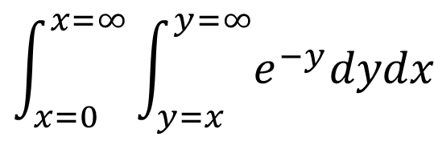


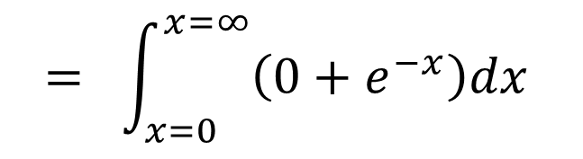
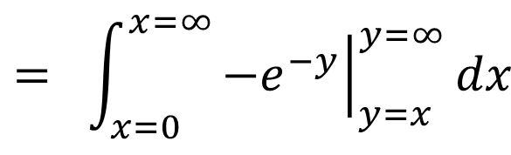
Review of Double Integrals
$$\int_{y=0}^{y=∞}{\int_{x=0}^{x=y}{e^{−y}dxdy }}$$
Q: Derive:
by first reversing the order of integration
$$\int_{x=0}^{x=∞}{\int_{y=x}^{y=∞}{e^{−y}dydx }}$$
$$= {\int_{x=0}^{x=∞}{{\left.−e^{−y}\right|}_{y=x}^{y=∞}dx}}_{ }^{ }$$
$$= {\int_{x=0}^{x=∞}{\left(0+e^{−x}\right)dx}}_{ }^{ }$$
$${\left.=−e^{−x}\right|}_{x=0}^{x=∞}$$
$$= 1_{ }^{ }$$

Slide 15

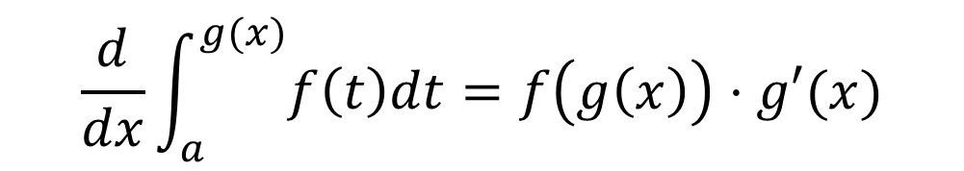
Fundamental Theorem of Calculus (FTC)
Theorem 1.8: (FTC) Let $f(t)$ be a continuous function defined on the interval $[a,b]$.
Then, for any $x$, where $a<x<b$,
$$\frac{d}{dx}\int_{a}^{x}{f\left(t\right)dt=f(x)}$$
Furthermore, for any differentiable function $g\left(x\right)$,
$$\frac{d}{dx}\int_{a}^{g(x)}{f\left(t\right)dt=f\left(g\left(x\right)\right)⋅g′(x)}$$

Slide 16

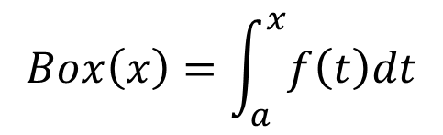
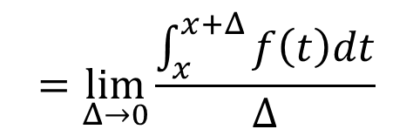
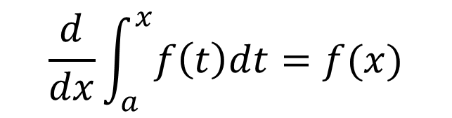
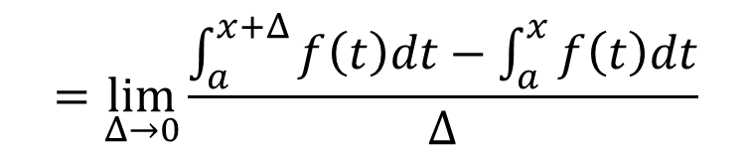
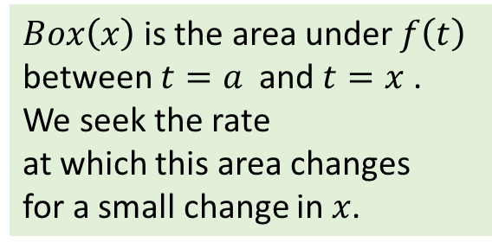

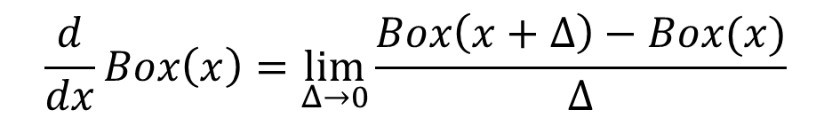

Fundamental Theorem of Calculus (FTC)
$$\frac{d}{dx}\int_{a}^{x}{f\left(t\right)dt=f(x)}$$
$Box\left(x\right)$is the area under $f\left(t\right)$
between $t=a$and $t=x$ .
We seek the rate
at which this area changes
for a small change in $x$.
Intuition:
$$Box\left(x\right)=\int_{a}^{x}{f\left(t\right)dt}$$
Let
$$\frac{d}{dx}Box\left(x\right)=\lim_{Δ→0}\frac{Box\left(x+Δ\right)−Box(x)}{Δ}$$
Since
$f\left(x\right)≈f(x+Δ)$
$$=\lim_{Δ→0}\frac{\int_{a}^{x+Δ}{f\left(t\right)dt}−\int_{a}^{x}{f\left(t\right)dt}}{Δ}$$
$$=\lim_{Δ→0}\frac{\int_{x}^{x+Δ}{f\left(t\right)dt}}{Δ}$$
$$≈\lim_{Δ→0}\frac{f\left(x\right)⋅Δ}{Δ}$$
$$=f(x)$$

Slide 17
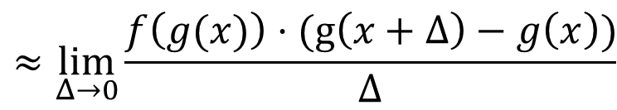
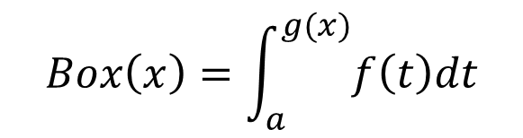
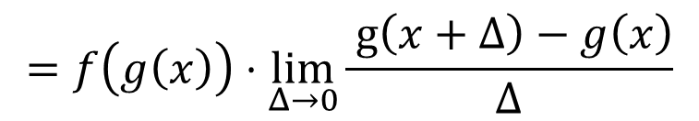
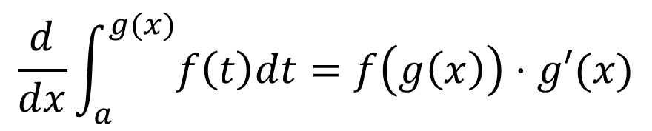

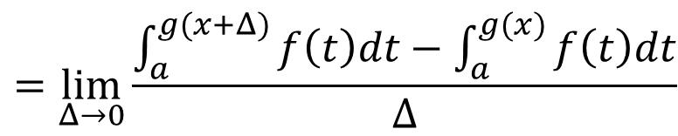
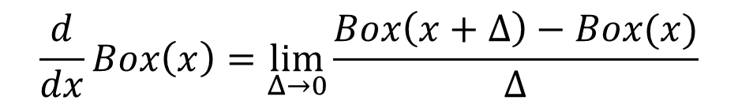

Fundamental Theorem of Calculus (FTC)
$$\frac{d}{dx}\int_{a}^{g(x)}{f\left(t\right)dt=f\left(g\left(x\right)\right)⋅g′(x)}$$
$$Box\left(x\right)=\int_{a}^{g(x)}{f\left(t\right)dt}$$
$$=\lim_{Δ→0}\frac{\int_{a}^{g(x+Δ)}{f\left(t\right)dt}−\int_{a}^{g(x)}{f\left(t\right)dt}}{Δ}$$
$$\frac{d}{dx}Box\left(x\right)=\lim_{Δ→0}\frac{Box\left(x+Δ\right)−Box(x)}{Δ}$$
$$=\lim_{Δ→0}\frac{\int_{g(x)}^{g(x+Δ)}{f\left(t\right)dt}}{Δ}$$
$$≈\lim_{Δ→0}\frac{f\left(g(x)\right)⋅(g\left(x+Δ\right)−g\left(x\right))}{Δ}$$
$$=f\left(g\left(x\right)\right)⋅\lim_{Δ→0}\frac{ g\left(x+Δ\right)−g\left(x\right)}{Δ}$$
$$=f\left(g\left(x\right)\right)⋅g′(x)$$

Slide 18


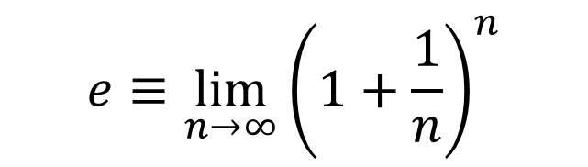

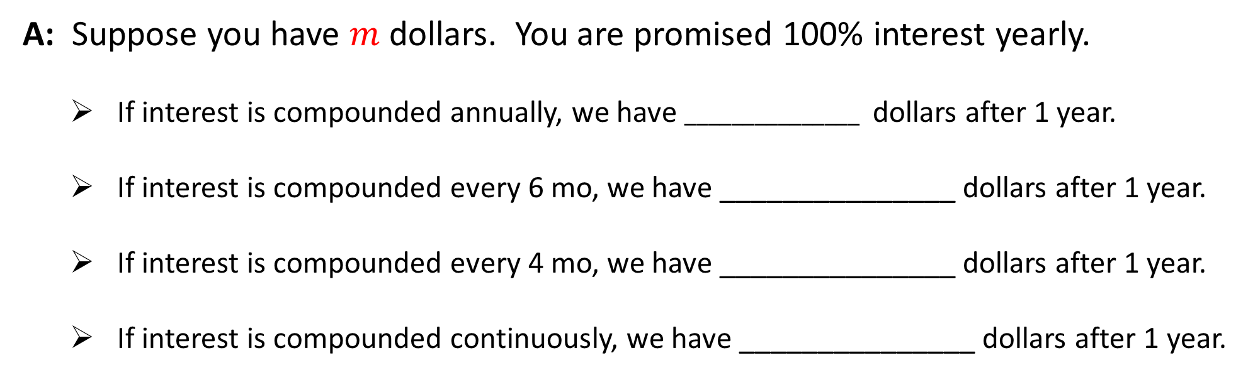
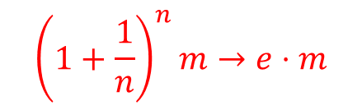
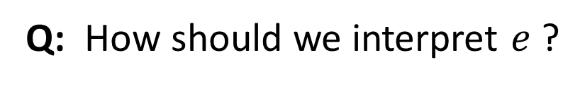
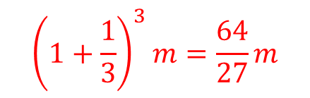

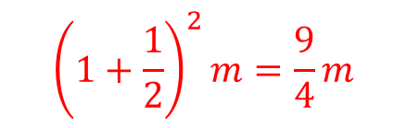
Understanding $e$
$$e≈2.7183$$
$$e≡\lim_{n→∞}{\left(1+\frac{1}{n}\right)}^{n}$$
Q: How should we interpret $e$ ?
A: Suppose you have $m$ dollars. You are promised 100% interest yearly.
  If interest is compounded annually, we have $_______________$ dollars after 1 year.
  If interest is compounded every 6 mo, we have _______________ dollars after 1 year.
  If interest is compounded every 4 mo, we have _______________ dollars after 1 year.
  If interest is compounded continuously, we have _______________ dollars after 1 year.
$$2m$$
$${\left(1+\frac{1}{2}\right)}^{2}m=\frac{9}{4}m$$
$${\left(1+\frac{1}{3}\right)}^{3}m=\frac{64}{27}m$$
$${\left(1+\frac{1}{n}\right)}^{n}m→e⋅m$$

Slide 19








Understanding $e^{x}$
$$\lim_{n→∞}{\left(1+\frac{x}{n}\right)}^{n}=e^{x}$$
Claim:
Proof:
Let $a=\frac{n}{x}$.
As $n→∞$, we have $a→∞.$
$$=\lim_{a→∞}{\left({\left(1+\frac{1}{a}\right)}^{a}\right)}^{x}$$
$$\lim_{n→∞}{\left(1+\frac{x}{n}\right)}^{n}$$
$$=\lim_{a→∞}{\left(1+\frac{1}{a}\right)}^{ax}$$
$$=e^{x}$$

Slide 20







Review of Taylor/Maclaurin series
Let $0<x<1$.
Q: Which is bigger, $1+x$ or $e^{x}$?
Q: Which is bigger, $1−x$ or $e^{−x}$?
A: Recall, we can express $f\left(x\right)$via its Taylor series expansion around $x=0:$
$$f\left(x\right)=f\left(0\right)+\frac{f′(0)}{1!}x+\frac{f′′(0)}{2!}x^{2}+\frac{f′′′(0)}{3!}x^{3}+⋯$$
$$e^{x}=1+\frac{x}{1!}+\frac{x^{2}}{2!}+\frac{x^{3}}{3!}+\frac{x^{4}}{4!}⋯$$
$$e^{x}>1+x$$
$$e^{−x}=1−\frac{x}{1!}+\frac{x^{2}}{2!}−\frac{x^{3}}{3!}+\frac{x^{4}}{4!}−⋯$$
$$e^{−x}>1−x$$

Slide 21



Harmonic Number
Defn: The $n$th harmonic number is denoted by $H_{n}$, where
$$H_{n}=1+\frac{1}{2}+\frac{1}{3}+\frac{1}{4}+⋯+\frac{1}{n}$$
Harmonic Number
Theorem:
We will prove
this next…
$$\ln\left(n+1\right)<H_{n}<1+ln⁡(n)$$
Cor:
$$H_{n}≈\ln\left(n\right)\text{for} \text{high} n$$
$${\lim_{n→∞}{H_{n}}}_{ }=1+\frac{1}{2}+\frac{1}{3}+⋯=∞$$

Slide 22








Proof of Harmonic Number Theorem
Area under
red curve
Area in blue
rectangles
$$<$$
$$\int_{1}^{n+1}{\frac{1}{x}dx=\ln{(n+1)}}$$
$$1+\frac{1}{2}+\frac{1}{3}+⋯+\frac{1}{n}=H_{n}$$
$$<$$
Area in yellow
rectangles
Area under red curve
up to yellow end
$$<$$
$$\frac{1}{2}+\frac{1}{3}+⋯+\frac{1}{n}=H_{n}−1$$
$$\int_{1}^{n}{\frac{1}{x}dx=\ln{(n)}}$$
$$<$$

Slide 23
Counting: Combinations versus Permutations
Suppose Baskin-Robins has $n$ flavors of ice cream. Your cone has $k<n$ scoops.
How many different cones can you make if each flavor can only be used once?
Permutations
Q: Answer the question if the order of the flavors matters.
Combinations
Q: Answer the question if the order of the flavors doesn’t matter.

Slide 24



Counting: Combinations versus Permutations
Suppose Baskin-Robins has $n$ flavors of ice cream. Your cone has $k<n$ scoops.
How many different cones can you make if each flavor can only be used once?
Permutations
Q: Answer the question if the order of the flavors matters.
$$n \left(n−1\right)\left(n−2\right)⋯\left(n−\left(k−1\right)\right)=\frac{n!}{\left(n−k\right)!}$$
Combinations
Q: Answer the question if the order of the flavors doesn’t matter.
$$ABC=ACB=BCA=BAC=CBA=CAB$$
so divide #permutations by $k!$
$$\frac{n!}{\left(n−k\right)!k!}= \left(\begin{matrix}n \\ k\end{matrix}\right)="n choose k"$$

Slide 25

Sums of combinations
Q: Evaluate:
$S_{1}=\left(\begin{matrix}n \\ 0\end{matrix}\right) +$ $\left(\begin{matrix}n \\ 1\end{matrix}\right) +$ $\left(\begin{matrix}n \\ 2\end{matrix}\right) + ⋯ + \left(\begin{matrix}n \\ n\end{matrix}\right)$

Slide 26



Sums of combinations
Q: Evaluate:
$S_{1}=\left(\begin{matrix}n \\ 0\end{matrix}\right) +$ $\left(\begin{matrix}n \\ 1\end{matrix}\right) +$ $\left(\begin{matrix}n \\ 2\end{matrix}\right) + ⋯ + \left(\begin{matrix}n \\ n\end{matrix}\right)$
All
subsets
of size 0
All
subsets
of size 1
All
subsets
of size 2
All
subsets
of size $n$
$S_{1}=$ total number of subsets of $n$ elements
$$=2^{n}$$
Each element is
either “in” or “out”

Slide 27

Sums of combinations
Q: Evaluate:
$S_{2}=\left(\begin{matrix}n \\ 0\end{matrix}\right)y^{n} +$ $\left(\begin{matrix}n \\ 1\end{matrix}\right)xy^{n−1} +$ $\left(\begin{matrix}n \\ 2\end{matrix}\right)x^{2}y^{n−2} + ⋯ + \left(\begin{matrix}n \\ n\end{matrix}\right)$ $x^{n}$
A: This is the binomial expansion of ${\left(x+y\right)}^{n}$

Slide 28

Sums of combinations
Q: Evaluate:
$S_{3}=\left(\begin{matrix}n \\ 0\end{matrix}\right)+$ $\left(\begin{matrix}n \\ 1\end{matrix}\right)x +$ $\left(\begin{matrix}n \\ 2\end{matrix}\right)x^{2} + ⋯ + \left(\begin{matrix}n \\ n\end{matrix}\right)$ $x^{n}$
A: This is the binomial expansion of ${\left(x+1\right)}^{n}$

Slide 29



Some useful bounds
Theorem 1.12:
${\left(\frac{n}{k}\right)}^{k}<$ $\left(\begin{matrix}n \\ k\end{matrix}\right)<{\left(\frac{ne}{k}\right)}^{k}$
See book for proof!
Theorem (Stirling):
${\sqrt{2πn}\left(\frac{n}{e}\right)}^{n}<$ $n!<e \sqrt{n}{\left(\frac{n}{e}\right)}^{n}$
Furthermore, for any differentiable function $g\left(x\right)$,
$$\frac{d}{dx}\int_{a}^{g(x)}{f\left(t\right)dt=f\left(g\left(x\right)\right)⋅g′(x)}$$

Slide 30





Asymptotic notation: big-O
Asymptotic notation is a way to summarize rate at which function $f\left(n\right)$ grows with $n.$
$O\left(g\left(n\right)\right)$ is the set of functions that grow no faster than $g(n).$
$3n, \sqrt{n}, \lg{lg \left(n\right)}∈O\left(n\right)$
w$e write$
$3n=O\left(n\right)$
$n^{2}, n\lg\left(n\right) ∉O\left(n\right)$
Defn: We say that $f\left(n\right)=O(g\left(n\right))$ , pronounced as $f\left(n\right)$ is big-O of $g\left(n\right)$,
if there exists a constant $c≥0$, s.t.,
$$\lim_{n→∞}{\frac{f(n)}{g(n) }=c}$$
Furthermore, for any differentiable function $g\left(x\right)$,
$$\frac{d}{dx}\int_{a}^{g(x)}{f\left(t\right)dt=f\left(g\left(x\right)\right)⋅g′(x)}$$

Slide 31




Asymptotic notation: little-o
$o\left(g\left(n\right)\right)$ is the set of functions that grow strictly slower than $g(n).$
2$\sqrt{n}, 15 lg{lg \left(n\right)}∈o\left(n\right)$
w$e write$
$\sqrt{n}=o\left(n\right)$
$\frac{n}{2}, n\lg{lg \left(n\right), n^{3}}∉o\left(n\right)$
Defn: We say that $f\left(n\right)=o(g\left(n\right))$ , pronounced as $f\left(n\right)$ is little-o of $g\left(n\right)$, if
$$\lim_{n→∞}{\frac{f(n)}{g(n) }=0}$$
Cor: We say that $f\left(n\right)=o(1)$ if $\lim_{n→∞}{f(n)=0.}$
Furthermore, for any differentiable function $g\left(x\right)$,
$$\frac{d}{dx}\int_{a}^{g(x)}{f\left(t\right)dt=f\left(g\left(x\right)\right)⋅g′(x)}$$

Slide 32




Asymptotic notation: big-Omega
$Ω\left(g\left(n\right)\right)$ is the set of functions that grow no slower than $g(n).$
$\frac{n}{2}, nlg n, n^{3}∈Ω\left(n\right)$
w$e write$
$n^{2}=Ω\left(n\right)$
$\sqrt{n}, 15\lg{lg \left(n\right), 25}∉Ω\left(n\right)$
Defn: We say that $f\left(n\right)=Ω(g\left(n\right))$ , pronounced as $f\left(n\right)$ is big-Omega of $g\left(n\right)$, if
$$\lim_{n→∞}{\frac{f(n)}{g(n) }>0}$$
Furthermore, for any differentiable function $g\left(x\right)$,
$$\frac{d}{dx}\int_{a}^{g(x)}{f\left(t\right)dt=f\left(g\left(x\right)\right)⋅g′(x)}$$

Slide 33




Asymptotic notation: little-omega
$ω\left(g\left(n\right)\right)$ is the set of functions that grow strictly faster than $g(n).$
$\frac{n^{2}}{2}, nlg n, n^{3}∈ω\left(n\right)$
w$e write$
$n^{2}=ω\left(n\right)$
$n, 15 \sqrt{n}, 25n∉ω\left(n\right)$
Defn: We say that $f\left(n\right)=ω(g\left(n\right))$ , pronounced as $f\left(n\right)$ is little-omega of $g\left(n\right)$, if
$$\lim_{n→∞}{\frac{f(n)}{g(n) }=∞}$$

Slide 34




Asymptotic notation: big-Theta
$Θ\left(g\left(n\right)\right)$ is the set of functions that grow at the same rate as $g(n).$
$15n, \frac{n}{2}∈Θ\left(n\right)$
w$e write$
${2n}^{ }=Θ\left(n\right)$
$nlg n, 15 \sqrt{n}, n^{2}∉Θ\left(n\right)$
Defn: We say that $f\left(n\right)=Θ(g\left(n\right))$ , pronounced as $f\left(n\right)$ is Theta of $g\left(n\right)$, if
$$f\left(n\right)=O\left(g\left(n\right)\right) \text{and} f\left(n\right)=Ω(g\left(n\right))$$
Furthermore, for any differentiable function $g\left(x\right)$,
$$\frac{d}{dx}\int_{a}^{g(x)}{f\left(t\right)dt=f\left(g\left(x\right)\right)⋅g′(x)}$$

