Slide 1
Logistic Regression Principal Component Analysis Sampling
TexPoint fonts used in EMF.
Read the TexPoint manual before you delete this box.: AAAAAAA

Slide 2
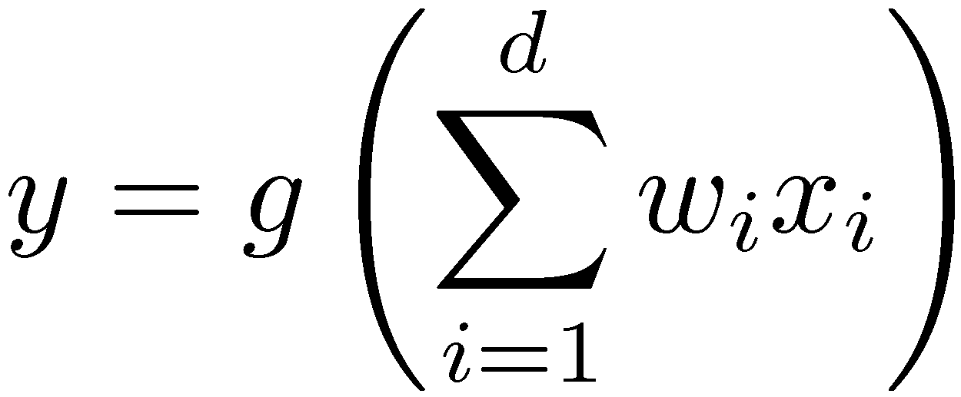
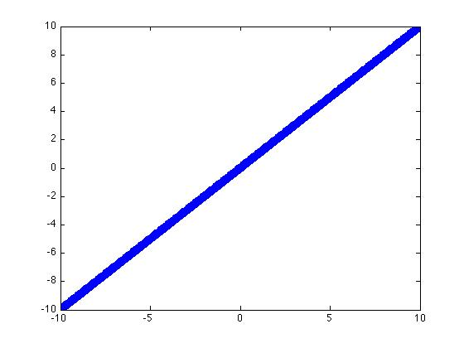
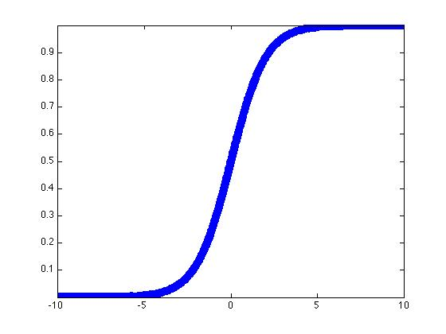
Logistic Regression:
A form of Generalized Linear Model (GLM):
Where:

Slide 3
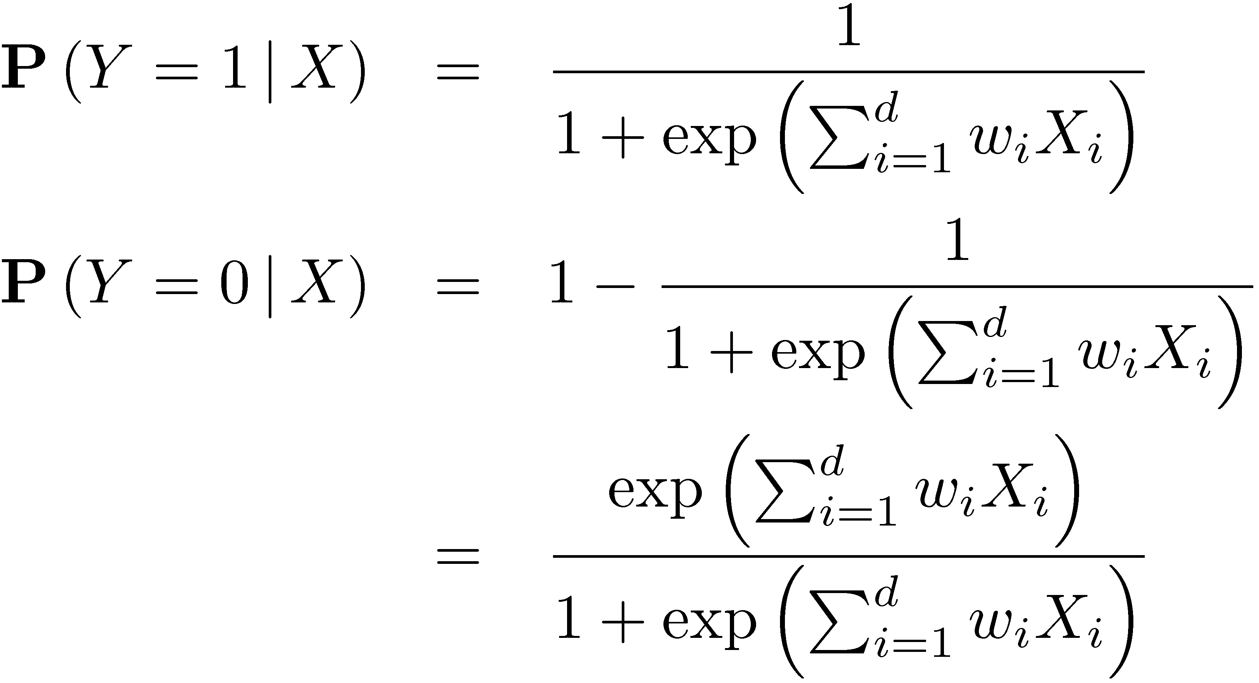
Logistic Regression Model
Classification Rule:

Slide 4
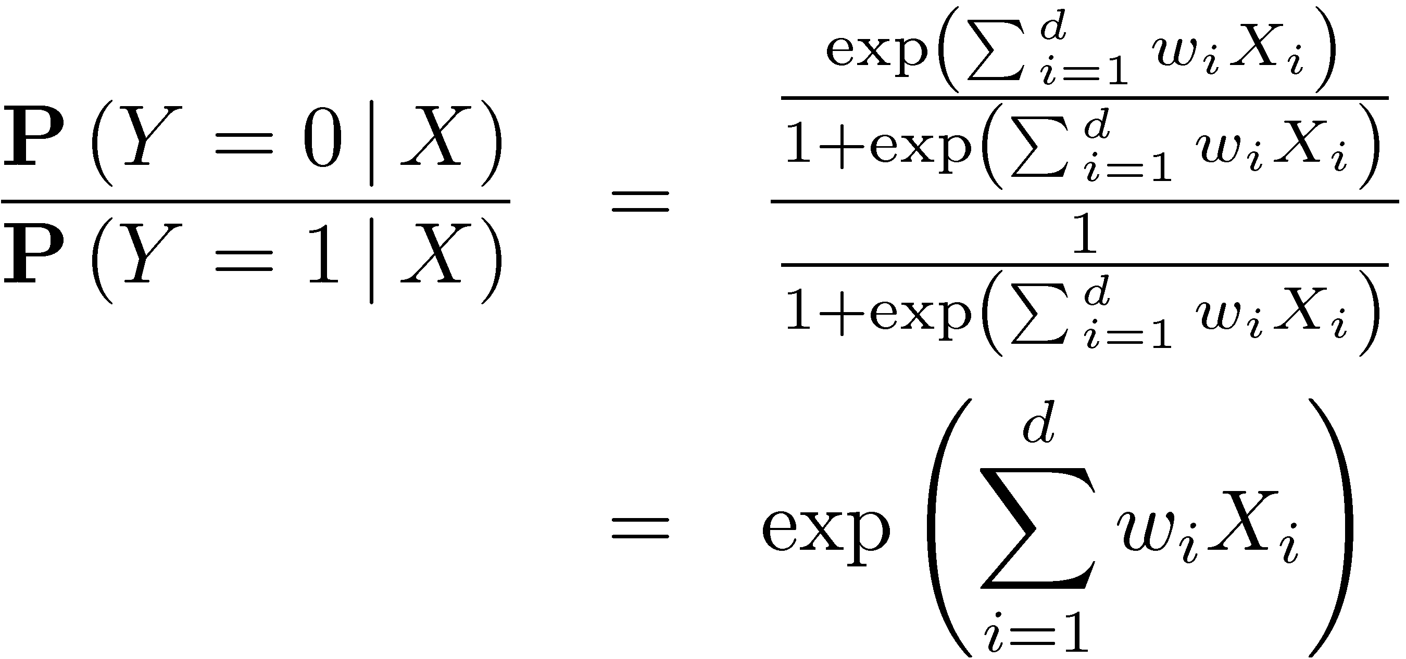
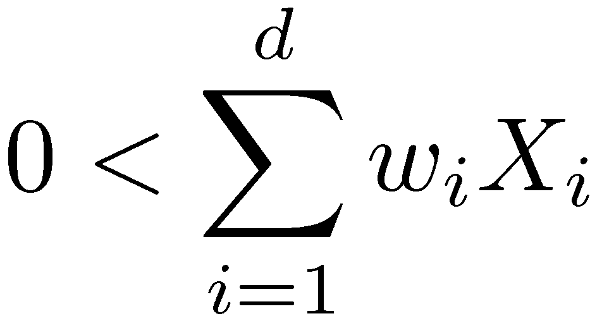
Decision Surface:
We say Y=0 when:
Therefore:
Which leads to:

Slide 5
How do we choose weights?
We want:
Writing the log-likelihood:
Rearranging terms:
Simplifying:
Take the derivative:

Slide 6
Minimizing the derivative:
Derivative:
Can’t be analytically solved so we use gradient ascent:
… or you could use:
Matlab

Slide 7
Gaussian Naïve Bayes
Class Label:
Y
Features:
X₁
X₂
X₃
General Gaussian Naï ve Bayes equation:
We can impose different assumptions about the class variances.
Mathematica Demo

Slide 9
Relation between GNB and LR
Prediction Probability from the (G)NB model
Factoring the model we get:

Slide 10
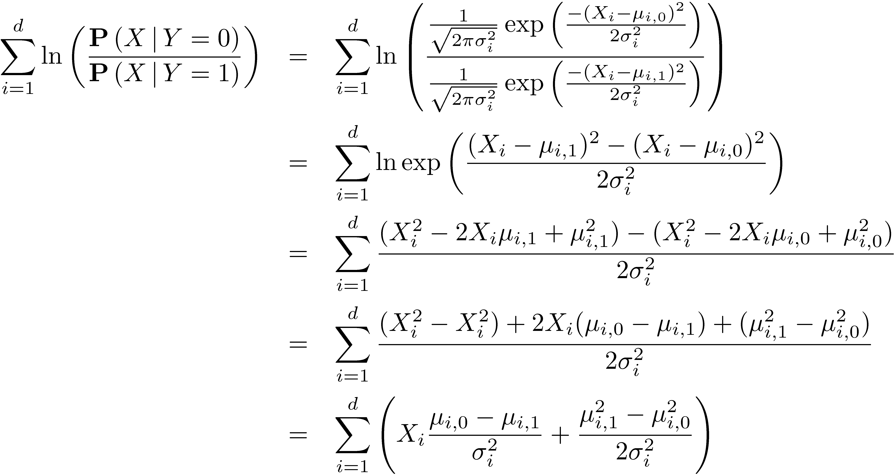
Further Expansion
More Algebra
Assume variance does not
depend on class label.

Slide 11
Finally!
We have shown that this:
Can be written like this:
Which is the same form as:

Slide 12
Big Question?
Can I compute the LR weights by learning a NB classifier?

Slide 13
Singular Value Decomposition Principal Component Analysis

Slide 14
The main idea (in 2 Dimensions)
Suppose I have the following data:
Uncorrelated Data
Z₂
Z₁
X₂
Z₁
Z₂
X₁
Anomaly Detection
Z₁
“High dimensional correlated data”
Low dimensional Approximation

Slide 15
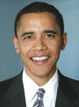
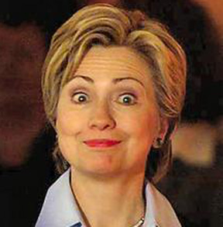
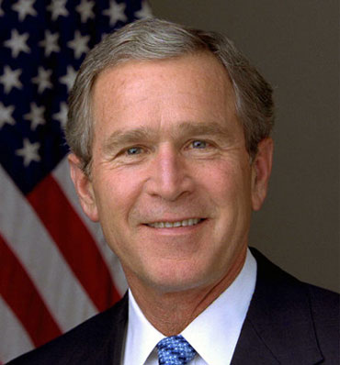
Your face as a Linear Combination
Suppose I wanted to represent your face as a weighted mixture of faces:
Could I accurately represent myself as a combination of these faces?
What are the “optimal” faces to represent my face as?
≈
z₁
+ z₂
+ z₃

Slide 16
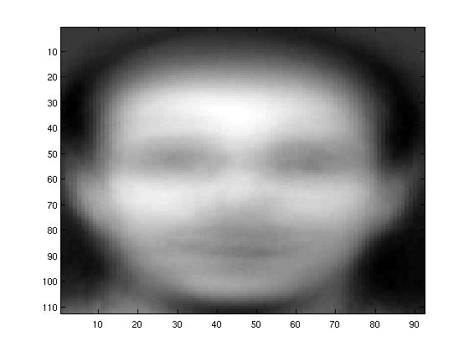
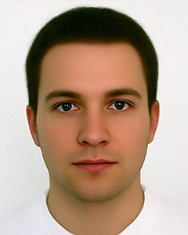
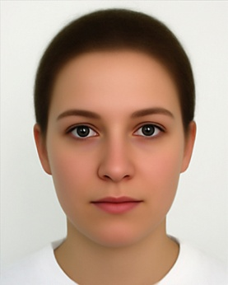
Graphical Intuition
Subtract the average face:
Example Average Faces:
http://www.uni-regensburg.de/Fakultaeten/phil_Fak_II/Psychologie/Psy_II/beautycheck/english/index.htm

Slide 17
Now I express my face as:
Second Eigenface
Second Eigenvector
≈
+ z₁
+ z₂
+ z₃
First Eigenface
First Eigenvector

Slide 18
The Math behind SVD
The SVD “Function”:
Matrix decomposition
U
S
V^{T}
X₁
X₂
X₃
=
X₄
When you call svd in matlab:
%> [u,s,v] = svds(X, 100);
Then:
X ≈ u * s * v’
X₅
X₆
Don’t Forget

Slide 19
Matlab Example:
Why don’t I subtract the mean?
z = randn(1000, 2); M = [1, 2; 3, 1]; x = z * M;
subplot(1,2,1); plot(z(:,1), z(:,2), '.'); axis('equal')
subplot(1,2,2); plot(x(:,1), x(:,2), '.'); axis('equal')
[u,d,v] = svds(M, 2);
vtrans = sqrt(d) * v';
line([0, vtrans(1,1)], [0, vtrans(1,2)], 'Color','r', 'Linewidth', 5);
line([0, vtrans(2,1)], [0, vtrans(2,2)], 'Color','g', 'Linewidth', 5);

Slide 20
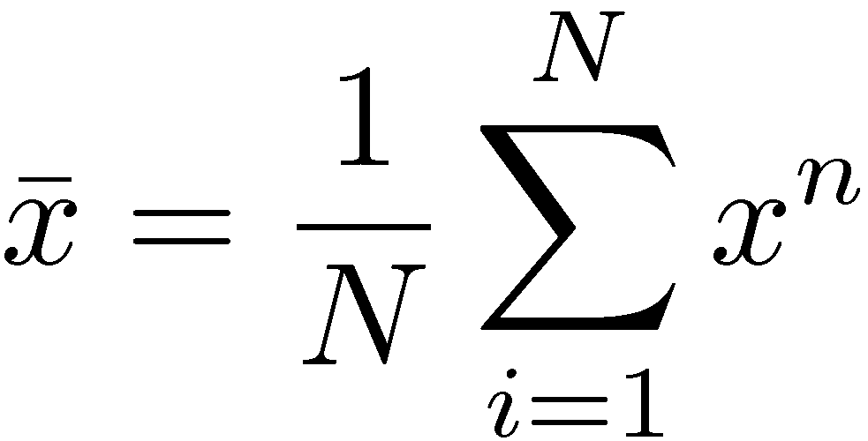
SVD and PCA
Typically PCA is thought of as finding the eigenvectors of the Covariance Matrix
Want to find a single dimension (vector) z to project onto
The projected variance becomes:
Add the constraint:
Unconstrained Lagrangian Optimization:
Setting derivative equal to zero and solving:
Average Vector:
Covariance:

Slide 21
SVD finds the PCA Eigenvectors:
Lets assume that the data matrix X is zero mean
Assume:
The covariance of X is:
Then by some linear algebra:
Where V are the eigenvectors of the covariance matrix.

Slide 22
Gibbs Sampling

Slide 23
Image Denoising Problem
Graphical represent of local statistical dependencies
Observed Random Variables
Noisy Picture
“True” Pixel Values
Continuity Assumptions
Latent Pixel Variables
Local Dependencies
Inference
What is the probability
that this pixel is black?

Slide 24
Some real Synthetic Data:

Slide 25
Conditioning on the Markov Blanket
1
Sweep:
For each vertex in the model (in some order):
Collect the joint assignment to all variables as a single sample and repeat.
f1
0
f2
X_{i}
f3
1
f4
1

