Slide 1
Lecture 13
Theory of Registration ch. 10 of Insight into Images edited by Terry Yoo, et al.
Notes:
Note: To print these slides in grayscale (e.g., on a laser printer), first change the Theme Background to “Style 1” (i.e., dark text on white background), and then tell PowerPoint’s print dialog that the “Output” is “Grayscale.” Everything should be clearly legible then. This is how I also generate the .pdf handouts.

Slide 2
Registration?
The process of aligning a target image to a source image
More generally, determining the spatial transform that maps points in one image to corresponding points in the other image

Slide 3
Registration Criteria
What do we compare to determine alignment?
Three general philosophies:
  Intensity-based
    This is what we’ve mostly seen so far
    Compare actual pixel values from one image to another
    Comparison can be complex, such as with mutual information
  Segmentation-based
    Segment the images
    Register the binary segmentations
  Landmark-based
    Mark key points in both images (often by hand)
    Derive a transform that makes every pair of landmarks match.

Slide 4
Types of Spatial Transforms
Rigid (rotate, translate)
Affine (rigid + scale & shear/skew)
Deformable (free-form = affine + vector field)
Many others

Slide 5
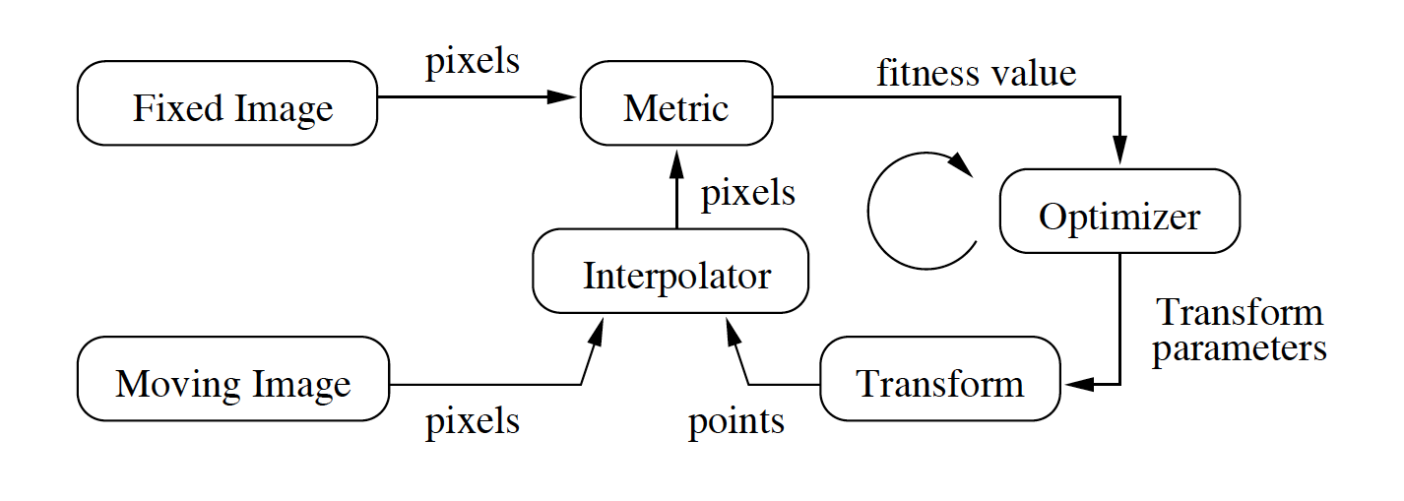
ITK (Legacy) Registration Flowchart, with Theory Notation
S(p|F,M,T)
F(x)
M(x)
p
T(p)
Figure 8.2 from the ITK Software Guide v 2.4, by Luis Ibáñez, et al., also showing the notation used by ch. 10 of Insight into Images, by Terry Yoo, et al.

Slide 6
Example Transform Notation
Example notation for a rigid 2D transform:
Goal: find parameter values (i.e., t_{x}, t_{y}, θ) that optimize some image similarity metric.

Slide 7
Optimizer
Optimizer adjusts the transform in an attempt to improve the metric
Often requires the derivative of the image similarity metric, S
Constant during registration!
Spatial
coordinates
(output of
transform)

Slide 8
Understanding the Transform Jacobian
J shows how changing p shifts a transformed point in the moving image space.
This allows efficient use of a pre-computed moving-image gradient to infer changes in corresponding-pixel intensities for changes in p
Now we can update dS/dp by just updating J

Slide 9
Transforms
Before we discuss specific transforms, let’s discuss the…
Fixed Set = the set of points (i.e. physical coordinates) that are unchanged by the transform
The fixed set is a very important property of a transform

Slide 10
Identity Transform
Does “nothing”
Every point is mapped to itself
Fixed set = everything (i.e., the entire space)

Slide 11
Translation Transform
Fixed set = empty set
Translation can be closely approximated by:
  Small rotation about distant origin, and/or…
  Small scale about distant origin
  Both of these do have a fixed point
Optimizers will frequently (accidently) do translation by using either rotation or scale
  This makes the optimization space harder to use
  The final transform may be harder to understand

Slide 12
Scaling Transform
Isotropic scaling (same in all directions)
Anisotropic scaling
Fixed set = origin = “center” = C
But, we can shift the origin:
C
C

Slide 13
Translation from Scaling
D = Scaling Factor
C = Fixed Set
  i.e., shifted origin
T_{i} = Translation derived from scaling along dimension i if using center C

Slide 14
2D Rotation Transform
Rotation transforms are typically specific to either 2D or 3D
Fixed set = origin = “center” = C
C
C

Slide 15
Translation from 2D Rotation
θ = Rotation angle
C = Fixed Set
  (Just one point)
T_{i} = Translation along dimension i derived from rotation about center C

Slide 16
Polar Coordinates:
2D Rotation = Multiplication

Slide 17
Optimizing 2D Rotations
Remember, optimization searches for the parameter values (i.e., θ) that give the best similarity score, S
Ex: Gradient descent update step:
The variation, G, is the gradient of S
Step length is λ

Slide 18
Optimizing 2D Rotations with Scaling
Transform is now multiplication by De^{iθ}:
Ex: Gradient descent update step:
Apply transform to point as:

Slide 19
Similarity Transform
P’ = T(P) = (P-C)De^{iθ}+C
P = arbitrary point
C = fixed point
D = scaling factor
  Rigid transform if D = 1
θ = rotation angle
P & C are complex numbers: (x+iy) or re^{iθ}
Store derivatives of P in Jacobian matrix

Slide 20
Affine Transform
Only thing guaranteed preserved is collinearity
x’ = A x + T
A is a complex matrix of coefficients
Translation expressed as shifted fixed point:
  x’ = A (x-C) + C
A is optimized similar to scaling factor

Slide 21
Quaternions: 3D Scaling & Rotation
Quotient of two vectors:
  Q = A / B
Operator that produces second vector:
  A = Q ★ B
Composed of a versor (for rotation) and a tensor (for scaling)
  Q = T  V
  Requires a total of 4 numbers

Slide 22
Tensors:
Representing 3D Scaling
Often denoted T
Tensors change the length of a vector
For parallel vectors, tensors are scalars

Slide 23
Versors:
Representing 3D Rotations
Often denoted V
Problem: 3D Polar coordinates have a singularity at the poles
  As do all 2-parameter 3D rotation representations
  Longitude lines converge at the north and south pole
Solution: Use 3 parameters!
A versor is a vector pointing along the axis of rotation.
The length of a versor gives the amount of rotation.

Slide 24
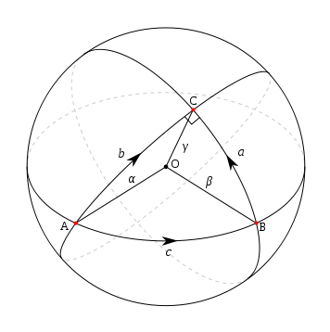
Versors on Unit Spheres
Arc c is the versor V_{AB} that rotates the unit vector A to the unit vector B
V_{AB} = B / A
The versor can be repositioned anywhere on the sphere without changing it
V_{AC} = V_{BC}  V_{AB}
  NOT commutative
V_{AC}
V_{BC}
V_{AB}
Notes:
Credit for sphere drawing: public domain from http://en.wikipedia.org/wiki/File:Spherical_triangle.svg

Slide 25
Versor Addition
Adding two versors is analogous to averaging them.
Do NOT use versor addition with gradient descent
  Use composition instead:
  V_{t+1}=dV_{t}  V_{t}

Slide 26
Optimization of Versors
Versor angle should be scaled using an exponent
V^{w} will rotate by w times as much as V
  Θ(V^{w}) = wθ, where Θ(V)=θ
Versor increment rule:

Slide 27
Rigid 3D Transform
Use versor instead of phasors/polar coordinates
P’ = V★(P-C) +C
P’ = V★P + T, where T=C-V★C
P = point, T = translation, C = fixed point, V = versor
Represented by 6 parameters:
  3 for versor
  3 for shifted center

Slide 28
Elementary Quaternions
The 3 elementary quaternions are the 3 orthogonally-oriented right versors (i,j,k):
  -i = k  j
  -j = i  k
  -k = j  i
j
The angle of
each of these
versors is a
right angle.
i
k

Slide 29
Versors:
Numerical Representation
Any right versor v can be represented as:
  v = xi + yj + zk, with x² + y² + z² = 1
Any generic versor V can be represented using the right versor v parallel to its axis of rotation, plus the rotation angle θ:
  V = e^{vθ}
  V = cosθ + v sinθ
  V = cosθ + (xi + yj + zk) sinθ, with x² + y² + z² = 1
  V = (cosθ, x sinθ, y sinθ, z sinθ) , with x² + y² + z² = 1

Slide 30
Similarity 3D Transform
Replace versor with quaternion to represent both rotation and scale
P’ = Q★(P-C) + C
P’ = Q★P + T, where T=C-Q★C
P = arbitrary point
C = fixed point
Q = quaternion

Slide 31
Mutual Information
An N-Dimensional Multi-Modal Registration Metric:

Slide 32
Different Modalities
Problem: In CT, a tumor may be darker than the surrounding liver tissue, but in MRI, the tumor may be brighter, while both modalities may have liver darker than other organs, but vasculature may be visible in CT but not in MRI, etc.
Directly comparing pixel values is hard
  Sometimes bright maps to bright
  Sometimes bright maps to dark
  Sometimes both bright & dark map to just dark, etc.
Old, “bad” solutions:
  Try to simulate CT pixel values from MRI data, etc.
    But if we could do this, then we wouldn’t need both modalities!
  Try to segment first, register second

Slide 33
Solution
For each registration attempt, optimize the “niceness” of the resulting joint probability distributions for mapping pixel values from one modality to the other
How?
Maximize the mutual information between the two images

Slide 34
Mutual Information
Based on information theory
Idea: If both modalities scan the same underlying anatomy, then there should be redundant (i.e., mutual) information between them.
  If bones are visible, then they should overlap
  Image edges should mostly overlap
  In general, each image intensity value in one image should map to only a few image intensities in the other image.

Slide 35
Mutual Information
Our similarity metric should now maximize:
  The mutual information between the images, =
  The information that each image provides about the other
Assumption: Mutual information will be at a maximum when images are correctly aligned
Note: We do NOT need a model of this mapping before registration—the mapping is learned as it is optimized

Slide 36
Mutual Information, Conceptually
Look at the joint histogram of pixel intensities
  For every pair of pixels, one mapped onto the other, use their pixel intensities to look up the appropriate bin of the 2D histogram, and then increment that bin.
  We want this joint histogram to be tightly clustered, i.e. “peaky”
  Bad registrations will make the joint histogram look like a diffuse cloud

Slide 37
Joint Histogram Examples
Good Registration →
Tightly Clustered Joint Histogram
Bad Registration →
Diffuse/Blurred Joint Histogram
CT Values MR Values | Vessels(darkest) | Tumor(dark) | Liver | Other(bright)
Liver & Vessels (dark) | ✔ |  | ✔
Other(bright) |  |  |  | ✔
Tumor (Brightest) |  | ✔
CT Values MR Values | Vessels(darkest) | Tumor(dark) | Liver | Other(bright)
Liver & Vessels (dark) | ✓ | ✓ | ✓ | ✓
Other(bright) | ✓ | ✓ | ✓ | ✓
Tumor (Brightest) | ✓ | ✓ | ✓ | ✓

Slide 38
Mutual Information: Details
Calculated by measuring entropies
  M.I. = difference between joint entropy and the sum of individual entropies
The math encourages transformations that make the images overlap on complex parts, something most similarity measures don’t do
In effect, M.I seeks a transform that finds complexity and explains it well.

Slide 39
Mutual Information:
Is robust with respect to occlusion—degrades gracefully
Is less sensitive to noise and outliers
Has an improved version, Mattes, which uses math that results in a smoother optimization space.
Is now the de-facto similarity metric for multi-modal registration.

