Slide 1
Lecture 4
Image Characterization ch. 4 of Machine Vision by Wesley E. Snyder & Hairong Qi
Notes:
Note: To print these slides in grayscale (e.g., on a laser printer), first change the Theme Background to “Style 1” (i.e., dark text on white background), and then tell PowerPoint’s print dialog that the “Output” is “Grayscale.” Everything should be clearly legible then. This is how I also generate the .pdf handouts.

Slide 2
Digital Images
How are they formed?
How can they be represented?

Slide 3
Image Representation
Hardware
  Storage
  Manipulation
Human
  Conceptual
  Mathematical

Slide 4
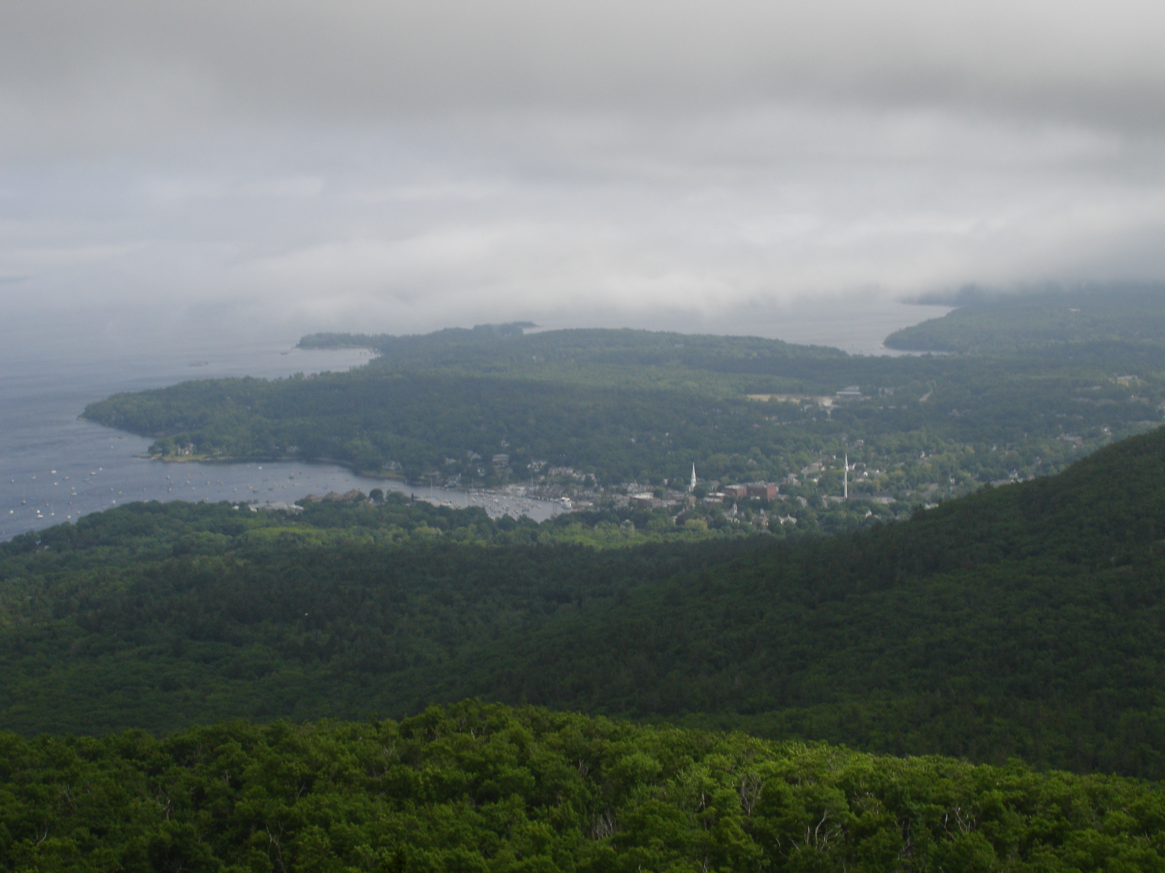
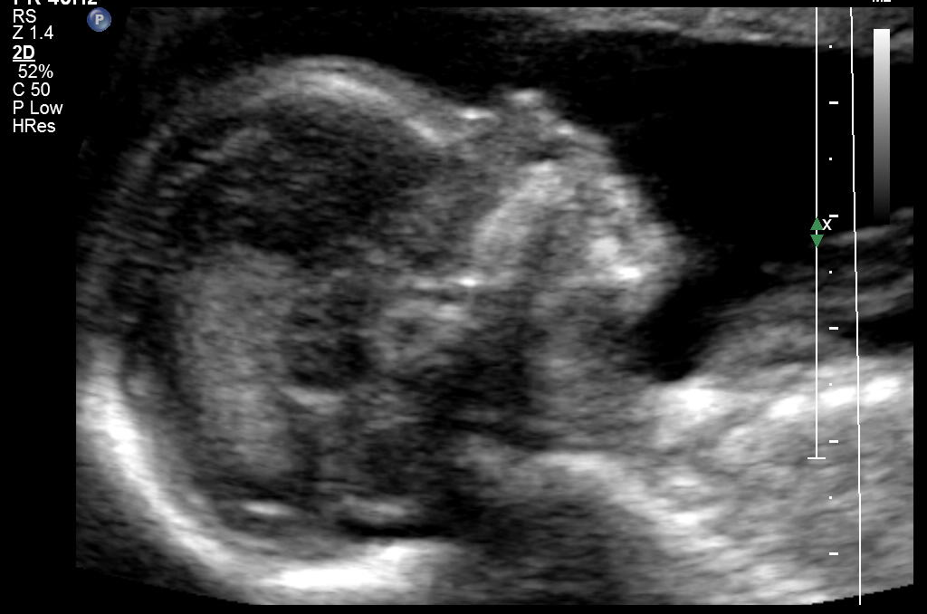
Iconic Representation
What you think of as an image, …
  Camera
  X-Ray
  CT
  MRI
  Ultrasound
  2D, 3D, …
  etc

Slide 5

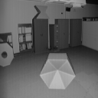
Iconic Representation
And what you might not
Corresponding Intensity Image
Range Image
Images from CESAR lab at Oak Ridge National Laboratory,
Sourced from the USF Range Image Database:
http://marathon.csee.usf.edu/range/DataBase.html
Acknowledgement thereof requested with redistribution.

Slide 6
Functional Representation
An Equation
  Typically continuous
Fit to the image data
  Sometimes the entire image
  Usually just a small piece of it
Examples (Quadratic Surfaces):
  Explicit:
  Implicit:
Notes:
Implicit: Zero set (neg = inside, pos = outside)

Slide 7
Linear Representation
Unwind the image
  “Raster-scan” it
Entire image is now a vector
  Now we can do matrix operations on it!
  Often used in research papers
Probabilistic & Relational Representations
Probability & Graphs
Discussed later (if at all)

Slide 8




Spatial Frequency Representation
Think “Fourier Transform”
Multiple Dimensions!
Varies greatly across different image regions
High Freq. = Sharpness
Steven Lehar’s details: http://sharp.bu.edu/~slehar/fourier/fourier.html

Slide 9
Image Formation
Sampling an analog signal
Resolution
  # Samples per dimension, OR
  Smallest clearly discernable physical object
Dynamic Range
  # bits / pixel (quantization accuracy), OR
  Range of measurable intensities
    Physical meaning of min & max pixel values
    light, density, etc.

Slide 10
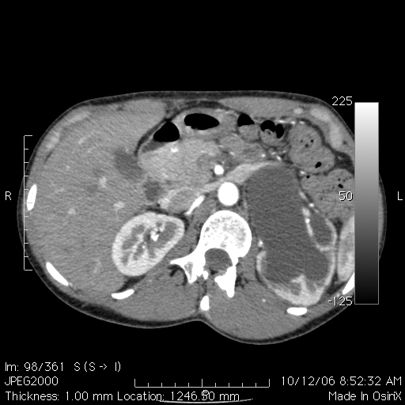

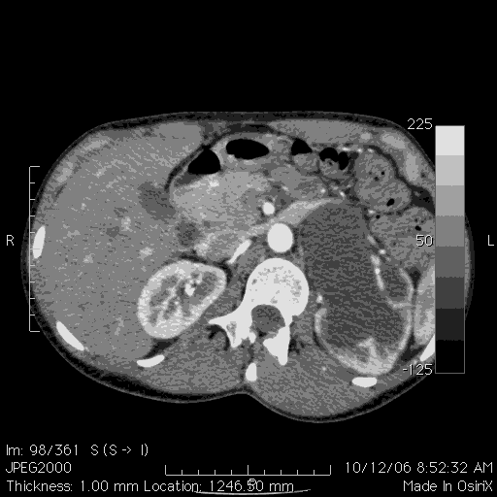
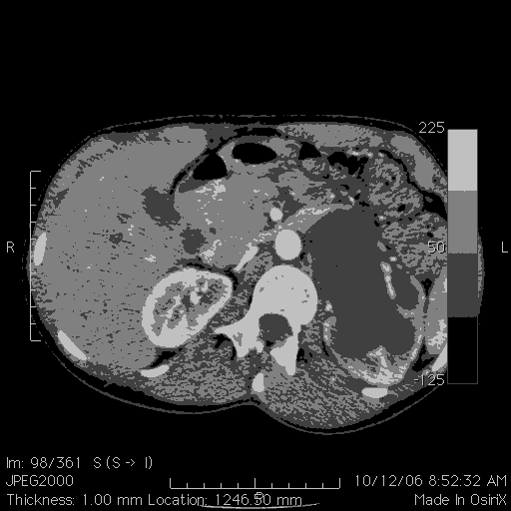
Dynamic Range Example
(A slice from a Renal Angio CT: 8 bits, 4 bits, 3 bits, 2 bits)

Slide 11
An Aside: The Correspondence Problem
My Definition:
  Given two different images of the same (or similar) objects,
  for any point in one image
  determine the exact corresponding point in the other image
Similar (identical?) to registration
Quite possibly, it is THE problem in computer vision
Notes:
Class discussion: How segmentation?

Slide 12
Image Formation: Corruption
Ideal
f (x,y)
Camera, CT, MRI, …
Measured
g(x,y)
There is an ideal image
  It is what we are physically measuring
No measuring device is perfect
  Measuring introduces noise
  g(x,y) = D( f(x,y) ), where D is the distortion function
Often, noise is additive and independent of the ideal image

Slide 13
Image Formation: Corruption
Noise is usually not the only distortion
If the other distortions are:
  linear &
  space-invariant
then they can always be represented with the convolution integral!
Total corruption:

Slide 14
The image as a surface
Intensity → height
  In 2D case, but concepts extend to ND
z = f ( x, y )
Describes a surface in space
  Because only one z value for each x, y pair
  Assume surface is continuous (interpolate pixels)

Slide 15
Isophote
“Uniform brightness”
C = f ( x, y )
A curve (2D) or surface (3D) in space
Always perpendicular to image gradient
  Why?

Slide 16
Isophotes & Gradient
Isophotes are like contour lines on a topography (elevation) map.
At any point, the gradient is always at a right angle to the isophote!

Slide 17
Ridges
One definition:
  Local maxima of the rate of change of gradient direction
  Sound confusing?
  Just think of ridge lines along a mountain
  If you need it, look it up
    Snyder references Maintz

Slide 18
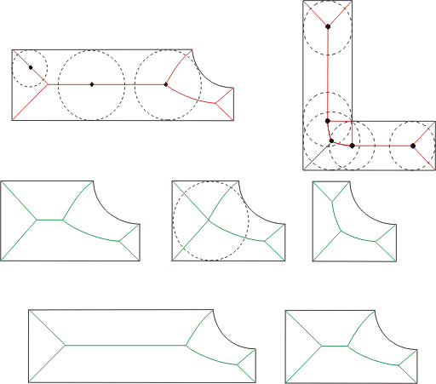
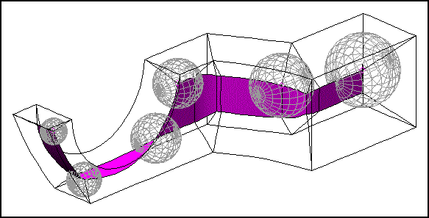
Medial Axis
Skeletal representation
Defined for binary images
  This includes segmented images!
“Ridges in scale-space”
  Details have to wait (ch. 9)
Image courtesy of TranscenData Europe
http://www.fegs.co.uk/motech.html
http://sog1.me.qub.ac.uk/Research/medial/medial.php

Slide 19
Neighborhoods
Terminology
  4-connected vs. 8-connected
  Side/Face-connected vs. vertex-connected
  Maximally-connected vs. minimally-connected (ND)
Connectivity paradox
  Due to discretization
Can define other neighborhoods
  Adjacency not necessarily required
Is this
shape
closed?
Is this
pixel
connected
to the
outside?
?

Slide 20
Curvature
Compute curvature at every point in a (range) image
  (Or on a segmented 3D surface)
Based on differential geometry
Formulas are in your book
2 scalar measures of curvature that are invariant to viewpoint, derived from the 2 principal curvatures, (K₁, K₂):
  Mean curvature (arithmetic mean)
  Gauss curvature (product)
    =0 if either K₁=0 or K₂=0

