Slide 1
Lecture 8
Registration with ITK
Notes:
Note: To print these slides in grayscale (e.g., on a laser printer), first change the Theme Background to “Style 1” (i.e., dark text on white background), and then tell PowerPoint’s print dialog that the “Output” is “Grayscale.” Everything should be clearly legible then. This is how I also generate the .pdf handouts.

Slide 2
For more info/gory detail…
Please see the following for exhaustive detail:
  Chapter 3 in the ITK Software Guide Book 2
  Insight into Images
  ITK Source Tree
    Examples/RegistrationITKv4/
    E.g. Examples/RegistrationITKv4/ImageRegistration1.cxx
  ITK Doxygen
    http://www.itk.org/Doxygen50/html/group__RegistrationFilters.html
    http://www.itk.org/Doxygen50/html/group__Group-Registration.html
    http://www.itk.org/Doxygen50/html/group__Group-Numerics.html
  SimpleITK:
    http://insightsoftwareconsortium.github.io/SimpleITK-Notebooks/
      See all the Python Registration (6x) notebooks, especially:
      http://insightsoftwareconsortium.github.io/SimpleITK-Notebooks/Python_html/60_Registration_Introduction.html
      https://itk.org/SimpleITKDoxygen/html/classitk_1_1simple_1_1ImageRegistrationMethod.html

Slide 3
What is registration?
The process of aligning a target image to a source image
More generally, determining the transform that maps points in the target image to points in the source image

Slide 4
Transform types
Rigid (rotate, translate)
Affine (rigid + scale & shear)
Deformable = non-rigid (affine + vector field)
Many others

Slide 5
Registration in ITK
ITK uses an extensible registration framework
Various interchangeable classes exist
Relatively easy to “twiddle” the part you’re interested in while recycling prior work
The newer ITKv4 Registration framework is separate from the legacy framework.
  The legacy framework follows traditional practice
  Version 4 registration is more flexible and thus more complex
  Use the v4 framework whenever practical
SimpleITK recently gained registration support at v. 0.9, improved in v1.0
For “simplified” complex registration, consider using ANTS instead:
  http://www.picsl.upenn.edu/ANTS/
  http://stnava.github.io/ANTs/

Slide 6
New in ITKv4 (ImageRegistrationMethodv4, etc.)
New unified, improved, and fully multi-threaded optimization and registration framework (including multi-threaded metrics)
Dense deformation fields (including a new transform that encapsulates a dense deformation field)
Point Set registration methods (landmark or label guided registration)
Automatic parameter scale estimation for transforms
Automatic step-size selection for gradient-based registration optimizers
Composite Transforms (grouping multiple transforms into a single one)
Symmetric registration (where the Fixed and Moving images make unbiased contributions to the registration)
New metrics for Demons and Mutual Information
Diffeomorphic (velocity field) deformable registration
Additional evolutionary optimizers
Improved B-Spline registration approach available and bug fixes to old framework
Accurately transform and reorient covariant tensors and vectors
List taken from http://www.itk.org/Wiki/ITK_Release_4/Why_Switch_to_ITKv4 and
http://www.itk.org/Wiki/ITK_Release_4/Migration_Plan/Release_Notes/ITKv4_Final_Release_Notes

Slide 7
ITKv4 Registration
Uses a different framework than “traditional” ITK registration. The new framework is designated with a “v4” suffix.
You must use a v4 metric and a v4 optimizer when doing a v4 registration!
Take a look here:
  http://www.itk.org/Doxygen50/html/group__ITKRegistrationMethodsv4.html
  http://www.itk.org/Doxygen50/html/group__ITKMetricsv4.html
  http://www.itk.org/Doxygen50/html/group__ITKOptimizersv4.html
  ITK source code: Modules/Registration/RegistrationMethodsv4/include/
  ITK source code: Modules/Registration/Metricsv4/include/
  ITK source code: Modules/Numerics/Optimizersv4/include/
Pay special attention to:
  MattesMutualInformationImageToImageMetricv4
  DemonsImageToImageMetricv4
  QuasiNewtonOptimizerv4 (an improved gradient descent)

Slide 8
Typical registration terminology
Fixed image f(x) - stationary in space
Moving image m(x) - the fixed image with an unknown transform applied
Goal: recover the transform T(x) which maps points in f(x) to m(x)

Slide 9
Typical registration framework
2 input images, fixed and moving
Metric - determines the “fitness” of the current registration iteration
Optimizer - adjusts the transform in an attempt to improve the metric
Interpolator - applies transform to image and computes sub-pixel values

Slide 10
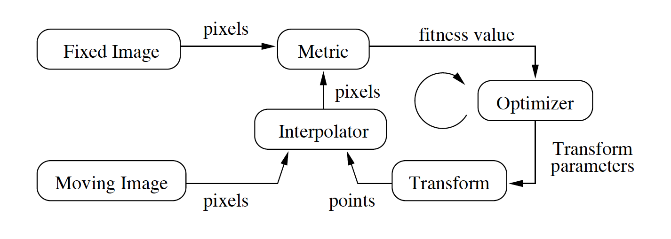
Typical registration flowchart
Figure 8.2 from the ITK Software Guide v 2.4, by Luis Ibáñez, et al.

Slide 11
ITK v4 registration flowchart
Figure 3.3 from the ITK Software Guide Book 2, Fourth Edition, by Hans J. Johnson, et al.

Slide 12
ITK v4: key differences
Both input images are transformed into a common virtual domain, which determines:
  The output resampled-image dimensions and spacing
  The sampling grid (not necessarily a uniform grid)
  Defaults to the fixed image domain
Only the Moving Transform is Optimized
Fixed Transform defaults to identity transform
  But it could be set to the result of a previous registration, etc.

Slide 13
ITK v4 Virtual Domain
Figure 3.8 from the ITK Software Guide Book 2, Fourth Edition, by Hans J. Johnson, et al.

Slide 14
ITK’s “Hello world” registration example
Uses ITK’s v4 framework, but in the “typical” traditional style
Please see the software guide (Book 2, Section 3.2) for code specifics
I am going to cover what each piece does, not look at code per se

Slide 15
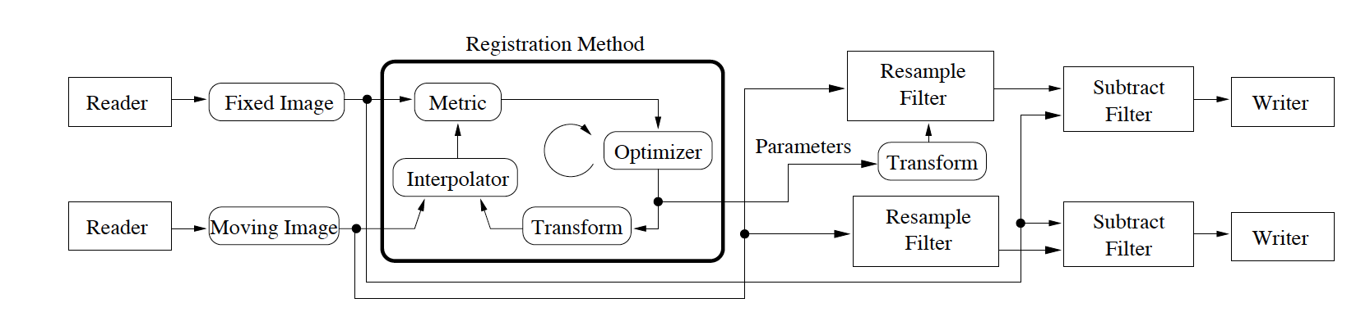
ITK’s “Hello World” Example:
Flow Chart for Everything
Figure 8.5 from the ITK Software Guide v 2.4, by Luis Ibáñez, et al.

Slide 16
Input images
2D floating point
Floating point avoids loss of precision problems with integer pixel types

Slide 17
Transform
TranslationTransform
Permits translation only in 2D
ITKv4 still uses the same legacy transforms
ITKv4 also supports new composite transforms:
  Two or more successive transforms…
  Combined into a single transform object
  Can initialize with one transform and optimize another

Slide 18
Metric
MeanSquaresImageToImageMetricv4
Sum of squared differences between 2 images on a “pixel-by-pixel” basis
  Remember that both images are transformed to the virtual domain before doing the comparisons
A bit naïve
Works for 2 images that were acquired with the same imaging modality

Slide 19
Optimizer
RegularStepGradientDescentOptimizerv4
Follows the derivative of the metric
Step size depends on rapid changes in the gradient’s direction
Step size eventually reaches a user-defined value that determines convergence

Slide 20
Interpolator
LinearInterpolateImageFunction
Fast and conceptually simple

Slide 21
Wrapper
ImageRegistrationMethodv4
Combines all of the previous classes into a master class
registration->SetMetric( metric );
registration->SetOptimizer( optimizer );
metric->SetFixedInterpolator( FixedInterpolator);
metric->SetMovingInterpolator( MovingInterpolator);
Registration method automatically instantiates its own internal transform
  Based on its template parameters

Slide 22
Other steps
Read the input images
Setup the virtual domain
  Defaults to the fixed image
Set the region of the fixed image the registration will operate on
  Useful for ignoring bad data
Initialize the transforms
  Fixed transform defaults to identity
Setup multi-level registration
  Like image-pyramids, but better
  Defaults to a single level
Use a C++ try/catch block to avoid crashing on errors
Twiddle the optimizer for best performance*
*may involve pain and suffering

Slide 23
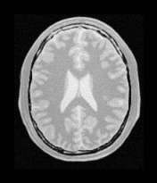
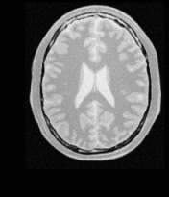
Hello world input
Figure 8.3 from the ITK Software Guide v 2.4, by Luis Ibáñez, et al.

Slide 24
X & Y translation vs. time
Figure 3.7 (left) from the ITK Software Guide Book 2, Fourth Edition, by Hans J. Johnson, et al.

Slide 25
Metric vs. time
Figure 3.7 (left) from the ITK Software Guide Book 2, Fourth Edition, by Hans J. Johnson, et al.

Slide 26
Registration results
After registration converges/terminates, you recover the optimized transform with:
registration->GetTransform()
For the Hello World example there are 2 parameters, X & Y translation
If you used a separate initial moving transform, create a composite to get the total transform:
outputCompositeTransform->AddTransform(
movingInitialTransform);
outputCompositeTransform->AddTransform(
registration->GetModifiableTransform());

Slide 27
Double checking results
Use ResampleImageFilter to apply the transform for the fixed and moving images
Take the outputs, and compute their difference
In this case, just subtract the registered images
  Good registration results in nothing much to see

Slide 28
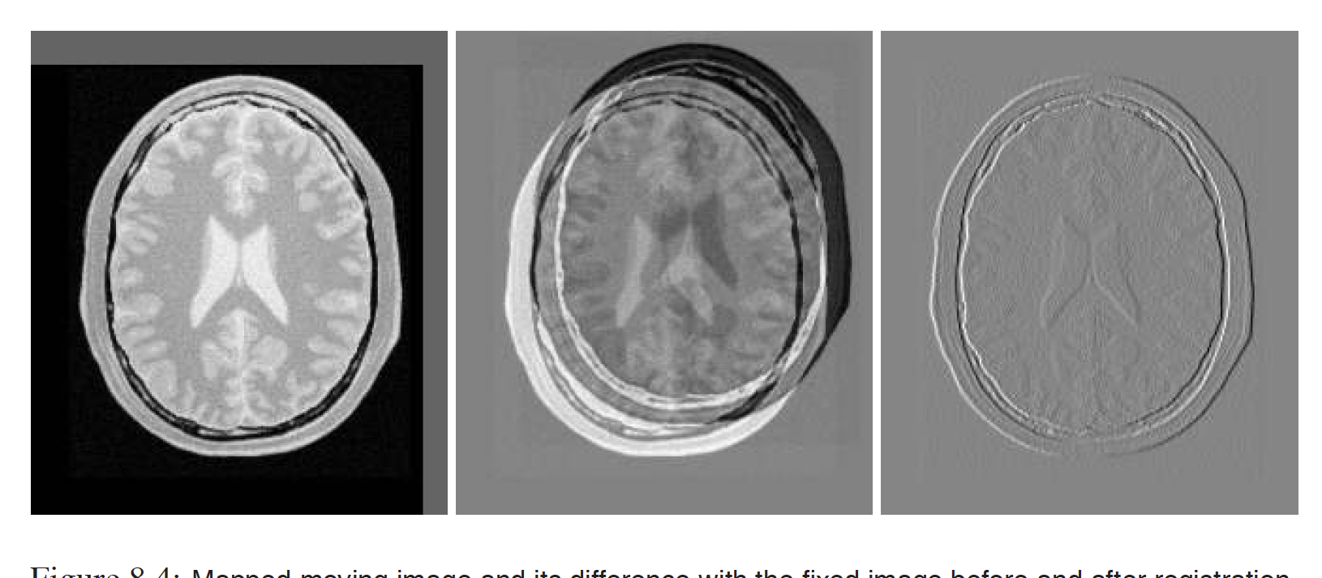
Image comparison
Registered
moving image
Difference before
registration
Difference after
registration
Figure 8.4 from the ITK Software Guide v 2.4, by Luis Ibáñez, et al.

Slide 29
Keeping tabs on registration
Registration is often time consuming
It’s nice to know that your algorithm isn’t just spinning it’s wheels
Use the observer (itk::Command) mechanism in ITK to monitor progress
  ITK software guide, book 1: 3.2.6 and book 2: 3.4
We’ll see this again later, when we discuss how to write your own ITK filters
  itk::ProgressEvent is one example

Slide 30
Observer steps
Write an observer class that will process “iteration” events
  (Just copy some code from an example)
Add the observer to the optimizer
  As a generic note, observers can observe any class derived from itk::Object
Start registration as usual

Slide 31
Things observers can do
Print debugging info
Update GUI
Other small management functions
Should not do anything too processor intensive

Slide 32
ITK v4 Registration Observer
Figure 3.9 from the ITK Software Guide Book 2, Fourth Edition, by Hans J. Johnson, et al.

Slide 33
Multi-modality registration
Remember how I said sum-of-squares difference is relatively naïve?
Mutual information helps overcome this problem
Section 3.5 shows how to implement a simple MI registration
  Note that Mattes MI is usually easier to use than Viola-Wells MI

Slide 34
Notes about the MI example
Significantly, largely the same piece of code as Hello World
Mutual Information is a metric, so we can keep the optimizer, the interpolator, and so on
Majority of differences are in tweaking the metric, not in rewriting code

Slide 35
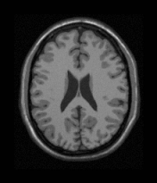
MI Inputs
T1 MRI
Proton density MRI
Figure 8.9 from the ITK Software Guide v 2.4, by Luis Ibáñez, et al.

Slide 36
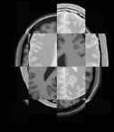
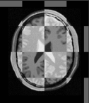
MI Output: Image Comparison
Before
After
This is an example of a checkerboard visualization
Taken from Figure 8.10 of the ITK Software Guide v 2.4, by Luis Ibáñez, et al.
Notes:
WHY USE Checkerboard?

Slide 37
Centered transforms
More natural (arguably) reference frame than having the origin at the corner of the image
Big picture is not appreciably different from other rigid registrations
But, for the moment there are implementation complexities and differences, see 3.6

Slide 38
An aside: “Twiddling”
A common criticism of many/most registration techniques is their number of parameters
A successful registration often depends on a very specific fine-tuning of the algorithm
“Generalized” registration is an open problem

Slide 39
Multi-Resolution registration
Useful to think of this as algorithmic “squinting” by using image pyramids
Start with something simple and low-res
Use low-res registration to seed the next higher step
Eventually run registration at high-res
Also called “coarse to fine”

Slide 40
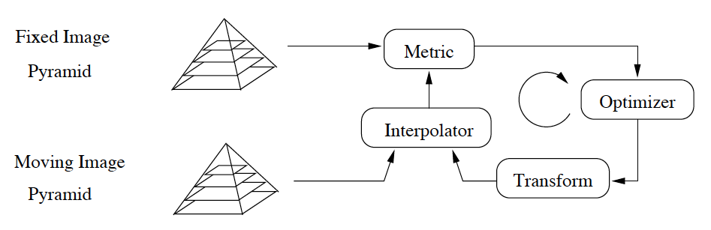
Multi-resolution idea
Figure 8.36 from the ITK Software Guide v 2.4, by Luis Ibáñez, et al.

Slide 41
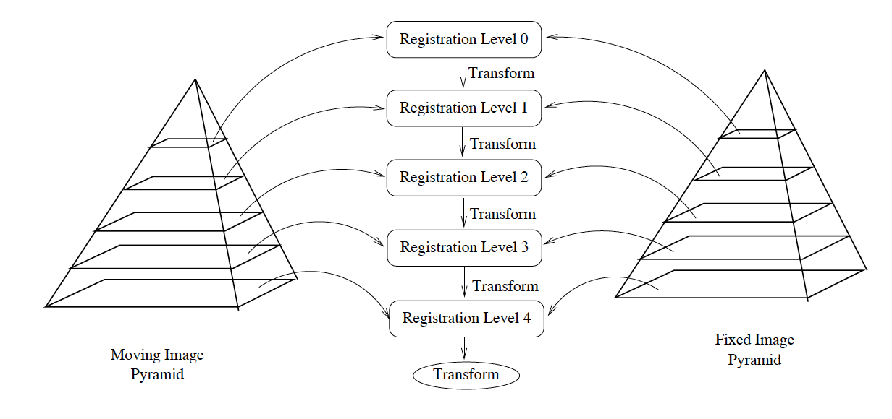
Image pyramids
Figure 8.37 from the ITK Software Guide v 2.4, by Luis Ibáñez, et al.

Slide 42
Optimization
Parameter dependency rears its ugly head
You often/usually need to adjust optimizer parameters as you move through the pyramid
You can do this using the Observer mechanism

Slide 43
Multi-resolution example
Again, mostly the same code as Hello World
Multi-Resolution is now built into all of ITKv4 registration, so no need for extra classes or image pyramids

Slide 44
Benefits of multi-resolution
Often faster
More tolerant of noise (from “squinting”)
Minimizes initialization problems to a certain extent, though not perfect

Slide 45
Multi-resolution
Remember, at large (high) scale only large objects are visible
Higher scale is higher in the image pyramid
  So higher scale has lower resolution
Lower scale is lower in the image pyramid
  So lower scale has higher resolution

Slide 46
See the software guide for…
Detailed list of:
  Transforms
  Optimizers
  Interpolation methods
You’re encouraged to mix and match!

Slide 47
Deformable registration
Three common techniques:
  Finite element: treat small image regions as having physical properties that control deformation
  Bsplines: deform a mapping grid
  Demons: images are assumed to have iso-intensity contours (isophotes); image deformations occur by pushing on these contours

Slide 48
Model based registration
Software guide, book 2, ch. 3, section 16.
Build a simplified geometric model from a training set
Identify parameters that control the characteristics of the model
Register the model to a target image to adapt to a particular patient

Slide 49
Model based, cont.
Uses the Spatial Objects framework for representing geometry
Useful because it derives analytical data from the registration process, not just a pixel-to-pixel mapping

Slide 50
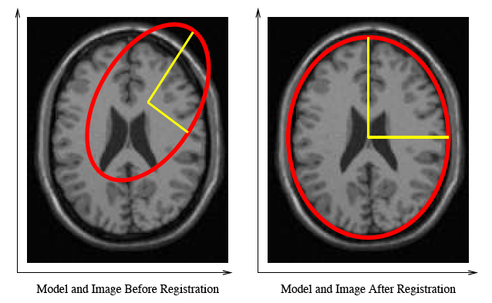
Model-based example
Note: This is what we want, NOT the output of an actual registration
Figure 8.60 from the ITK Software Guide v 2.4, by Luis Ibáñez, et al.

Slide 51
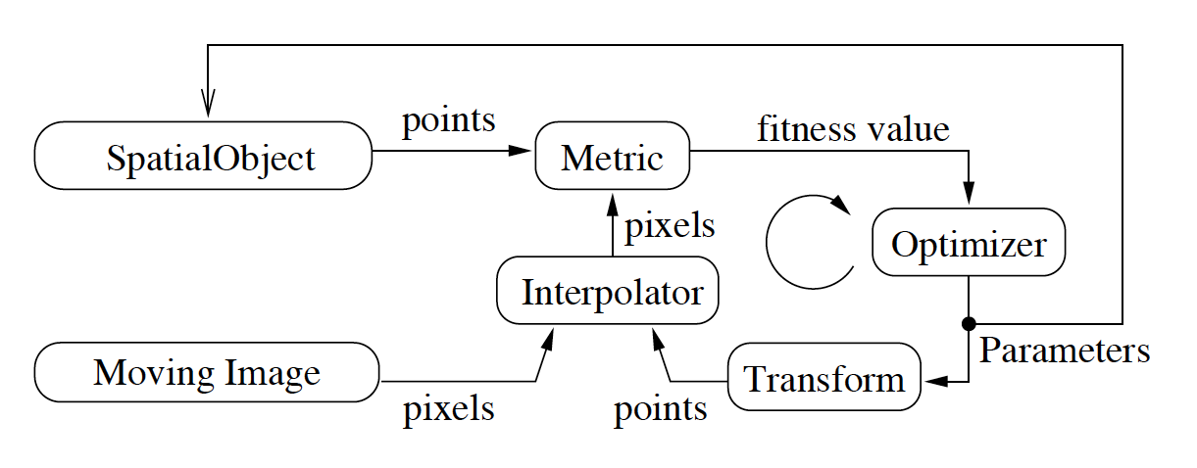
Model-based reg. schematic
Figure 8.59 from the ITK Software Guide v 2.4, by Luis Ibáñez, et al.

Slide 52
Model-based registration: Warning!
ITK does not yet directly support generic model-based registration “out of the box”
ITKv4 does support point-set to image registration
Otherwise, model-based reg. requires writing your own custom ITK transform, with new parameters
  Transform’s new parameters → Spatial Object parameters
  You must individually map your custom transform’s new parameters to the specific spatial object parameters you want to allow registration to adjust
  This isn’t too complicated if you know what you’re doing
  Search Insight Journal for examples

Slide 53
Speed issues
Execution time can vary wildly
  Optimizer (more naïve = faster)
  Image dimensionality (fewer = faster)
  Transform (fewer DOF = faster)
  Interpolator (less precise = faster)

Slide 54
Take home messages
Exactly what parameters do what is not always obvious, even if you are familiar with the code
Successful registrations can be something of an art form
Multi-resolution techniques can help
Work within the framework!

