Slide 1
Lecture 3 Getting Started with ITK!
Notes:
Note: To print these slides in grayscale (e.g., on a laser printer), first change the Theme Background to “Style 1” (i.e., dark text on white background), and then tell PowerPoint’s print dialog that the “Output” is “Grayscale.” Everything should be clearly legible then. This is how I also generate the .pdf handouts.

Slide 2
First: Online Course Content
Today’s lecture is online
I will usually place lectures online before 4 AM the day of the class.
Using Diderot course management:
https://www.diderot.one/courses/125
You should already be added to the Diderot class
If not, email the instructor

Slide 3
You need the book
There will be an online Diderot quiz due at 3:10pm on Thursday (just after the beginning of class)
The quiz is supposed to be a not-too-hard assessment if you read the book and paid attention. I don’t usually ask quiz questions requiring deep/complex understanding.

Slide 4
Goals for this lecture
Compile, compile, compile
Learn how to use SVN & CMake
Build ITK
Compile several programs that use ITK
Find documentation online
Learn the quirks (if any) of the system you choose to use

Slide 5
Getting help
Email your instructor
Join the insight-users mailing list; instructions are at http://www.itk.org
Notes:
First bullet normally:
Email your TA
Do this sooner rather than later!

Slide 6
Assignments
Collaboration is encouraged; unless told otherwise, feel free to discuss assignments with other students
But… please submit your own code - don’t copy and paste stuff from friends; see syllabus for details
More so than other classes, you will be learning techniques that translate directly to the real world - don’t cheat yourself

Slide 7
Grading of assignments
Grading criteria:
Does it accomplish the specified task?
Is it well commented? Follow the “6 month rule” - if you leave for 6 months, you should be able to pick up where you left off.
Many/most assignments will be divided into sections, with each section pass-fail.
We may give opportunities to fix “stupid” problems before final judgment is passed

Slide 8
Assignments, cont.
Please interpret due dates as absolute, unless told otherwise
Really
We’re happy to spend time helping you debug code, but not at 11 pm the day before the assignment is due

Slide 9
Computer requirements: recommended
Your own computer is preferable (especially in COVID)
Remote-login to university computers should also work
Please be aware that ITK can consume a lot of disk space during the build process (feel free to use BOXDrive or Gdrive)
Windows 10 with Visual Studio 2017 with MSVC toolset ≥ v140; Python ≥ 3.7 (x64)
Suggest Win10x64 1909 or newer
Suggest Visual Studio Enterprise 2017 and Anaconda ≥ 3.7
Windows 11 and newer Visual Studio should work, but not verified
Mac OS X, X-Code, user-installed Anaconda Python ≥ 3.7
Recent x64 Linux (e.g. Ubuntu, RHEL, or CentOS), system gcc; user-installed Anaconda Python ≥ 3.7

Slide 10
What am I using?
Mac OS X Big Sur (& Ubuntu 20.x):
Anaconda Python 3.8 x64
Latest Xcode and/or Visual Studio 2017
Notes:
We aren’t trying to force everyone to use this, but…
These are what the grader (windows) and instructor (OS X) will be using.
Run Linux? Consider VMware Workstation

Slide 11
Alternative usable computer configurations
Any platform supported by ITK (Mac, Linux, etc.)
If there are problems, you will have to work with us to get your code working on one of our machines.
Try having us check your code before it is due.
If the grader’s computer can’t run your code, you will have a short (but reasonable) period of time to fix it after he emails you that your code appears broken (along with what errors he got).
If you are trying to make things work, but have many things to “fix,” then more time may be granted.
For final projects, we may decide to let you show us your code running on your own machine, on a case-by-case basis.

Slide 12
What is ITK?
To clarify, ITK is a source-code/library toolkit
It doesn’t “do” anything
You can’t “run” it
There isn’t an itk.exe file
Typically, you use ITK in conjunction with other toolkits to handle visualization and GUI interaction

Slide 13
So, what’s it good for?
ITK code is easy to add to existing C++ code
Also Python, C#, Java, …
It provides a variety of flexible data containers, and ways of processing / analyzing them
You can do a lot in only a few lines of code
Once you get used to it, it’s easy to use (gasp!)

Slide 14
What we assume you can do
Understand C++ and/or Python syntax
Standard flow control such as for, do, calling functions, etc.
Classes
Inheritance
For C++: Pointers, dereferencing, passing by reference
Work comfortably in the operating system of your choice, using the compiler or Python environment of your choice, running programs from the command line (i.e. terminal)

Slide 15
You may have not…
Used revision control using SVN (or git)
Engaged in collaborative programming
Written C++ code that builds on multiple platforms
Used cross-platform make software
(CMake or Jam, for example)
Designed software using a data-flow architecture, worried about smart pointers, etc.

Slide 16
Revision control with SVN
Revision control software allows you to store incremental changes to software
You will be expected to use SVN to manage your homework assignments
SVN is like CVS, but better
SVN is simpler than git (git is better for larger projects)
I encourage you to use revision control on your code outside of this class as well - it’s a good habit to develop

Slide 17
SVN terms
Server - what it sounds like
Module - a group of files that can be accessed on the server
User - each module has associated users, with varying levels of access (read only, read/write, etc.).

Slide 18
SVN terms, cont.
Checkout - Download a fresh copy of a module from the server to your computer
Update - Sync your copy of a module with the server copy; much faster than a checkout
Commit - Merge changes made to your local copy with the server

Slide 19
SVN setup
The SVN server for this course will be:
https://biglab.ri.cmu.edu/svn/mimia22/{your user name}
You will each have a module, based on your email; you will get email about this in a week or two.
Only you and the instructor/TA will have access to this module

Slide 20
SVN setup, cont.
GUI wrappers for SVN
Windows: Tortoise SVN
http://tortoisesvn.net/
Mac: SnailSVN Lite
Find it on the app store; when you start it choose the ”Bundled” SVN binaries version “1.10.x”
Windows, Mac, and Linux (cross-platform):
RapidSVN: http://rapidsvn.org/download/release/0.12.1/
SmartSVN: http://www.wandisco.com/subversion/download
Command line works fine too, but may be more awkward if you’re used to GUI’s

Slide 21
Cross platform (C++) development
ITK builds on a large combination of operating systems and platforms
For C++, each compiler has it’s own input format: Makefiles, workspaces, etc.
Q: How can you possibly coordinate builds on different platforms?

Slide 22
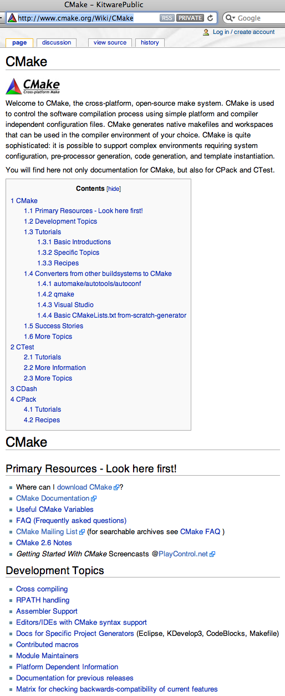

The answer: CMake
Cross platform tool to manage the build process
Simplifies the build process
Auto-configuration
Easy access to external libraries
Used by several other open source projects
www.cmake.org

Slide 23
CMake is:
Required to build native (C++) ITK
Cross-platform project generator
Often simpler than particular environments
Text as input
Project file as output:
Windows | Visual Studio Solution
UNIX | Makefile or Ninja
Mac OS X | Xcode project or Ninja or Makefile

Slide 24
How CMake runs
Write a CMakeLists.txt file describing your project in CMake’s language
Run CMake to generate an appropriate makefile/project/workspace for your compiler
Compile as you normally would

Slide 25
How CMake runs, cont.
This is not unlike the configure-make process you may be familiar with from various Unix systems
But… it works with many compilers
CMakeLists.txt files are easy to perform revision control on

Slide 26
CMakeLists.txt syntax
Comment lines indicated with #
Look at examples in ITK
Simple example:
cmake_minimum_required(VERSION 3.15)
# Make sure the user’s CMake is recent enough
# CMake poicies sometimes change, so it is
# recommended that new projects require the
# latest CMake version
#Give this project a name:
PROJECT(cool_demo)
#The command-line executable “demo”
#is built from “demo_code.cxx” and
#must be linked with the ITK libraries
ADD_EXECUTABLE(demo demo_code.cxx)
TARGET_LINK_LIBRARIES(demo ${ITK_LIBRARIES})

Slide 27
Full Example of CMakeLists.txt
CMAKE_MINIMUM_REQUIRED(VERSION 3.15)
# specify the C++ standard; ITK5 uses C++11
set(CMAKE_CXX_STANDARD 11)
set(CMAKE_CXX_STANDARD_REQUIRED True)
PROJECT(cool_demo)
# Find ITK:
FIND_PACKAGE(ITK REQUIRED)
INCLUDE(${ITK_USE_FILE})
ADD_EXECUTABLE(demo demo_code.cxx)
TARGET_LINK_LIBRARIES(demo ${ITK_LIBRARIES})

Slide 28
Steps to get started with C++ ITK & SimpleITK
Pay Attention
This is important for everyone for HW2
If you are compiling C++ SimpleITK, you do not need to compile ITK separately
Compiling C++ SimpleITK using the “SuperBuild” approach automatically downloads and compiles ITK for us—we’ll explain more shortly
I suggest you make a directory to hold all your source code and build trees for this class, e.g. c:\mimia
Windows WARNING: Do not use long directory names on Windows, or place the directory in your Documents folder, or else the total path names will become too long for Windows and building (Simple)ITK will fail.

Slide 29
Step 0 – Don’t panic!
There is substantial documentation on everything I’m going to present here, and vastly more about things that we will never cover in this course
https://simpleitk.readthedocs.io/
https://simpleitk.readthedocs.io/en/master/faq.html
ITK C++ API: https://itk.org/Doxygen/html/index.html
Download a copy of the ITK Software Guide
https://itk.org/ItkSoftwareGuide.pdf

Slide 30
Step 1 - Install CMake
Check if CMake ≥ 3.18 is already installed on your computer.
If not, …
Download and install the latest stable binary distribution of CMake from:
http://www.cmake.org/

Slide 31
Step 2 - Install (Simple)ITK
Note: If you are going to compile SimpleITK (we are), then do not install ITK directly
SimpleITK’s “SuperBuild” will compile & install ITK for you
…Following a procedure similar to that for ITK
Create a directory to hold the source and build for both SimpleITK and ITK
Open a command prompt and go to the new directory
Download the latest version of SimpleITK using git:
git clone https://github.com/SimpleITK/SimpleITK.git
Notes:
Used to be git clone --recursive https://itk.org/SimpleITK.git

Slide 32


In source vs. out source builds
Source Tree
Binary Tree
Out
Source Build
ITK
ITKb
Recommended !
Common
Common
Algorithms
Algorithms
BasicFilter
BasicFilter
Numerics
In
Source
Build
Numerics
IO
IO

Slide 33
Why use two trees?
Keeps your C++ source and binary code separate
Minimizes the amount of damage you can do to your SVN tree
We suggest that you build SimpleITK in a new folder you create named SITKBin
WARNING: Because ITK is downloaded automatically by building SimpleITK, both the source and the build directories for ITK will be found inside the SITKBin directory

Slide 34
Where Will Everything Be?
After building the SimpleITK SuperBuild as instructed, your important stuff will be here:
SimpleITK Source:
.\SimpleITK
SimpleITK Build:
.\SITKBin
SimpleITK C++ Libraries (one or both of these two):
.\SITKBin\lib{\Release OR \Debug may be present}
.\SITKBin\SimpleITK-Build\lib{\Release OR \Debug}
ITK Source:
.\SITKBin\ITK
ITK C++ Build:
.\SITKBin\ITK-build
ITK C++ Libraries:
.\SITKBin\ITK-build\lib{\Release OR \Debug may be present}

Slide 35
Configuring a SimpleITK Build: Easy Start
Run CMake
Select the SOURCE directory:
.\SimpleITK\SuperBuild
Select the BINARY directory:
.\SITKBin
Press the “Configure” button

Slide 36
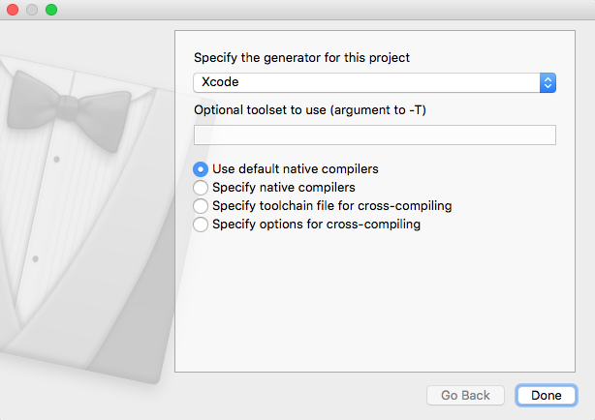
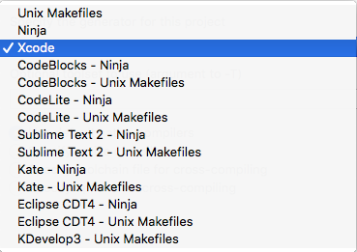
CMake: Choosing a Compiler
CMake may ask to choose which compiler (“generator”) you want to use for compiling:
On my OS X system, here are the choices:
On Windows, choose your version of Visual Studio
On OS X, choose Xcode (recommended) or ”Unix Makefiles”
On Linux, choose an appropriate Makefiles or Ninja option

Slide 37
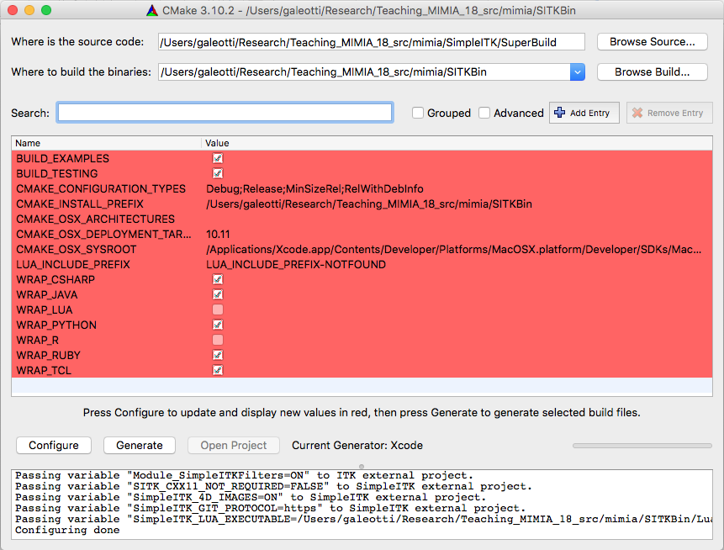
Configure - Easy Start, cont.
If you get a message about needing Java, just click ok.

Slide 38
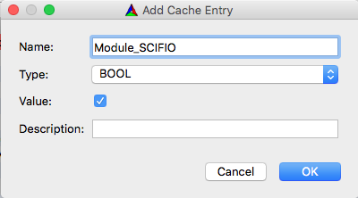
Configure - Easy Start, cont.
Disable each of these:
BUILD_EXAMPLES
BUILD_TESTING
WRAP_*, e.g. WRAP_JAVA, WRAP_LUA, etc.
To read special microscopy-format images
Click the “Add Entry” button
Fill in the dialog as shown

Slide 39
Configuring and Generating
After you change an option or options you will need to “configure” CMake again
If the generate button (“OK” under Windows) is not presented, you definitely need to click the “configure” button again
If any of the options are highlighted in red, you need to click the “configure” button again
When done, click either “Generate” or “OK
Generating is usually very fast

Slide 40
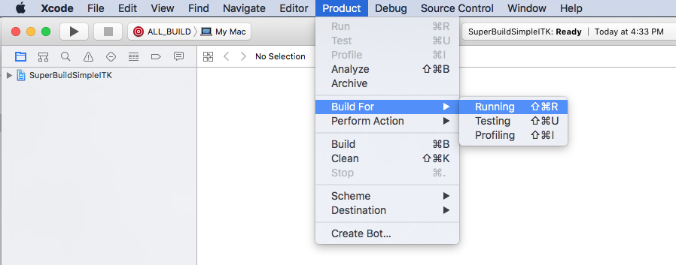
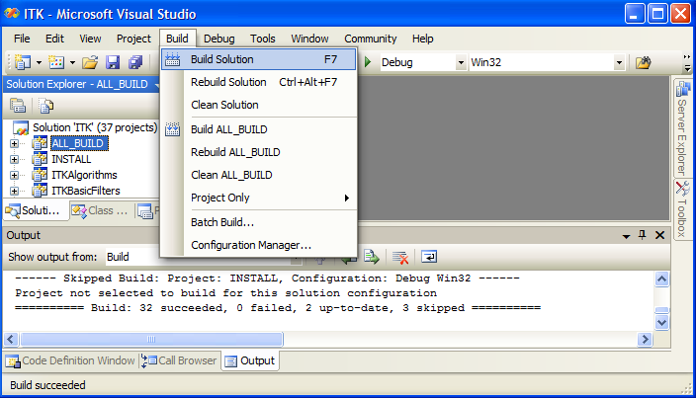
Build ITK
You are now ready to actually compile C++ SimpleITK and ITK
In Cmake, click “Open Project”
This will open up Visual Studio or Xcode, etc. for your SimpleITK project
Visual Studio:
Build→Build Solution
Xcode:
Product→Build
It will probably take somewhere between 30- 300 minutes, but your time may vary a lot

Slide 41
Verify the Build
SimpleITK Libraries will be found in:
SITK_BINARY / { SimpleITK-Build / } lib / { Debug, Release}
ITK Libraries will be found in:
SITK_BINARY / ITK-build / bin / { Debug, Release}

Slide 42
Alternative Approach: Building with Makefiles and gcc
WARNING: Do not follow this alternative approach if you already followed the previous CMake instructions.
Order of operations is the same
Differences
Can only configure for a debug OR a release build
Run the ccmake executable, with one of these:
-DCMAKE_BUILD_TYPE=DEBUG
-DCMAKE_BUILD_TYPE=RELEASE
ccmake uses a curses TUI, “identical” to the GUI
Run make instead of Visual Studio
Think of CMake as replacing the “./configure” step you may be used to

Slide 43
Alternative Approach: Building with Makefiles and gcc
Start in the directory containing SimpleITK
mkdir SITKBin
cd SITKBin
ccmake -DCMAKE_BUILD_TYPE=RELEASE
-Module_SCIFIO=ON
../SimpleITK/SuperBuild
Edit CMake options
Reconfigure if needed
make

Slide 44
Now what?
At this point, you have a bunch of source code and a bunch of compiled libraries
As mentioned earlier, you don’t yet have anything executable

Slide 45
Reminder: What Will Be Where
SimpleITK Source:
.\SimpleITK
SimpleITK Build:
.\SITKBin
SimpleITK C++ Libraries (one or both of these two):
.\SITKBin\lib{\Release OR \Debug may be present}
.\SITKBin\SimpleITK-Build\lib{\Release OR \Debug}
ITK Source:
.\SITKBin\ITK
ITK C++ Build:
.\SITKBin\ITK-build
ITK C++ Libraries:
.\SITKBin\ITK-build\lib{\Release OR \Debug may be present}

Slide 46
Building an application
ITK comes with a simple application you can build in order to test the ITK libraries “out of source” (i.e. not built inside ITK)
It can be found in:
SITKBin/ITK/Examples/Installation

Slide 47
How to build HelloWorld
Copy & rename the Installation directory somewhere outside of the Insight directory
Run CMake on HelloWorld
Remember the source/binary distinction and use HelloWorldBin as your build location
CMake should automatically find ITK
if not, edit the ITK_DIR option

Slide 48
How to build HelloWorld, cont.
Once CMake is happy, generate the Makefile/project for your compiler
Build HelloWorld
Give it a try

Slide 49
More examples
You can turn on ITK’s Examples option in CMake, which will build all of the examples for you
Or… you can copy the examples out-of-source and build them like you did HelloWorld
These examples link into ITK Software Guide; read the chapter, poke the code and see what happens…

Slide 50
C++ Workflow thoughts
You should get used to the idea of:
Writing some code
Writing a CMakeLists.txt file
Running CMake
Building your code
Rinse, repeat

Slide 51
An aside: how to use ITK with existing C/C++ applications
Your existing app may not use CMake
In this case, you need to link to the ITK libraries explicitly and include the appropriate source directories
This isn’t hard, but it may take some trial and error to discover everything you need
You don’t need to worry about this in the context of this class

Slide 52
ITK Documentation
Most of the ITK documentation is generated automatically from source comments using Doxygen
Please familiarize yourself with the various means of navigating the Doxygen documentation online, e.g. selecting a Module and then selecting a Class
Don’t forget the URLs on slide 27 (“Step 0”).

Slide 53
Assignment 1…
Will be assigned later this week or early next week.
Please do NOT start until we have it ready
New: Uses SVN instead of email to submit
You should have received email with your svn account

Slide 54
Assignment 2…
Will be assigned next week.
Please do NOT start until we have it ready
Follows this pattern of CMake & Compilation
Don’t procrastinate!
If you’re going to have compiler problems, they will show up early in the course, so don’t procrastinate this assignment.

